Slide 1
Unit 3
Lesson Four

Slide 2
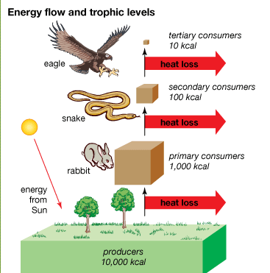
Read and Explain a diagram
Break a process into steps
Create a diagram as part of an infographic
  Use titles, headings and sections
  Use images

Slide 3

How to Hold a Pencil
Explain the steps needed to hold a pencil to your partner
Think about :
What language can I use?
How do I explain the steps?
What is the important information?

Slide 4
Diagram Reading!
Write down the Steps shown in the Diagram
Include
Important information
Words that show order
Number the steps
Complete sentences

Slide 5
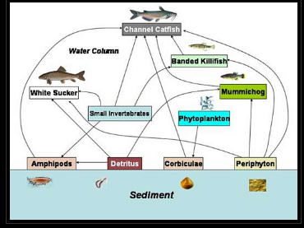
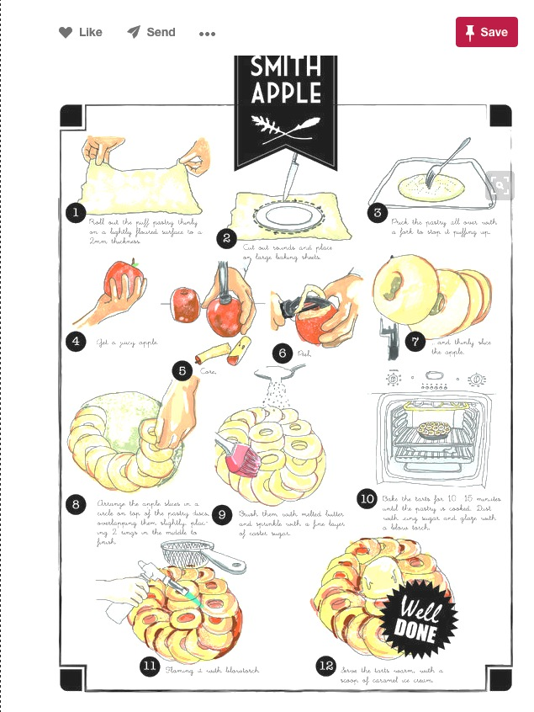
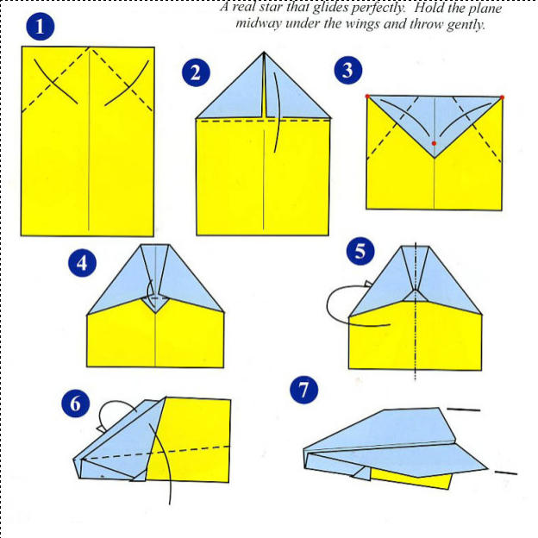
Different Types of Diagrams
Notes:
Reference: Channel Catfish Diagram. http://earxagangnad.blogspot.ca/2011/05/food-chain-diagram-for-kids.html
Airplane diagram. https://hannahphang.wordpress.com/2011/02/21/instructions/
Granny Smith Apple recipe. cookingwithmunira.com

Slide 6
Lesson Assignment
In this assignment, you will brainstorm a topic for which you would like to make a diagram. You will: pick a topic to express an idea about, include pictures to help develop the idea, and include text that develops your idea.
Remember to include:
Include all elements needed for the diagram: title, text , arrows, numbers, pictures.
Make sure to plan where pictures, text, and title will be in outline.
Use ordering words to make ideas clear.

Slide 7
Rubrics
Category | Level 4 | Level 3 | Level 2 | Level 1
Thinking | Had a very specific idea I am communicating about my topic . I included all parts needed in my diagram type, and they connect well to develop my idea | Had a solid idea I am communicating about my topic I included most parts needed in my diagram type, and they connect to develop my idea | Had a general idea I am communicating about my topic I included some parts needed in my diagram type, and they have some connection to developing my idea | Had a vague idea I am communicating about my topic I included few parts needed for my diagram type, and they do not connect to develop my idea
Communication | Included 3 or more ordering words My sentences were full and I had no spelling mistakes | Included 2-3 ordering words Most sentences were full, and I had no spelling mistakes | Included 1-2 ordering words Some sentences were full, and some spelling mistakes | Included 1 or no ordering words No sentences were full, and many spelling mistakes

Slide 8
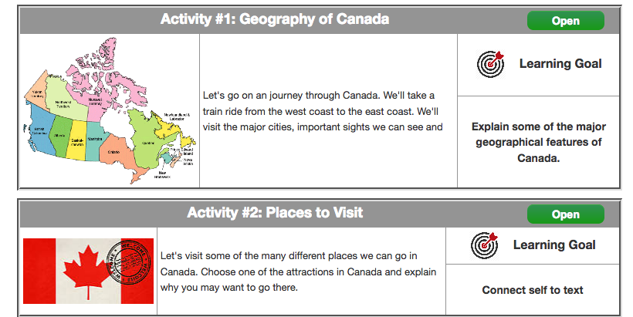
Coming Up Next!

Slide 9


Slide 10
