Slide 1
Unit 4: Introduction to Canada
Lesson Two

Slide 2
Explain the major features of Canada's geography
Complete basic research on a topic
Explain why Canadians live where they do
Discuss places you might want to visit

Slide 3
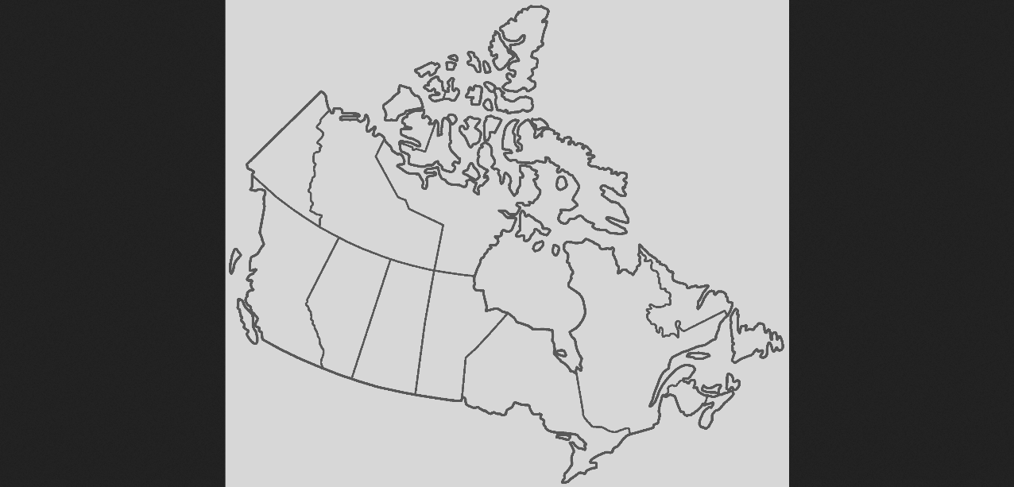
Build a Map of Canada
Include all Provinces and Capital Cities

Slide 4
What about that Province?
Pick one province in Canada and tell about its interesting features.
Include:
What is the location of the province?
At least 3 interesting facts?
Make sure you use full, proper sentences.

Slide 5
Brainstorming Tips
First, make a list of things you need to know.
Some Examples:
Where you can stay
How much things cost
How to get there
Safety information
What you need to learn before doing the activity
Then, make a list of what you need to know about the place.
Some Examples:
Historical information
Geographical information
What you need to learn before doing the activity

Slide 6
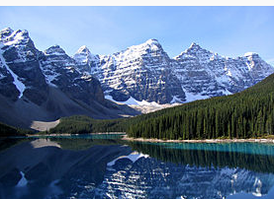
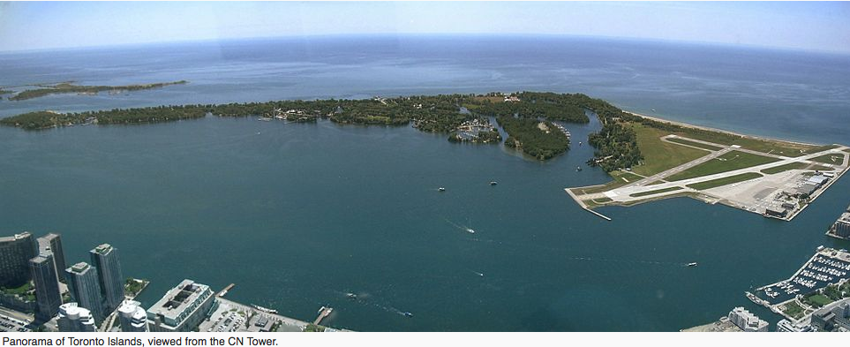
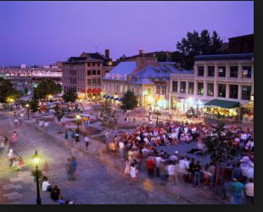
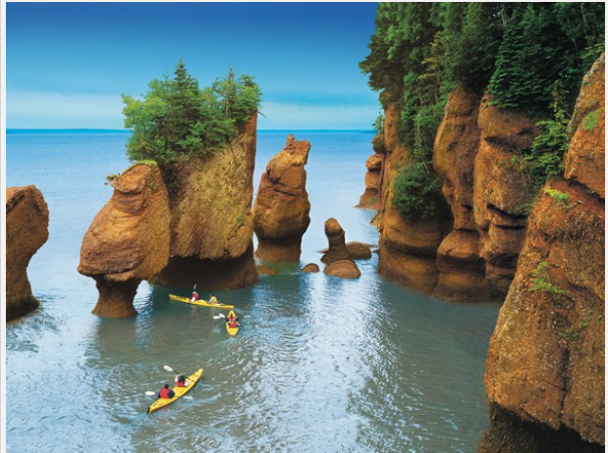
Places We Can Go!
Rocky Mountains
Toronto Island
Old Montreal
Bay of Fundy
Notes:
Reference: Rocky Mountains. https://en.wikipedia.org/wiki/Rocky_Mountains. Toronto Island. https://en.wikipedia.org/wiki/Toronto_Islands
Old Montreal. http://gocanada.about.com/od/montreal/tp/Old_Montreal.htm
Bay of Fundy. http://vacay.ca/2012/07/wonders-of-the-bay-of-fundy/

Slide 7
Lesson Assignment
In this assignment, you will brainstorm, research and write 5-6 sentences about why a person would live in a selected province. You will include: one geographical reason, include industries, and special places, and include full proper sentences.
Remember to include:
Include all 5-6 sentences.
Include: important geographical features, what type of industry is dominant, what other key elements, like population, events or places may make it a good place to live.
Make sure to have proper sentences, and spelling.

Slide 8
Rubrics
Category | Level 4 | Level 3 | Level 2 | Level 1
Thinking | Had 4 or more very specific facts I was communicating about my topic. I included 1-2 geographical reasons to live in my province | Had 3 good facts I was communicating about my topic. I included 1 geographical reasons to live in my province | Had 1-2 general facts I was communicating about my topic. I included vague geographical reasons to live in my province | Had 1 vague fact I was communicating about my topic. I included no geographical reasons to live in my province
Communication | I had 6 or more sentences My sentences were full and I had no spelling mistakes | I had 5 or more sentences Most sentences were full, and I had no spelling mistakes | I had 3-4 or more sentences Some sentences were full, and some spelling mistakes | I had 1-3 or more sentences No sentences were full, and many spelling mistakes

Slide 9
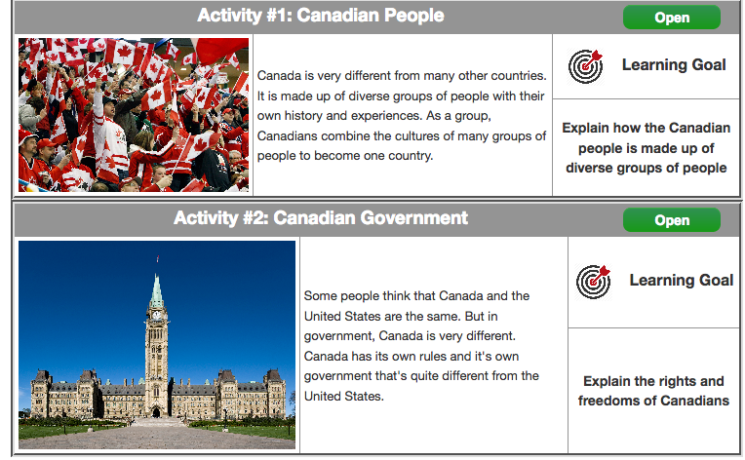
Coming Up Next!

Slide 10
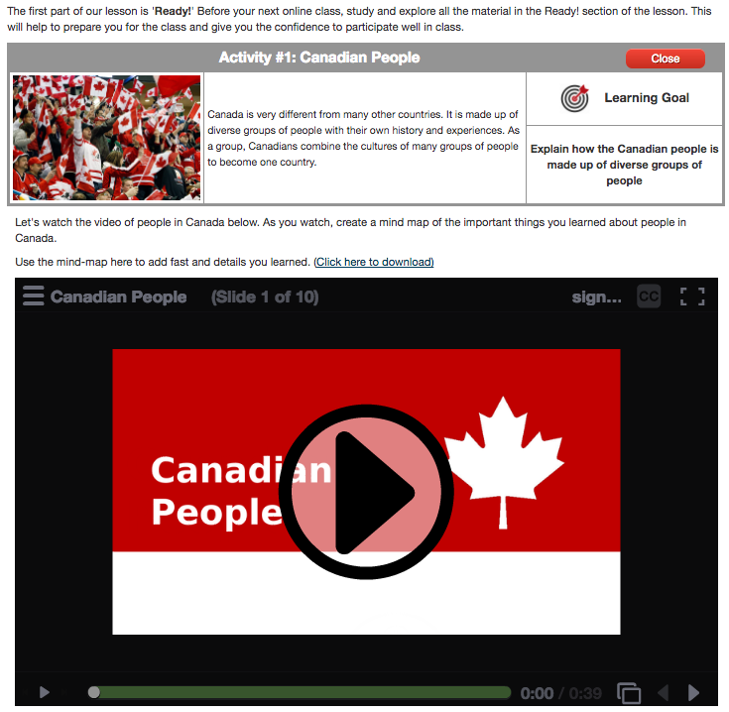

Slide 11
