Slide 1
Unit 4: Introduction to Canada
Lesson Two

Slide 2
Explain the origins of the people of Canada and some of the important parts of Canadian Society
Explain how Canadian government is organized
Explain the rights of Canadians

Slide 3
Why Come to Canada?
Explain two reason why someone may immigrate to Canada.

Slide 4
Rights and Freedoms!
Pick one right or freedom in Canada and write 4-5 sentences about it.
Include
What right or freedom do I feel is important?
Why is this right or freedom important to a Canadian Citizen?
How does this right or freedom protect, help, or uphold fairness?

Slide 5
How to Write a Canadian Law!
Create a name for your bill. Example B-31
Write down what the bill will be changing.
Write down what areas will be affected by this law.
Create a first reading date, and second reading date.

Slide 6
Lesson Assignment
In this assignment, you will read a bill, answer the key question to decide if you are for or against the bill and write 6-7 sentences about why you are for or against the bill.
Remember to include:
Include one statement of if you are for or against the bill.
Include at least 2-3 reason that are answers to key questions.
Make sure to use proper sentences and spelling.

Slide 7
Rubrics
Category | Level 4 | Level 3 | Level 2 | Level 1
Thinking | I had a clear for or against statement I included 3-4 reasons that were answers to the key questions | I had a for or against statement I included 2-3 reasons that were answers to the key questions | I had a general for or against statement . I included 1-2 reasons that were answers to the key questions | I had a no for or against statement I included 1 or no reasons that were answers to the key questions
Communication | I had 7 or more sentences My sentences were full and I had no spelling mistakes | I had 6-7 sentences Most sentences were full, and I had no spelling mistakes | I had 5-6 sentences Some sentences were full, and some spelling mistakes | I had 2-4 sentences No sentences were full, and many spelling mistakes

Slide 8
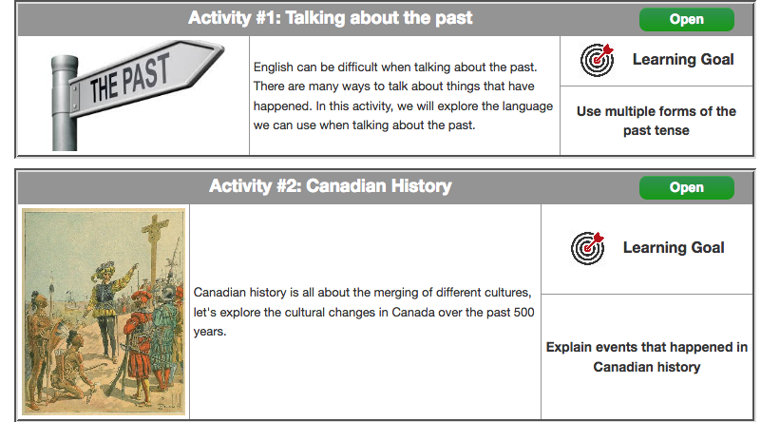
Coming Up Next!

Slide 9
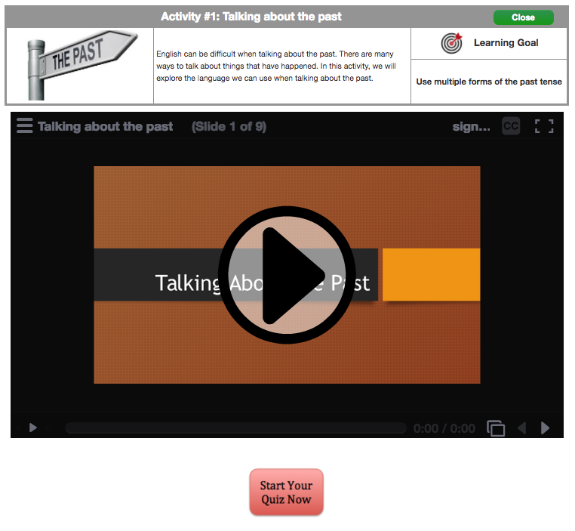

Slide 10
