Slide 1
Unit 4: Introduction to Canada
Lesson Three

Slide 2
Understand how Canadian history has developed over time, from early explorers to today
Explain the interactions that have made Canada a multicultural society
Use the past, past perfect and past continuous tenses to explain what happened in Canadian history

Slide 3
What happened yesterday?
Share with the groups what happened yesterday.
Example: I had an appointment with the doctor!

Slide 4
Write about an Event in the Past!
Think about:
What event can I talk about?
What did I do, and what happened?
What parts should be expressed with past perfect tense, past tense, or past conditional tense?

Slide 5
Historical Story
Sailing Home
Two hundred years separate their stories: the women who arrived as les filles du roi in New France and the ones who sailed into Victoria on bride ships.
August, 1665, Off the Coast of Quebec
“Isabelle! Les oiseaux! We must be close to land!” Marie-Claude shook her friend’s shoulder and pointed at the birds circling overhead. Could it be true? After three months of throwing up from seasickness and huddling against cold ocean spray, was the journey truly almost over?
“There—land! I'm sure of it!" Marie-Claude exclaimed. “I'm going to tell the others!”
As her young friend hurried below decks, Isabelle stared at the far-off grey line on the horizon. New France. What life was waiting for her there? Better than the worry and poverty she and the other girls had left behind in Paris? Would her husband be a kind man or a one roughened by life in this wild place?

Slide 6
September, 1655, Ville Marie (Montreal)
In the cool of her stone room, Isabelle opened the small wooden chest. She liked to think of it as a personal gift from King Louis to all of the girls who had sailed with her. Les filles du rois, they were being called — the daughters of the king.”
“And we know our duty to the king and to France and to the church,” Isabelle thought as she looked through the chest. To marry and to have many children who would help on the farm and settle this new country. Even to her, one of the older girls at 16, it seemed like an awfully big job.
“Did you see the beautiful lace?” Marie-Claude had burst into the room holding a wooden chest just like Isabelle’s. “And the king gave us shoes, a bonnet, a comb, cloth, sewing stuff — isn’t it wonderful? We’ll be able to make such nice things for our husbands.”
Isabelle envied her friend’s excitement. Marie-Claude was 14, but she couldn’t wait to get married. “Maybe I just worry too much,” Isabelle thought.
She smiled at her friend. “Be careful with the knives the king gave us,” she teased. “We might need them to kill bears and wolves!”
Before Marie-Claude could respond, a nun in her long grey and white habit appeared in the doorway. “Isabelle, there’s a young man here to see you. He’s one of the soldiers from the Carignan regiment who’s decided to settle down here in New France.”
Sister Marguerite could see the uncertainty on Isabelle’s face. “He’s clean and nicely dressed, and he seems polite. I’ll tell him you will be out shortly.”
“How exciting!” Marie-Claude squeaked. Isabelle stood up, smoothed her dress and patted her hair. It was a good thing no one could hear her hammering heart. She gave Marie-Claude a little smile and a big hug, and then she slowly walked out toward the future.

Slide 7
Lesson Assignment
In this assignment, you will chose a event in Canadian history. You will research this event and write 7-8 sentences about it.
Remember to include:
Important information about the event
what it tells us about Canadian: culture, environment, people, politics, cities/provinces
Write 7-8 full sentences, and check your spelling

Slide 8
Rubrics
Category | Level 4 | Level 3 | Level 2 | Level 1
Thinking | I had a clear event in Canadian history that I summarized I included 2-3 aspects it tells us about Canada today | I had a clear event in Canadian history that I summarized I included 1-2 aspects it tells us about Canada today | I had a general event in Canadian history that I summarized I included 1 aspect it tells us about Canada today | I had a no event in Canadian history that I summarized I included no aspects it tells us about Canada today
Communication | I had 8 or more sentences My sentences were full and I had no spelling mistakes | I had 7-8 sentences Most sentences were full, and I had no spelling mistakes | I had 5-6 sentences Some sentences were full, and some spelling mistakes | I had 2-4 sentences No sentences were full, and many spelling mistakes

Slide 9
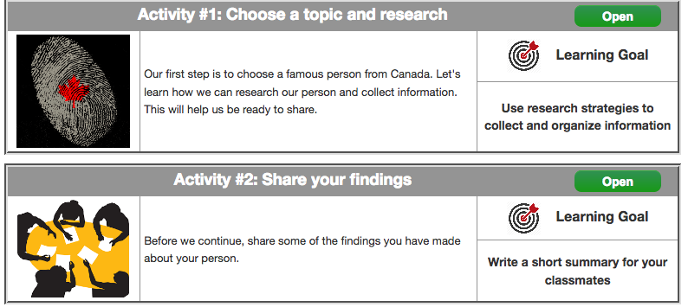
Coming Up Next!

Slide 10
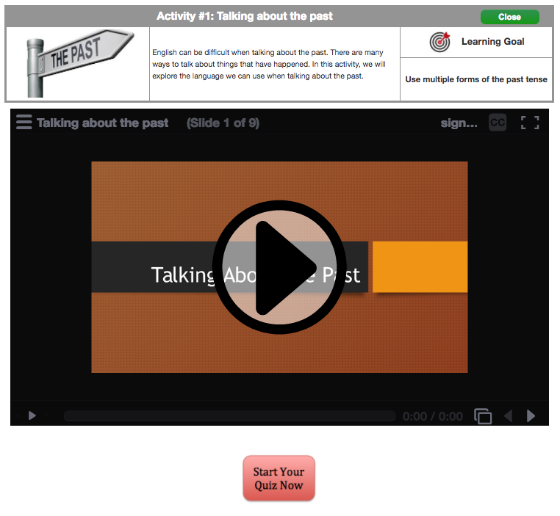

Slide 11
