Slide 1
Unit 4: Introduction to Canada
Lesson Four

Slide 2
Find information on a topic from multiple sources
Organize your ideas using an organizer
Create a poster based on your research.

Slide 3
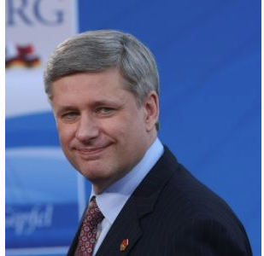
Famous Canadian Match?
What are these Canadians famous for?
Match them with what made them successful!
Stephen Harper
Prime Minister of Canada from 2006 to 2015.

Slide 4
Create 3 questions you would like to ask a famous Canadian
What am I interested in knowing more about this person?
Why was this person famous for this?
How did their life lead them to success?
Think about:

Slide 5
Key Questions for Research
Create a name for your bill. Example B-31
Write down what the bill will be changing.
Write down what areas will be affected by this law.
Create a first reading date, and second reading date.

Slide 6
Lesson Assignment
In this assignment, you will use the research you have done in the previous task, and create a multimedia presentation on your famous Canadian.
You can include:
  Text
  poems, writing, music lyrics
  pictures
  video clips
  music.

Slide 7
Rubrics
Category | Level 4 | Level 3 | Level 2 | Level 1
Thinking | I had a detailed information about my famous persons life I included specific information about what made them famous | I had clear information about my famous persons life I included information about what made them famous | I had a general information about my famous persons life. I included vague information about what made them famous | I had no information about my famous persons life. I included no information about what made them famous
Communication | I had 3 or more different types of media in my presentation My text was in full sentences and I had no spelling mistakes | I had 2-3 different types of media in my presentation Most of my text was in full sentences and I had no spelling mistakes | I had 1-2 different types of media in my presentation Some of my text was in full sentences and I had no spelling mistakes | I had 1 type of media in my presentation None of my text was in full sentences and I had no spelling mistakes

Slide 8
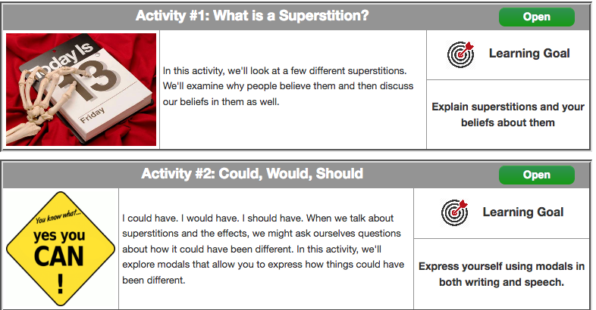
Coming Up Next!

Slide 9
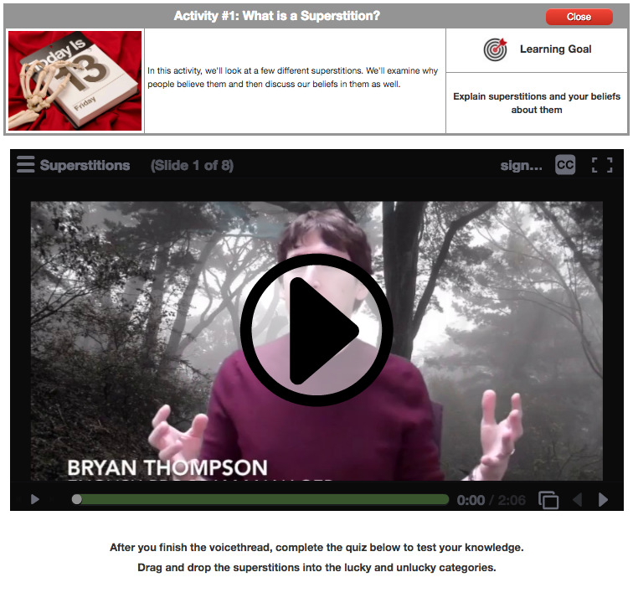

Slide 10
