Slide 1
The Carnival
Rosedale Academy
Introduction to ESL
Notes:
Remember:
When you ask a question, ask it in two different ways. This saves you wait time before having to rephrase a question.
Direct questions at specific students for the first few lessons. When you ask open questions to everyone, students will not generally answer.
Double wait time – whatever you think is enough, wait that much time again after asking a student.

Slide 2
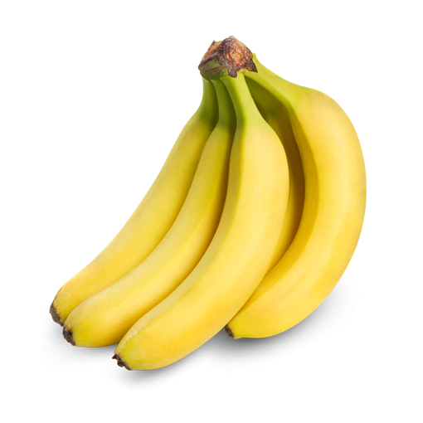
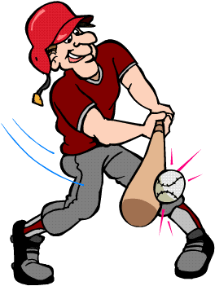
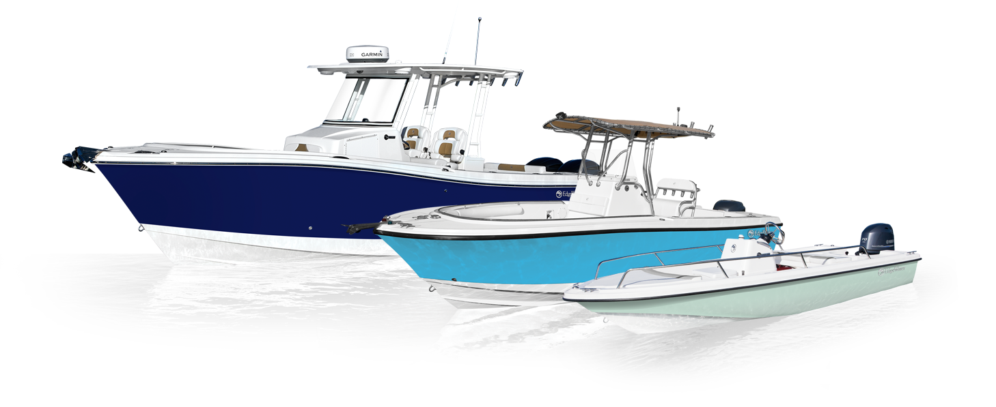
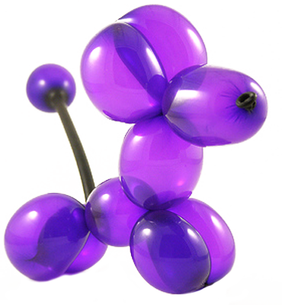
My name is Brian and I like:
baseball | bananas
boats | balloons
Notes:
Update this page with your own likes.
I highlighted the “B”s because that is one of the sounds that I will be teaching later in the presentation.
You can get them to say their name and something that they like.
See if any of them pick up on the alliteration.

Slide 3
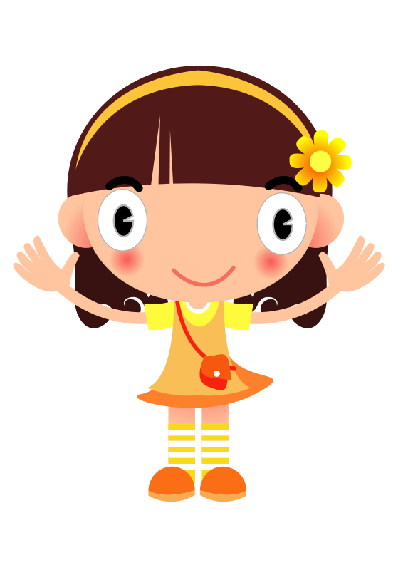
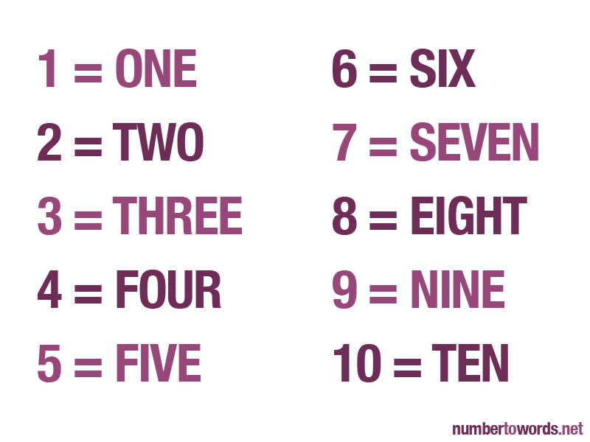
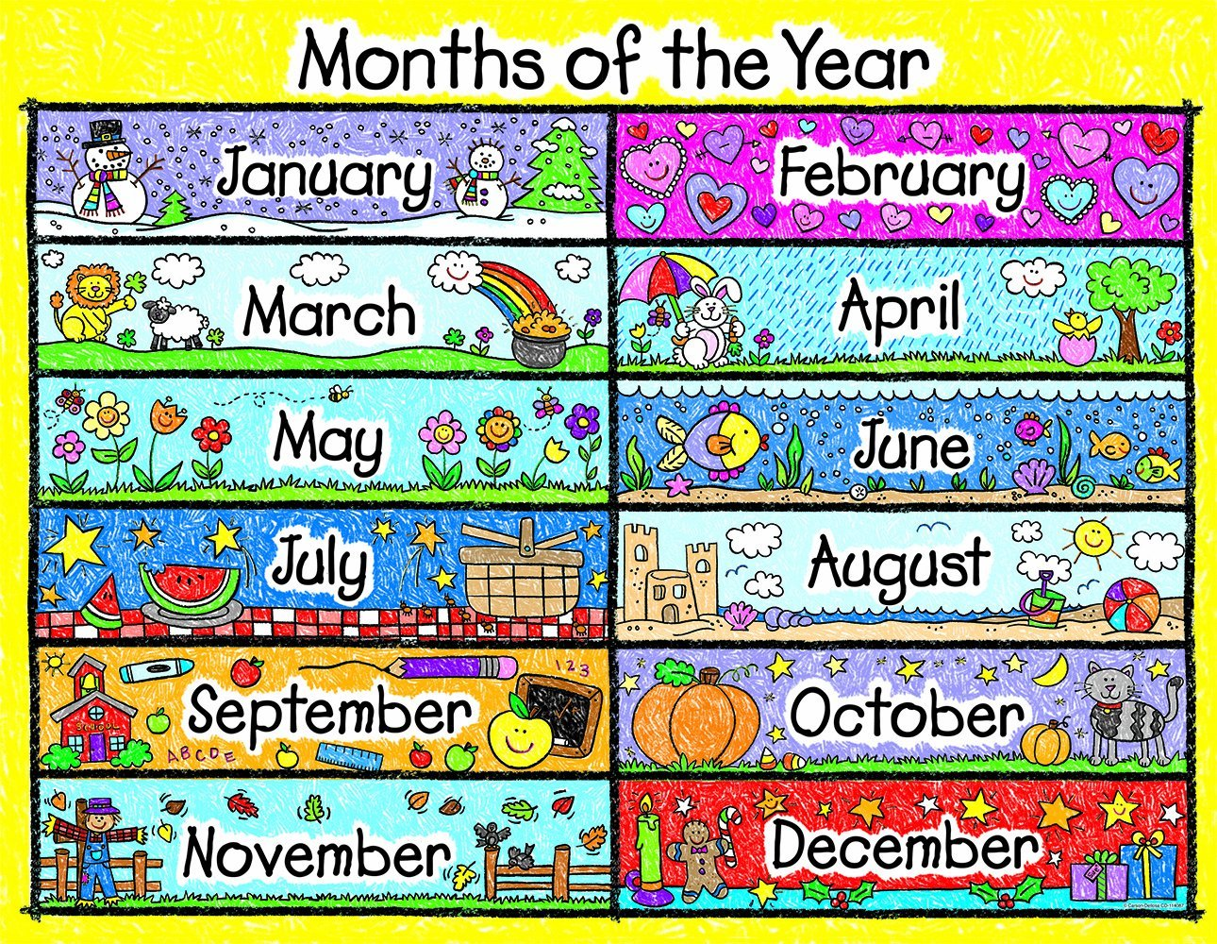
About Me:
Hello, my name is …
What is your name?
How old are you?
When is your birthday?
Notes:
Go through basic questions about personal information.
This is one of the learning goals for this lesson.
You can ask further questions like: what did you do for your last birthday? What is the weather like where you are? What is your favourite food, colour, etc.

Slide 4
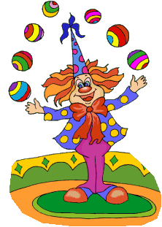
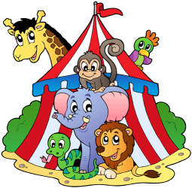
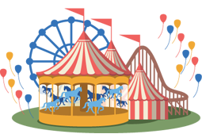
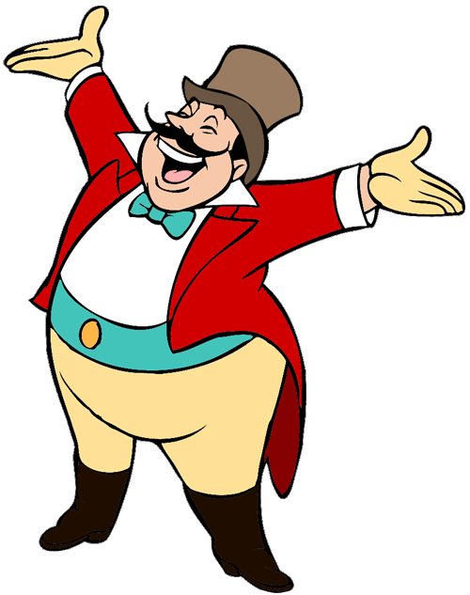
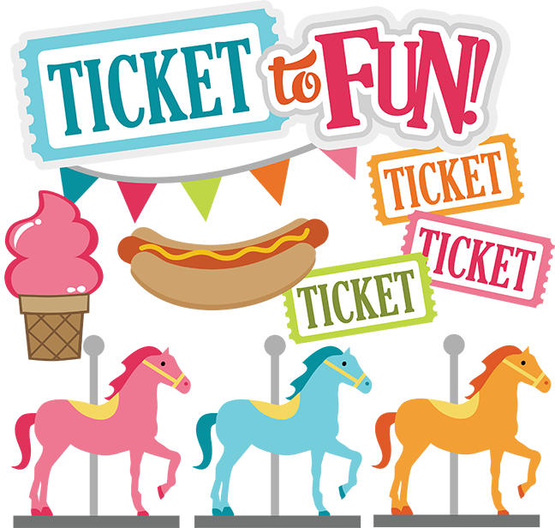
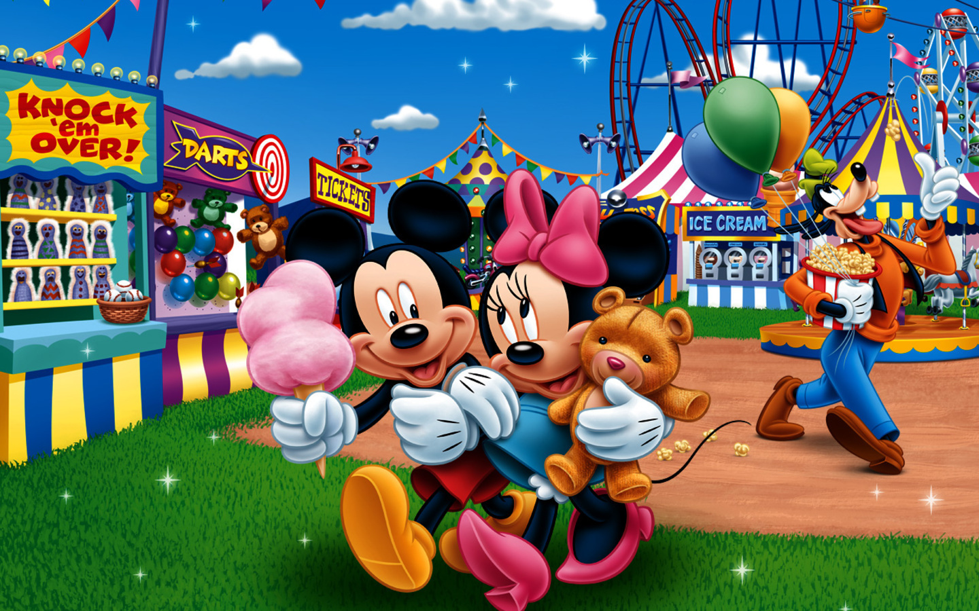
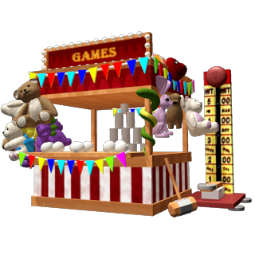
Welcome to the Carnival
Notes:
Define the word carnival for them and/or ask them if they have ever seen or been to a carnival.
Ask, “What might you see at a carnival?”
Take this opportunity to write new words on the screen. Ringmaster, Candy Apple, Cotton Candy, juggling, and carousel are all words that may be new to them.
If you need more space to write words and define them, you can flip over to a blank Whiteboard screen
If they are lower level English speakers, ask them to circle their favourite animal with their mouse.
You can hold up your mouse to the camera and then draw a circle on the page so they can see it and they will copy.

Slide 5
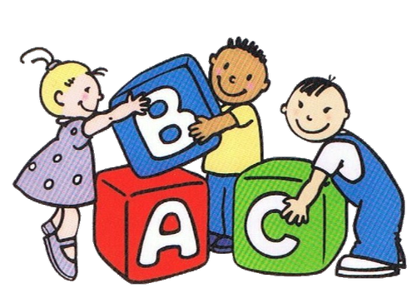
What we will learn today:
Sounds (the letters b,c,d,f )
Describing ourselves and our likes
New carnival and magic words
Answer questions about our favourite animals
Notes:
You can read these goals to them or have them read the goals if they can.
I find that underlining sentences and asking students to read one sentence at a time works well.

Slide 6
Notes:
“Would you like to help me read a story?”
By now, you may have some indication of whether or not the students can read on their own.
If unsure, have them repeat the title of the book after you.
“I say … The Eye Book, you say .....” (While pointing to yourself and then to them)

Slide 7
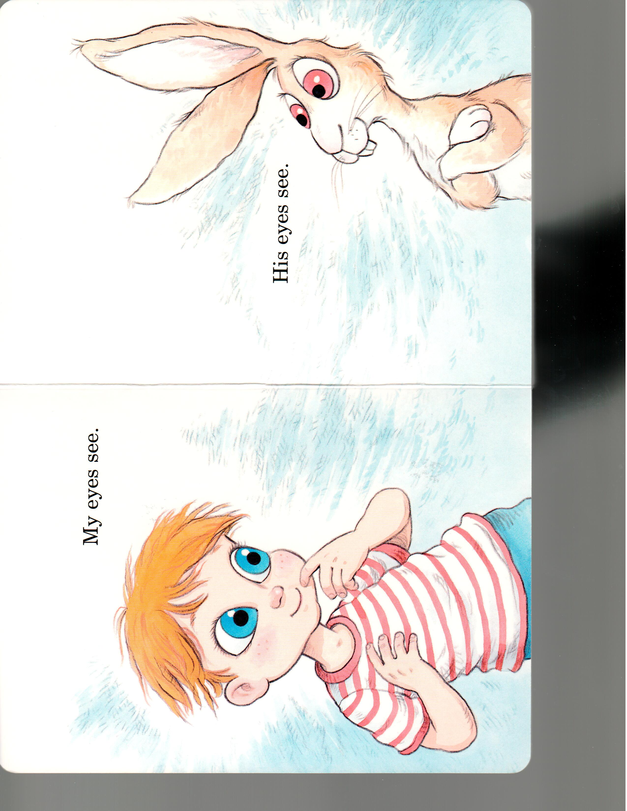
Notes:
My eyes see.
Can you say that? Or “I say …, you say…”

Slide 8
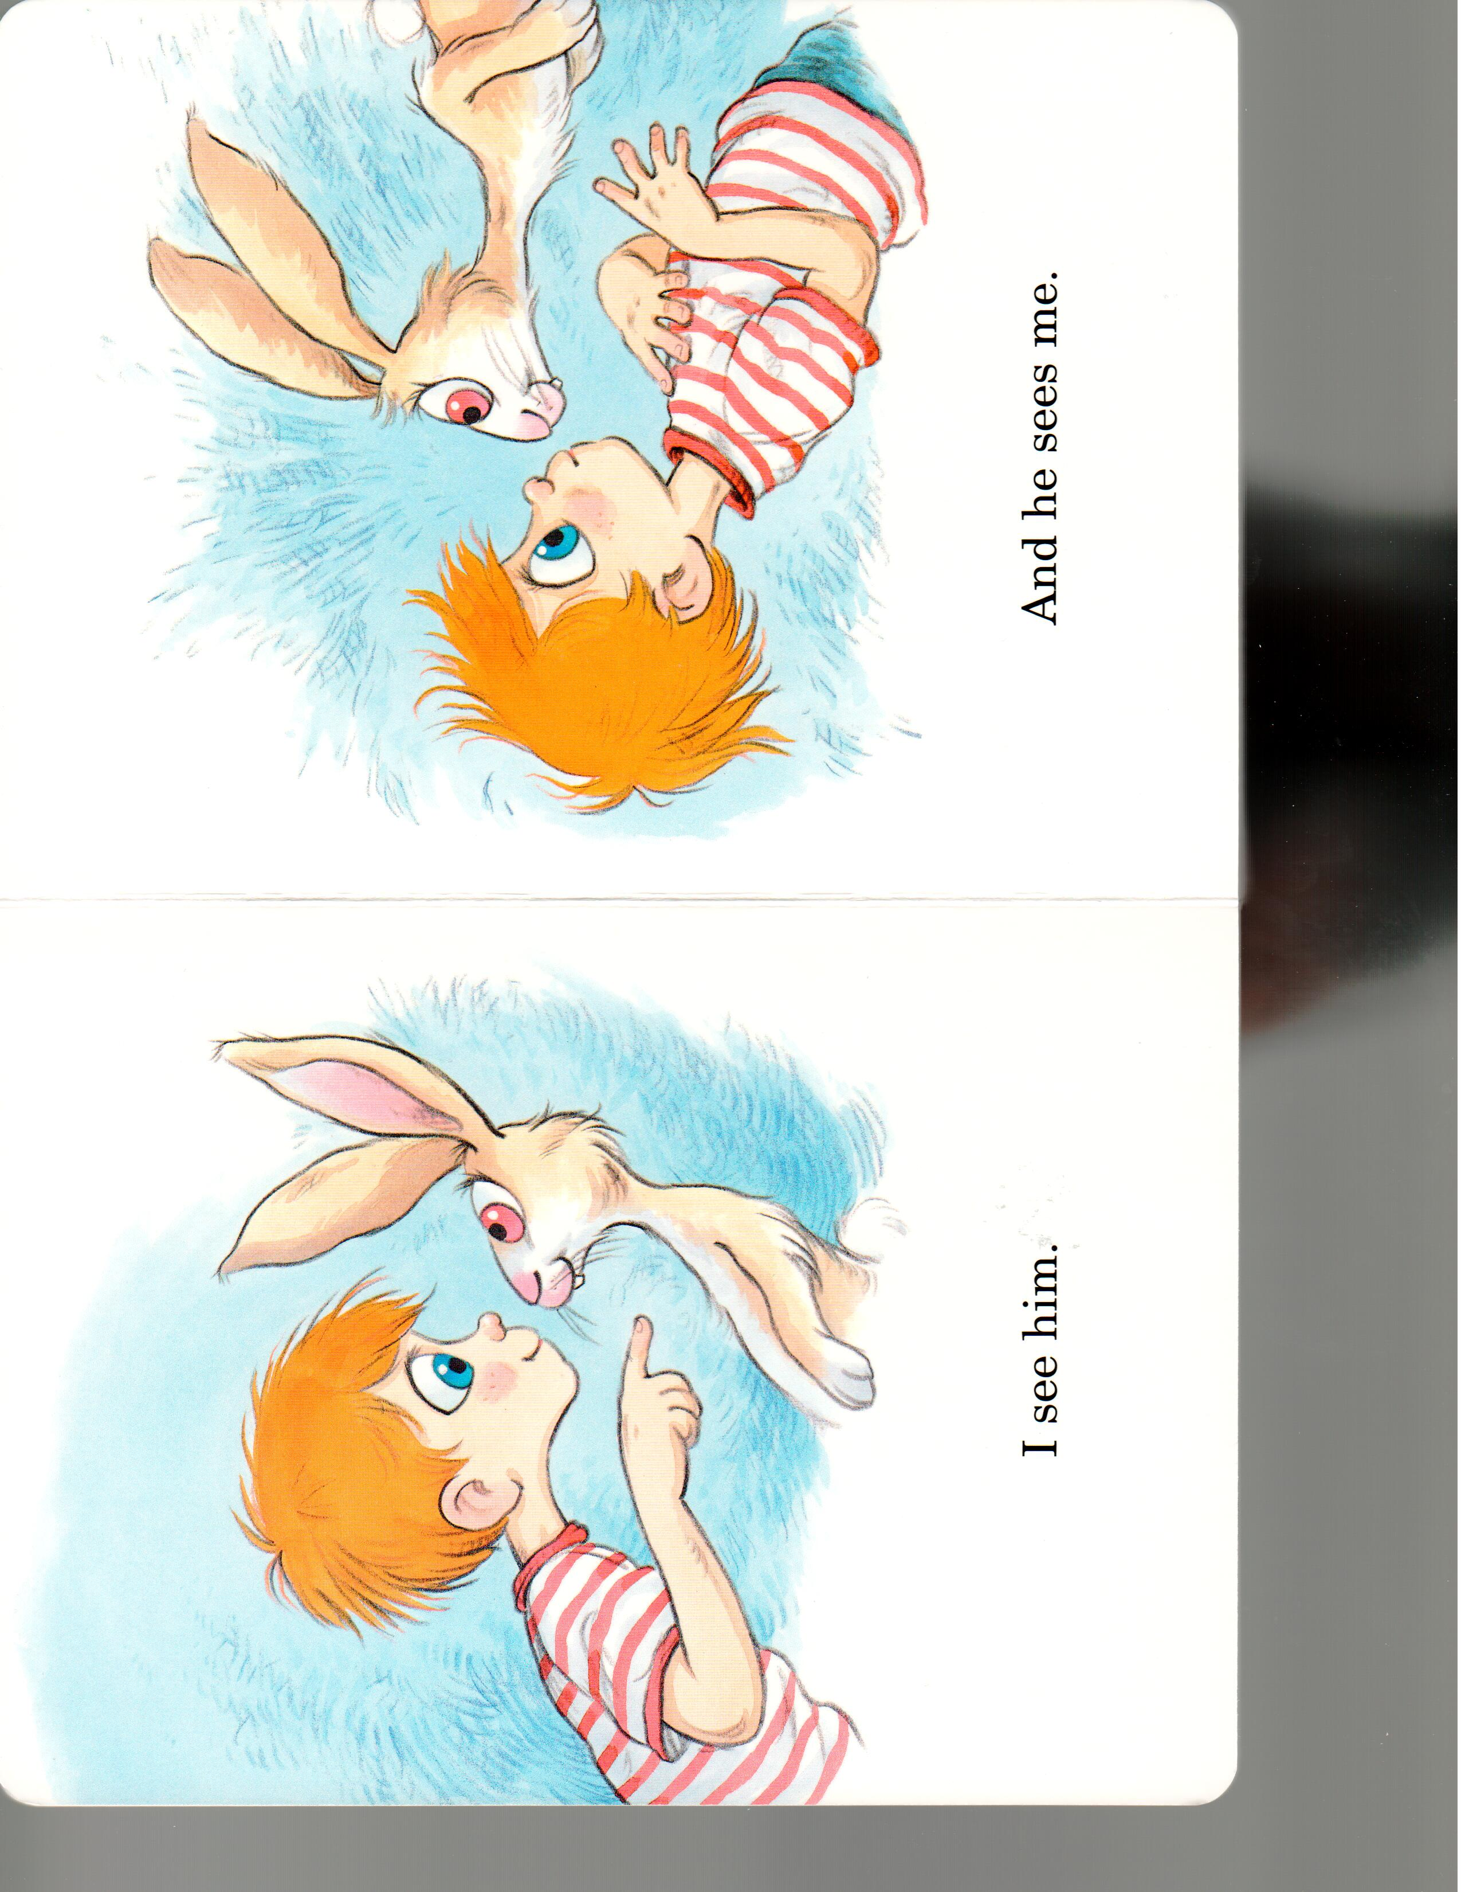
Notes:
You can explain that the I in this story is the boy and the he is the rabbit.

Slide 9
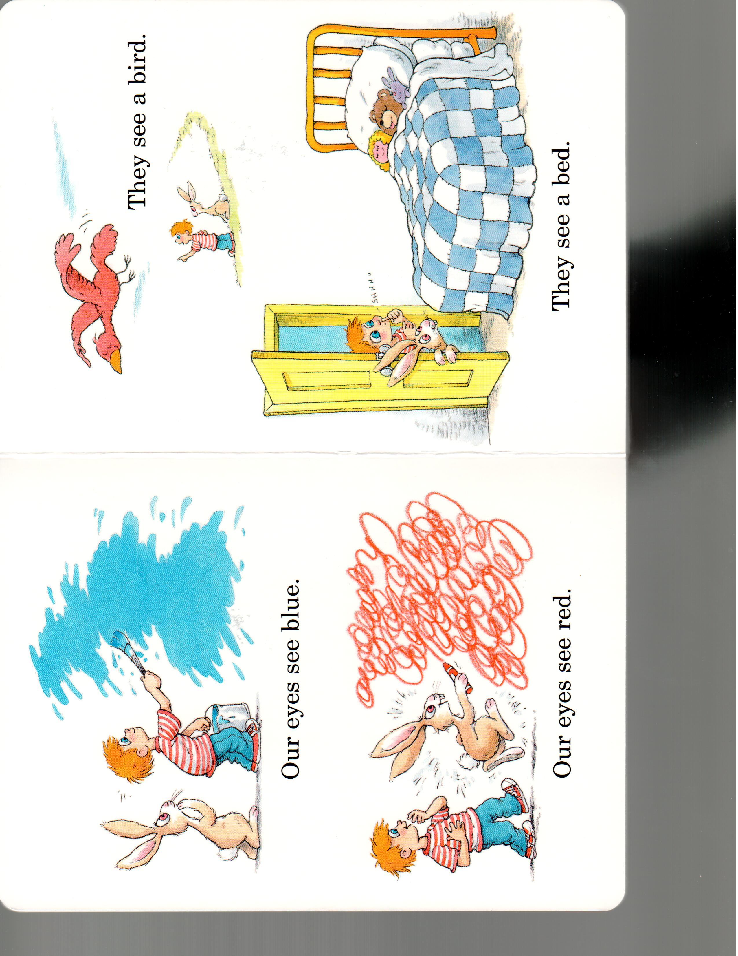
Notes:
Students can generally close these sentences because of the pictures.
You can read the first three words and ask them to complete the sentence by circling the objects.

Slide 10
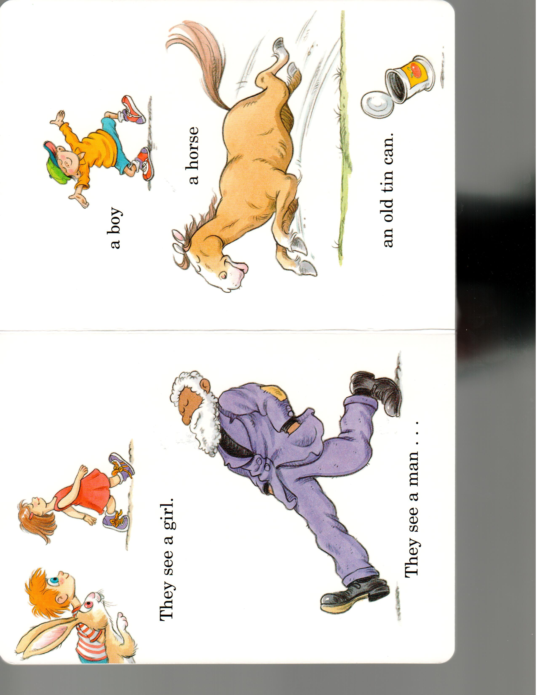
Notes:
You do not need to complete the story.
If the students are having difficulty, you can move on.
If you feel that they are enjoying it, you can continue.

Slide 11
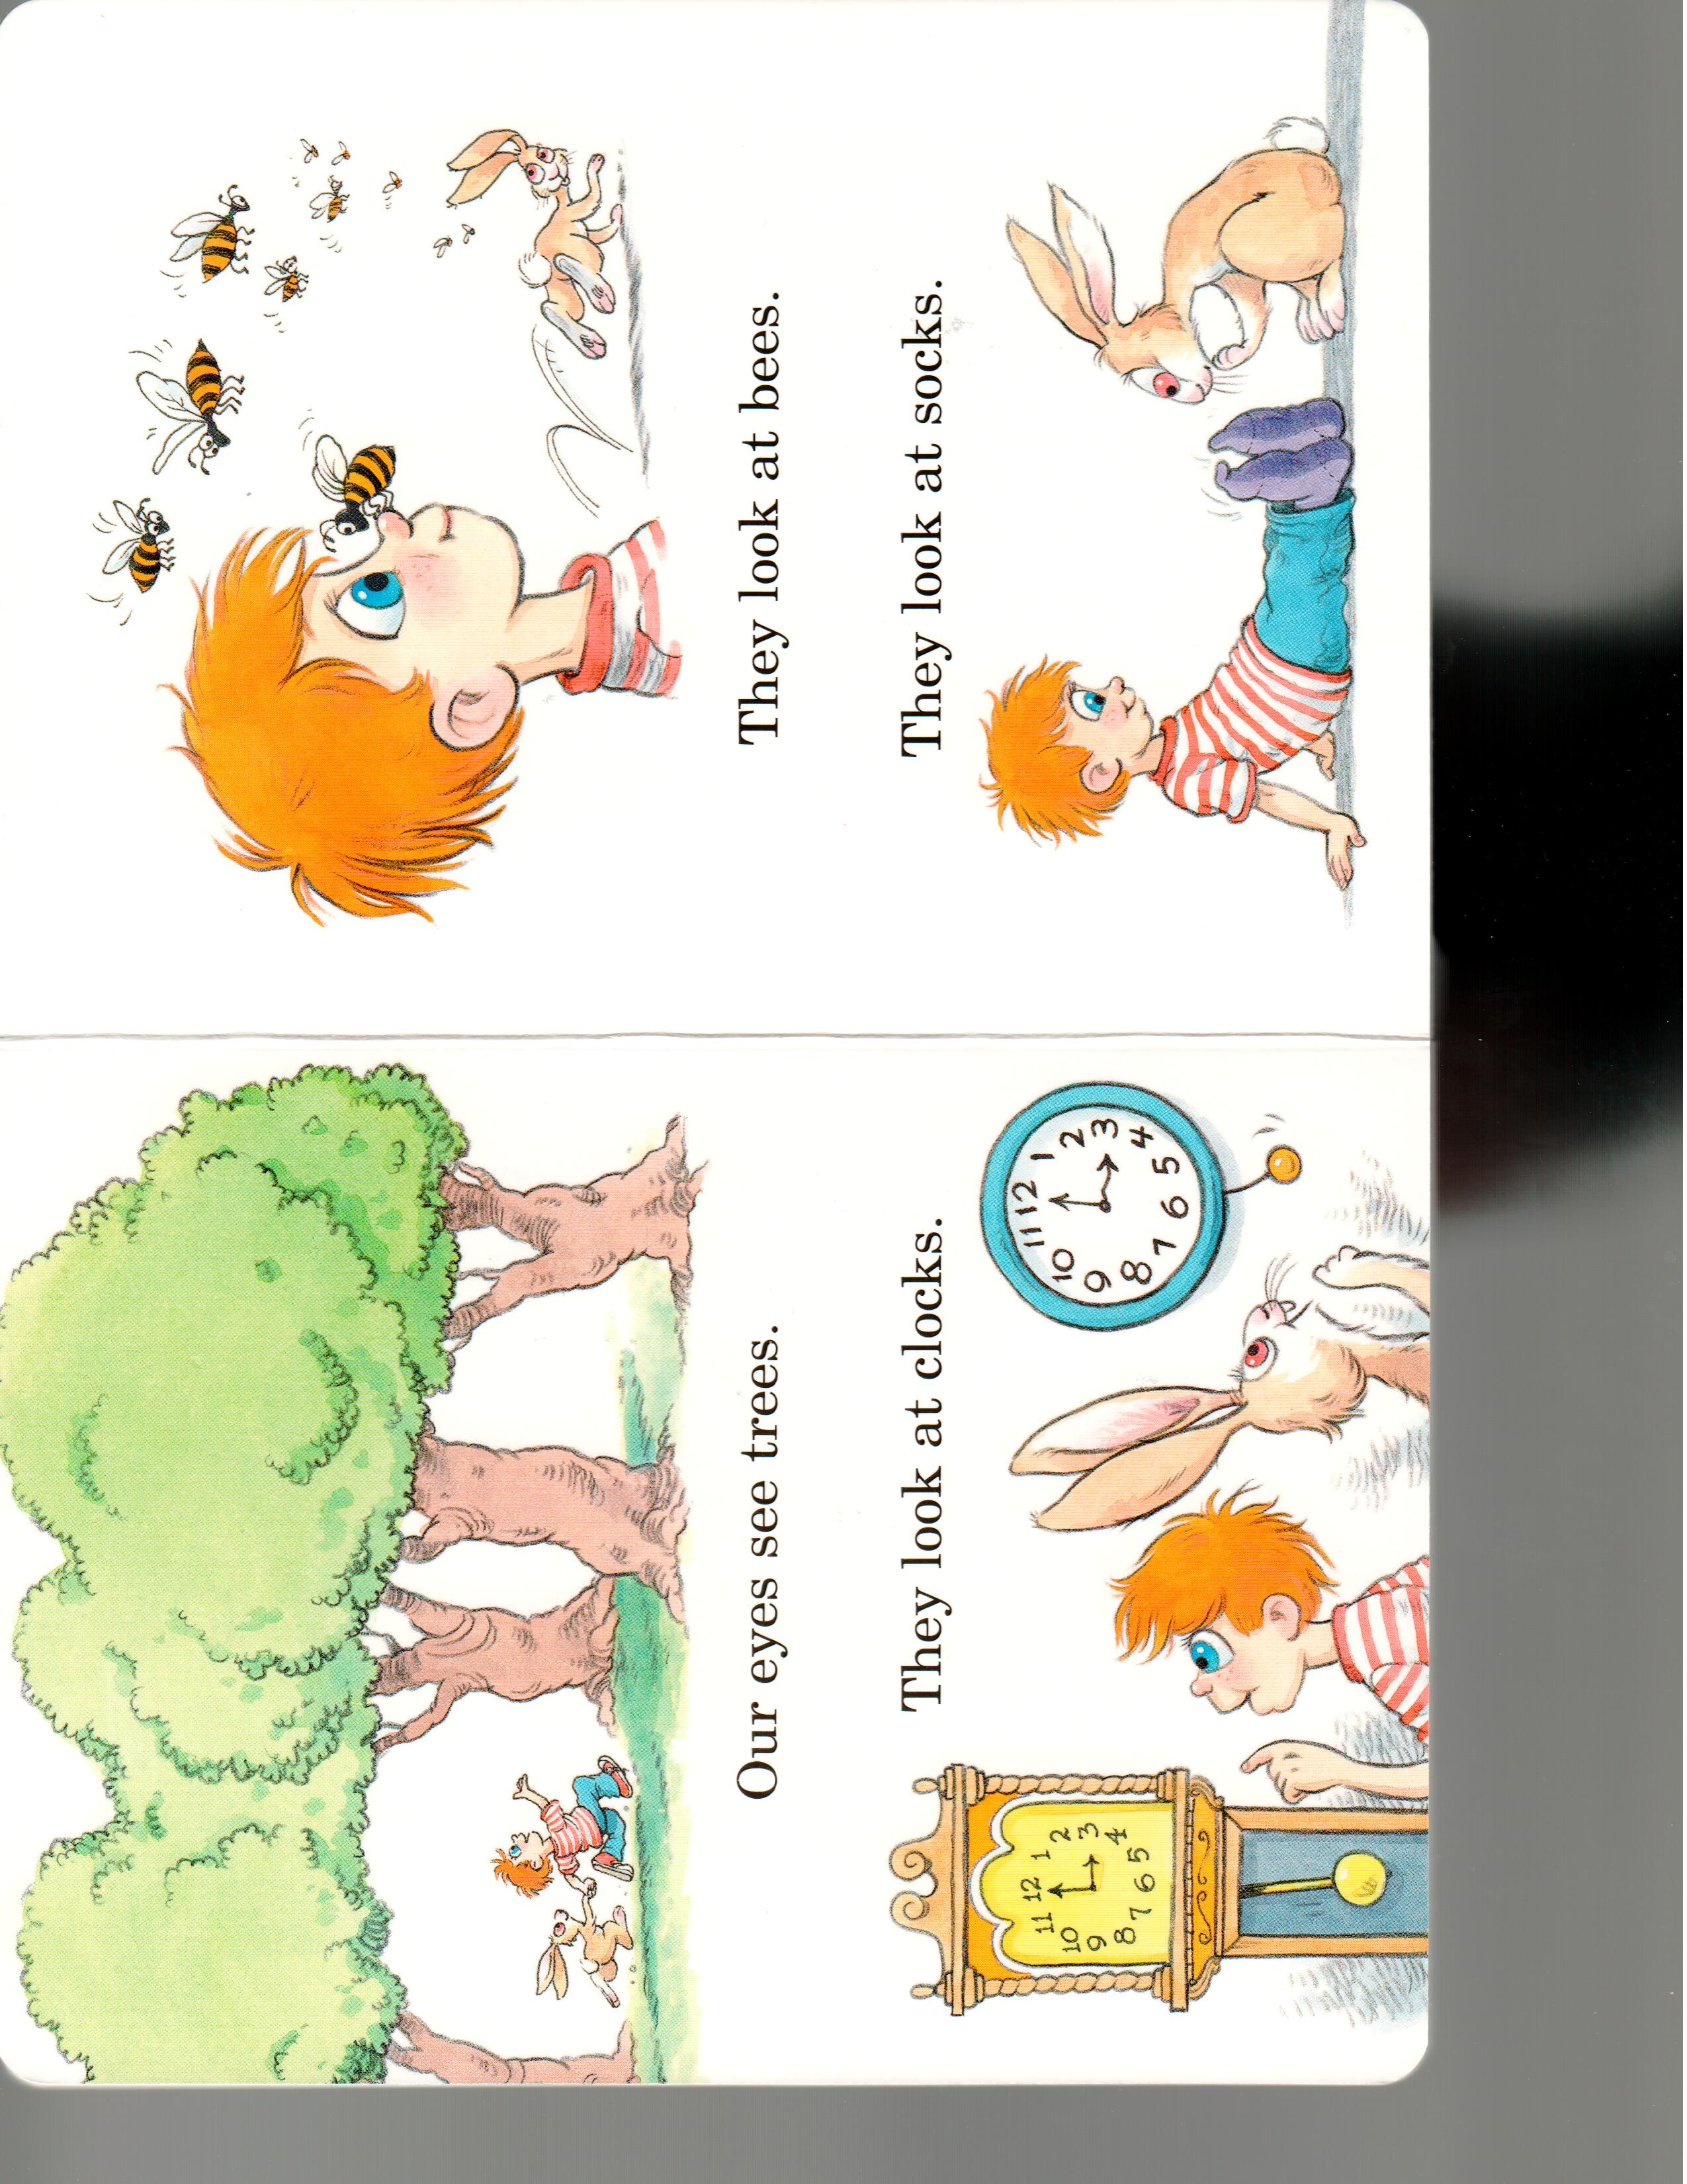

Slide 12
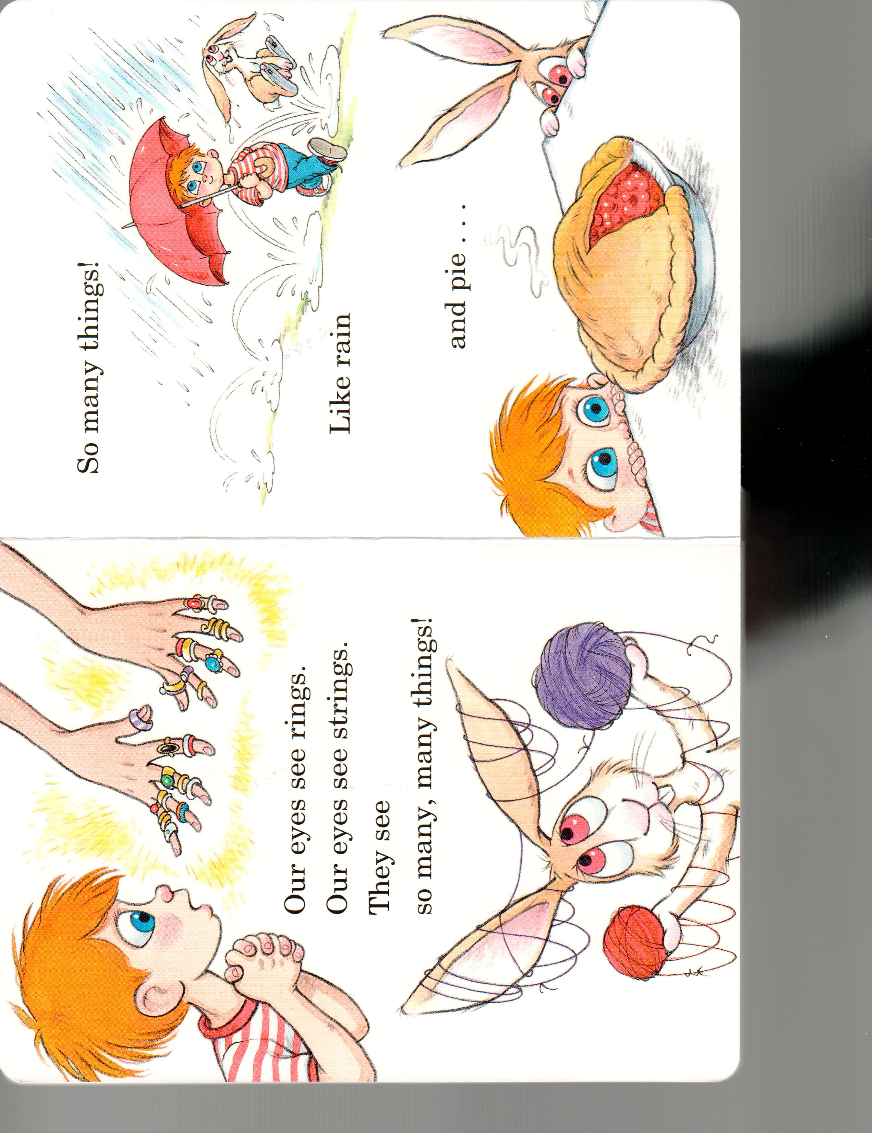

Slide 13
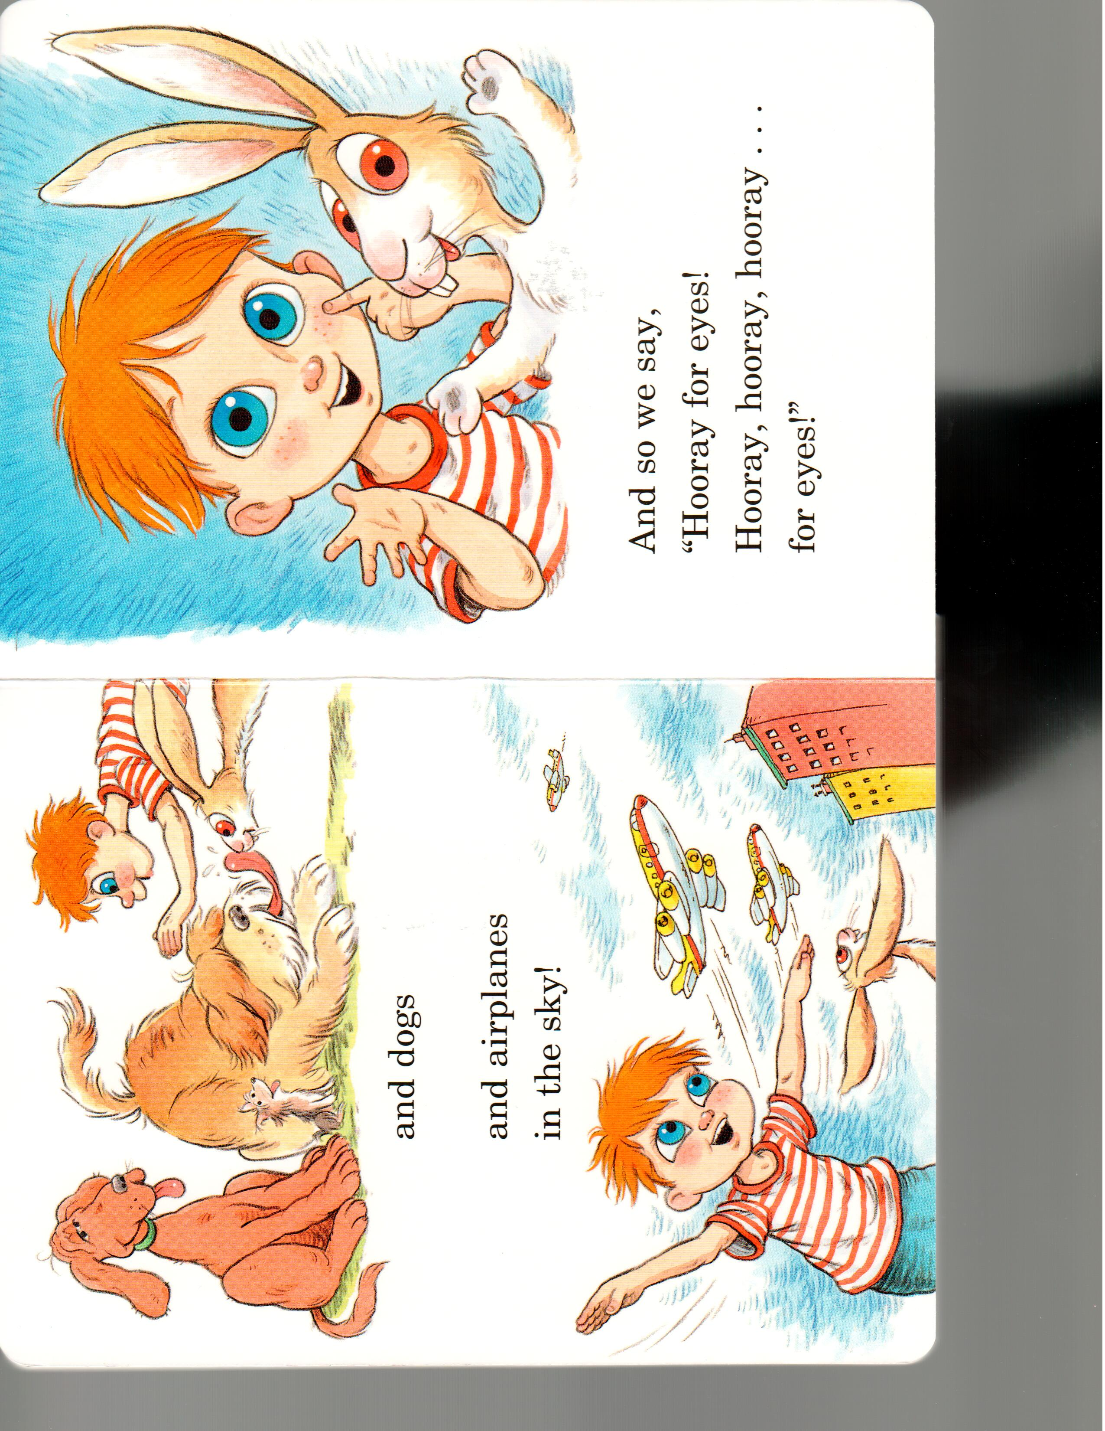
The end

Slide 14
I SPY WITH MY LITTLE EYE:
Notes:
Ask What they might see at a carnival.
Here you can teach the students to play the game “I spy”
you can use colours and talk about games, balloons, roller coasters, stuffed animals, cotton candy, tents, etc.
With each new word, be sure to write it out on the picture somewhere so the students can see how it is spelled.
Use a new whiteboard if you do not have enough space to write the words.

Slide 15
What we will learn today:
Sounds (the letters b,c,d,f )
Describing ourselves and our likes
New carnival words
New magic words
Answer questions about our favourite animals
Notes:
Have the students read the goal that they just completed.
Explain what they learned if needed.
Congratulate them.

Slide 16
I spy … with a cat!
Notes:
Play the cat video for the students.
It’s in the videos resources section on Moodle.
If you cannot load or play the video, then play it on screen with the picture and see who can guess what you’re spying at first by circling it with their mouse. (Ha, that’s ironic. A mouse is going to help a student win the I spy with a cat game. LOL I kill me.)

Slide 17
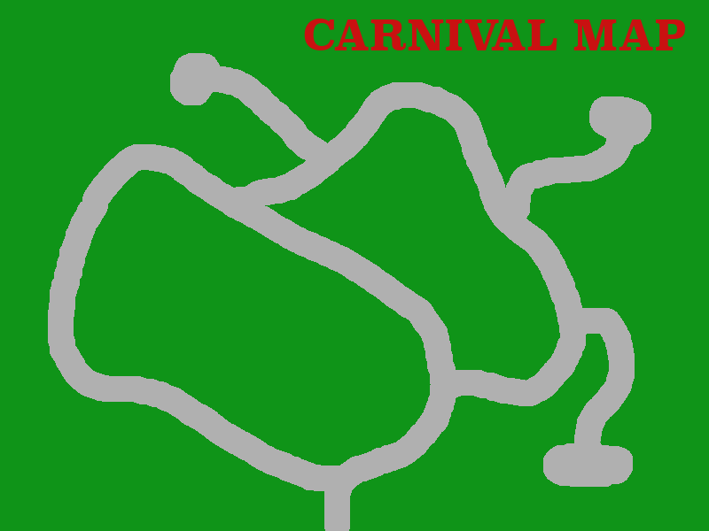
SHOW
RIDES
CIRCUS
FOOD
GAMES
PIE EATING CONTEST
EXIT
Notes:
Talk about the different areas that you can go when you are at a carnival. Today, you will go to the magic show and the circus.

Slide 18
The Magic Show
Notes:
Before you enter the magic show, you will need something. Ask them what they will need to get in. Define/discuss tickets. What type of tickets are there? What are they made of?
Then ask them for their ticket to the show. When they cannot produce one, make a ticket appear out of your hat. Yes, I said your hat. You may need to buy a magic hat or make one out of construction paper. Either way, add a black pocket into it where you can store a long string of scarves or balloons tied together (the long ones not the round ones – uninflated of course) and a ticket stub. Don’t worry about getting caught – remember you’re on camera – a grainy one at that and the students will only see black when you show them the hat with the trick pocket in it.
Show the students that the hat is empty. Then, start pulling the scarves or balloons out of the hat first, then finally find the ticket.
Tada, they’ve just seen their first magic trick with you … yes I said first. ☺

Slide 19
Student 1
Student 2
Student 3
What does a ticket tell us?
Student 4
Notes:
Before class, put the students’ names on the tickets. Just double click the word “Student #” and replace it with your students’ names. If you only have three students, then put your name on a ticket as well.
Talk about
WHAT the tickets are for.
WHO the tickets belong to.
WHERE the event is taking place.
WHEN the show will take place.
The five Ws will be taught later in the course – if the students do not understand the questions, you can move on – this is not a learning goal, but more a diagnostic tool for you to guage where they may be at in terms of asking and responding to questions. You do not need to teach the 5Ws at this point.

Slide 20
What trick was your favourite?
Describe your favourite magic trick.
Notes:
You now proceed to show them two more magic tricks – this is the magic show portion.
I have these cups and a rope trick that I bought from Walmart, but you can add any pictures to this slide and even make your own magic tricks.
http://magictricksforkids.org/list-magic-tricks/
You may want to show some magic videos (e.g., Penn and Teller or Darcy Oake) as well as doing the magic yourself.
LEARNING GOAL:
Ask students in turn which magic trick was their favourite.
Then ask them to describe what happened … or ask them why they liked it best if you think they can answer that question.

Slide 21
What we will learn today:
Sounds (the letters b,c,d,f )
Describing ourselves and our likes
New carnival words
New magic words
Answer questions about our favourite animals
Notes:
Have the students read the goal that they just completed.
Explain what they learned if needed.
Congratulate them.

Slide 22
SHOW
RIDES
CIRCUS
FOOD
GAMES
PIE EATING CONTEST
EXIT
Notes:
Take them back to the map and tell them that the circus is next.

Slide 23
Circus Animal Mix Up
Notes:
Define and discuss a circus.
Make the noises of the animals and ask the students to identify (circle using their mouse) the animal that you are imitating.

Slide 24
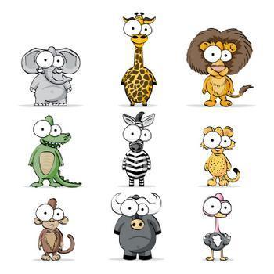
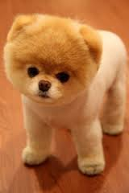
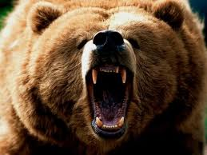
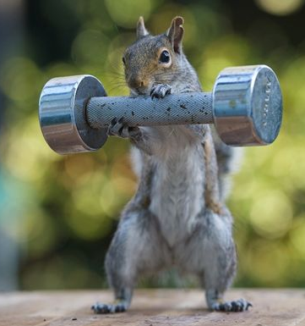
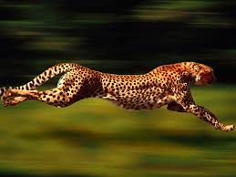
Animals:
What is your favourite animal?
What does your favourite animal look like?
Where does your favourite animal live?
Why is this animal your favourite?
cute
scary
strong
fast
Notes:
Ask the questions and rephrase if necessary.
The students can be offered choice if they cannot come up with answers with a little bit of wait time.
Make sure they have had enough time to process before offering choices.
NOW ASK THEM TO TAKE OUT THEIR HANDOUT – Get them to draw the animals that are listed on the handout.
You should load the handout in the whiteboard as well and go draw with them or have them do it on screen instead of on their paper.
Then ask them to write on their paper the name of their favourite animal. If they can, have them describe it. They can copy down some of the words on this slide - cute, scary, etc.

Slide 25
What we will learn today:
Sounds (the letters b,c,d,f )
Describing ourselves and our likes
New carnival words
New magic words
Answer questions about our favourite animals
Notes:
Have the students read the goal that they just completed.
Explain what they learned if needed.
Congratulate them.

Slide 26
Circus animal mix up
The animals have run away from the carnival
Find them by spelling their names using the letters
L
N
O
I
Notes:
Each slide has scrambled letters.
You can start by giving hints. Like this animal growls.
If they cannot unscramble, click or proceed to show the picture of the animal.
They will likely get the name then. Slowly pronounce the name and ask them to guess which letter or letters come next.
LOGISTICS
If you bring this presentation into Fast Meeting as a document, then you will have to copy each slide three times. First have the letters only, on the second slide have the letters and the picture. On the third slide have the unscrambled letters with the picture.
You do not have to go through all the animals. If the students are having a tough time with it, you can cut this exercise early. The main learning objective was covered in them being able to describe some of the animals. Get through the first four if you can: Bear, Dog, Cat, and Fox as these contain new sounds or vocabulary words.

Slide 27
Circus animal mix up
A
E
R
B

Slide 28
Circus animal mix up
C
T
A

Slide 29
Circus animal mix up
G
O
D

Slide 30
Circus animal mix up
X
F
O

Slide 31
B, c, d, f Sounds
bear |  |  | robber
cat |  |  | acorn
dog |  |  | lid
fox |  |  | wife
Notes:
ASK THEM TO GET THEIR HANDOUTS
Go through each of the words and pronounce it for the students. Then give the definition.
Then you can get them to pronounce it…
Have them write the words into their handout.
“I SAY BEAR, YOU SAY...” as you point to you and then to them.
Do the same with each noun.

Slide 32
What we will learn today:
Sounds (the letters b,c,d,f )
Describing ourselves and our likes
New carnival words
New magic words
Answer questions about our favourite animals
Notes:
Have the students read the goal that they just completed.
Explain what they learned if needed.
Congratulate them.

Slide 33
Circus animal mix up
L
E
S
A

Slide 34
Circus animal mix up
S
R
E
H
O

Slide 35
Circus animal mix up
R
A
Z
E
B

Slide 36
Circus animal mix up
G
I
R
E
T

Slide 37
Circus animal mix up
K
Y
M
O
E
N

Slide 38
Circus animal mix up
R
G
F
I
F
A
E

Slide 39
Circus animal mix up
Back to Map
T
P
N
H
E
E
L
A

Slide 40
What we will learn today:
Sounds (the letters b,c,d,f )
Describing ourselves and our likes
New carnival words
New magic words
Answer questions about our favourite animals
Notes:
Have the students read the goal that they just completed.
Explain what they learned if needed.
Congratulate them.

Slide 41
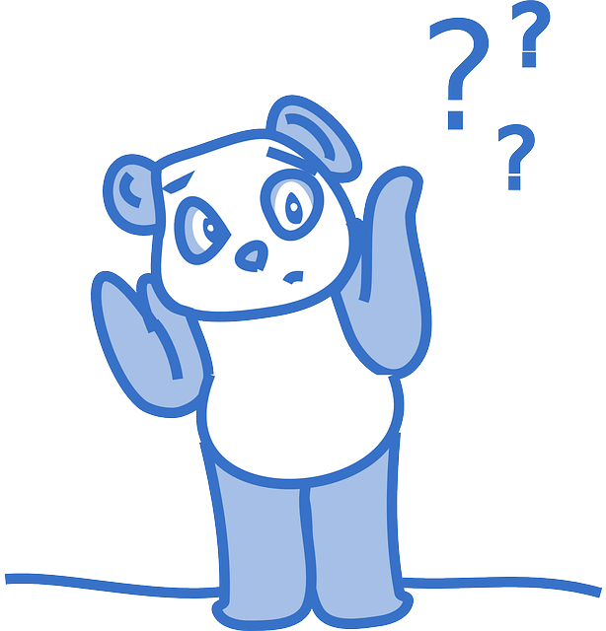
Final Thoughts?
Do you have any questions?
What are you taking away from today?
Do you understand the handout?
Contact me: brian.chen@rosedaleacademy.com
Notes:
If I have spare time at the end of a class, I like to go to a blank whiteboard and have the students tell me about what they did today. I will write out (in words) what they did and ask them to illustrate it. Then we read the story and I take a screen shot of it and send it to the administrators in China to pass on to the students.

