Slide 1
The carnival
Rosedale Academy
Introduction to ESL

Slide 2
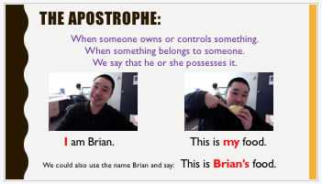
What I learned last class:
The long and short i sound
Simple possessives using names
Telling a story using personal experiences
Notes:
You can review with the students everything that they learned in the last class.

Slide 3
What will I learn today?
Labelling a picture
Using pictures to find meaning
Numbers 1-20
The long and short o sound
Notes:
Have the students read the goals if they can. I find that underlining sentences and asking students to read one sentence at a time works well.

Slide 4
How many triangles are in this picture?
Notes:
Have the students label the triangles they see.
Use different colours to show the different sized triangles.
13 → 9 small ones; 3 made up of four triangles; 1 large one made up of all the triangles.

Slide 5
Notes:
What do you see in the picture?
What is in the foreground?
What is in the background?
What seems to be the focus of the picture?
What may be important?
What may not be important?

Slide 6
Notes:
What do you see in the picture?
What is in the foreground?
What is in the background?
What seems to be the focus of the picture?
What may be important?
What may not be important?

Slide 7
Notes:
What do you see in the picture?
What is in the foreground?
What is in the background?
What seems to be the focus of the picture?
What may be important?
What may not be important?

Slide 8
What will I learn today?
Labelling a picture
Using pictures to find meaning
Numbers 1-20
The long and short o sound
Notes:
Read the goal(s) you just completed.
Congratulate the students.

Slide 9
what is going on?
Notes:
Ask students what they see.

Slide 10
what is going on?
What is happening?
What do you think happened before this?
What do you think will happen next?
Notes:
Three questions to ask when figuring out a situation:
What is happening?
What do you think happened before?
What do you think is going to happen next.

Slide 11
what is going on?
Notes:
What is happening?
What do you think happened before?
What do you think is going to happen next.

Slide 12
what is going on?
Notes:
What is happening?
What do you think happened before?
What do you think is going to happen next.

Slide 13
what is going on?
Notes:
What is happening?
What do you think happened before?
What do you think is going to happen next.

Slide 14
what is going on?
Notes:
What is happening?
What do you think happened before?
What do you think is going to happen next.

Slide 15
What will I learn today?
Labelling a picture
Using pictures to find meaning
Numbers 1-20
The long and short o sound
Notes:
Read the goal(s) you just completed.
Congratulate the students.

Slide 16
Long and short o sound:
Normally, the short o sound is formed in words that do not end with the letter e (dog, mop)
Sometimes a single o will create a long e sound (so, no, go, hotel, poem)
The long e sound is also formed by the following letters:
o_e (rose, home)
oa (boat, road)
oe (toe, Joe)
Notes:
Go through the short i sound
Go through the different long i sounds.
Have the students think of even more examples.
You can link this to brainstorming that you did in lesson 3.

Slide 17
Single o
o_e
THE LONG E SOUND
ow
oa
Notes:
Have the students brainstorm the different forms of long i sounds

Slide 18
Carnival Circle race:
The next page will have words and pictures of nouns with the short o and long o sounds.
Student 1 __________________, will change his/her pencil colour to purple. He/she will have to circle all words and pictures that have the short o sound.
Student 2 __________________, will change his/her pencil colour to red. He/she will have to circle all words and pictures that have the long o sound.
The first student to circle all of his/her words or pictures, without making a mistake, wins.
Notes:
Read the instructions and then play the game with your students. If you have an odd number of students, you play with one of them. Copy the slide over for as many students you have and then go back and see who was correct at the end of the game.

Slide 19
roar
contest
throw a ball
popcorn
top hat
ring toss
magic show
Notes:
If you have more than two students – copy this slide once or twice so that everyone gets to play. On the copied slides, you may want to move things around or use entirely new words/pictures.

Slide 20
What will I learn today?
Labelling a picture
Using pictures to find meaning
Numbers 1-20
The long and short o sound
Notes:
Read the goal(s) you just completed.
Congratulate the students.

Slide 21
What is the number
Guess the number before you run out of time

Slide 22
Numbers one to twenty: Hangman
_ _ _
a b c d e f g h i j k l m n o p q r s t u v w x y z
Notes:
ten

Slide 23
Numbers one to twenty: Hangman
_ _ _ _ _ _ _
a b c d e f g h i j k l m n o p q r s t u v w x y z
Notes:
fifteen

Slide 24
Numbers one to twenty: Hangman
_ _ _ _ _ _ _ _
a b c d e f g h i j k l m n o p q r s t u v w x y z
Notes:
Nineteen

Slide 25
Numbers one to twenty: Hangman
_ _ _ _ _ _ _ _
a b c d e f g h i j k l m n o p q r s t u v w x y z
Notes:
thirteen

Slide 26
Numbers one to twenty: Hangman
_ _ _ _ _ _ _
a b c d e f g h i j k l m n o p q r s t u v w x y z
Notes:
sixteen

Slide 27
Numbers one to twenty: Hangman
_ _ _ _ _ _
a b c d e f g h i j k l m n o p q r s t u v w x y z
Notes:
twelve

Slide 28
Numbers one to twenty: Hangman
_ _ _ _ _
a b c d e f g h i j k l m n o p q r s t u v w x y z
Notes:
eight

Slide 29
What will I learn today?
Labelling a picture
Using pictures to find meaning
Numbers 1-20
The long and short o sound
Notes:
Read the goal(s) you just completed.
Congratulate the students.

Slide 30
And Now …
“That Sounds Great!”
Brought to you today by the sounds:
Short o and Long o

Slide 31
Notes:
Octagon, rocket, lottery ticket
Ocean, ogre, rainbow
You may want to open this as a document before the class begins and put black boxes over the words. Then you can use the eraser when you are going through this slide and remove the annotated block to reveal the word.
HAVE THE STUDENTS TAKE OUT THEIR WORKSHEET AND WRITE THE WORDS INTO THE BOXES.
Define each noun.
Use each noun in a sentence.

Slide 32
And Now …
“Got it? Go!”
Find one thing in your house that has the short o sound.
Find one thing in your house that has the long o sound
Short o and Long o

Slide 33
Story time
Can you tell a story without writing down or saying any words?
Notes:
Ask the students if this is possible.

Slide 34
Charlie Chaplin
Notes:
Now show the video.

Slide 35
Story time
Can you tell a story just by looking at pictures
Notes:
Use the following pictures to tell me a story.

Slide 36
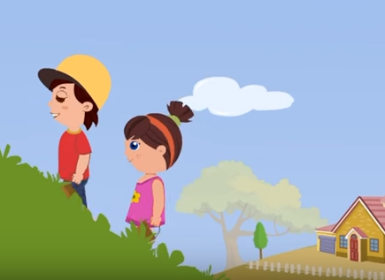
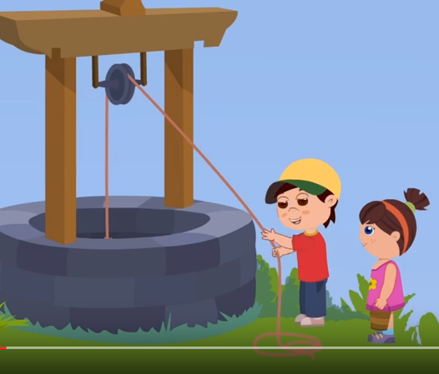
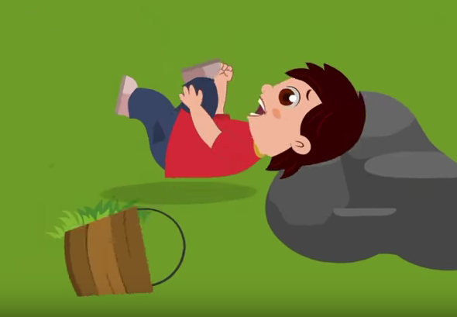
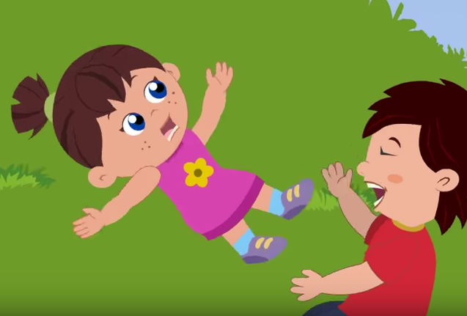
Notes:
Tell me a story of what happened. What order did it happen?

Slide 37
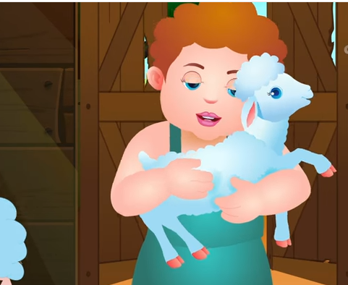
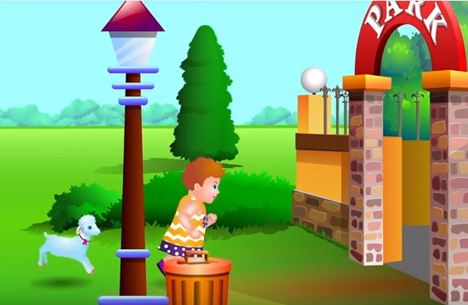
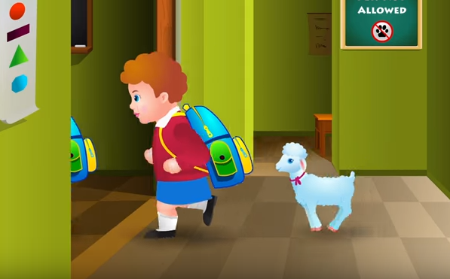
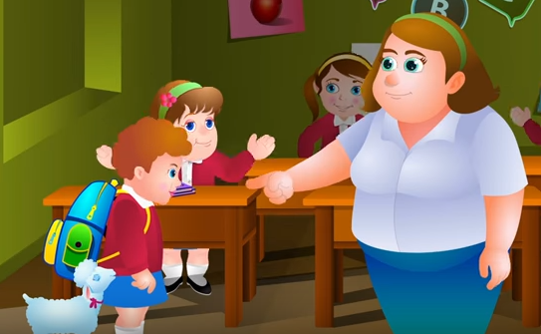
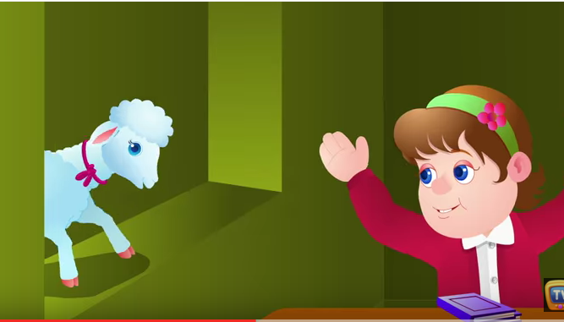

Slide 38
What I learned today:
Labelling a picture
Using pictures to find meaning
Numbers 1-20
The long and short o sound
Notes:
Read the goal(s) you just completed.
Congratulate the students.

Slide 39
Final Thoughts?
Do you have any questions?
What are you taking away from today?
Do you understand the handout?

