Slide 1
The carnival
Rosedale Academy
Introduction to ESL

Slide 2
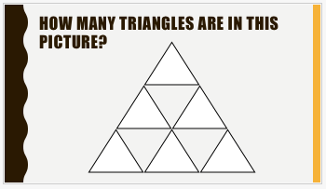
What I learned last class:
Labelling a picture
Using pictures to find meaning
Numbers 1-20
The long and short o sound
Notes:
You can review with the students everything that they learned in the last class.

Slide 3
What will I learn today?
Prepositions
Arranging objects by following simple directions
The short and long u sound
Notes:
Have the students read the goals if they can. I find that underlining sentences and asking students to read one sentence at a time works well.

Slide 4
Where is Kathy?
Notes:
Read the story. Where is Kathy?

Slide 5
This is Kathy the cat. She loves to hide.

Slide 6
Kathy is hiding in the kitchen. Where is Kathy?

Slide 7
Kathy is on top of the refrigerator.

Slide 8
Kathy runs into the living room. Where is Kathy?

Slide 9
Kathy is under the table.

Slide 10
Kathy is hiding in the bathroom. Where is Kathy?

Slide 11
Kathy is in the sink. Kathy jumps down.

Slide 12
Now Kathy is inside the shower. The shower is around the cat.

Slide 13
Kathy runs into the bedroom. Where is Kathy?

Slide 14
Kathy is beside the teddy bear. She is to the left of the bear.

Slide 15
Kathy scampers into the garage. Where is Kathy?

Slide 16
Kathy is between the cars. She is to the right of the red car.

Slide 17
Kathy crawls into the playroom. Where is Kathy?

Slide 18
Kathy is behind the red block.

Slide 19
It has been a long day and Kathy is ready to sleep. Goodnight Kathy.

Slide 20
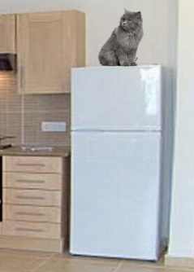
Review:
Kathy is:
beside between
on top of inside
under behind
the refrigerator.
Notes:
Circle the correct word

Slide 21
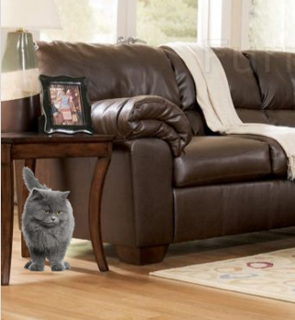
Review:
Kathy is:
beside between
on top of inside
under behind
the table.
Notes:
Circle the correct word

Slide 22
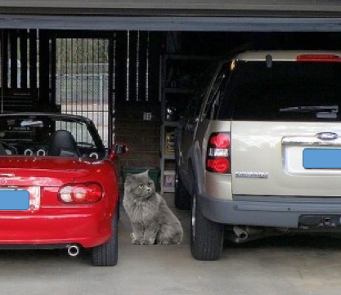
Review:
Kathy is:
beside between
on top of inside
under behind
the cars.
Notes:
Circle the correct word

Slide 23
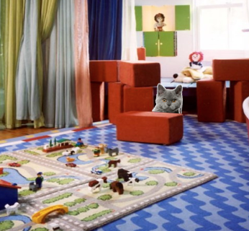
Review:
Kathy is:
beside between
on top of inside
under behind
the red block.
Notes:
Circle the correct word

Slide 24
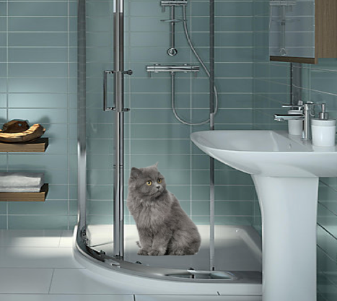
Review:
Kathy is:
beside between
on top of inside
under behind
the shower.
Notes:
Circle the correct word

Slide 25
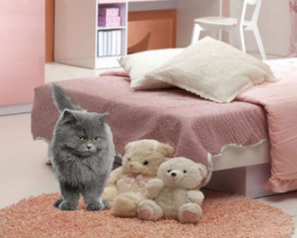
Review:
Kathy is:
beside between
on top of inside
under behind
the teddy bear.
Notes:
Circle the correct word

Slide 26
What will I learn today?
Prepositions
Arranging objects by following simple directions
The short and long u sound
Notes:
Have the students read the goal that they just accomplished.
Congratulate them.

Slide 27
Rotating:
Rotate means to spin or to turn.
Rotate means to spin or to turn.
Rotate means to spin or to turn.
Rotate means to spin or to turn.

Slide 28
We can rotate clockwise
(Just like a clock moves)

Slide 29
We can rotate counter-clockwise
(the opposite way that a clock moves)

Slide 30
Rotate the happy face clockwise:
Normal
Notes:
Explain rotating things clockwise.

Slide 31
Rotate the happy face clockwise:
Normal 90 degrees clockwise

Slide 32
Rotate the happy face clockwise:
Normal 90 degrees clockwise 180 degrees clockwise

Slide 33
Rotate the happy face clockwise:
Normal 90 degrees clockwise 180 degrees clockwise 270 degrees clockwise

Slide 34
Rotate the happy face counter-clockwise:
Normal
Notes:
Talk about rotating counter clockwise

Slide 35
Rotate the happy face counter-clockwise:
Normal 90 degrees counter-
clockwise

Slide 36
Rotate the happy face counter-clockwise:
Normal 90 degrees counter- 180 degrees counter-
clockwise clockwise

Slide 37
Rotate the happy face counter-clockwise:
Normal 90 degrees counter- 180 degrees counter- 270 degrees counter-
clockwise clockwise clockwise

Slide 38
You Try it: The man at the carnival
There is a man walking at the carnival. He has no arms. Draw a stick man with no arms.
It starts to rain around his head. Draw small dots around him as rain drops.
Two big rain drops fall right beside each other. Draw two big raindrops beside each other on top of the man’s head.
The man decides to go into an archway for shelter. But the raindrops follow him. Draw a big arch around the man and the raindrops.
Two giant hot dogs fall beside the archway. One on the left side and one on the right side. Rotate them 90 degrees (or 270 degrees) clockwise so that they are standing up.
90 degrees
Notes:
Have the students try drawing this using the instructions.

Slide 39
Is this what you got?

Slide 40
Is this what you got?

Slide 41
Is this what you got?

Slide 42
Is this what you got?

Slide 43
Is this what you got?

Slide 44
What will I learn today?
Prepositions
Arranging objects by following simple directions
The short and long u sound
Notes:
Have the students read the goal that they just accomplished.
Congratulate them.

Slide 45
Long and short o sound:
Normally, the short u sound is formed in words that do not end with the letter e (tub, cub)
Sometimes a single u will create a long e sound (unit, utopia, uniform)
The long u sound is also formed by the following letters:
u_e (tube, cube)
oo (too, root)
ew (few, threw)
ou (you, youth)
ui (suit, juice)
Notes:
Go through the short u sound
Go through the different long u sounds.
Have the students think of even more examples.
You can link this to brainstorming that you did in lesson 3.

Slide 46
ou
Single U
u_e
THE LONG U SOUND
ew
oo
ui
Notes:
Have the students brainstorm the different forms of long i sounds

Slide 47
Carnival Circle race:
The next page will have words and pictures of nouns with the short o and long u sounds.
Student 1 __________________, will change his/her pencil colour to purple. He/she will have to circle all words and pictures that have the short u sound.
Student 2 __________________, will change his/her pencil colour to red. He/she will have to circle all words and pictures that have the long u sound.
The first student to circle all of his/her words or pictures, without making a mistake, wins.
Notes:
Read the instructions and then play the game with your students. If you have an odd number of students, you play with one of them. Copy the slide over for as many students you have and then go back and see who was correct at the end of the game.

Slide 48
Carnival food
circus
costume
tooth
ducks
teacup ride
Notes:
If you have more than two students – copy this slide once or twice so that everyone gets to play. On the copied slides, you may want to move things around or use entirely new words/pictures.
*** NOT Balloons can be both short and long u

Slide 49
What will I learn today?
Prepositions
Arranging objects by following simple directions
The short and long u sound
Notes:
Have the students read the goal that they just accomplished.
Congratulate them.

Slide 50
And Now …
“Gather up something unique”
Find one thing in your house that has the short u sound.
Find one thing in your house that has the long u sound
Short u and Long u

Slide 51
Final Thoughts?
Do you have any questions?
What are you taking away from today?
Do you understand the handout?

Slide 52
Giving Directions Game
Take away one student’s ability to see and hear classmates.
Then have him/her give instructions for:
Brushing Teeth
Drinking from a water bottle
Dancing
Using the telephone to make a phone call
Ordering fast food from a menu
Replacing the batteries in a toy/mouse/camera/etc.
…anything else you can think of
Notes:
You can play the communication alien video here.
Try to have one student describe a process to either you or another student. If it is you, do everything literally and do not infer anything. This shows students how detailed instructions must be.
The alien game:
You can play it like the alien game. Assume you are an alien that does not know anything about life on Earth. All you know is the English language. Therefore, students have to be very explicit when giving directions. “Put the toothpaste on the toothbrush” may make an alien try to balance the tube of toothpaste on top of the tip of the toothbrush, etc.

