Slide 1
The carnival
Rosedale Academy
Introduction to ESL

Slide 2
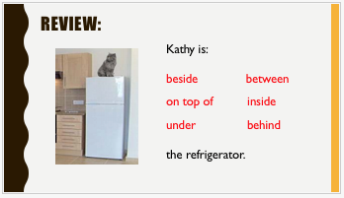
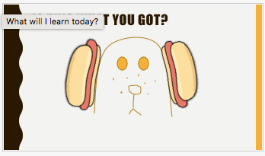
What I learned last class:
Prepositions
Arranging objects by following simple directions
The short and long u sound
Notes:
You can review with the students everything that they learned in the last class.

Slide 3
What will I review today?
Possessives
Using pictures to represent words
Writing short words and phrases
Songs – the long vowel songs
Notes:
Have the students read the goals if they can. I find that underlining sentences and asking students to read one sentence at a time works well.

Slide 4
My carnival
Congratulations, you are going to start your very own carnival. Complete the following phrase:
My carnival is called: ___________________________________
Notes:
HAVE STUDENTS FILL OUT WORKSHEET #1

Slide 5
My carnival has…
Now that we know the name of your carnival, describe the different things we will see at your carnival.
My carnival is will have: ________________________________________________________________________________________________________________________________________________________
Notes:
HAVE STUDENTS FILL OUT WORKSHEET #1

Slide 6
Sharing Time:
Each student will now share the name and description of his/her carnival.
Then, students will use possessives to create a sentence that describes other people’s carnivals. For example, Kim’s carnival has balloons; your carnival has food; his carnival has the log ride.

Slide 7
Create a flag for your carnival
Use your worksheet to create a flag that you will put at the front entrance of your carnival. Draw and write words that describe your carnival in this box.
Put your carnival name here

Slide 8
Create a flag for your carnival
Food
Games
Rides
Teacher’s Carnival
Notes:
HAVE STUDENTS FILL OUT WORKSHEET #2
WORKSHEET #2 Will be a part of the student’s portfolio.
Tell them that they can tell their parents to download the quiver app and then view their child’s flag on the app. It turns 3d and comes to life.

Slide 9
What will I review today?
Possessives
Using pictures to represent words
Writing short words and phrases
Songs – the long vowel songs
Notes:
Have the students read the goals if they can. I find that underlining sentences and asking students to read one sentence at a time works well.

Slide 10
Apples and bananas song
L
O
N
G
A
E
I
O
U
Lyrics:
I like to eat, eat, eat apples and bananas (x2)
I like to ate, ate, ate, ay-ples and ba-nay-nays (x2)
I like to eat, eat, eat, ee-ples and bee-nee-nees (x2)
I like to ite, ite, ite, i-ples and by-ny-nys (x2)
I like to ote, ote, ote, oh-ples and bo-no-nos (x2)
I like to oote, oote, oote, oo-ples and boo-noo-noos (x2)
Notes:
Play the apples and bananas video.
Sing the song with them together.

Slide 11
What will I review today?
Possessives
Using pictures to represent words
Writing short words and phrases
Songs – the long vowel songs
Notes:
Have the students read the goals if they can. I find that underlining sentences and asking students to read one sentence at a time works well.

Slide 12
Final Thoughts?
Do you have any questions?
What are you taking away from today?
Do you understand the handout?

Slide 13
Extra time?
Go back to lesson 11 and do the extra time activity – communication and instructions
OR
Have them download the quiver app or you download the quiver app and show them your flag and how it comes to life.

