Slide 1
The Carnival
Rosedale Academy
Introduction to ESL

Slide 2
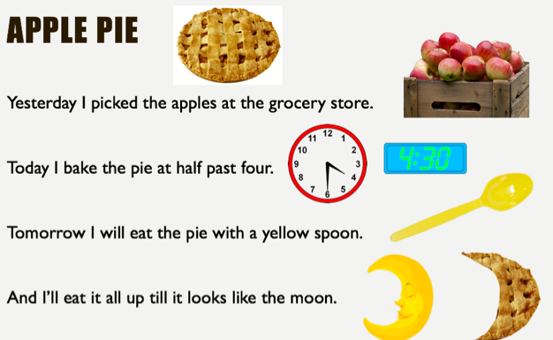
What I learned last class:
How to find information in text using pictures
How to listen in basic conversations
How to use the “g, h, j, k” sounds
Notes:
You can review with the students everything that they learned in the last class.

Slide 3
What will I learn today?
Recognizing patterns in words
Reading direction
Brainstorming
New food vocabulary
The sounds L, M, N and P
Notes:
Have the students read the goals if they can. I find that underlining sentences and asking students to read one sentence at a time works well.

Slide 4
SHOW
RIDES
CIRCUS
FOOD
GAMES
PIE EATING CONTEST
EXIT
Notes:
Talk about the different areas that you can go when you are at a carnival. Today, you will go to the food and games areas.

Slide 5
Carnival Food

Slide 6
Notes:
Ask students if they know what this food is.
Ask students to describe what they see.
Tell the students that we will “BRAINSTORM” in order to try to learn more about this carnival food.

Slide 7
What is it called?
What does it taste like?
What is the texture?
What is it made of?
Notes:
Define brainstorming for the students or ask them if they know what it is.
Talk about the idea that when we brainstorm, we may create categories like the questions on this page.
Go through each question and write words / answers in the boxes.
What does it taste like? (bitter, sweet, sour, salty, plain, spicy, hot, cold, etc.)
What is the texture? (hard, soft, chewy, grainy, sticky, etc.)
What is it made of? (salt, sugar, water, flour, fruits, etc.)

Slide 8
Licorice candy
Notes:
Talk about what licorice is, where it comes from, etc.

Slide 9
Notes:
Ask students if they know what this food is.
Ask students to describe what they see.
Tell the students that we will “BRAINSTORM” in order to try to learn more about this carnival food.

Slide 10
Notes:
Now ask students to make up their own categories.
They may and probably will make up the same categories that you did.
You may want to add: colour, smell, etc.
Write the categories and words that the students offer into the boxes.

Slide 11
Mexican funnel cake
Notes:
WATCH THE VIDEO OF A MEXICAN FUNNEL CAKE.
The video is provided on the Moodle page and in the Moodle Resources.
Talk about what a funnel cake is, where it comes from, etc.

Slide 12
Notes:
Ask students if they know what this food is.
Ask students to describe what they see.
Tell the students that we will “BRAINSTORM” in order to try to learn more about this carnival food.

Slide 13
Notes:
Again, ask students to make up their own categories.
Write the categories and words that the students offer into the boxes.

Slide 14
Nachos
Notes:
Talk about what nachos are, where they come from, etc.

Slide 16
Cotton candy
Notes:
WATCH THE VIDEO OF THE COTTON CANDY BEING MADE.

Slide 17
What will I learn today?
Recognizing patterns in words
Reading direction
Brainstorming
New food vocabulary
The sounds L, M, N and P
Notes:
Have the students read the goal that they just completed.
Explain what they learned if needed.
Congratulate them.

Slide 18
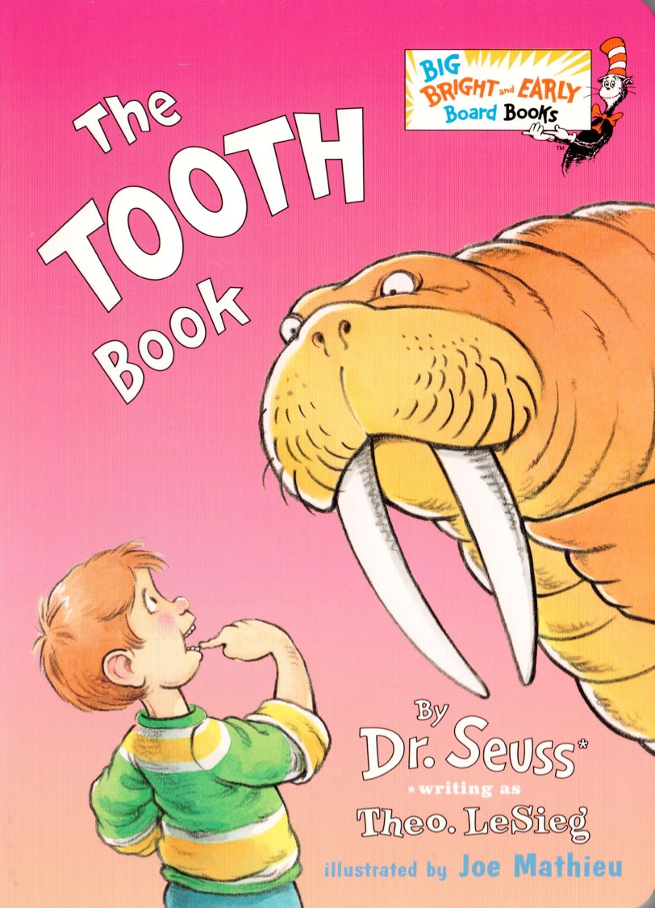
Notes:
“All that food is making me hungry. I would love something to eat. What do I use to eat and chew my food?”
“Can you help me read a story about teeth?”

Slide 19
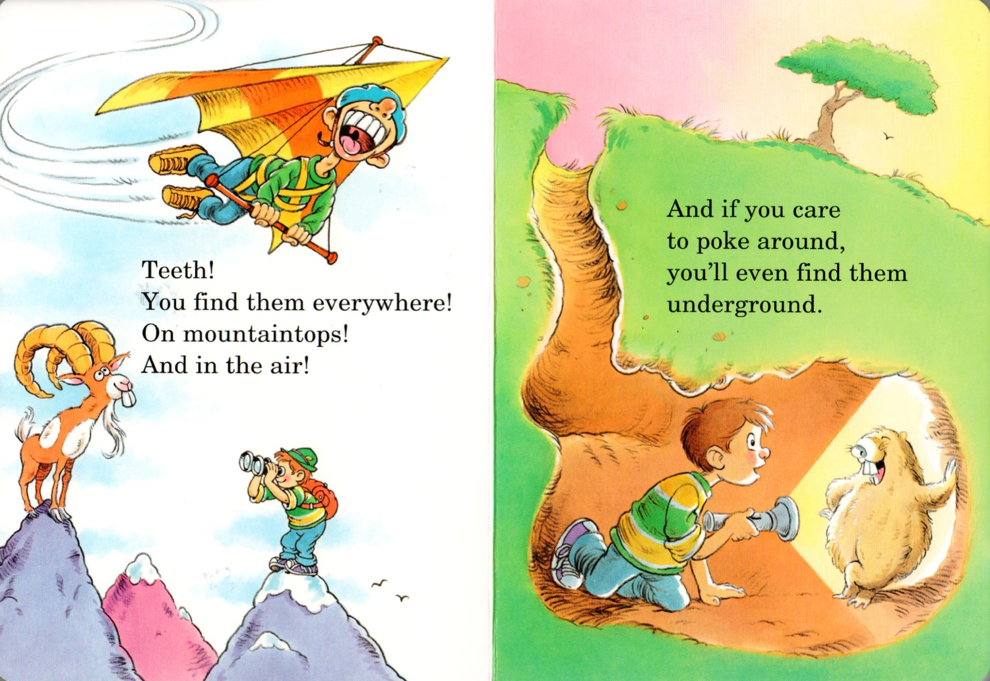
Notes:
Read for 5-10 minutes.
You do not have to finish the book if the students are disengaged or if you are taking time to explain words or talk about the story or other pictures in the book.
The students have this book as a .pdf and also in audio/video format.

Slide 20
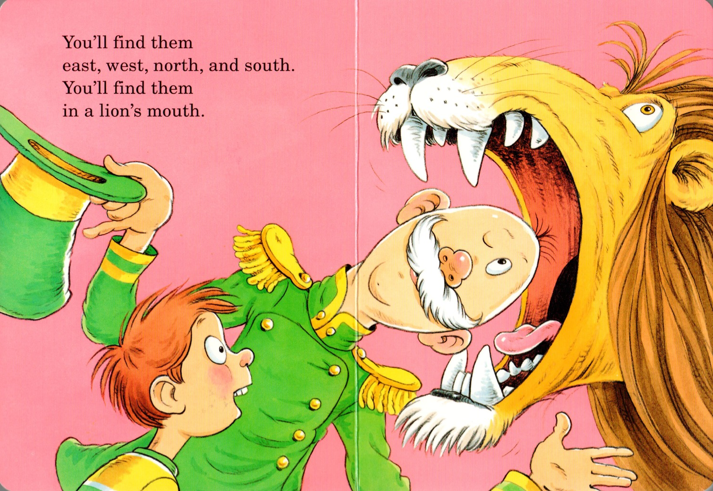

Slide 21
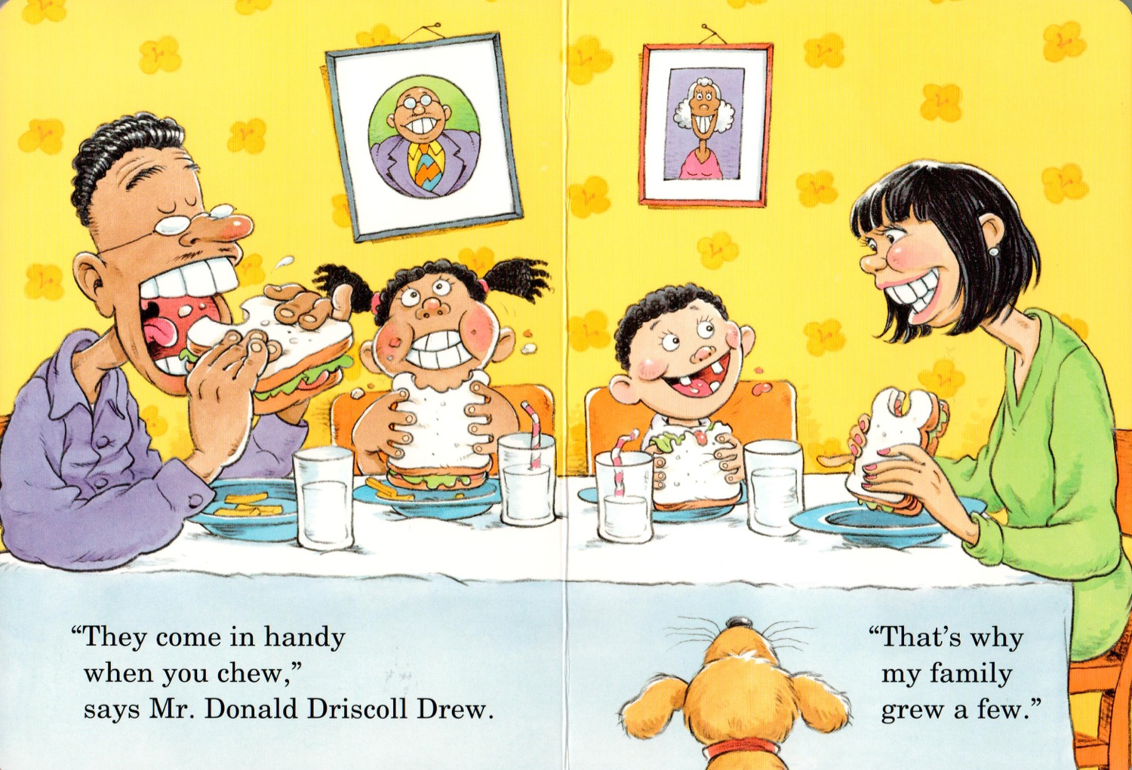

Slide 22
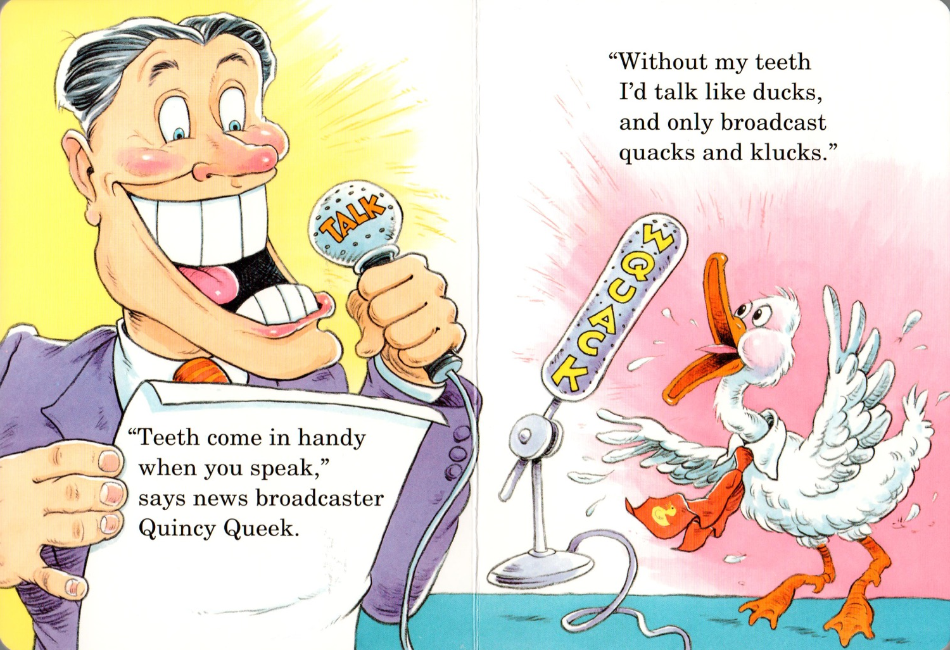

Slide 23
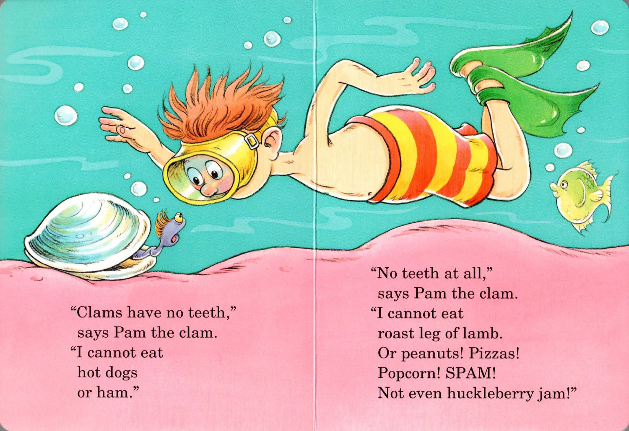

Slide 24
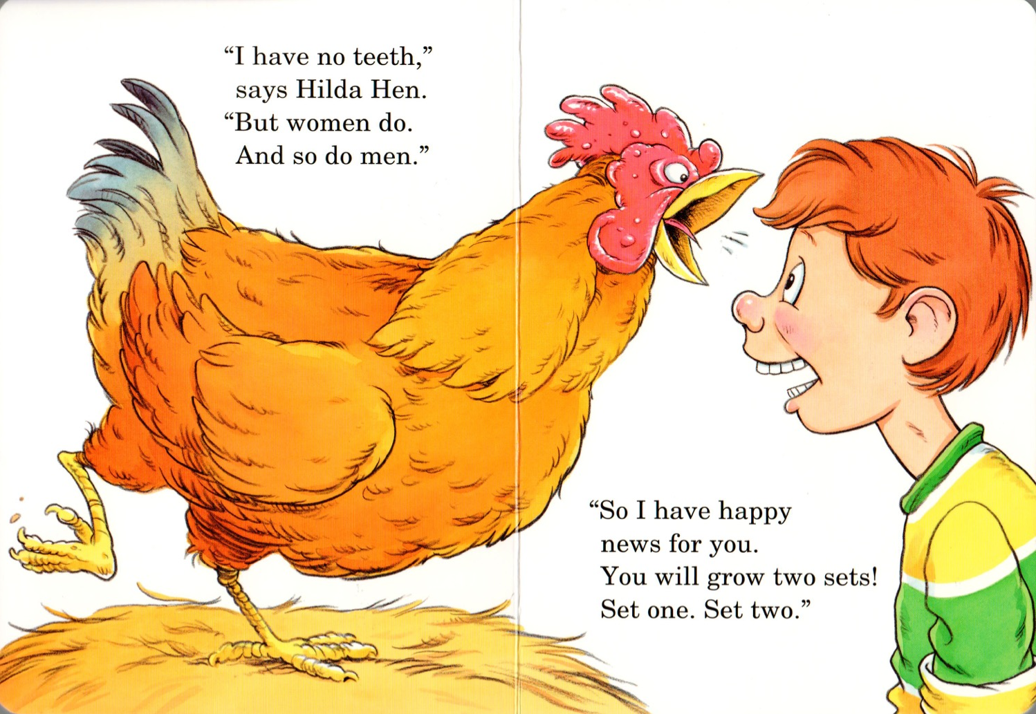

Slide 25
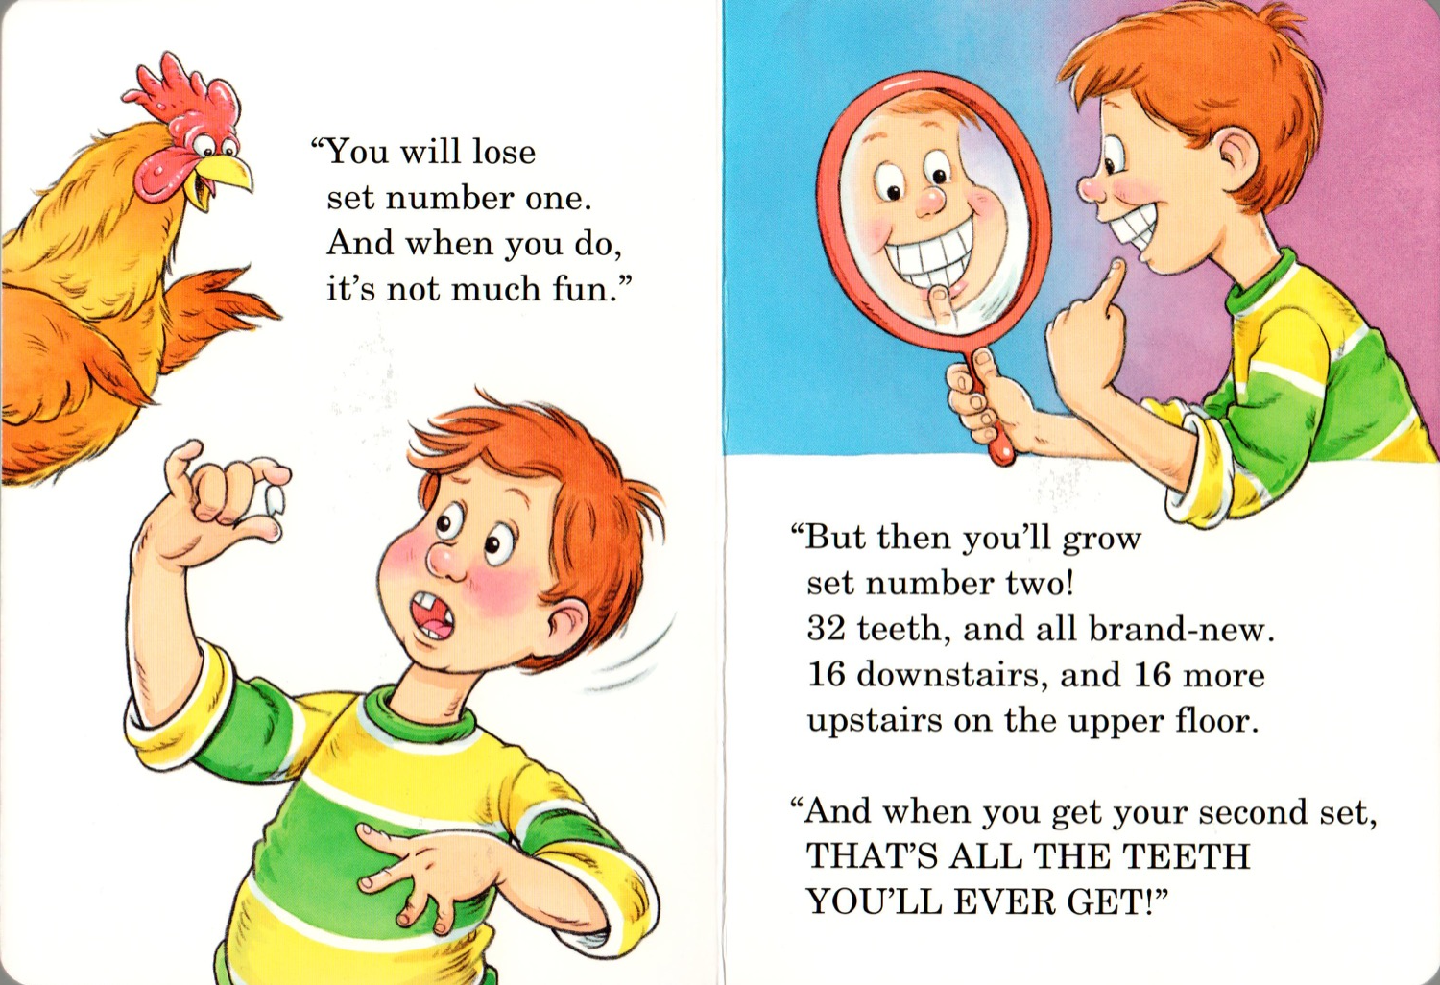

Slide 26
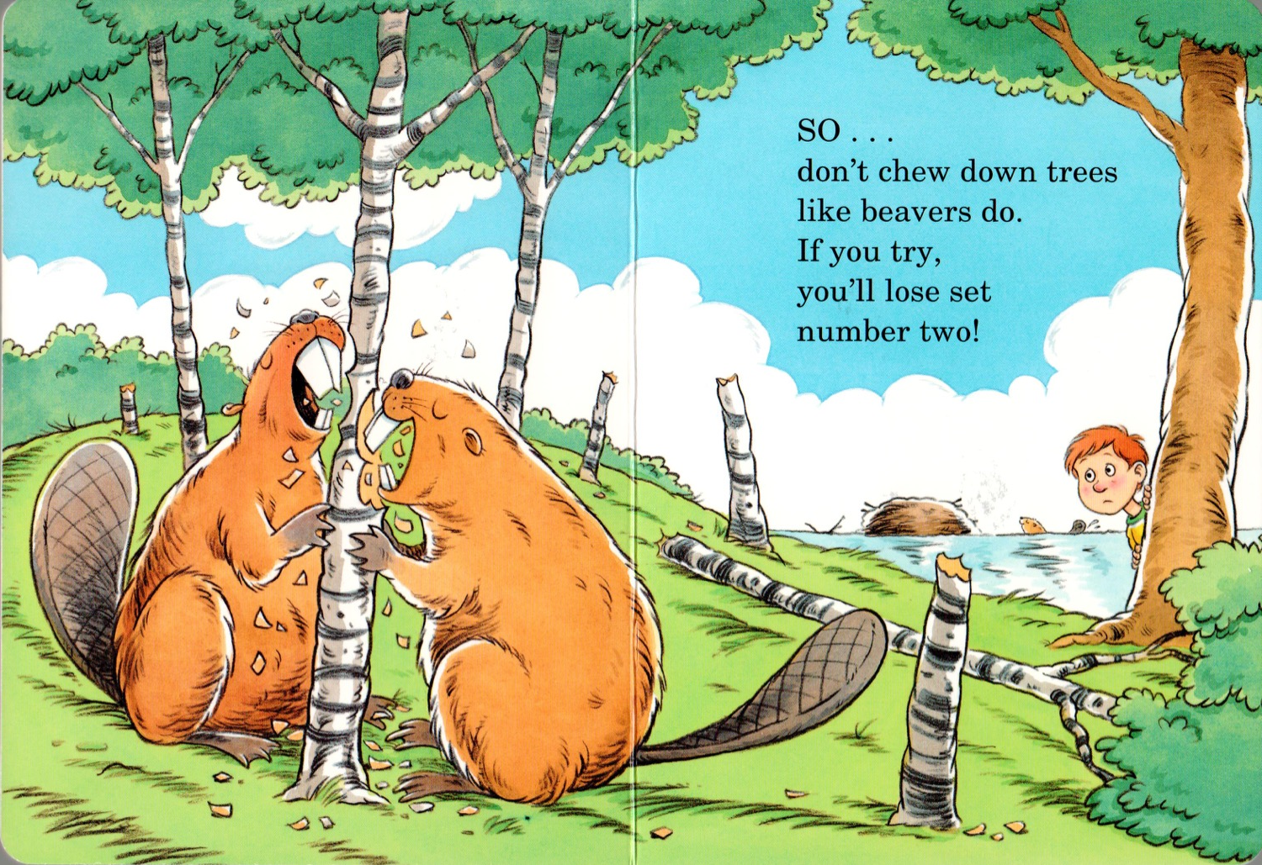

Slide 27
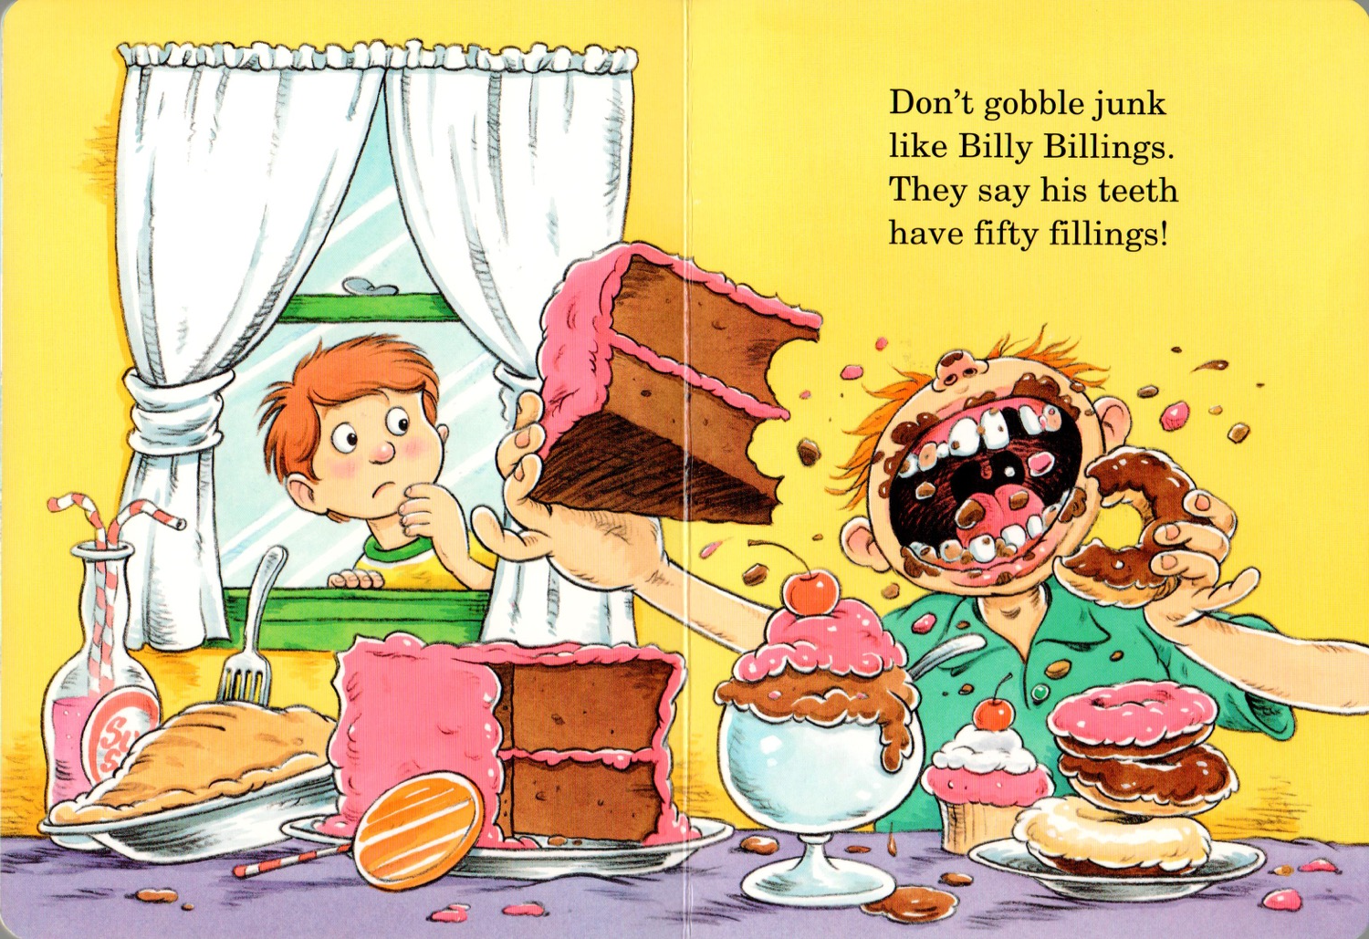

Slide 28
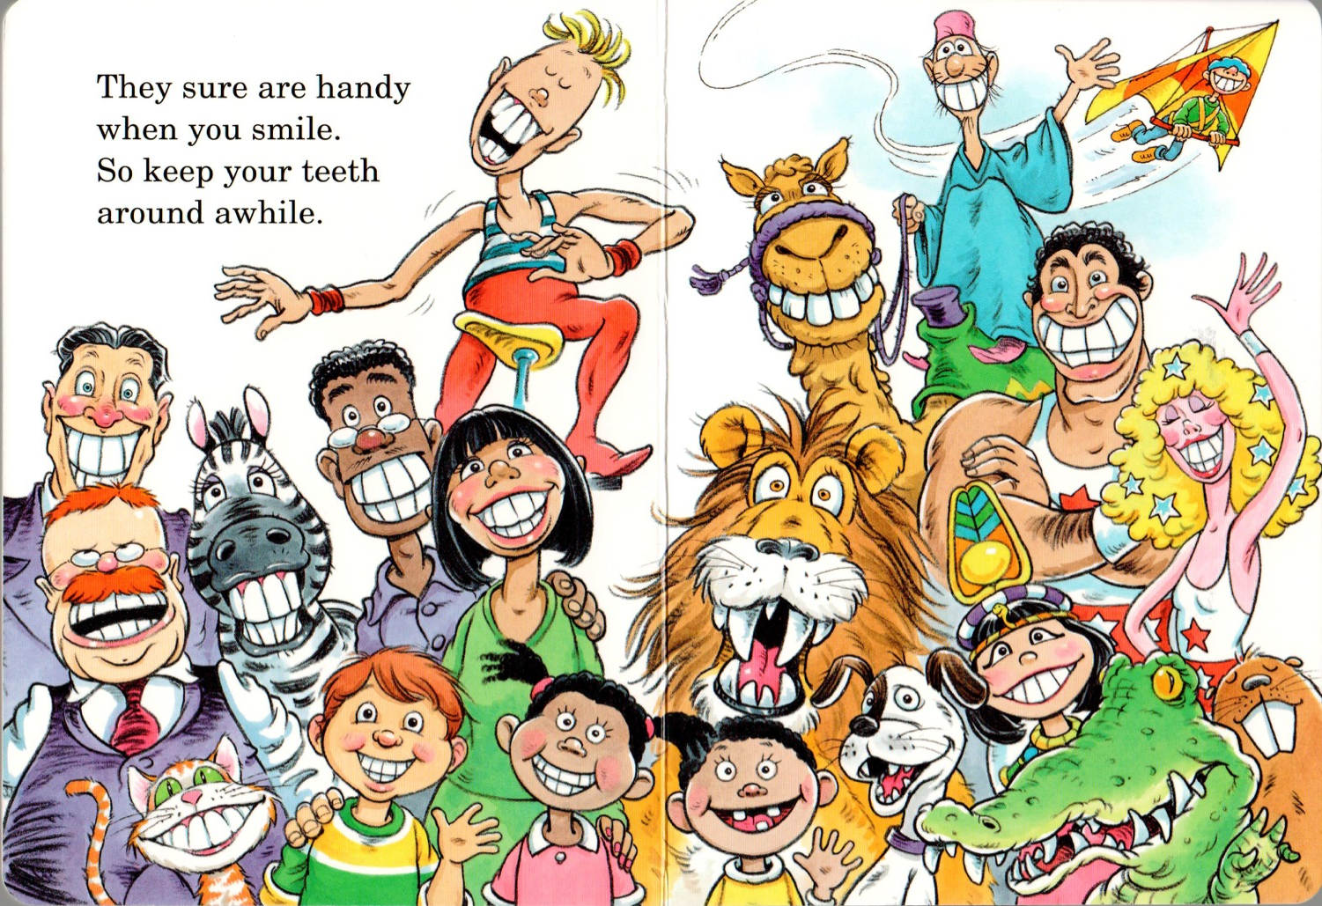

Slide 29
What will I learn today?
Recognizing patterns in words
Reading direction
Brainstorming
New food vocabulary
The sounds L, M, N and P
Notes:
Have the students read the goal that they just completed.
Explain what they learned if needed.
Congratulate them.

Slide 30
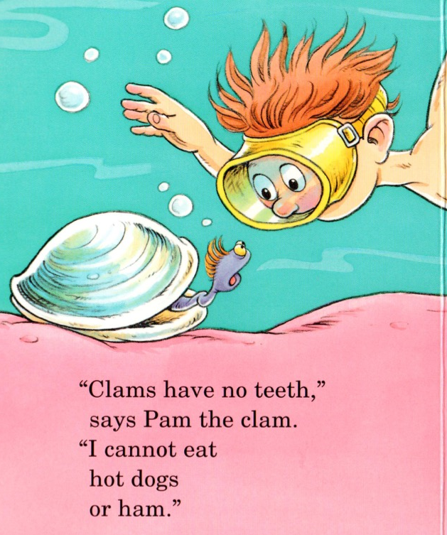
The End
Let’s look at one of the words in the book: “ham”
What other words end in with the letters “am”
Can you use: r, h, d, j
Notes:
See if the students can use the “am” text pattern to match the letters r, h, d and j with the pictures.
Ask them if they can find other words that have the same word endings.

Slide 31
Write the words and match the endings
Notes:
Have the students draw lines from the words on the top to the similar word patterns on the bottom.
Write the words for the pictures as each student tells you how to spell the word.
DOG – FROG
BED – RED
CAT – HAT
HAVE THE STUDENTS TAKE OUT THEIR WORKSHEET AND MAKE MORE “AT” WORDS.

Slide 32
What will I learn today?
Recognizing patterns in words
Reading direction
Brainstorming
New food vocabulary
The sounds L, M, N and P
Notes:
Have the students read the goal that they just completed.
Explain what they learned if needed.
Congratulate them.

Slide 33
And Now …
“That Sounds Great!”
Brought to you today by the letters:
Notes:
Just a timing slide. Go to the next slide to see the letters.

Slide 34
And Now …
“That Sounds Great!”
Brought to you today by the letters:
Notes:
Ask students if they recognize the letters.
Then ask them if they recognize the logos for the companies:
The Liberal Party in Canada, McDonalds, Nintendo 64, Pinterest.

Slide 35
The sounds “L” and “M”
Lamp | Leader | Luggage
Mop | Mall | Myth
Notes:
You may want to open this as a document before the class begins and put black boxes over the words. Then you can use the eraser when you are going through this slide and remove the annotated block to reveal the word.
HAVE THE STUDENTS TAKE OUT THEIR WORKSHEET AND WRITE THE WORDS INTO THE BOXES.
Define each noun.
Use each noun in a sentence.

Slide 36
The sounds “N” and “P”
Nut | Neck | Neighbour
Pan | Party | Parcel
Notes:
You may want to open this as a document before the class begins and put black boxes over the words. Then you can use the eraser when you are going through this slide and remove the annotated block to reveal the word.
HAVE THE STUDENTS TAKE OUT THEIR WORKSHEET AND WRITE THE WORDS INTO THE BOXES.
Define each noun.
Use each noun in a sentence.

Slide 37
Pick Two:
Go and pick up any two items in your house that start with any of the following letters and bring them back for us to see!
l m n p
Notes:
Read this slide to them and explain the game if they do not understand.
Then run off and grab two items that start with any of these letters yourself.
Whatever they bring back, write the words on the slide so they can see the spelling.

Slide 38
What will I learn today?
Recognizing patterns in words
Reading direction
Brainstorming
New food vocabulary
The sounds L, M, N and P
Notes:
Have the students read the goal that they just completed.
Explain what they learned if needed.
Congratulate them.

Slide 39
Final Thoughts?
Do you have any questions?
What are you taking away from today?
Do you understand the handout?

Slide 40
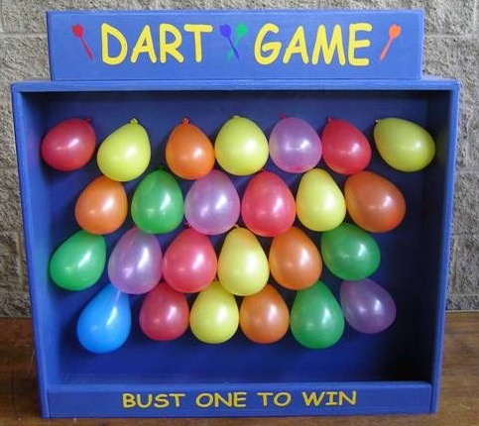
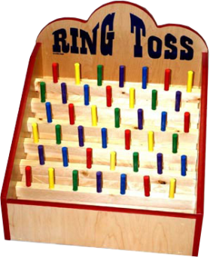
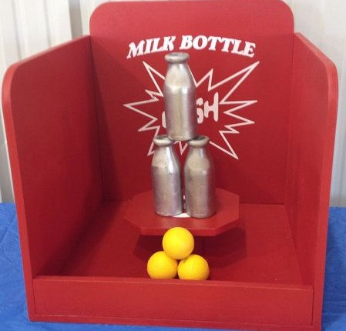
Carnival GAMES
Notes:
Talk about the different carnival games that you or the students have played before.
Discuss the games that are on this page.
Ask them what happens when you win a game at the carnival or fair.

Slide 41
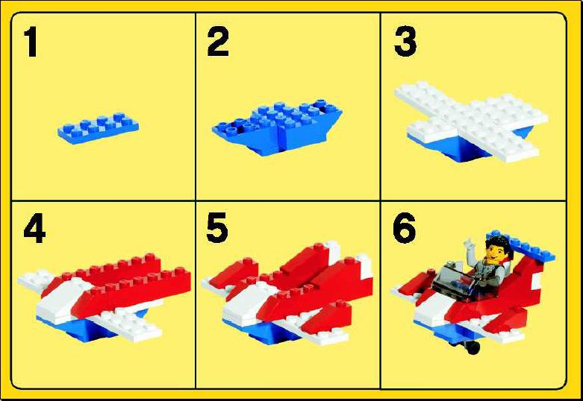
Instructions:
You will be given four different pictures or phrases.
Each picture or phrase will be represented by a certain colour.
There will be four boxes at the bottom of the page numbered 1-4.
You need to figure out the order of events.
Match the colours with the correct number order the events.

Slide 42
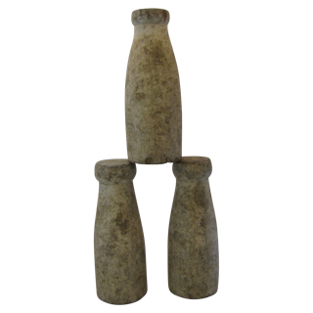
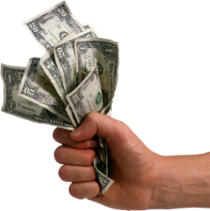
The Bottle Game
Throw the ball
Pay to play the game
Win a stuffed toy
Knock over bottles
1 | 2 | 3 | 4
Notes:
WATCH THE VIDEO.
Read each square with the students before starting the ordering process.
Have the students tell you which colour should go first. … second ... Third and fourth.

Slide 43
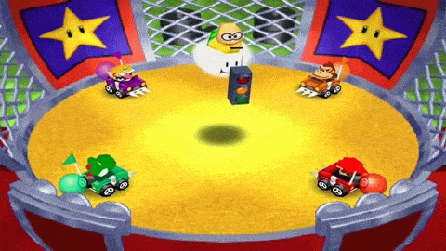
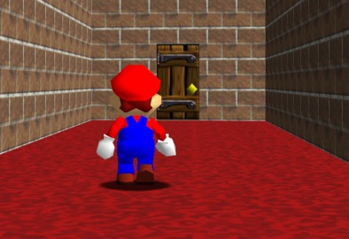
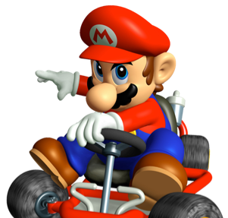
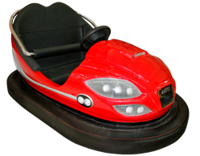
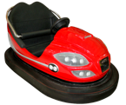
The BUMPER CAR Game
Exit the game area
Put on your seatbelt
Bump into other players
Get in the bumper car
EXIT
1 | 2 | 3 | 4
Notes:
Read each square with the students before starting the ordering process.
Have the students tell you which colour should go first. … second ... Third and fourth.

Slide 44
The horse race Game
42
35
63
You get a prize for winning.
The bell rings.
Roll the balls.
Your horse moves faster.
1 | 2 | 3 | 4
Notes:
WATCH THE VIDEO.
Read each square with the students before starting the ordering process.
Have the students tell you which colour should go first. … second ... Third and fourth.

Slide 45
Notes:
You can continue on with the food without brainstorming if you feel the students have exhausted brainstorming.
If you feel that they need more work, you can open up a new whiteboard and brainstorm with them there. Use other graphic organizers for brainstorming that you have to expose students to other forms of brainstorming.
Definitely do the last one on slide #23 – Cotton Candy

Slide 46
pretzels

Slide 48
Corn dog

Slide 50
Candy apples

Slide 52
Chicken wings

