Slide 1
The Carnival
Rosedale Academy
Introduction to ESL

Slide 2
What will I learn today?
Writing letters in order to write words.
Retell key events from a story heard aloud.
The “q, r, s, t” sounds
Notes:
Have the students read the goals if they can. I find that underlining sentences and asking students to read one sentence at a time works well.

Slide 3
LOST AT The Carnival
Notes:
Ask them if they have ever been lost before?
What should you do if you are ever lost?

Slide 4
Notes:
Talk about who you should get help from if you are lost.
Note two people at a ticket booth is best. Try to find people in groups to help you.
Men you don’t know, clowns and even mothers with children may not be the best idea.
Policemen are good as well – even better if there are two of them or more.

Slide 5
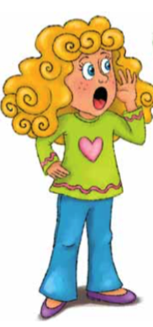
Today’s story
Notes:
We are going to read a story about a girl who gets lost in a forest.
But first, we will do some pre-reading by identifying some of the words we will hear in the story.

Slide 6
Word preview:
Here are some words that we will encounter today. Can you complete the word by filling in the correct letter?
__ed
b __ wl
chai __
Fores__
__tairs
Notes:
Have students tell you the names of the words.
Then use sounds to fill in the words.
If the students can, have them write the letter to fill in the blank.
When you hit bowl – talk about things you can put in bowls. *** Maybe talk about (introduce) PORRIDGE here.
If they cannot use their mouse to write letters, you can write three letters on the screen and have them circle the correct one.

Slide 7
What will I learn today?
Writing letters in order to write words.
Retell key events from a story heard aloud.
The “q, r, s, t” sounds
Notes:
Have the students read the goal that they just completed.
Explain what they learned if needed.
Congratulate them.

Slide 8
Notes:
“We will now read a story about a little girl who was lost in the forest. Her name is Goldilocks.”
Show the video of this book – it is in the resources section as a video file. You can share it as a multimedia item.
If the video doesn’t load – share the .pdf file of the book and read the book yourself.
This is a listening and recalling activity for the students.
Ask the students to pay attention to the important parts of the story – like the chairs, the porridge and the sleeping in the beds.

Slide 9
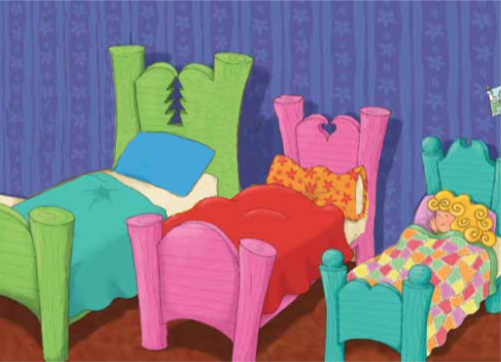
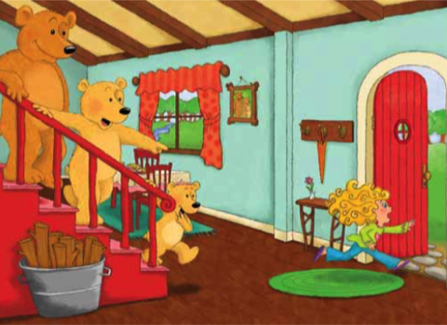
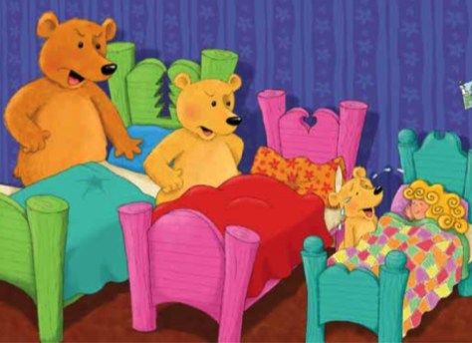
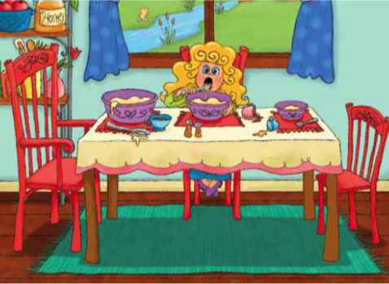
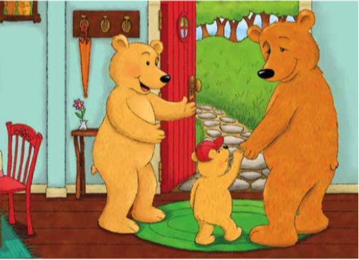
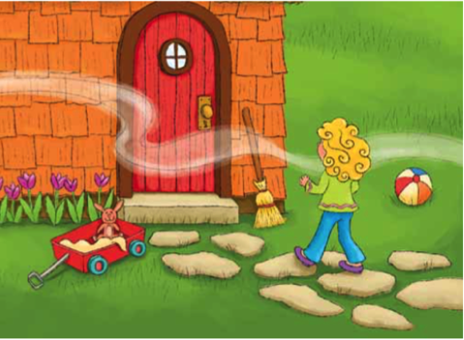
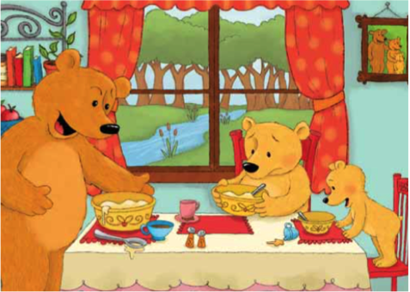
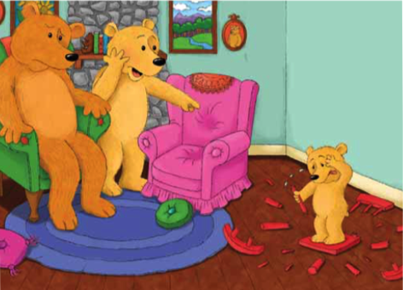
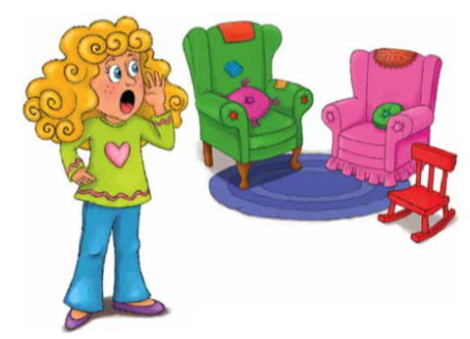
A
B
C
D
E
F
G
H
I
Notes:
**** Go to the “MORE FUNCTIONS” button and “record” this part of the session. We will use it as part of the student’s portfolio.
Have the students order the story.
E, F, I, D, A, H, G, C, B
Get them to tell you a little bit about what happened in each picture.

Slide 10
What will I learn today?
Writing letters in order to write words.
Retell key events from a story heard aloud.
The “q, r, s, t” sounds
Notes:
Have the students read the goal that they just completed.
Explain what they learned if needed.
Congratulate them.

Slide 11
And Now …
“That Sounds Great!”
Brought to you today by the letters:
Notes:
Just a timing slide. Go to the next slide to see the letters.

Slide 12
And Now …
“That Sounds Great!”
Brought to you today by the letters:
Notes:
Ask students if they recognize the letters.
Then ask them if they recognize the logos for the companies:
Google, Honda, The Toronto Blue Jays, Special K cereal.

Slide 13
The “q” Sound:
Notes:
Define garden and gown.
Have the students pronounce the words, then use them in a sentence

Slide 14
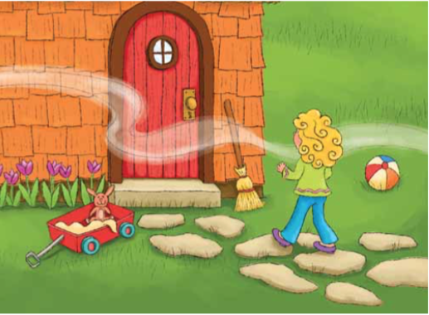
The “r” Sound:
Notes:
Define hospital and helmet
Have the students pronounce the words, then use them in a sentence

Slide 15
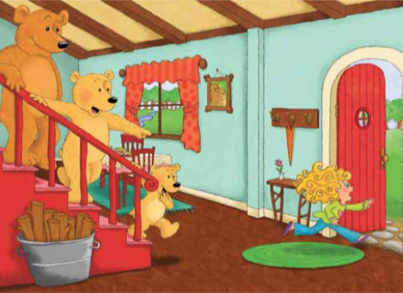
The “s” Sound:
Notes:
Define jeep and jungle.
Have the students pronounce the words, then use them in a sentence

Slide 16
The “t” Sound:
Notes:
Define kite and kayak.
Have the students pronounce the words, then use them in a sentence

Slide 17
Pick Two:
Go and pick up any two items in your house that start with any of the following letters and bring them back for us to see!
q r s t
Notes:
Read this slide to them and explain the game if they do not understand.
Then run off and grab two items that start with any of these letters yourself.
Whatever they bring back, write the words on the slide so they can see the spelling.

Slide 18
What will I learn today?
Writing letters in order to write words.
Retell key events from a story heard aloud.
The “q, r, s, t” sounds
Notes:
Have the students read the goal that they just completed.
Explain what they learned if needed.
Congratulate them.

Slide 19
Story Time:
Let’s write the story of Goldilocks and the Three Bears in our own words.
Notes:
If I have spare time at the end of a class, I like to go to a blank whiteboard and have the students tell me about the story.
I will write out (in words) what they remember from the story and ask them to illustrate it.
Have them illustrate setting and Goldilocks – but leave out the three bears – then you can make them the three bears. Get screen captures of their heads from previous lessons and import them onto the whiteboard. The draw bear bodies on them.
If you have more than three students, make one Goldilocks. If you have less than three - add yourself into the mix.

Slide 20
What I learned today?
Writing letters in order to write words.
Retell key events from a story heard aloud.
The “q, r, s, t” sounds
Notes:
Have them review and tell you about what they learned today.

Slide 21
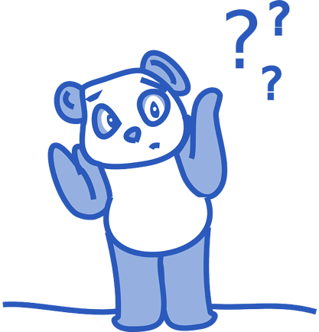
Final Thoughts?
Do you have any questions?
What are you taking away from today?
Do you understand the handout?

