Slide 1
The carnival
Rosedale Academy
Introduction to ESL

Slide 2
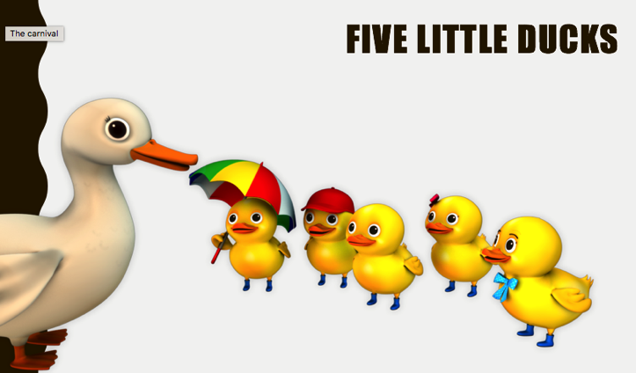
What I learned last class:
Repeating words in song
Words that are in the same family ”_ay"
How to use the “v, w, x, y, and z” sounds
Notes:
You can review with the students everything that they learned in the last class.

Slide 3
What will I learn today?
Review of all the things we have learned this far:
Finding information in pictures
Retell key events from a story heard aloud
Describing our likes
Listening to others
Word families and patterns
Vocabulary Words
Notes:
Have the students read the goals if they can. I find that underlining sentences and asking students to read one sentence at a time works well.

Slide 4
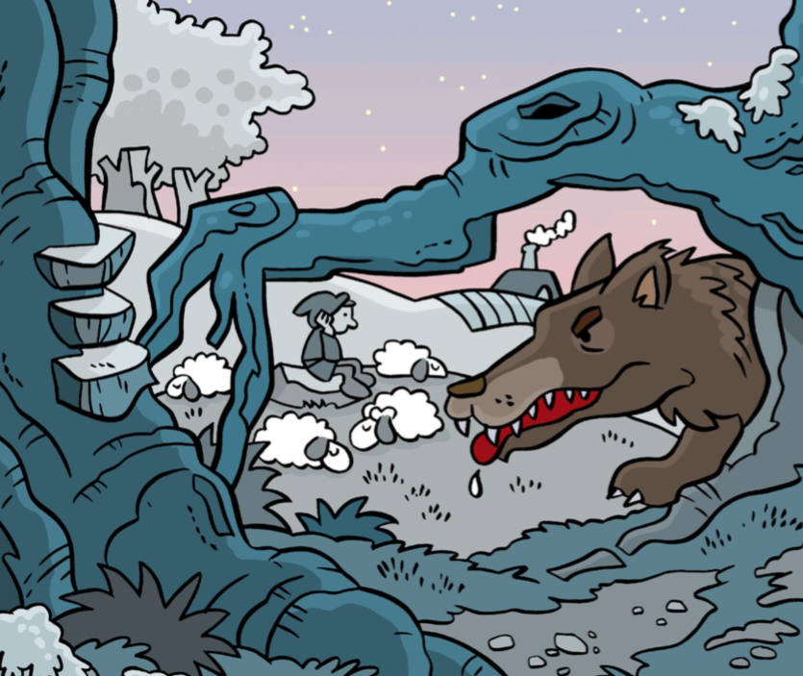
Story time
Notes:
Have students tell you about the picture.
Have them locate information in the picture – the sheep, the boy, the wolf, the field, etc.
Ask thinking questions like:
What time is it?
What do you think the wolf is thinking?
What is the boy doing?
What will happen next?

Slide 5
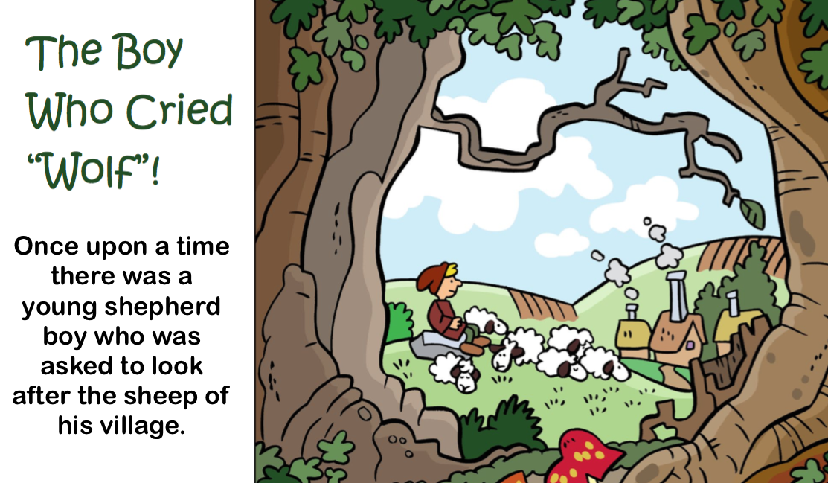
The Boy who cried wolf
Notes:
Play the video or read the .pdf file with them.
When you are done, have the students tell you what happened in the story.
You can go through each student one at a time.

Slide 6
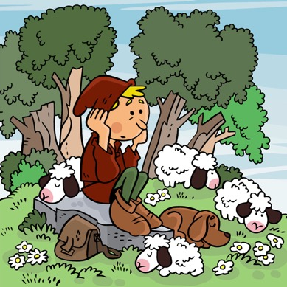
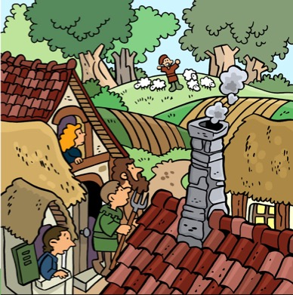
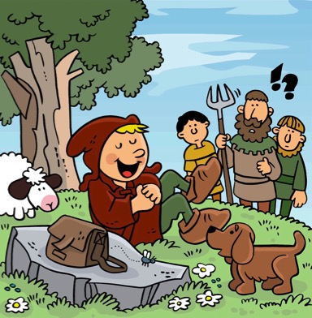
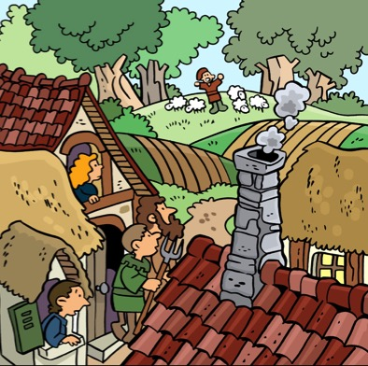
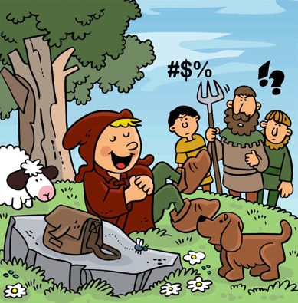
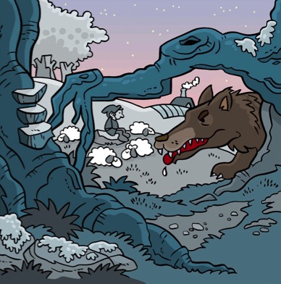
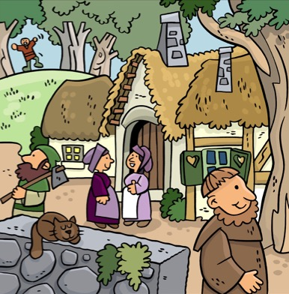
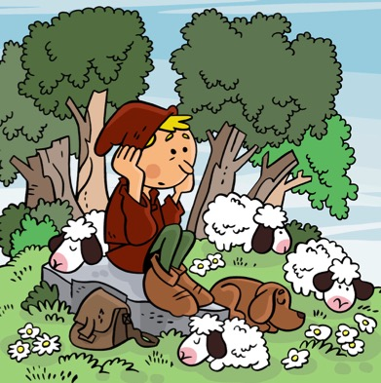
What happened in the story?
Notes:
Ask the students to go through the pictures and tell you what happened in each part of the story.

Slide 7
What will I learn today?
Review of all the things we have learned this far:
Finding information in pictures
Retell key events from a story heard aloud
Describing our likes
Listening to others
Word families and patterns
Vocabulary Words
Notes:
Have the students read the goals that they just completed.
Explain what they learned if needed.
Congratulate them.

Slide 8
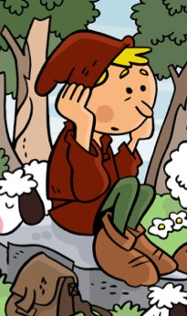
Replace that word
boy
_oy
Object for a child to play with.
Notes:
Help the students write the word that is in the same family.

Slide 9
Replace that word
boy
toy
Object for a child to play with.

Slide 10
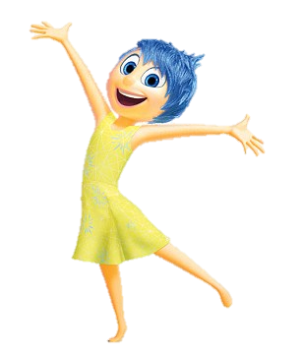
Replace that word
boy
_oy
A feeling of great happiness.
Notes:
Help the students write the word that is in the same family.

Slide 11
Replace that word
boy
joy
A feeling of great happiness.

Slide 12
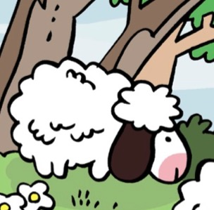
Replace that word
sheep
_eep
To shed tears or cry.
Notes:
Help the students write the word that is in the same family.

Slide 13
Replace that word
sheep
weep
To shed tears or cry.

Slide 14
Replace that word
sheep
_eep
A small, sturdy vehicle
Usually used by the
military

Slide 15
Replace that word
sheep
jeep
A small, sturdy vehicle
Usually used by the
military

Slide 16
Replace that word
town
_own
A long dress for special occasions.
Notes:
Help the students write the word that is in the same family.

Slide 17
Replace that word
town
gown
A long dress for special occasions.

Slide 18
Replace that word
town
__own
A facial expression of disapproval or disappointment.
Notes:
Help the students write the word that is in the same family.

Slide 19
Replace that word
town
frown
A facial expression of disapproval or disappointment.
Notes:
Help the students write the word that is in the same family.
### Teachers: make more of these if you want.

Slide 20
What will I learn today?
Review of all the things we have learned this far:
Finding information in pictures
Retell key events from a story heard aloud
Describing our likes
Listening to others
Word families and patterns
Vocabulary Words
Notes:
Have the students read the goals that they just completed.
Explain what they learned if needed.
Congratulate them.

Slide 21
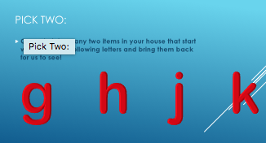
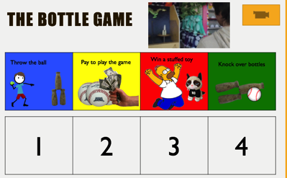
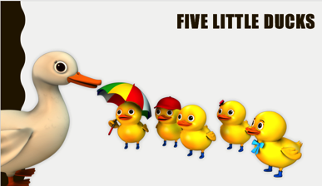
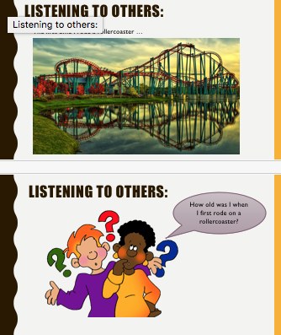
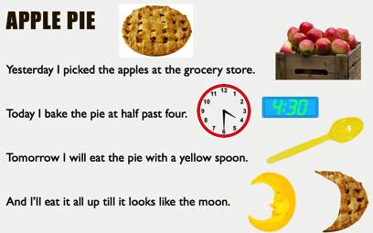
Half way through this unit:
What was your favourite part of the unit so far?
Notes:
Have each student describe their favourite part of the unit so far:
Pick Two – going and finding objects
Magic show
Story reading
Brainstorming
Ordering games
Learning sounds
Listening and retelling
Finding patterns
Singing songs
Reciting poems
Spelling animal names
Leaning new words
Then ask each student to describe what another student in the class liked (and possibly why).

Slide 22
What will I learn today?
Review of all the things we have learned this far:
Finding information in pictures
Retell key events from a story heard aloud
Describing our likes
Listening to others
Word families and patterns
Vocabulary Words
Notes:
Have the students read the goals that they just completed.
Explain what they learned if needed.
Congratulate them.

Slide 23
And Now …
“That Sounds Great!”
Brought to you today by the letters:
b c d f g h j k l m n p q r s t v w x y z
Notes:
Ask students if they recognize the letters.
Then ask them if they recognize the logos for the companies:
Vine, Wilson, X Box 360, YMCA (Young Men’s Christian Association – or the song by the Village People), Zelda (Nintendo Character).

Slide 24
b | c | d
Notes:
Review each of the words.
See if the students can spell them from memory.
Have them refer to their handouts if they forget some words.
Some words are not in the handouts – but were part of a theme in a lesson
Define each noun.
Use each noun in a sentence.

Slide 25
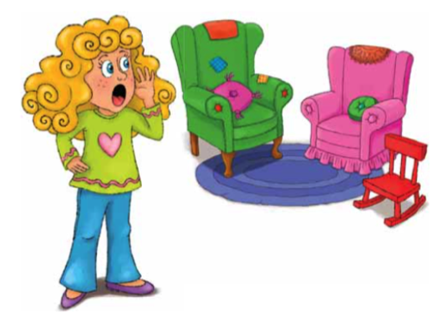
f | g | h
j | k | l
Notes:
You may want to open this as a document before the class begins and put black boxes over the words. Then you can use the eraser when you are going through this slide and remove the annotated block to reveal the word.
HAVE THE STUDENTS TAKE OUT THEIR WORKSHEET AND WRITE THE WORDS INTO THE BOXES.
Define each noun.
Use each noun in a sentence.

Slide 26
m | n | p
q | r | s
Notes:
You may want to open this as a document before the class begins and put black boxes over the words. Then you can use the eraser when you are going through this slide and remove the annotated block to reveal the word.
HAVE THE STUDENTS TAKE OUT THEIR WORKSHEET AND WRITE THE WORDS INTO THE BOXES.
Define each noun.
Use each noun in a sentence.

Slide 27
t | v | w
x | y | z
Notes:
You may want to open this as a document before the class begins and put black boxes over the words. Then you can use the eraser when you are going through this slide and remove the annotated block to reveal the word.
HAVE THE STUDENTS TAKE OUT THEIR WORKSHEET AND WRITE THE WORDS INTO THE BOXES.
Define each noun.
Use each noun in a sentence.

Slide 28
What I Learned Today:
Review of all the things we have learned this far:
Finding information in pictures
Retell key events from a story heard aloud
Describing our likes
Listening to others
Word families and patterns
Vocabulary Words
Notes:
Have the students read the goals that they just completed.
Explain what they learned if needed.
Congratulate them.

Slide 29
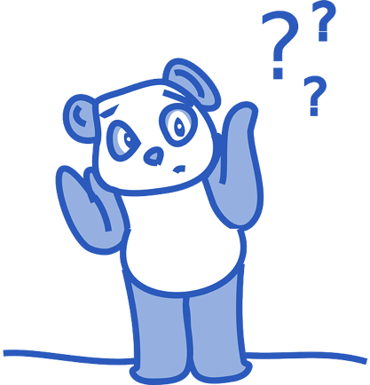
Final Thoughts?
Do you have any questions?
What are you taking away from today?
Do you understand the handout?

