Slide 1
The carnival
Rosedale Academy
Introduction to ESL

Slide 2
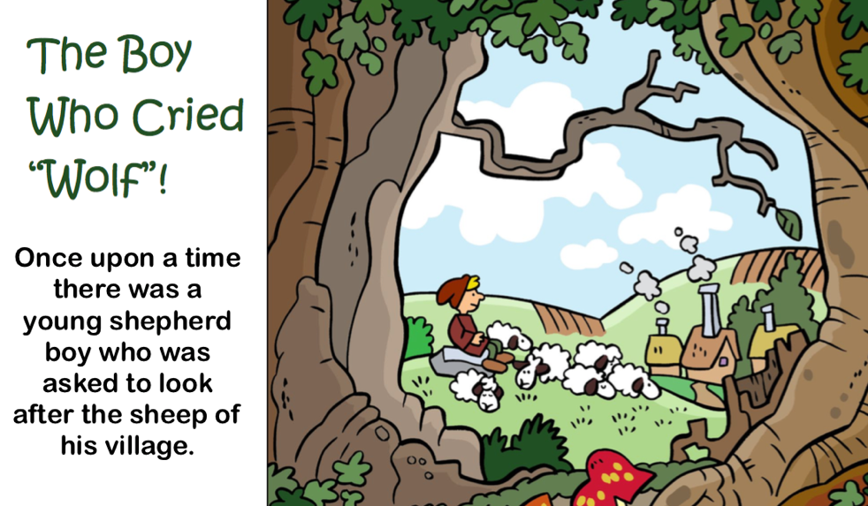
What I learned last class:
Finding information in pictures
Retell key events from a story heard aloud
Describing our likes
Listening to others
Word families and patterns
Vocabulary Words
Notes:
You can review with the students everything that they learned in the last class.

Slide 3
What will I learn today?
The subject of a sentence
Writing short three and four letter words
The long A and short A sound
Notes:
Have the students read the goals if they can. I find that underlining sentences and asking students to read one sentence at a time works well.

Slide 4
Story time
Kat and Kate
Notes:
Have students tell you about the picture.
Ask thinking questions like:
Where are the girls?
What do you think they are thinking?
What will happen next?

Slide 5
Kat and Kate
Notes:
Have the students read the story.
Make note of the short a sounds (coloured purple)
Make note of the long a sounds (coloured red)

Slide 6
This is Katrina. Her friends call her Kat for short.
Notes:
Short a sounds are coloured purple.

Slide 7
This is Kate.
Notes:
Long a sounds are coloured red.

Slide 8
Kat and Kate are best friends.

Slide 9
Kat likes to act
and Kate likes to play.

Slide 10
Kat likes cats
and Kate likes snakes.

Slide 11
Kat will gab on and on.
Kate will say things once.

Slide 12
Today is Kate’s Birthday.
She is eight.

Slide 13
Kat will use a pan
to bake Kate a Cake.

Slide 14
Kate loves the taste of maple.
Kat gets sap from tree.

Slide 15
Kat bakes Kate a maple cake.

Slide 16
Kat and Kate have a great day.

Slide 17
Long and short a sound:
Normally, the short a sound is formed in words that do not end with the letter e (hat, mat)
Normally, the long a sound is formed in words that end in e (hate, mate)
The long a sound is also formed by the following letters:
ay (day, say, way)
ei (eight, vein)
ai (wait, fail)
Notes:
Go through the short a sound
Go through the different long a sounds.
Have the students think of even more examples.
You can link this to brainstorming that you did in lesson 3.

Slide 18
A then E
AY
THE LONG A SOUND
AI
EI
Notes:
Have the students brainstorm the different forms of long a sounds

Slide 19
Circle race:
The next page will have words and pictures of nouns with the short a and long a sounds.
Student 1 __________________, will change his/her pencil colour to purple. He/she will have to circle all words and pictures that have the short a sound.
Student 2 __________________, will change his/her pencil colour to red. He/she will have to circle all words and pictures that have the long a sound.
The first student to circle all of his/her words or pictures, without making a mistake, wins.
Notes:
Read the instructions and then play the game with your students. If you have an odd number of students, you play with one of them. Copy the slide over for as many students you have and then go back and see who was correct at the end of the game.

Slide 20
pat
rat
fat
hate
rate
mat
date
eight
fate
Notes:
If you have more than two students – copy this slide once or twice so that everyone gets to play. On the copied slides, you may want to move things around or use entirely new words/pictures.
Rat, fat, mat, pat, cat, bat, hat (or cap)
Plate, date, eight, fate, rate, hate, gate.

Slide 21
What will I learn today?
The subject of a sentence
Writing short three and four letter words
The long A and short A sound
Notes:
Have the students read the goal(s) they just completed.
Congratulate them.

Slide 22
Write the words:
Use the given letters and the letters “at” or “ate” to write words that contain the short a and long a sounds. The first one is done for you.
LETTER | SHORT A SOUND | LONG A SOUND
 | Fat | Fate
Notes:
Have the students take out their worksheets and complete them as you go through this with them.

Slide 23
What will I learn today?
The subject of a sentence
Writing short three and four letter words
The long A and short A sound
Notes:
Have the students read the goal(s) they just completed.
Congratulate them.

Slide 24
Subjects at the carnival
People, places and things

Slide 25
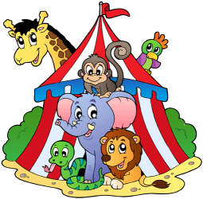
What is the subject in a sentence?
I liked watching the magic show.
Cotton candy tasted delicious.
The circus had a lot of animals.
A subject is a noun (person, place or thing).
A subject usually does an action.
A subject is who or what the sentence is about.
Notes:
Define what a subject in a sentence is: A person, place or thing (noun or pronoun). It is usually the performer of the action (verb).

Slide 26
You try it:
The boy ate licorice at the carnival.
I watched people ride a rollercoaster.
Bill watched the children ride the teacups.
The pie eating contest had two winners.
The food at the carnival was sweet.
Notes:
Read each sentence with the students and have them identify the subject of each sentence.

Slide 27
You try it:
The boy ate licorice at the carnival.
I watched people ride a rollercoaster.
Bill watched the children ride the teacups.
The pie eating contest had two winners.
The food at the carnival was sweet.
Notes:
Answer Key – go through this with the students.

Slide 28
What will I learn today?
The subject of a sentence
Writing short three and four letter words
The long A and short A sound
Notes:
Have the students read the goal(s) they just completed.
Congratulate them.

Slide 29
And Now …
“That Sounds Great!”
Brought to you today by the sounds:
Short A and Long A

Slide 30
Notes:
Van, Lab, Ram
Crate, tray, Bait
You may want to open this as a document before the class begins and put black boxes over the words. Then you can use the eraser when you are going through this slide and remove the annotated block to reveal the word.
HAVE THE STUDENTS TAKE OUT THEIR WORKSHEET AND WRITE THE WORDS INTO THE BOXES.
Define each noun.
Use each noun in a sentence.

Slide 31
What I learned today:
The subject of a sentence
Writing short three and four letter words
The long A and short A sound

Slide 32
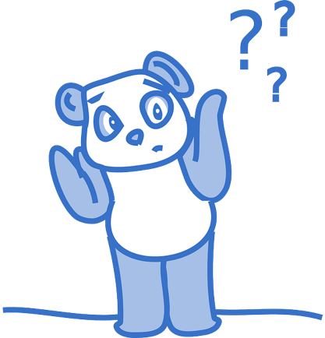
Final Thoughts?
Do you have any questions?
What are you taking away from today?
Do you understand the handout?

Slide 33
Extra time rhyme
Get a beat going!
You are going to the store.
So tell me what you have to do.
Find the subject...
The subject is You!
I am playing with a ball.
I throw it high into the sky.
Find the subject...
The subject is I!
We are playing hide and seek.
The subject is easy, can’t you see.
Find the subject...
The subject is We!
They are driving in a car.
The subject is as plain as day.
Find the subject...
The subject is They!
Notes:
Record yourself rapping this (or singing it). Play it for and then sing/rap it with the students.

