Slide 1
The carnival
Rosedale Academy
Introduction to ESL

Slide 2
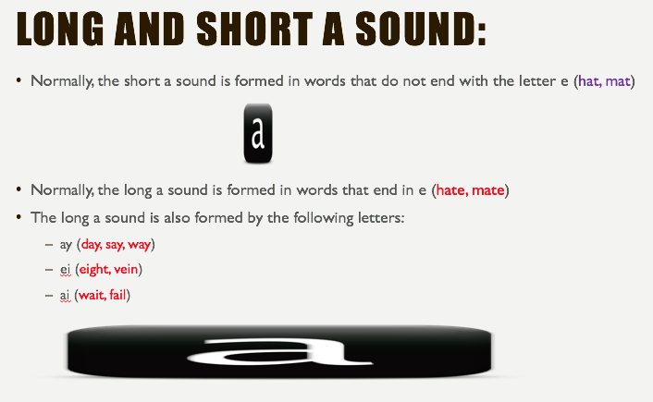
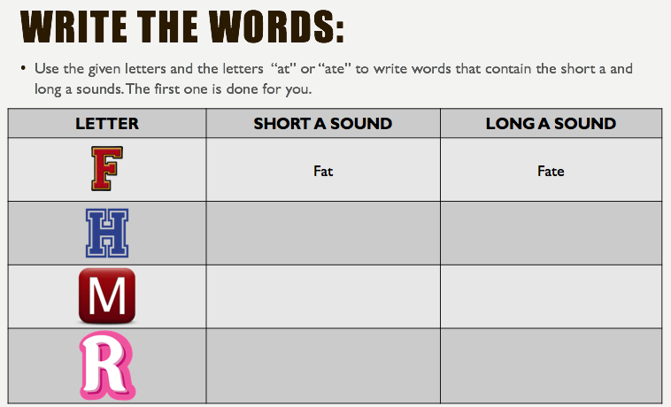

What I learned last class:
The subject of a sentence
Writing short three and four letter words
The long A and short A sound
Notes:
You can review with the students everything that they learned in the last class.

Slide 3
What will I learn today?
Possessives (my, your, his, her, its, our, their)
Writing short three and four letter words
The long E and short E sound
Notes:
Have the students read the goals if they can. I find that underlining sentences and asking students to read one sentence at a time works well.

Slide 4

Story time
The ”Long E” sound:
Feet
Notes:
Have students tell you about the picture.
Ask thinking questions like:
What do you think this book is about?

Slide 5


Slide 6
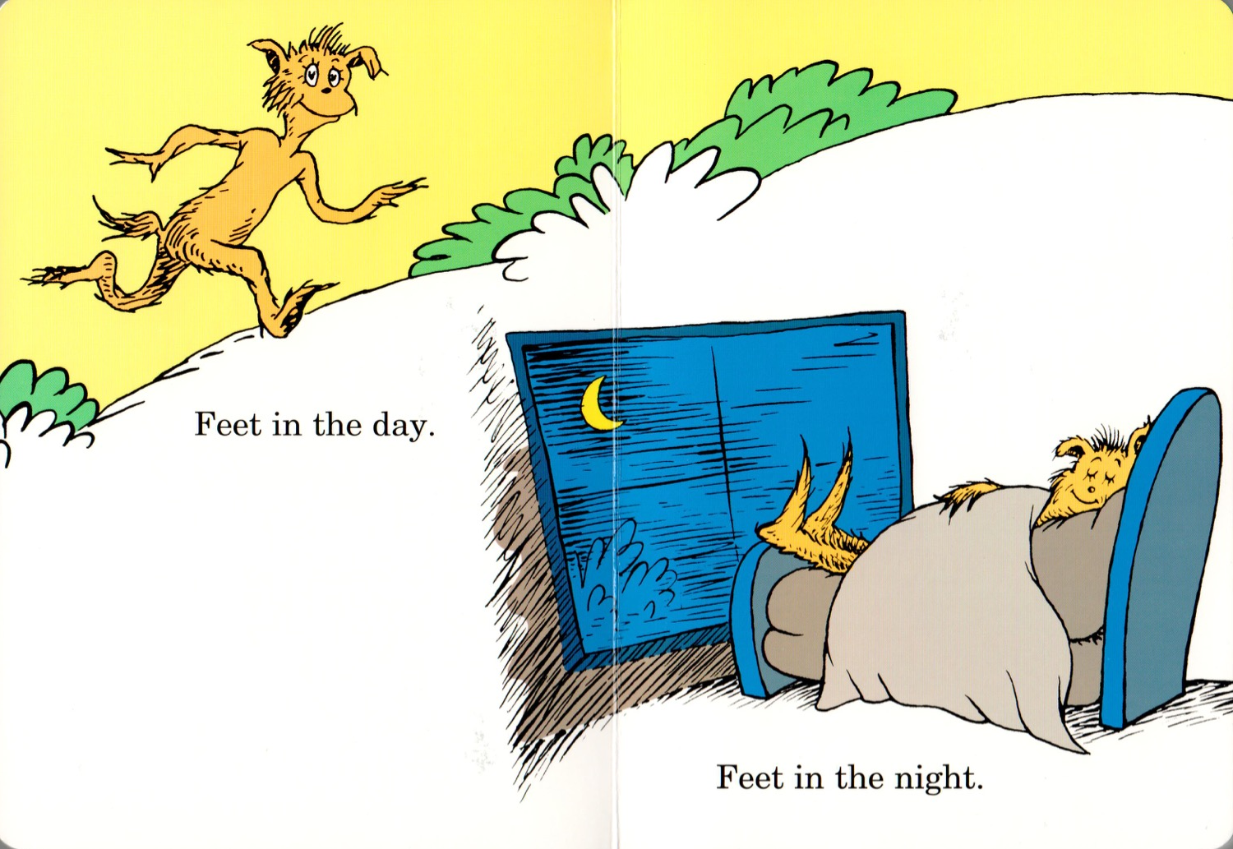

Slide 7
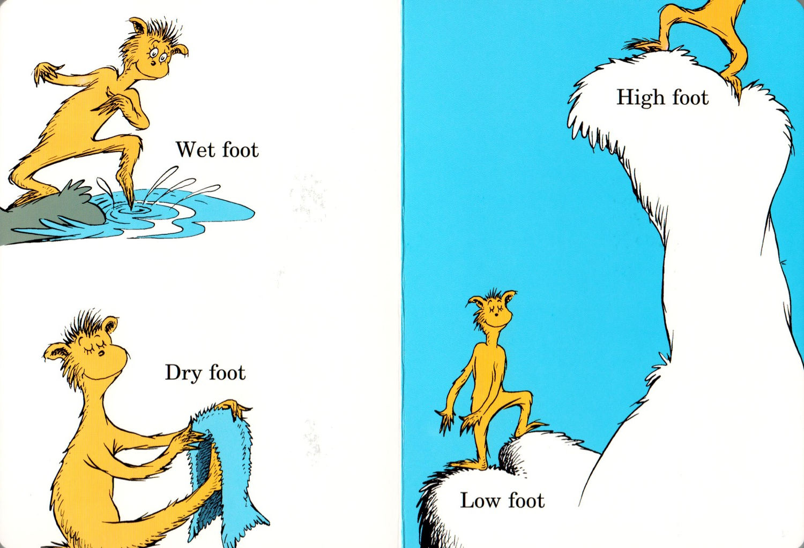

Slide 8
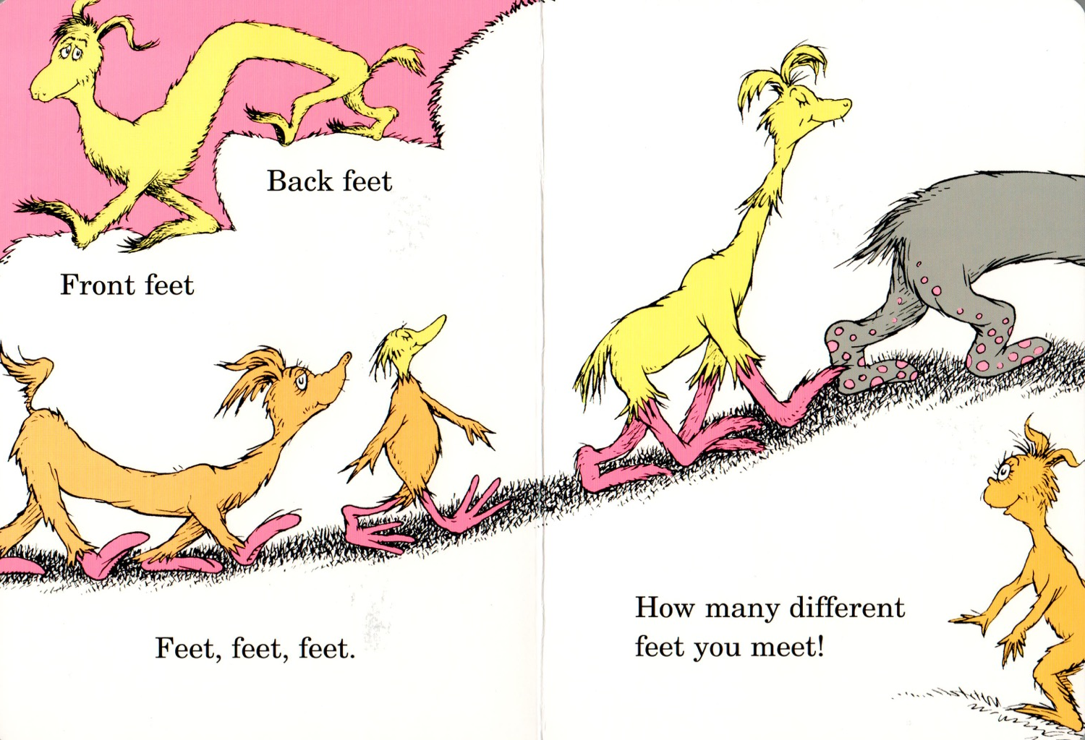

Slide 9


Slide 10
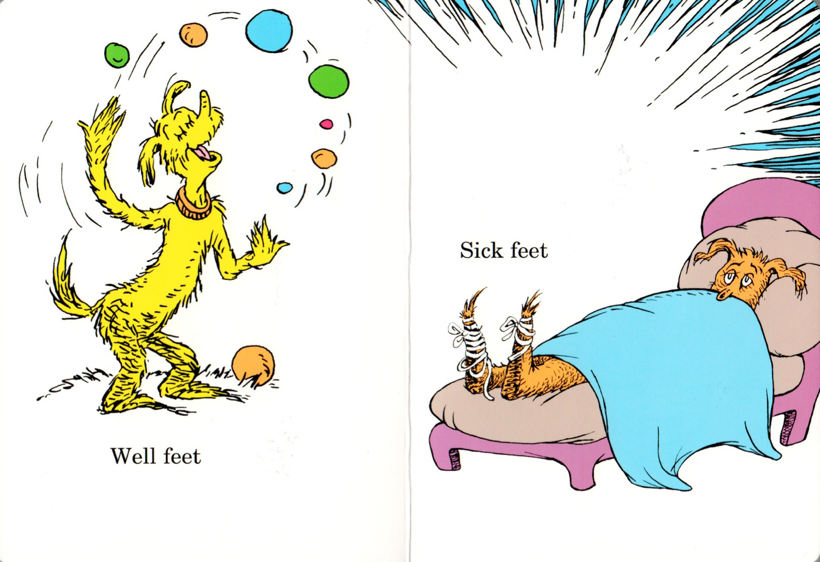

Slide 11
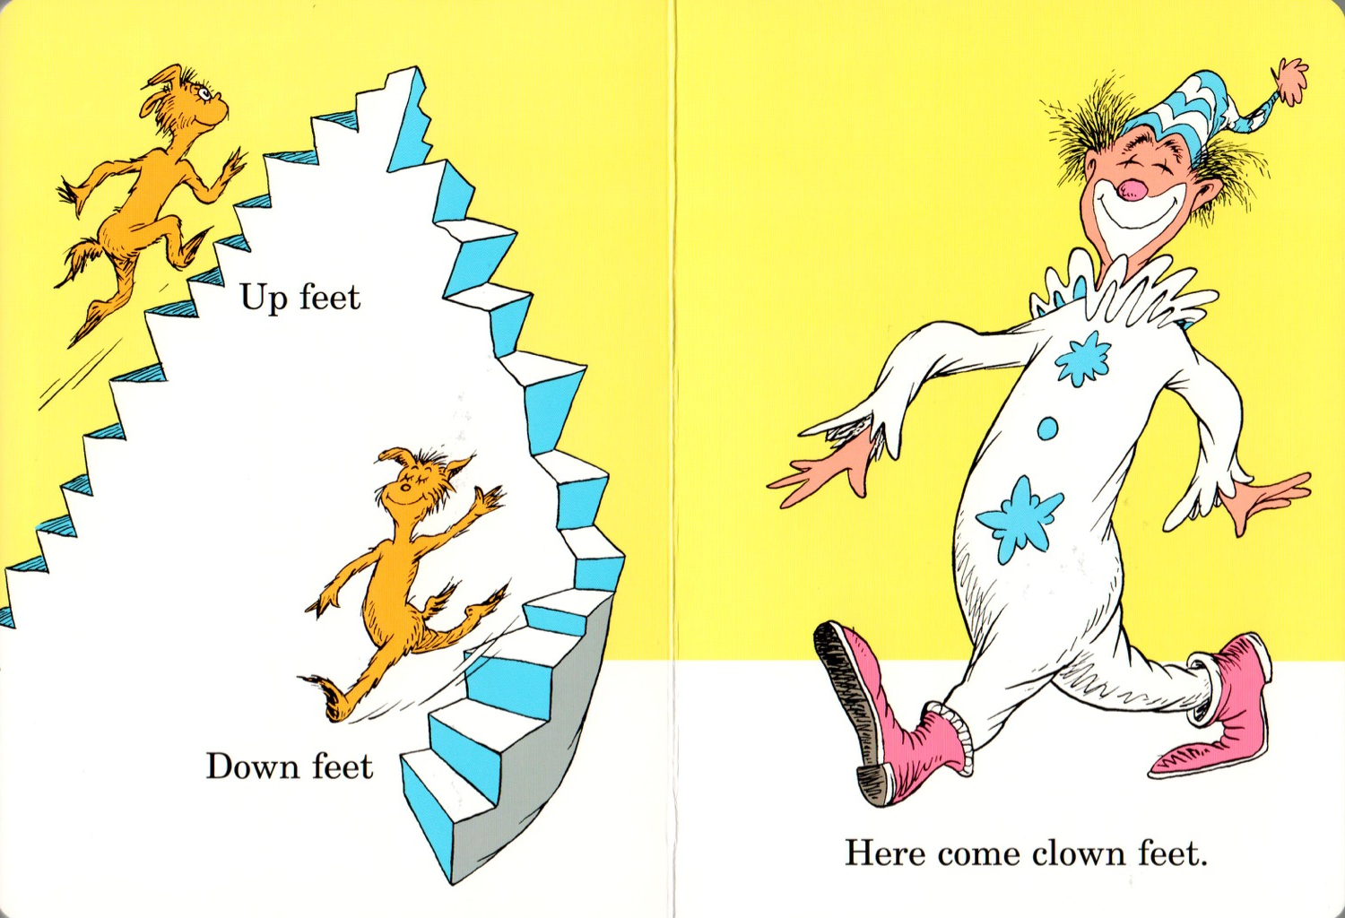

Slide 12
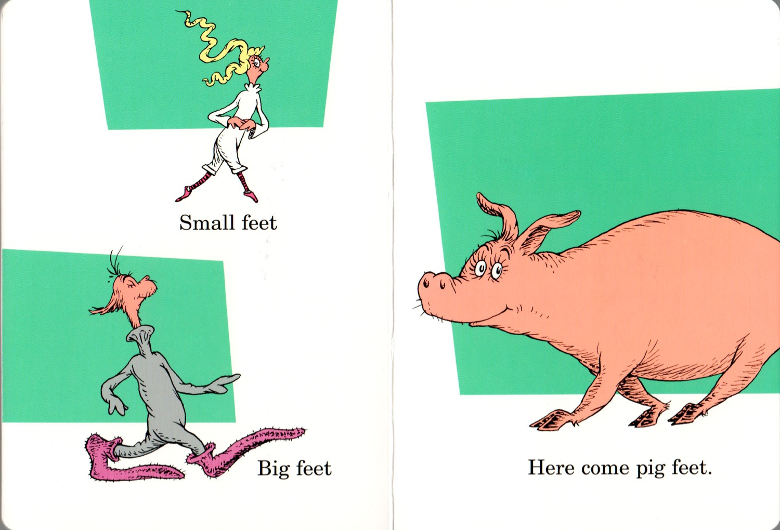

Slide 13
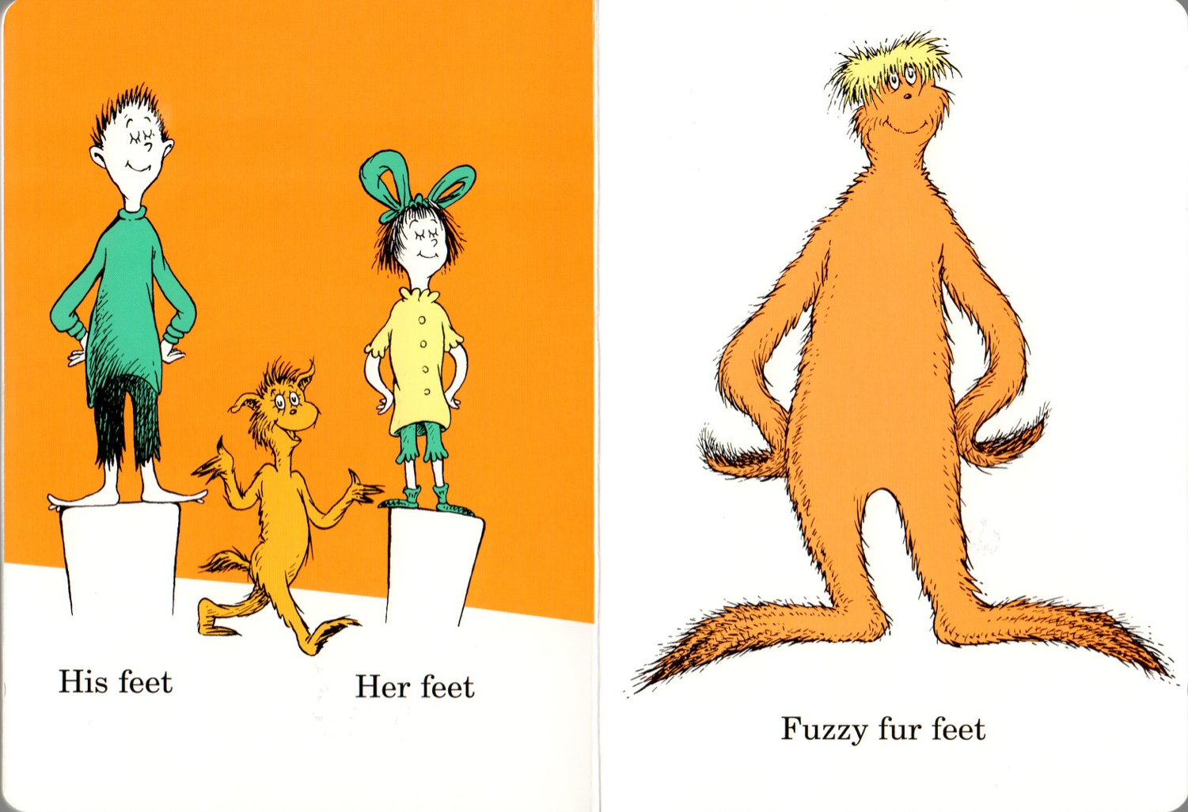

Slide 14
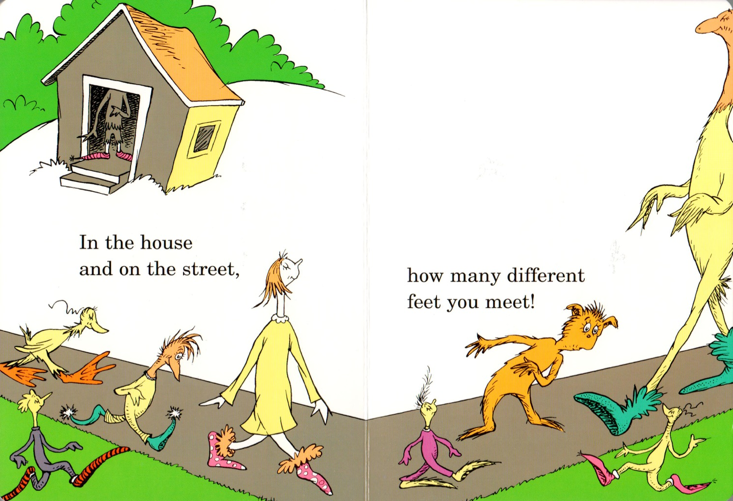

Slide 15
Long and short E sound:
Normally, the short e sound is formed in words that do not end with the letter e (bed, pet)
Sometimes a single e will create a long e sound (we, be, each, equal, evil)
The long e sound is also formed by the following letters:
ea (meat, treat)
ee (feet, tree)
ie (field, thief)
Notes:
Go through the short e sound
Go through the different long e sounds.
Have the students think of even more examples.
You can link this to brainstorming that you did in lesson 3.

Slide 16
Single E
EA
THE LONG E SOUND
EI
EE
Notes:
Have the students brainstorm the different forms of long e sounds

Slide 17
Circle race:
The next page will have words and pictures of nouns with the short e and long e sounds.
Student 1 __________________, will change his/her pencil colour to purple. He/she will have to circle all words and pictures that have the short e sound.
Student 2 __________________, will change his/her pencil colour to red. He/she will have to circle all words and pictures that have the long e sound.
The first student to circle all of his/her words or pictures, without making a mistake, wins.
Notes:
Read the instructions and then play the game with your students. If you have an odd number of students, you play with one of them. Copy the slide over for as many students you have and then go back and see who was correct at the end of the game.

Slide 18
pencil
pet
beat
red
seed
we
meat
medal
thief
better
Notes:
If you have more than two students – copy this slide once or twice so that everyone gets to play. On the copied slides, you may want to move things around or use entirely new words/pictures.

Slide 19
What will I learn today?
Possessives (my, your, his, her, its, our, their)
Writing short three and four letter words
The long E and short E sound
Notes:
Have the students read the goal they just completed.
Congratulate them.

Slide 20
Write the words:
Use the given letters and the letters “ed” or “eed” to write words that contain the short e and long e sounds. The first one is done for you.
LETTER | SHORT A SOUND | LONG A SOUND
 | fed | feed
Notes:
Have the students write the words using their mouse if possible. This is so you can get an idea of their vocabulary and ability to write short words using patterns.

Slide 21
What will I learn today?
Possessives (my, your, his, her, its, our, their)
Writing short three and four letter words
The long E and short E sound
Notes:
Have the students read the goal they just completed.
Congratulate them.

Slide 22
Who has it?
Learning about possessives at the carnival

Slide 23

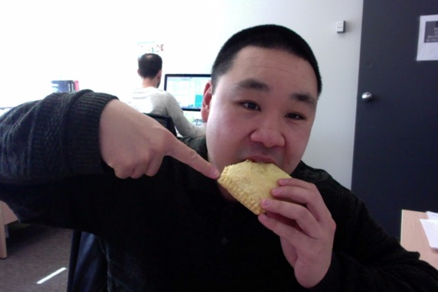
Possessives:
When someone owns or controls something.
When something belongs to someone.
We say that he or she possesses it.
I am Brian. This is my food.
Notes:
Define what possessives are
Give a few examples
Circle the red I and tell the students that this is the person.
Circle the red my and tell the students that this is the possessive.
The possessive word my is used to show that the food belongs to I (Brian)

Slide 24
The I possessive:
When the subject of a sentence is “I”,
We will use the possessive “my”.
Hello, I am Bart.
I have a skateboard.
This is my skateboard.
Notes:
Show which is the person (pronoun) and which is the possessive (adjective).

Slide 25
The you possessive:
When the subject of a sentence is “you”,
We will use the possessive “your”.
You are Lisa.
You have a saxophone.
That is your saxophone.
Notes:
Show which is the person (pronoun) and which is the possessive (adjective).

Slide 26
The he possessive:
When the subject of a sentence is “he”,
We will use the possessive “his”.
This is Homer.
He has a donut.
This is his donut.
Notes:
Show which is the person (pronoun) and which is the possessive (adjective).

Slide 27
The she possessive:
When the subject of a sentence is “she”,
We will use the possessive “her”.
This is Marge.
She has a lot of hair.
Her hair is tall.
Notes:
Show which is the person (pronoun) and which is the possessive (adjective).

Slide 28
The we possessive:
When the subject of a sentence is “we”,
We will use the possessive “our”.
We are a family.
We have a dog.
This is our dog.
Notes:
Show which is the person (pronoun) and which is the possessive (adjective).

Slide 29
The it possessive:
When the subject of a sentence is “it”,
We will use the possessive “its”.
This is the family dog.
It has a bone.
The dog ate its bone.
Notes:
Show which is the person (pronoun) and which is the possessive (adjective).

Slide 30
The they possessive:
When the subject of a sentence is “they”,
We will use the possessive “their”.
The Flanders live beside us.
They have a house.
This is their house.
Notes:
Show which is the person (pronoun) and which is the possessive (adjective).

Slide 31
Summary of Possessive Words:
Subject or Pronoun | Possessive
I | My
You | Your
He | His
She | Her
We | Our
It | Its
They | Their
Notes:
Ask students to make a sentence for each of the possessive words.

Slide 32
You try it:
When I was at the circus, I gobbled up _____ cotton candy.
Notes:
Have the students fill in the blanks with the correct possessive word.

Slide 33
You try it:
Before you enter the magic show, you must give _______ ticket to the door person.
Notes:
Have the students fill in the blanks with the correct possessive word.

Slide 34
You try it:
Mr. Chen turned ________ rope into a handkerchief.
Notes:
Have the students fill in the blanks with the correct possessive word.

Slide 35
You try it:
She ate 10 pies in the pie eating contest. When she finished _______ belly was full.
Notes:
Have the students fill in the blanks with the correct possessive word.

Slide 36
You try it:
We got scared riding the roller coaster at the carnival and ______ screams were very loud.
Notes:
Have the students fill in the blanks with the correct possessive word.

Slide 37
You try it:
The elephant at the circus would not listen to _______ trainer.
Notes:
Have the students fill in the blanks with the correct possessive word.

Slide 38
You try it:
Children needed money for games so they went to look for ______ parents.
Notes:
Have the students fill in the blanks with the correct possessive word.

Slide 39
What will I learn today?
Possessives (my, your, his, her, its, our, their)
Writing short three and four letter words
The long E and short E sound
Notes:
Have the students read the goal they just completed.
Congratulate them.

Slide 40
And Now …
“That Sounds Great!”
Brought to you today by the sounds:
Short E and Long E

Slide 41
Notes:
Lemon, hen, vest
Feast, seesaw, wreath
You may want to open this as a document before the class begins and put black boxes over the words. Then you can use the eraser when you are going through this slide and remove the annotated block to reveal the word.
HAVE THE STUDENTS TAKE OUT THEIR WORKSHEET AND WRITE THE WORDS INTO THE BOXES.
Define each noun.
Use each noun in a sentence.

Slide 42
And Now …
“Go Get It for Me!”
Find one thing in your house that has the short e sound.
Find one thing in your house that has the long e sound
Short E and Long E

Slide 43


Final Thoughts?
Do you have any questions?
What are you taking away from today?
Do you understand the handout?

