Slide 1
The carnival
Rosedale Academy
Introduction to ESL

Slide 2
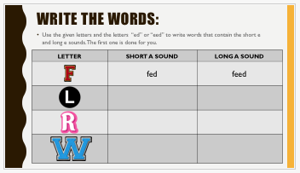
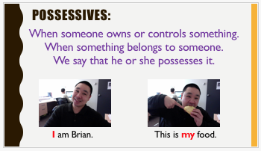
What I learned last class:
Possessives (my, your, his, her, its, our, their)
Writing short three and four letter words
The long E and short E sound
Notes:
You can review with the students everything that they learned in the last class.

Slide 3
What will I learn today?
The long and short i sound
Simple possessives using names
Telling a story using personal experiences
Notes:
Have the students read the goals if they can. I find that underlining sentences and asking students to read one sentence at a time works well.

Slide 4
Long and short i sound:
Normally, the short i sound is formed in words that do not end with the letter e (kid, pit)
Sometimes a single i will create a long e sound (hi, idea)
The long e sound is also formed by the following letters:
i_e (time, pile)
y (sky, bye)
ie (pie, tie)
Notes:
Go through the short i sound
Go through the different long i sounds.
Have the students think of even more examples.
You can link this to brainstorming that you did in lesson 3.

Slide 5
Single i
i_e
THE LONG E SOUND
ie
y
Notes:
Have the students brainstorm the different forms of long i sounds

Slide 6
Carnival Circle race:
The next page will have words and pictures of nouns with the short i and long i sounds.
Student 1 __________________, will change his/her pencil colour to purple. He/she will have to circle all words and pictures that have the short i sound.
Student 2 __________________, will change his/her pencil colour to red. He/she will have to circle all words and pictures that have the long i sound.
The first student to circle all of his/her words or pictures, without making a mistake, wins.
Notes:
Read the instructions and then play the game with your students. If you have an odd number of students, you play with one of them. Copy the slide over for as many students you have and then go back and see who was correct at the end of the game.

Slide 7
magic show
rides
ferris wheel
animals
carnival
pie
ice cream
prizes
ringmaster
fireworks
Notes:
If you have more than two students – copy this slide once or twice so that everyone gets to play. On the copied slides, you may want to move things around or use entirely new words/pictures.

Slide 8
What will I learn today?
The long and short i sound
Simple possessives using names
Telling a story using personal experiences
Notes:
Have the students read the goal that they just completed.
Congratulate them.

Slide 9
Who has it?
Learning about possessives at the carnival

Slide 10
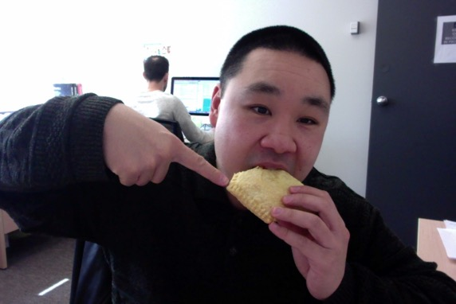
Remember possessives?
When someone owns or controls something.
When something belongs to someone.
We say that he or she possesses it.
I am Brian. This is my food.
Notes:
Define what possessives are
Give a few examples
Circle the red I and tell the students that this is the person.
Circle the red my and tell the students that this is the possessive.
The possessive word my is used to show that the food belongs to I (Brian)

Slide 11
The Apostrophe:
When someone owns or controls something.
When something belongs to someone.
We say that he or she possesses it.
I am Brian. This is my food.
We could also use the name Brian and say: This is Brian’s food.
Notes:
Review what possessives are
Give a few examples
Explain how an apostrophe shows ownership when we use names.

Slide 12
The simple possessive:
When using the name of a person, place or thing, we can put an apostrophe and the letter s at the end of the name to show posession of something.
Hello, I am Bart.
Bart has a skateboard.
This is Bart’s skateboard.
Notes:
Show which is the person (pronoun) and which is the possessive (adjective).

Slide 13
The simple possessive:
You are Lisa.
Lisa has a saxophone.
That is Lisa’s saxophone.
Notes:
Show which is the person (pronoun) and which is the possessive (adjective).

Slide 14
The simple possessive:
This is Homer.
Homer has a donut.
This is Homer’s donut.
Notes:
Show which is the person (pronoun) and which is the possessive (adjective).

Slide 15
The simple possessive:
This is Marge.
Marge has a lot of hair.
Marge’s hair is tall.
Notes:
Show which is the person (pronoun) and which is the possessive (adjective).

Slide 16
The possessive:
We are the Simpsons.
We have a dog.
This is the Simpsons’ dog.
What happened when the name already ends in the letter “s”?
Notes:
Show which is the person (pronoun) and which is the possessive (adjective).
Explain how possessive apostrophes work when the name ends with the letter s.

Slide 17
The possessive:
This is the family dog.
The dog’s bone is in its mouth.
Notes:
Show which is the person (pronoun) and which is the possessive (adjective).

Slide 18
The possessive:
This is our house.
The house’s windows are dirty and need washing.
Notes:
Show which is the person (pronoun) and which is the possessive (adjective).

Slide 19
Summary of Possessive Words:
Name | Possessive
Proper Noun (Bill, Sally, etc) | ‘s
Proper Noun with an ending s | ‘
Proper noun with an existing apostrophe | ‘s
Proper noun with an existing apostrophe and ending in s | ‘
Notes:
Ask students to make a sentence for each of the possessive words.

Slide 20
You try it:
Sally was at the circus, _________ cotton candy was gobbled up.
Notes:
Have the students fill in the blanks with the correct possessive word.

Slide 21
You try it:
Before entering the theatre, you must give the _________ door person your ticket.
Notes:
Have the students fill in the blanks with the correct possessive word.

Slide 22
You try it:
Mr. Chen performed a rope trick. _______________
rope trick was funny.
Notes:
Have the students fill in the blanks with the correct possessive word.

Slide 23
You try it:
She ate 10 pies in the contest. She said that the ________ crust was delicious.
Notes:
Have the students fill in the blanks with the correct possessive word.

Slide 24
You try it:
The _______________
wheels were squeaky.
Notes:
Have the students fill in the blanks with the correct possessive word.

Slide 25
What will I learn today?
The long and short i sound
Simple possessives using names
Telling a story using personal experiences
Notes:
Have the students read the goal that they just completed.
Congratulate them.

Slide 26
And Now …
“That Sounds Great!”
Brought to you today by the sounds:
Short i and Long i

Slide 27
Notes:
stick, brick, pill
Island, exercise, disguise
You may want to open this as a document before the class begins and put black boxes over the words. Then you can use the eraser when you are going through this slide and remove the annotated block to reveal the word.
HAVE THE STUDENTS TAKE OUT THEIR WORKSHEET AND WRITE THE WORDS INTO THE BOXES.
Define each noun.
Use each noun in a sentence.

Slide 28
And Now …
“Find it!”
Find one thing in your house that has the short i sound.
Find one thing in your house that has the long i sound
Short i and Long i

Slide 29
Story time
Notes:
Have students tell you about the picture.
Ask thinking questions like:
What do you think this book is about?

Slide 31
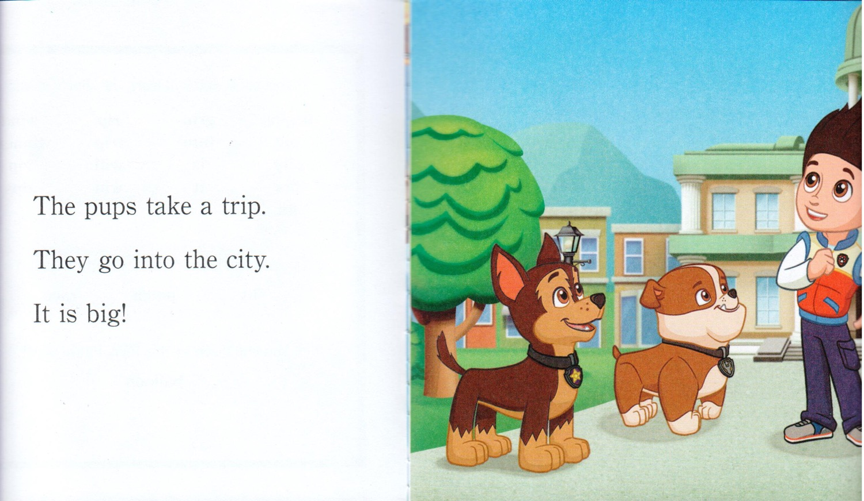

Slide 33
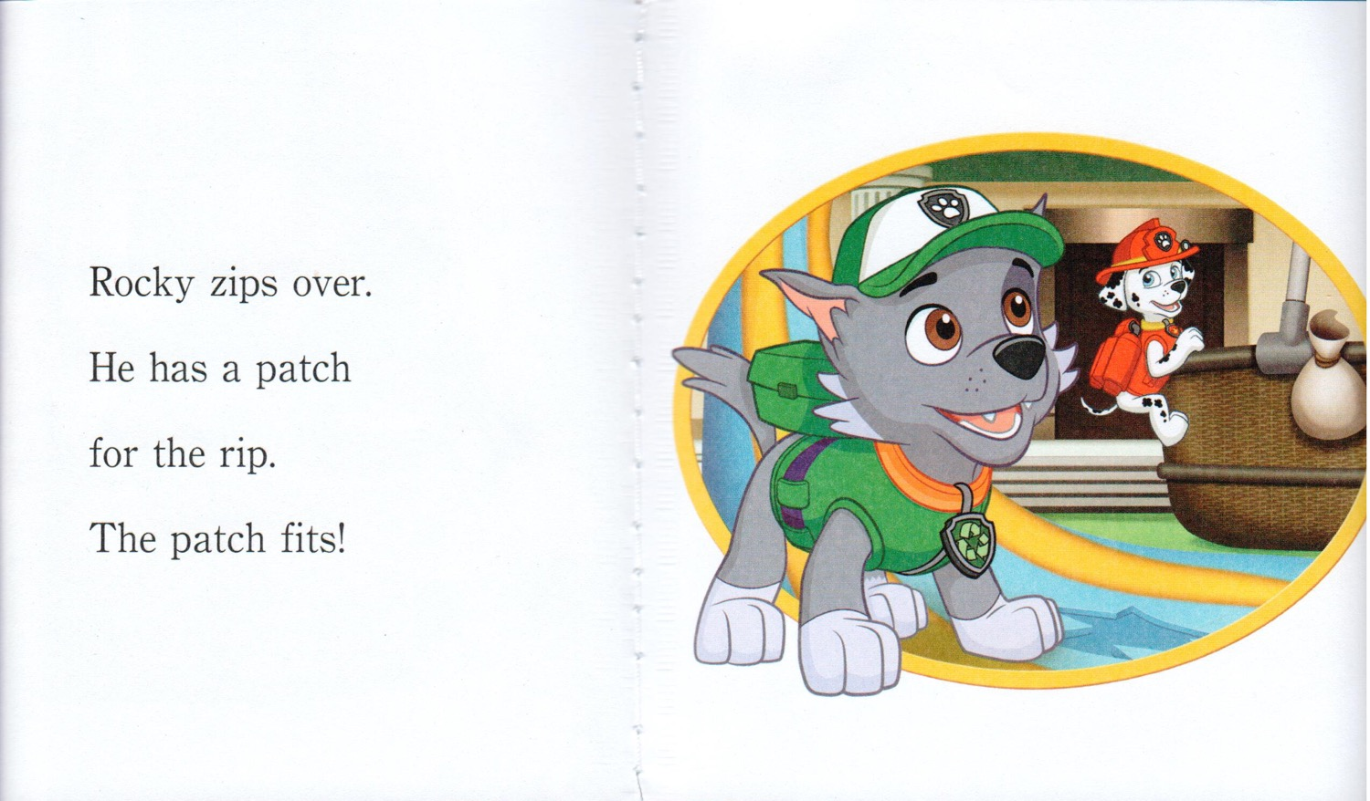

Slide 35
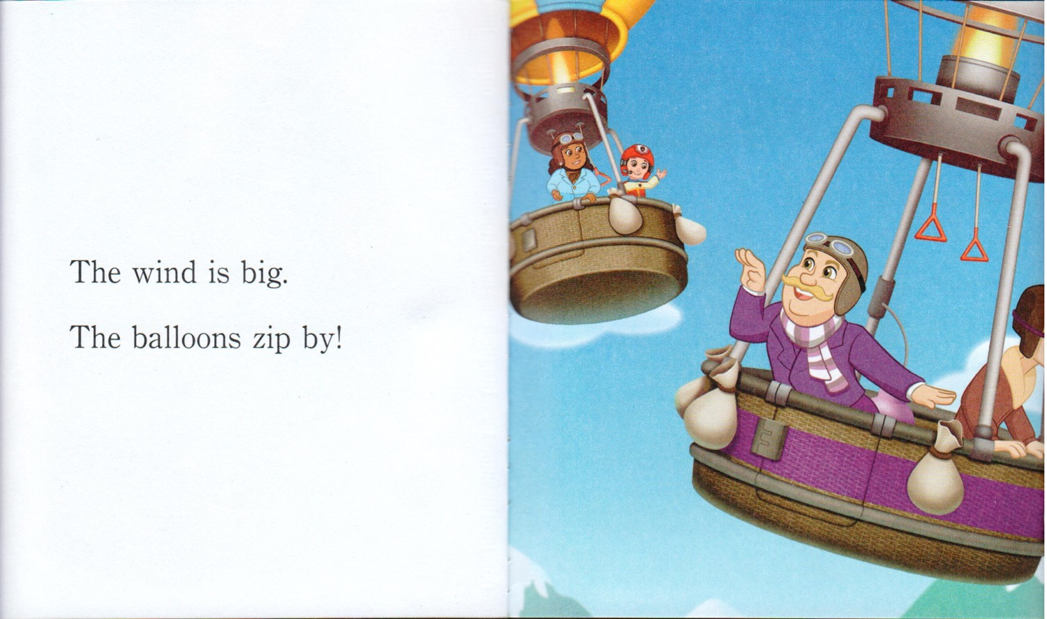

Slide 37
Tell your story about:
You heard a lot of different things in the story.
Can you tell me a story about a time in your life where you:
took a trip?
ran a race?
played with Dogs?
saw balloons?
Let’s move over to the whiteboard and create a story.
Notes:
Tell them that stories usually have something exciting or unique happen.
There should be suspense or some sort of surprise that we maybe do not expect.
Think of a time in your life that was exciting or had something really fun or new happen.

Slide 38
What will I learn today?
The long and short i sound
Simple possessives using names
Telling a story using personal experiences
Notes:
Have the students read the goal that they just completed.
Congratulate them.

Slide 39
Final Thoughts?
Do you have any questions?
What are you taking away from today?
Do you understand the handout?

