Slide 1
Adventures!
Notes:
Unit 2, Lesson 1. Adventures. Let the students know that this unit we will be talking about adventures! See if the students can sound the word out on their own and see if they know what it means. The visual cue should help them (the airplane!)

Slide 2
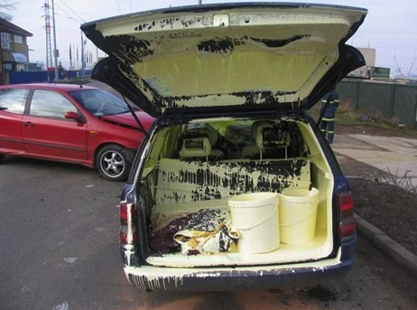
Notes:
‘What’s going on?” <- each lesson in this unit will have a section called Whats going on in the beginning to stimulate conversation and break the ice before class begins! Make your pen colour white and draw all of the key words on the board that the students come up with when they are describing or talking about the picture. Some words like ‘car’ ‘paint’ might come up! Have fun with it!

Slide 3
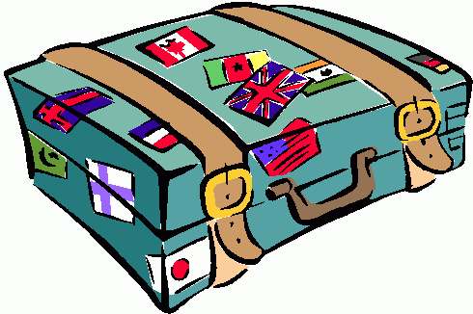
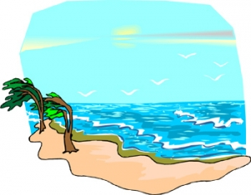
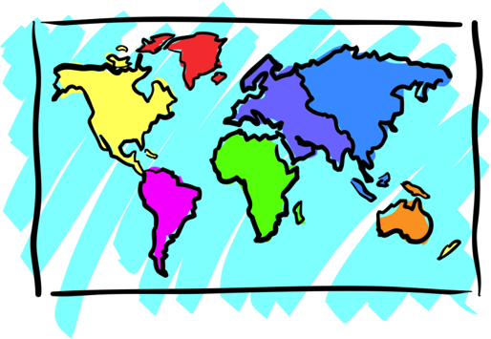
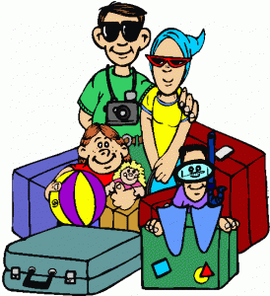
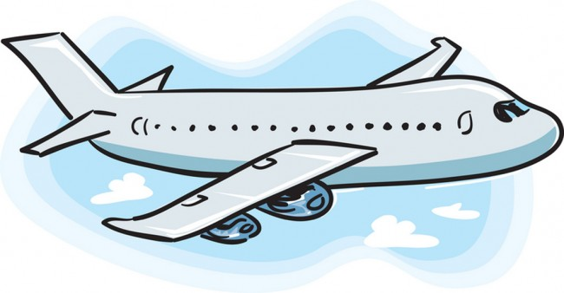
Adventures
Notes:
Define the word adventure for them and/or ask them if they have ever been on an adventure and with whom.
Ask, “What do you see on an adventure” or “What do you take with you on an adventure?”
Take this opportunity to write new words on the screen. Backpacking, Eiffel Tower, family vacation are all words that may be new to them.
If you need more space to write words and define them, you can flip over to a blank Whiteboard screen
If they are lower level English speakers, ask them to circle their favourite image with their mouse.
You can hold up your mouse to the camera and then draw a circle on the page so they can see it and they will copy.

Slide 4
What will I learn today?
The sound of the letters ‘tt’
Talk to each other using words like ‘thank you’ and ‘please’
Talk about where we would like to travel
Learn about different ways to travel
Notes:
You can read these goals to them or have them read the goals if they can.
Underlining sentences and asking students to read one sentence at a time works well.

Slide 5
Let’s talk!
?
Where have you been in the world?
Where would you like to travel to?
Have you ever been on an airplane?
Notes:
This is an open discussion with the students. Manage the discussion and direct the conversation towards travel and adventures. You can also write sentences on the whiteboard of what their responses are.

Slide 6
Let’s talk!
Where would you like to travel to?
I would like to travel to _______________________
because _____________________________________________.
Notes:
You can go through an example first with the students of where you would like to travel to and then erase the board and have the students fill it in themselves. You can let them know that this exercise is also on their Worksheet which they should have with them.

Slide 7
What did I just learn?
Talk about where we would like to travel
Notes:
You can read these goals to them or have them read the goals if they can.
Underlining sentences and asking students to read one sentence at a time works well.

Slide 8
How do you travel?
What are some things that help us travel around the world?
Let’s brainstorm together!
Travel
Notes:
Brainstorming! The students should be somewhat familiar with what brainstorming is, however you can remind them beforehand. You can talk about words like planes, suitcases, tickets, family, adventures etc . Be sure to talk about what a vehicle is to set up for the next slide

Slide 9
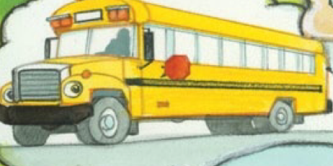
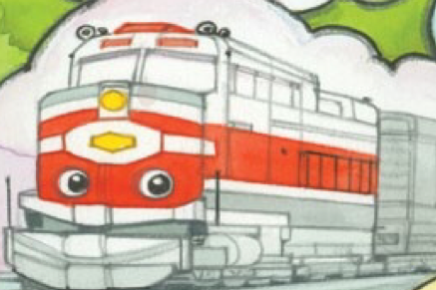
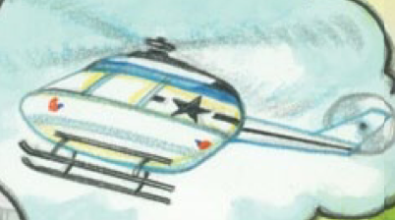
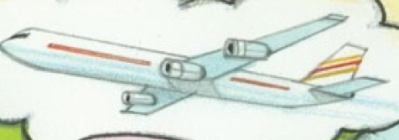
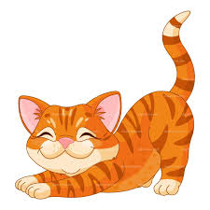
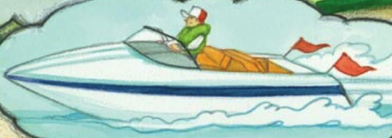
How do you travel?
Let’s circle the pictures that help you travel.
Notes:
Have the students circle the vehicles in the slide above. If the students pens are not working make sure you check the icon beside their profile on the left side of FastMeeting and ensure that they are able to write on the whiteboard!

Slide 10
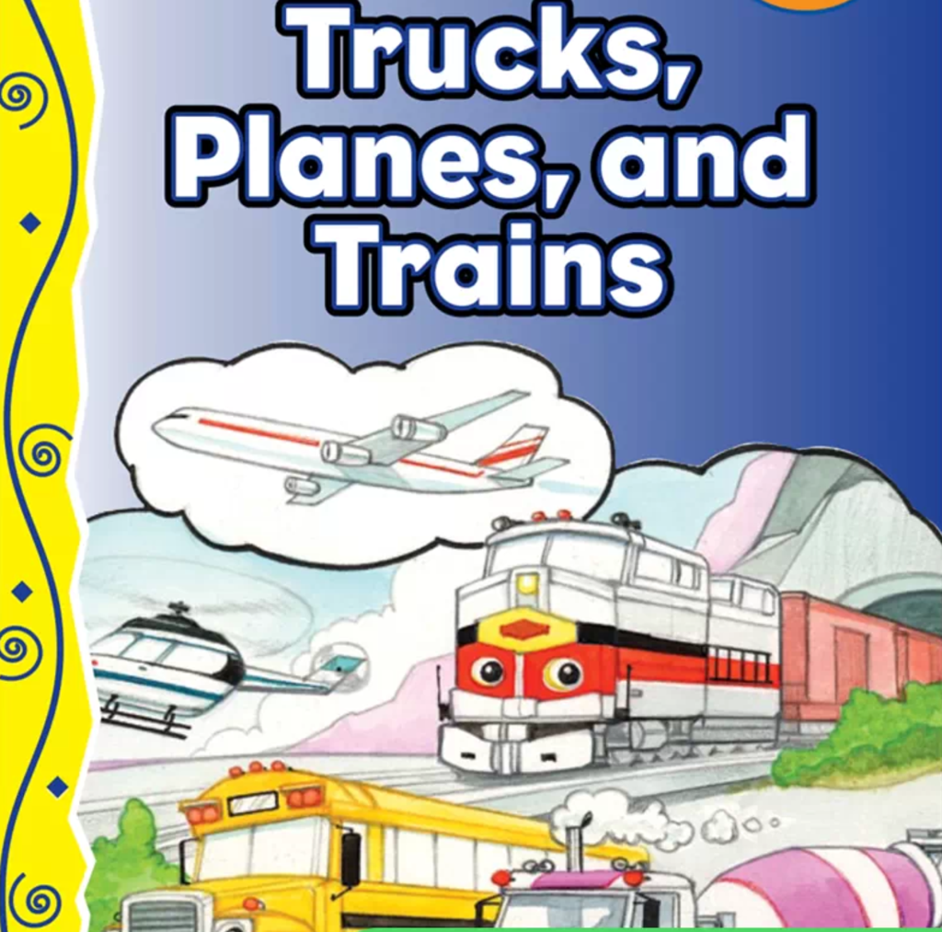
Notes:
Introduce the book to them . See if they know what types of vehicles are in the picture. You can also have them interact with the picture in a more general way if their language level is lower by just asking them if they can circle something that is red or blue.
“Would you like to help me read a story?”
By now, you may have some indication of whether or not the students can read on their own.
If unsure, have them repeat the title of the book after you.
“I say … Trucks, Planes and Trains, you say .....” (While pointing to yourself and then to them)

Slide 11
Notes:
Depending on the level of the students, you can either read the book to them, use the audio file or have them read the book to you. If I am reading the book, I like to read out the first sentence to them. You can have them circle the truck and have them tell you more about the truck as well.

Slide 12
Notes:
During the next few slides, have the students tell you what vehicle is in the picture as well as what it’s function is. You can also have students circle other things in the image such as the sun, the engines and the wheels to further the students understanding. If the students is lower A level then you can have the students circle certain colours ex: “can you circle something yellow for me?” and the student should circle the sun. Use this template for the rest of the story, highlighting key events in the images as well as the functions of the vehicles!

Slide 14
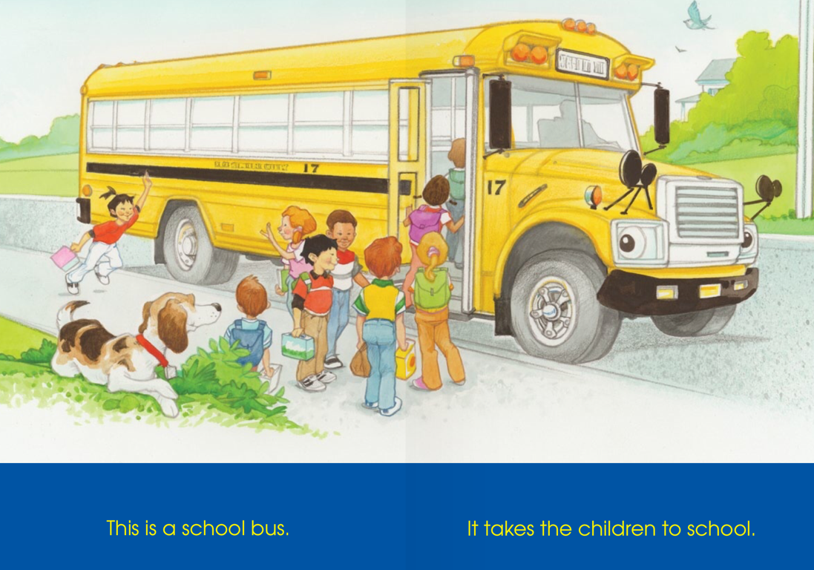

Slide 17
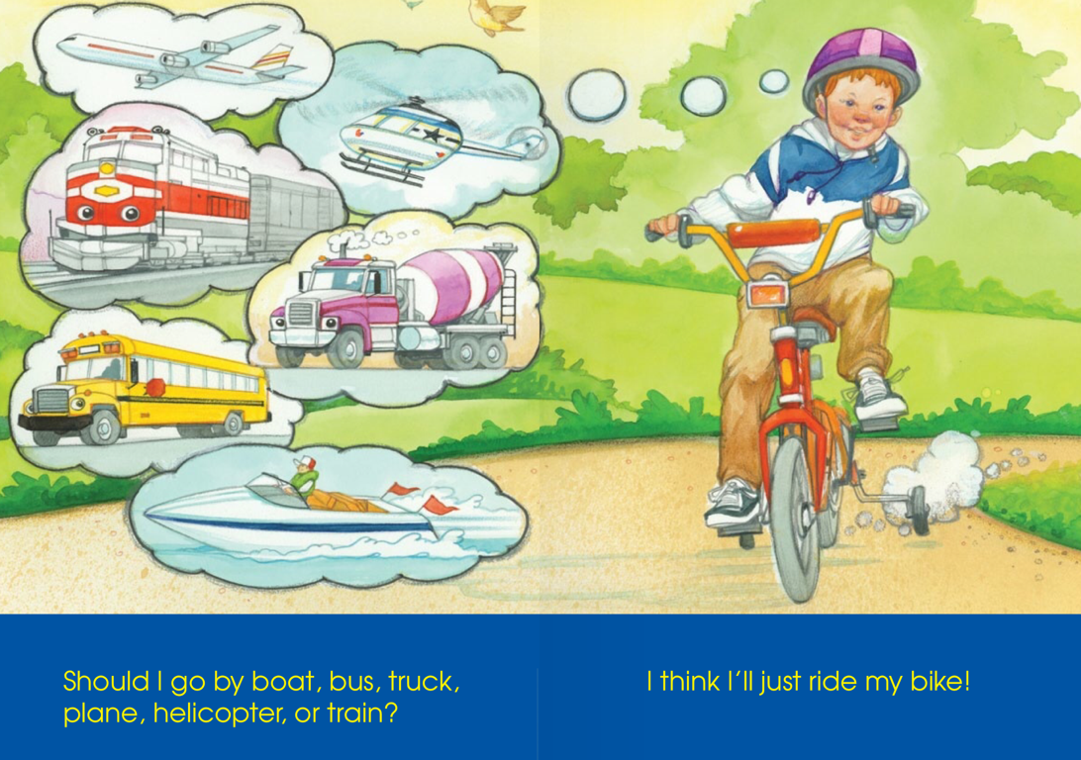
Notes:
For this slide, you can have the students tell you what each vehicle is after you have read the pages to them or before. You can write the name of each vehicle beside the image. You can then also talk about types of transportation that does not use a motor such as a bike or kayak.

Slide 18
What did I just learn?
Learn about different ways to travel
Notes:
Have the students read the goal that they just completed.
Explain what they learned if needed.
Congratulate them.

Slide 19
What is that sound?
Listen closely and see if you know what the sound is!
Notes:
This is the description of what race cars do. You can have the students tell you what they think racecars do first, and then show this slide to further their understanding.

Slide 20
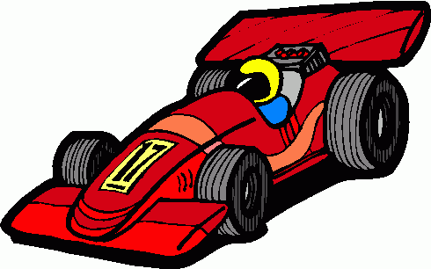
What is that sound?
Listen closely and see if you know what the sound is!
Circle the correct answer below
Notes:
This is the description of what race cars do. You can have the students tell you what they think racecars do first, and then show this slide to further their understanding.

Slide 21
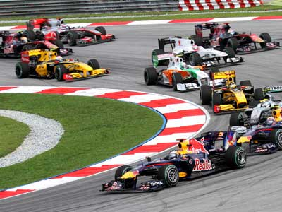
You’re right! It is a race car!
A race car is a car that was made for speed races!
They can go very fast,
much faster than cars on the street! ZOOM !
Notes:
This is the description of what race cars do. You can have the students tell you what they think racecars do first, and then show this slide to further their understanding.

Slide 22
Where are we going today?
Notes:
Let the students know that each lesson they will be going on a trip with you! After showing this slide, play the ‘Where are we going today?” video clip for the students. Talk about airplanes and if they would be scared or excited to go on an airplane.

Slide 23
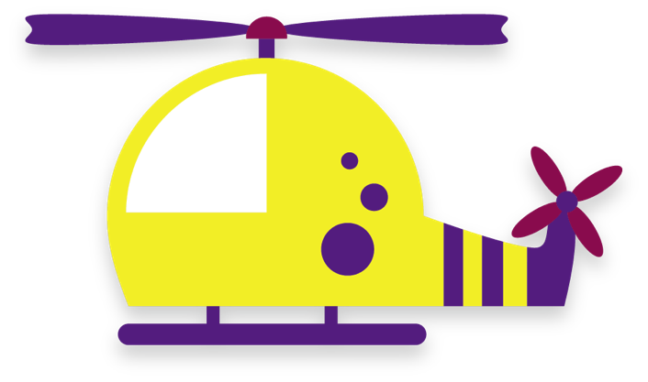
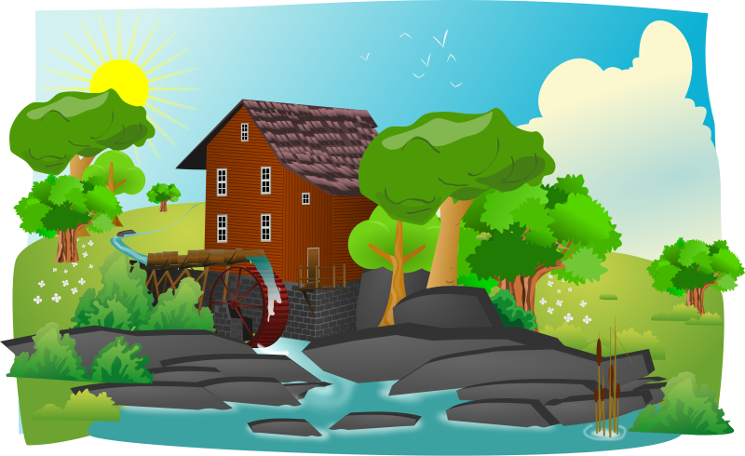
We are taking our helicopter to the cottage.
Notes:
The words with the bold red have the vocab words for the day the TT sound. You can talk about what a cottage is with the students and the types of activities there are to do at a cottage. Play the VIDEO file of the helicopter taking off!

Slide 24
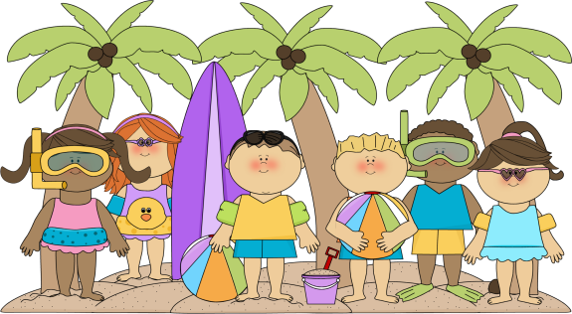
At the cottage, we fly to a little beach and meet some new friends.
Notes:
Talk about the toys that the kids in the image are holding and the different types of activities they were doing throughout the day.
Write the new words down on the whiteboard or even on this slide. Some new words might be, surf board, rubber ducky

Slide 25
We spent the
with our new friends.
“Hi, my name is Jessica”
‘Hello,
my name is Holly”
Notes:
This is where the students share a conversation, assign a different colour of speech bubble to a different student and have them role play. They may also continue the conversation too if they would like!

Slide 26
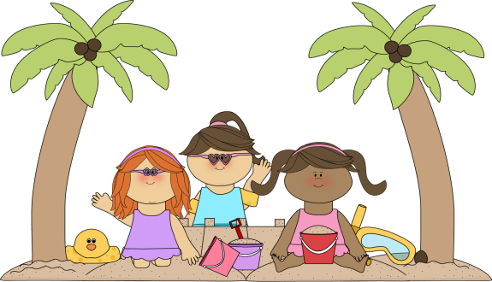
‘Nice to meet you. May I borrow your bucket please?’
“Yes, you can borrow it! Nice to meet you too.”

Slide 27
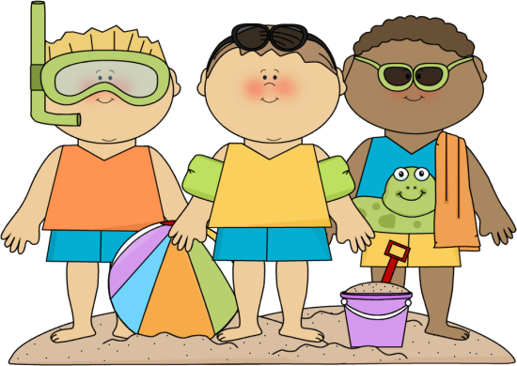
‘Thank you for playing with us. We are having so much fun!’
‘You are welcome! Let’s go swimming!’
‘That’s a great idea!
I like swimming!”
Notes:
You can reassign the characters to different students as you go, or they can keep the same role. Talk about how the kids are having a conversation together and point out key words such as “thank you”

Slide 28
“It is time to go home!
Let’s go back to the helicopter.”
‘Yes, it is late! I am getting hungry!’
Notes:
You can have the students continue reading according to their assigned colour. In addition, you can ask them questions about the kids in the picture such as, ‘Why are they going home?”

Slide 29
‘I had a great day.
See you later.’
‘Me too! I had a lot of fun! Good bye!”

Slide 30
Let’s Practice!
With a partner, talk about
what you like to do on a summer day!
Ready...Set...
GO!
Notes:
Introduce this activity to the students, you can direct the conversation for them so that it stays on track. You can ask prompting questions such as “Who would you spend your favourite summer day with?” You can also bring up a whiteboard and write down their answers.

Slide 31
In the summer, I like _____________________
____________________________________
____________________________________
Notes:
Introduce this activity to the students, you can direct the conversation for them so that it stays on track. You can ask prompting questions such as “Who would you spend your favourite summer day with?” You can also bring up a whiteboard and write down their answers.

Slide 32
What did I just learn?
Talk to each other using words like ‘Thank you’ and ‘please’
Notes:
Have the students read the goal that they just completed.
Explain what they learned if needed.
Congratulate them.

Slide 33
Today’s letters! -> ‘TT’
Today’s Letters -> ‘tt’
Notes:
Talk about the word ‘cottage’ which the students are familiar with from before. Write the word on the whiteboard for them so that they know how to spell it. Have them sound the word out as well.

Slide 34
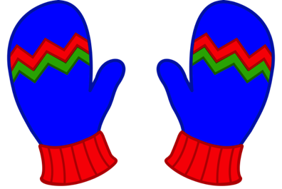
Match the picture with the word
Mittens
Kettle
Kitten
Notes:
Let the students know that this activity is on their worksheet which they should have in front of them. Make sure the students pens work if not ensure that you enable them to work on FastMeeting. Point out the “TT” written in red and have the students draw lines for the corresponding words.

Slide 35
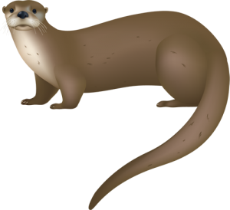
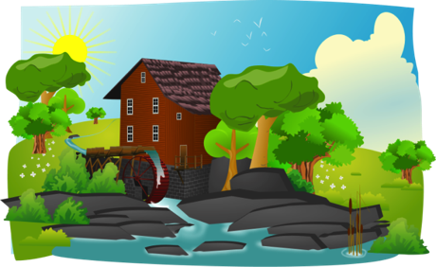
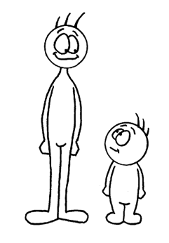
Match the picture with the word
Cottage
Little
Otter

Slide 36
What did I learn today?
Learn about different ways to travel
Notes:
Have the students read the goal that they just completed.
Explain what they learned if needed.
Congratulate them.
You can write down the different names of vehicles here as well or assign the students to do that on their own using their pens.

Slide 37
What did I learn today?
Talk to each other using words like ‘Thank you’ and ‘please’
“Hi, my name is Jessica”
‘Hello,
my name is Holly”
Notes:
Have the students read the goal that they just completed.
Explain what they learned if needed.
Congratulate them.

Slide 38
What did I learn today?
The sound of the letters ‘tt’
Notes:
Have the students read the goal that they just completed.
Explain what they learned if needed.
Congratulate them.
write down the new vocabulary words on the board and have the students write these new words on their worksheets under “Vocabulary”

Slide 39
New words I learned today
Helicopter
Otter
Kettle
Cottage
Notes:
Have the students read the goal that they just completed.
Explain what they learned if needed.
Congratulate them.
write down the new vocabulary words on the board and have the students write these new words on their worksheets under “Vocabulary”. These are the words that the students should be practicing!

Slide 40
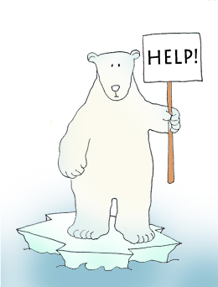
Final Thoughts
Do you have any questions?
Do you understand the handout?
Notes:
Wrap up your lesson and play the extra activities if you have any time. Answer any questions and pull up the worksheet if you want and go over the activities with them to ensure they understand.

Slide 41
Before the next class
Listen and read along with the ‘Truck, Planes and Trains’ book
Read book to yourself and to your family/friends
Complete the worksheet
Practice writing new vocabulary words
Notes:
You can read these goals to them or have them read the goals if they can.
Underlining sentences and asking students to read one sentence at a time works well.

Slide 42
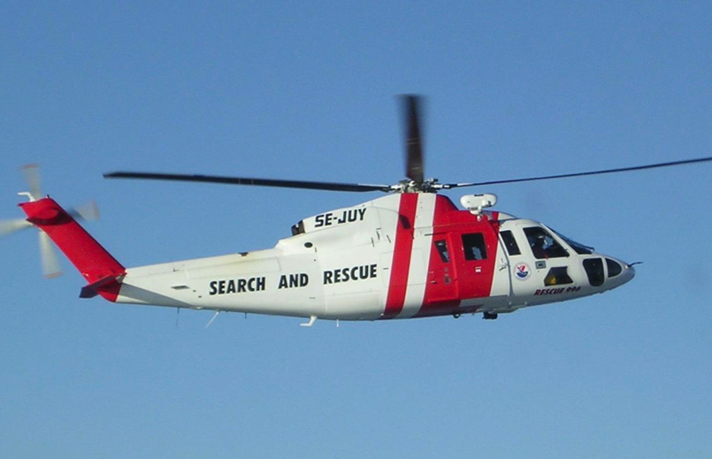
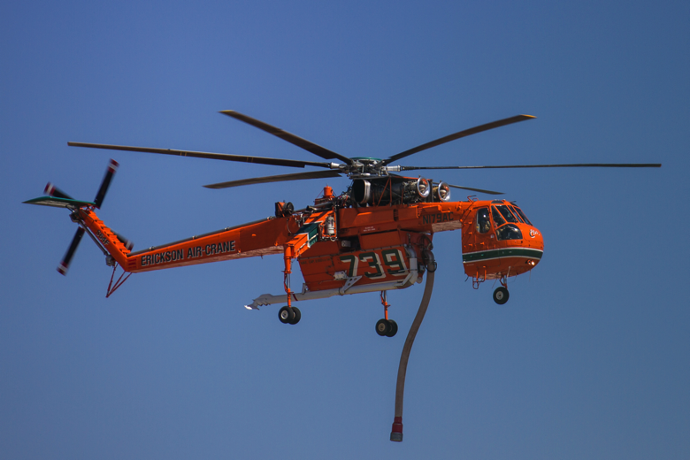
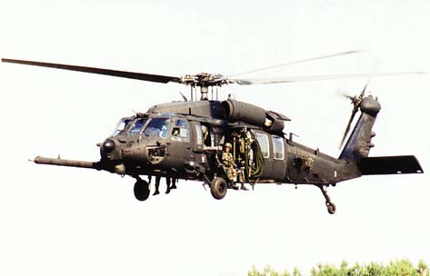
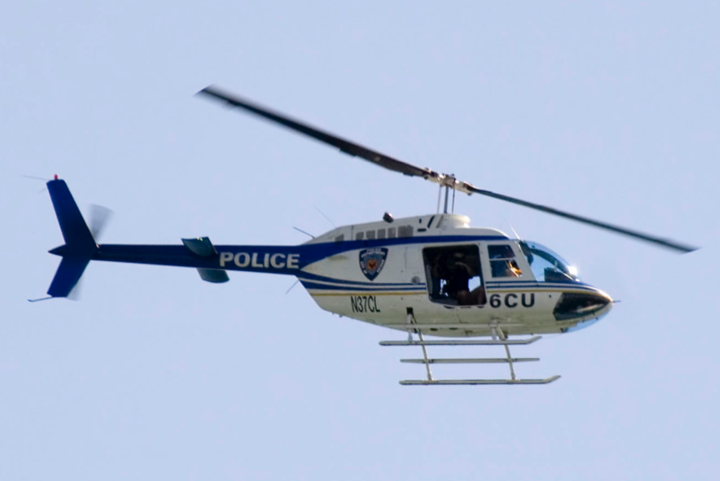
Types of Helicopters
Notes:
Talk about different types of helicopters and their uses. You can include your own slides with different types of planes and boats!
Above helicopter picture needs to be replaced due to 123RF (completed)

Slide 43
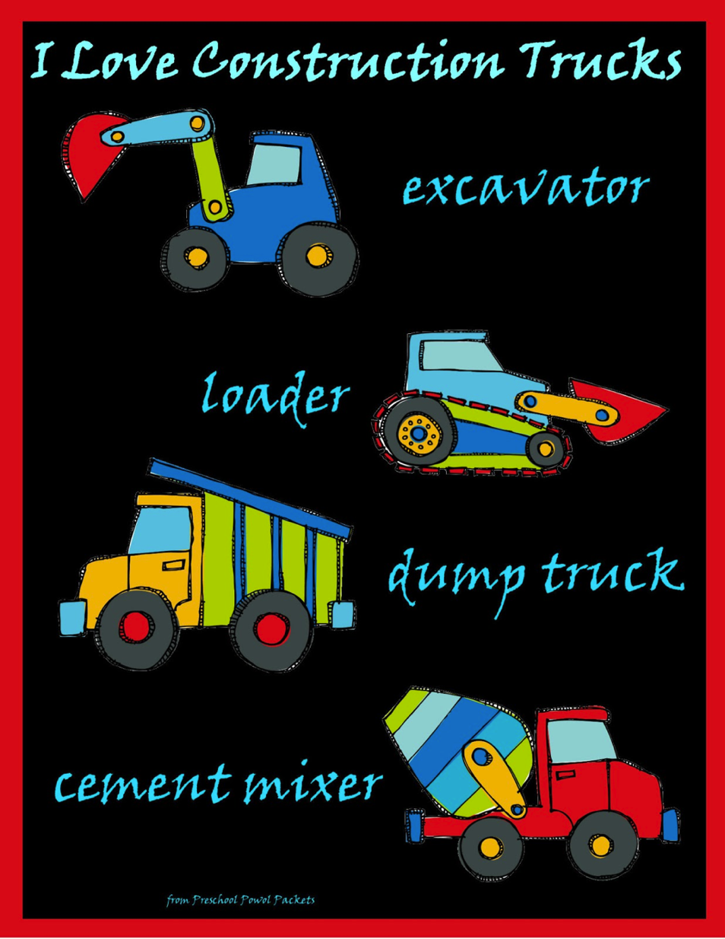
Type of Construction Trucks
Notes:
Talk about different types of construction trucks and their uses. You can include your own slides with different types of planes and boats!

Slide 44
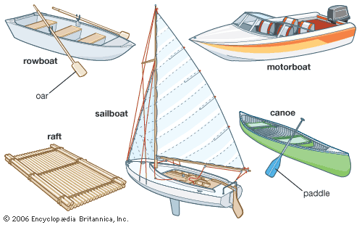
Types of Boats
Notes:
Talk about different types of boats and their uses. You can include your own slides with different types of planes!

Slide 45
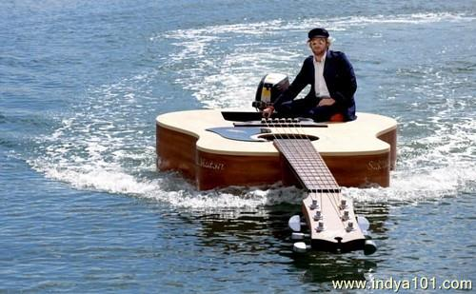
What kind of boat?

