Slide 1

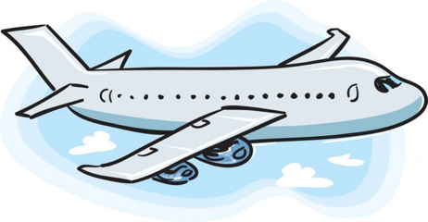

Adventures!
Adventures
Notes:
Unit 2, Lesson 1. Adventures. Let the students know that this unit we will be talking about adventures! See if the students can sound the word out on their own and see if they know what it means. The visual cue should help them (the airplane!)

Slide 2
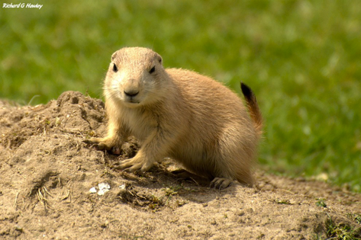
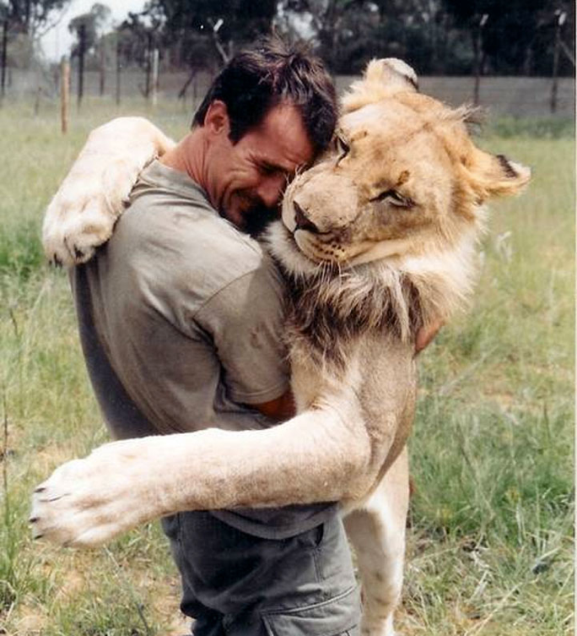
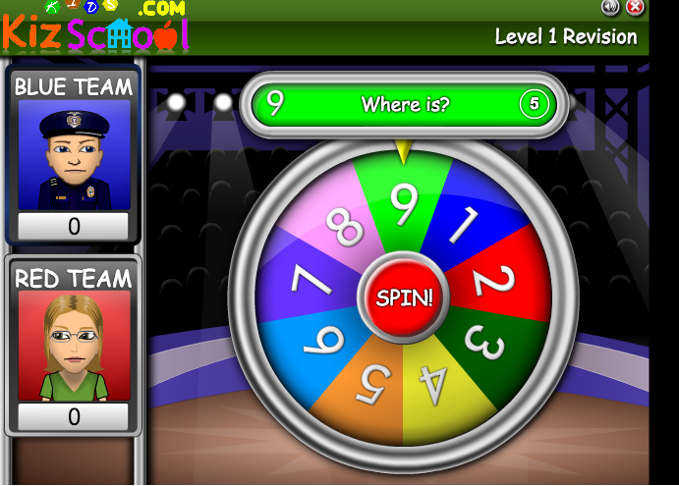


What did I learn last class?
Sounds of the letters ‘tt’, ‘pp’, ‘nn’, ‘mm’,’dd’
Word Banks
Word Walls
New safari words
Notes:
You can read these goals to them or have them read the goals if they can.
Underlining sentences and asking students to read one sentence at a time works well.

Slide 3
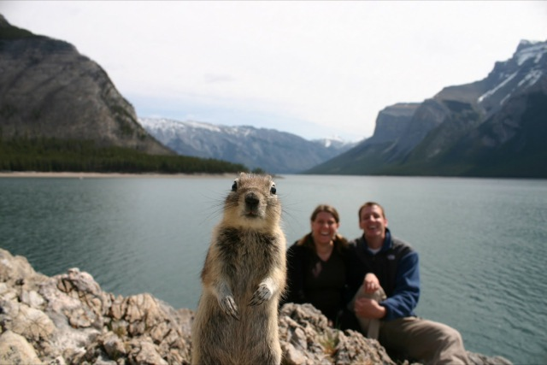

Notes:
‘What’s going on?” <- each lesson in this unit will have a section called Whats going on in the beginning to stimulate conversation and break the ice before class begins! Make your pen colour white and draw all of the key words on the board that the students come up with when they are describing or talking about the picture. Some words like ‘car’ ‘paint’ might come up! Have fun with it!

Slide 4
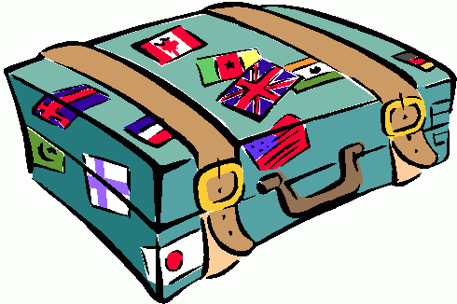
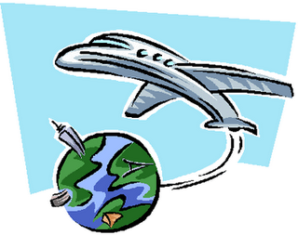
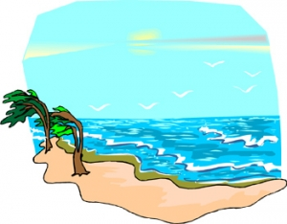
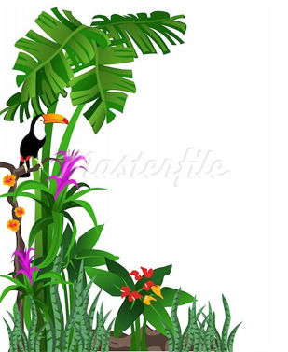
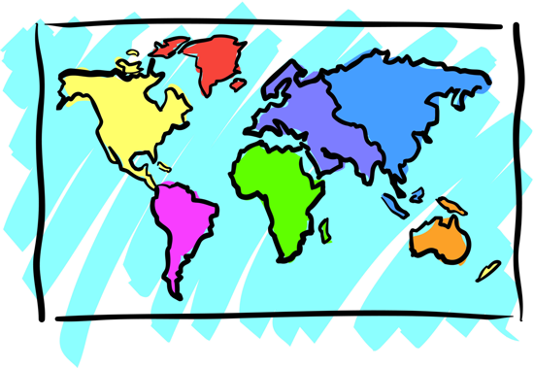

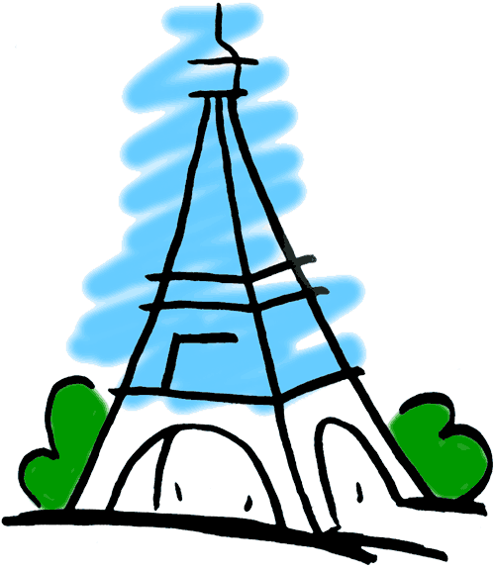
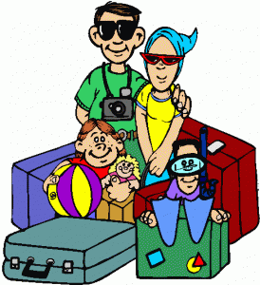

Adventures
Notes:
Define the word adventure for them and/or ask them if they have ever been on an adventure and with whom.
Ask, “What do you see on an adventure” or “What do you take with you on an adventure?”
Take this opportunity to write new words on the screen. Backpacking, Eiffel Tower, family vacation are all words that may be new to them.
If you need more space to write words and define them, you can flip over to a blank Whiteboard screen
If they are lower level English speakers, ask them to circle their favourite image with their mouse.
You can hold up your mouse to the camera and then draw a circle on the page so they can see it and they will copy.

Slide 5
What will I learn today?
Sounds of the letters ‘ss’
Negation (Using ‘do not’)
New Australia Words
Notes:
You can read these goals to them or have them read the goals if they can.
Underlining sentences and asking students to read one sentence at a time works well.

Slide 6

Today’s letters! -> ‘SS’
Notes:
Talk about the word ‘cottage’ which the students are familiar with from before. Write the word on the whiteboard for them so that they know how to spell it. Have them sound the word out as well.

Slide 7
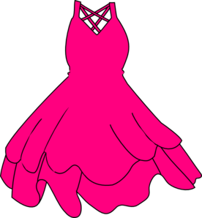



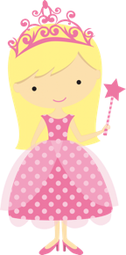
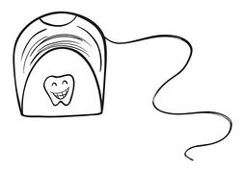

Write in the correct ‘ss’ word

Slide 8

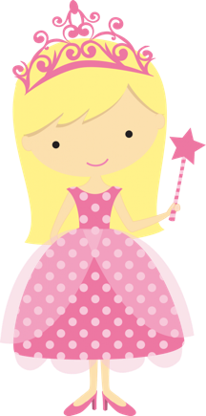
Write a sentence with a ‘ss’ word
__________________________________
__________________________________
__________________________________

Slide 9

What did I learn today?
The sounds of the letters ‘ss’
Notes:
Have the students read the goal that they just completed.
Explain what they learned if needed.
Congratulate them.
write down the new vocabulary words on the board and have the students write these new words on their worksheets under “Vocabulary”

Slide 10

Let’s take a trip together!
Where are we going today?
Notes:
Let the students know that each lesson they will be going on a trip with you! After showing this slide, play the ‘Where are we going today?” video clip for the students. Talk about airplanes and if they would be scared or excited to go on an airplane.

Slide 11
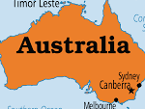
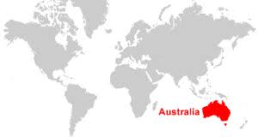
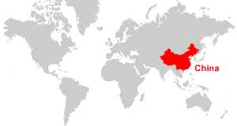

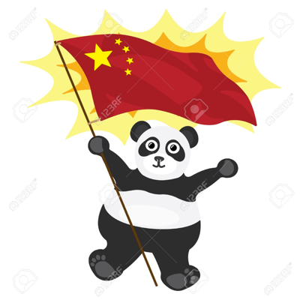
We are going to

Slide 12
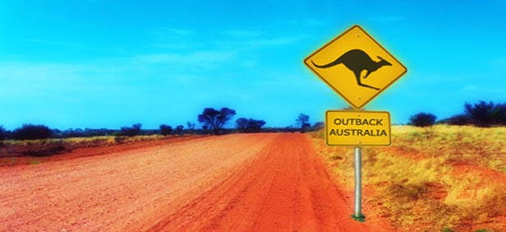
We are going to Australia
to see wild animals!

Slide 13
What is the Outback?
The Australian Outback is big open land
with many wild animals!

Slide 14

What is that sound?
Listen closely and see if you know what the sound is!
Notes:
Find the movie clip “wave” and play it for the students. It is a blank image so that the students can only hear the lion roaring and not see it. Have the students guess before showing them the next slide.

Slide 15
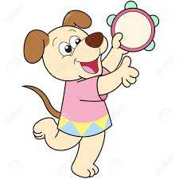
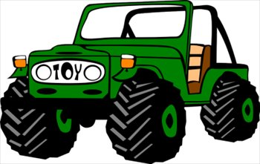
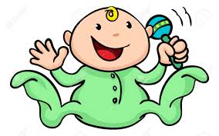
What is that sound?
Listen closely and see if you know what the sound is!
Circle the correct answer below
Notes:
Have them circle the what they thought the sound was. Talk about Kettle and kitten, two t’s, other words in our vocabulary. You can write the words down underneath so that the students can visualize the vocabulary.

Slide 16
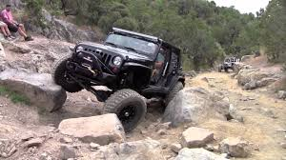
You’re right!
It is a car driving off road!
In Australia there are many areas that do not have cement roads such as the Outback!

Slide 17
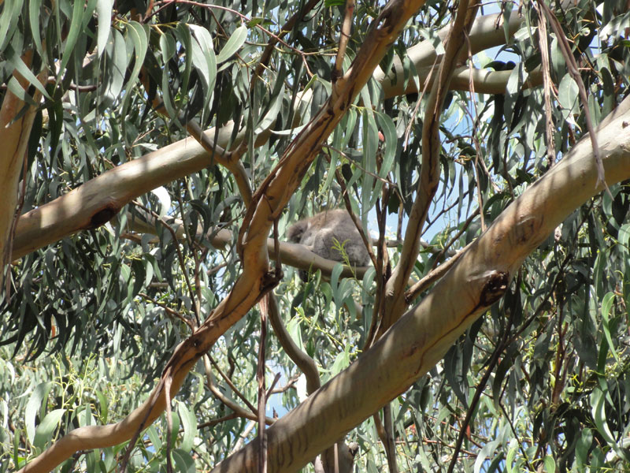
Can you find the monkey in this picture?

Slide 18
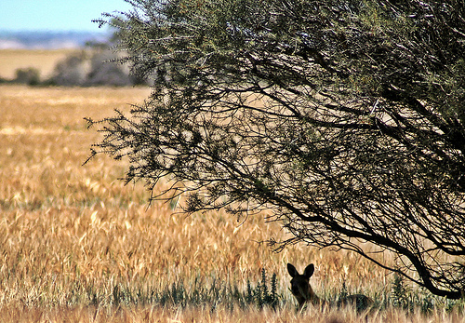
Can you find the kangaroo in this picture?

Slide 19

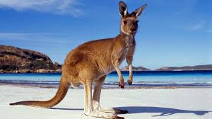
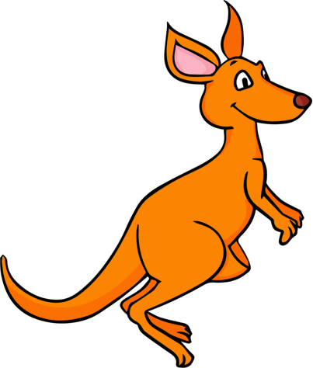
Do you like kangaroos?
Yes
No
Why?
__________________________________
__________________________________
__________________________________

Slide 20
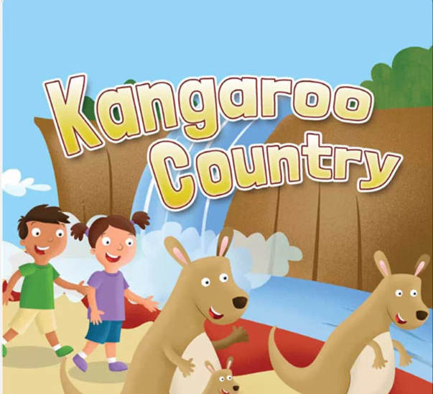

Slide 21
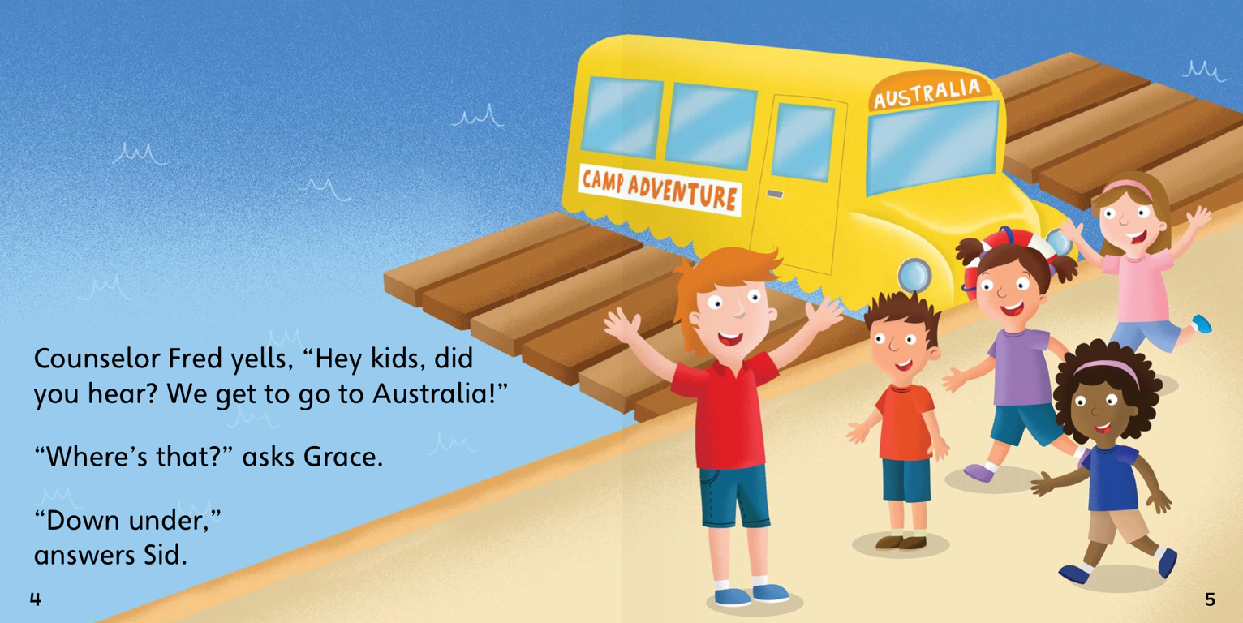
Teacher Mr. Fred says,
“Hey Kids!
We are going to Australia!
We are going to see the animals!”

Slide 22
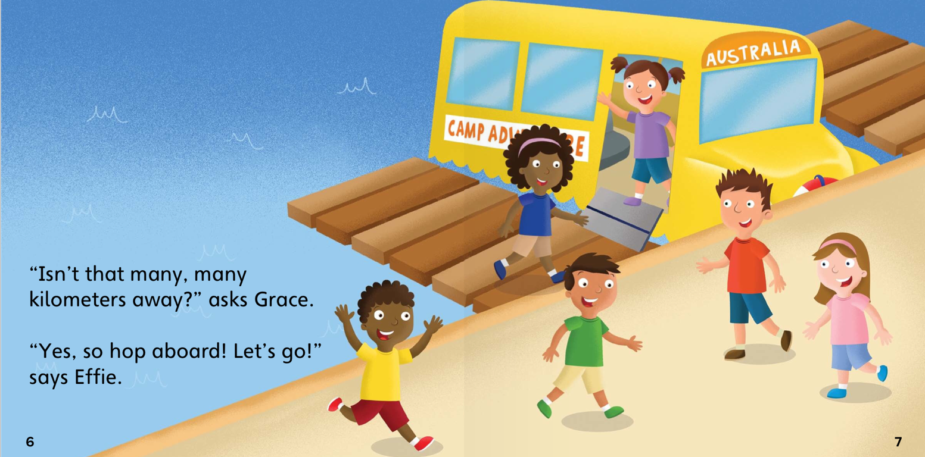
“Horray! We love going on trips!” said the students.
“Let’s go!”

Slide 23
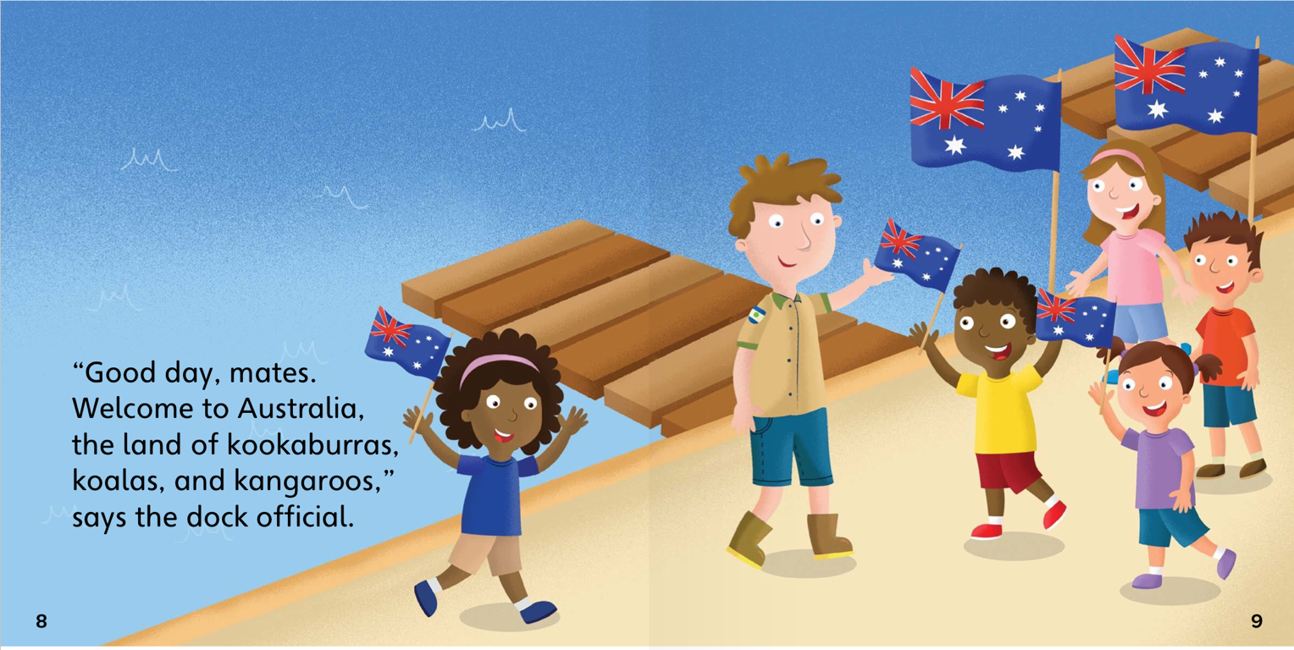
“Hello friends! “Welcome to Australia!
Let’s go explore”

Slide 24
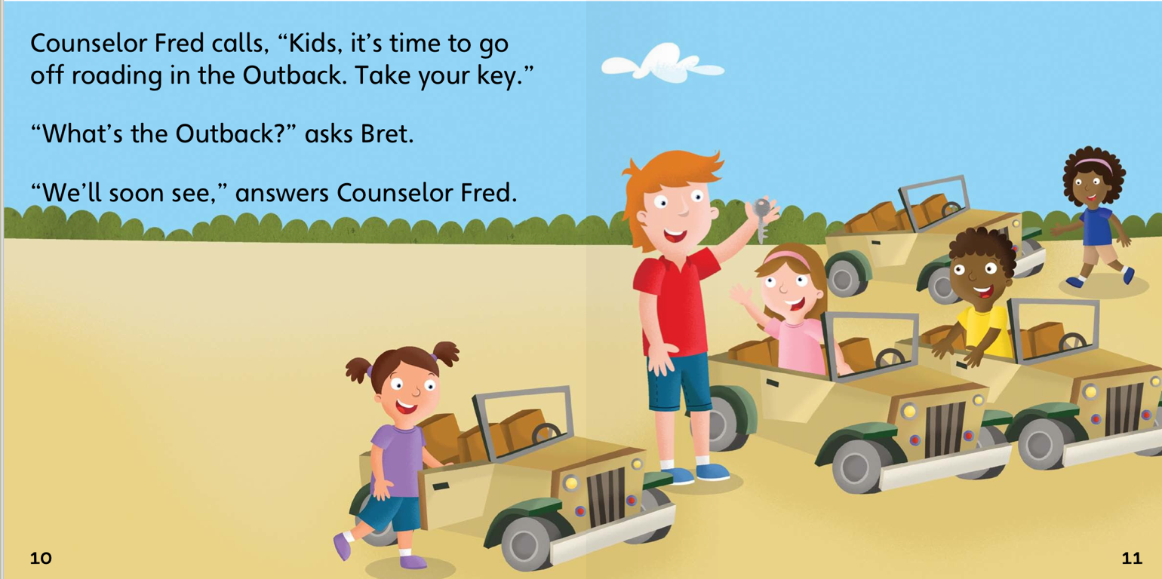
“Get in your car. We are going to see the animals!”

Slide 25
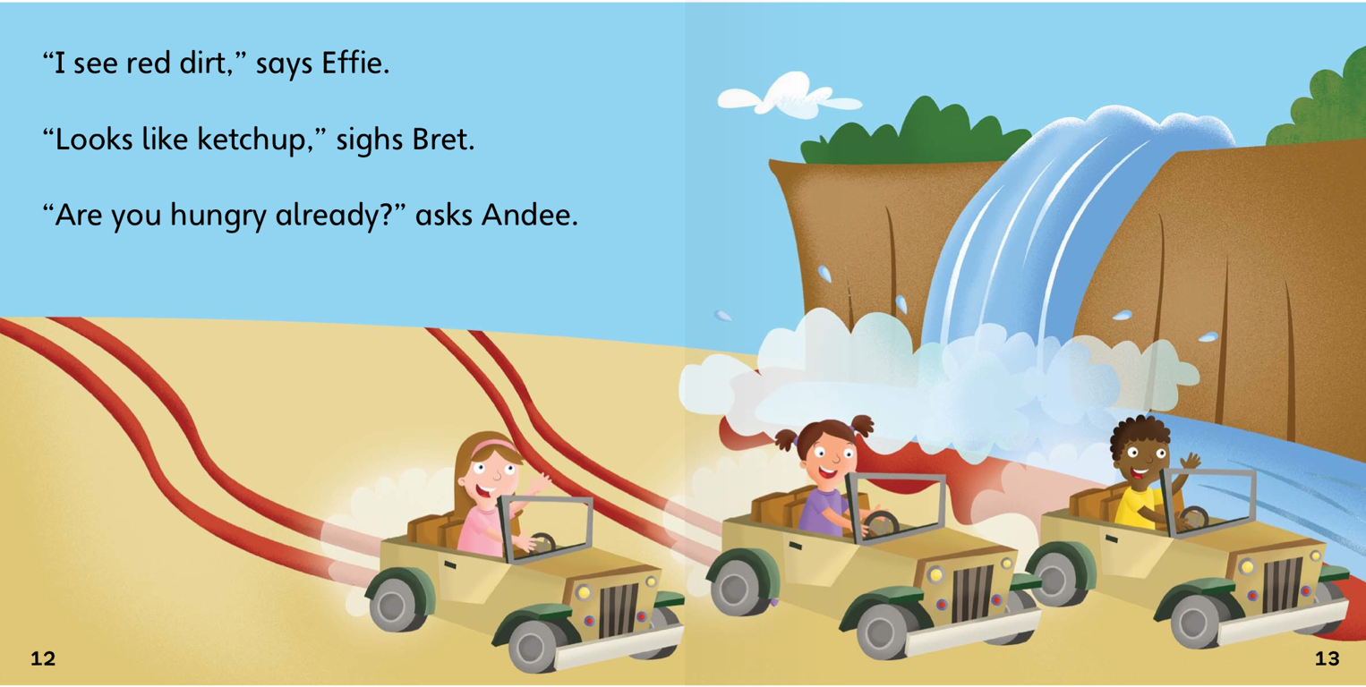
“Wow! Look at that waterfall! It is so big!
Where are the animals?”

Slide 26
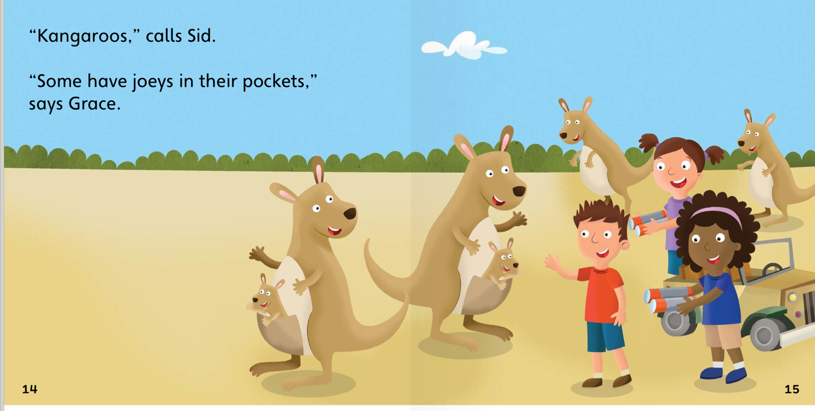
The class stopped when they saw the kangaroos.
They were with their babies.

Slide 27
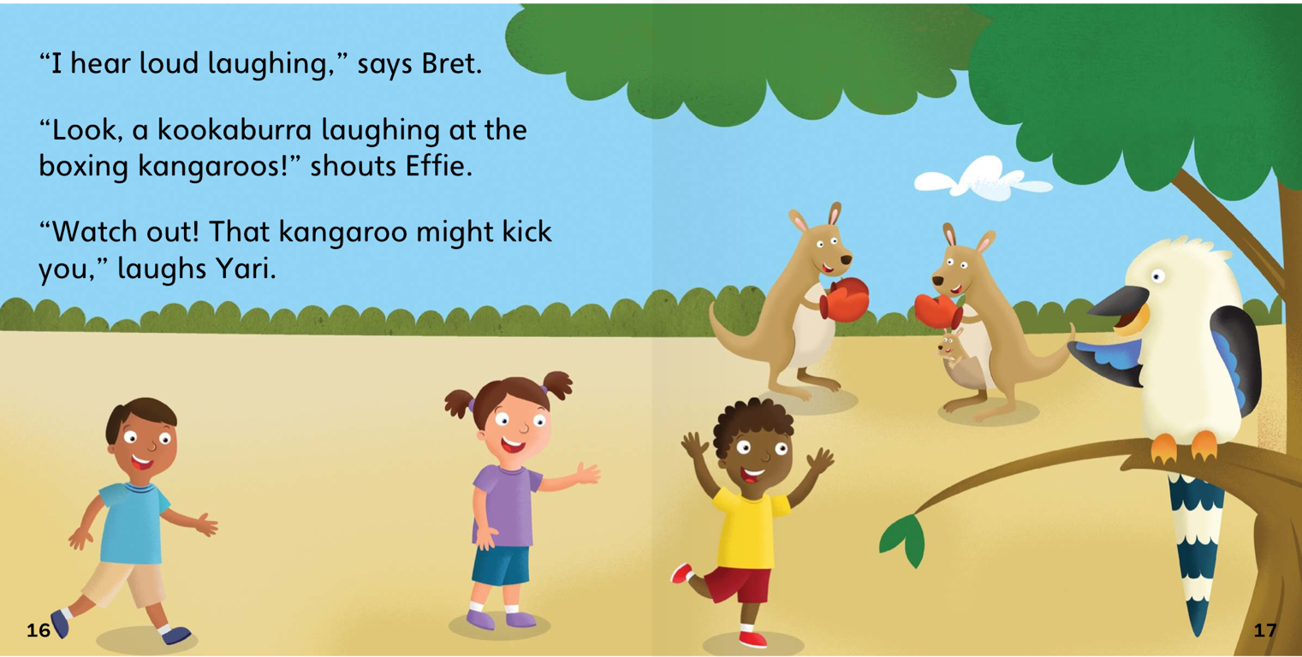
The second animal the class saw was a beautiful bird. The bird was in a tree.

Slide 28
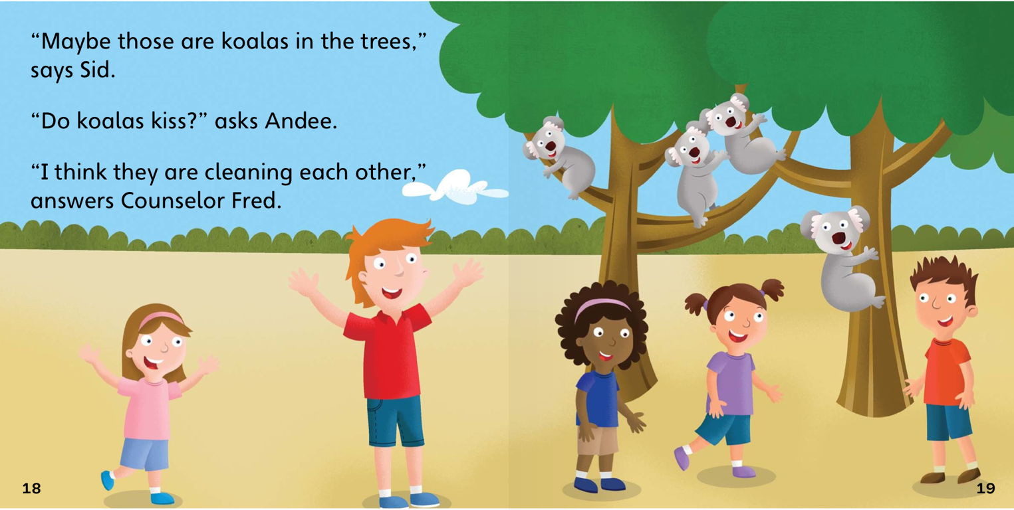
Next the class saw koalas! They were up, up, in trees eating leaves.
I wonder what we will see next!

Slide 29
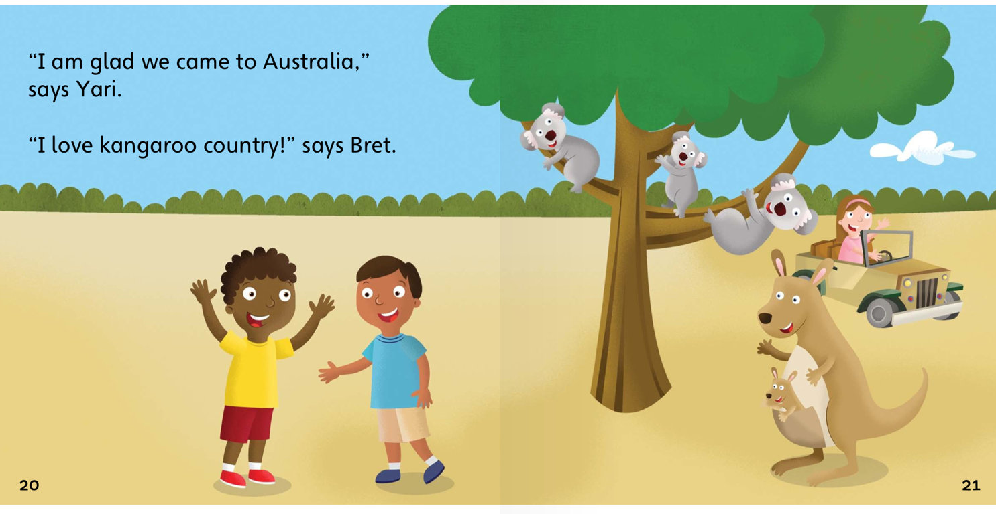
“I am very happy we came to Australia!
This is fun!”

Slide 30
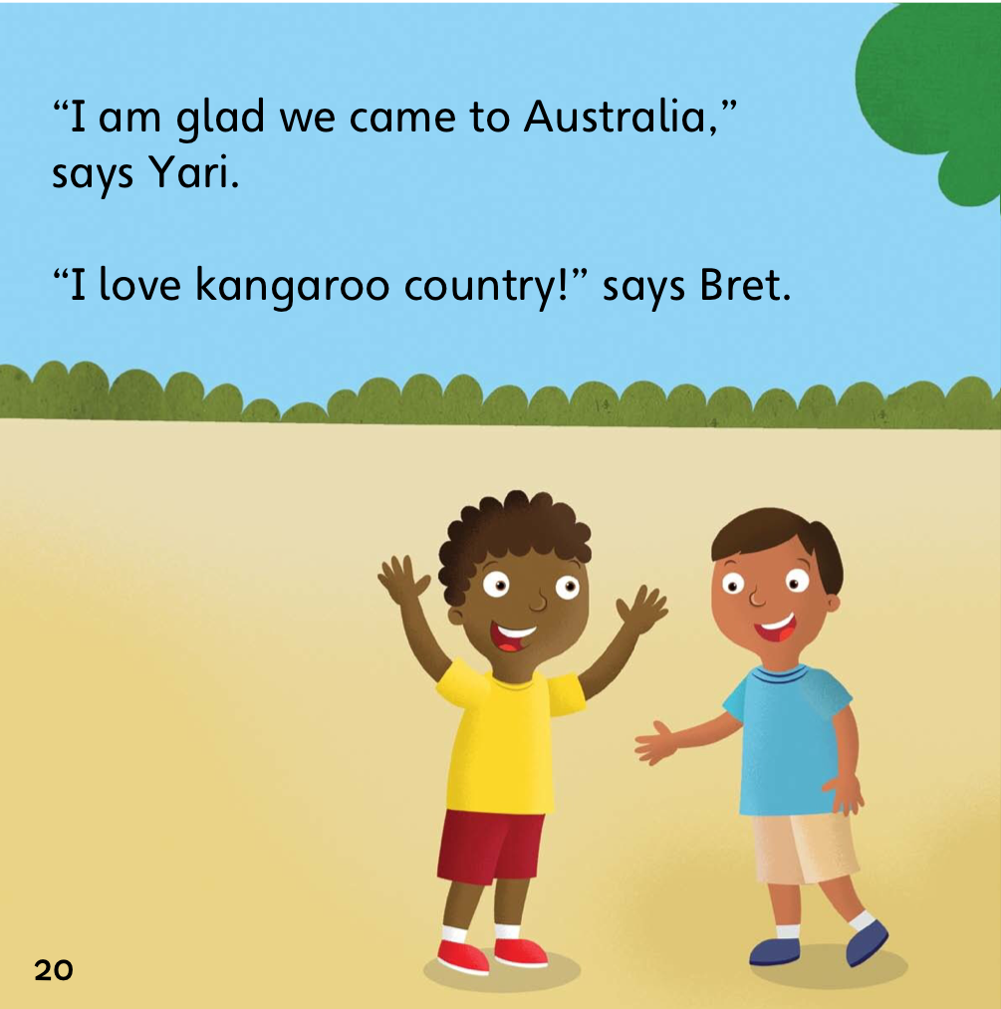
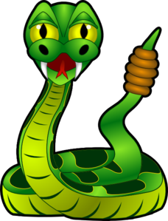
Before the class left they met one more animal.
A rattle snake!

Slide 31
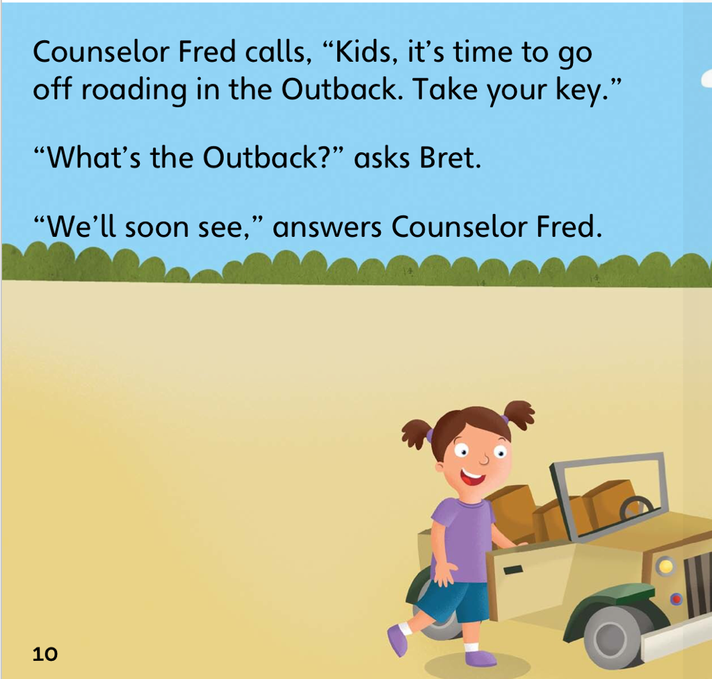
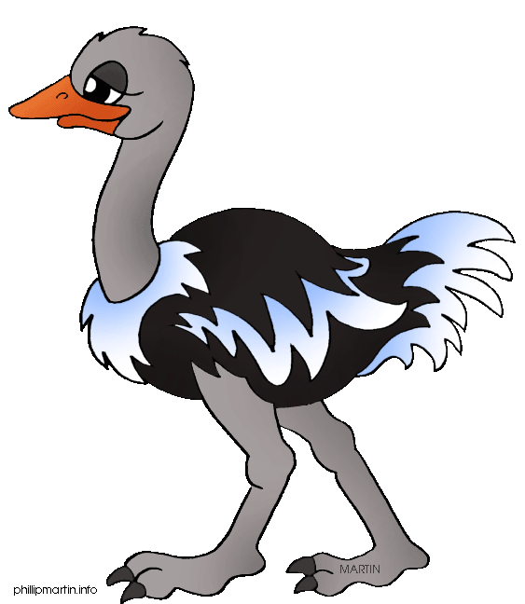
Mr. Fred calls to the class, “It is time to go!”
We had a great day. Now it is time to go home.
Goodbye Australia!

Slide 32
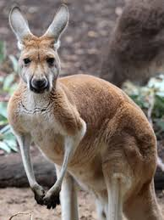
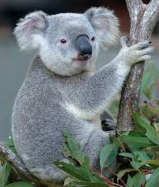
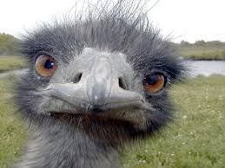
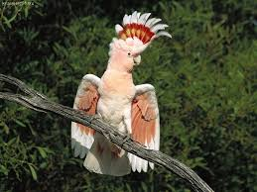
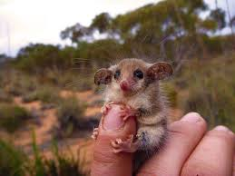
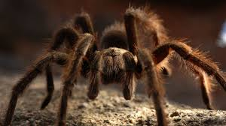
What other animals are in Australia?

Slide 33

What I just learned
Negation
Notes:
Have the students read the goal that they just completed.
Explain what they learned if needed.
Congratulate them.

Slide 34
Negation
When we add the word ‘not’ to a sentence.

Slide 35
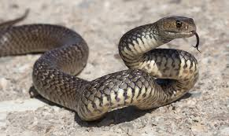
Negation
I like snakes
I do not like snakes
When we add the word ‘not’ to a sentence.

Slide 36


This is a _____________ .
Can it swim?
Yes it can / No it cannot

Slide 37

This is a _____________ .
Can it swim?
Yes it can / No it cannot

Slide 38

This is a _____________ .
Can it swim?
Yes it can / No it cannot

Slide 39

This is a _____________ .
Can it swim?
Yes it can / No it cannot

Slide 40


This is a _____________ .
Can it climb?
Yes it can / No it cannot

Slide 41

This is a _____________ .
Can it climb?
Yes it can / No it cannot

Slide 42

This is a _____________ .
Can it climb?
Yes it can / No it cannot

Slide 43

This is a _____________ .
Can it climb?
Yes it can / No it cannot

Slide 44


This is a _____________ .
Can it fly?
Yes it can / No it cannot

Slide 45

This is a _____________ .
Can it fly?
Yes it can / No it cannot

Slide 46

This is a _____________ .
Can it fly?
Yes it can / No it cannot

Slide 47

This is a _____________ .
Can it fly?
Yes it can / No it cannot

Slide 48
What I just learned
Negation
Notes:
Have the students read the goal that they just completed.
Explain what they learned if needed.
Congratulate them.

Slide 49

New words I learned today
Outback
Floss
Koala
Kangaroo
Notes:
Have the students read the goal that they just completed.
Explain what they learned if needed.
Congratulate them.
write down the new vocabulary words on the board and have the students write these new words on their worksheets under “Vocabulary”. These are the words that the students should be practicing!

Slide 50
What did I learn today?
Negation
Notes:
Have the students read the goal that they just completed.
Explain what they learned if needed.
Congratulate them.

Slide 51
What did I learn today?
Sounds of the letters ‘ss’
This is a ___________.
Notes:
Have the students read the goal that they just completed.
Explain what they learned if needed.
Congratulate them.

Slide 52
What did I learn today?
New Australia Words
Notes:
Have the students read the goal that they just completed.
Explain what they learned if needed.
Congratulate them.

Slide 53


Final Thoughts
Do you have any questions?
Do you understand the handout?
Notes:
Wrap up your lesson and play the extra activities if you have any time. Answer any questions and pull up the worksheet if you want and go over the activities with them to ensure they understand.

Slide 54

Before next class ...
Listen and read along with the ‘Kangaroo Country’ book
Read book to yourself and to your family/friends
Complete the worksheet
Practice writing new vocabulary words
Notes:
You can read these goals to them or have them read the goals if they can.
Underlining sentences and asking students to read one sentence at a time works well.

Slide 55


Slide 56


Kangaroos have pouches for their babies!
Their babies are called kids!
Why do you think kangaroos keep their babies in pouches?

Slide 57


