Slide 1


Adventures!

Slide 2
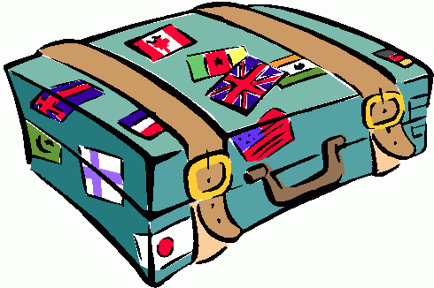

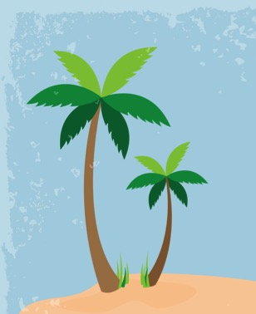
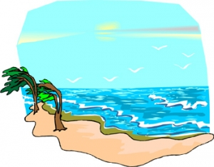
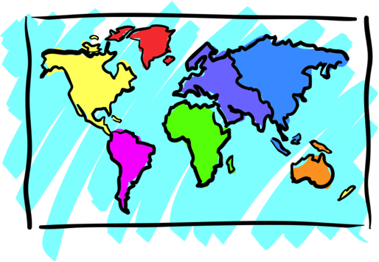


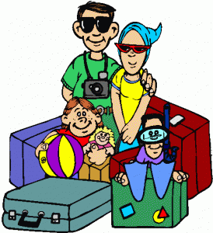
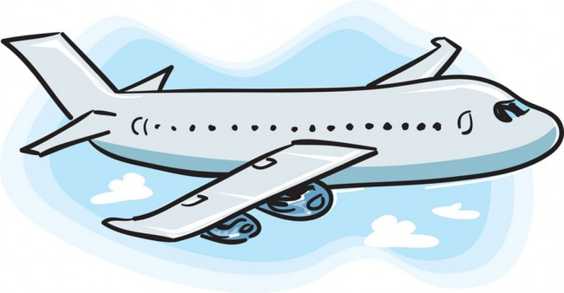
Adventures

Slide 3



What will I learn today?
Fill in the blanks
Use present tense
The sound of the letters ‘pp’
Notes:
Have the students read the goals if they can. I find that underlining sentences and asking students to read one sentence at a time works well.

Slide 4

Today’s Story

Slide 5
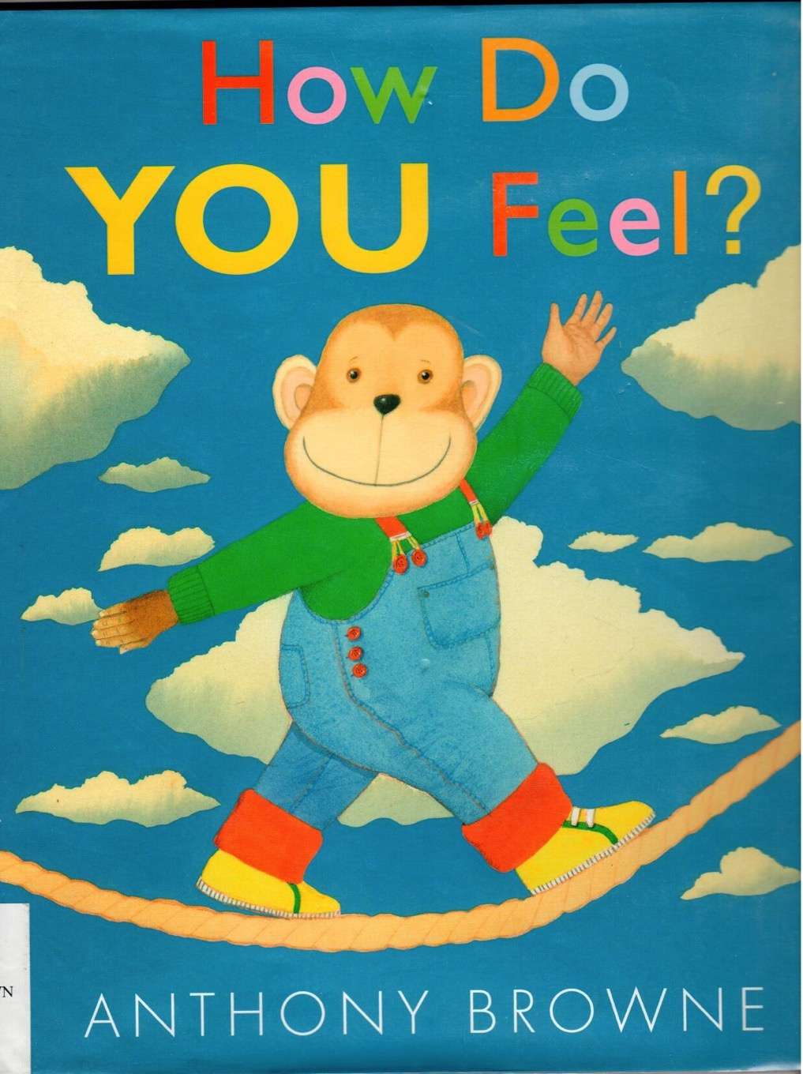
Notes:
Have one of the students read the title or you can read it yourself. Have the students point out what they see in the image as well as what kind of animal is in the image. You can even ask the students how they feel right now and see if they are able to answer it.

Slide 6
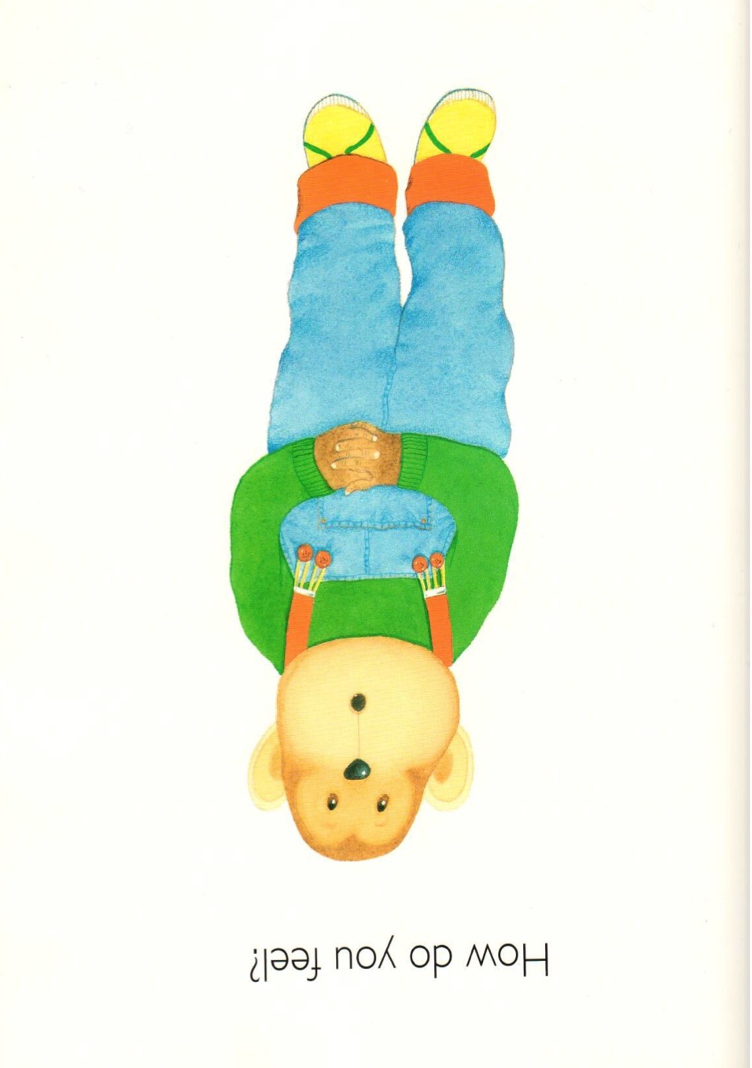

Slide 7
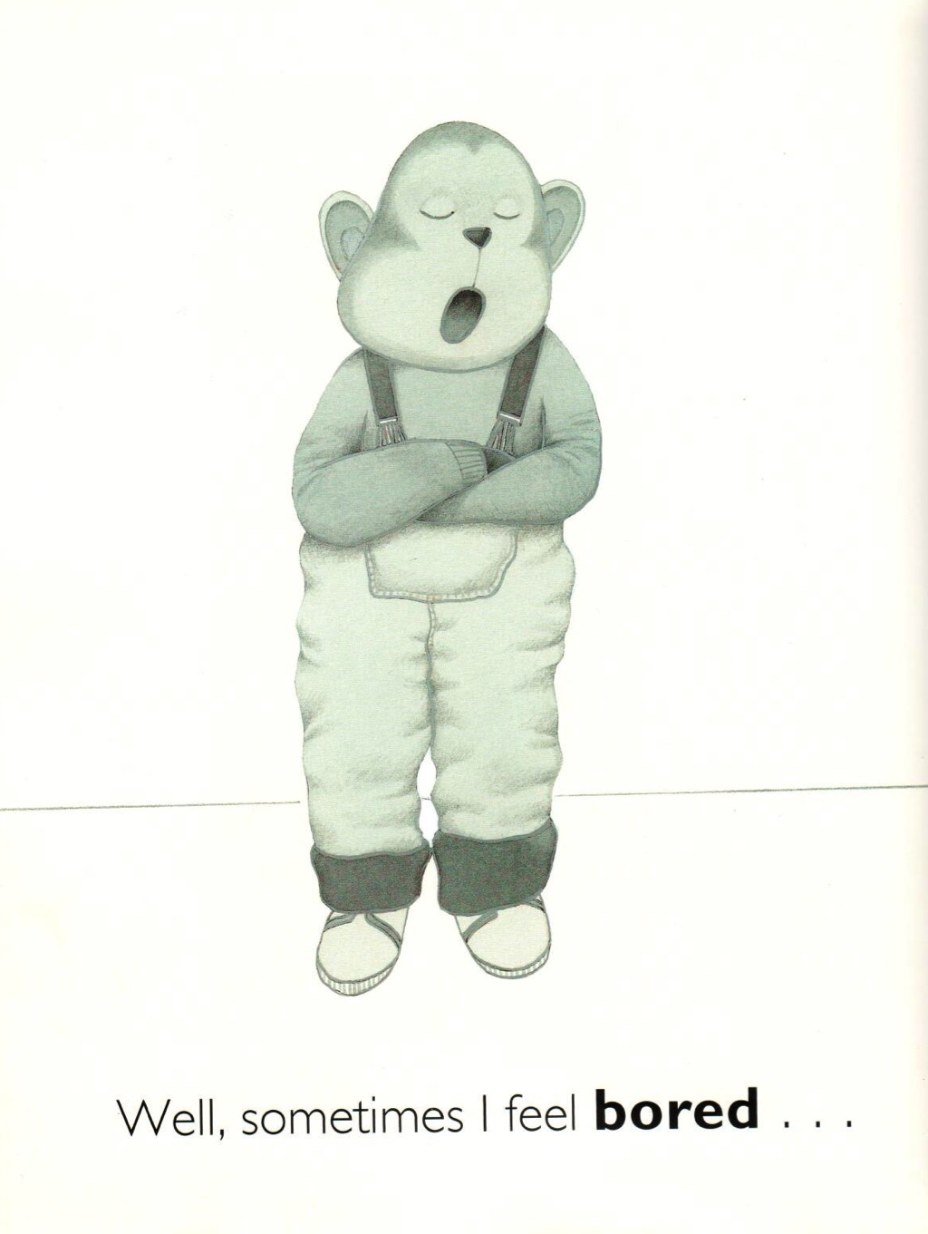

Slide 8
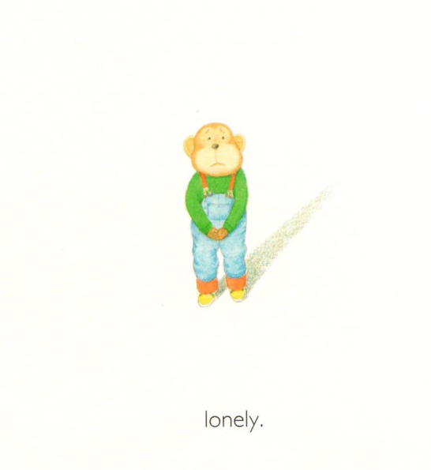

Slide 9
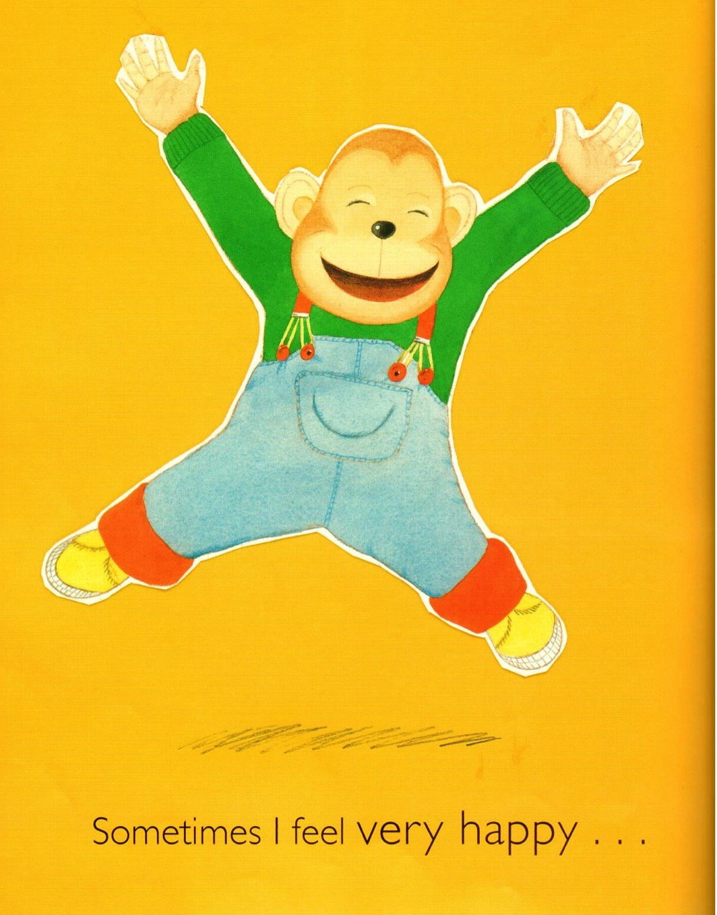

Slide 10


Slide 11
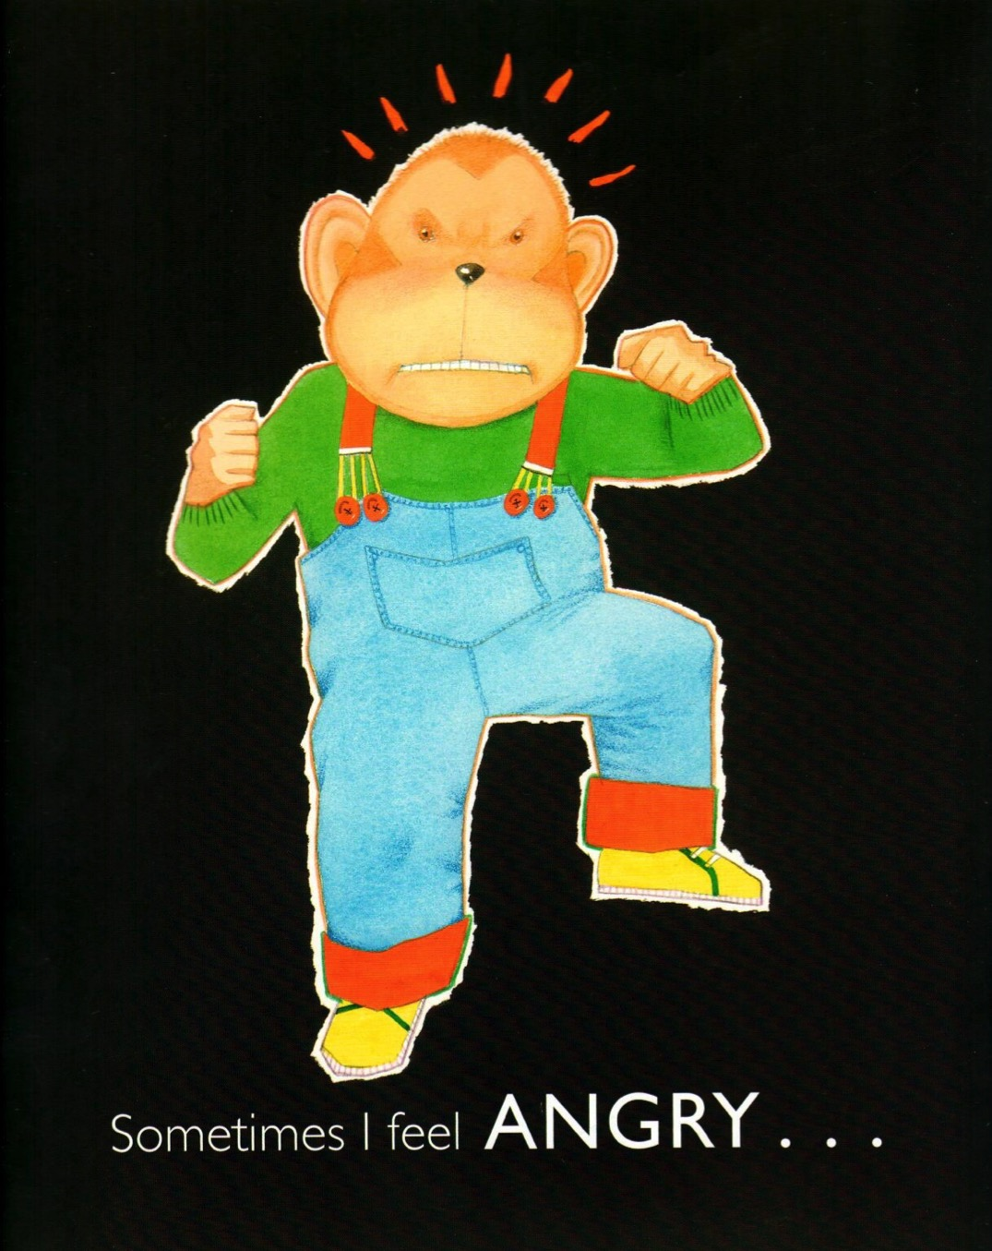

Slide 12
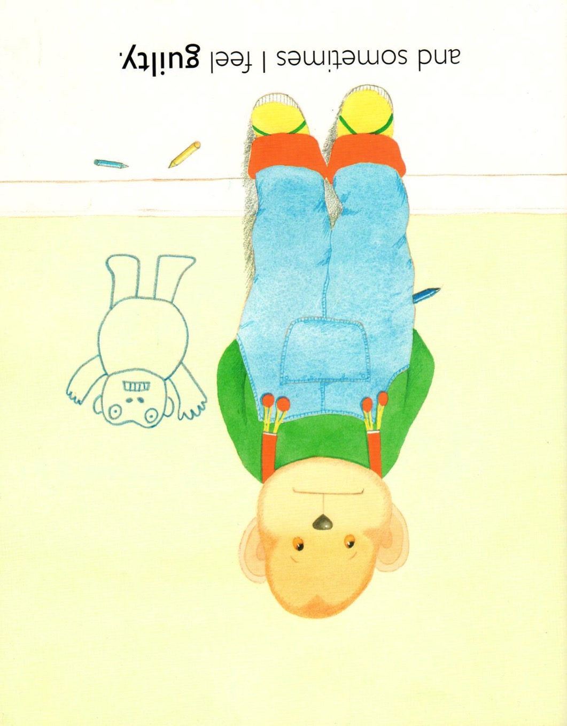

Slide 13


Slide 14
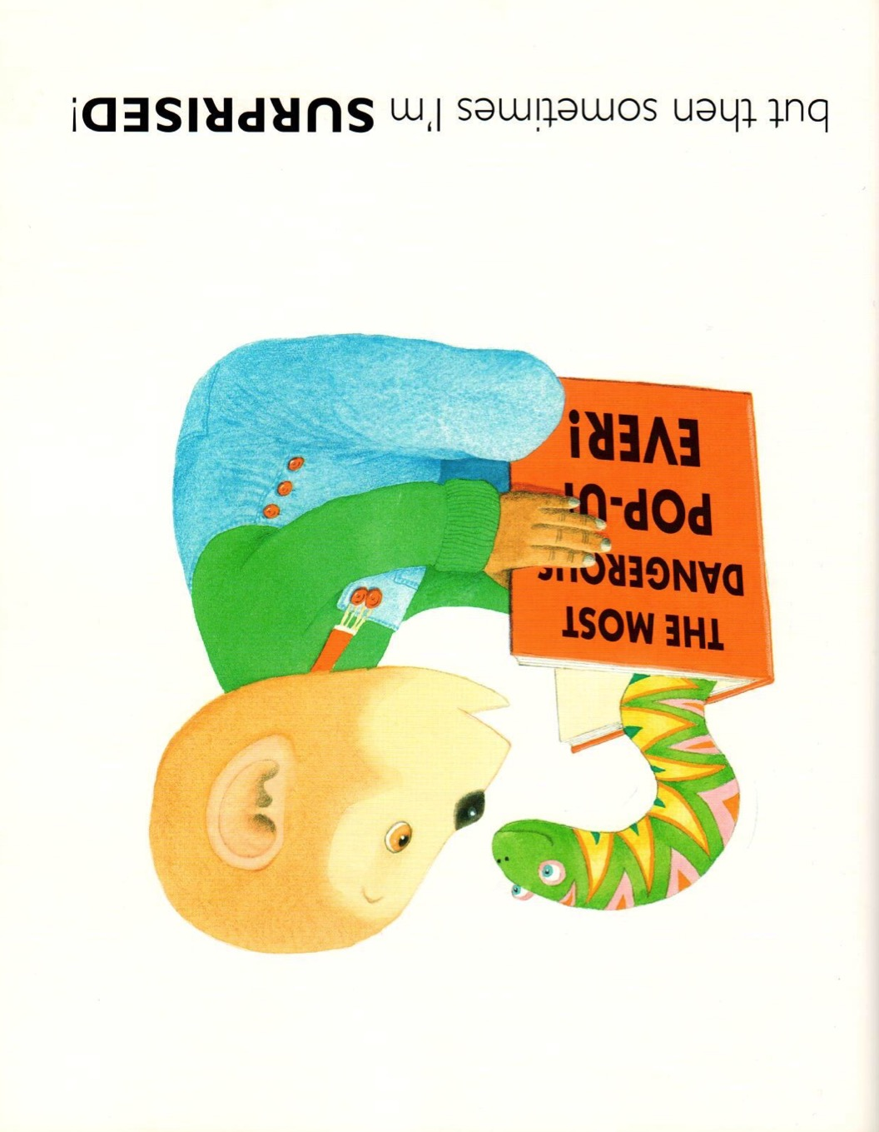

Slide 15
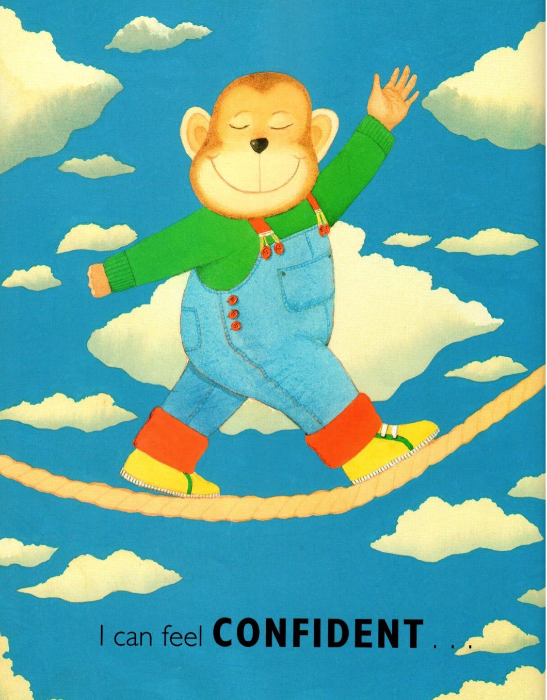

Slide 16
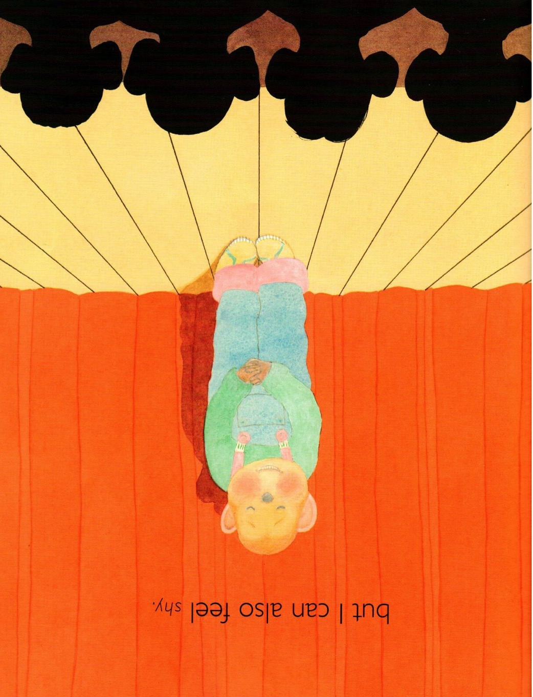

Slide 17
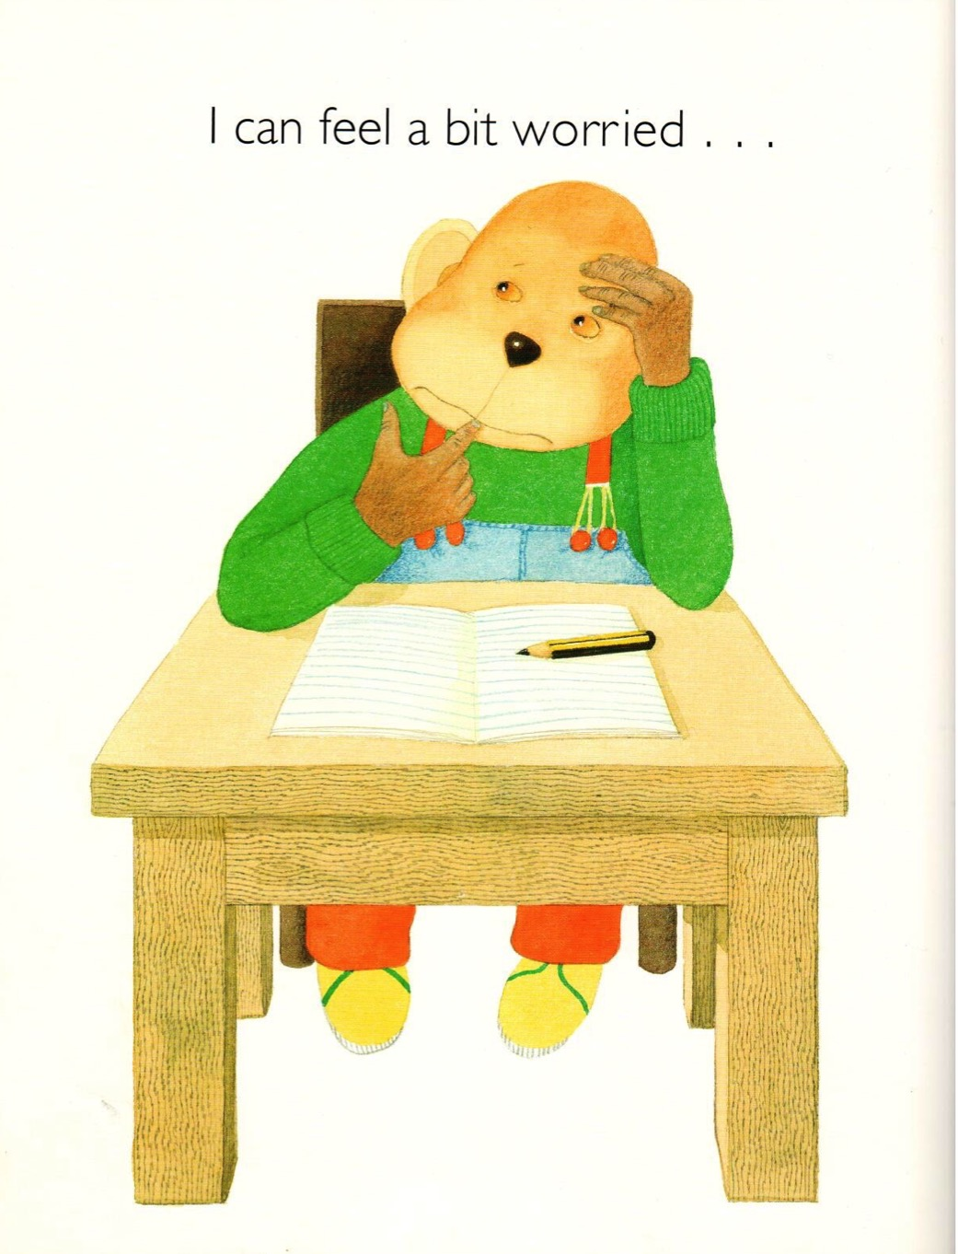

Slide 18
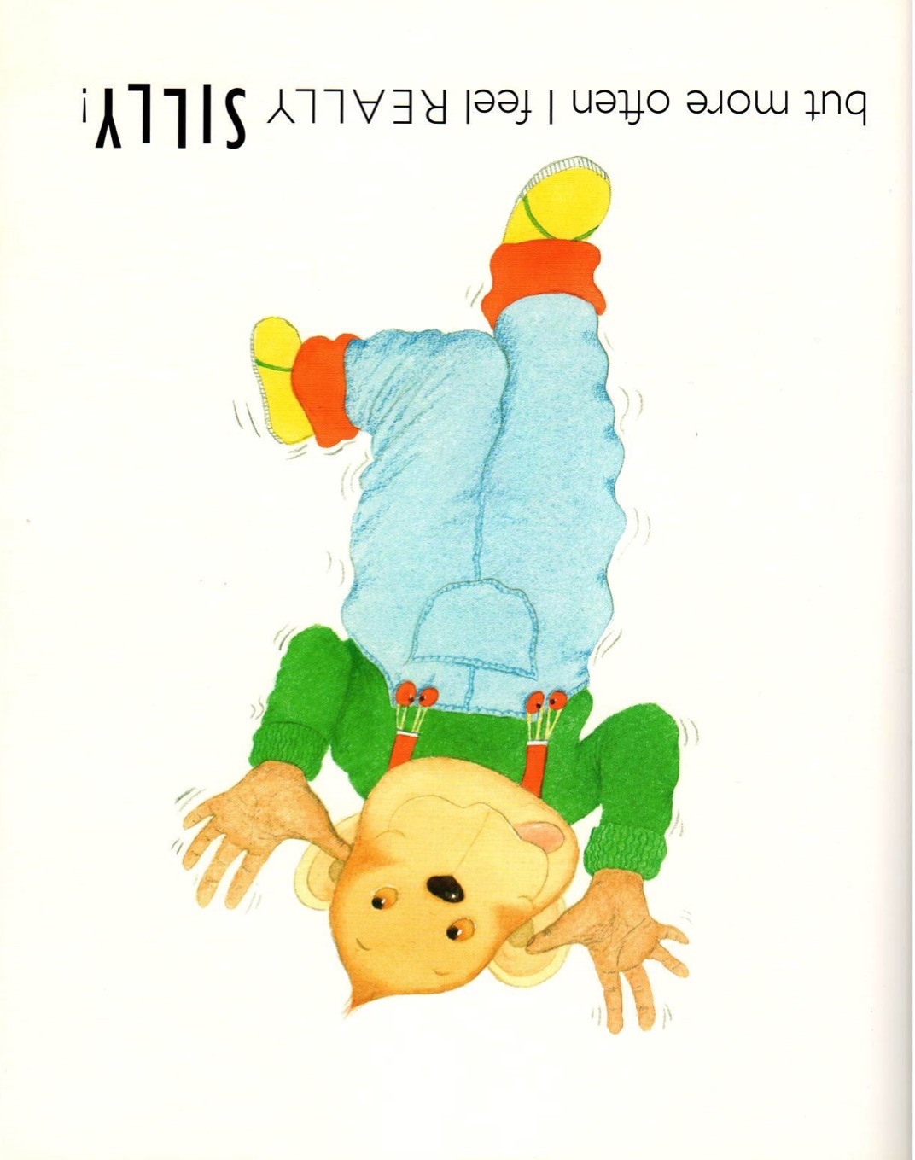

Slide 19

Where are we going today?
Notes:
Play the ‘where are we going today?’ video. They can guess where they will be going.
Have the students talk about the picture, there are books and children all holding hands. The students are learning about places all over the world!

Slide 20
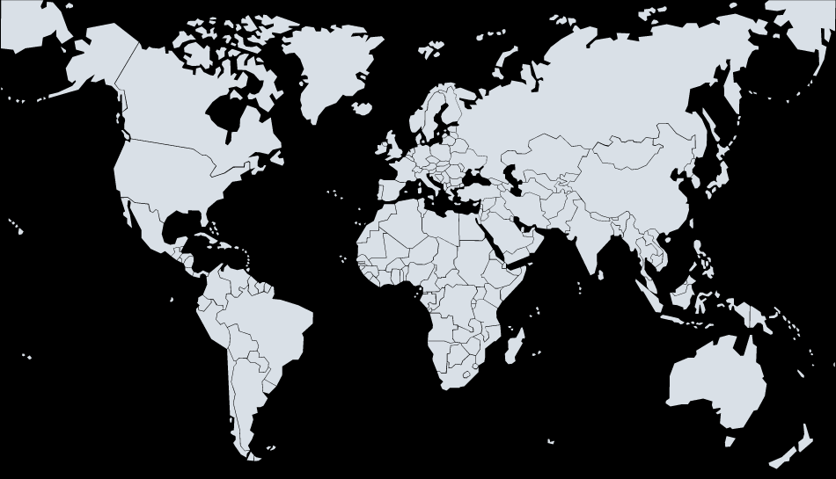



We are going to Costa Rica!
Notes:
We are going to Costa Rica! Have the students talk about how far away Costa Rica is from China, they can also talk about the size difference in the countries. You can also ask the students to tell you what colours the flags are. Ask them if they know anything about Costa Rica!

Slide 21

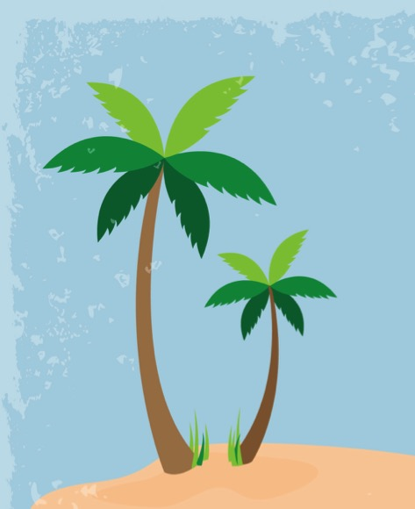
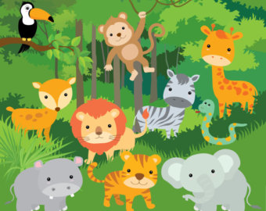
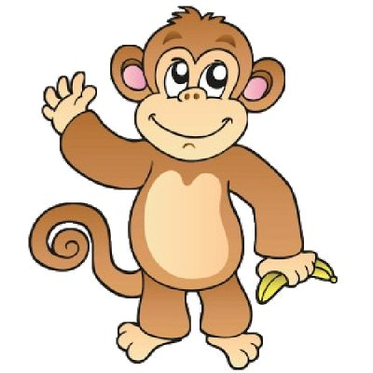
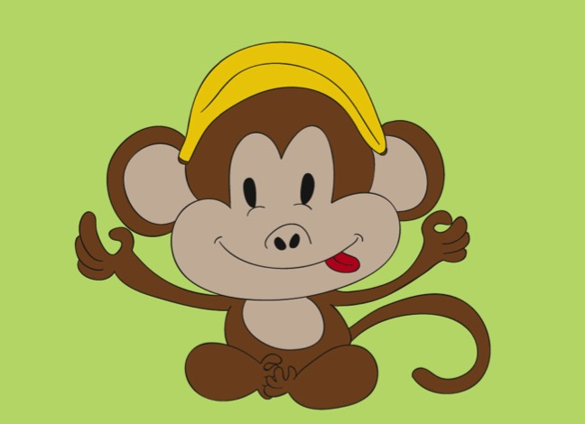
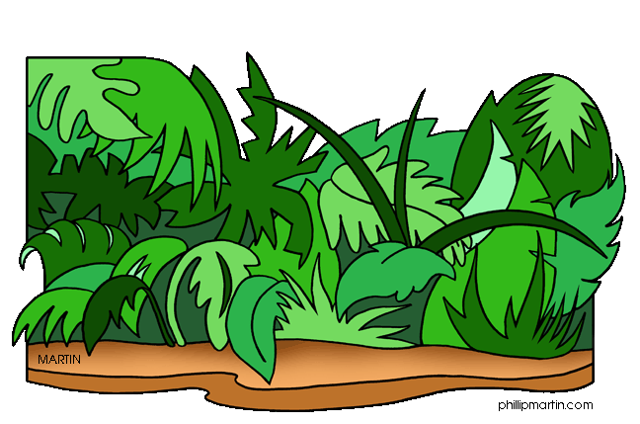
Jungle of Costa Rica!
Notes:
We are going to the jungle in Costa Rica! Have the students point out what they see in this image. Have them circle key words and write them down on the board as well. Have them circle things like specific animals and have them tell you about the forest and about how green the environment is!

Slide 22

Today’s letters! -> ‘PP’
Notes:
Todays letters are pp, see if they know any words that have the letters’ pp’ in it. Write these words down on the whiteboard. Have the students sound out the letters.

Slide 23

What is that sound?
Listen closely and see if you know what the sound is!
Notes:
Find the movie clip “Flippers” and play it for the students. It is a blank image so that the students can only hear the water splashing and not see it. Have the students guess before showing them the next slide.

Slide 24
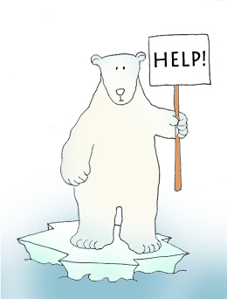


Final Thoughts
Do you have any questions?
Do you understand the handout?
Notes:
Wrap up your lesson and play the extra activities if you have any time. Answer any questions and pull up the worksheet if you want and go over the activities with them to ensure they understand.

Slide 25

Before the next class
Listen and read along with the ‘How do you feel’ book
Read book to yourself and to your family/friends
Complete the worksheet
Practice writing new vocabulary words
Notes:
You can read these goals to them or have them read the goals if they can.
Underlining sentences and asking students to read one sentence at a time works well.

