Slide 1
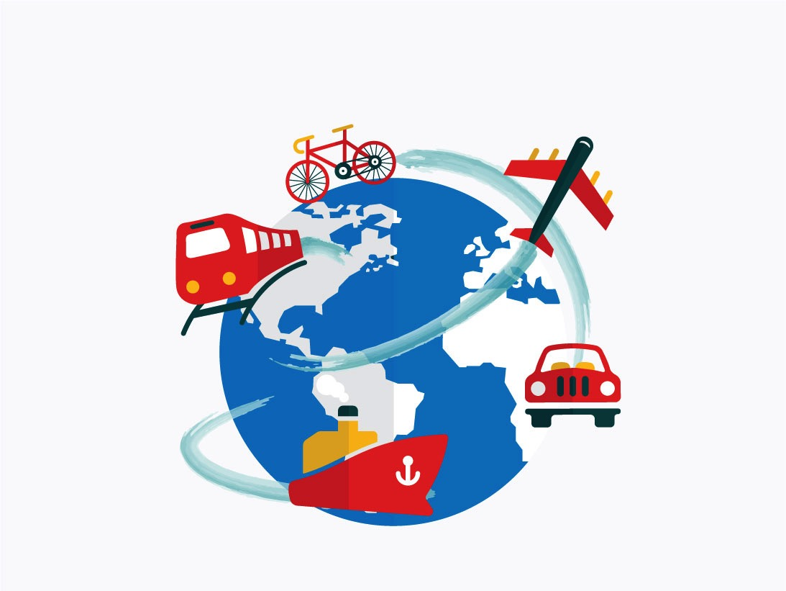

Adventures!

Slide 2
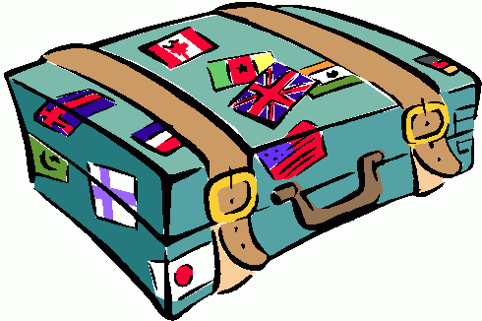
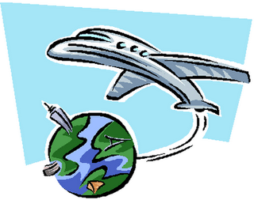
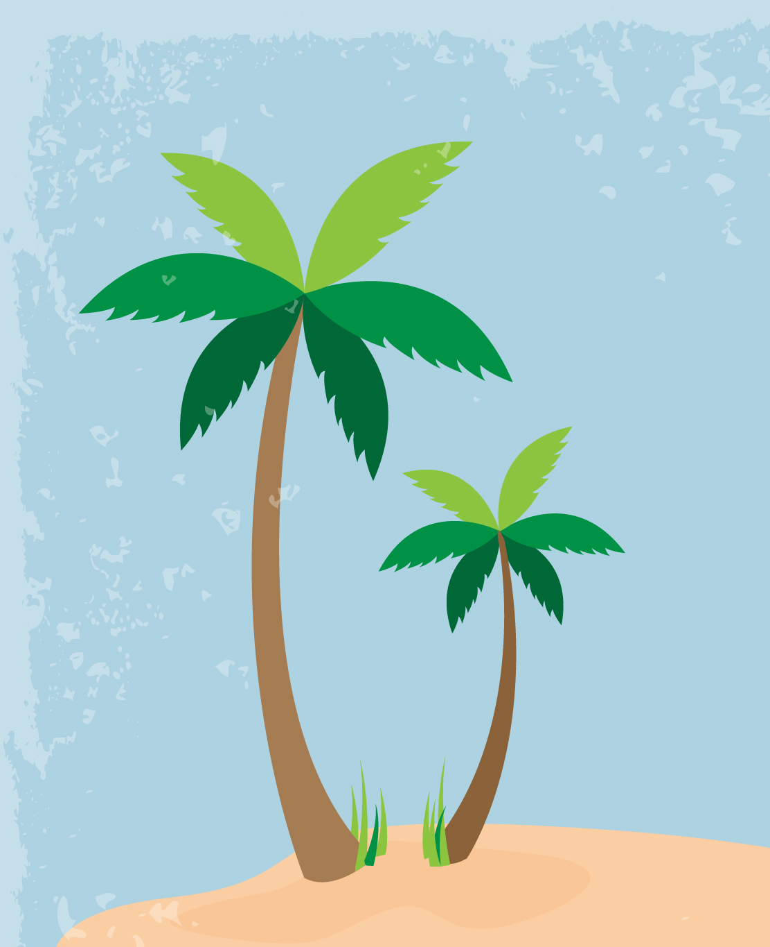
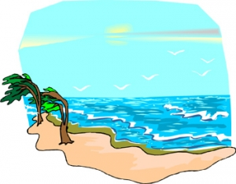
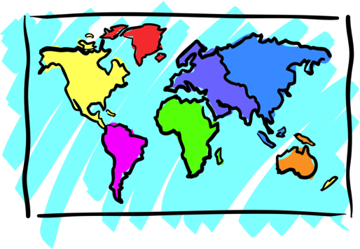

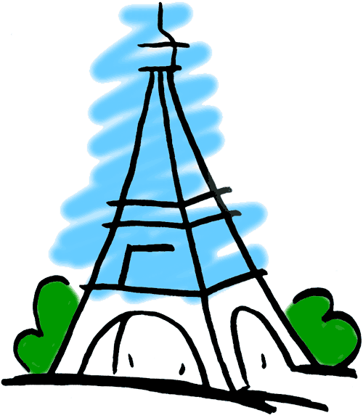
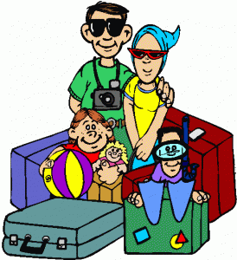
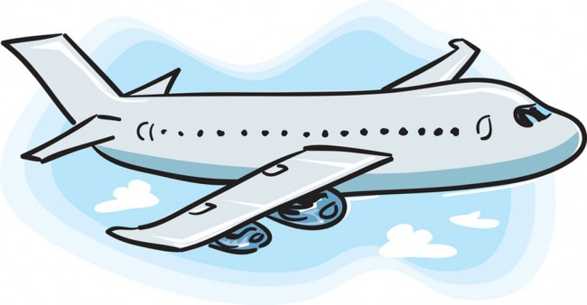
Adventures

Slide 3



What will I learn today?
Use simple dictionaries
Word Banks
Word Walls
Sound of the letters ‘nn’
Notes:
Have the students read out the learning goals for the day.
Congratulate them!

Slide 4
Story Time!
Where are we going today ?!
Notes:
You can ask the students where they think they are going today.

Slide 5
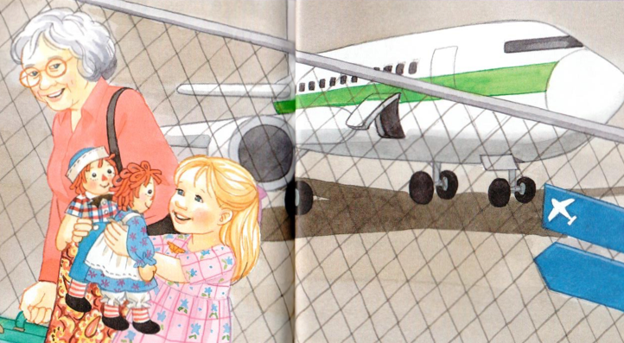
We are going to Grandma’s House!
Notes:
Have the students read where they are going, or you can read it for them
Have the students circle things in the picture with their pens such as the dolls, the grandmother or the girl.
You can ask the students prompting questions such as “How did the girl get to her grandmothers house?”
Once you play the “where are we going” video, play the video of the airplane taking off. Once the airplane takes off and the video ends, ask questions such as “where are we going?” the students should reply with “to Grandma’s house!”.

Slide 6

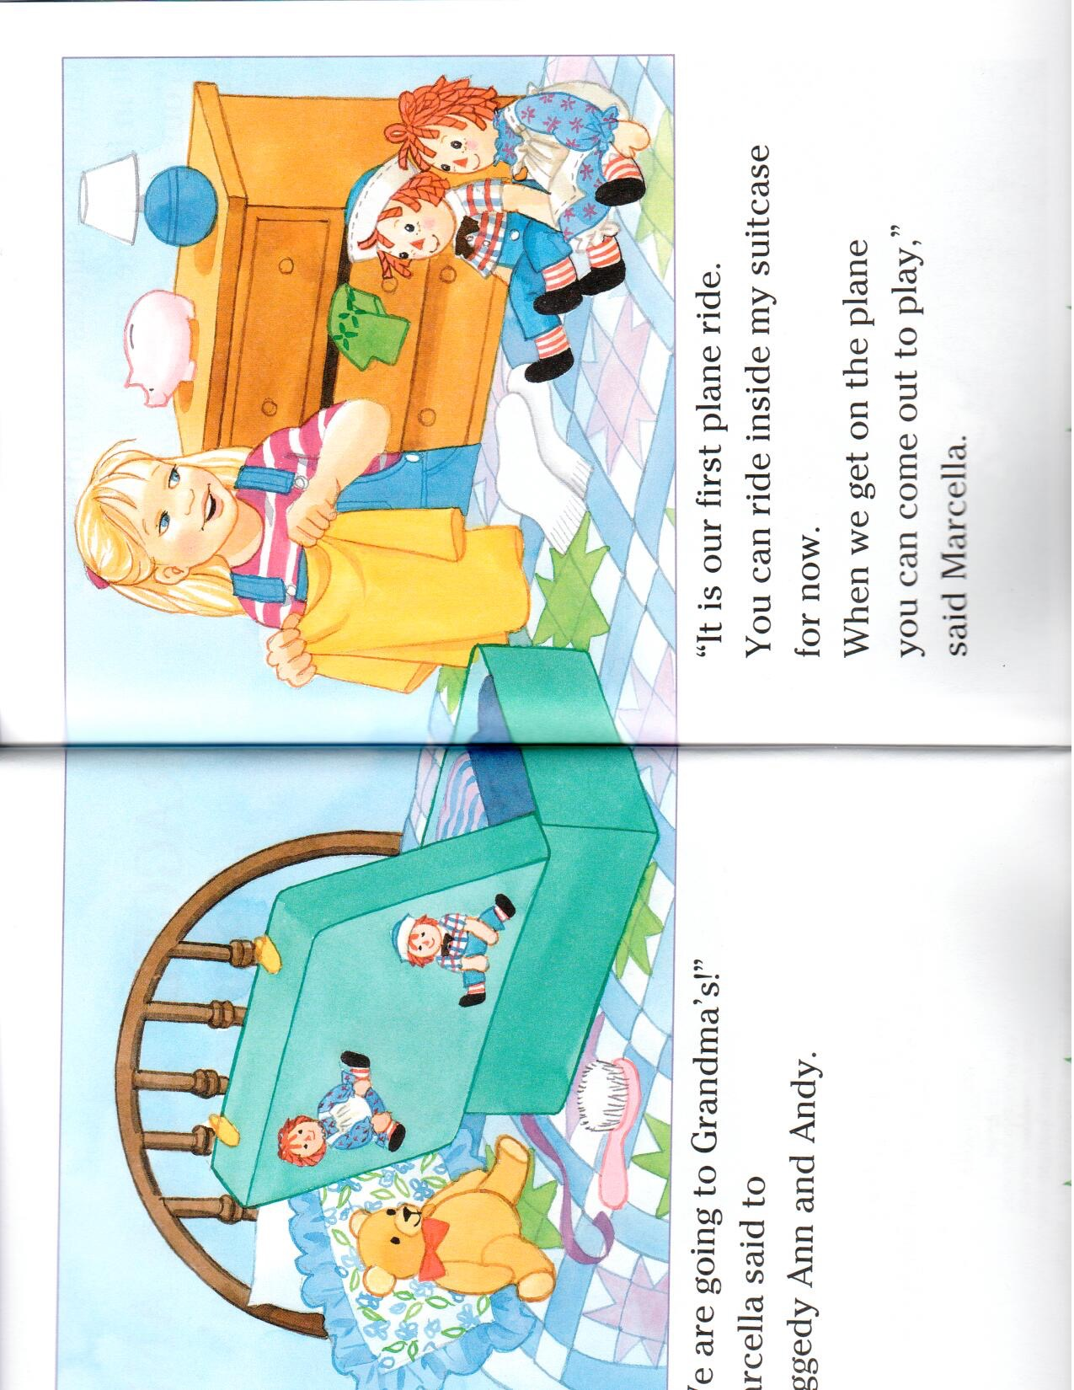

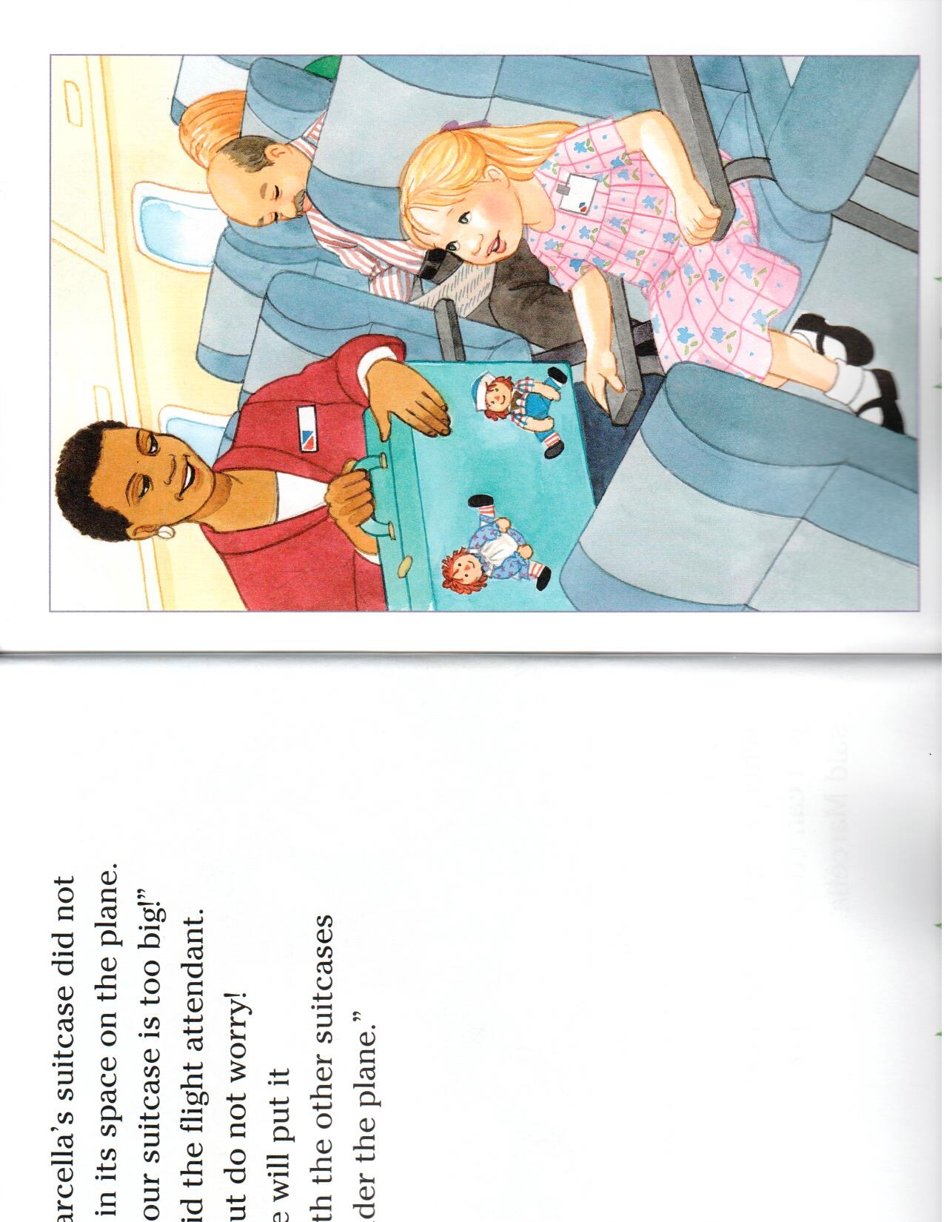

New Words
Raggedy Ann and Andy
They are dolls !
Flight Attendant
She helps people stay safe on the plane
Marcella
The girl in the story visiting her Grandma
Notes:
Point out the key words from the story. The words above may be new words for them.Read their definitions you can also write them in a sentence.

Slide 7

Raggedy Ann and Andy
Visiting Grandma!

Slide 8
“We are going to Grandma’s!”
Marcella said to her dolls.
“It is our first plane ride!” said Marcella.
Notes:
Have the students either help you read the story of read it to them. Have the students circle key things in the picture such as “can you circle the dolls for me’, ‘can you circle something that is pink?”

Slide 9
‘Your suitcase is too big!”
said the flight attendant.
“But do not worry,
we will put it with the
other suitcases under
the plane!”

Slide 10
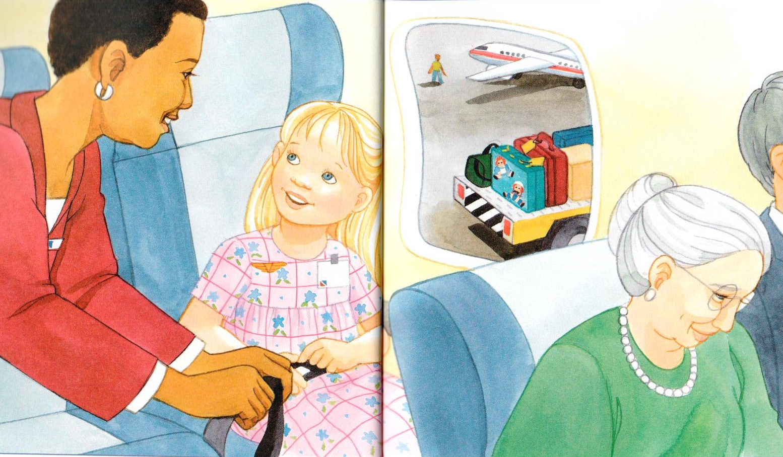
It was time for take-off so
Marcella sat down.
“I am going to Grandma’s”
she said. She was
very excited.

Slide 11
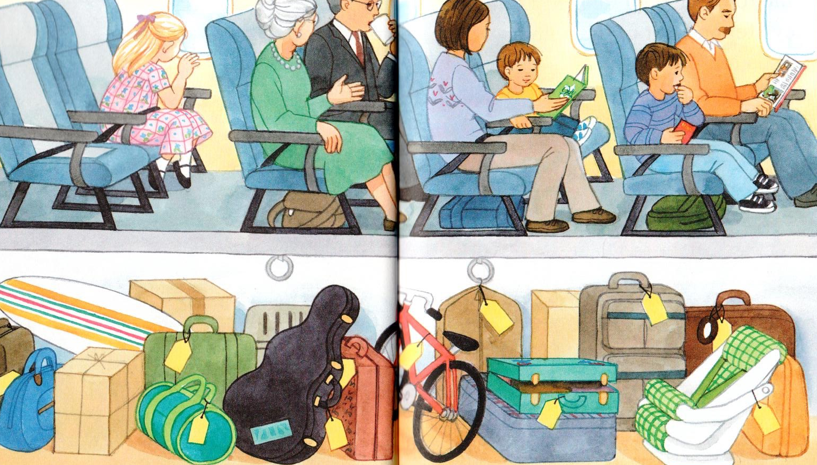
“Everything is so small!” said Marcella. “Is that my house?”
Marcella was having a lot of fun. She did not miss her dolls.
Notes:
Make note that Marcella’s suitcase is open... where could the dolls be? Have the students tell you what else they see in the airplane and ask if they know what the yellow tags are on all of the luggage. You can also have them circle different things for you such as a green suitcase.

Slide 12
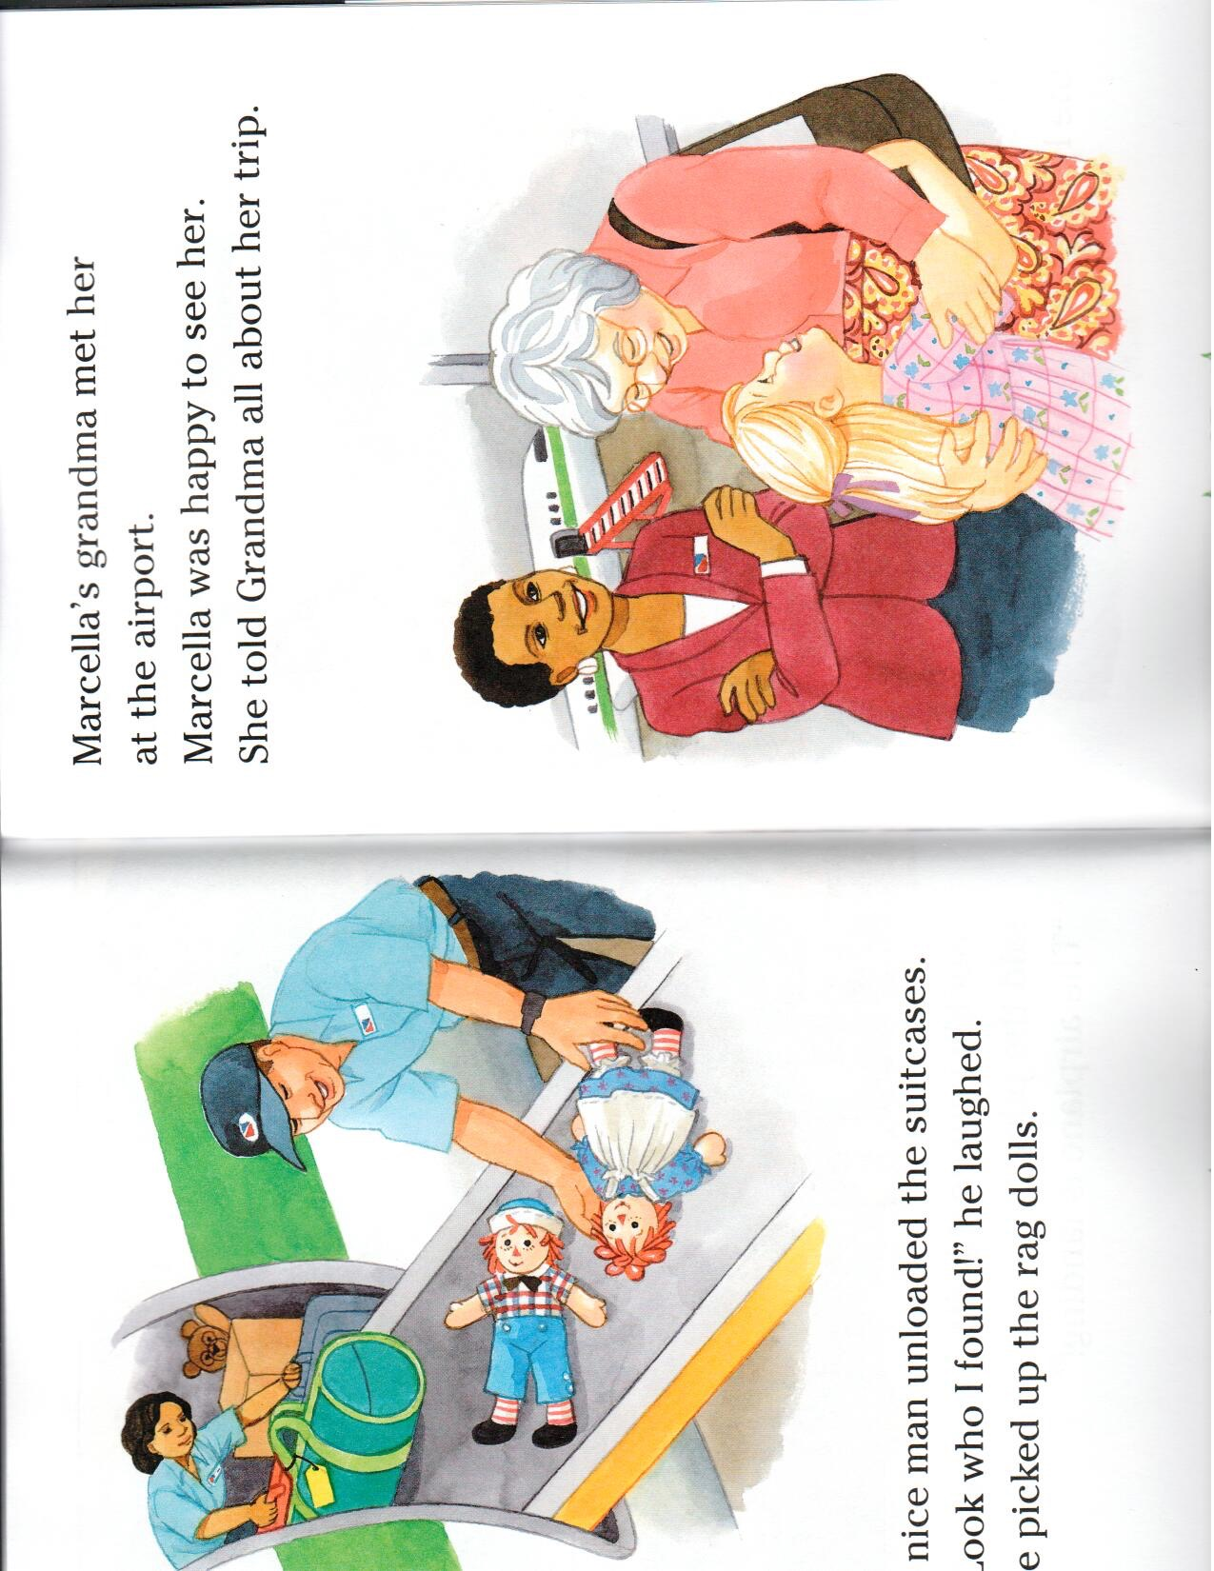
“Look who I found!” nice man said.
The plane landed. Marcella told her Grandma all about her trip!

Slide 13
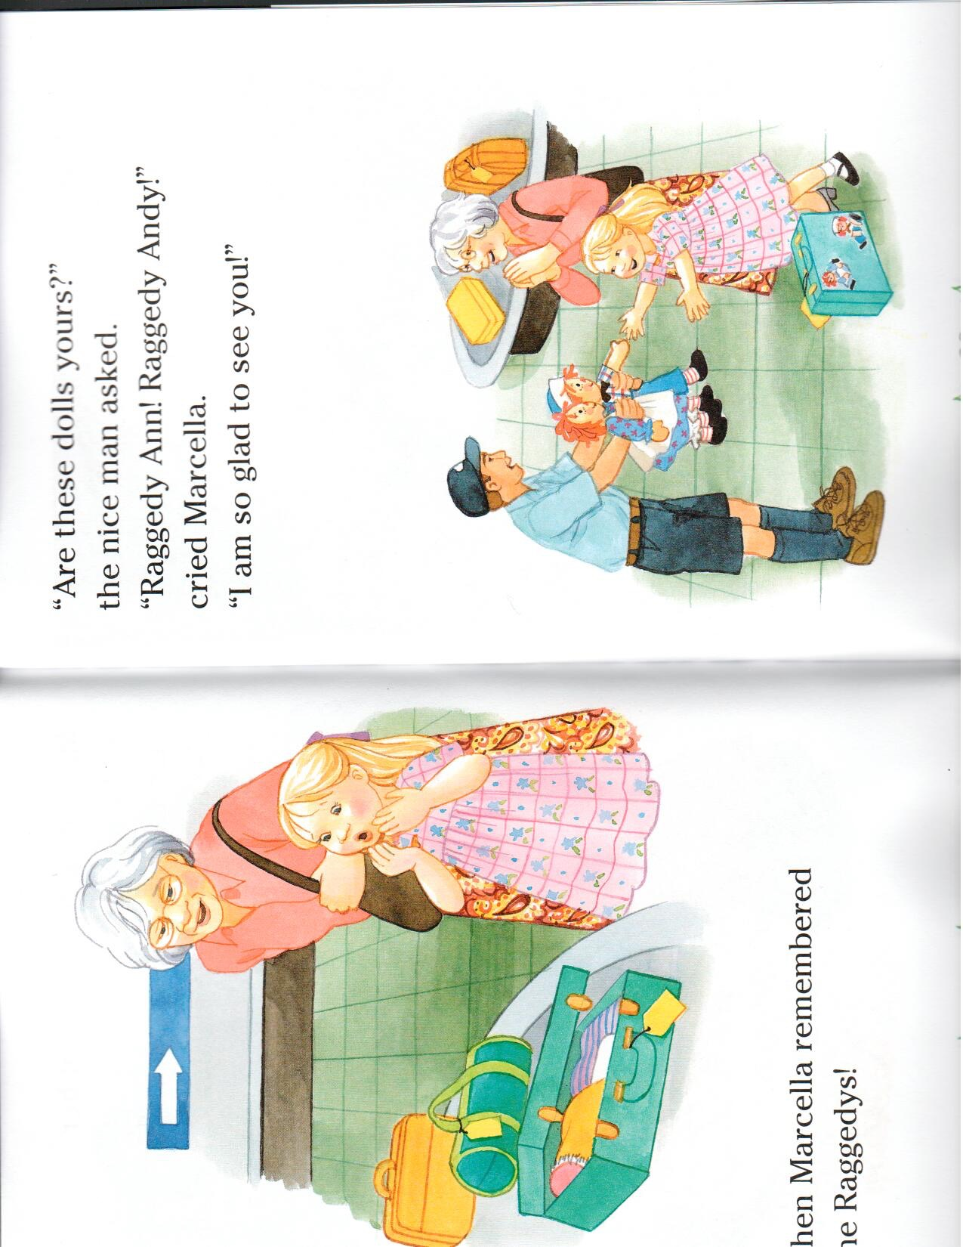
Then Marcella remembered the Raggedy’s
“Are these dolls yours?” the nice man asked.
“Yes!” cried Marcella. “I am so glad to see you!” Marcella hugged her dolls.

Slide 14
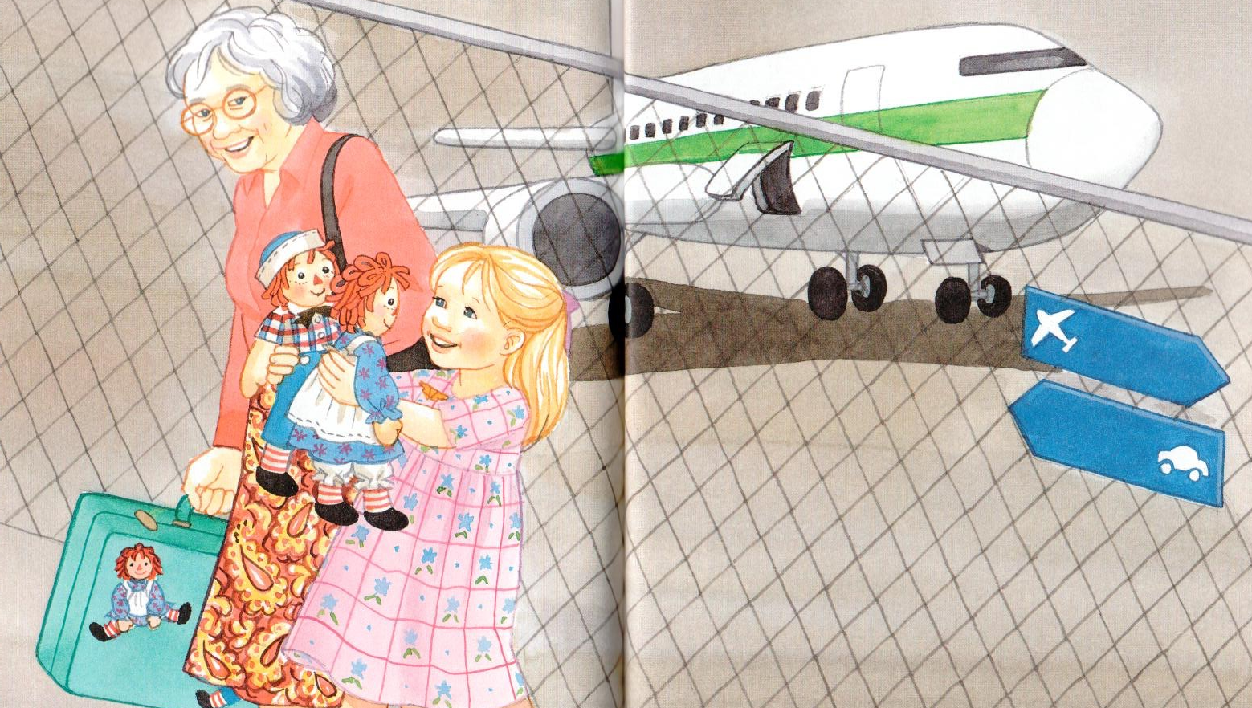
“I am sorry you fell out of my suitcase,” Marcella said.
“I hope you did not miss me.”

Slide 15
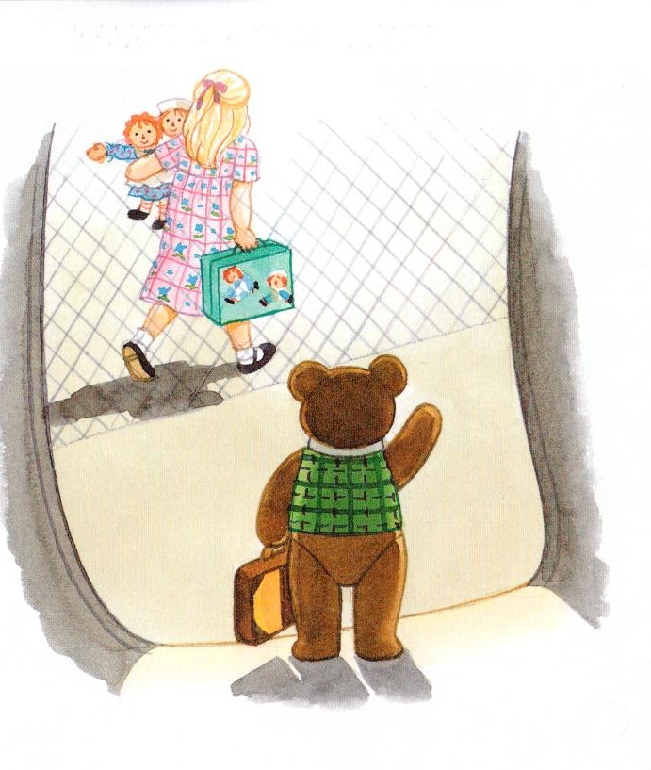
Raggedy Ann and Andy just smiled. Because everyone knows that rag dolls do not talk!

Slide 16
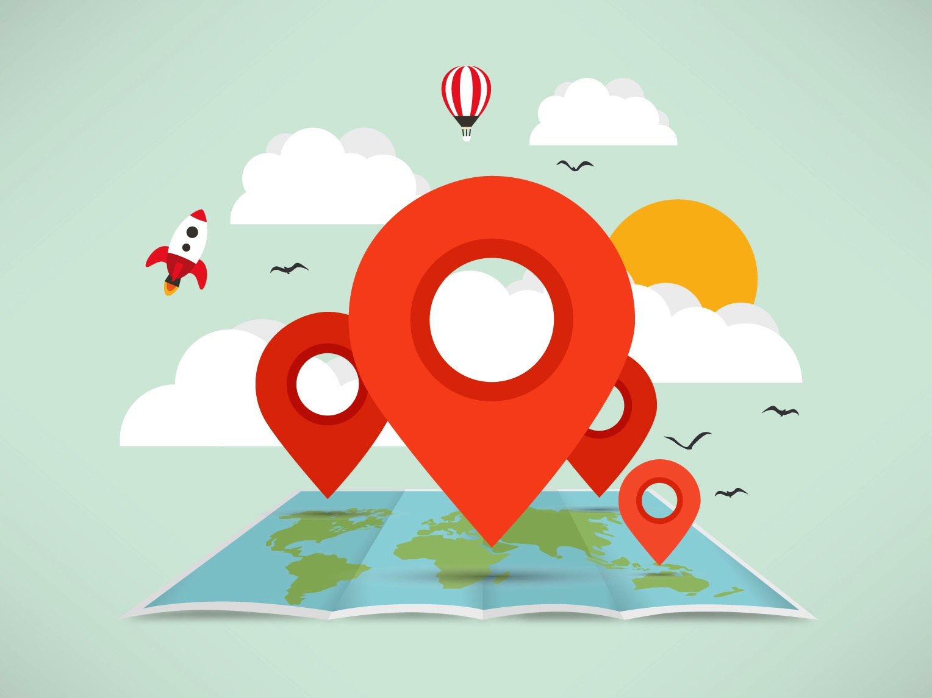
Where are we going today?
Notes:
Let the students know that each lesson they will be going on a trip with you! After showing this slide, play the ‘Where are we going today?” video clip for the students. Talk about airplanes and if they would be scared or excited to go on an airplane.

Slide 17

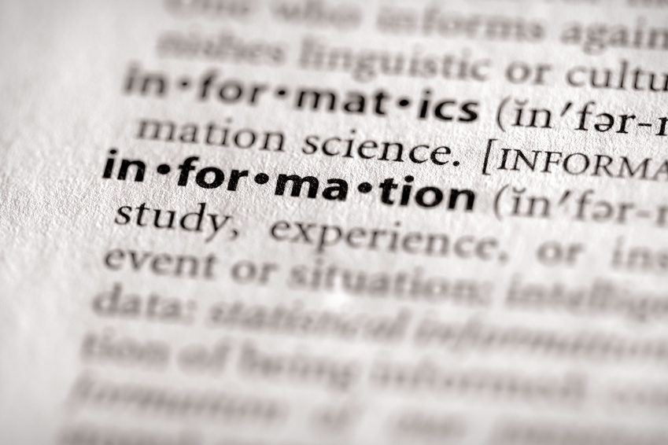
Using a dictionary
What is a dictionary?
A dictionary is a book that helps you understand words.
Notes:
Introduce dictionaries in this portion, see if they already know what this is and if they know how to use one.

Slide 18
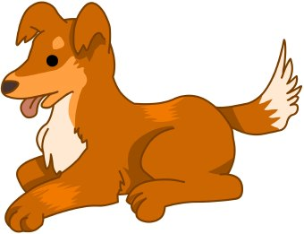
Using a dictionary
Dog:
An animal with fur, four legs
and a tail.
People keep them as pets.
Notes:
This is an example of a simple dictionary about what a dog is.

Slide 19

Today’s letters! -> ‘NN’
Notes:
Talk about the ‘nn’ sound and have them try it out. Write the other ‘nn’ words the students can think of on the whiteboard for them so that they know how to spell it. Have them sound the word out as well.
bandanna etc ..

Slide 20

What is that sound?
Listen closely and see if you know what the sound is!
Notes:
Find the movie clip “Flippers” and play it for the students. It is a blank image so that the students can only hear the water splashing and not see it. Have the students guess before showing them the next slide.

Slide 21
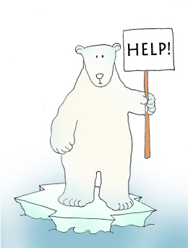


Final Thoughts
Do you have any questions?
Do you understand the handout?
Notes:
Wrap up your lesson and play the extra activities if you have any time. Answer any questions and pull up the worksheet if you want and go over the activities with them to ensure they understand.

Slide 22

Before the next class
Listen and read along with the ‘Raggedy Ann and Andy’ book
Read book to yourself and to your family/friends
Complete the worksheet
Practice writing new vocabulary words
Notes:
You can read these goals to them or have them read the goals if they can.
Underlining sentences and asking students to read one sentence at a time works well.
This is where you let the students know what they should be doing between now and their next session with you, you can tell them to read the story on their own and then to their family members as well as practicing the new vocab words.

