Slide 1
Adventures!

Slide 2
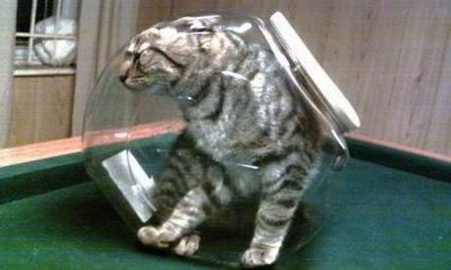
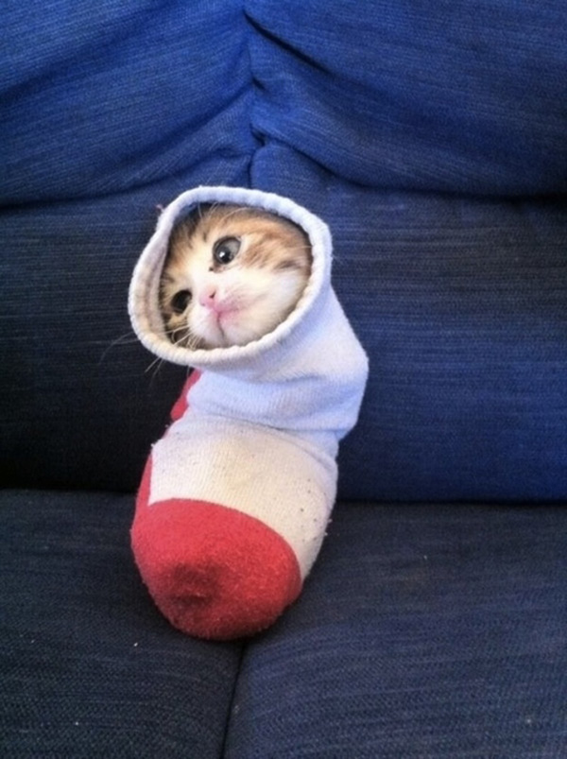
Notes:
What’s going on?” <- each lesson in this unit will have a section called Whats going on in the beginning to stimulate conversation and break the ice before class begins! Make your pen colour white and draw all of the key words on the board that the students come up with when they are describing or talking about the picture.

Slide 3
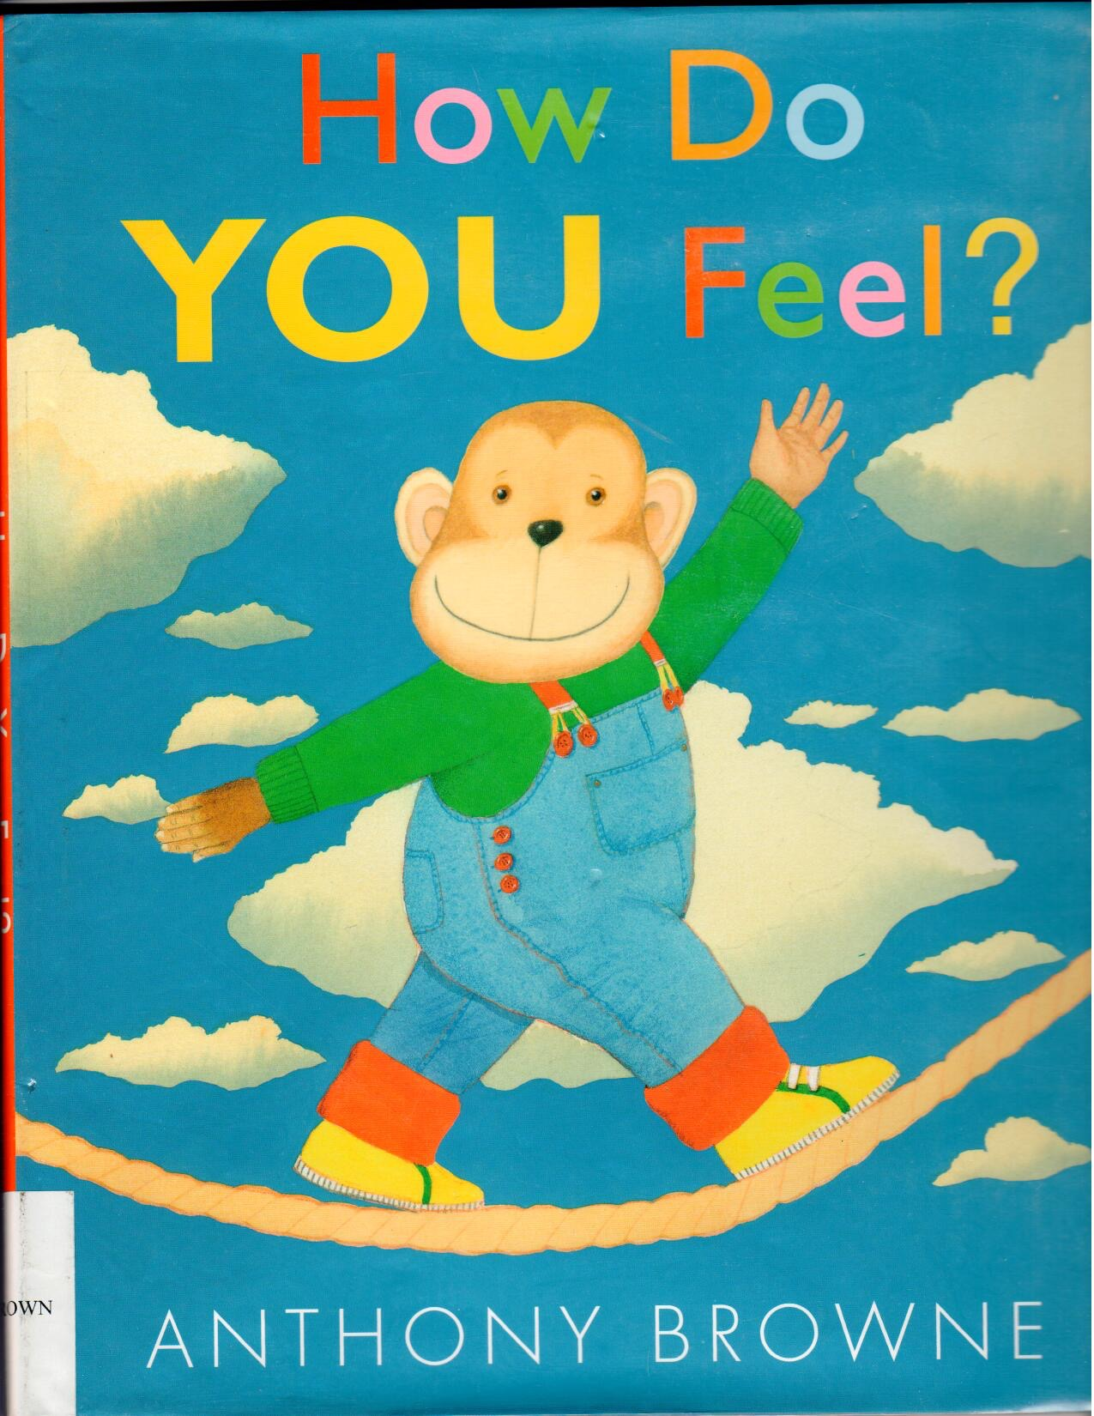
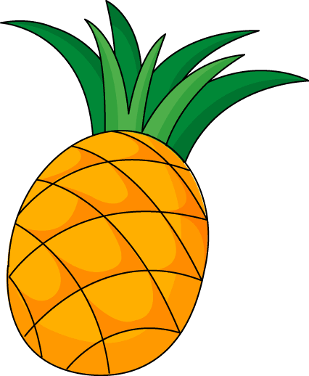
What did I learn last class?
Complete short closed sentences
Use present tense
The ‘pp’ sound
Notes:
Have the students read the goals if they can. I find that underlining sentences and asking students to read one sentence at a time works well.

Slide 4
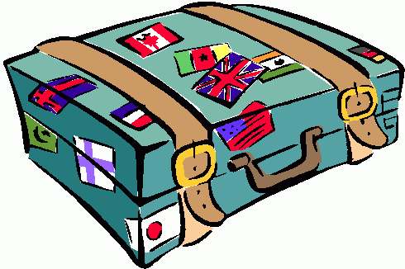
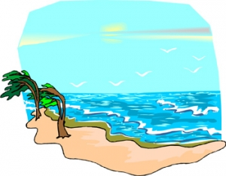
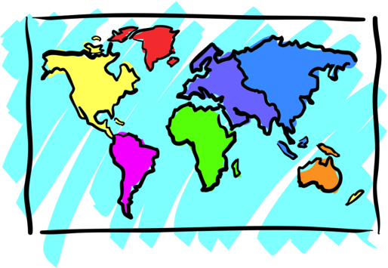
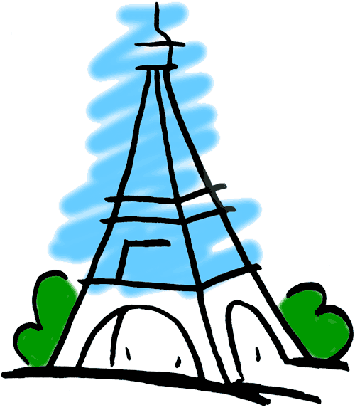
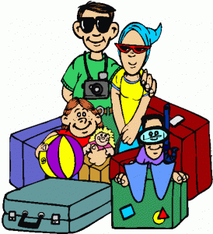
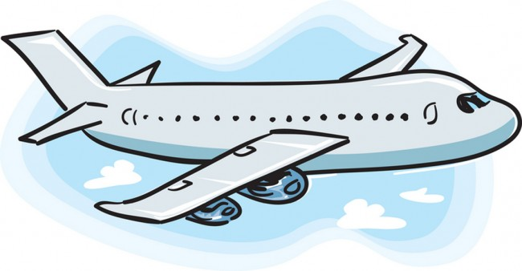
Adventures

Slide 5
What will I learn today?
Use simple dictionaries
Word Banks
Word Walls
Sound of the letters ‘nn’
Notes:
Have the students read out the learning goals for the day.
Congratulate them!

Slide 6
Story Time!
Where are we going today ?!
Notes:
You can ask the students where they think they are going today.

Slide 7
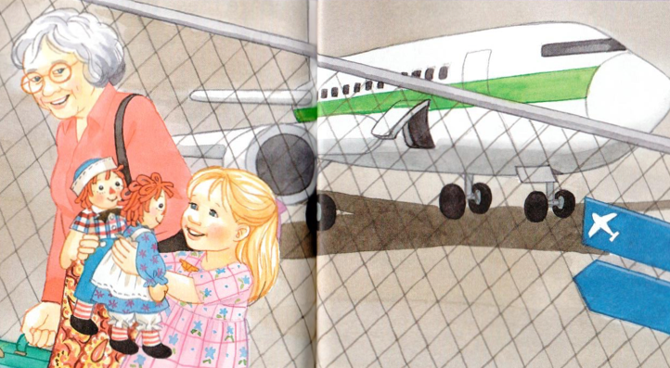
We are going to Grandma’s House!
Notes:
Have the students read where they are going, or you can read it for them
Have the students circle things in the picture with their pens such as the dolls, the grandmother or the girl.
You can ask the students prompting questions such as “How did the girl get to her grandmothers house?”
Once you play the “where are we going” video, play the video of the airplane taking off. Once the airplane takes off and the video ends, ask questions such as “where are we going?” the students should reply with “to Grandma’s house!”.

Slide 8
New Words
Raggedy Ann and Andy
They are dolls !
Flight Attendant
She helps people stay safe on the plane
Marcella
The girl in the story visiting her Grandma
Notes:
Point out the key words from the story. The words above may be new words for them.Read their definitions you can also write them in a sentence.

Slide 9
Raggedy Ann and Andy
Visiting Grandma!

Slide 10
“We are going to Grandma’s!”
Marcella said to her dolls.
“It is our first plane ride!” said Marcella.
Notes:
Have the students either help you read the story of read it to them. Have the students circle key things in the picture such as “can you circle the dolls for me’, ‘can you circle something that is pink?”

Slide 11
‘Your suitcase is too big!”
said the flight attendant.
“But do not worry,
we will put it with the
other suitcases under
the plane!”

Slide 12
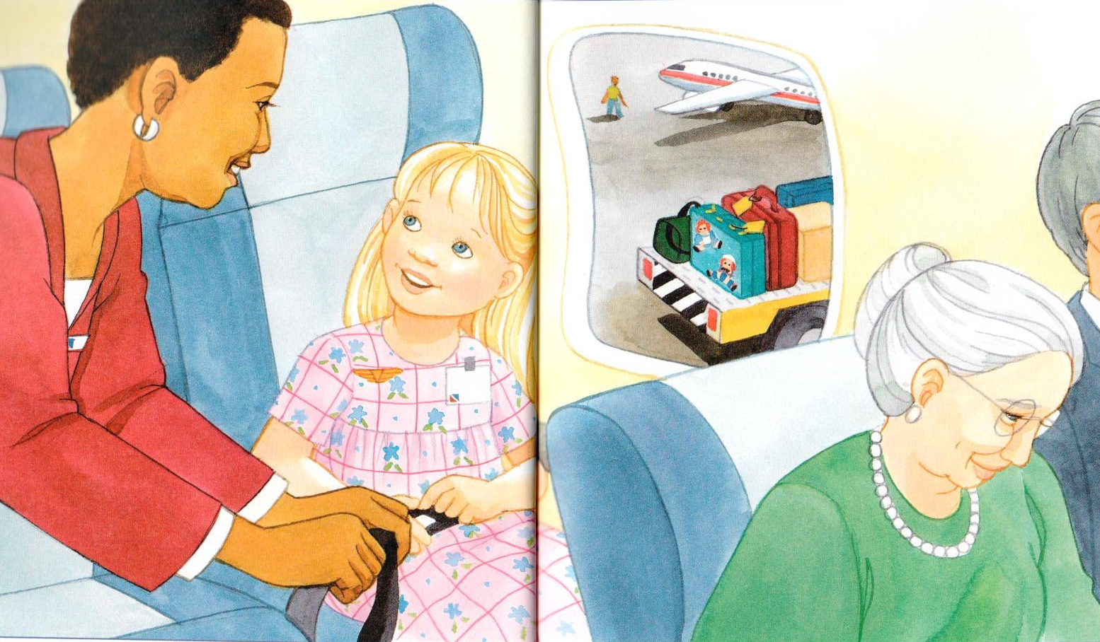
It was time for take-off so
Marcella sat down.
“I am going to Grandma’s”
she said. She was
very excited.

Slide 13
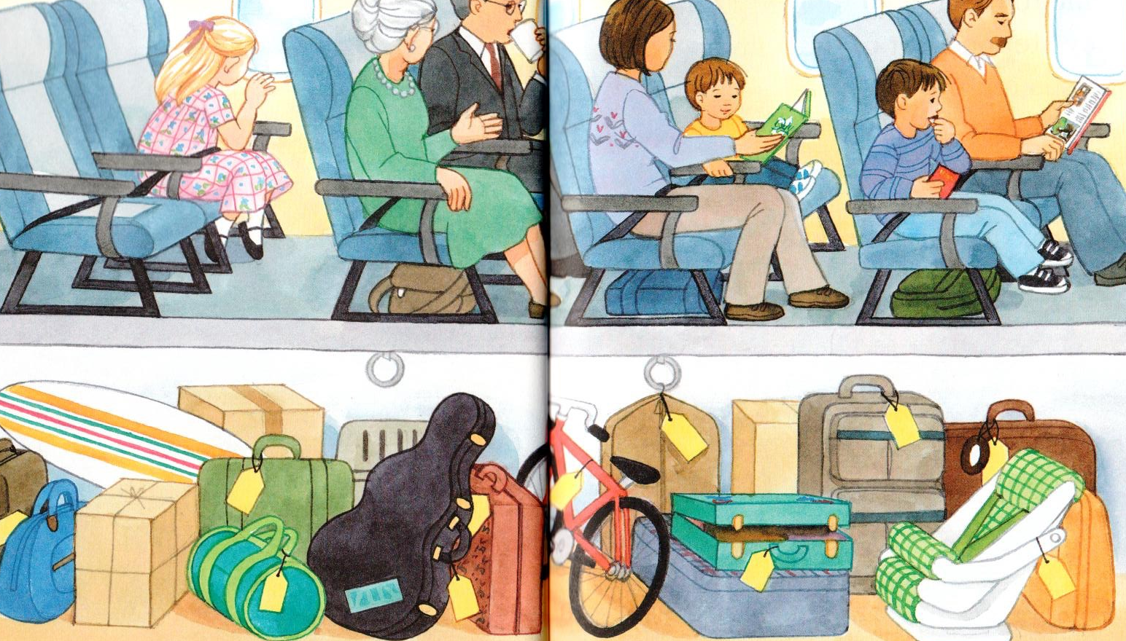
“Everything is so small!” said Marcella. “Is that my house?”
Marcella was having a lot of fun. She did not miss her dolls.
Notes:
Make note that Marcella’s suitcase is open... where could the dolls be? Have the students tell you what else they see in the airplane and ask if they know what the yellow tags are on all of the luggage. You can also have them circle different things for you such as a green suitcase.

Slide 14
“Look who I found!” nice man said.
The plane landed. Marcella told her Grandma all about her trip!

Slide 15
Then Marcella remembered the Raggedy’s
“Are these dolls yours?” the nice man asked.
“Yes!” cried Marcella. “I am so glad to see you!” Marcella hugged her dolls.

Slide 16
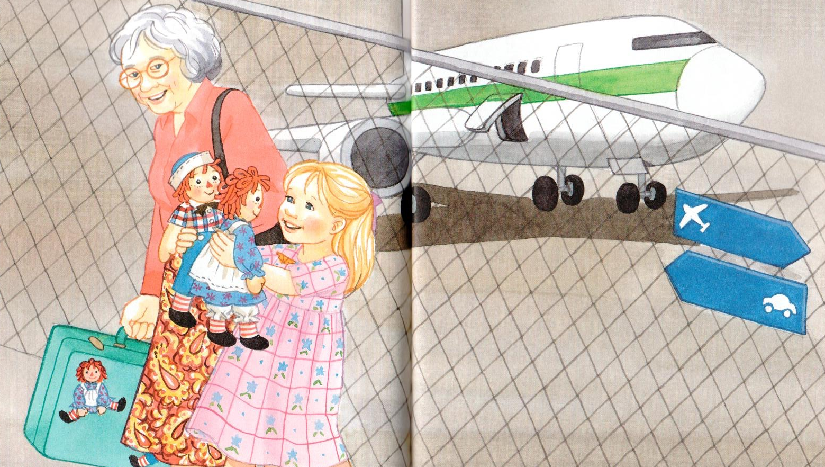
“I am sorry you fell out of my suitcase,” Marcella said.
“I hope you did not miss me.”

Slide 17
Raggedy Ann and Andy just smiled. Because everyone knows that rag dolls do not talk!

Slide 18
Marcella’s Trip!
Suitcase
Airplanes
Ra_ _ edy A_ n
T_ck_t
Notes:
Take this moment to Brainstorm about key events from Marcella’s trip, you can talk about the airport, the Raggedy’s, suitcases, visiting Grandma etc.. There are a few examples already on the board. There are also a couple of fill in the blanks which are Ticket and Raggedy Ann
Write down the answers on the whiteboard or have the students write it in on their own, ensure that they are able to annotate on the whiteboard!

Slide 19
Marcella’s Trip!
Complete the sentences using the correct word from the story
fly airplanes
Example:
eat
swim
play with my dolls
I like to ______________________ .
Notes:
Have the students choose the correct word from the story. On this slide a few options may work, see what the students answer and either write it in or have the students write the answer in.

Slide 20
Grandma’s
play
“We are going to ____________!”
Marcella said to her dolls.
eat
sleep
Notes:
Be mindful during each of these slides, to have the students talk about what happened at this point in the story and if they remember who they key characters are!

Slide 21
Grandma’s
“We are going to ____________!”
Marcella said to her dolls.
Notes:
Be mindful during each of these slides, to have the students talk about what happened at this point in the story and if they remember who they key characters are!

Slide 22
It is Marcella’s first
________________ ride.
car
airplane
helicopter
spaceship

Slide 23
It is Marcella’s first
________________ ride.
airplane

Slide 24
big
colourful
“Everything is so ________!” said Marcella. “Is that my house?”
smelly
small

Slide 25
“Everything is so ________!” said Marcella. “Is that my house?”
small

Slide 26
“Are these your __________?” the nice man asked.
dolls
candies
hands
suitcases

Slide 27
“Are these your __________?” the nice man asked.
dolls

Slide 28
“I’m sorry you fell out of my
______________ !” cried Marcella.
hands
suitcase
car
lap

Slide 29
“I’m sorry you fell out of my
______________ !” cried Marcella.
suitcase

Slide 30
What did I just learn?
Word Banks
Word Walls
Notes:
have the students read out the learning goals they have just completed.
Congratulate them!

Slide 31
Where are we going today?
Notes:
Let the students know that each lesson they will be going on a trip with you! After showing this slide, play the ‘Where are we going today?” video clip for the students. Talk about airplanes and if they would be scared or excited to go on an airplane.

Slide 32
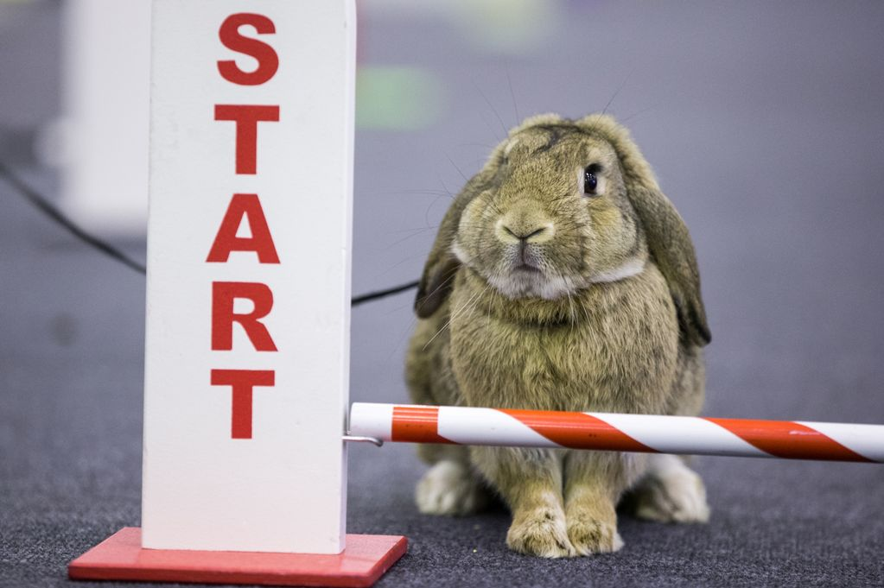
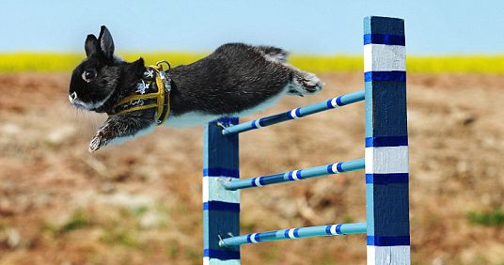
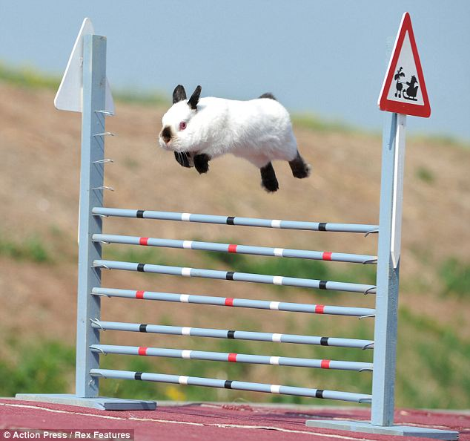
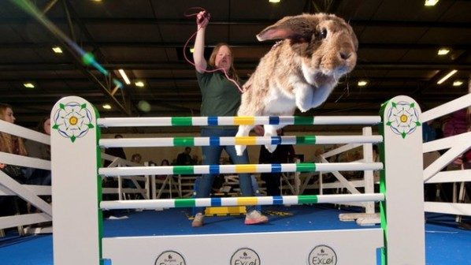
Bunny Jumping Competition
Notes:
Here you can play the video called “Bunny Jumping Competition” Before you play the video, be sure to talk about the pictures on the slide, introducing the video. Ask the students what they think the bunny jumping competition is as what will happen in the video.

Slide 33
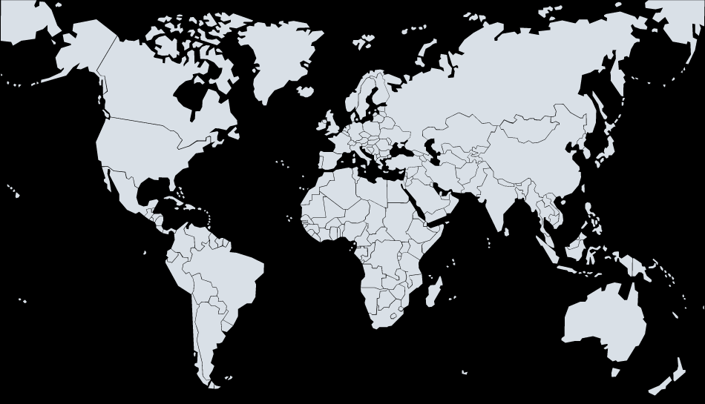
We are going to Sweden!
Notes:
Talk about Sweden vs China, talk about the flags, where they are located in the world etc, see if anyone has ever been there before!

Slide 34
Question?
Would you like to go to a bunny jumping competition?

Slide 35
Using a dictionary
What is a dictionary?
A dictionary is a book that helps you understand words.
Notes:
Introduce dictionaries in this portion, see if they already know what this is and if they know how to use one.

Slide 36
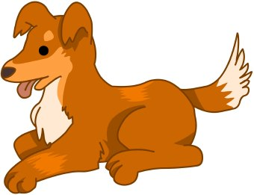
Using a dictionary
Dog:
An animal with fur, four legs
and a tail.
People keep them as pets.
Notes:
This is an example of a simple dictionary about what a dog is.

Slide 37
Match the word with the definition
1. A sweet fruit
2. An animal with long ears, long back legs and a short tail.
3. An animal who is awake at night with big eyes and hoots.
Bunny / Rabbit
Notes:
Read out all of the definitions and see if they know which one defines a bunny! Continue on with the rest of the slides practicing more dictionary words.

Slide 38
Match the word with the definition
2. An animal with long ears, long back legs and a short tail.
Bunny / Rabbit

Slide 39
Match the word with the definition
1. A sweet fruit
2. An animal with long ears, long back legs and a short tail.
3. An animal who is awake at night with big eyes and hoots.
Owl

Slide 40
Match the word with the definition
3. An animal who is awake at night with big eyes and hoots.
Owl

Slide 41
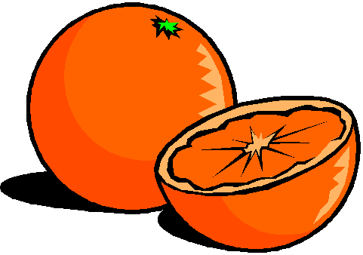
Match the word with the definition
1. A sweet fruit
2. An animal with long ears, long back legs and a short tail.
3. An animal who is awake at night with big eyes and hoots.
Oranges

Slide 42
Match the word with the definition
1. A sweet fruit
Oranges

Slide 43
What did I just learn?
Use simple dictionaries
Notes:
Have the students read out what they have just done.
Congratulate them!

Slide 44
Today’s letters! -> ‘NN’
Notes:
Talk about the ‘nn’ sound and have them try it out. Write the other ‘nn’ words the students can think of on the whiteboard for them so that they know how to spell it. Have them sound the word out as well.
bandanna etc ..

Slide 45
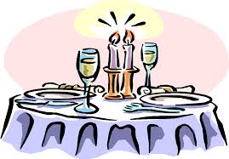
What’s that word?
b_nn_
_ _ nny
c_nn_n
s_nn_
d_nn__
b_nn_r
Notes:
Have the students write down on the line what the correct word from the box. A new word might be pinapple as well as flippers.

Slide 46
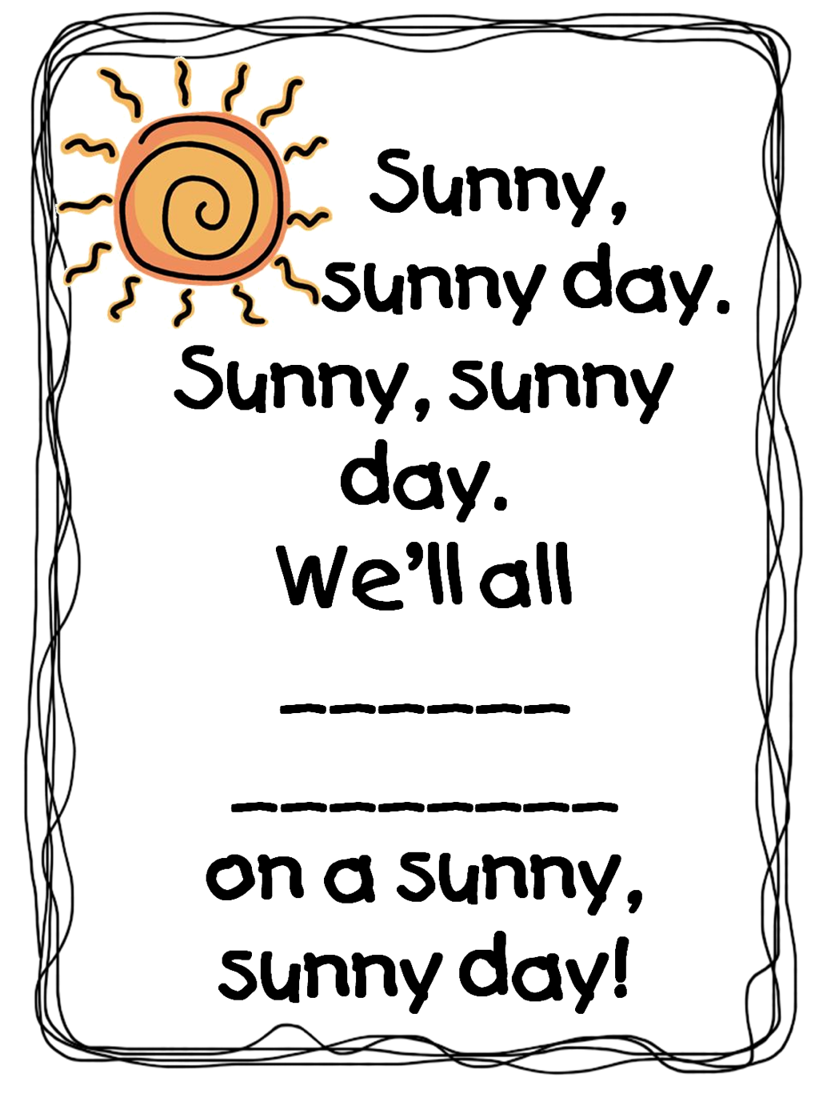
Notes:
Read this poem yourself first and then have the students read it out afterwards. Have the students fill in the blank to the poem. You can give them suggestions and model an answer beforehand.

Slide 47
What did I just learn?
Sound of the letters ‘nn’
Notes:
Have the students write in the remaining letters of these words.
The words are bunny, funny, cannon, sunny, dinner and banner.

Slide 48
What is that sound?
Listen closely and see if you know what the sound is!
Notes:
Find the movie clip “Flippers” and play it for the students. It is a blank image so that the students can only hear the water splashing and not see it. Have the students guess before showing them the next slide.

Slide 49
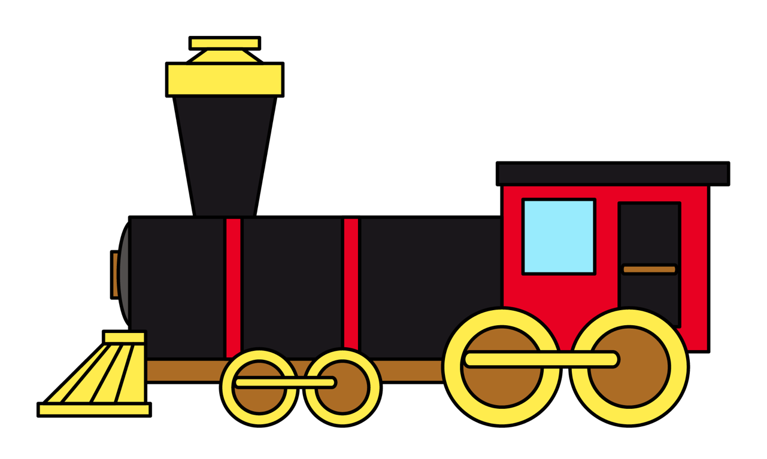
What is that sound?
Listen closely and see if you know what the sound is!
Notes:
Have them circle the what they thought the sound was.

Slide 50
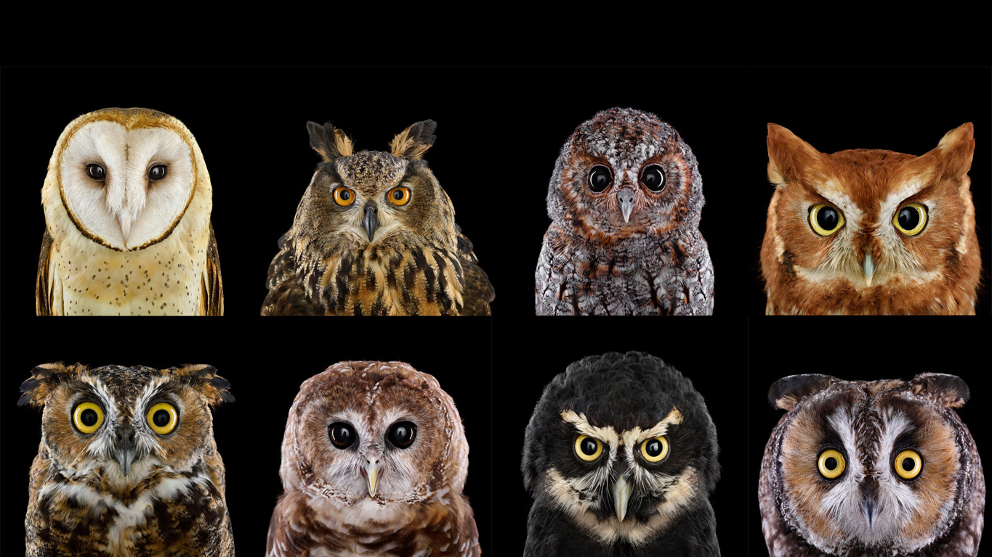
You’re right!
Owls are birds that are awake at night.
Owls make a HOOT sound !

Slide 51
What did I learn today?
Sound of the letters ‘nn’
Notes:
Have the students read out the goals the have just completed.
Congratulate them!
You can have them write the words out on the board.

Slide 52
What did I learn today?
Word Banks
Word Walls
“We are going to ____________!”
Marcella said to her dolls.
Grandma’s
play
eat
sleep
Notes:
Have the students read the goals if they can. I find that underlining sentences and asking students to read one sentence at a time works well.

Slide 53
What did I learn today?
Use simple dictionaries
Owl
3. An animal who is awake at night with big eyes and hoots.
Notes:
Have the students read the goals if they can. I find that underlining sentences and asking students to read one sentence at a time works well.

Slide 54
New words I learned today
bunny
sunny
cannon
sunny
dinner
banner
Notes:
Have the students read the goal that they just completed.
Explain what they learned if needed.
Congratulate them.
write down the new vocabulary words on the board and have the students write these new words on their worksheets under “Vocabulary”. These are the words that the students should be practicing!

Slide 55
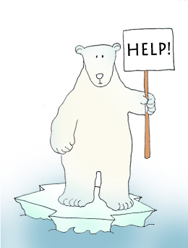
Final Thoughts
Do you have any questions?
Do you understand the handout?
Notes:
Wrap up your lesson and play the extra activities if you have any time. Answer any questions and pull up the worksheet if you want and go over the activities with them to ensure they understand.

Slide 56
Before the next class
Listen and read along with the ‘Raggedy Ann and Andy’ book
Read book to yourself and to your family/friends
Complete the worksheet
Practice writing new vocabulary words
Notes:
You can read these goals to them or have them read the goals if they can.
Underlining sentences and asking students to read one sentence at a time works well.
This is where you let the students know what they should be doing between now and their next session with you, you can tell them to read the story on their own and then to their family members as well as practicing the new vocab words.

Slide 58
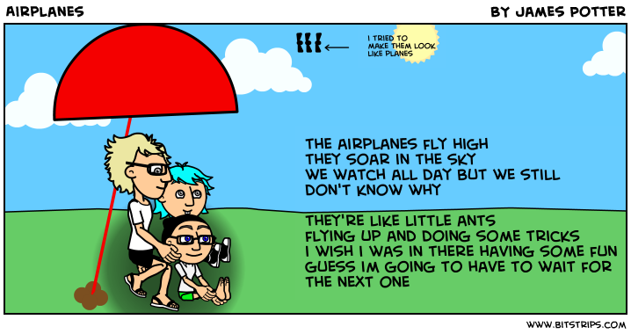

Slide 59
