Slide 1
Adventures!

Slide 2
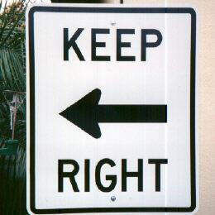
Notes:
What’s going on?” <- each lesson in this unit will have a section called Whats going on in the beginning to stimulate conversation and break the ice before class begins! Make your pen colour white and draw all of the key words on the board that the students come up with when they are describing or talking about the picture.

Slide 3
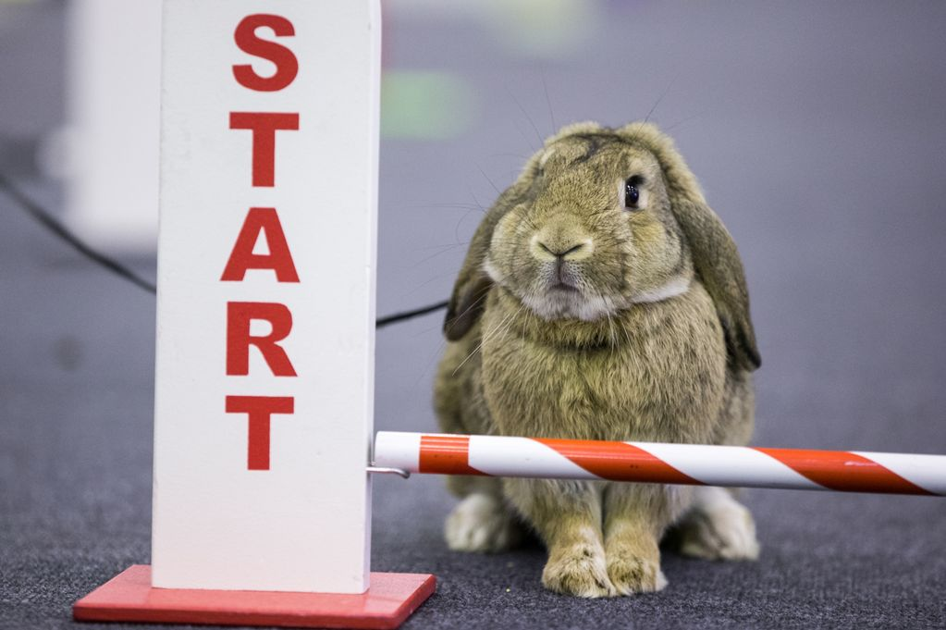
What did I learn last class?
Use simple dictionaries
Word Banks
Word Walls
Sound of the letters ‘nn’
Notes:
Recap what the students learned in the previous lesson.
Congratulate them!

Slide 4
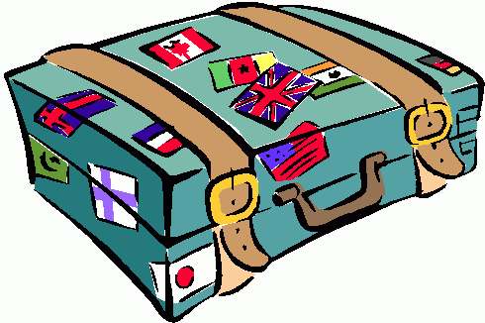
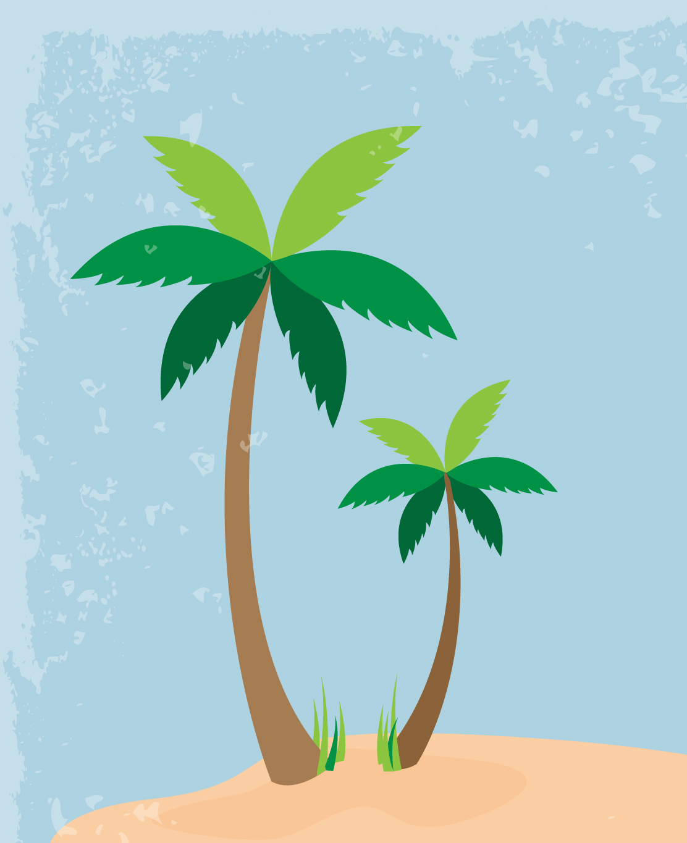
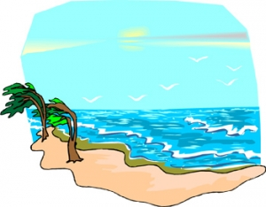
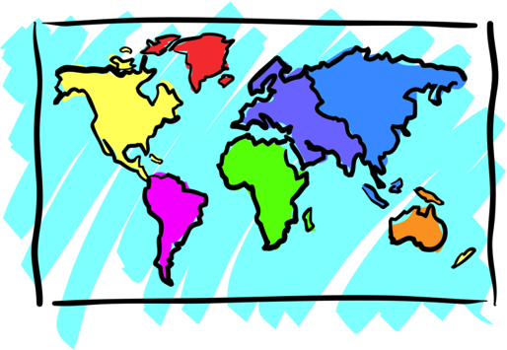
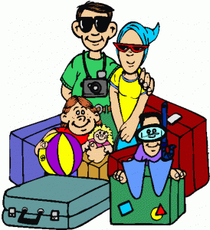
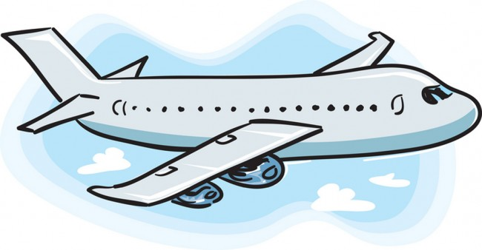
Adventures

Slide 5
What will I learn today?
Draw a picture of a story
Descriptive adjectives
Sounds of the letter ‘MM’
Rhyming words
Notes:
You can read these goals to them or have them read the goals if they can.
Underlining sentences and asking students to read one sentence at a time works well.

Slide 6
Story Time!
Where are we going today ?!
Notes:
You can ask the students where they think they are going today.
Play the movie clip called “Where are we going today?”

Slide 7
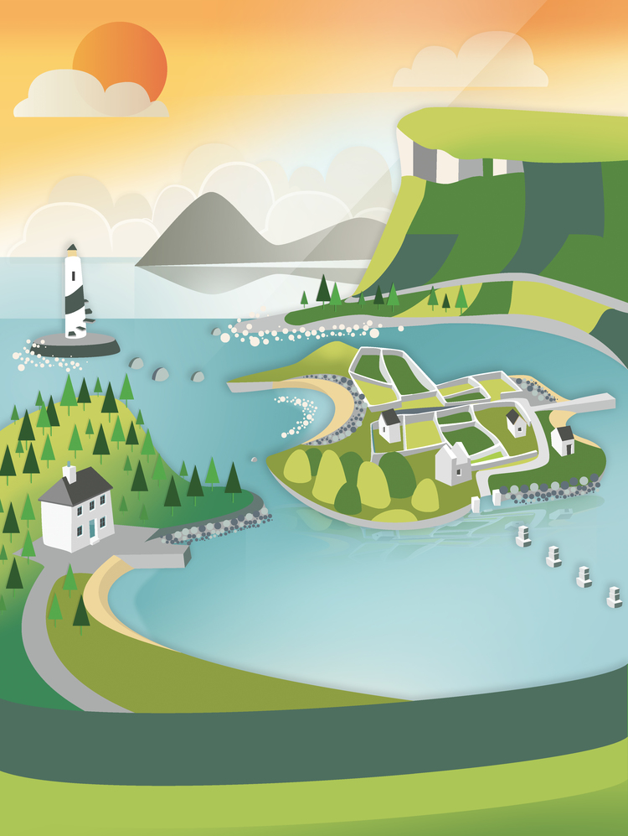
Let’s take a trip together!
Where are we going today?
Down By the Bay!
Notes:
Let the students know that each lesson they will be going on a trip with you! After showing this slide, play the ‘Where are we going today?” video clip for the students, go to the next slide, do not play the Down By the Bay clip just yet!

Slide 8
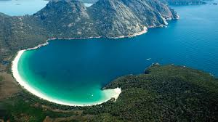
What is a bay?
A bay is where the sea goes into the land
Notes:
Talk about what a bay is and introduce the song to the students.

Slide 9
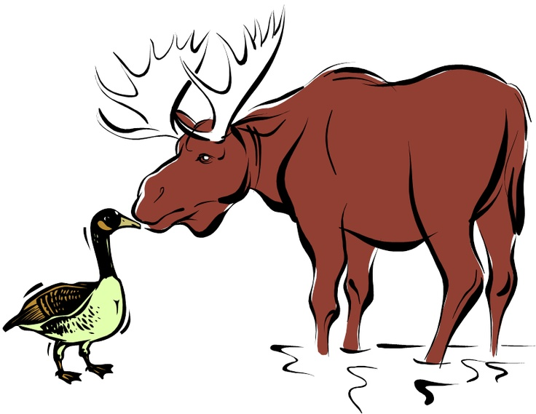
Let’s Read Together
Down by the bay
Where the watermelons grow
Back to my home
I dare not go
For if I do
My mother will say
"Did you ever see a goose
kissing a moose?"
Down by the bay
Notes:
Play the ‘Down By the Bay’ video for the student before showing this slide. Once you show the video, come back to these slides and go over all of the rhyming words, the sentences in GREEN.

Slide 10
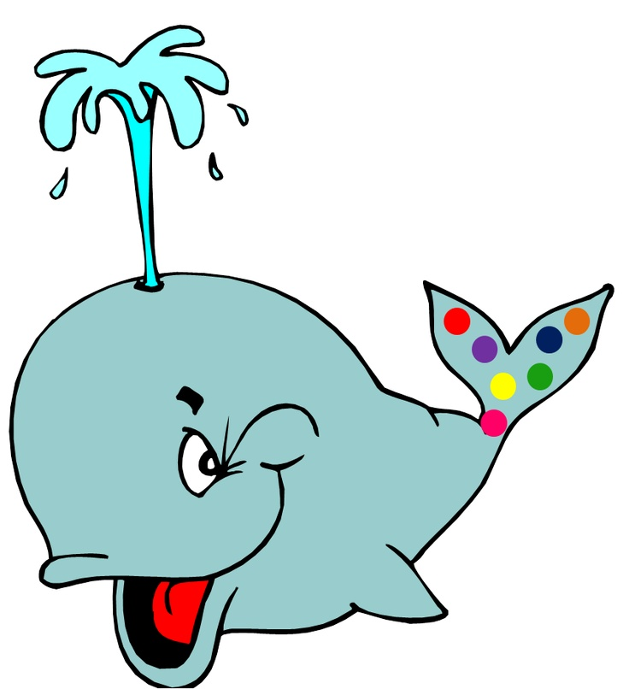
Let’s Read Together
Down by the bay
Where the watermelons grow
Back to my home
I dare not go
For if I do
My mother will say
“Did you ever see a whale
with a polka dot tail"
Down by the bay
Notes:
Go through each of these story slides and talk about any new words that may arise. Tell the students to write these words down in their word dictionary.

Slide 11
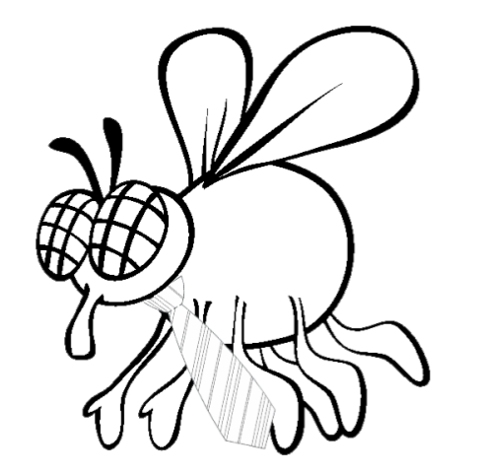
Let’s Read Together
Down by the bay
Where the watermelons grow
Back to my home
I dare not go
For if I do
My mother will say
“Did you ever see a fly
Wearing a tie"
Down by the bay

Slide 12
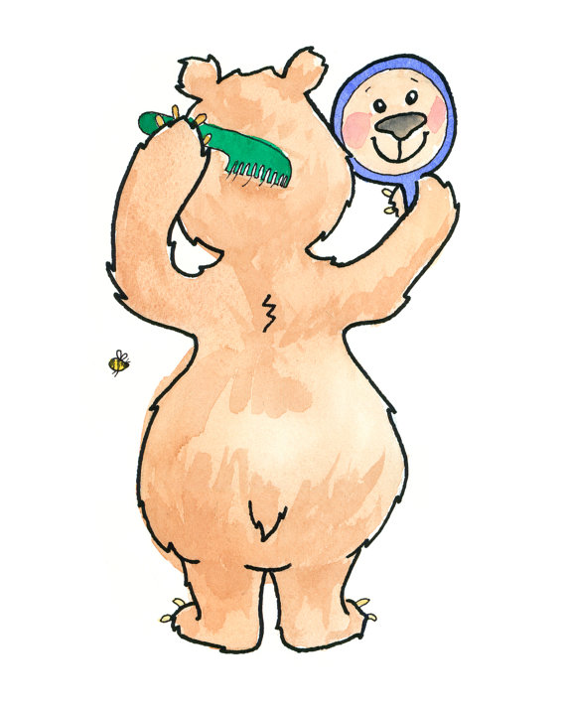
Let’s Read Together
Down by the bay
Where the watermelons grow
Back to my home
I dare not go
For if I do
My mother will say
“Did you ever see a bear
coming his hair"
Down by the bay

Slide 13
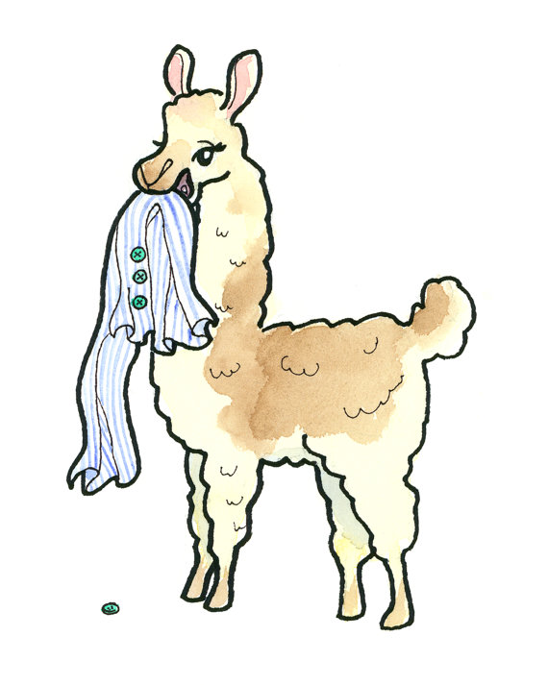
Let’s Read Together
Down by the bay
Where the watermelons grow
Back to my home
I dare not go
For if I do
My mother will say
“Did you ever see a llama
eating pajamas"
Down by the bay

Slide 14
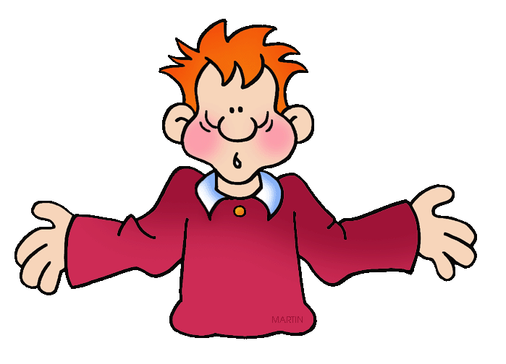
Let’s Read Together
Down by the bay
Where the watermelons grow
Back to my home
I dare not go
For if I do
My mother will say
“Did you ever have a time
when you could not think of a rhyme"
Down by the bay

Slide 15
What did I just learn?
Rhyming words
Notes:
Have the students read out what they have just completed and have them recap the content as well. Congratulate them!

Slide 16
Where are we going today?
Notes:
Let the students know that each lesson they will be going on a trip with you! After showing this slide, play the ‘Where are we going today?” video clip for the students. Talk about airplanes and if they would be scared or excited to go on an airplane.

Slide 17
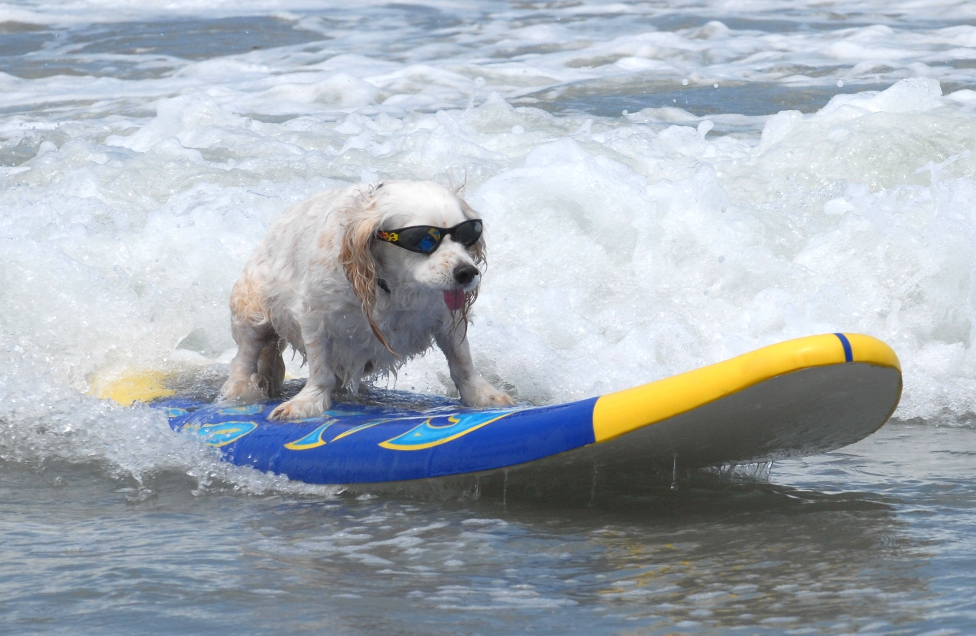
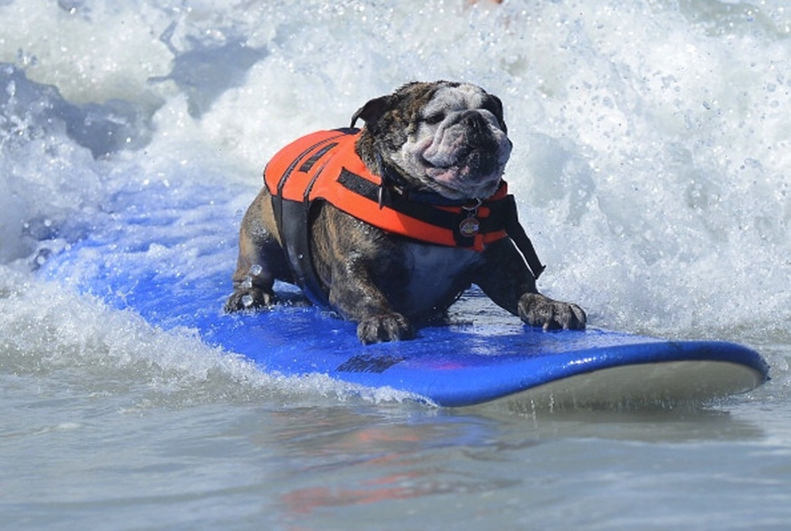
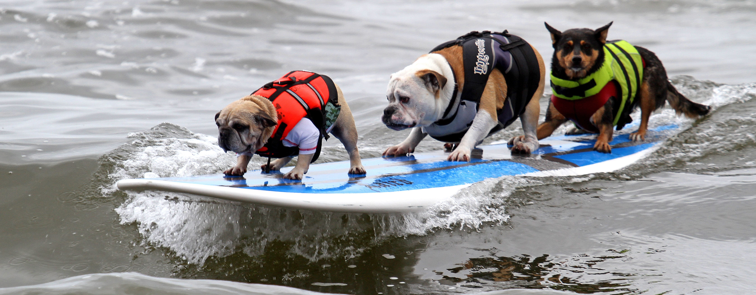
Dog Surfing
Notes:
Here you can play the video called “Dog surfing competition” Before you play the video, be sure to talk about the pictures on the slide, introducing the video. Ask the students what they think the dog surfing is.

Slide 18
We are going to California, U.S.A.!

Slide 19
Question?
Would you like to go to a dog surfing competition?

Slide 20
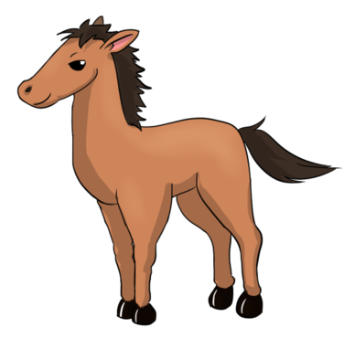
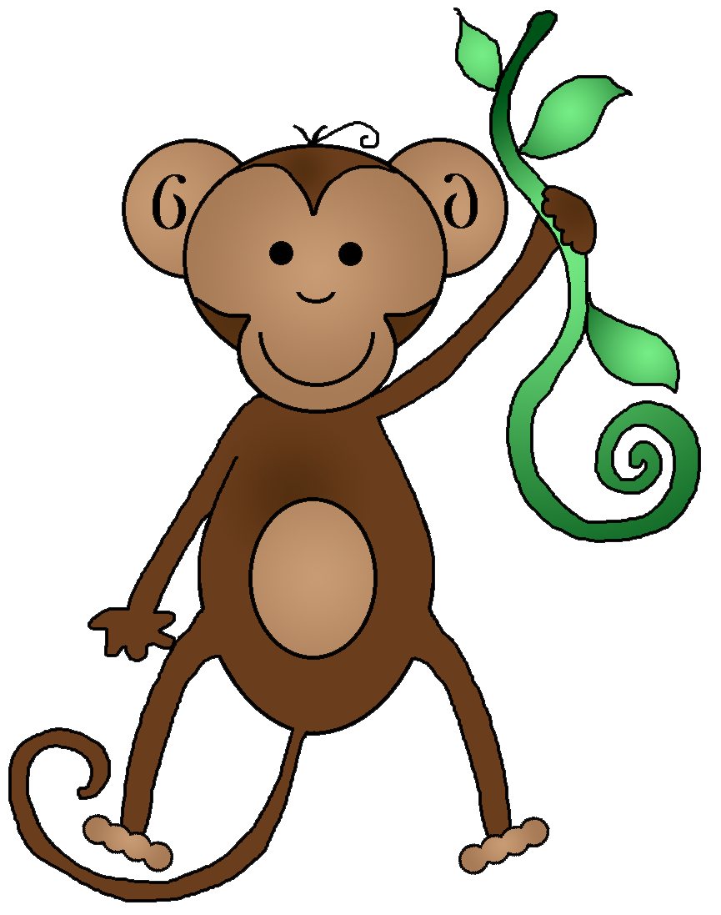
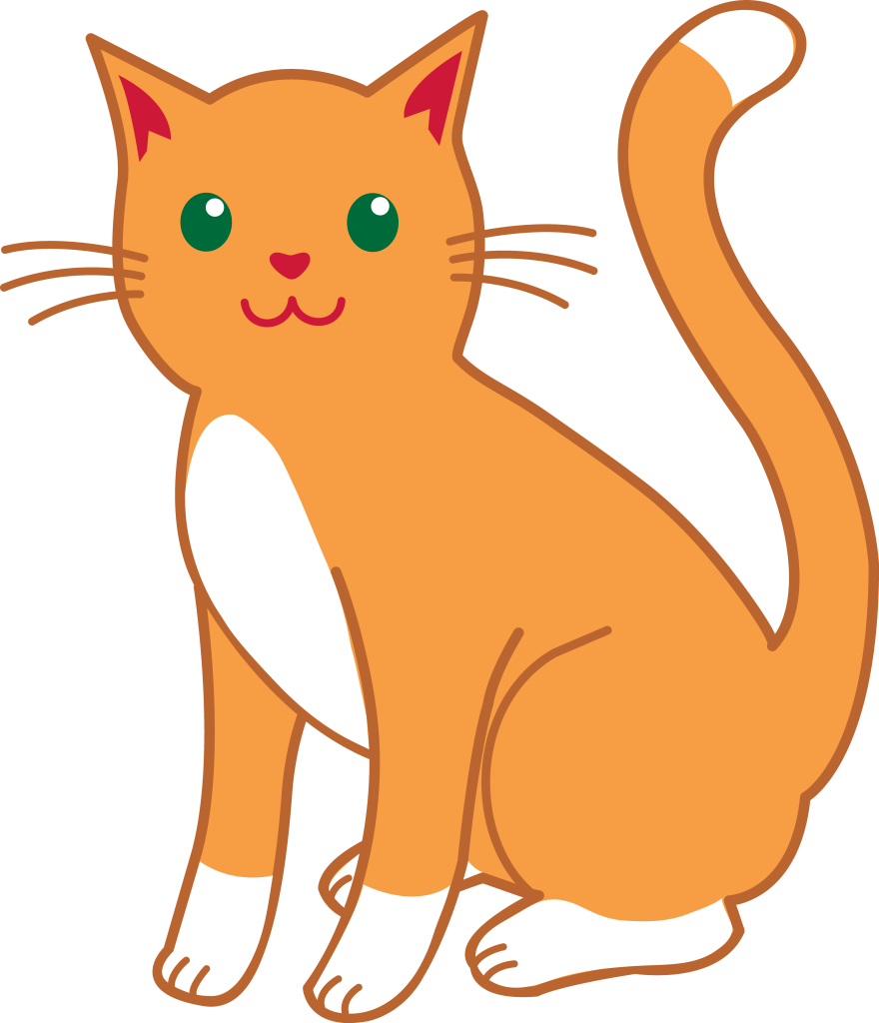
Let’s Talk
What kind of animal do you have?
Do you want to take them surfing?
On the whiteboard, let’s write a short story about taking our pets surfing.
Notes:
Have an open discussion with the students about their pets. Let them know that if they do not have a pet they can make one up or choose one from the pictures on the slide. Go to a separate whiteboard slide and have the students continue the discussion. Try to have one line written down per student about the pet they would or would not take surfing.

Slide 21
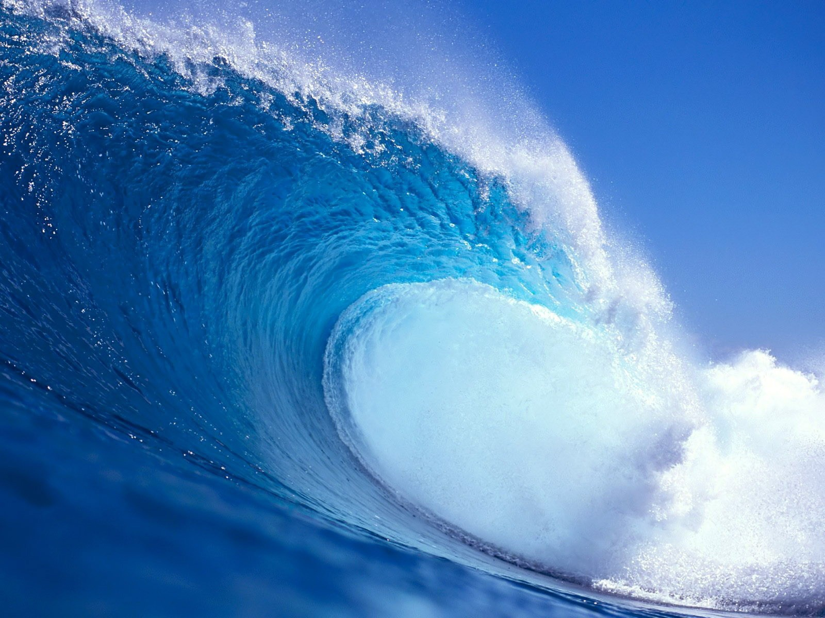
Notes:
Have the students draw their animals onto the surf boards in this slide, make sure the pictures reflect the story that you wrote on the whiteboard with them about their pets on surfboards.

Slide 22
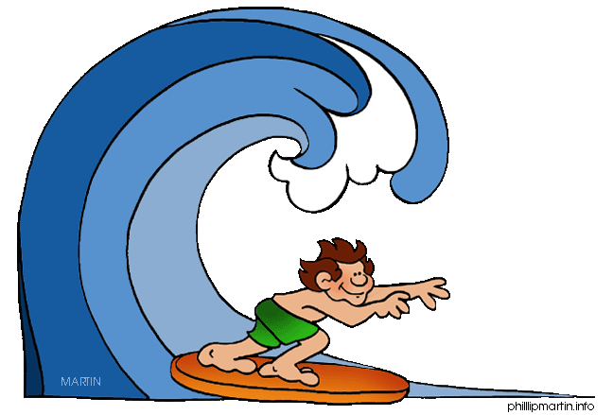
What did I just learn?
Draw a picture of a story
Notes:
Have the students read out what they have just completed and have them recap the content as well. Congratulate them!

Slide 23
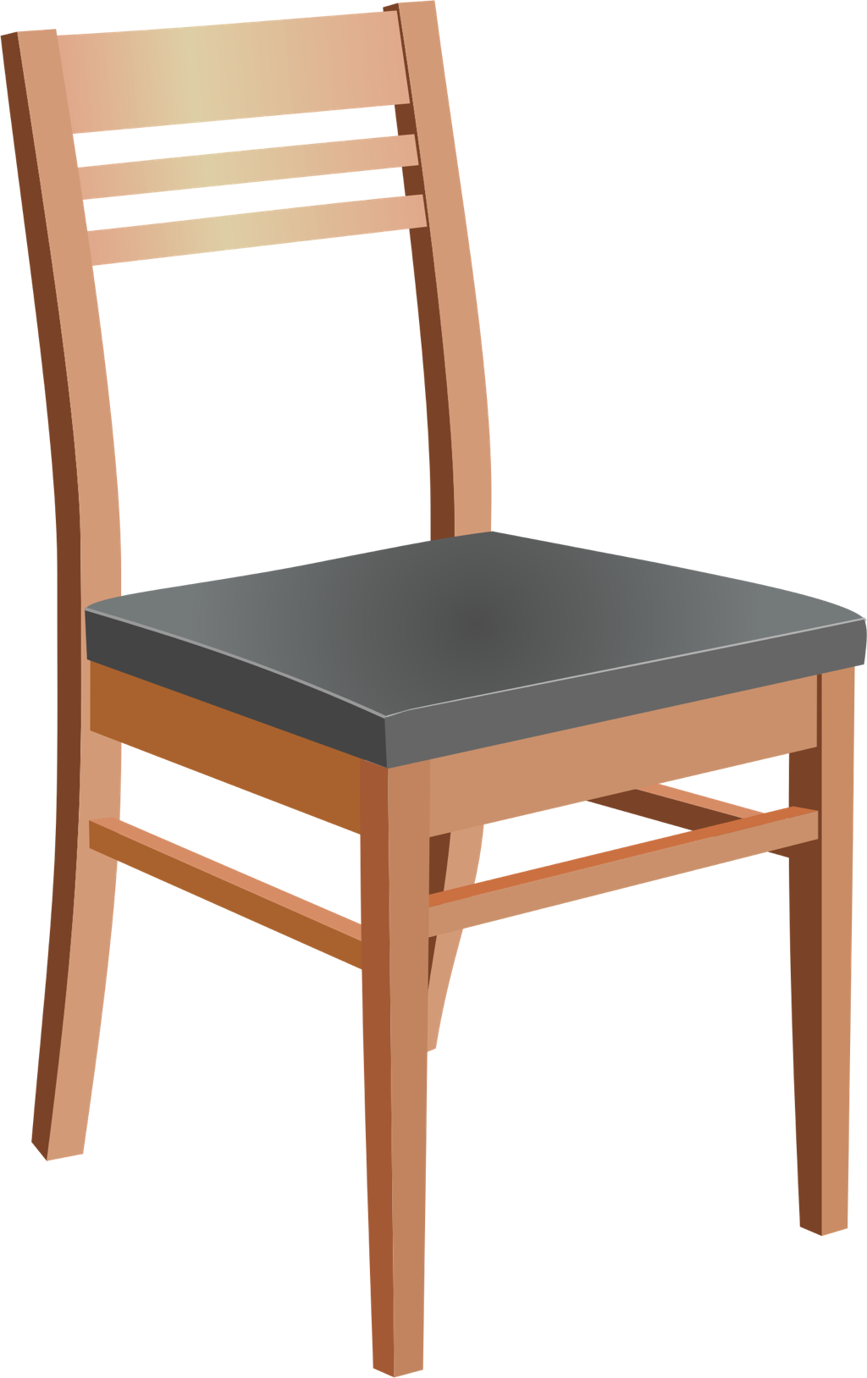
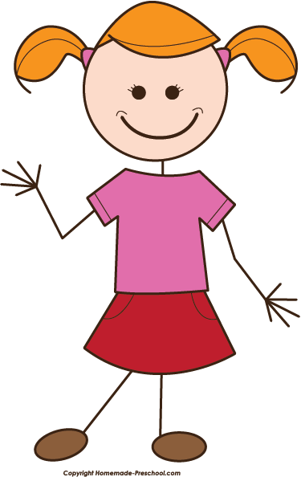
Descriptive Adjectives
Nouns are a person, place or thing (example: Chair, Vanessa, Cat)
Descriptive Adjectives are words that explain more about nouns
Notes:
Descriptive adjectives, have the students tell you a few more nouns to ensure that they remember what a noun is.

Slide 24
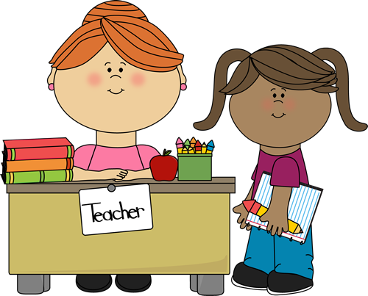
Descriptive Adjectives
Nouns are a person, place or thing (example: Chair, Vanessa, Cat)
Descriptive Adjectives are words that explain more about nouns
The teacher.
The ____________ teacher.
nice
happy
busy
Notes:
All of the examples above work (in the green circles) so no matter what the students choose will work. You can go over the sentence three times with each different word being represented in the box.

Slide 25
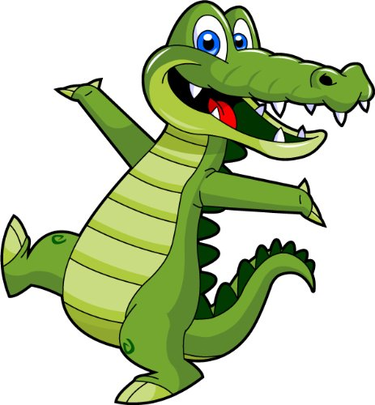
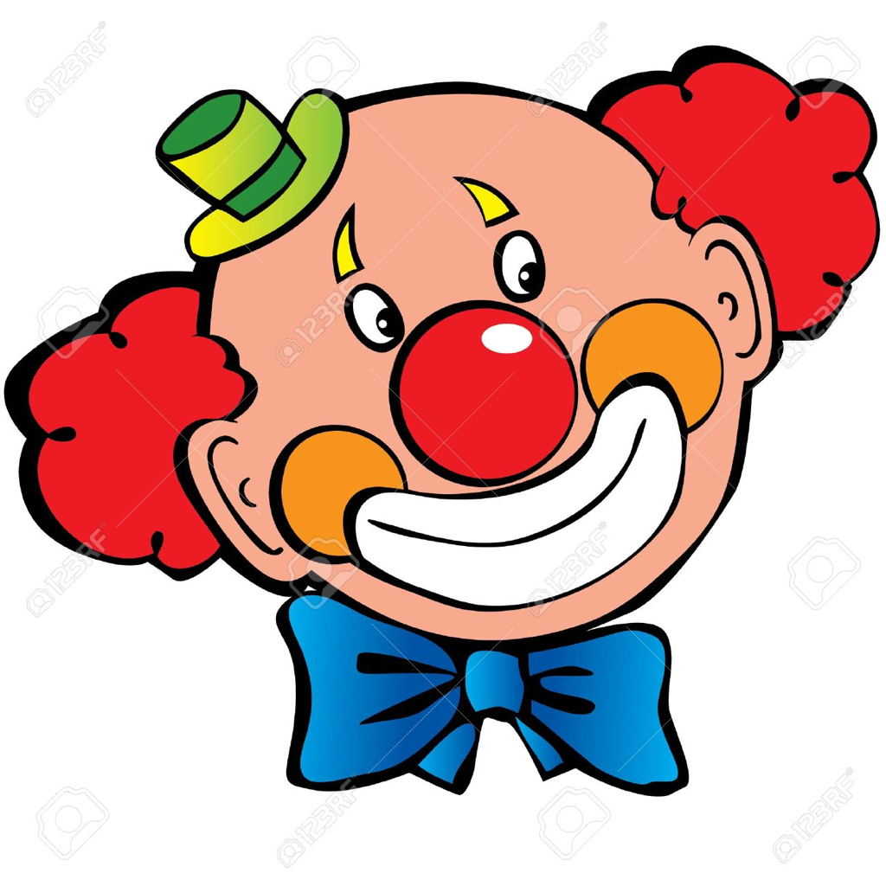
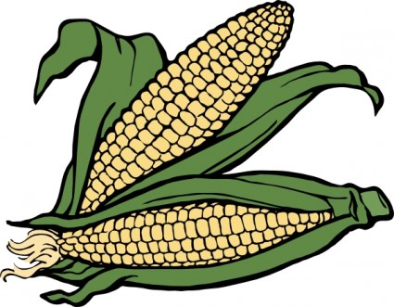
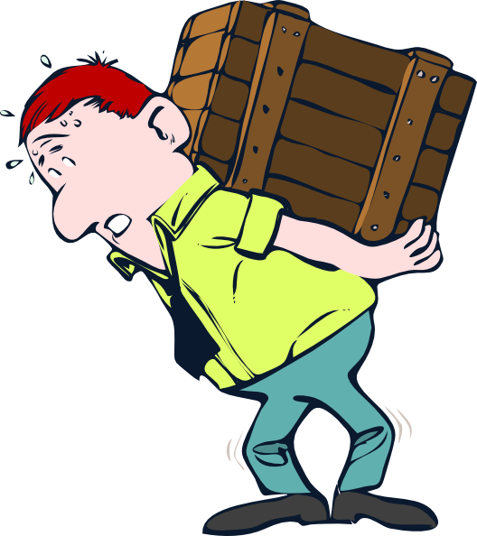
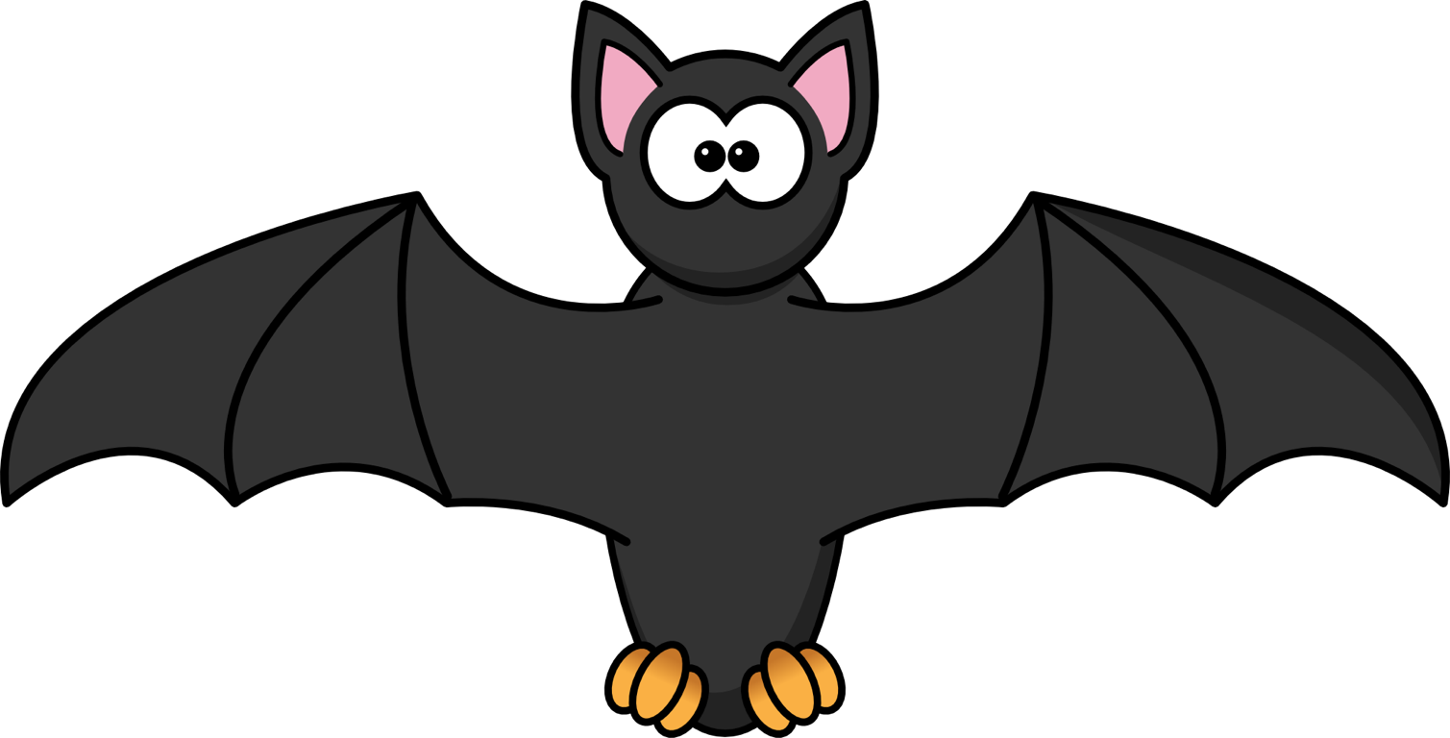
Circle the correct adjective
soft
green
orange
far
wet
funny
red
nice
purple
ugly
yellow
fuzzy
close
heavy
far
light
heavy
black
black
far
happy
scary
funny
happy
Notes:
Have the students circle the correct descriptive adjective.
(green, funny, red, yellow, heavy, light, black, scary)

Slide 26
What did I just learn?
Descriptive Adjectives
Notes:
Have the students read out what they have just completed and have them recap the content as well. Congratulate them!

Slide 27
Today’s letters! -> ‘MM’
Notes:
Talk about the ‘MM’ sound and have them try it out. Write the other ‘MM’ words the students can think of on the whiteboard for them so that they know how to spell it. Have them sound the word out as well.
bandanna etc ..

Slide 28
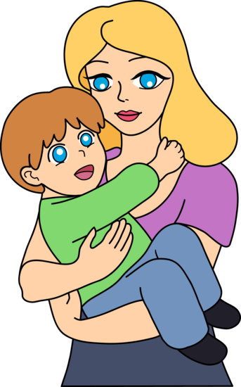
Today’s letters! -> ‘MM’
T _______
M_______
Notes:
Have the students fill in the blanks with their pens.

Slide 29
Today’s letters! -> ‘MM’
Tummy
Mommy
Notes:
Have the students fill in the blanks with their pens.

Slide 30
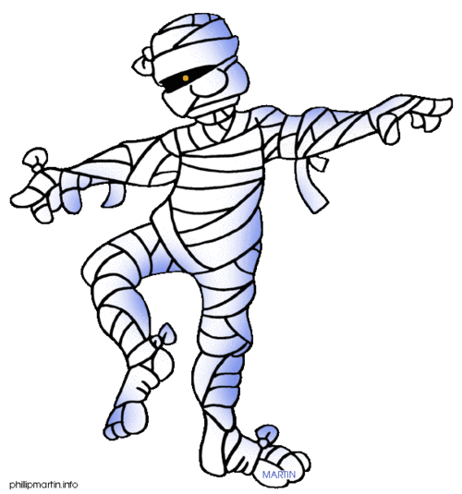
Today’s letters! -> ‘MM’
G_____ B____
M_______
Notes:
Have the students fill in the blanks with their pens.

Slide 31
Today’s letters! -> ‘MM’
Gummy Bear
Mummy
Notes:
Have the students fill in the blanks with their pens.

Slide 32
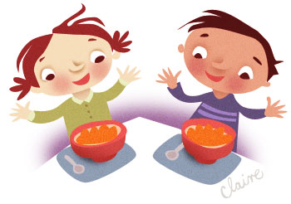
Today’s letters! -> ‘MM’
Y_______ !
Notes:
Have the students fill in the blanks with their pens.

Slide 33
Today’s letters! -> ‘MM’
Yummy !
Notes:
Have the students fill in the blanks with their pens.

Slide 34
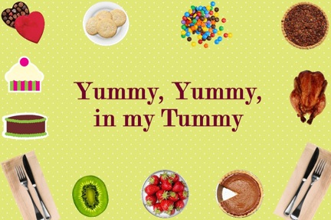
Today’s letters! -> ‘MM’
Notes:
Read this ‘mm’ poem with the students. Talk about the different types of food in the picture!
Which one is their favourite food?

Slide 35
Today’s letters! -> ‘MM’
My favourite food is _____________________.
It is yummy in my tummy !
Notes:
Read this ‘mm’ poem with the students. Talk about the different types of food in the picture!
Which one is their favourite food?

Slide 36
What did I just learn?
Sound of the letters ‘MM’
Notes:
Have the students read out what they have just completed and have them recap the content as well. Congratulate them!

Slide 37
What is that sound?
Listen closely and see if you know what the sound is!
Notes:
Find the movie clip “Grizzly Bear” and play it for the students. It is a blank image so that the students can only hear the bear and not see it. Have the students guess before showing them the next slide.

Slide 38
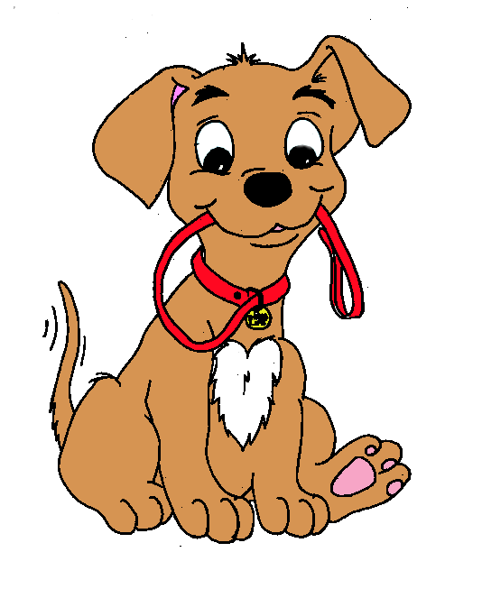
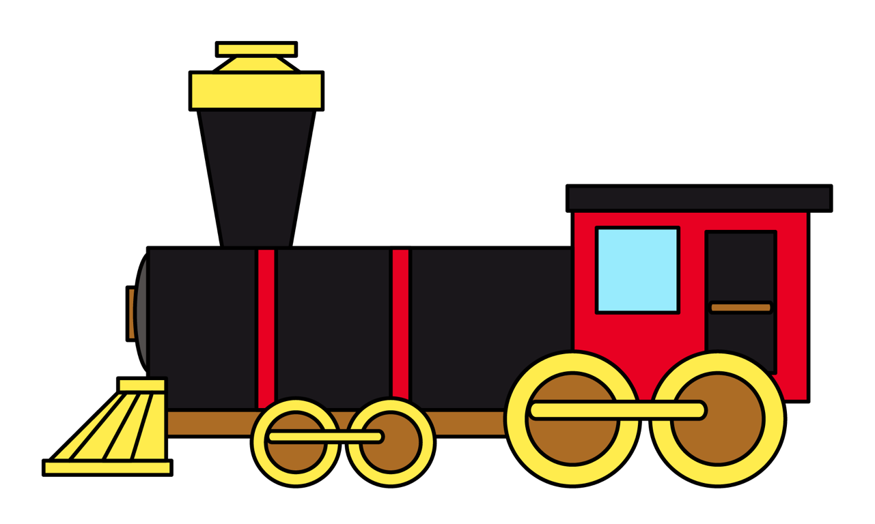
What is that sound?
Listen closely and see if you know what the sound is!

Slide 39
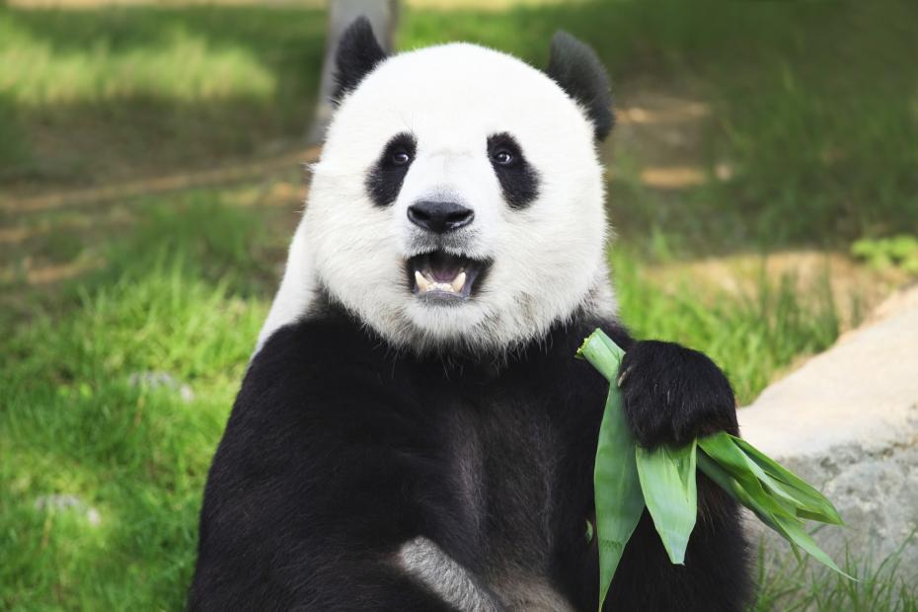
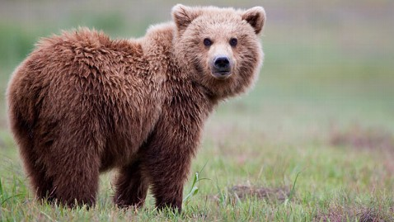
You’re right!
Bears are furry animals with four feet.
They can be brown, black, red and white!
You might know the panda bear!
Notes:
Read out the description for bears. See if they have ever seen a bear in a zoo before, ask them to tell you what it looked like, where it lived etc..

Slide 40
What did I learn today?
Descriptive adjectives
soft
green
orange
scary
funny
happy
Notes:
Have the students read out what they have just completed and have them recap the content as well. Congratulate them!

Slide 41
What did I learn today?
Sounds of the letter ‘MM’
Notes:
Have the students read the goals if they can. I find that underlining sentences and asking students to read one sentence at a time works well.

Slide 42
What did I learn today?
Rhyming Words
Notes:
Have the students read the goals if they can. I find that underlining sentences and asking students to read one sentence at a time works well.

Slide 43
What did I learn today?
Draw a picture of a story
Notes:
Have the students read the goals if they can. I find that underlining sentences and asking students to read one sentence at a time works well.

Slide 44
New words I learned today
Surf
Gummy Bear
Mummy
llama
Notes:
Have the students read the goal that they just completed.
Explain what they learned if needed.
Congratulate them.
write down the new vocabulary words on the board and have the students write these new words on their worksheets under “Vocabulary”. These are the words that the students should be practicing!

Slide 45
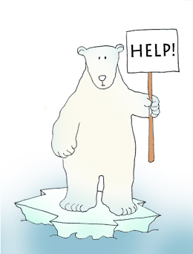
Final Thoughts
Do you have any questions?
Do you understand the handout?
Notes:
Wrap up your lesson and play the extra activities if you have any time. Answer any questions and pull up the worksheet if you want and go over the activities with them to ensure they understand.

Slide 46
Before the next class
Listen and read along with the ‘Down, By the Bay’ book
Read book to yourself and to your family/friends
Complete the worksheet
Practice writing new vocabulary words
Notes:
You can read these goals to them or have them read the goals if they can.
Underlining sentences and asking students to read one sentence at a time works well.
This is where you let the students know what they should be doing between now and their next session with you, you can tell them to read the story on their own and then to their family members as well as practicing the new vocab words.

Slide 47
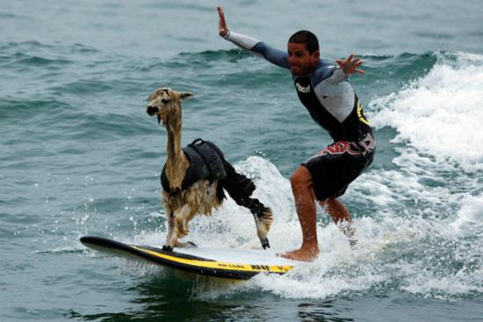
Notes:
llama on a surfboard!

Slide 48
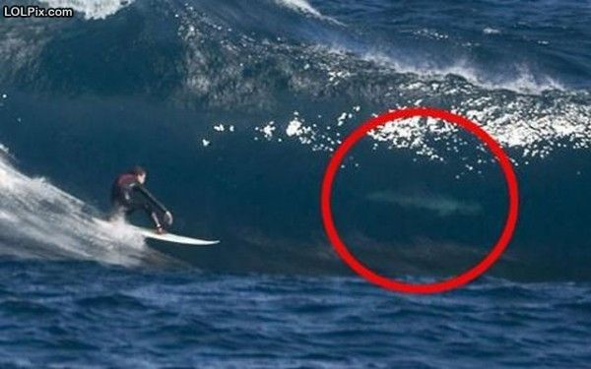
Notes:
Write a story about this picture!

Slide 49
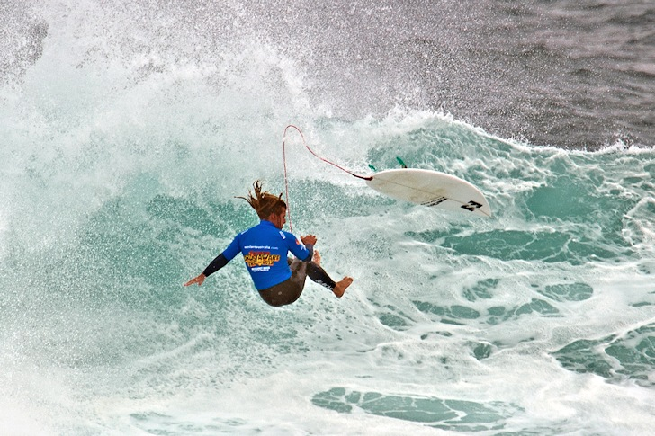
Notes:
Write a story about this picture!

Slide 50
Apple!
An apple can taste very nice
Try a bite or a slice.
If its red or if its green
It will taste good if its clean.
My grandma says, “an apple a day’
Keeps the doctor away!”

