Slide 1
Adventures!

Slide 2
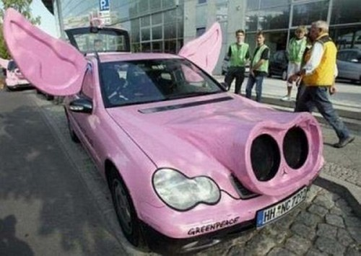
Notes:
What’s going on?” <- each lesson in this unit will have a section called Whats going on in the beginning to stimulate conversation and break the ice before class begins! Make your pen colour white and draw all of the key words on the board that the students come up with when they are describing or talking about the picture.

Slide 3
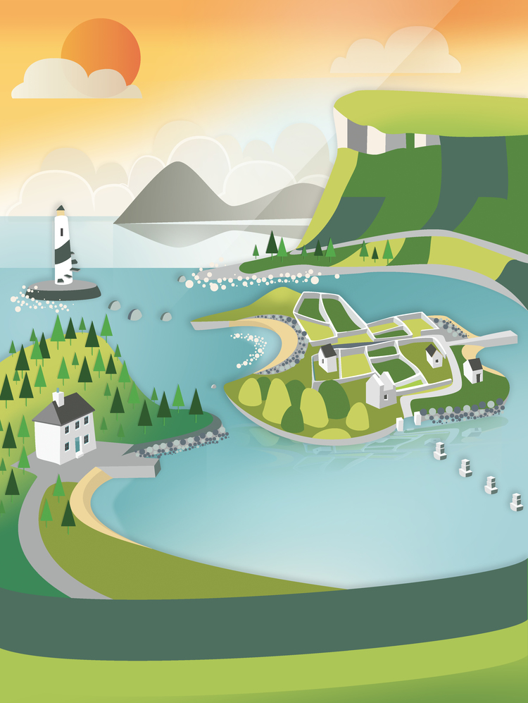
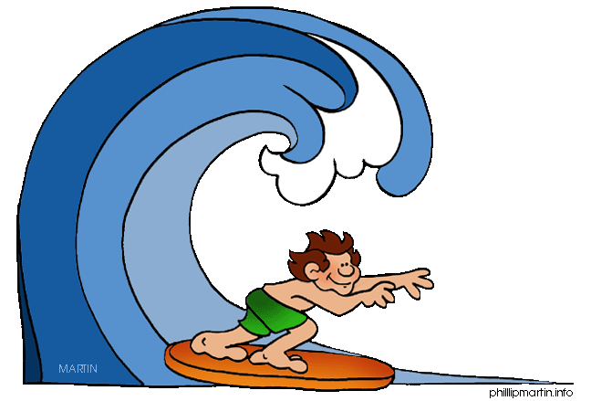
What did I learn last class?
Draw a picture of a story
Descriptive adjectives
Sounds of the letter ‘MM’
Notes:
Have the students read out what they have just completed and have them recap the content as well. Congratulate them!

Slide 4
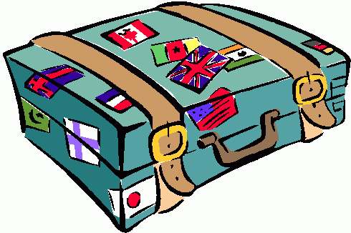
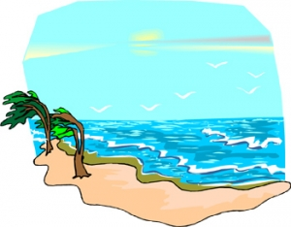
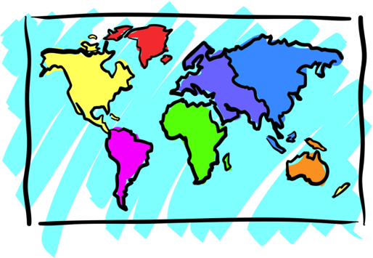
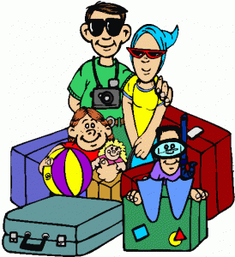
Adventures

Slide 5
What will I learn today?
Adverbs
Sounds of the letter ‘dd’
Learn new winter words
The months of the year
Notes:
You can ask the students where they think they are going today.
Play the movie clip called “Where are we going today?”

Slide 6
Story Time!
Where are we going today ?!
Notes:
You can ask the students where they think they are going today.
Play the movie clip called “Where are we going today?”

Slide 7
Notes:
llama on a surfboard!

Slide 8
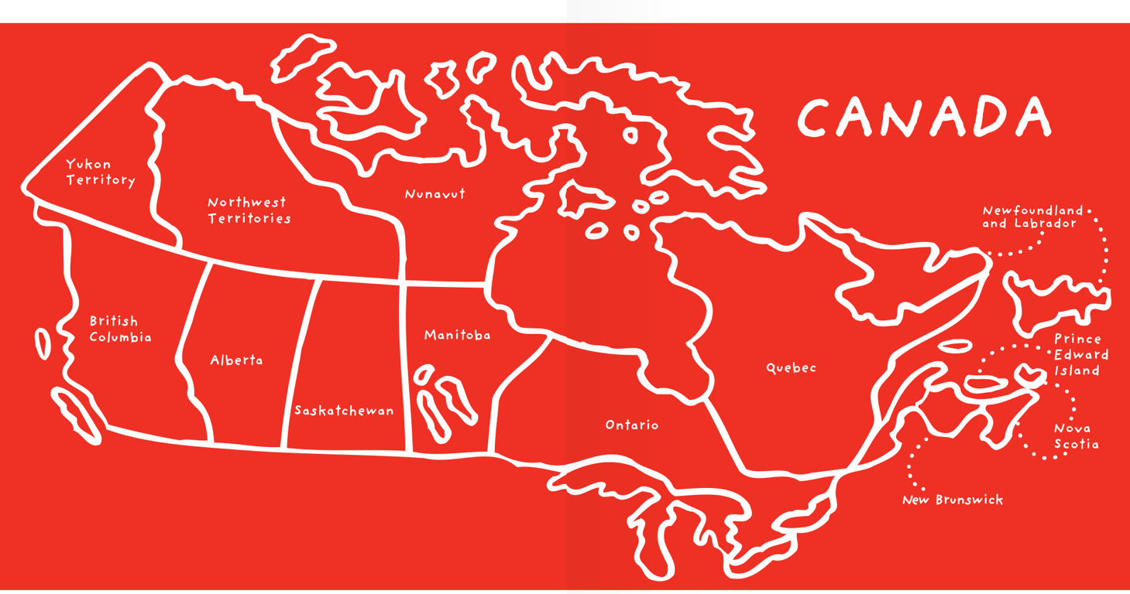
Notes:
llama on a surfboard!

Slide 9
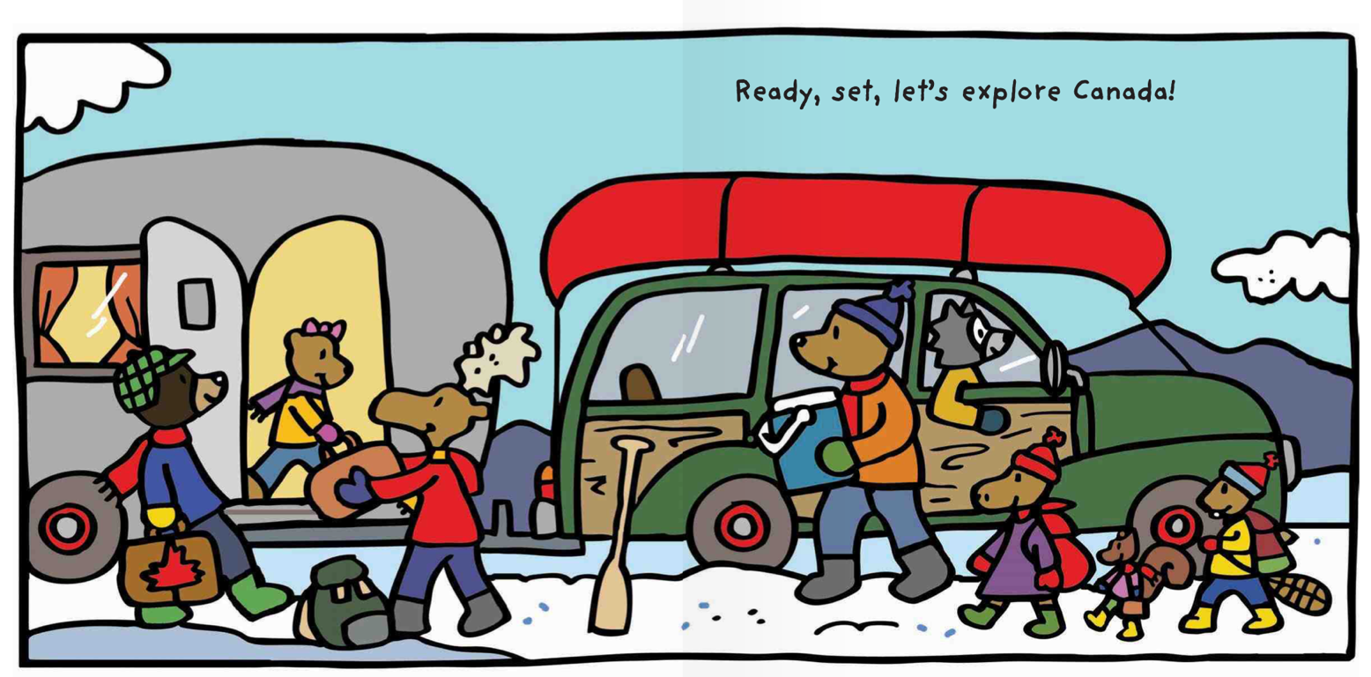
Let’s go to Canada!

Slide 10
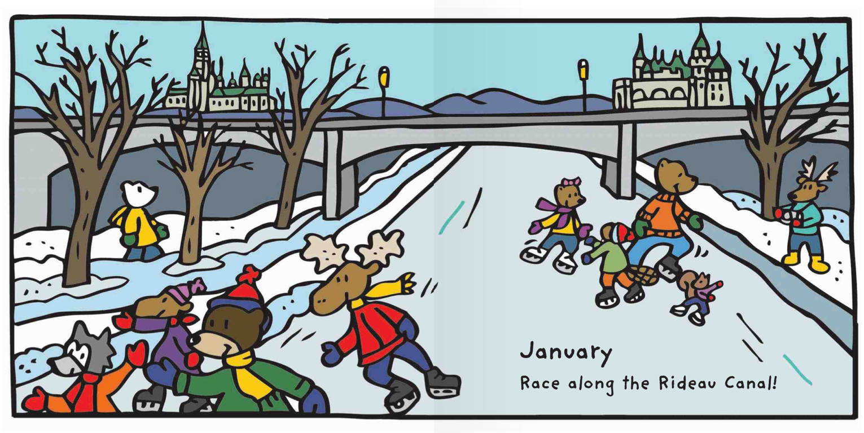
In January we skate on the
frozen river

Slide 11
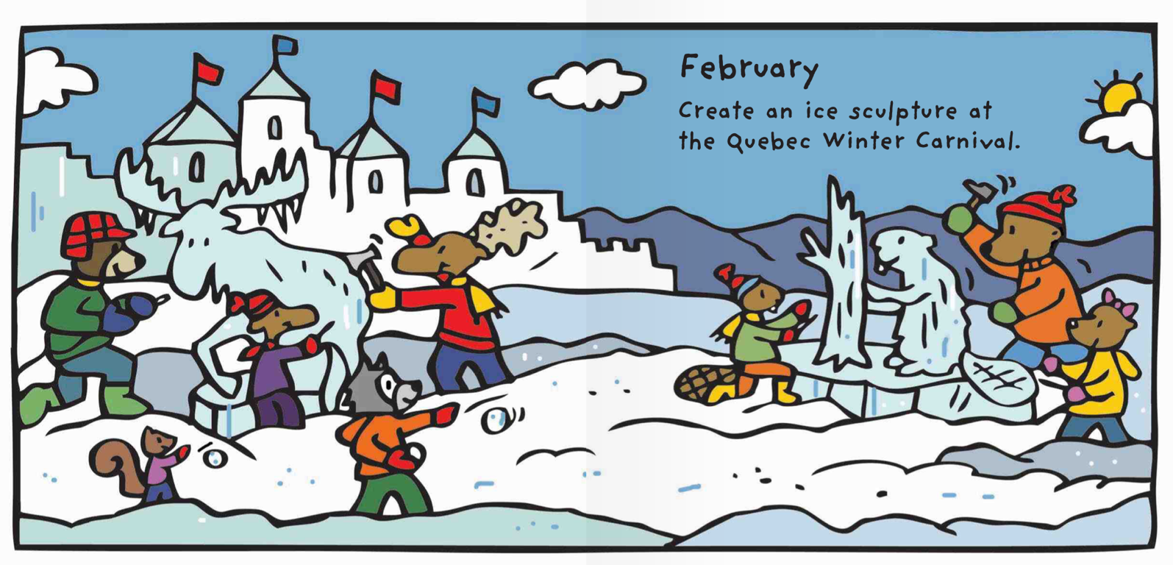
In February, we make
things out of ice!

Slide 12
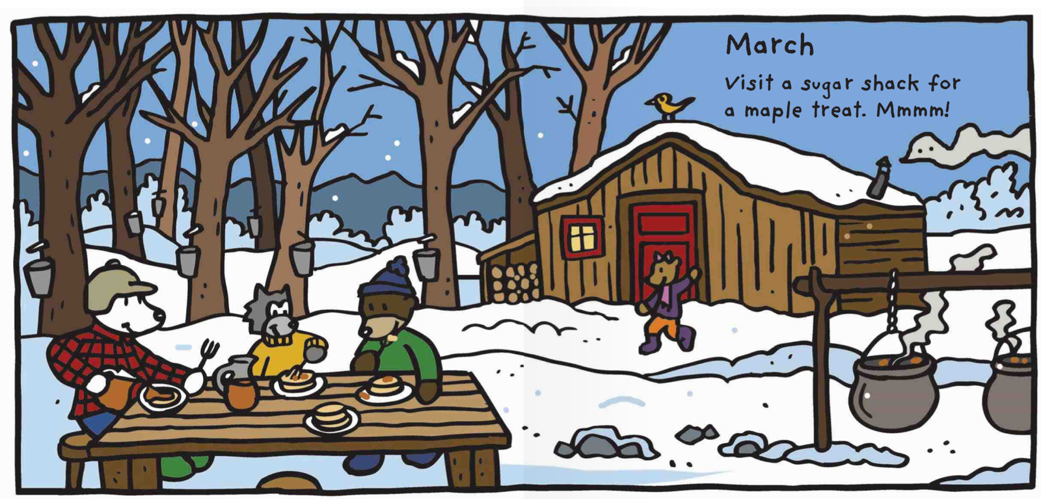
In March we eat
maple syrup.

Slide 13
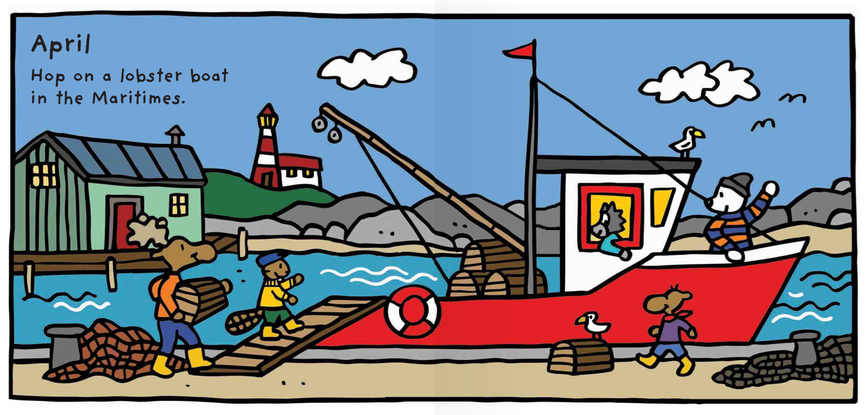
In April we
go on a boat.

Slide 14
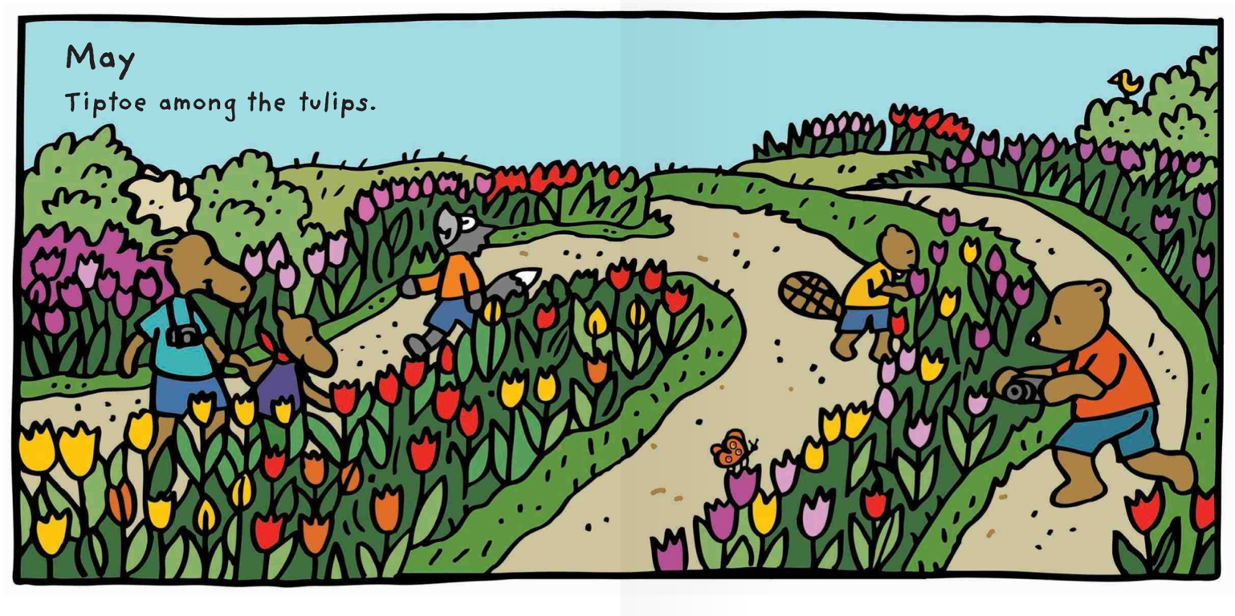
In May we see flowers.

Slide 15
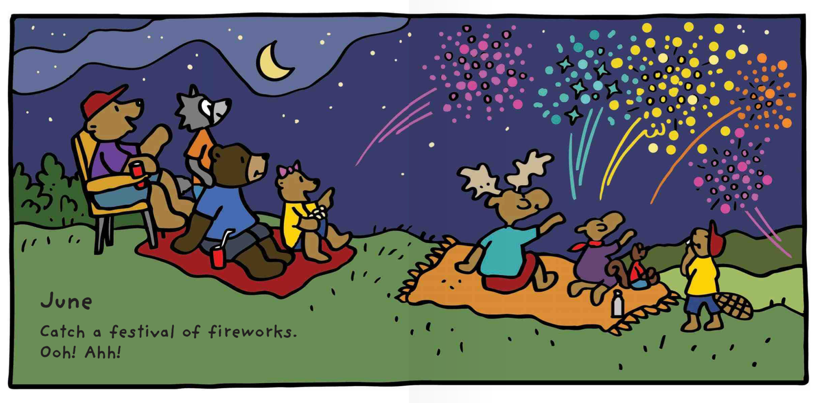
In June we
see fireworks!

Slide 16
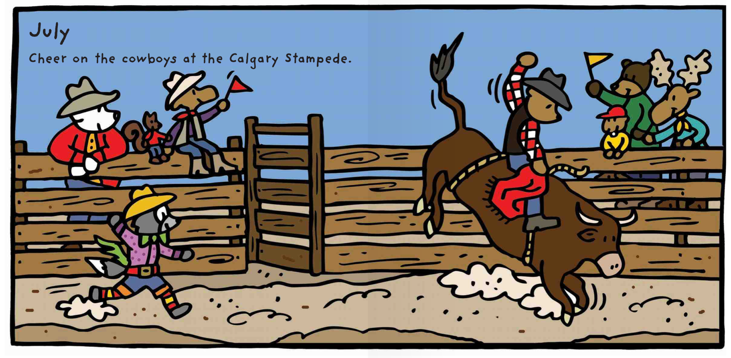
In July we see cowboys.

Slide 17
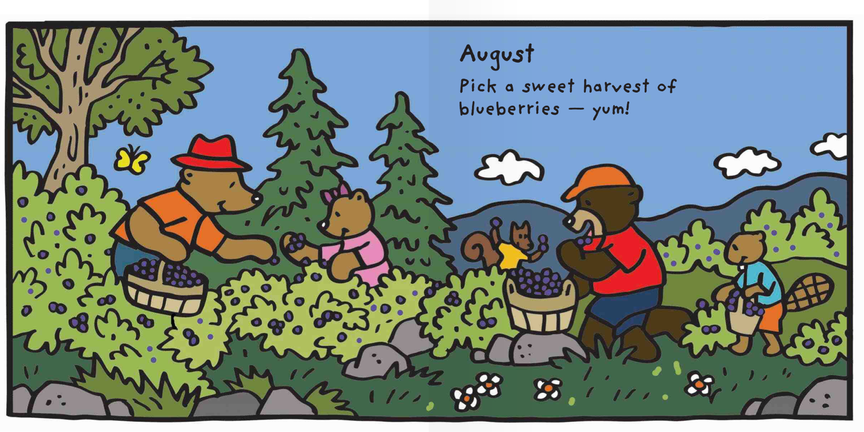
In August we find fruit.

Slide 18
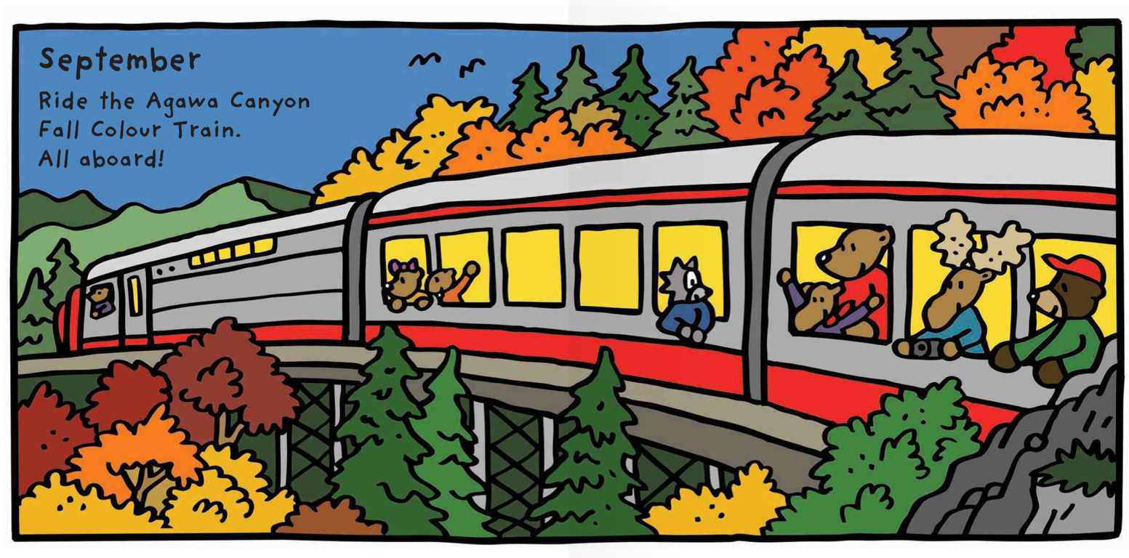
In September
we ride a train.

Slide 19
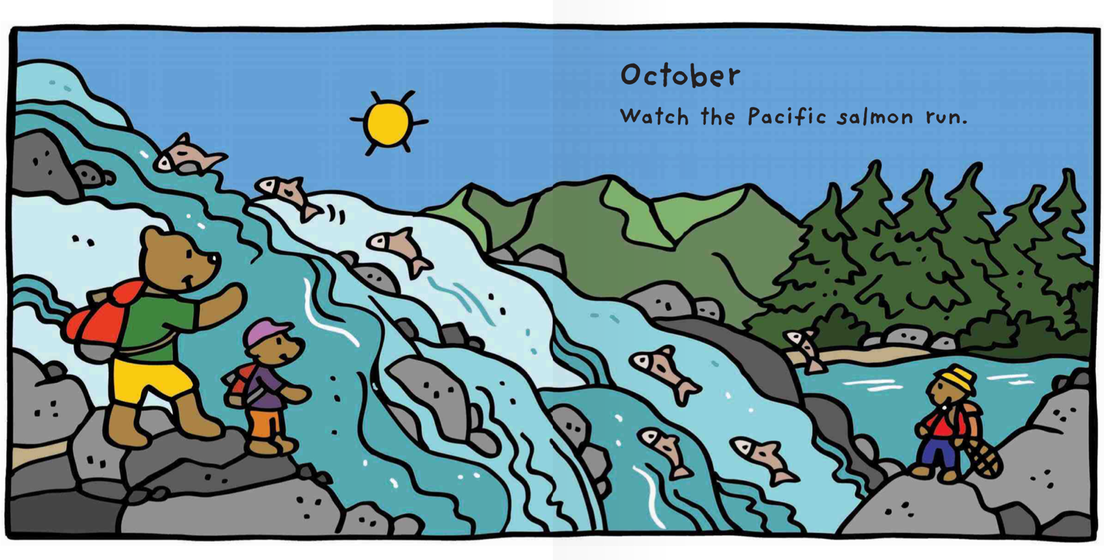
In October
we see fish!

Slide 20
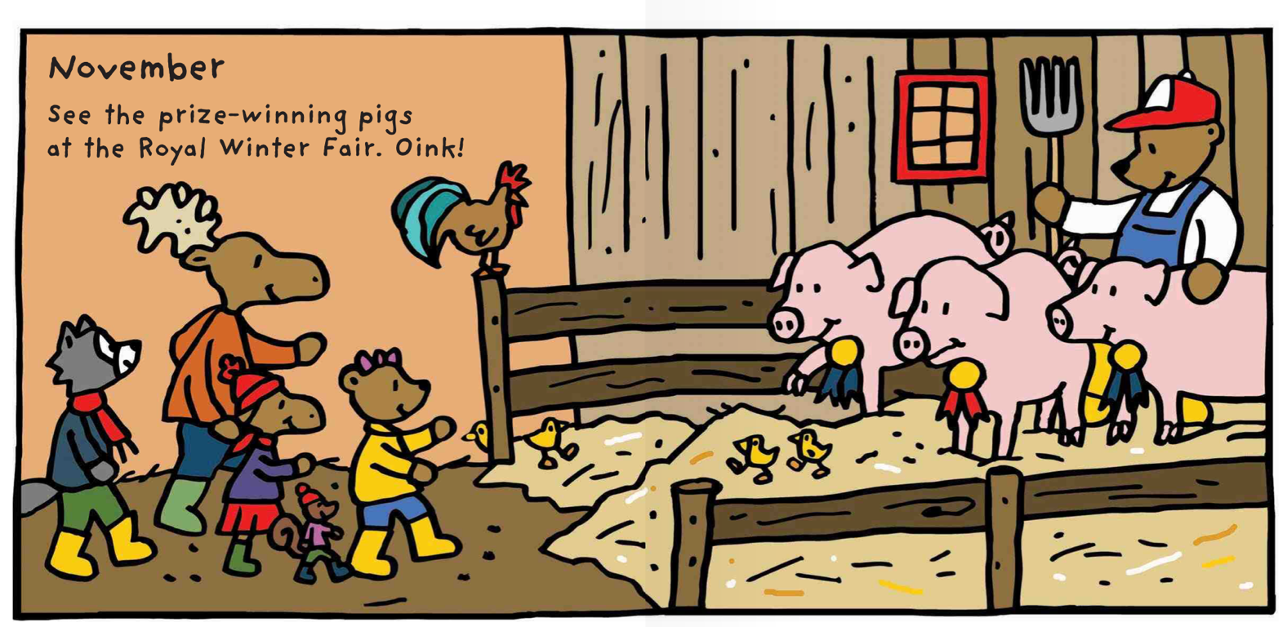
In November
we go to the fair.

Slide 21
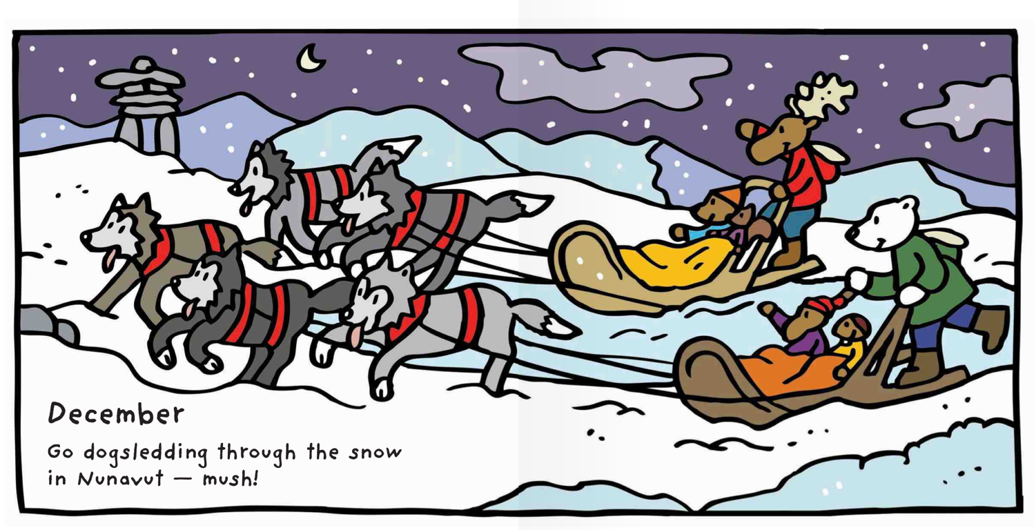
In December, we go dog sledding in the snow

Slide 22
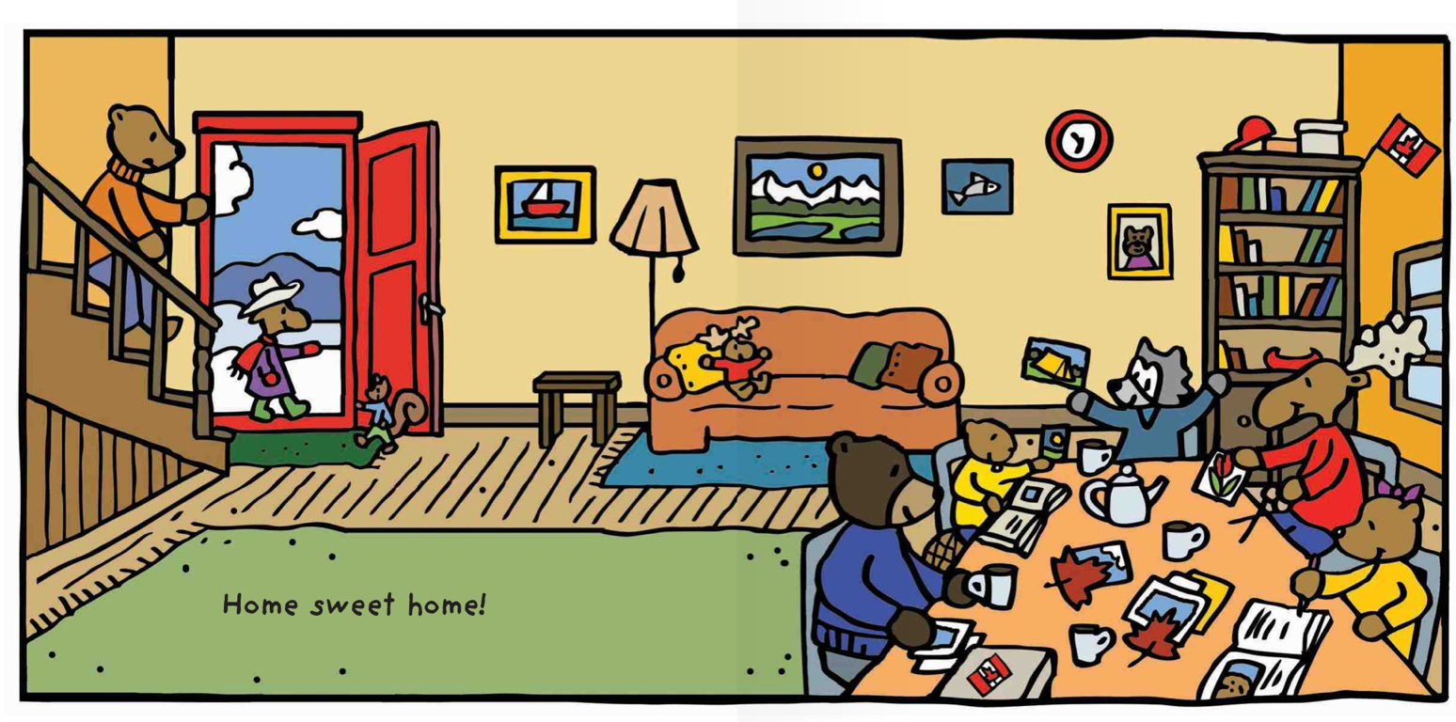
Home sweet home!

Slide 23
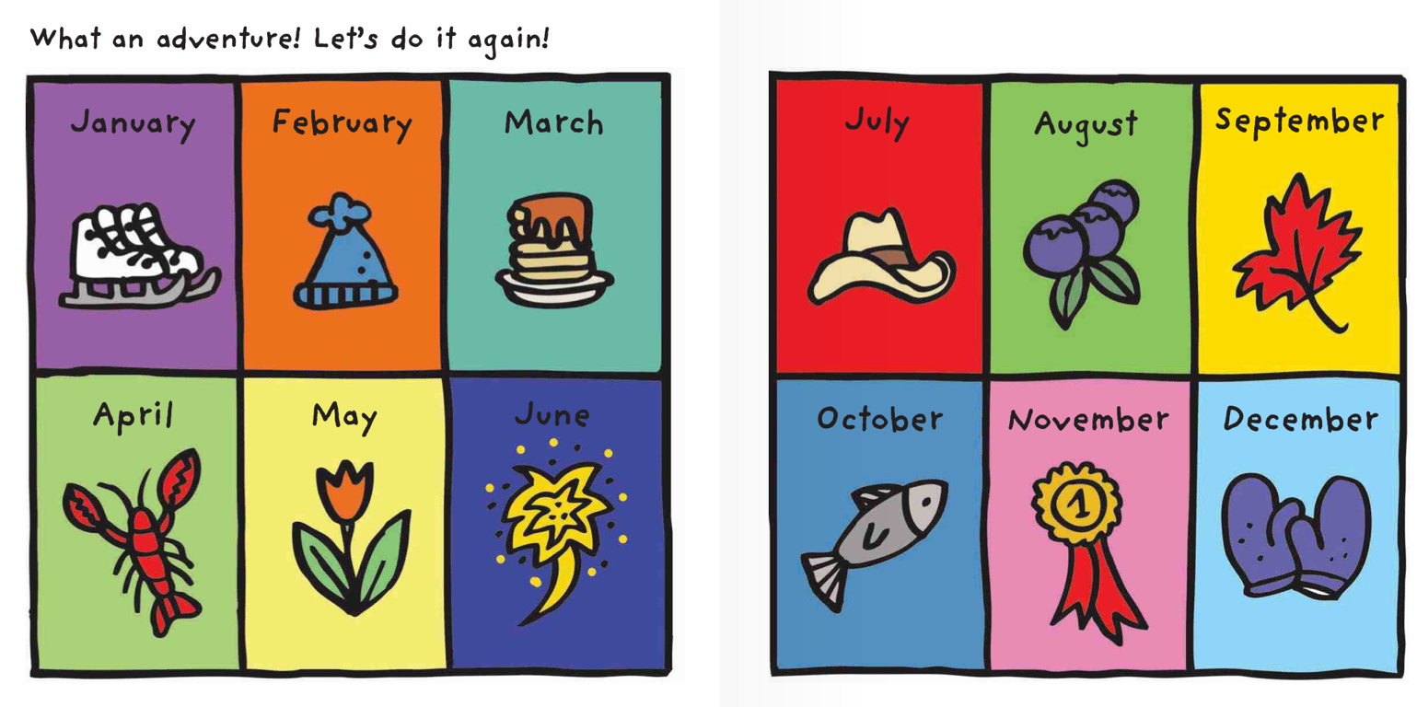
The month I like is ________________!
Notes:
Have the students talk about which month they like and why. They can circle their favourite month as well.

Slide 24
What did I just learn?
Learn new winter words
The months of the year
Notes:
Have the students read out what they have just completed and have them recap the content as well. Congratulate them!

Slide 25
Adverbs
Notes:
Adverbs. The following section has fill in the blanks with adverbs and answers on the following slides. Have the students write in the answers before you continue on to the next slide.

Slide 26
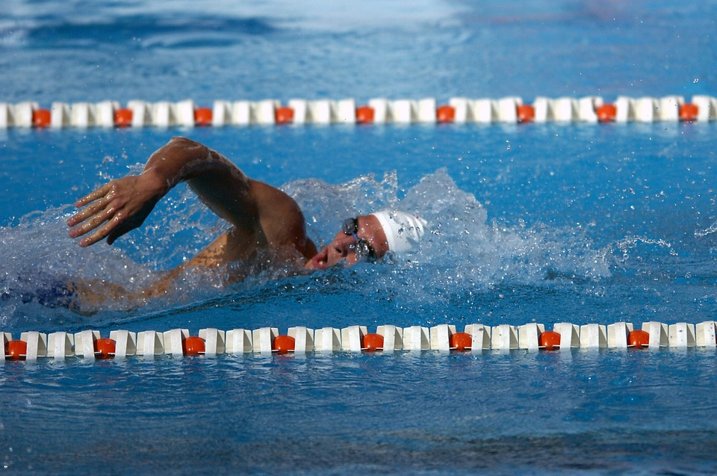
What is an adverb?
An adverb is a word that changes a verb, adjective, or sentence.
They can swim fast.
They can swim _________ fast.

Slide 27
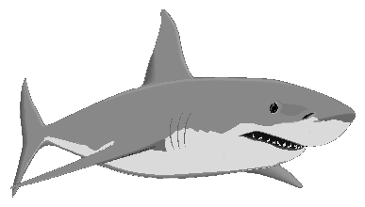
What is a bay?
An adverb is a word that changes a verb, adjective, or sentence.
They can swim fast.
They can swim very fast.

Slide 28
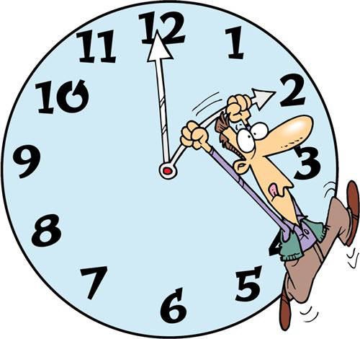
What is a bay?
An adverb usually answers questions like
How? In what way? Where? When?

Slide 29
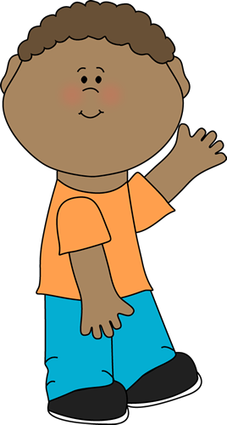
What is a bay?
An adverb usually answers questions like How? In what way? Where? When?
The boy walked past the sleeping bear.
The boy walked ________ past the sleeping bear.

Slide 30
What is a bay?
An adverb usually answers questions like How? In what way? Where? When?
The boy walked past the sleeping bear.
The boy walked quietly past the sleeping bear.

Slide 31
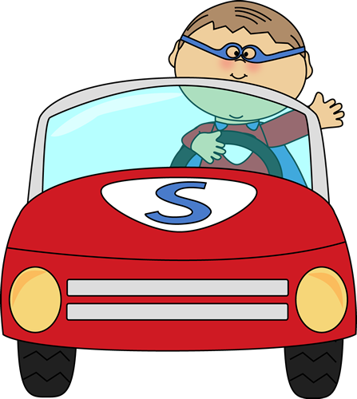
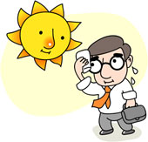
Let’s try it!
She walks ________________.
The boy ____________ drove the car.
The day was ____________ hot.

Slide 32
Let’s try it!
She walks slowly.
The boy quickly drove the car.
The day was very hot.

Slide 33
Let’s circle the adverbs!
Door
Terrible
Fishing
Hard
Noisy
Loudly
House
Cat
Quietly
Slowly
Good
Quickly
Dog
Notes:
Terrible, Loudly, Hard, Noisy, Quietly, Slowly, Good, Quickly! <- These words are the adverbs.
You can have each student use a different colour each so that you can identify which student circled what words.

Slide 34
What did I just learn?
Adverbs
Notes:
Have the students read out what they have just completed and have them recap the content as well. Congratulate them!

Slide 35
Where are we going today?
Notes:
Play the ‘Where are we going today?” video and have the students guess where they are going today.

Slide 36
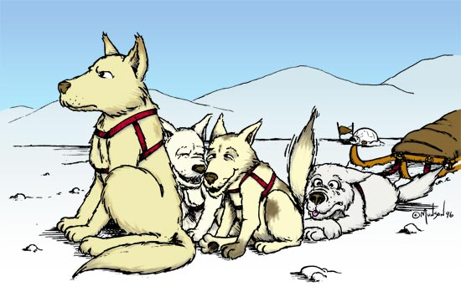
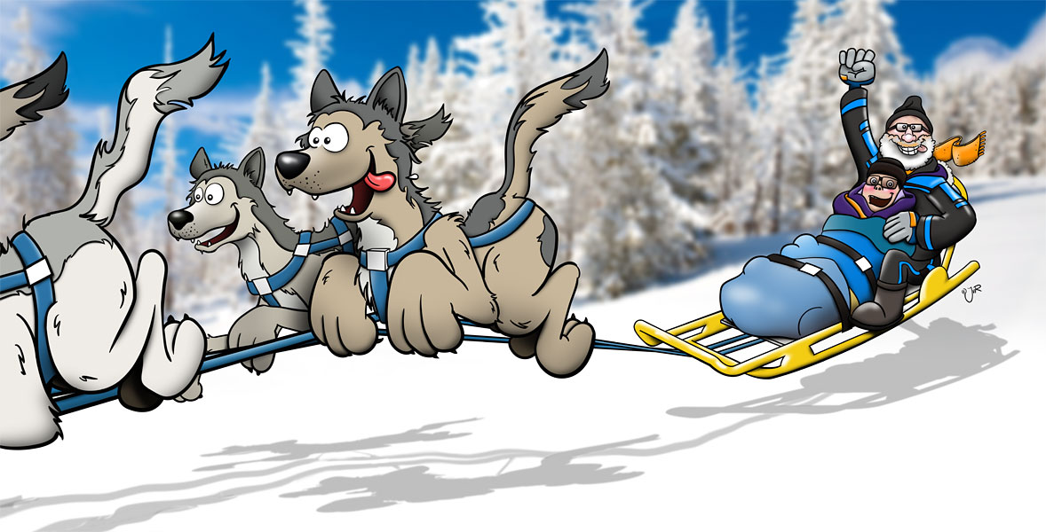
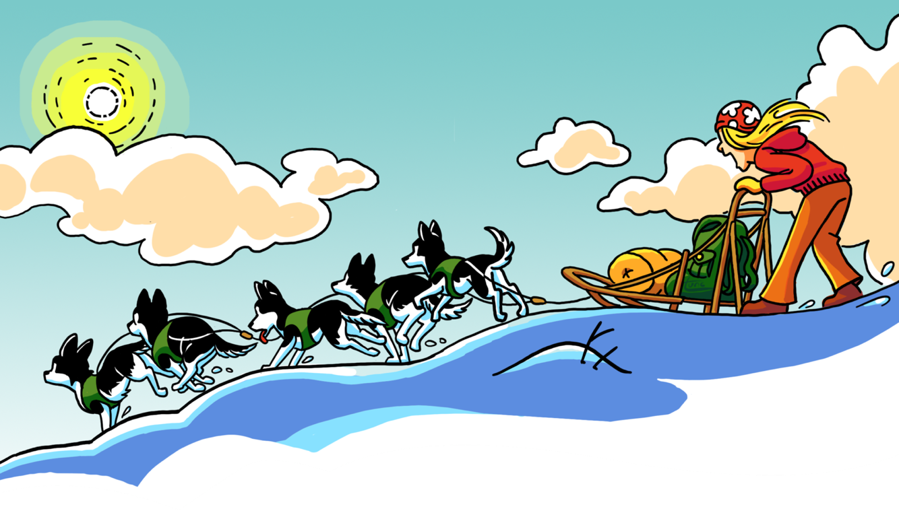
Dog Sledding
Notes:
Ask the students what they see in the pictures. Have them circle specific colours and see if they have ever seen dogsledding before, maybe on tv. Play the video “Dog Sledding” video.

Slide 37
We are going to Canada!
Notes:
Talk about Canada vs China, talk about the flags, where they are located in the world etc, see if anyone has ever been there before!

Slide 38
Question?
Would you like to go dog sledding?
Notes:
Ask the students if they would like to go dogsledding or not. Have them circle yes or no.

Slide 39
Let’s Talk
I (want / do not want) to go dog sledding because…
_________________________________________
_________________________________________
____________________
____________________
Notes:
Have the students tell you why they do or do not want to go dogsledding. Some reasons might be that it is too cold or that they are afraid.

Slide 40
In the snow I can…
Let’s brainstorm together!
Snow
Notes:
Brainstorm together about how snow would feel. write the key words on the board such as wet, cold. what are some things you could do with snow such a make snowballs, snow angels, snow forts, igloos etc..

Slide 41
What did I just learn?
Learn new winter words
Notes:
Have the students read out what they have just completed and have them recap the content as well. Congratulate them!

Slide 42
Today’s letters! -> ‘DD’
Notes:
Talk about the ‘nn’ sound and have them try it out. Write the other ‘nn’ words the students can think of on the whiteboard for them so that they know how to spell it. Have them sound the word out as well.
bandanna etc ..

Slide 43
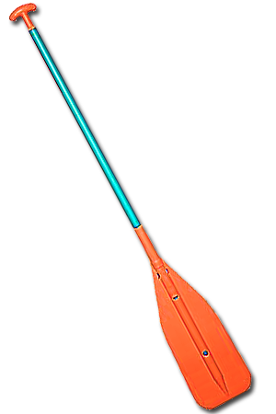
Today’s letters! -> ‘DD’
puddle
add
paddle
Notes:
Have the students fill in the blanks with their pens.

Slide 44
Today’s letters! -> ‘DD’
wedding
daddy
ladder
Notes:
Let the students know that this activity is on their worksheet which they should have in front of them. Make sure the students pens work if not ensure that you enable them to work on FastMeeting. Point out the “dd” written in red and have the students draw lines for the corresponding words.

Slide 45
What did I just learn?
Sound of the letters ‘DD’
Notes:
Have the students read out what they have just completed and have them recap the content as well. Congratulate them!

Slide 46
What is that sound?
Listen closely and see if you know what the sound is!
Notes:
Find the movie clip “Skates” and play it for the students. It is a blank image so that the students can only hear the bear and not see it. Have the students guess before showing them the next slide.

Slide 47
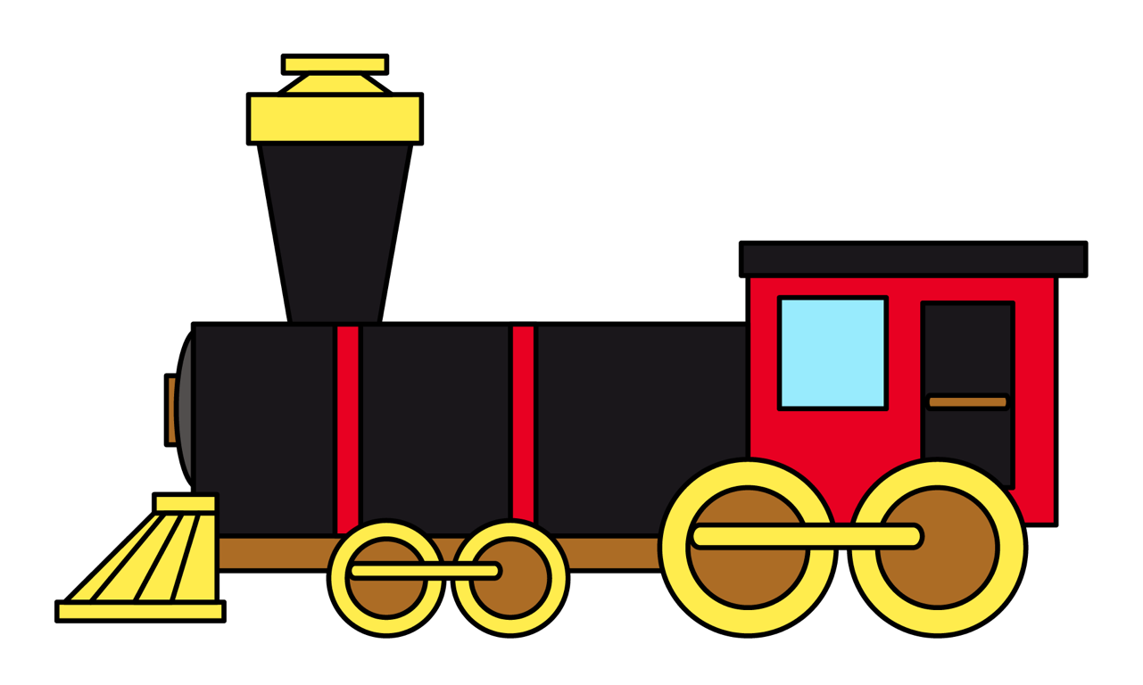
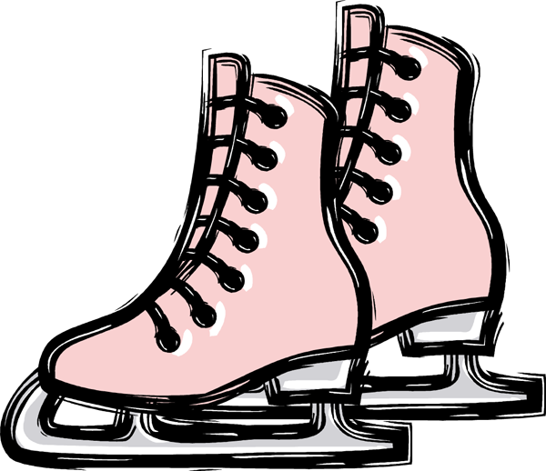
What is that sound?
Listen closely and see if you know what the sound is!
Notes:
Have them circle the what they thought the sound was. You can write the words down underneath so that the students can visualize the vocabulary.

Slide 48
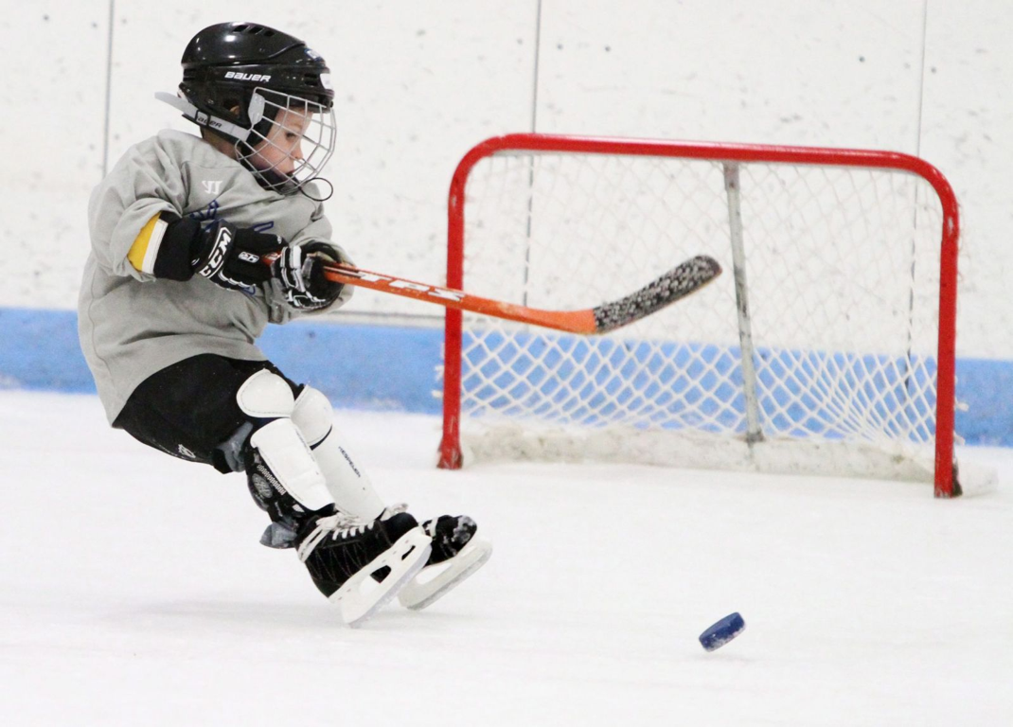
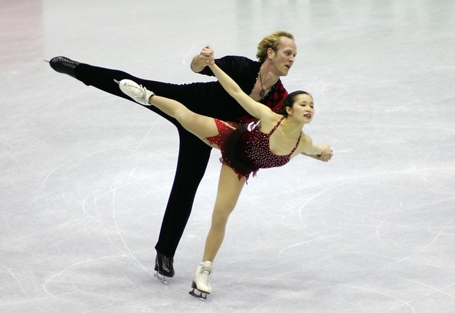
You’re right!
People put skates on their feet to travel on ice faster!
People play sports with skates like ice hockey and figure skating
Notes:
Read out the description for bears. See if they have ever seen a bear in a zoo before, ask them to tell you what it looked like, where it lived etc..

Slide 49
What did I learn today?
Adverbs
They can swim fast.
They can swim very fast.
Notes:
Have the students read out what they have just completed and have them recap the content as well. Congratulate them!

Slide 50
What did I learn today?
Sounds of the letter ‘DD’
Notes:
Have the students read the goals if they can. I find that underlining sentences and asking students to read one sentence at a time works well.

Slide 51
What did I learn today?
Learn new winter words
Notes:
Have the students read the goals if they can. I find that underlining sentences and asking students to read one sentence at a time works well.

Slide 52
What did I learn today?
Months of the year
Notes:
Have the students read out what they have just completed and have them recap the content as well. Congratulate them!

Slide 53
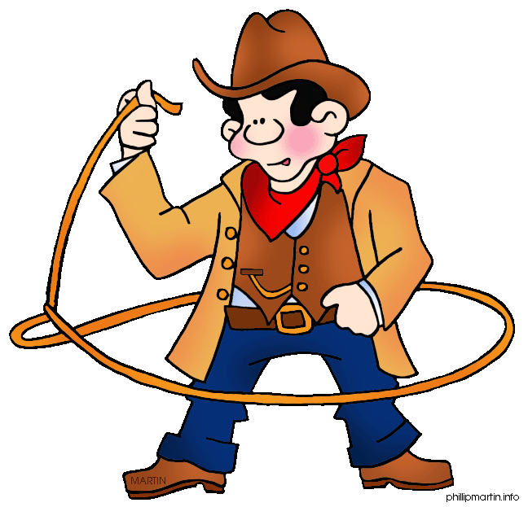
New words I learned today
fireworks
paddle
cowboy
dogsledding
Notes:
Have the students read the goal that they just completed.
Explain what they learned if needed.
Congratulate them.
write down the new vocabulary words on the board and have the students write these new words on their worksheets under “Vocabulary”. These are the words that the students should be practicing!

Slide 54
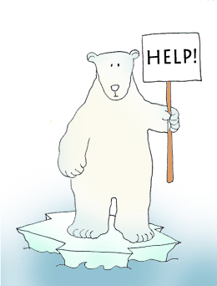
Final Thoughts
Do you have any questions?
Do you understand the handout?
Notes:
Wrap up your lesson and play the extra activities if you have any time. Answer any questions and pull up the worksheet if you want and go over the activities with them to ensure they understand.

Slide 55
Before the next class
Listen and read along with the ‘Canada All Year’ book
Read book to yourself and to your family/friends
Complete the worksheet
Practice writing new vocabulary words
Notes:
You can read these goals to them or have them read the goals if they can.
Underlining sentences and asking students to read one sentence at a time works well.

Slide 56
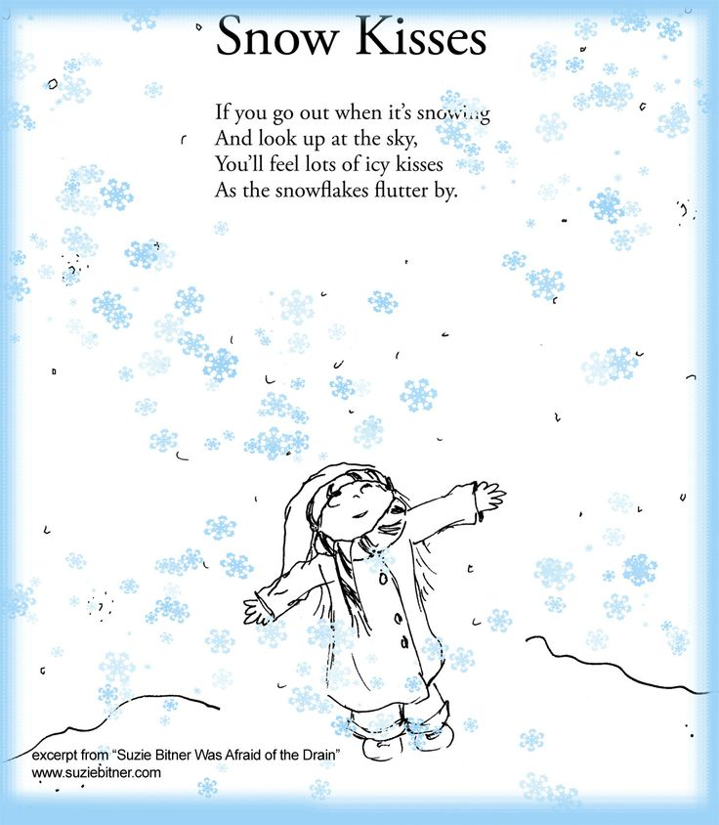
Notes:
llama on a surfboard!

Slide 57
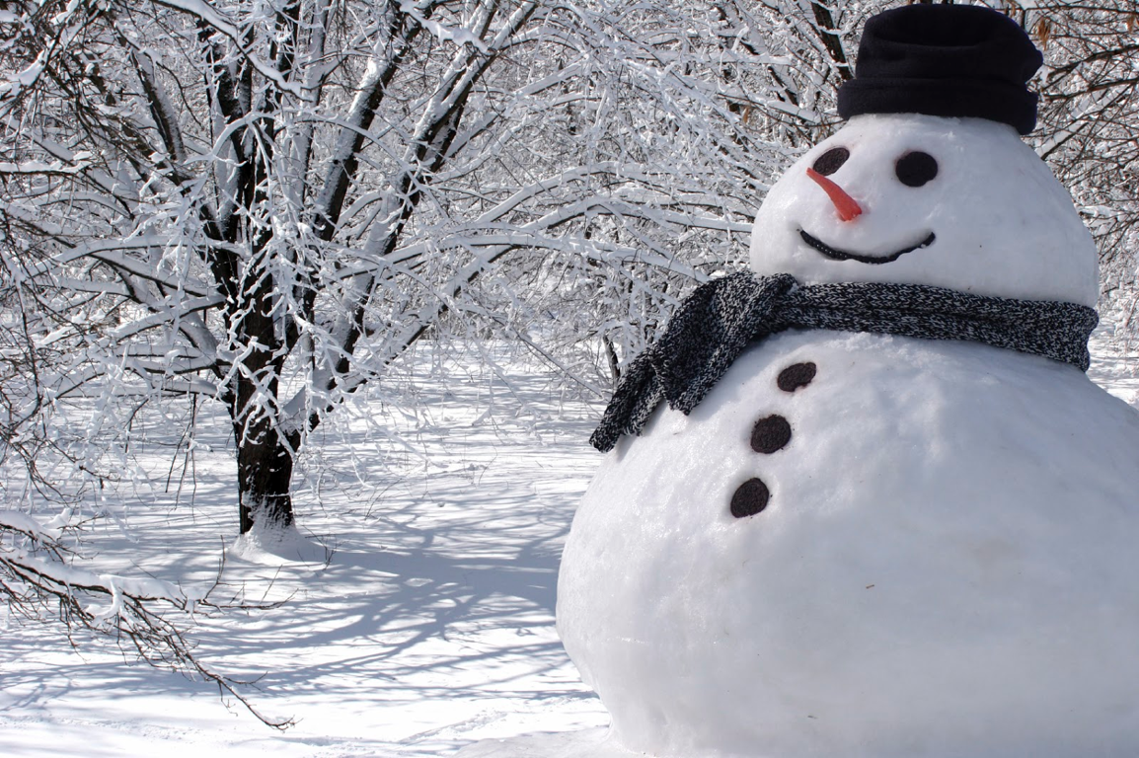
Snow
I like snow
Cold snow
White snow
Icy snow
I like snow!
Notes:
Write a story about this picture!

Slide 58
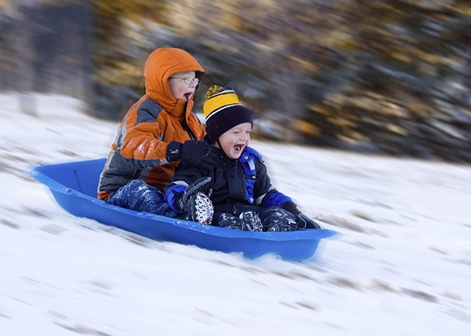
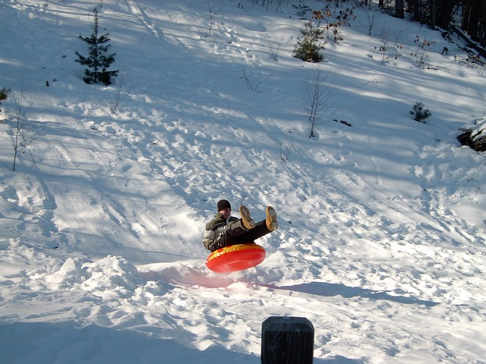
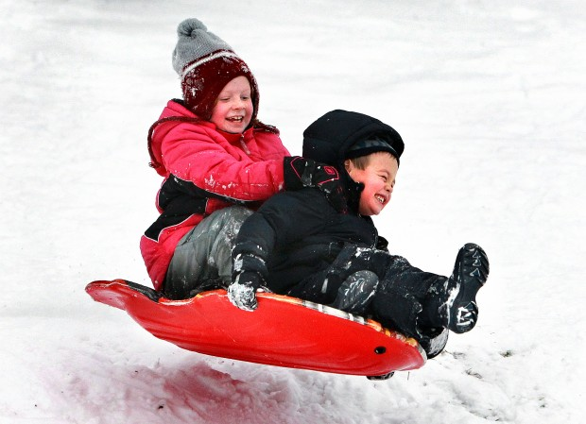
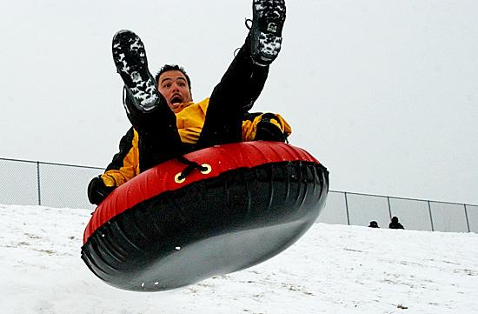
Notes:
Write a story about this picture!

