Slide 1
Adventures!

Slide 2
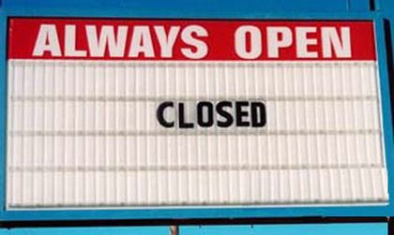
Notes:
What’s going on?” <- each lesson in this unit will have a section called Whats going on in the beginning to stimulate conversation and break the ice before class begins! Make your pen colour white and draw all of the key words on the board that the students come up with when they are describing or talking about the picture.

Slide 3
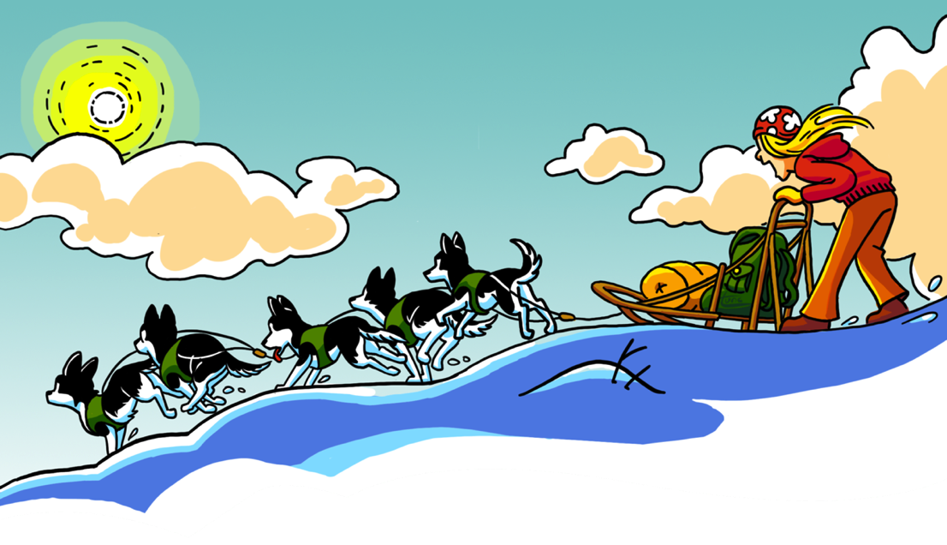
What did I learn last class?
Adverbs
Sounds of the letter ‘DD’
New Winter words
Notes:
Have the students read out what they have just completed and have them recap the content as well. Congratulate them!

Slide 4
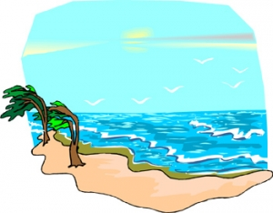
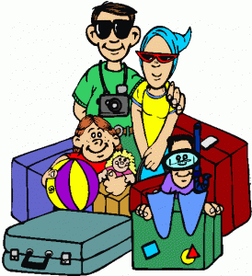
Adventures

Slide 5
What will I review today?
Sounds of the letters ‘TT’, ‘PP’, ‘NN’, ‘MM’, and ‘DD’
Word Banks
Word Walls
New Safari words
Notes:
Have the students read out the learning goals for the day.

Slide 6
What is that sound?
Listen closely and see if you know what the sound is!
Notes:
Find the movie clip “LionRoar” and play it for the students. It is a blank image so that the students can only hear the lion roaring and not see it. Have the students guess before showing them the next slide.

Slide 7
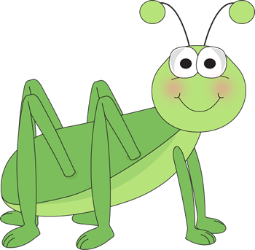
What is that sound?
Listen closely and see if you know what the sound is!
Notes:
Have them circle the what they thought the sound was. You can write the words down underneath so that the students can visualize the vocabulary.

Slide 8
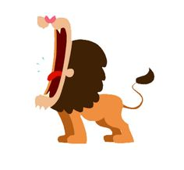
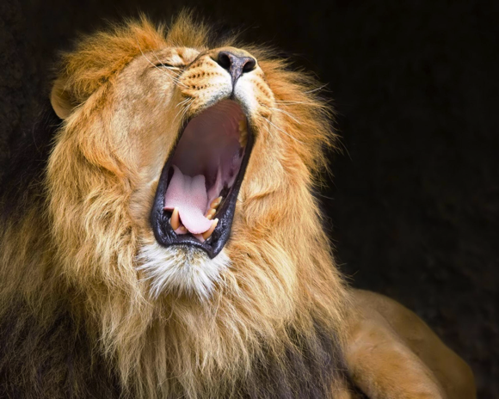
You’re right!
A lion roars to talk to other lions
Lions roar to tell others to stay away.
Notes:
Read out the description for bears. See if they have ever seen a bear in a zoo before, ask them to tell you what it looked like, where it lived etc..

Slide 9
Story Time!
Where are we going today ?!
Notes:
You can ask the students where they think they are going today.
Play the movie clip called “Where are we going today?”

Slide 10
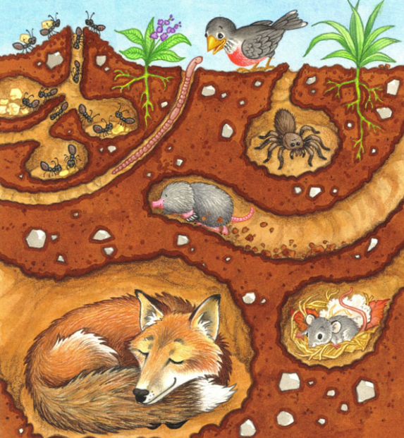
We are going underground!
Notes:
You can ask the students where they think they are going today.
Play the movie clip called “Where are we going today?”
See if the students know which animals are in the pictures.

Slide 11
Notes:
llama on a surfboard!

Slide 12
Phones
Holes
Black
__________

Slide 13
Holes

Slide 14
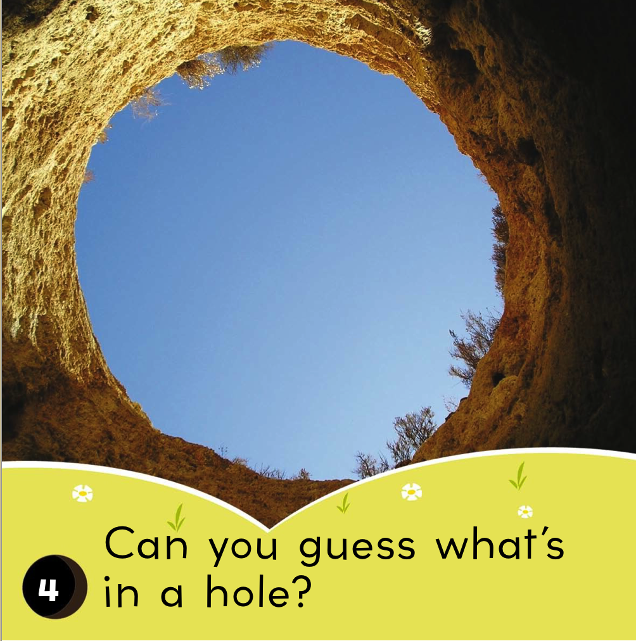

Slide 15
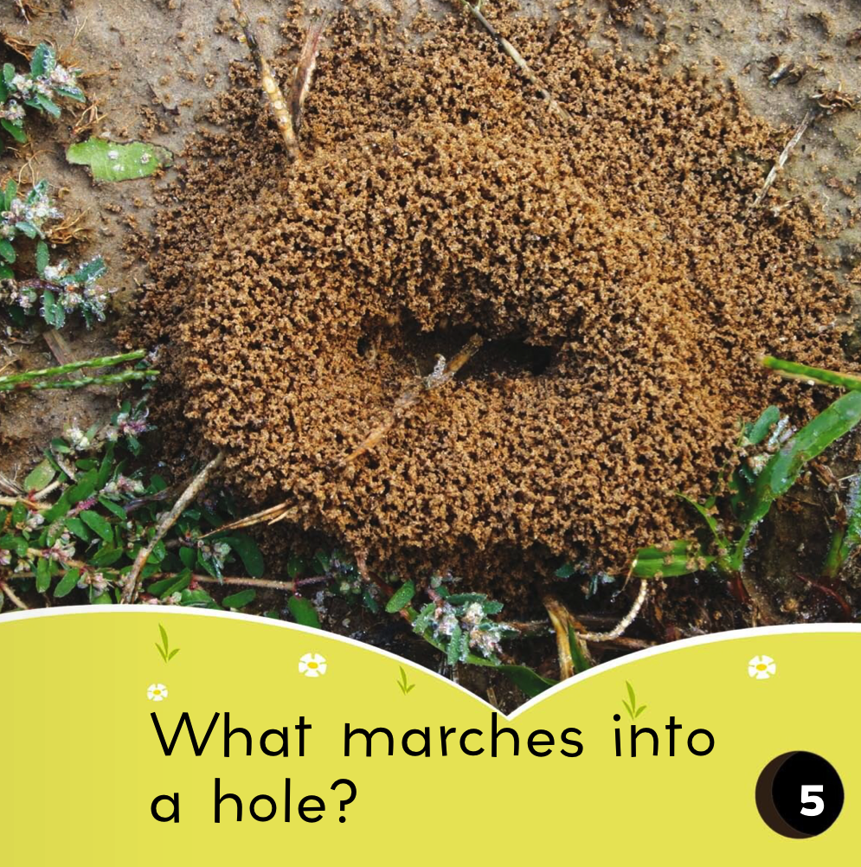

Slide 16
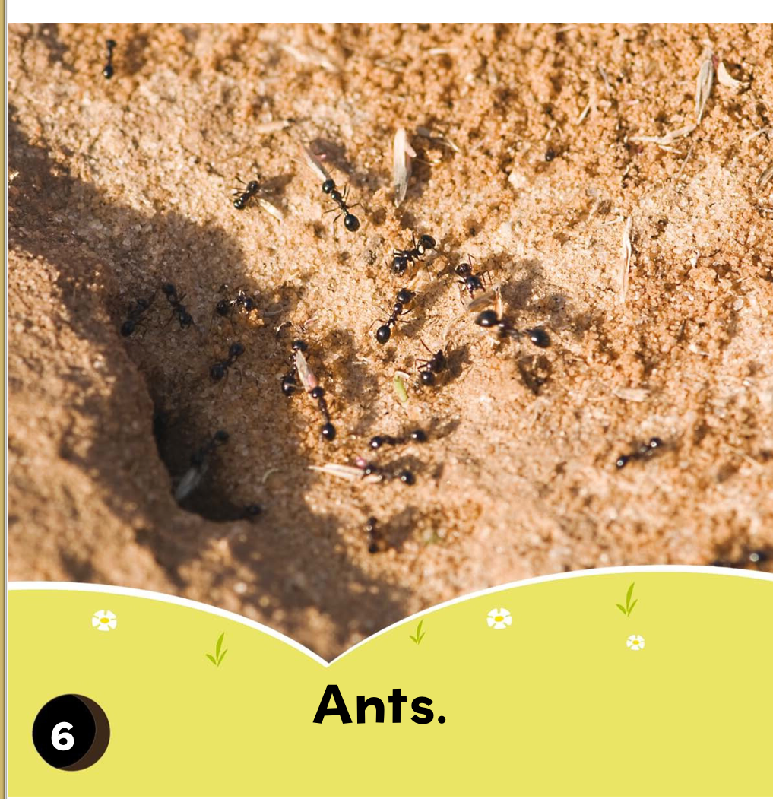
Ants
Birds
Spiders
__________

Slide 17
Ants

Slide 18
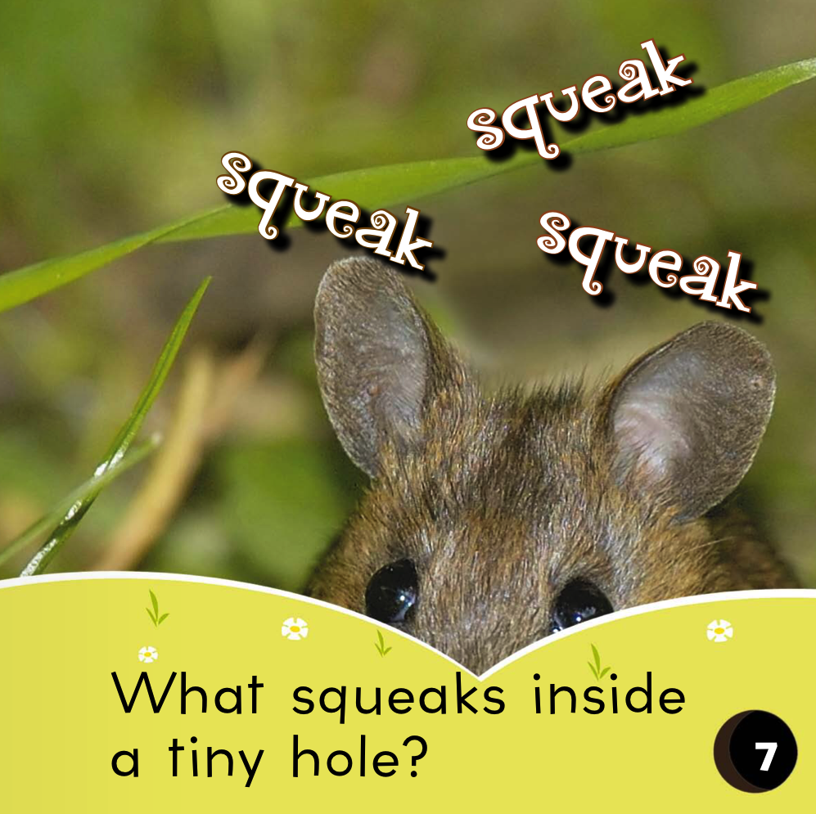

Slide 19
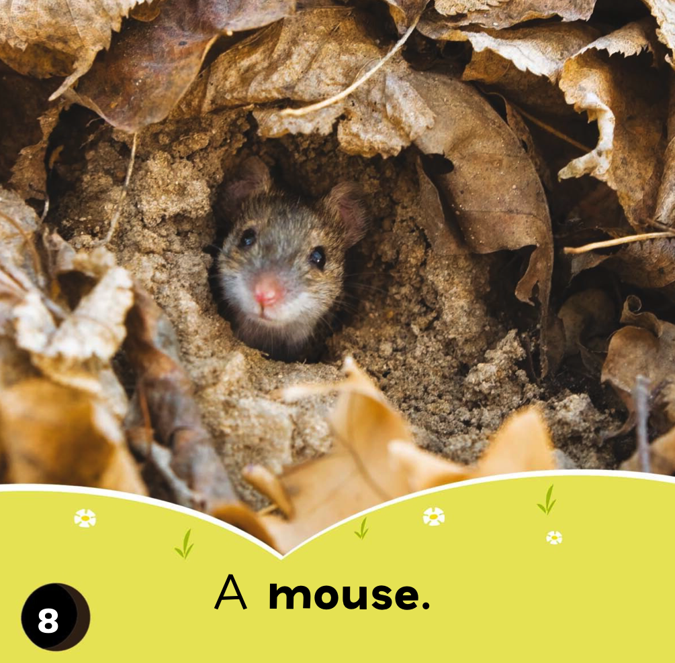
Dog
Rabbit
Mouse
__________

Slide 20
Mouse

Slide 22
Rabbits
Frogs
Fish
__________

Slide 23
Rabbits

Slide 25
Bear
Prairie Dogs
Cat
__________

Slide 26
Prairie Dogs

Slide 27
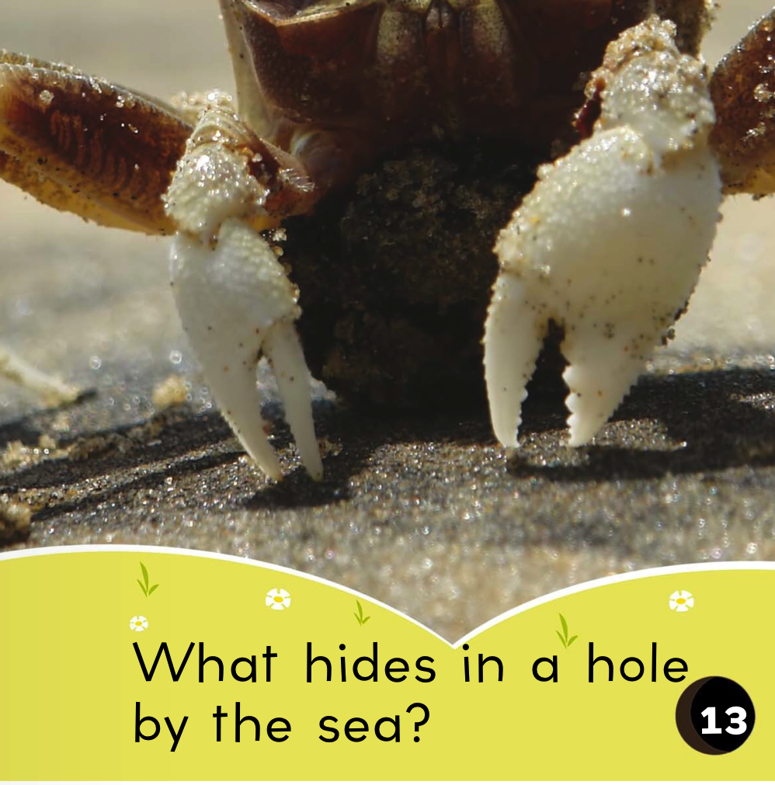

Slide 28
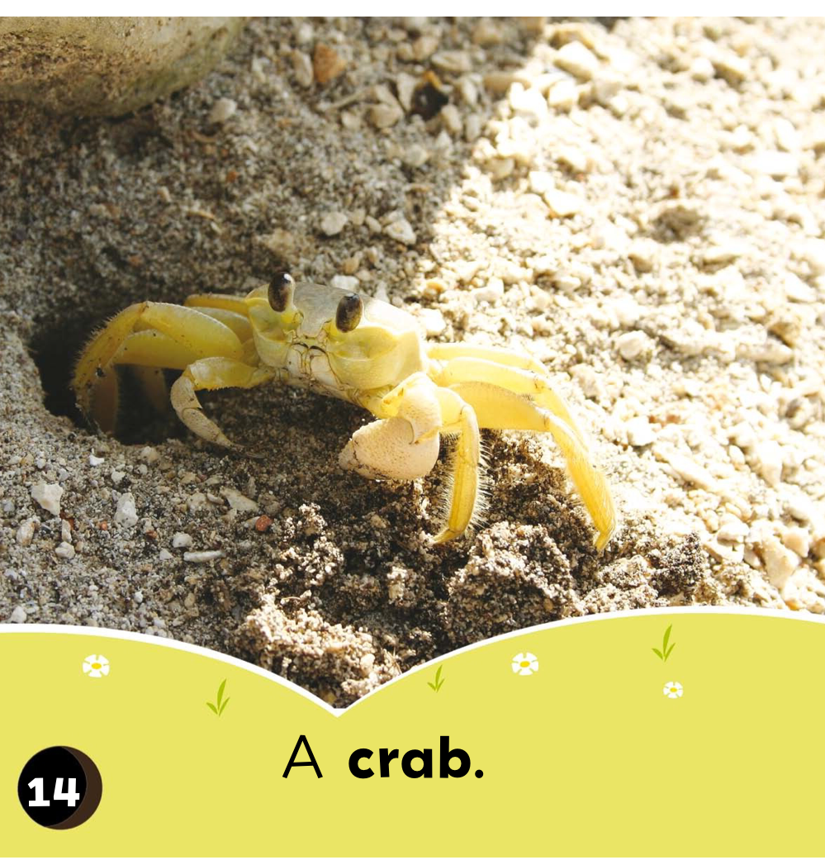
Pig
Monkey
Crab
__________

Slide 29
Crab

Slide 30
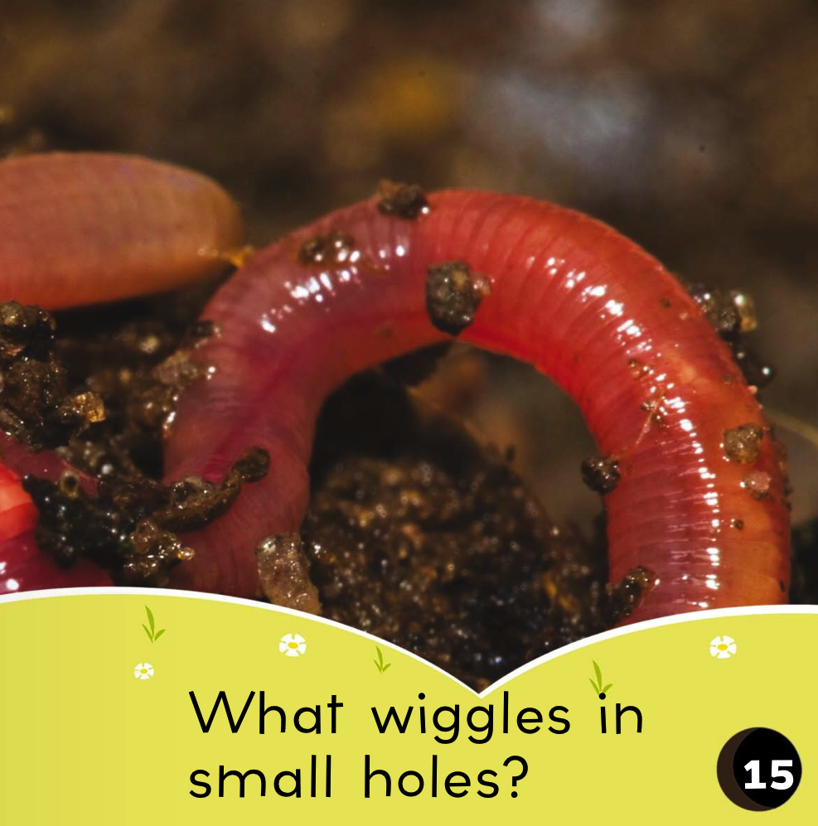

Slide 31
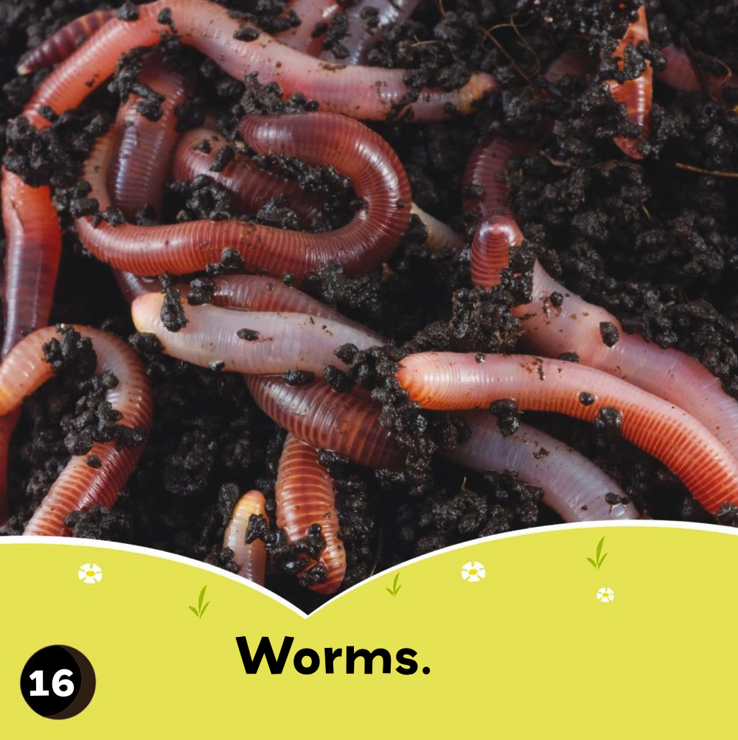
Chickens
Cows
Worms
__________

Slide 32
Worms

Slide 33
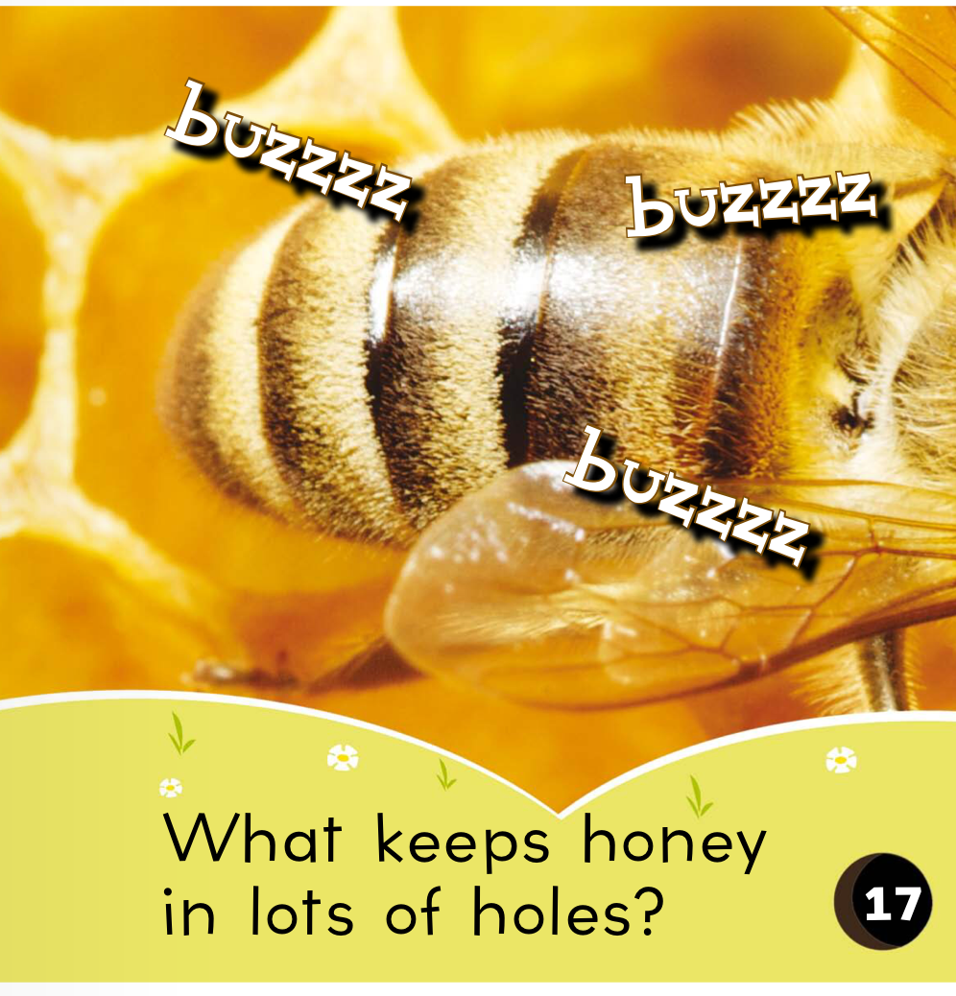

Slide 34
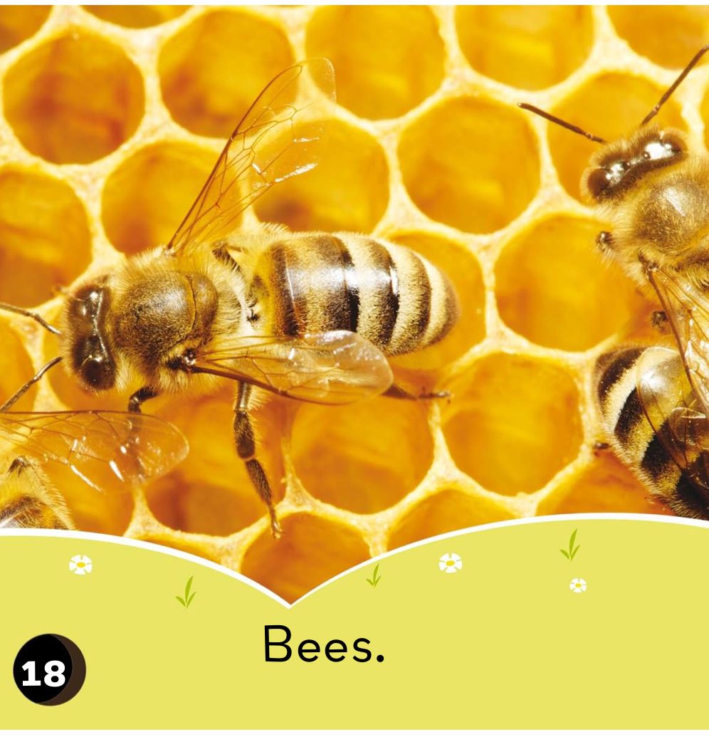
Ants
Bees
Bats
__________

Slide 35
Bees

Slide 36
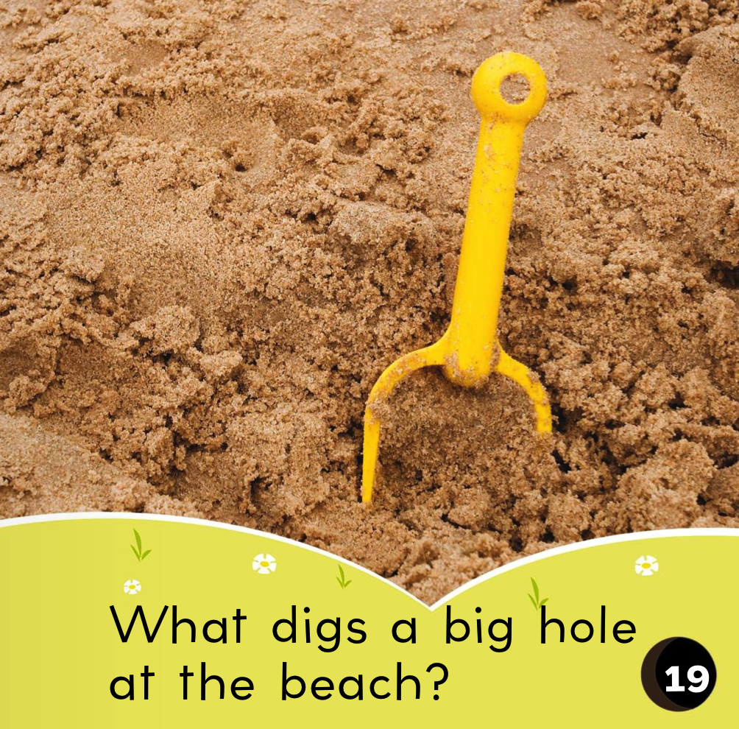

Slide 37
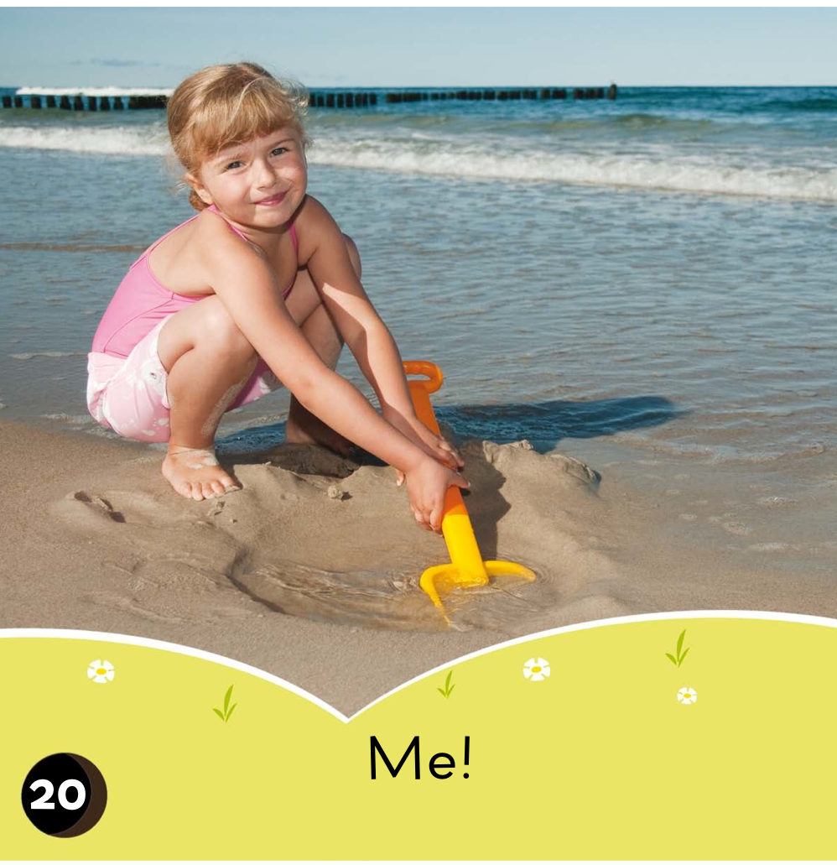

Slide 38
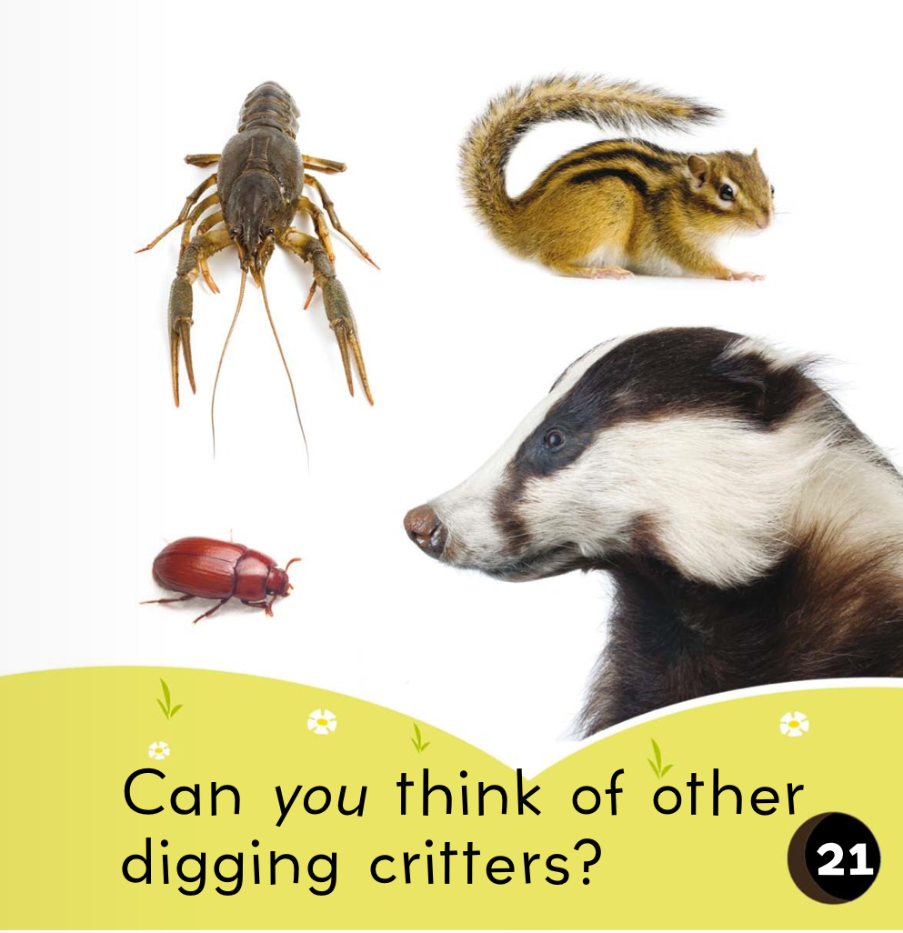

Slide 39
What did I just learn?
Word banks
Word walls
Notes:
Have the students read out what they have just completed and have them recap the content as well. Congratulate them!

Slide 40
Where are we going today?
Notes:
Play the ‘Where are we going today?” video and have the students guess where they are going today.

Slide 41
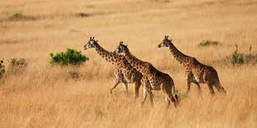
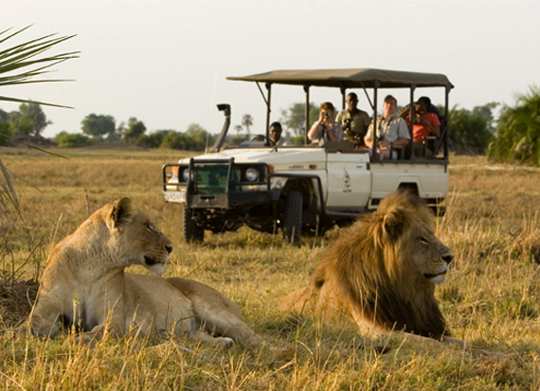
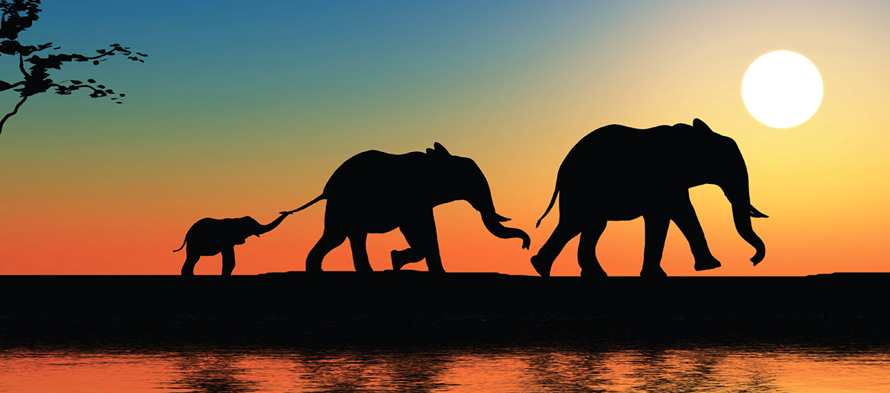
Safari in Africa
Notes:
Point out key words from the safari, like the types of animals that are in the picture.

Slide 42
We are going to Africa!
Notes:
Talk about how far Africa is from China, talk about the different colours of the flags. You can even see how long of a plane ride it is from China to Africa!

Slide 43
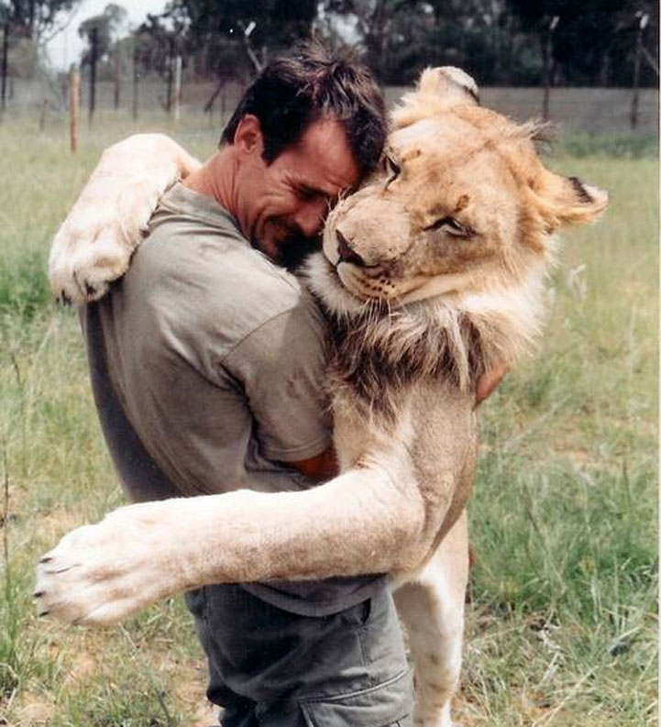
Question?
Do you want to play with lions
Notes:
Ask the students if they would like to go dogsledding or not. Have them circle yes or no.

Slide 44
Let’s Talk
I (want / do not want) to play with lions because
_________________________________________
_________________________________________
_________________________________________
_________________________________________
Notes:
Have the students tell you why they do or do not want to go dogsledding. Some reasons might be that it is too cold or that they are afraid.

Slide 45
What did I just learn?
New Safari words
Notes:
Have the students read out what they have just completed and have them recap the content as well. Congratulate them!

Slide 46
Review: Double Consonant
Notes:
These are all of the letters we did from lessons 1-5!

Slide 47
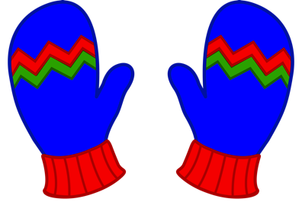
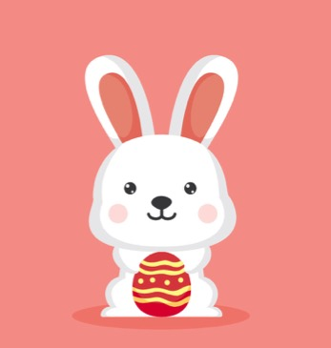
Review
__tt__
__pp__
__nn__
__mm__
__dd__
Notes:
Have the students fill in the blanks with their pens.

Slide 48
What did I just learn?
Sounds of the letters ‘tt’, ‘pp’, ‘nn’, ‘mm’,’dd’
Notes:
Have the students read out what they have just completed and have them recap the content as well. Congratulate them!

Slide 49
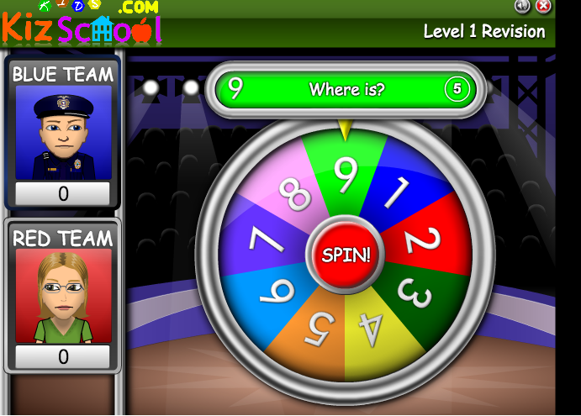
Review Game
Notes:
Share your screen with the students and have them play this interactive game with you using pictoral induction in order to complete sentences in the present tense. Be sure to try the game out yourself before the lesson! To make this more fun, write in the students names above the images ! Please find the link below.
http://www.eslgamesworld.com/Revision/Level1/play.html

Slide 50
Review Game
Notes:
Take this moment to talk about any new words or content that arose in the game, write down any key words on the whiteboard to further students understanding.

Slide 51
What did I learn today?
Sounds of the letters ‘tt’, ‘pp’, ‘nn’, ‘mm’,’dd’
Notes:
Have the students read out what they have just completed and have them recap the content as well. Congratulate them!

Slide 52
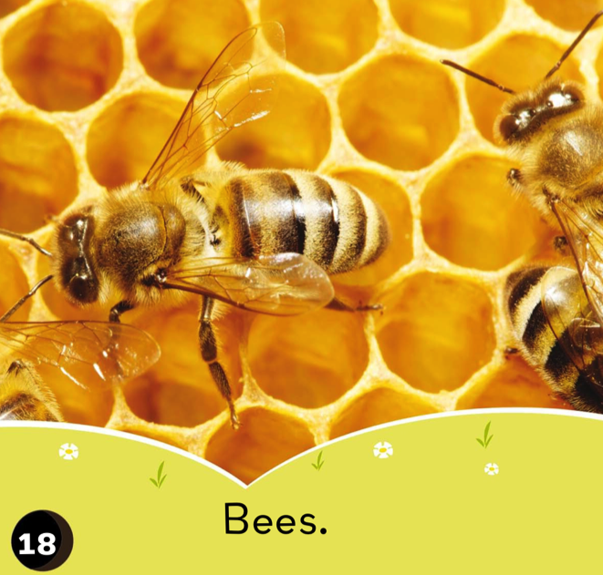
What did I learn today?
Word Banks
Word Walls
Notes:
Have the students read the goals if they can. I find that underlining sentences and asking students to read one sentence at a time works well.

Slide 53
What did I learn today?
New Safari Words
Notes:
Have the students read the goals if they can. I find that underlining sentences and asking students to read one sentence at a time works well.

Slide 54
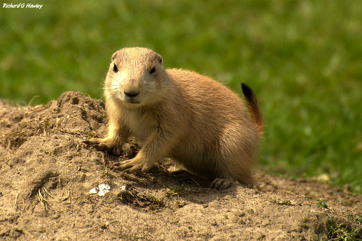
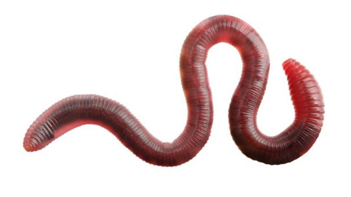
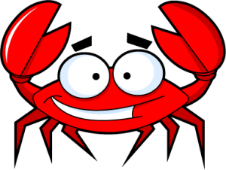
New words I learned today
prairie dogs
worms
safari
crab
Notes:
Have the students read the goal that they just completed.
Explain what they learned if needed.
Congratulate them.
write down the new vocabulary words on the board and have the students write these new words on their worksheets under “Vocabulary”. These are the words that the students should be practicing!

Slide 55
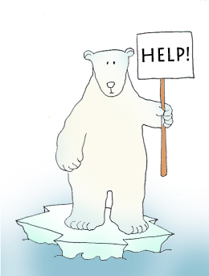
Final Thoughts
Do you have any questions?
Do you understand the handout?
Notes:
Take this time to see if the students have any questions and if they would like to go over the handout and fill in some of the questions they had difficulty with.

Slide 56
Before the next class
Listen and read along with the ‘What’s in a hole’ book
Read book to yourself and to your family/friends
Complete the worksheet
Practice writing new vocabulary words
Notes:
You can read these goals to them or have them read the goals if they can.
Underlining sentences and asking students to read one sentence at a time works well.

Slide 57
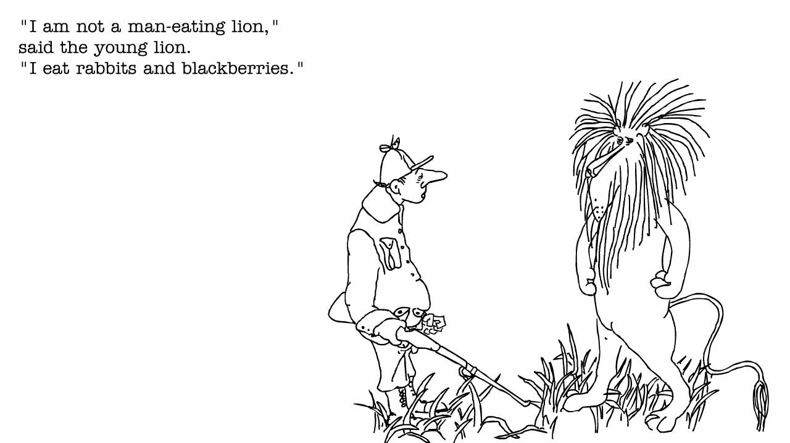

Slide 58
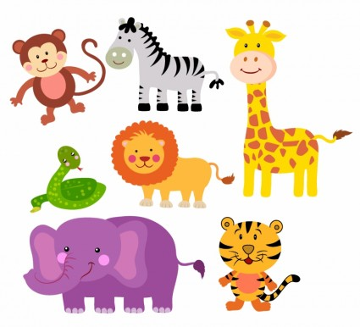
Like a.....
I run like a _________________.
I eat like a _________________.
I sleep like a________________.
I swim like a ________________.
I play like a ________________.
I walk like a_________________.
Notes:
Write a story about this picture!

