Slide 1


Adventures!

Slide 2
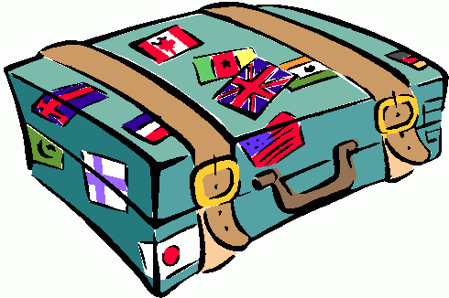


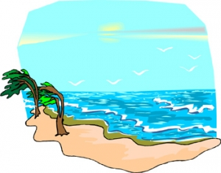
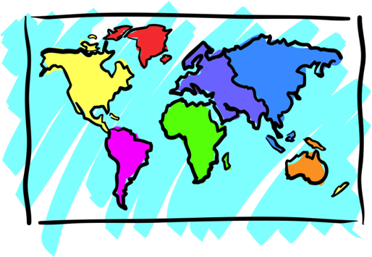


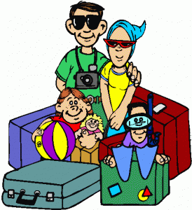

Adventures

Slide 3



What will I learn today?
Sound of the letters ‘gg’ and ‘ff’
Answering questions
Using Questions Marks: ??
Notes:
Have the students read out the learning goals for the day.

Slide 4


Slide 5
All around and under the sea.
Look around and explore with me!
What do you see ?

Slide 6
It is fun to explore in the water so blue. There are lots of nice fish and plants too!

Slide 7
It is fun to explore in the water so blue. There are lots of nice fish and plants too!
Can you show me the plants and fish ?

Slide 8
Look at all the fish swimming in a school.
Swimming underwater
is very cool!

Slide 9
Look at all the fish swimming in a school.
Swimming underwater
is very cool!
When a lot of fish swim together it is called a SCHOOL OF FISH!

Slide 10
Starfish, sunfish.
I wonder why
some fish sound like they should be in the sky!

Slide 11
Starfish, sunfish.
I wonder why
some fish sound like they should be in the sky!
Why do starfish and sunfish belong in the sky ?

Slide 12
One fish. Two fish.
Three fish. Four fish.

Slide 13
One fish. Two fish.
Three fish. Four fish.
How many blue fish
can you count?

Slide 14
I love to explore the sea so blue! It is even more fun with you!

Slide 15
I love to explore the sea so blue! It is even more fun with you!
What is your
favourite fish?

Slide 16


What did I just learn?
Questions & Question Marks
Answering Questions
Notes:
Have the students read out what they have just completed and have them recap the content as well. Congratulate them!

Slide 17


Today’s Letters!

Slide 18


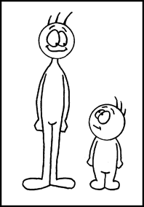
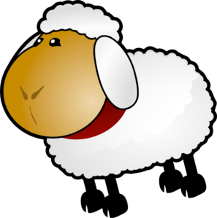


Today’s letters! -> ‘GG’ ‘FF’

Slide 19
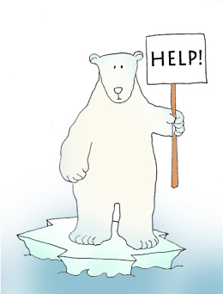

Final Thoughts
Do you have any questions?
Do you understand the handout?
Notes:
Take this time to see if the students have any questions and if they would like to go over the handout and fill in some of the questions they had difficulty with.

