Slide 1


Adventures!

Slide 2

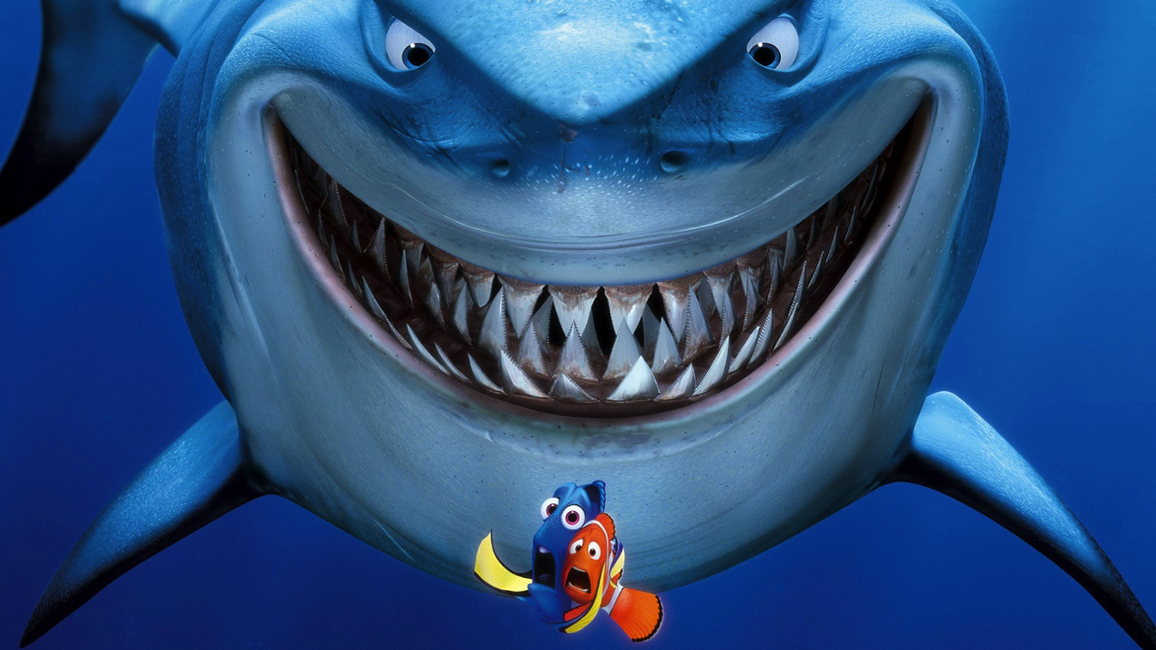
Notes:
What’s going on?” <- each lesson in this unit will have a section called Whats going on in the beginning to stimulate conversation and break the ice before class begins! Make your pen colour white and draw all of the key words on the board that the students come up with when they are describing or talking about the picture.

Slide 3

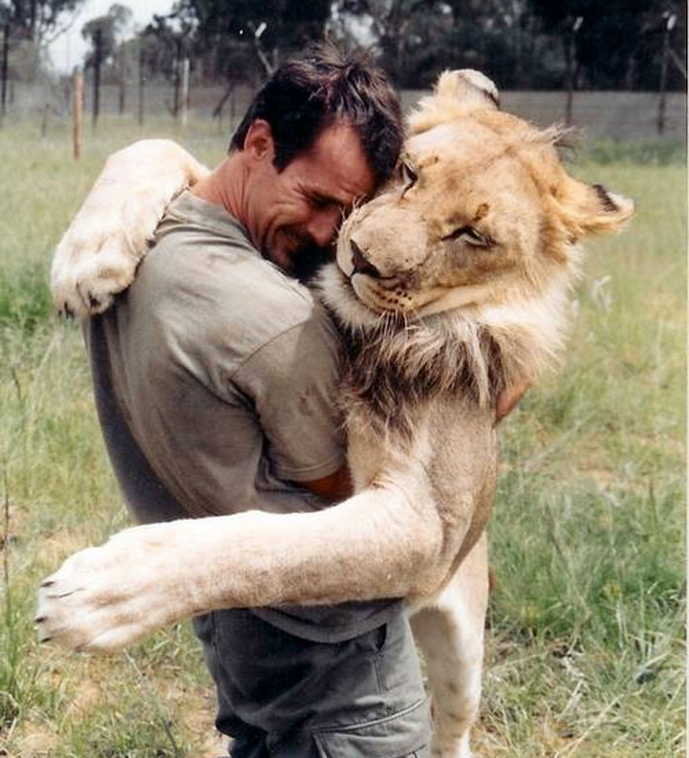
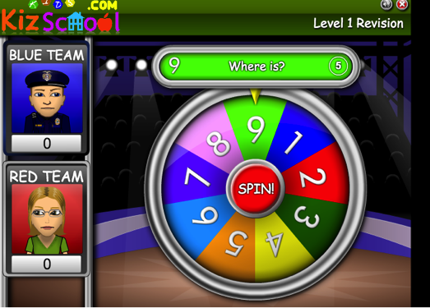
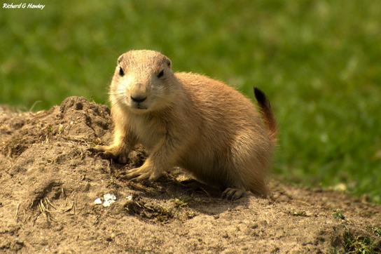

What did I learn last class?
Sounds of the letters ‘tt’, ‘pp’, ‘nn’, ‘mm’,’dd’
Word Banks
Word Walls
New safari words
Notes:
Have the students read out what they have just completed and have them recap the content as well. Congratulate them!

Slide 4
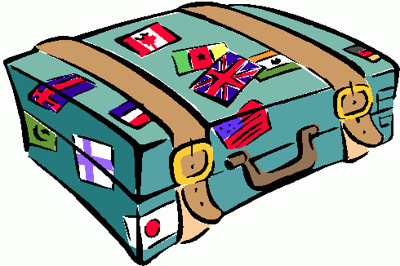


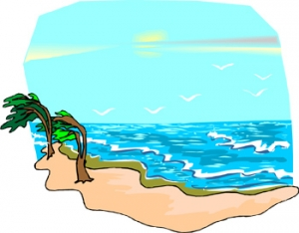
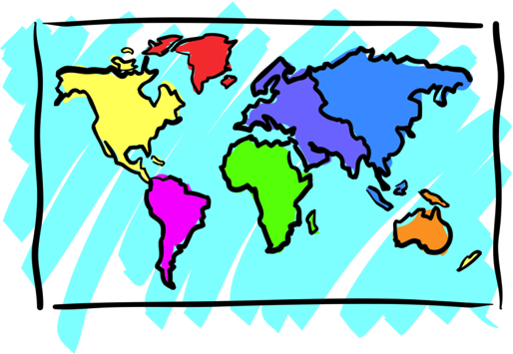


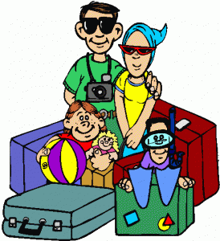

Adventures

Slide 5

What will I learn today?
Sound of the letters ‘gg’ and ‘ff’
Answering questions
Using Questions Marks: ??
Notes:
Have the students read out the learning goals for the day.

Slide 6

What is that sound?
Listen closely and see if you know what the sound is!
Notes:
Find the movie clip “wave” and play it for the students. It is a blank image so that the students can only hear the lion roaring and not see it. Have the students guess before showing them the next slide.

Slide 7
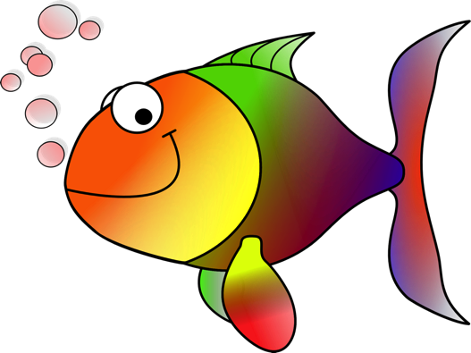

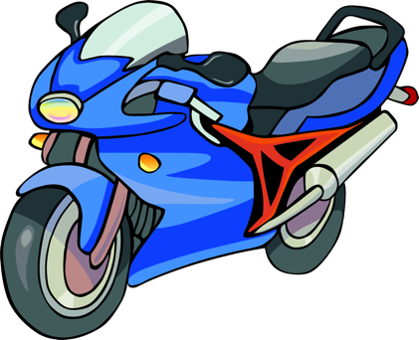
What is that sound?
Listen closely and see if you know what the sound is!
Notes:
Have them circle the what they thought the sound was. You can write the words down underneath so that the students can visualize the vocabulary.

Slide 8
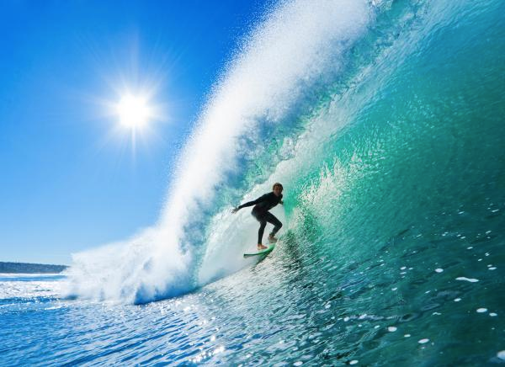
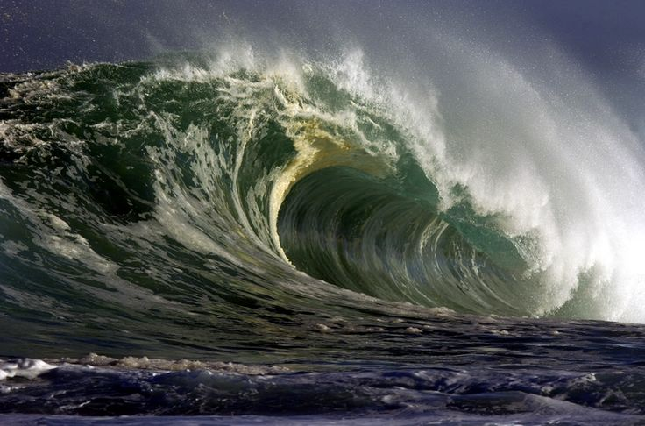
You’re right!
SPLASH! It is waves crashing!
Surfers use waves for fun!
Notes:
Read out the description.

Slide 9

Where are we going today?
Notes:
Play the ‘Where are we going today?” video and have the students guess where they are going today.

Slide 10
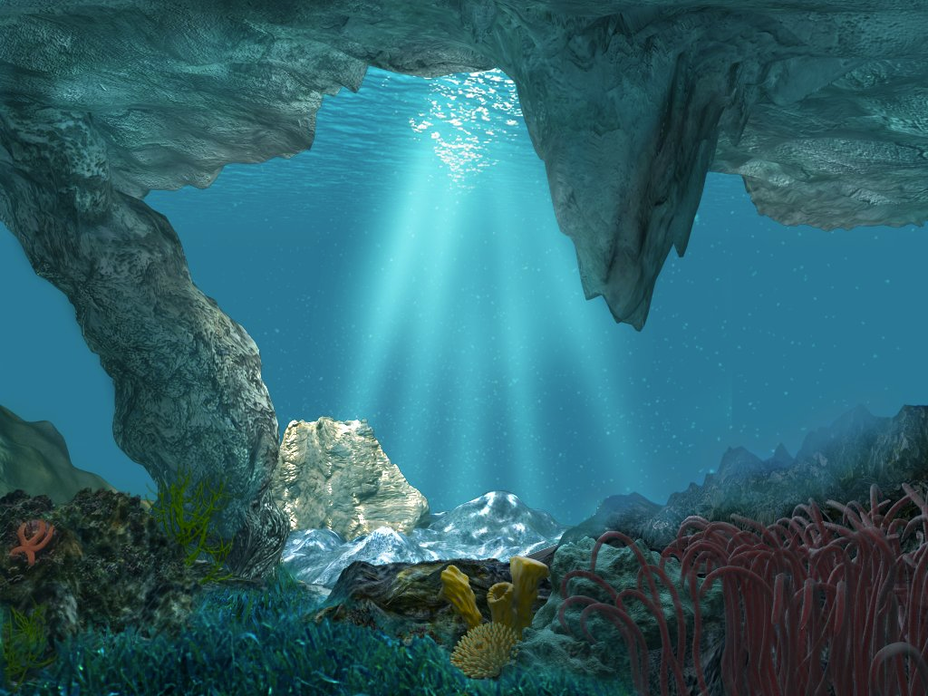
We are going UNDERWATER!

Slide 11

What lives underwater?

Slide 12


Slide 13
All around and under the sea.
Look around and explore with me!
What do you see ?

Slide 14
It is fun to explore in the water so blue. There are lots of nice fish and plants too!

Slide 15
It is fun to explore in the water so blue. There are lots of nice fish and plants too!
Can you show me the plants and fish ?

Slide 16
Look at all the fish swimming in a school.
Swimming underwater
is very cool!

Slide 17
Look at all the fish swimming in a school.
Swimming underwater
is very cool!
When a lot of fish swim together it is called a SCHOOL OF FISH!

Slide 18
Starfish, sunfish.
I wonder why
some fish sound like they should be in the sky!

Slide 19
Starfish, sunfish.
I wonder why
some fish sound like they should be in the sky!
Why do starfish and sunfish belong in the sky ?

Slide 20
One fish. Two fish.
Three fish. Four fish.

Slide 21
One fish. Two fish.
Three fish. Four fish.
How many blue fish
can you count?

Slide 22
I love to explore the sea so blue! It is even more fun with you!

Slide 23
I love to explore the sea so blue! It is even more fun with you!
What is your
favourite fish?

Slide 24

Question Mark
To show that we are asking a question we use a ‘Question Mark’ at the end of a sentence.
Example:
What is your name ?

Slide 25

Question Mark
Most questions ask :
Who
What
Where
When
Why
How

Slide 26


Let’s Practice!
Add the question mark in the right spot!
What is your name
How old are you
What school do you go to

Slide 27

Let’s Practice!
Circle the sentences that ask a question.
I like swimming
Do you like fish
I am going to the store
Do you want to come to the store

Slide 28
Let’s Practice!
Circle the sentences that ask a question.
Who ate the cookies
Where is the cat
I am doing homework
Leave me alone

Slide 29
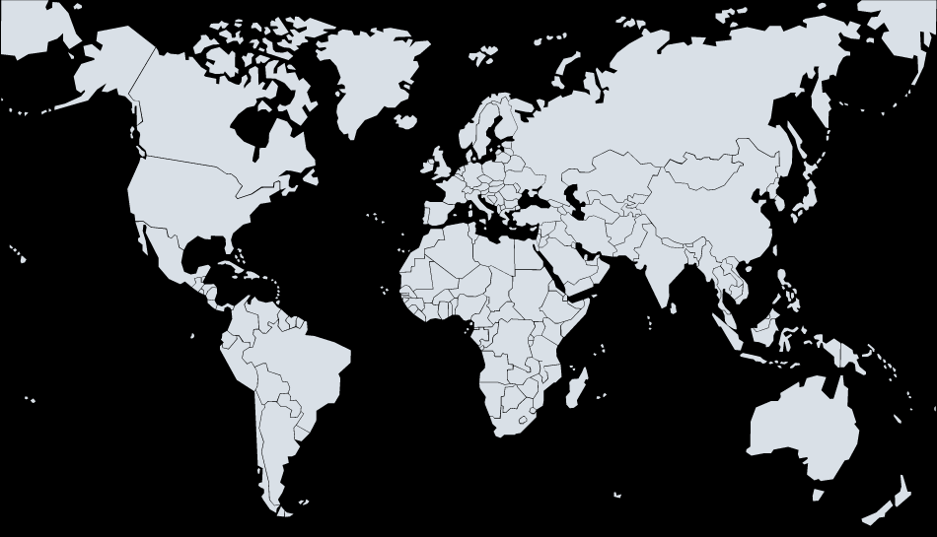


We are going to Indian Ocean!

Slide 30

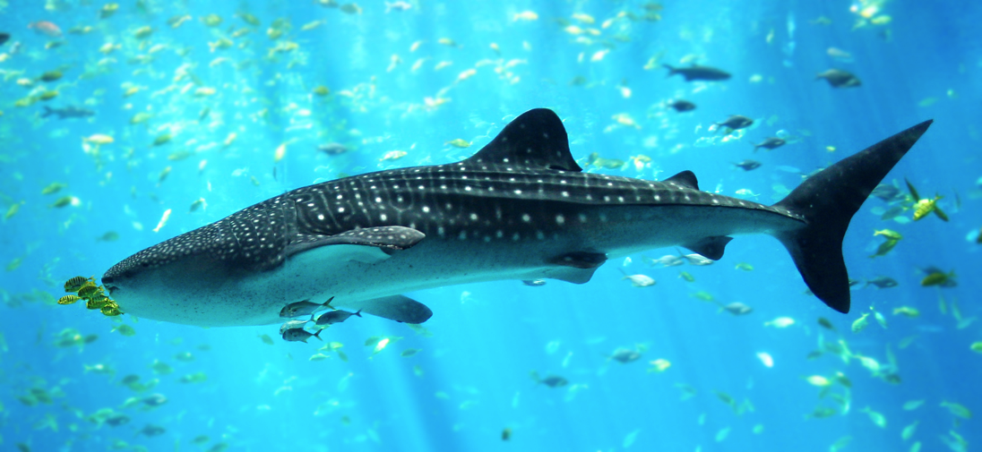
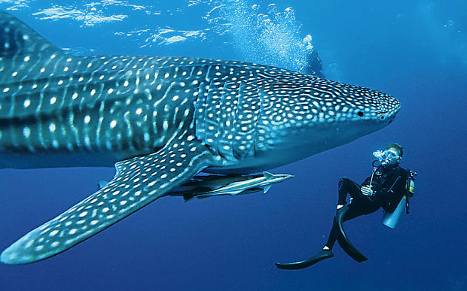
We are going swimming with WHALE SHARKS!

Slide 31
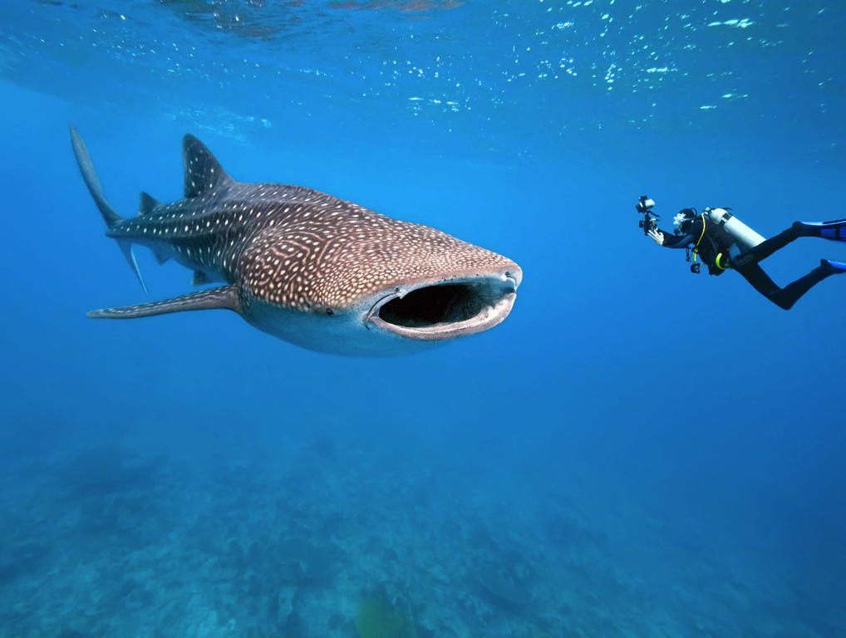
We are going swimming with WHALE SHARKS!
Are whale sharks whales or sharks?!
What do you think?

Slide 32
We are going swimming with WHALE SHARKS!
They are sharks!
They move very slow and do not hurt people

Slide 33
Let’s Practice!
Circle the sentences that ask a question.
What sharks are blue
Are whale sharks blue
What do whale sharks eat
My name is Vanessa

Slide 34


What did I just learn?
Questions & Question Marks
Answering Questions
Notes:
Have the students read out what they have just completed and have them recap the content as well. Congratulate them!

Slide 35
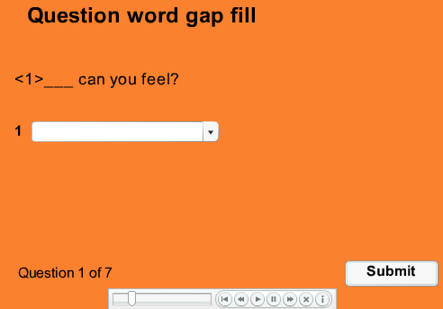
Fill in the Gap game !
Fill in the blank with the right question word!
http://www.englishmedialab.com/Quizzes/beginners/beginner%20question%20word%20gap%20fill.htm
Notes:
http://www.englishmedialab.com/Quizzes/beginners/beginner%20question%20word%20gap%20fill.htm

Slide 36
Fill in the Gap game !
What is something new we learned during the game?
Notes:
http://www.englishmedialab.com/Quizzes/beginners/beginner%20question%20word%20gap%20fill.htm

Slide 37


Today’s Letters!

Slide 38
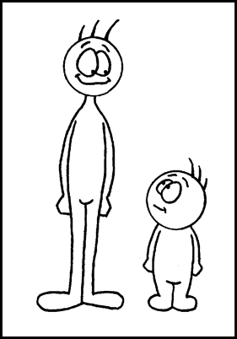


Today’s letters! -> ‘GG’
This is a digger.
It can make big holes.
This is an egg.
It comes from a chicken.
Bill is bigger than Jack.

Slide 39

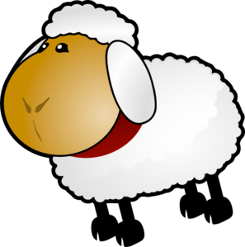

Today’s letters! -> ‘FF’
This sheep is white and fluffy.
This is a buffalo.
They live in big groups.
Coffee is a warm drink!

Slide 40




Today’s letters! -> ‘GG’ ‘FF’

Slide 41
What did I just learn?
‘GG’ and ‘FF’ sounds
Notes:
Have the students read out what they have just completed and have them recap the content as well. Congratulate them!

Slide 42
What did I learn today?
Questions & Answers
Using Question Mark
‘GG’ and ‘FF’ Sounds

Slide 43
What did I learn today?
Digger
Egg
Coffee
Buffalo
Notes:
Have the students read the goal that they just completed.
Explain what they learned if needed.
Congratulate them.
write down the new vocabulary words on the board and have the students write these new words on their worksheets under “Vocabulary”. These are the words that the students should be practicing!

Slide 44
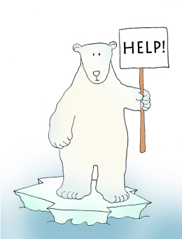

Final Thoughts
Do you have any questions?
Do you understand the handout?
Notes:
Take this time to see if the students have any questions and if they would like to go over the handout and fill in some of the questions they had difficulty with.

Slide 45
Before the next class
Listen and read along with the ‘Under the Sea’ book
Read book to yourself and to your family/friends
Complete the worksheet
Practice writing new vocabulary words

Slide 46
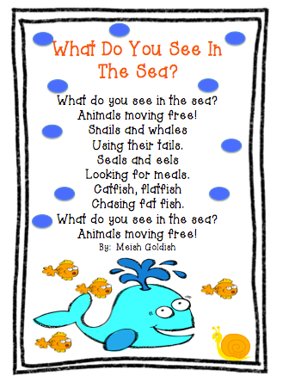

Slide 47
Let’s talk!
What is your favourite sea animal?

