Slide 1


Adventures!

Slide 2

Notes:
What’s going on?” <- each lesson in this unit will have a section called Whats going on in the beginning to stimulate conversation and break the ice before class begins! Make your pen colour white and draw all of the key words on the board that the students come up with when they are describing or talking about the picture.

Slide 3




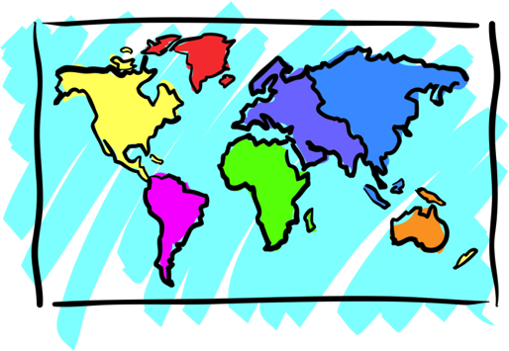


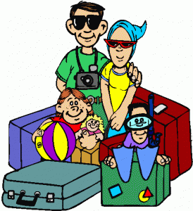
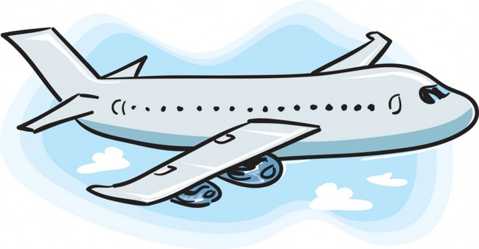
Adventures

Slide 4



What will I learn today?
The sound of the letters ‘RR’
Transition words (And, But, Then, Because)
Notes:
Have the students read out the learning goals for the day.

Slide 5

What is that sound?
Listen closely and see if you know what the sound is!
Notes:
Find the movie clip “monkeysound” and play it for the students. It is a blank image so that the students can only hear the lmonkey and not see it. Have the students guess before showing them the next slide.

Slide 6

Where are we going today?
Notes:
Play the ‘Where are we going today?” video and have the students guess where they are going today.

Slide 7




We are going to Germany!
Notes:
Talk about how far Africa is from China, talk about the different colours of the flags. You can even see how long of a plane ride it is from China to Africa!

Slide 8
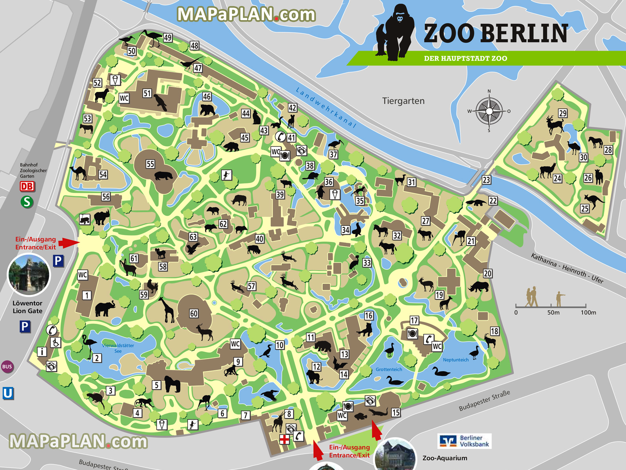
This is a map of the Berlin Zoo
Look at all the animals!

Slide 9
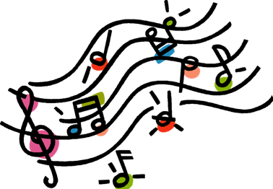
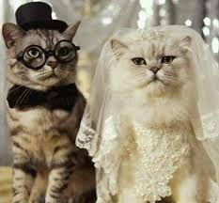
Song: Will You Marry Me ?
Will You Marry Me?
Will, will, will, will, will,
will you marry me?

Slide 10
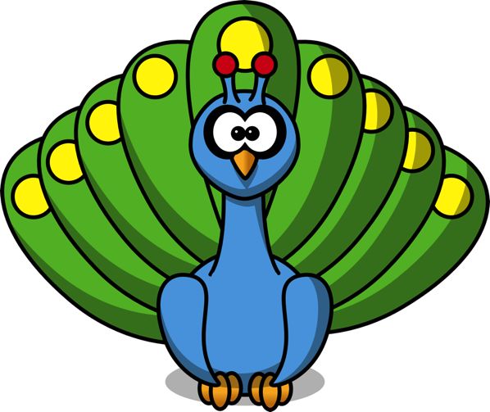
Song: Will You Marry Me ?
Miss. Peacock, will you marry me?
I’m an elegant peacock.
Look at my tail, the most beautiful tail.
Live happily with me. La la la la la.
I’m in love with you!

Slide 11
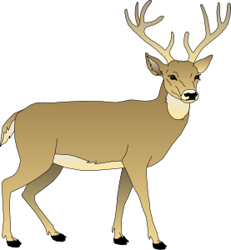
Song: Will You Marry Me ?
Miss. Deer, will you marry me?
I’m a handsome deer.
Look at my horns, the biggest horns.
I will make you smile. La la la la la.
Oh, my love!

Slide 12
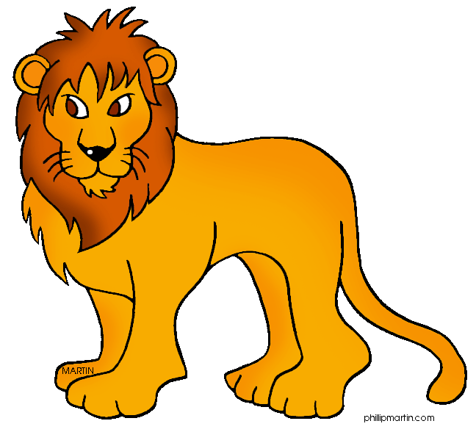
Song: Will You Marry Me ?
Miss. Lioness, will you marry me?
I’m a strong lion.
Look at my mane, the greatest mane.
I will protect you. La la la la la.
Yes, yes, yes!

Slide 13

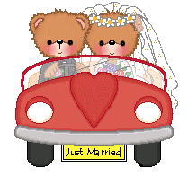
Song: Will You Marry Me ?
Congratulations!
Happy wedding!

Slide 14

Today’s Letters!

Slide 15

Transition Words
Transition words help bring two sentences or words together
AND
OR
BUT
THEN
BECAUSE

Slide 16

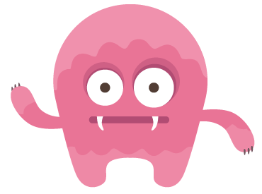

Question?
This is Mike.
Should he take the arrow or the strawberry?

Slide 17
Transition Words
Transition words help us tell the order of things.
FIRST
SECOND
THIRD
FINALLY
LAST

Slide 18

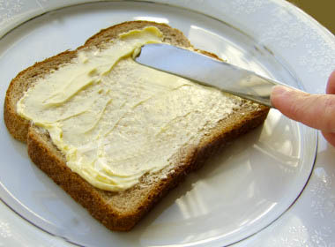
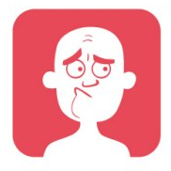
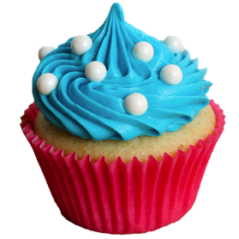
What did I learn today?
Arrow
Butter
Worry
Cupcake
Notes:
Have the students read the goal that they just completed.
Explain what they learned if needed.
Congratulate them.
write down the new vocabulary words on the board and have the students write these new words on their worksheets under “Vocabulary”. These are the words that the students should be practicing!

Slide 19
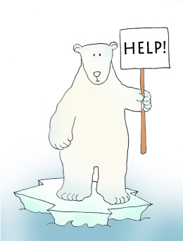


Final Thoughts
Do you have any questions?
Do you understand the handout?
Notes:
Take this time to see if the students have any questions and if they would like to go over the handout and fill in some of the questions they had difficulty with.

Slide 20

Before the next class
Listen and read along with the ‘Will You Marry Me’ song
Read book to yourself and to your family/friends
Complete the worksheet
Practice writing new vocabulary words
Notes:
You can read these goals to them or have them read the goals if they can.
Underlining sentences and asking students to read one sentence at a time works well.

