Slide 1
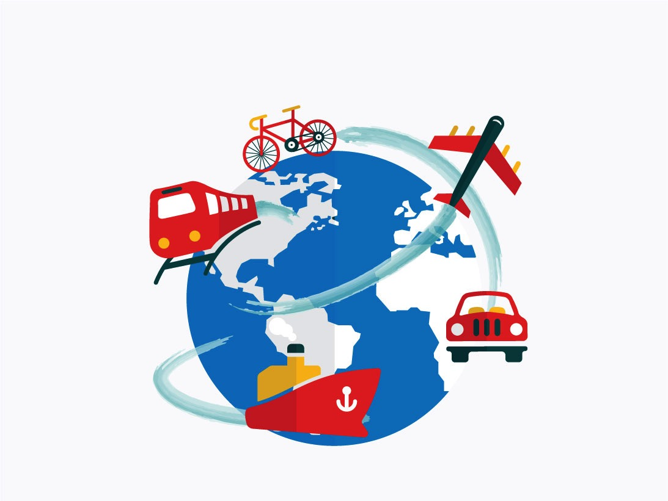

Adventures!

Slide 2

Notes:
What’s going on?” <- each lesson in this unit will have a section called Whats going on in the beginning to stimulate conversation and break the ice before class begins! Make your pen colour white and draw all of the key words on the board that the students come up with when they are describing or talking about the picture.

Slide 3


What did I learn last class?
Sound of the letters ‘gg’ and ‘ff’
Answering questions using question marks (??)
Notes:
Have the students read out what they have just completed and have them recap the content as well. Congratulate them!

Slide 4
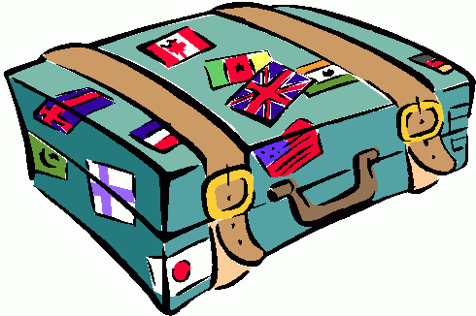


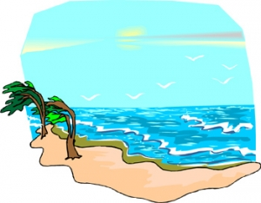
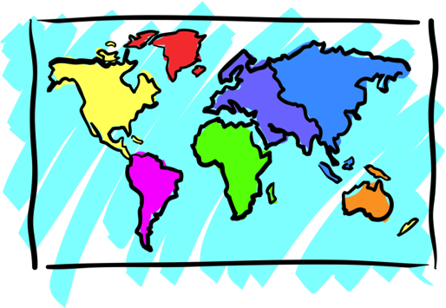


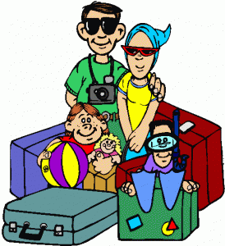
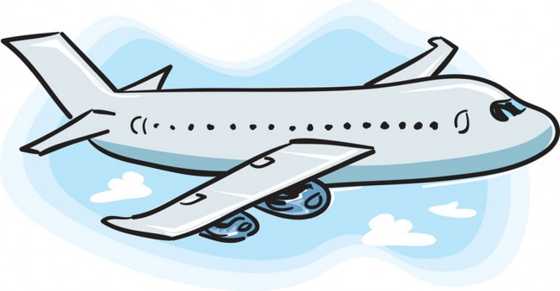
Adventures

Slide 5

What will I learn today?
The sound of the letters ‘RR’
Transition words (And, But, Then, Because)
Notes:
Have the students read out the learning goals for the day.

Slide 6

What is that sound?
Listen closely and see if you know what the sound is!
Notes:
Find the movie clip “monkeysound” and play it for the students. It is a blank image so that the students can only hear the lmonkey and not see it. Have the students guess before showing them the next slide.

Slide 7

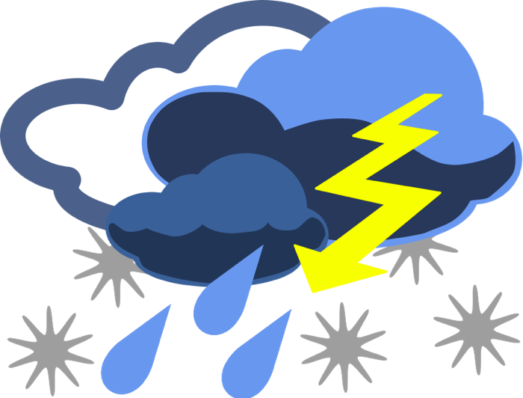
What is that sound?
Listen closely and see if you know what the sound is!
Notes:
Have them circle the what they thought the sound was. You can write the words down underneath so that the students can visualize the vocabulary.

Slide 8
You’re right!
It is a monkey!
Monkeys make noises to talk to each other!
There are many different types of monkeys!
Notes:
Read out the description for monkeys. See if they have ever seen a monkey in a zoo before, ask them to tell you what it looked like, where it lived etc.. Play the video clip ‘MoneyVideo’ for the students.

Slide 9

Where are we going today?
Notes:
Play the ‘Where are we going today?” video and have the students guess where they are going today.

Slide 10
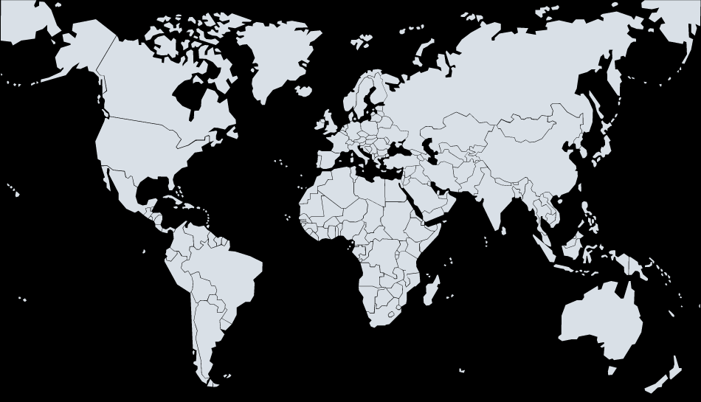



We are going to Germany!
Notes:
Talk about how far Africa is from China, talk about the different colours of the flags. You can even see how long of a plane ride it is from China to Africa!

Slide 11
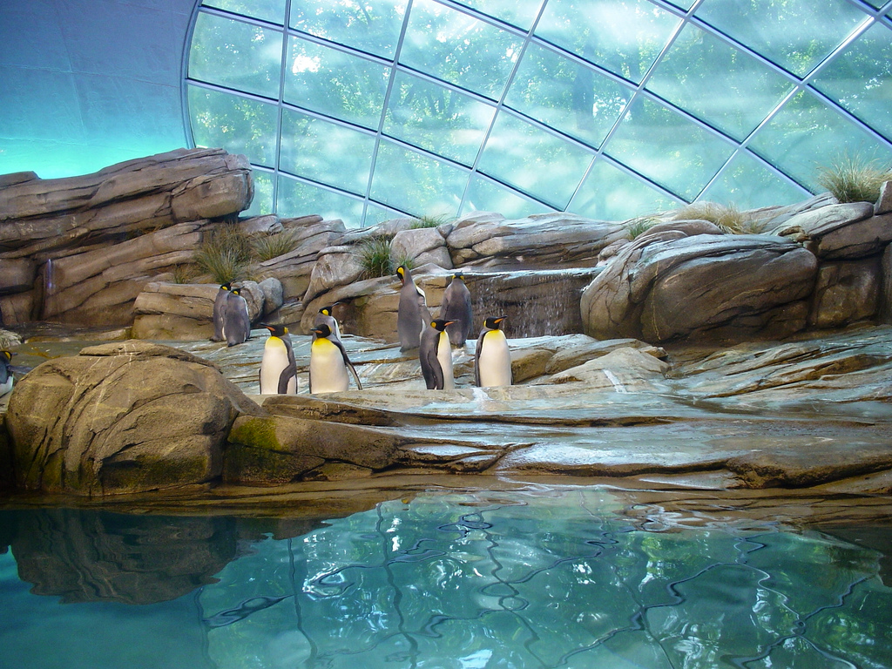
We are going to Berlin, Germany
to see one of the biggest zoos in the world!
Notes:
You can ask the students where they think they are going today.
Play the movie clip called “Where are we going today?”
See if the students know which animals are in the pictures.

Slide 12
The Berlin Zoo has over 1500 different types of species and over 17 000 animals at the zoo!
Notes:
You can ask the students where they think they are going today.
Play the movie clip called “Where are we going today?”
See if the students know which animals are in the pictures.

Slide 13
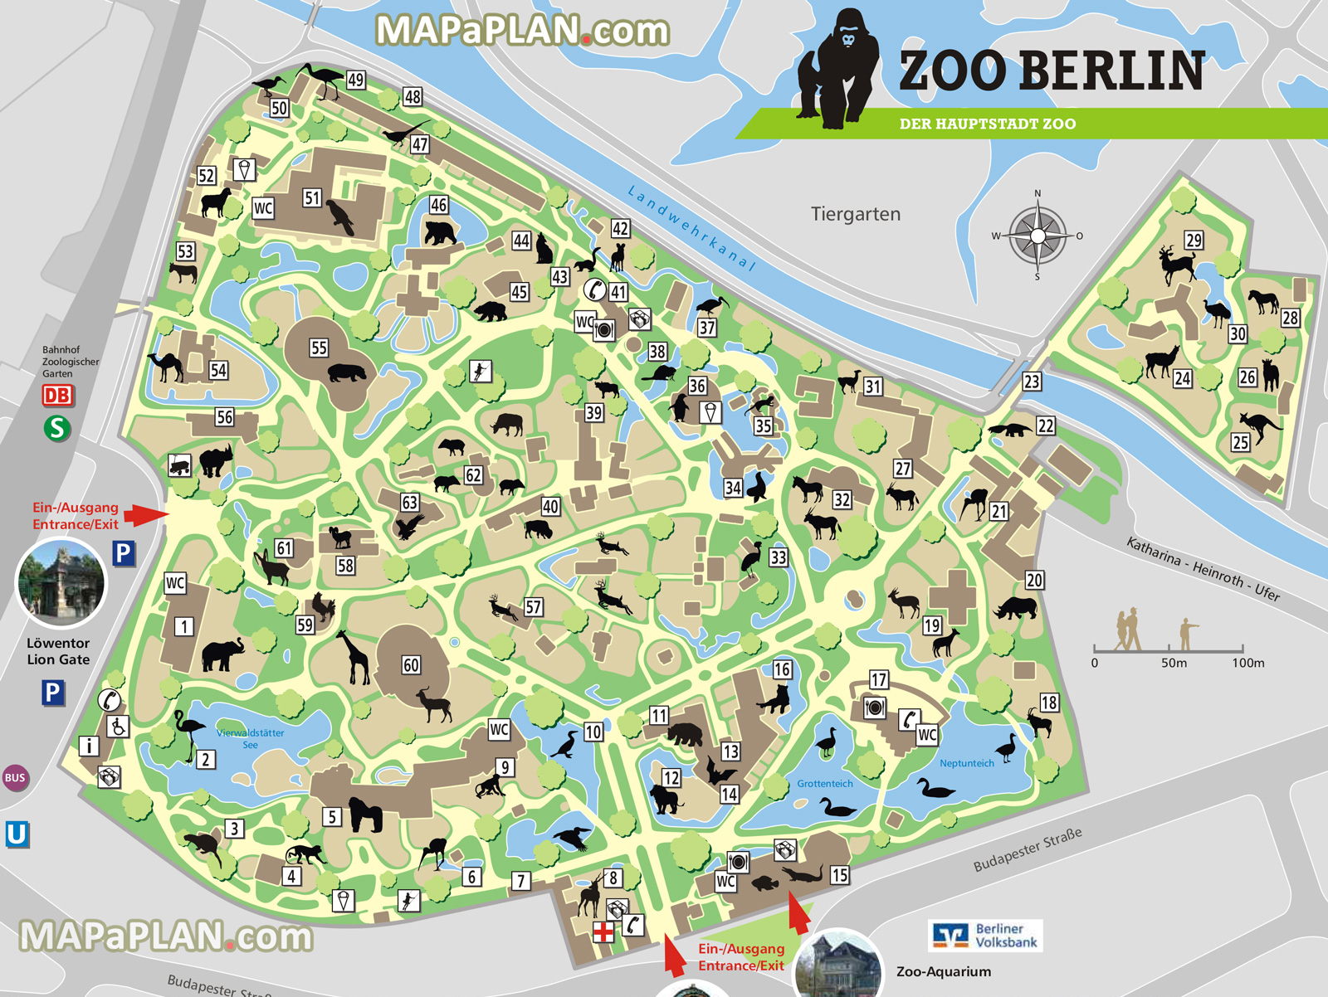
This is a map of the Berlin Zoo
Look at all the animals!

Slide 14
What animal do you want to see at the zoo?
At the zoo, I want to see a ____________ because ____________________________________________________
Notes:
You can ask the students where they think they are going today.
Play the movie clip called “Where are we going today?”
See if the students know which animals are in the pictures.

Slide 15
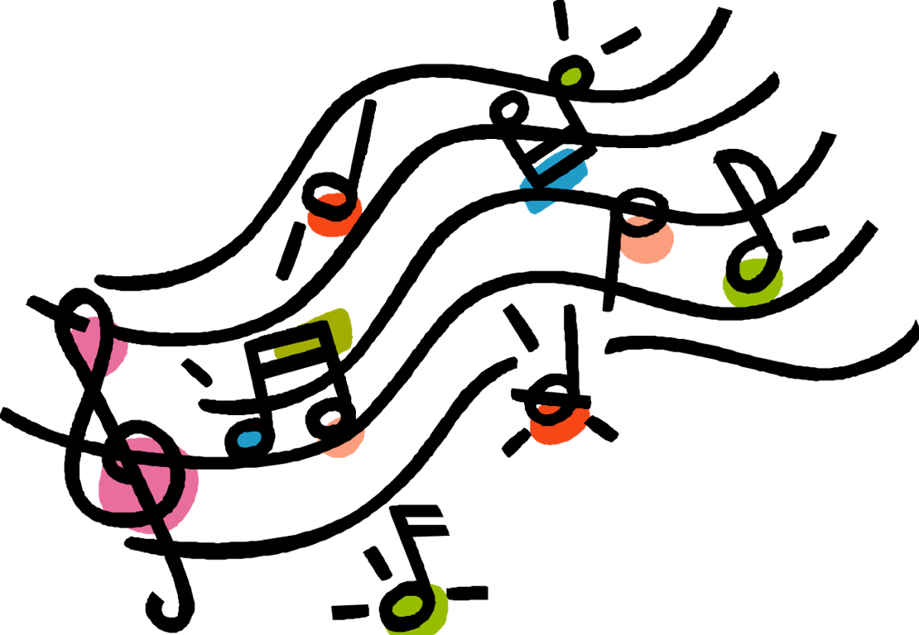
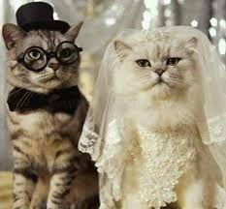
Song: Will You Marry Me ?
Will You Marry Me?
Will, will, will, will, will,
will you marry me?

Slide 16
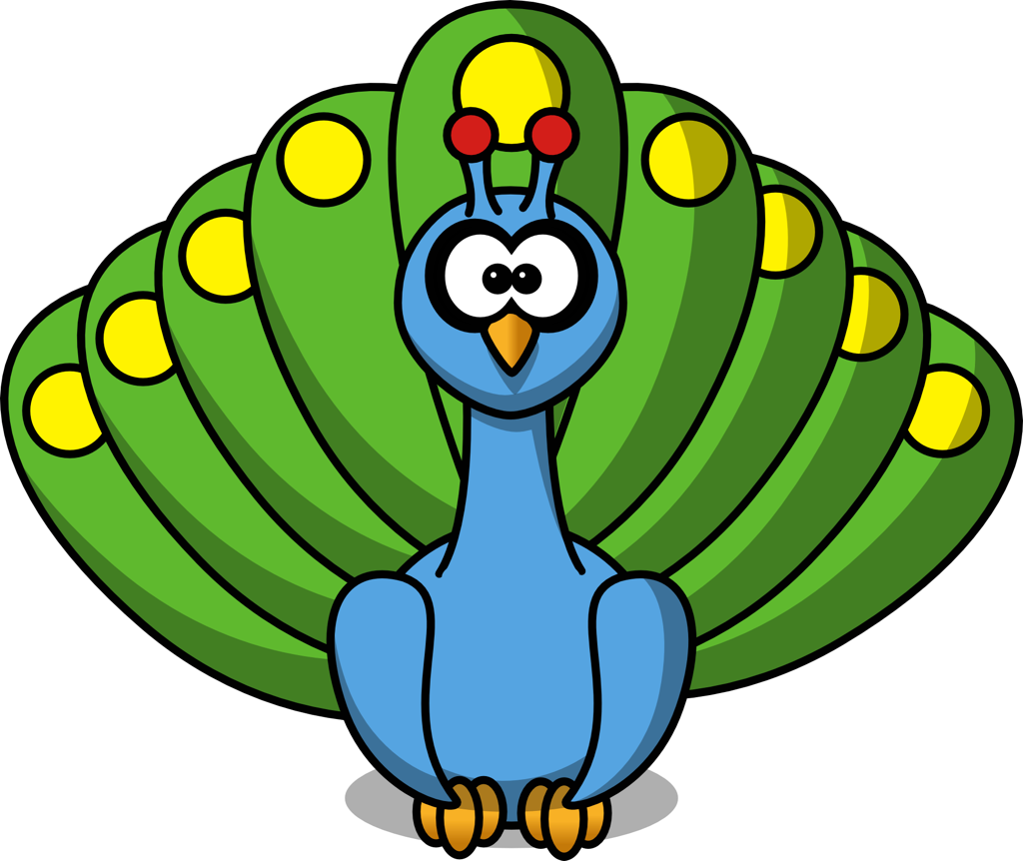
Song: Will You Marry Me ?
Miss. Peacock, will you marry me?
I’m an elegant peacock.
Look at my tail, the most beautiful tail.
Live happily with me. La la la la la.
I’m in love with you!

Slide 17
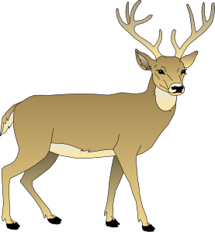
Song: Will You Marry Me ?
Miss. Deer, will you marry me?
I’m a handsome deer.
Look at my horns, the biggest horns.
I will make you smile. La la la la la.
Oh, my love!

Slide 18
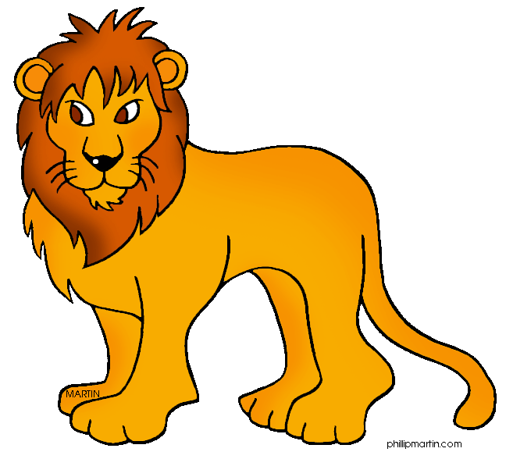
Song: Will You Marry Me ?
Miss. Lioness, will you marry me?
I’m a strong lion.
Look at my mane, the greatest mane.
I will protect you. La la la la la.
Yes, yes, yes!

Slide 19
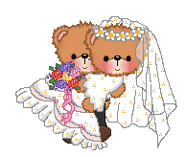
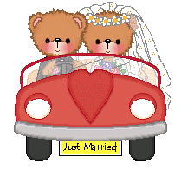
Song: Will You Marry Me ?
Congratulations!
Happy wedding!

Slide 20


What did I just learn?
Sounds of the letters ‘rr’
Notes:
Have the students read out what they have just completed and have them recap the content as well. Congratulate them!

Slide 21

Today’s Letters!

Slide 22



Today’s letters! -> ‘RR’
Match the picture with the word
Carrot
Arrow
Strawberry

Slide 23
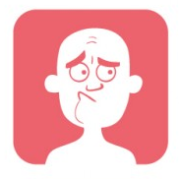
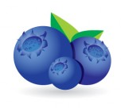
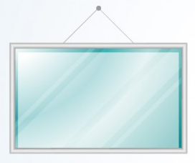
Today’s letters! -> ‘RR’
Match the picture with the word
Mirror
Worry
Blueberry

Slide 24
What did I just learn?
The sounds of the letters ‘RR’
Notes:
Have the students read out what they have just completed and have them recap the content as well. Congratulate them!

Slide 25
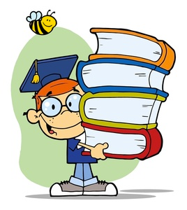
Transition Words
Transition words help bring two sentences or words together
AND
OR
BUT
THEN
BECAUSE

Slide 26
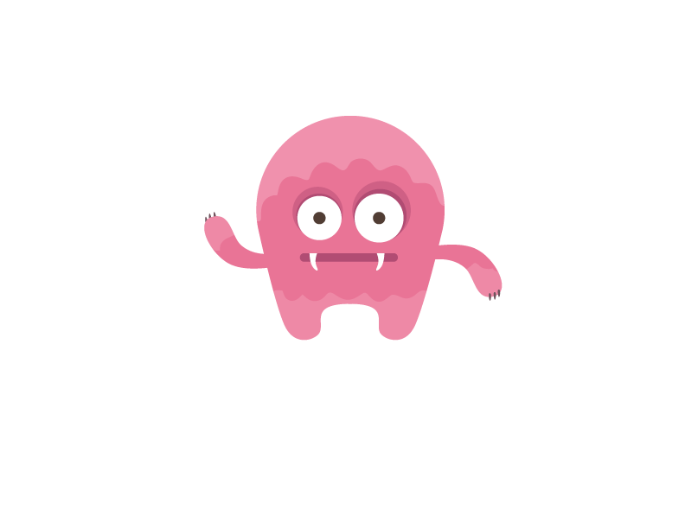
Question?
This is Mike.
Should he take the arrow or the strawberry?

Slide 27
Question?
This is Mike.
He is holding an arrow and a strawberry

Slide 28

Question?
Mike likes strawberries but he also likes blueberries.

Slide 29
Transition Words
Transition words help us tell the order of things.
FIRST
SECOND
THIRD
FINALLY
LAST

Slide 30
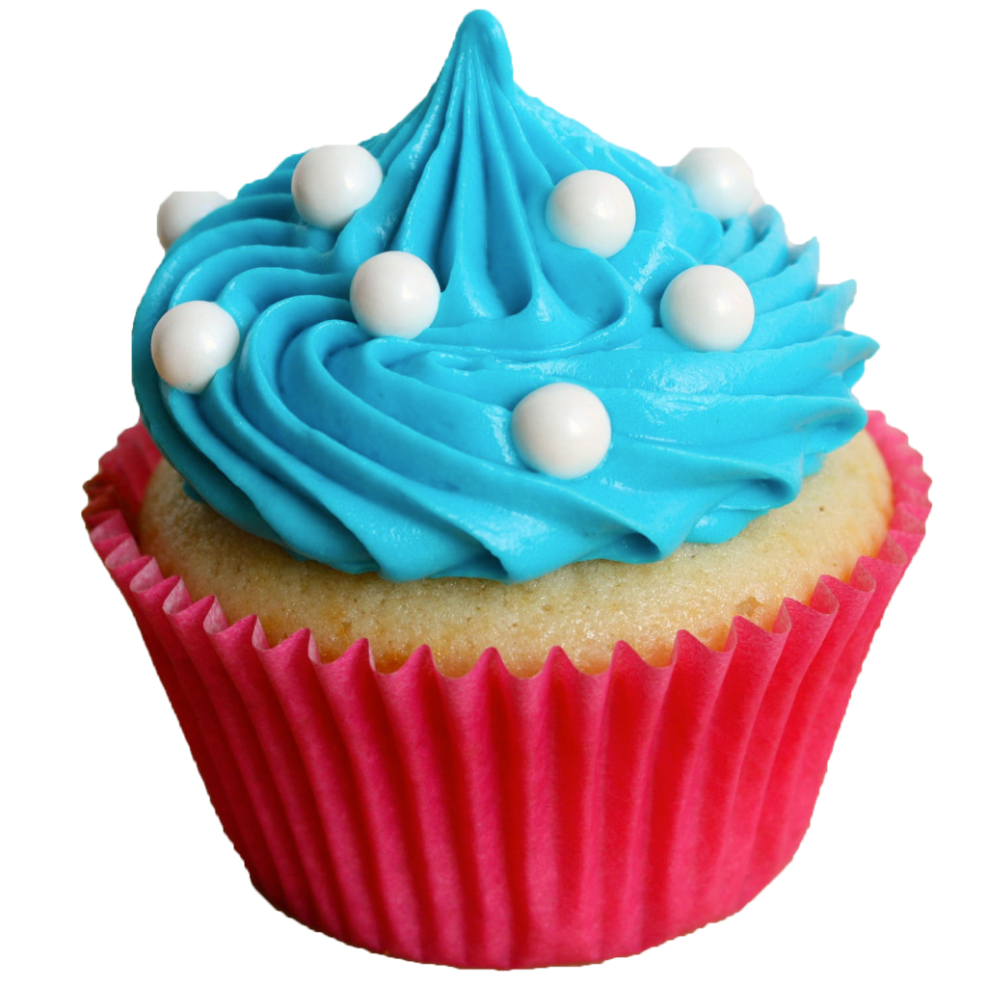
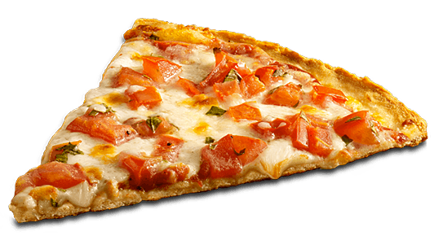
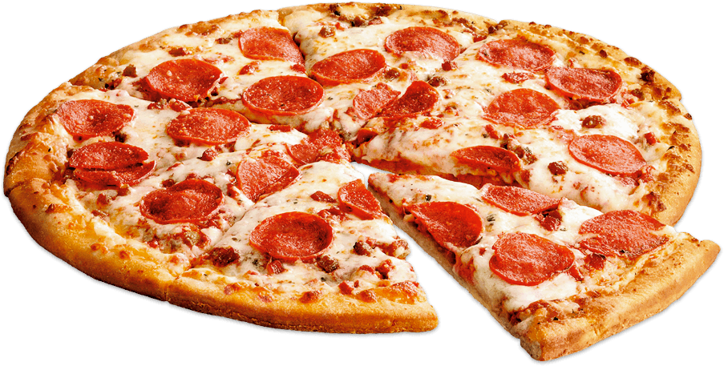
Question?
Mike has to choose what to eat. There is so much food he likes!

Slide 31
Question?
First Mike eats the blueberries.

Slide 32
Question?
Second Mike eats the cupcakes.

Slide 33
Question?
Finally Mike eats the pizza!

Slide 34
Question?
Mike is feeling very full and cannot finish the pizza!

Slide 35
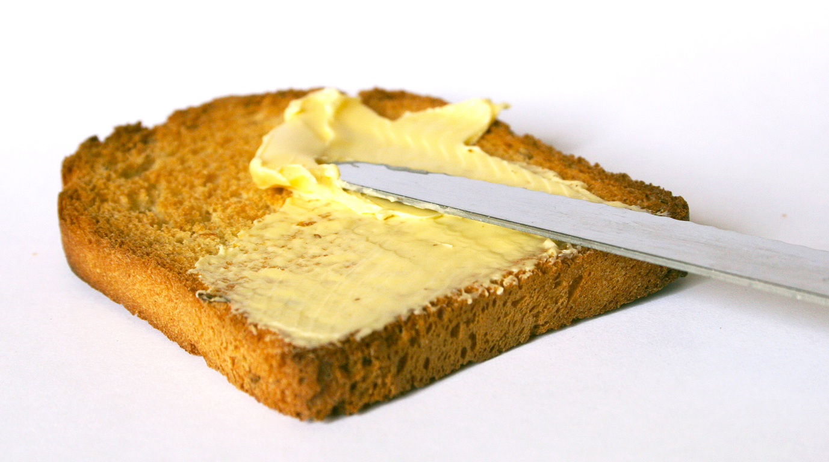
Practice
Using new transition words let’s tell Mike how to put butter on bread!

Slide 36
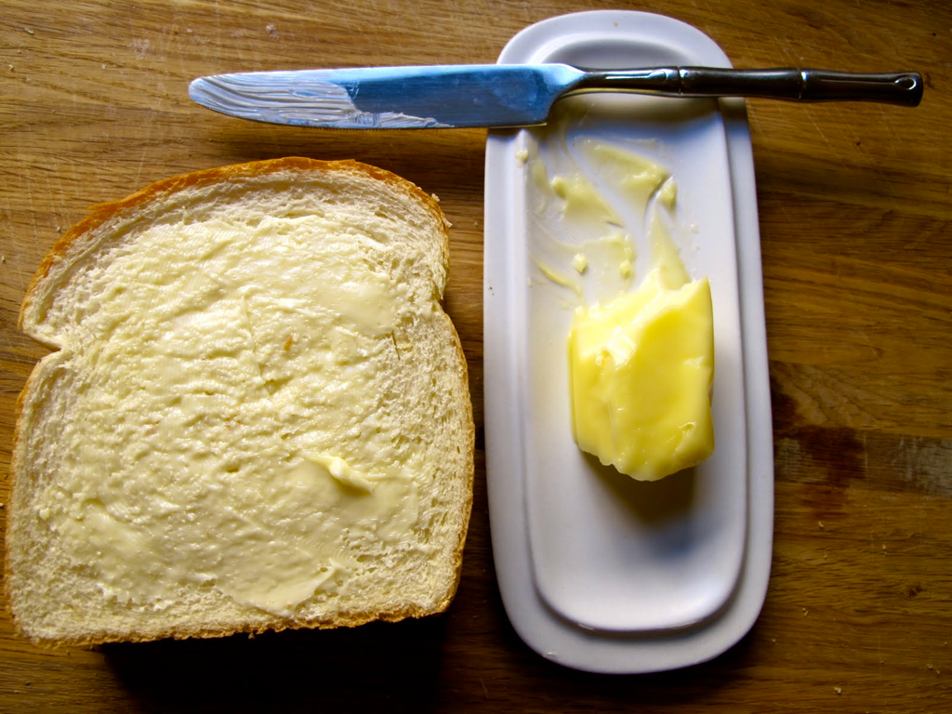
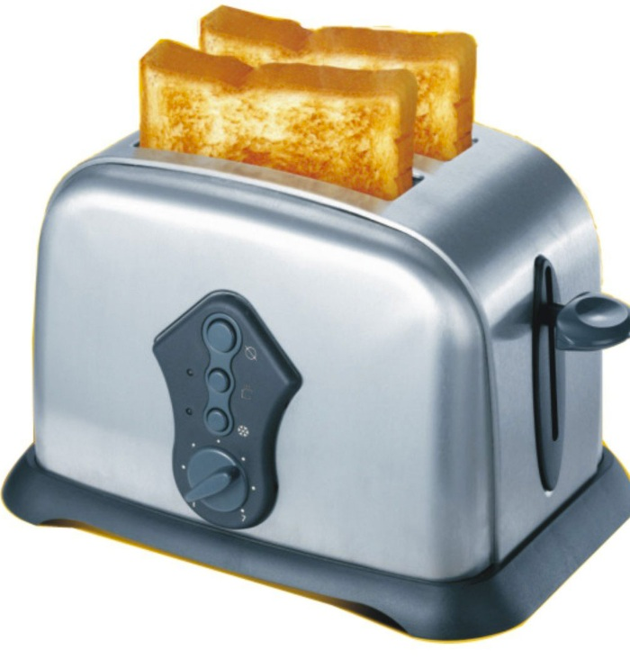
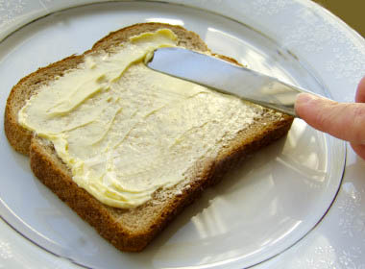
Practice
First ___________________________________
Second _______________________________
Third __________________________________

Slide 37
What did I just learn?
Transition Words
Notes:
Have the students read out what they have just completed and have them recap the content as well. Congratulate them!

Slide 38
What did I learn today?
Arrow
Butter
Worry
Cupcake
Notes:
Have the students read the goal that they just completed.
Explain what they learned if needed.
Congratulate them.
write down the new vocabulary words on the board and have the students write these new words on their worksheets under “Vocabulary”. These are the words that the students should be practicing!

Slide 39
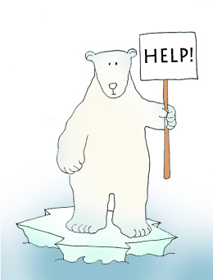

Final Thoughts
Do you have any questions?
Do you understand the handout?
Notes:
Take this time to see if the students have any questions and if they would like to go over the handout and fill in some of the questions they had difficulty with.

Slide 40

Before the next class
Listen and read along with the ‘Will You Marry Me’ song
Read book to yourself and to your family/friends
Complete the worksheet
Practice writing new vocabulary words
Notes:
You can read these goals to them or have them read the goals if they can.
Underlining sentences and asking students to read one sentence at a time works well.

Slide 42
