Slide 1


Adventures!

Slide 2

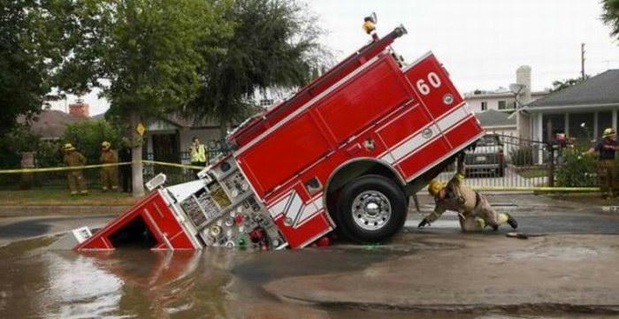
Notes:
What’s going on?” <- each lesson in this unit will have a section called Whats going on in the beginning to stimulate conversation and break the ice before class begins! Make your pen colour white and draw all of the key words on the board that the students come up with when they are describing or talking about the picture.

Slide 3


What did I learn last class?
The sound of the letters ‘RR’
Transition words (And, But, Then, Because)
Notes:
Have the students read out what they have just completed and have them recap the content as well. Congratulate them!

Slide 4
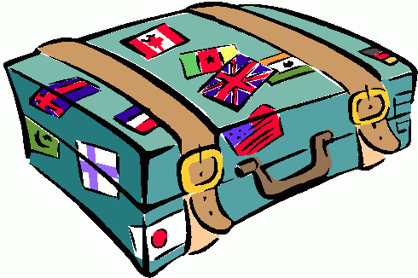


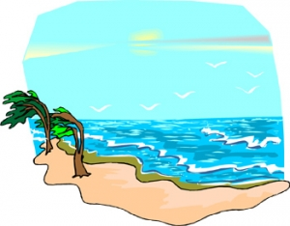
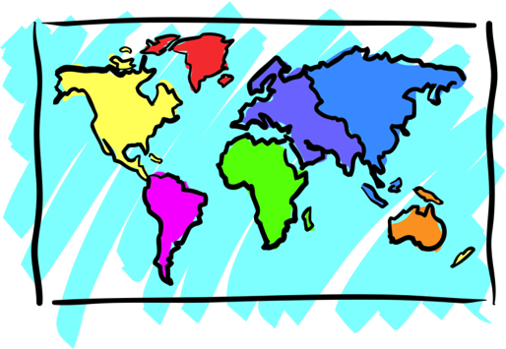


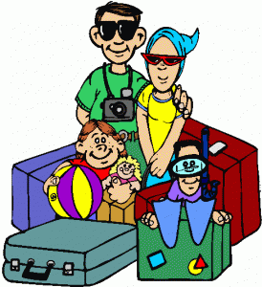
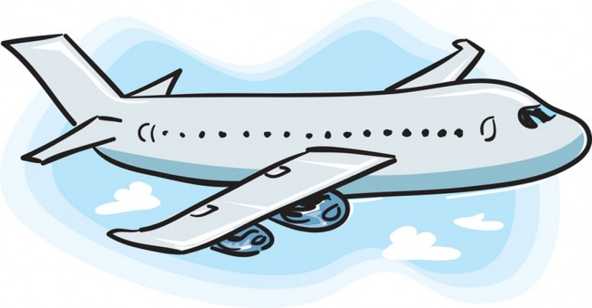
Adventures

Slide 5

What will I learn today?
The sound of the letters ‘BB’
Writing short sentences
Notes:
Have the students read out the learning goals for the day.

Slide 6

What is that sound?
Listen closely and see if you know what the sound is!
Notes:
Find the movie clip “wave” and play it for the students. It is a blank image so that the students can only hear the lion roaring and not see it. Have the students guess before showing them the next slide.

Slide 7

Where are we going today?
Notes:
Play the ‘Where are we going today?” video and have the students guess where they are going today.

Slide 8
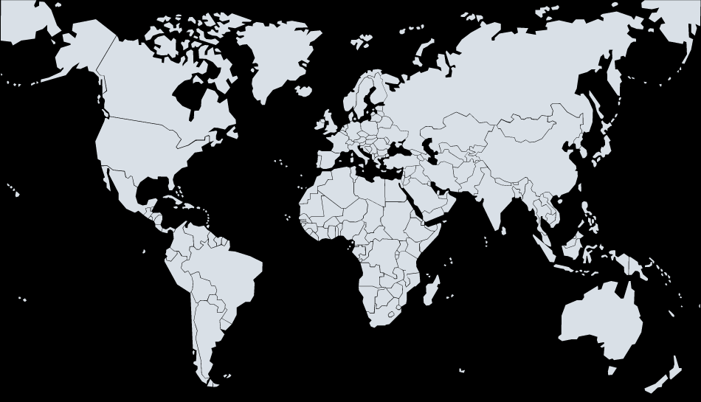



We are going to Hawaii!
Notes:
Talk about how far Africa is from China, talk about the different colours of the flags. You can even see how long of a plane ride it is from China to Africa!

Slide 18

Fling the Teacher Game
Notes:
http://www.englishmedialab.com/GrammarGames/fling%20the%20teacher/actionverbs/present%20progressive%20multiple%20choice.html

Slide 19
Bubble Poem

Slide 21

Today’s letters! -> ‘BB’

Slide 22

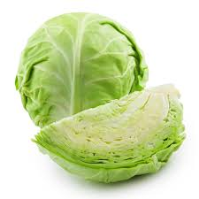

Today’s letters! -> ‘BB’

Slide 23


What did I just learn?
The sounds of the letters ‘BB’
Notes:
Have the students read out what they have just completed and have them recap the content as well. Congratulate them!

Slide 24
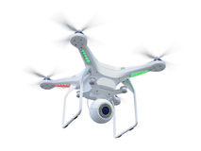
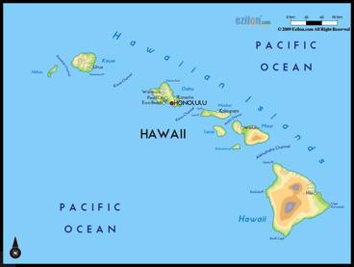
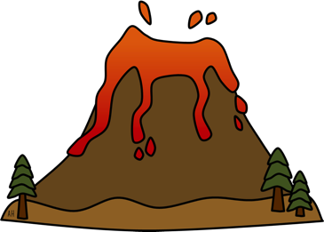
What did I learn today?
drone
cabbage
Hawaii
volcano
Notes:
Have the students read the goal that they just completed.
Explain what they learned if needed.
Congratulate them.
write down the new vocabulary words on the board and have the students write these new words on their worksheets under “Vocabulary”. These are the words that the students should be practicing!

Slide 25
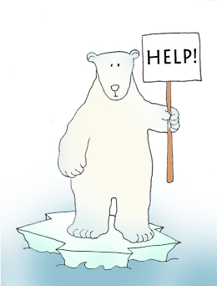

Final Thoughts
Do you have any questions?
Do you understand the handout?
Notes:
Take this time to see if the students have any questions and if they would like to go over the handout and fill in some of the questions they had difficulty with.

Slide 26

Before the next class
Listen and read along with the ‘’Slippers in Hawaii’ book
Read book to yourself and to your family/friends
Complete the worksheet
Practice writing new vocabulary words
Notes:
You can read these goals to them or have them read the goals if they can.
Underlining sentences and asking students to read one sentence at a time works well.

