Slide 1


Adventures!

Slide 2

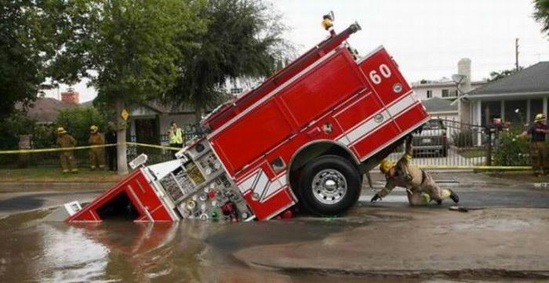
Notes:
What’s going on?” <- each lesson in this unit will have a section called Whats going on in the beginning to stimulate conversation and break the ice before class begins! Make your pen colour white and draw all of the key words on the board that the students come up with when they are describing or talking about the picture.

Slide 3


What did I learn last class?
The sound of the letters ‘RR’
Transition words (And, But, Then, Because)
Notes:
Have the students read out what they have just completed and have them recap the content as well. Congratulate them!

Slide 4
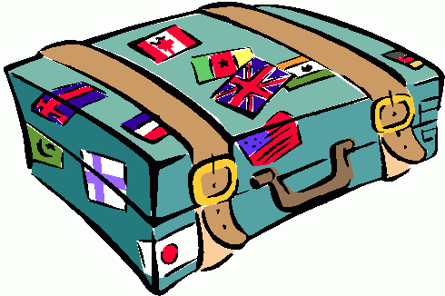


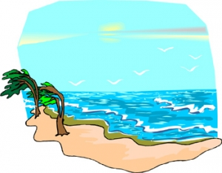
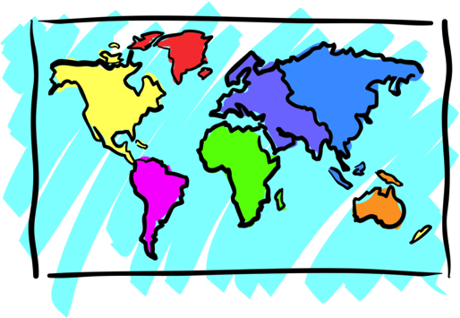

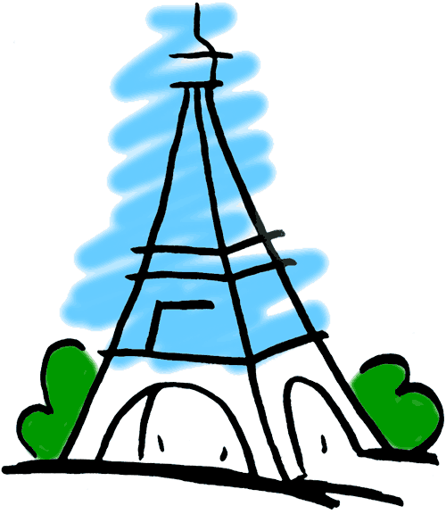
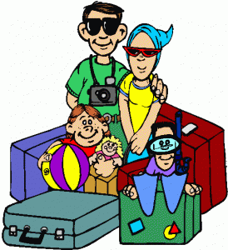
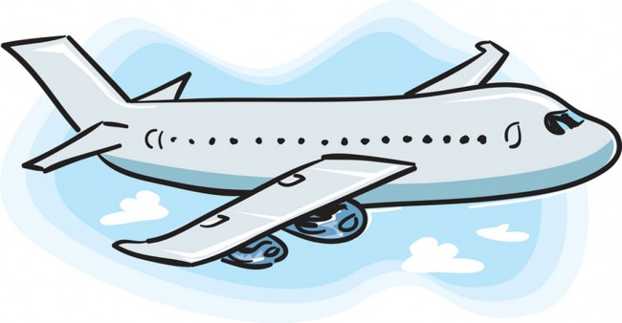
Adventures

Slide 5

What will I learn today?
The sound of the letters ‘BB’
Writing short sentences
Notes:
Have the students read out the learning goals for the day.

Slide 6

What is that sound?
Listen closely and see if you know what the sound is!
Notes:
Find the movie clip “wave” and play it for the students. It is a blank image so that the students can only hear the lion roaring and not see it. Have the students guess before showing them the next slide.

Slide 7

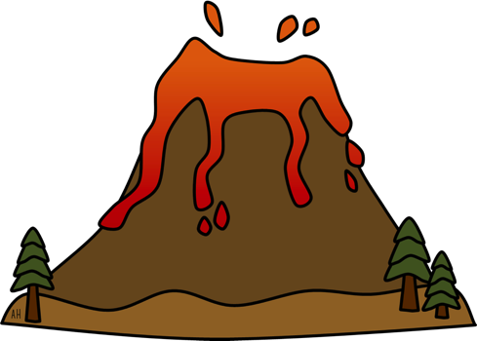
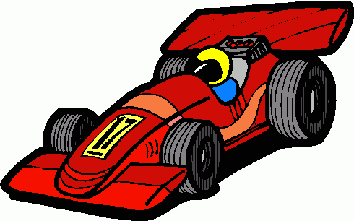
What is that sound?
Listen closely and see if you know what the sound is!
Notes:
Have them circle the what they thought the sound was. You can write the words down underneath so that the students can visualize the vocabulary.

Slide 8
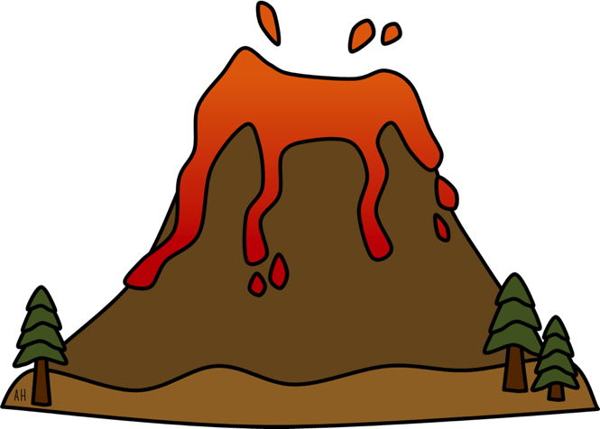
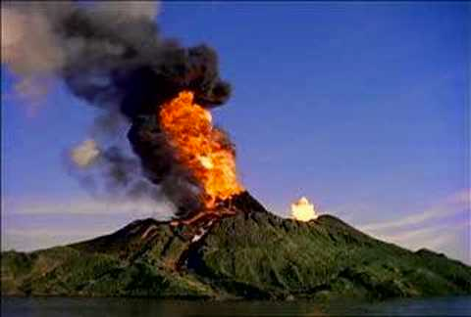
You’re right!
It is volcano erupting!
Volcanos are all over the world. When they erupt, hot red lava flows out of the volcano!
Notes:
Read out the description for bears. See if they have ever seen a bear in a zoo before, ask them to tell you what it looked like, where it lived etc..

Slide 9

Where are we going today?
Notes:
Play the ‘Where are we going today?” video and have the students guess where they are going today.

Slide 10
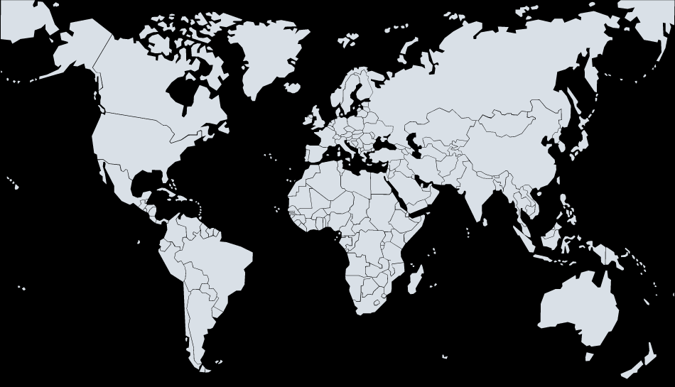



We are going to Hawaii!
Notes:
Talk about how far Africa is from China, talk about the different colours of the flags. You can even see how long of a plane ride it is from China to Africa!

Slide 20
Tell me about these slippers!
These slippers are ___________________________ .

Slide 21
Tell me about these slippers!
These slippers are red and blue with lightning bolts on them!

Slide 22
Tell me about these slippers!
These slippers are ___________________________ .

Slide 23
Tell me about these slippers!
These slippers are green and pink with hearts on them!

Slide 24
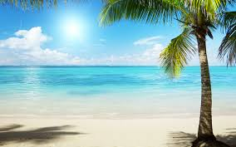

Tell me about these slippers!
These slippers are ___________________________ .

Slide 25
Tell me about these slippers!
These slippers are purple, orange and greent. These slippers are on the beach!

Slide 26


Tell me about these slippers!
These slippers are ___________________________ .

Slide 27
Tell me about these slippers!
These slippers are purple and they are on a chair.

Slide 28

Tell me about these slippers!
These slippers are ___________________________ .

Slide 29
Tell me about these slippers!
These slippers are in a tree.

Slide 30


Tell me about these slippers!
These slippers are ___________________________ .

Slide 31
Tell me about these slippers!
These slippers are in the dog’s mouth.

Slide 32


What did I just learn?
Writing short sentences.
Notes:
Have the students read out what they have just completed and have them recap the content as well. Congratulate them!

Slide 33
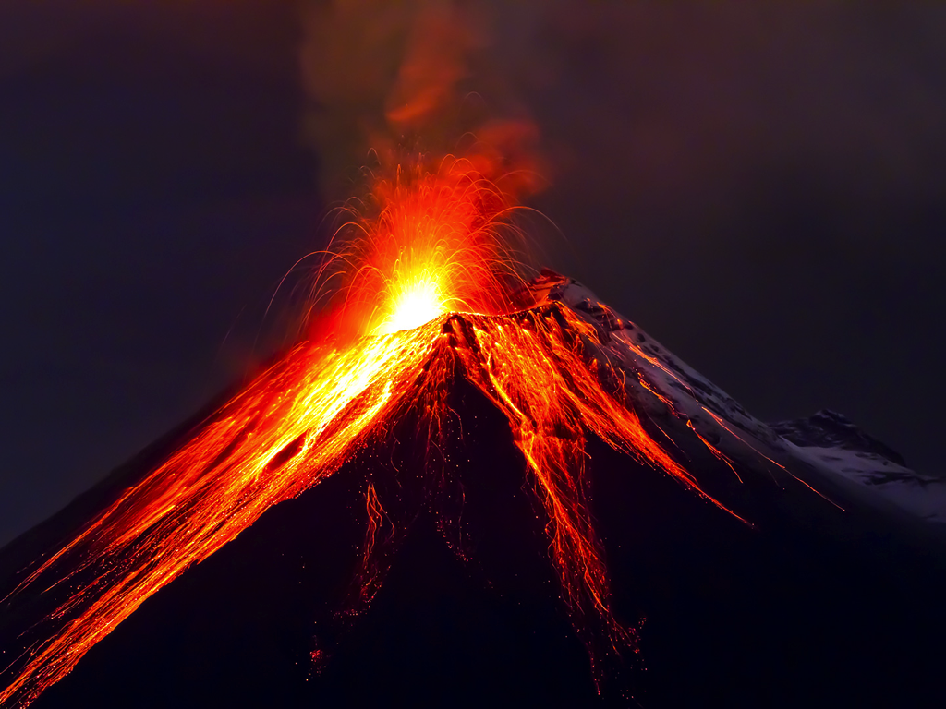
We are going to fly a drone over a volcano in Hawaii!

Slide 34
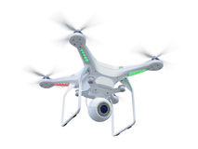
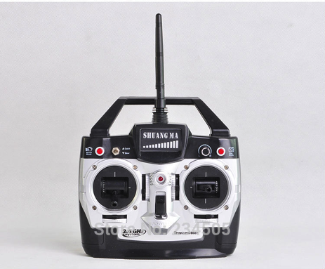
We are going to fly a drone over a volcano in Hawaii!
This is a drone.
A person controls the drone with a remote.

Slide 35
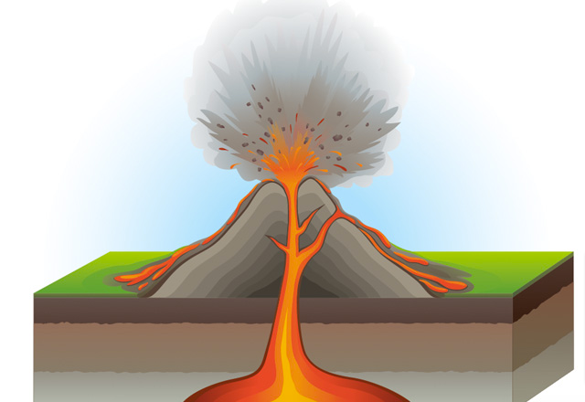
Hawaii has five volcanoes.

Slide 36

Fling the Teacher Game
Notes:
http://www.englishmedialab.com/GrammarGames/fling%20the%20teacher/actionverbs/present%20progressive%20multiple%20choice.html

Slide 37
What did I just learn?
Present Tense
Notes:
Have the students read out what they have just completed and have them recap the content as well. Congratulate them!

Slide 38
Bubble Poem

Slide 40

Today’s letters! -> ‘BB’

Slide 41

Today’s letters! -> ‘BB’
These are bubbles.
Where can you find bubbles?

Slide 42



Today’s letters! -> ‘BB’
These are _ _bb_ _ _ _ _s.

Slide 43
Today’s letters! -> ‘BB’
These are bubble gums.

Slide 44
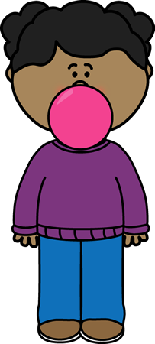
Today’s letters! -> ‘BB’
Where can you
find bubble gum?

Slide 45
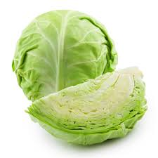
Today’s letters! -> ‘BB’
This is _ _bb_ _ _.

Slide 46
Today’s letters! -> ‘BB’
This is cabbage.
Where can you find cabbage?

Slide 47

Today’s letters! -> ‘BB’

Slide 48
What did I just learn?
The sounds of the letters ‘BB’
Notes:
Have the students read out what they have just completed and have them recap the content as well. Congratulate them!

Slide 49
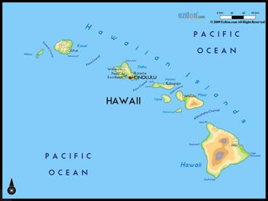

What did I learn today?
drone
cabbage
Hawaii
volcano
Notes:
Have the students read the goal that they just completed.
Explain what they learned if needed.
Congratulate them.
write down the new vocabulary words on the board and have the students write these new words on their worksheets under “Vocabulary”. These are the words that the students should be practicing!

Slide 50
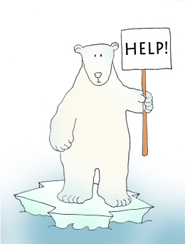

Final Thoughts
Do you have any questions?
Do you understand the handout?
Notes:
Take this time to see if the students have any questions and if they would like to go over the handout and fill in some of the questions they had difficulty with.

Slide 51

Before the next class
Listen and read along with the ‘’Slippers in Hawaii’ book
Read book to yourself and to your family/friends
Complete the worksheet
Practice writing new vocabulary words
Notes:
You can read these goals to them or have them read the goals if they can.
Underlining sentences and asking students to read one sentence at a time works well.

Slide 52

How big can you make a bubble?

Slide 53
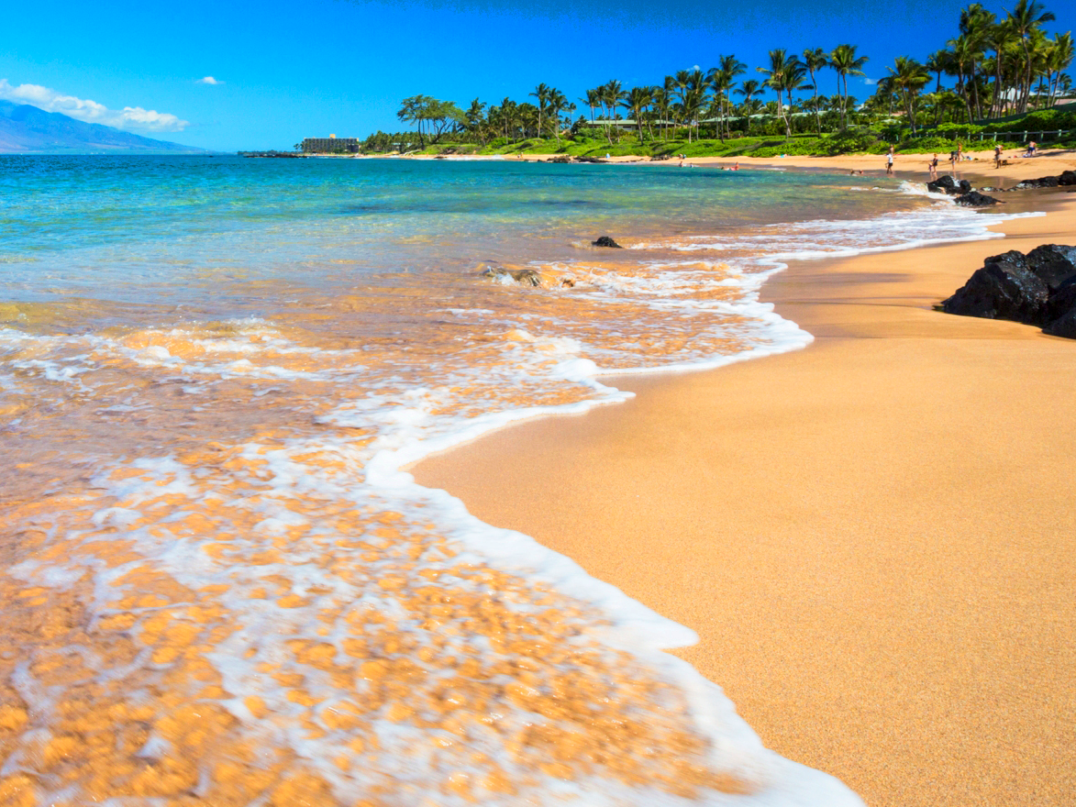
The Beach
Come to the beach
Where the sea is blue
And little white waves
Come running at you.
A wave comes splashing
Over your toes.
You should just stand still
And away it goes.
We’ll build a castle
Down by the sea
And look for shells
If you’ll come with me.
The Beach
Come to the beach
Where the sea is blue
And little white waves
Come running at you.
A wave comes splashing
Over your toes.
You should just stand still
And away it goes.
We’ll build a castle
Down by the sea
And look for shells
If you’ll come with me.

Slide 54
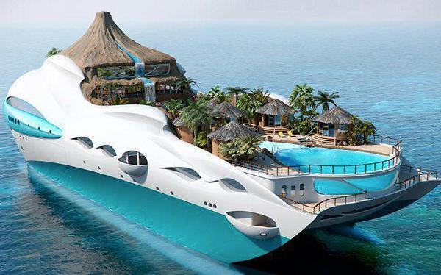
Amazing Boat! Do you like this boat?

