Slide 1

Holiday
Lesson 1, Unit 2

Slide 2
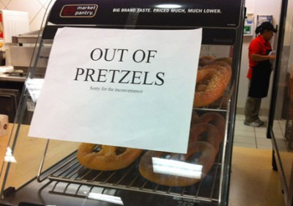
What’s going on?

Slide 3
What’s going on?

Slide 4


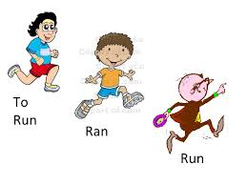


What will I learn today?
The consonant sound KN
Simple past irregular verbs
How to read for meaning and make connections

Slide 5

KN

Slide 6
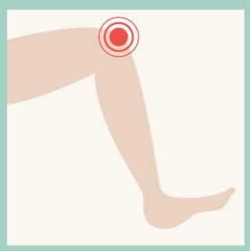
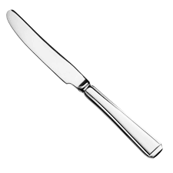
‘KN’ words
knee
knife

Slide 7
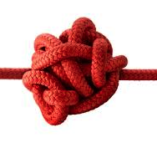
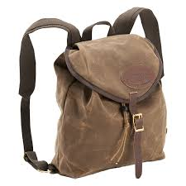
‘KN’ words
knot
knapsack

Slide 8

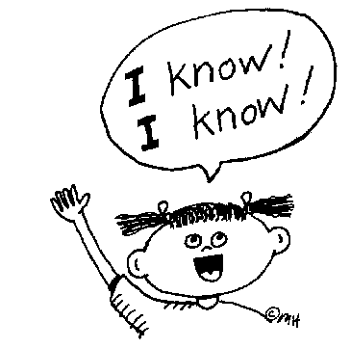
‘KN’ words
knock
know

Slide 9


What did I just learn?
KN Words & Sound
Notes:
Have the students read the goals if they can. I find that underlining sentences and asking students to read one sentence at a time works well.

Slide 10
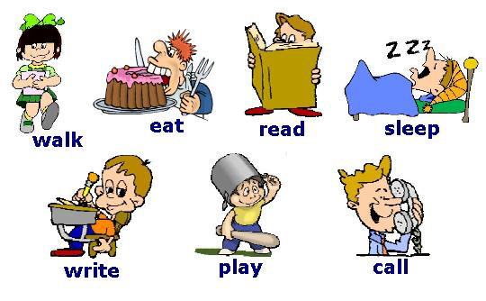
Verb is an action

Slide 11

Simple Past Irregular Verbs
PRESENT= NOW
PAST= BEFORE
When we speak to others about
the present we say…
I give five dollars.
When we speak in the past we say…
Yesterday, I gave five dollars.

Slide 12
Examples
Begin
Began
Blow
Blew
Become
Became
Come
Came
Drink
Drank
Draw
Drew

Slide 13
Examples
Dig
Dug
Forget
Forgot
Fall
Fell
Give
Gave
Grow
Grew
Get
Got

Slide 14
Examples
Ride
Rode
Know
Knew
Rise
Rose
Ring
Rang
Run
Ran
Sing
Sang

Slide 15
Examples
Shine
Shone
Sink
Sank
Sit
Sat
Swim
Swam
Throw
Threw
Wake
Woke

Slide 16
Examples
Win
Won
Write
Wrote

Slide 17
Fill in the past verbs
Run
R_______
Give
G______
Sing
S______

Slide 18
Fill in the past verbs
Win
W____
Wake
W______
Eat
A______

Slide 19
Fill in the past verbs
Rise
R____
Forget
F______
Drink
D______

Slide 20
Fill in the past verbs
Shine
S____
Blow
B______
Write
W______

Slide 21
Fill in the past verbs
Come
C____
Get
G______
Draw
D______

Slide 22
What did I just learn?
Simple Past Irregular Verbs
Notes:
Have the students read the goals if they can. I find that underlining sentences and asking students to read one sentence at a time works well.

Slide 23

Today’s Story

Slide 24
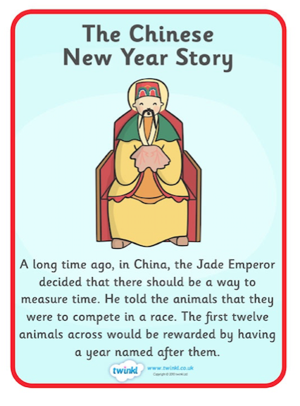

Slide 25
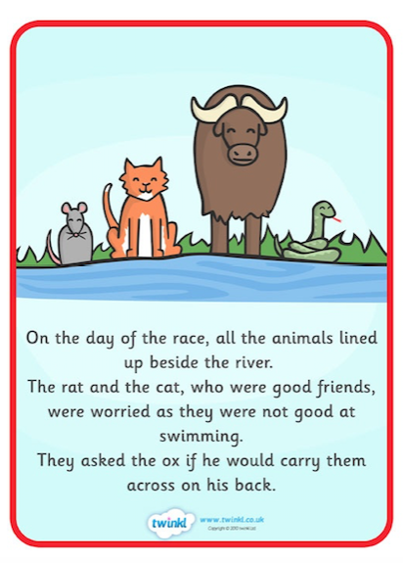

Slide 26
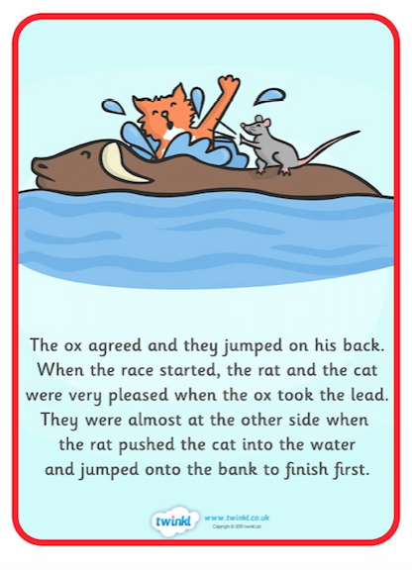

Slide 27

Notes:
Please have the students read the poem.

Slide 28

What did I just learn?
Consonant Sound KN
Notes:
Have the students read the goals if they can. I find that underlining sentences and asking students to read one sentence at a time works well.

Slide 29
What did I just learn?
Simple Past Irregular Verbs
Come – Came
Get – Got
Draw – Drew
Notes:
Have the students read the goals if they can. I find that underlining sentences and asking students to read one sentence at a time works well.

Slide 30
What did I just learn?
How to read for meaning and make connections
Notes:
Have the students read the goals if they can. I find that underlining sentences and asking students to read one sentence at a time works well.

Slide 31

Final Thoughts
Do you have any questions?
Do you understand KN sound?
Can you study the past irregular verbs until the next class?
Homework:
Study the verbs
Write 5 to 7 sentences about your Chinese New Year day using past irregular verbs.
(Example: I ate a moon cake on my Chinese New Year.)
Notes:
Have the students read the goals if they can. I find that underlining sentences and asking students to read one sentence at a time works well.

