Slide 1
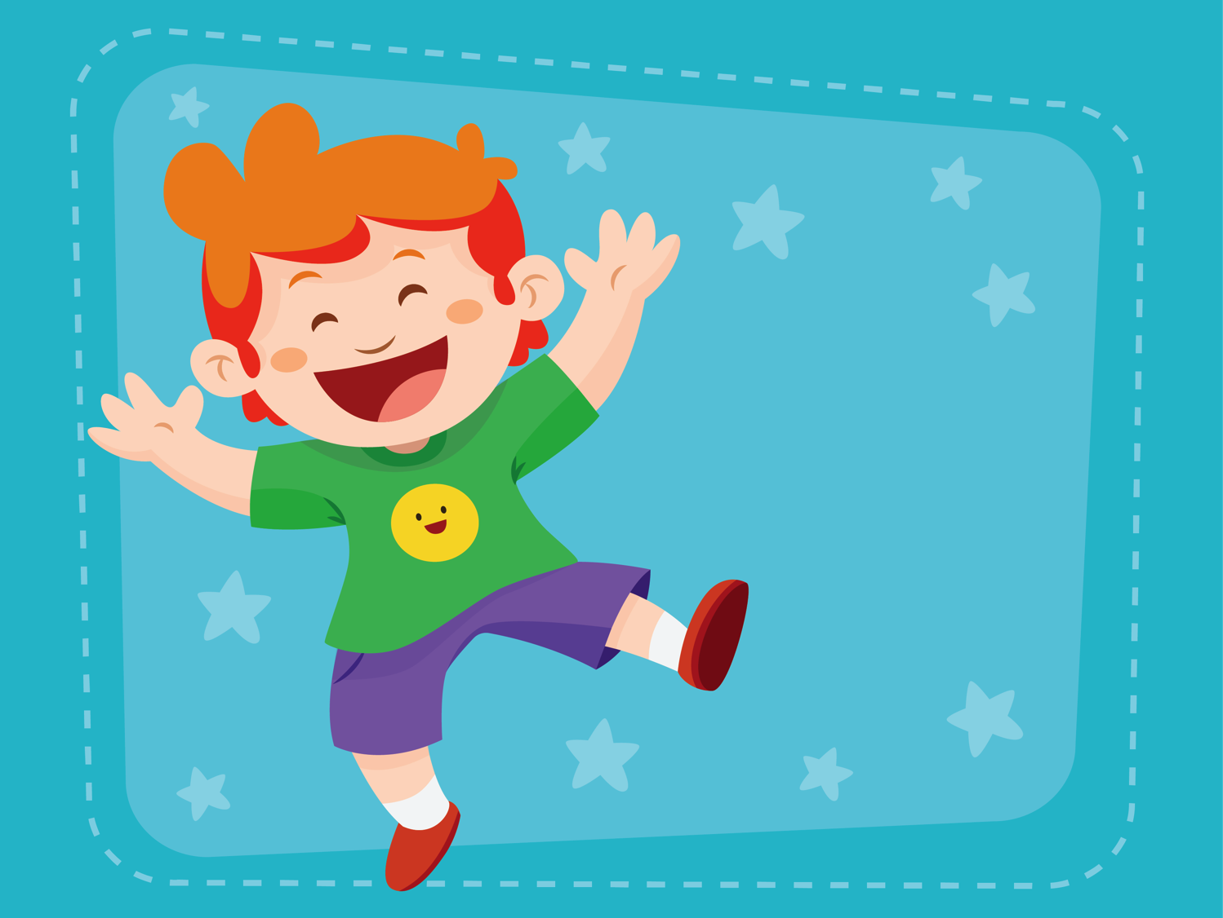
Holiday
Lesson 1, Unit 2

Slide 2
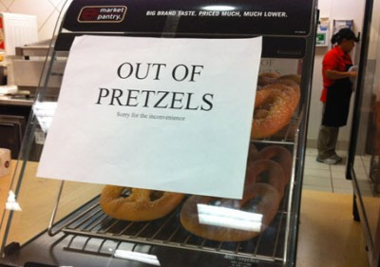
What’s going on?

Slide 3
What’s going on?

Slide 4


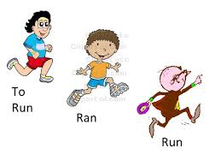


What will I learn today?
The consonant sound KN
Simple past irregular verbs
How to read for meaning and make connections

Slide 5

KN

Slide 6
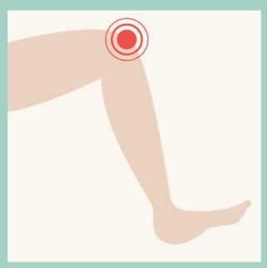
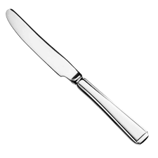
‘KN’ words
knee
knife

Slide 7
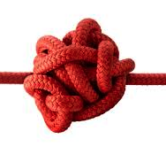
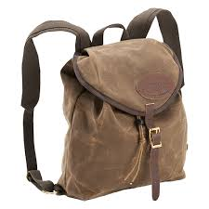
‘KN’ words
knot
knapsack

Slide 8
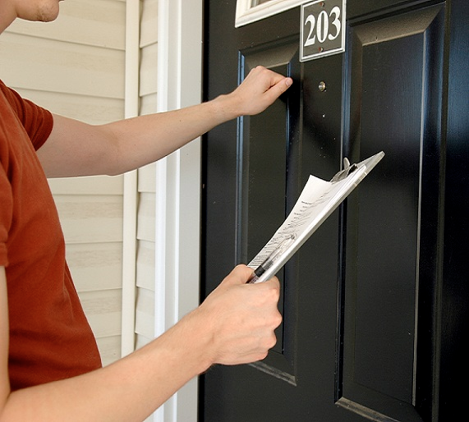
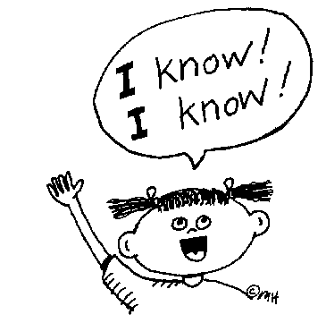
‘KN’ words
knock
know

Slide 9
‘KN’ words
_ _ ee
_ _ apsack
_ _ ock

Slide 10
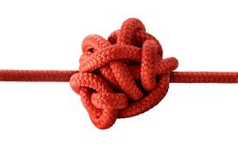
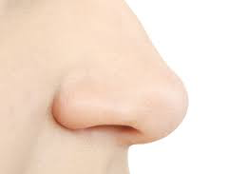
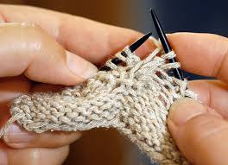
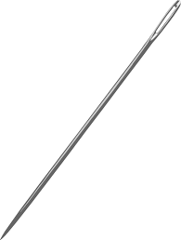
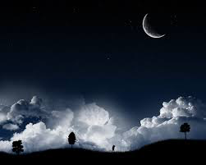
Circle the pictures that contain the letters ‘KN’

Slide 11


What did I just learn?
KN Words & Sound
Notes:
Have the students read the goals if they can. I find that underlining sentences and asking students to read one sentence at a time works well.

Slide 12
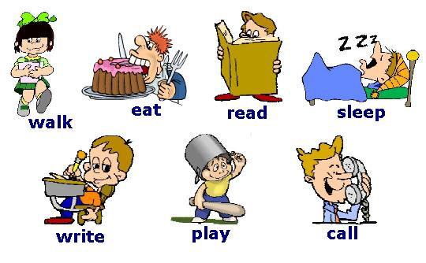
Verb is an action

Slide 13

Simple Past Irregular Verbs
PRESENT= NOW
PAST= BEFORE
When we speak to others about
the present we say…
I give five dollars.
When we speak in the past we say…
Yesterday, I gave five dollars.

Slide 14
Examples
Begin
Began
Blow
Blew
Become
Became
Come
Came
Drink
Drank
Draw
Drew

Slide 15
Examples
Dig
Dug
Forget
Forgot
Fall
Fell
Give
Gave
Grow
Grew
Get
Got

Slide 16
Examples
Ride
Rode
Know
Knew
Rise
Rose
Ring
Rang
Run
Ran
Sing
Sang

Slide 17
Examples
Shine
Shone
Sink
Sank
Sit
Sat
Swim
Swam
Throw
Threw
Wake
Woke

Slide 18
Examples
Win
Won
Write
Wrote

Slide 19
Fill in the past verbs
Run
R_______
Give
G______
Sing
S______

Slide 20
Fill in the past verbs
Win
W____
Wake
W______
Eat
A______

Slide 21
Fill in the past verbs
Rise
R____
Forget
F______
Drink
D______

Slide 22
Fill in the past verbs
Shine
S____
Blow
B______
Write
W______

Slide 23
Fill in the past verbs
Come
C____
Get
G______
Draw
D______

Slide 24
Write in!
1. Sarah _________ (ran/run) to see her friends.
2. Joey ________ (see/saw) an action movie last night.
3. Mom _________ (drank/drink) water yesterday.
4. Bobby _______ (rode/ride) his bike to school yesterday.
5. I _____ (eat/ate) chicken for lunch yesterday.

Slide 25
What did I just learn?
Simple Past Irregular Verbs
Notes:
Have the students read the goals if they can. I find that underlining sentences and asking students to read one sentence at a time works well.

Slide 26

Today’s Story

Slide 27
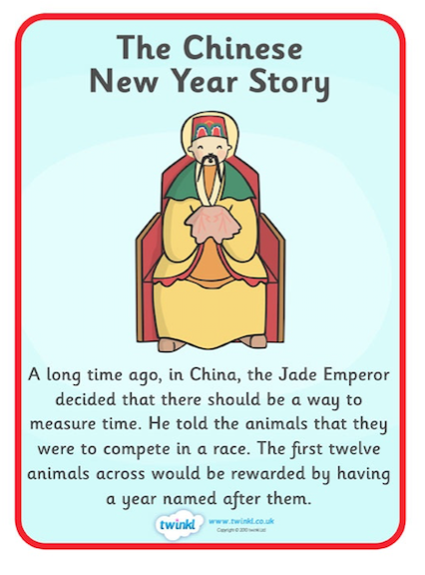

Slide 28
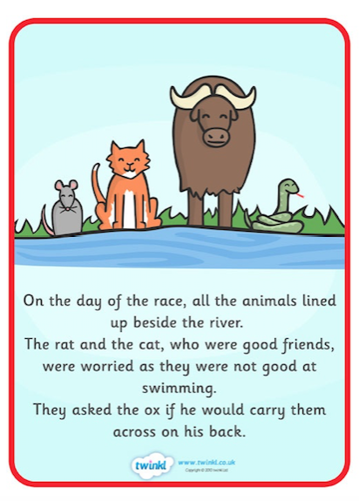

Slide 29
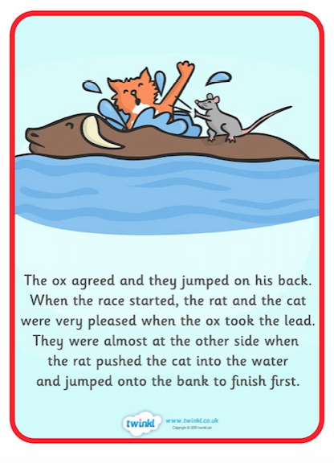

Slide 30
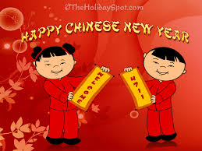
Connecting to the story
Can you name any of the animals that are part of Chinese New Year?

Slide 31
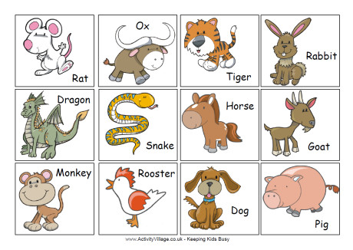
Can you name your animal?

Slide 32
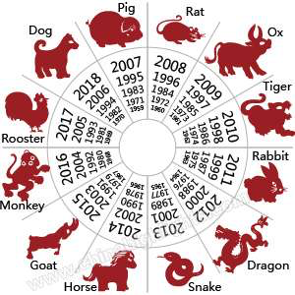
Let’s find out!

Slide 33

Did you know that

Slide 34
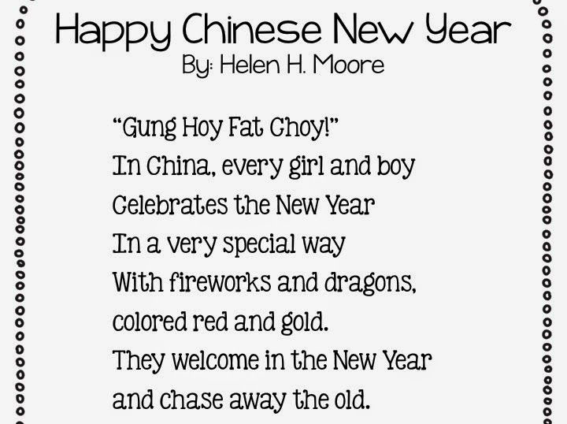
Notes:
Please have the students read the poem.

Slide 35
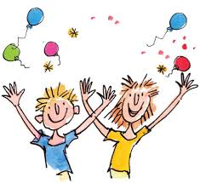
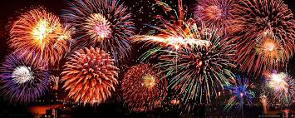
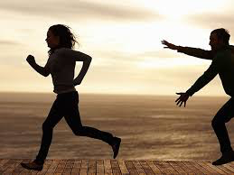
New Words from Poem
fireworks
celebrate
chase
Notes:
Review the vocabulary above.

Slide 36
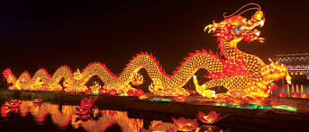

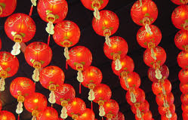
How did you celebrate Chinese New Year?
How did you celebrate Chinese New Year?

Slide 37

What did I just learn?
Consonant Sound KN
Notes:
Have the students read the goals if they can. I find that underlining sentences and asking students to read one sentence at a time works well.

Slide 38
What did I just learn?
Simple Past Irregular Verbs
Come – Came
Get – Got
Draw – Drew
Notes:
Have the students read the goals if they can. I find that underlining sentences and asking students to read one sentence at a time works well.

Slide 39
What did I just learn?
How to read for meaning and make connections
Notes:
Have the students read the goals if they can. I find that underlining sentences and asking students to read one sentence at a time works well.

Slide 40

Final Thoughts
Do you have any questions?
Do you understand KN sound?
Can you study the past irregular verbs until the next class?
Homework:
Study the verbs
Write 5 to 7 sentences about your Chinese New Year day using past irregular verbs.
(Example: I ate a moon cake on my Chinese New Year.)
Notes:
Have the students read the goals if they can. I find that underlining sentences and asking students to read one sentence at a time works well.

