Slide 1

Holiday
ESL B (Level 2)
Lesson 2, Unit 2

Slide 2

What did I learn last class?
Sounds of the letters ‘kn’
New Chinese New Year words
Simple Past and Irregular Verbs
Making connections between ourselves and the world

Slide 3

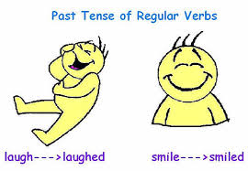

Today you will learn…
Sound of the letters ‘cl’
More simple past irregular verbs
Retelling a story we have read in our own words
New Birthday words

Slide 4

What day are we
celebrating today?

Slide 5

We are celebrating Your Birthday!
Notes:
Ask the students to describe what is happening in the picture? What do they see? Describe what the women are wearing? What colour are the flowers? What season do they think it takes place? What is the name of Chinese festival where a photo like this would be taken?

Slide 6
Birthday!
When it is your birthday, you celebrate the day you were born!
Many people have a birthday party
with their friends and family to celebrate their special day!
Notes:
Ask the students to describe what is happening in the picture? What do they see? Describe what the women are wearing? What colour are the flowers? What season do they think it takes place? What is the name of Chinese festival where a photo like this would be taken?

Slide 7
When is your birthday?
We first say the month,
then the day and then the year we were born.
My birthday is month, day, year
Example: My birthday is June 26th 1997
Notes:
Ask the students to describe what is happening in the picture? What do they see? Describe what the women are wearing? What colour are the flowers? What season do they think it takes place? What is the name of Chinese festival where a photo like this would be taken?

Slide 8
When is your birthday?
My birthday is month, day, year
My birthday is __________________________
Notes:
Ask the students to describe what is happening in the picture? What do they see? Describe what the women are wearing? What colour are the flowers? What season do they think it takes place? What is the name of Chinese festival where a photo like this would be taken?

Slide 9
How old are you ?
I am ______ years old !
Notes:
Ask the students to describe what is happening in the picture? What do they see? Describe what the women are wearing? What colour are the flowers? What season do they think it takes place? What is the name of Chinese festival where a photo like this would be taken?

Slide 10
How do you celebrate your Birthday?
On my birthday I ___________________
______________________________________
______________________________________
Notes:
Ask the students to describe what is happening in the picture? What do they see? Describe what the women are wearing? What colour are the flowers? What season do they think it takes place? What is the name of Chinese festival where a photo like this would be taken?

Slide 11
What did I just learn?
New Birthday words

Slide 13
Today is August 9th and it is a special day for Nana.
Nate is excited for Nana’s birthday. He goes outside and gets Nana some birthday flowers!

Slide 14
Nana will love her birthday flowers!
‘Those are nice flowers,’ says Dad. ’Do not forget to put them in water!’

Slide 15
Nate is too busy making a birthday card for Nana. He does not hear his dad.

Slide 16
Nate forgets to put the flowers for Nana in water.

Slide 17
Now it is time to bake a birthday cake for Nana.
“Mix the cake good!” says Mom.
Oh no! Nana’s birthday cake fell on the floor!

Slide 18
“I did not put the flowers in water and the cake is on the floor!
What will I give Nana for her special day?” cried Nate.

Slide 19
“I am sorry Nana. I only have a card for you. The cake is on the floor and the flowers have no water.”

Slide 20
“It is okay Nate,” said Nana, “All I want is to spend time with you! That is the best gift for my special birthday!”

Slide 21
What did I just learn?
Talking about what happened in a story in our own words

Slide 22


Today’s letters are…

Slide 23

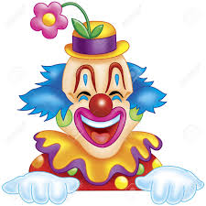
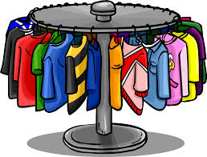
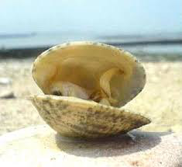
Words with the sound “CL”
clouds | clown
clothes | clam
Notes:
See is they can pronounce the words on their own. You may discuss some of the images with them, especially “clam” and “clover”.

Slide 24


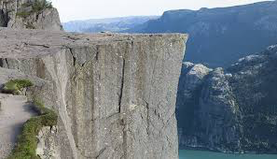
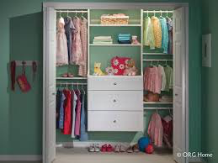
Words with the sound “CL”
clover | clock
cliff | closet
Notes:
See is they can pronounce the words on their own. You may discuss some of the images with them, especially “clam” and “clover”.

Slide 25
What did I just learn?
Sound of the letters ‘CL’

Slide 26
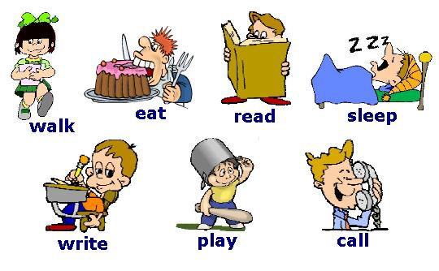
Simple past verbs
Review: A verb is an action
Notes:
Be sure to review these terms with them. Depending on your students, you may want to ask them to MIME/PANTOMIME the actions along with you. Focus on the past terms for EAT, SLEEP and WRITE. This is a review from the last lesson.

Slide 27
Simple past verbs
Circle and write in the correct word in the past
Yesterday, I ____ my birthday cake!
wrote
ate
slept
Notes:
Be sure to review these terms with them. Depending on your students, you may want to ask them to MIME/PANTOMIME the actions along with you. Focus on the past terms for EAT, SLEEP and WRITE. This is a review from the last lesson.

Slide 28
Simple past verbs
Circle and write in the correct word in the past
Yesterday, I _____ a test!
wrote
ate
slept
Notes:
Be sure to review these terms with them. Depending on your students, you may want to ask them to MIME/PANTOMIME the actions along with you. Focus on the past terms for EAT, SLEEP and WRITE. This is a review from the last lesson.

Slide 29
Simple past verbs
Circle and write in the correct word in the past
Yesterday, I _______ until 11 am!
wrote
ate
slept
Notes:
Be sure to review these terms with them. Depending on your students, you may want to ask them to MIME/PANTOMIME the actions along with you. Focus on the past terms for EAT, SLEEP and WRITE. This is a review from the last lesson.

Slide 30
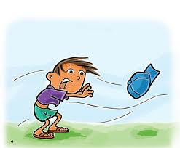
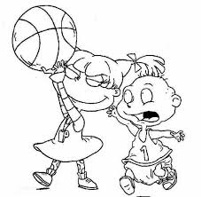
Fill in the past verbs…
blow ________ | take _______ | sweep ________
took
swept
blew
Notes:
Use the TEXT tool.

Slide 31
Fill in the past verbs…
rise ________ | find _______ | Throw ________
threw
rose
found
Notes:
Use the TEXT tool.

Slide 32
Writing Sentences
1. I watched the sun _________ (rose/rise).
2. Jess ________ (find/found) her moms cell phone.
Notes:
Have students circle the appropriate word or use the TEXT tool to type in their answers.

Slide 33
Writing Sentences
3. Suzy _______ (sweep/swept) the floor.
4. The pitcher _______ (threw/throw) the baseball.
Notes:
Have students circle the appropriate word or use the TEXT tool to type in their answers.

Slide 34
Writing Sentences
5. My brother _____ (take/took) my toy.
Notes:
Have students circle the appropriate word or use the TEXT tool to type in their answers.

Slide 35
What did I just learn?
Simple and past irregular verbs

Slide 37
Who do you want to make a birthday card for?

Slide 38
I want to make a birthday card for
_____________________

Slide 39
What did I learn today?
Sounds of the letter ‘CL’

Slide 40
What did I learn today?
Simple and past irregular verbs

Slide 41
What did I learn today?
Retelling a story we have read in our own words

Slide 42
What did I learn today?
New Birthday words

Slide 43
Great Job Today!!
Do you have any questions?
Do you understand the handout?

