Slide 1

Holiday
ESL B (Level 2)
Lesson 2, Unit 2

Slide 2
What do you see in this picture?
Notes:
Ask the students to describe what is happening in the picture? What do they see? Describe what the women are wearing? What colour are the flowers? What season do they think it takes place? What is the name of Chinese festival where a photo like this would be taken?

Slide 3

What did I learn last class?
Sounds of the letters ‘kn’
New Chinese New Year words
Simple Past and Irregular Verbs
Making connections between ourselves and the world

Slide 4

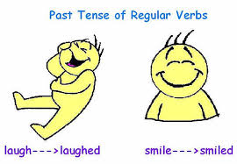

Today you will learn…
Sound of the letters ‘cl’
More simple past irregular verbs
Retelling a story we have read in our own words
New Birthday words

Slide 5

What day are we
celebrating today?

Slide 6

We are celebrating
Your Birthday!
Notes:
Ask the students to describe what is happening in the picture? What do they see? Describe what the women are wearing? What colour are the flowers? What season do they think it takes place? What is the name of Chinese festival where a photo like this would be taken?

Slide 7
Birthday!
When it is your birthday, you celebrate the day you were born!
Many people have a birthday party
with their friends and family to celebrate their special day!
Notes:
Ask the students to describe what is happening in the picture? What do they see? Describe what the women are wearing? What colour are the flowers? What season do they think it takes place? What is the name of Chinese festival where a photo like this would be taken?

Slide 8
When is your birthday?
We first say the month,
then the day and then the year we were born.
My birthday is month, day, year
Example: My birthday is June 26th 1997
Notes:
Ask the students to describe what is happening in the picture? What do they see? Describe what the women are wearing? What colour are the flowers? What season do they think it takes place? What is the name of Chinese festival where a photo like this would be taken?

Slide 9
When is your birthday?
My birthday is month, day, year
My birthday is __________________________
Notes:
Ask the students to describe what is happening in the picture? What do they see? Describe what the women are wearing? What colour are the flowers? What season do they think it takes place? What is the name of Chinese festival where a photo like this would be taken?

Slide 10
How old are you ?
I am ______ years old !
Notes:
Ask the students to describe what is happening in the picture? What do they see? Describe what the women are wearing? What colour are the flowers? What season do they think it takes place? What is the name of Chinese festival where a photo like this would be taken?

Slide 11
How do you celebrate your Birthday?
On my birthday I ___________________
______________________________________
______________________________________
Notes:
Ask the students to describe what is happening in the picture? What do they see? Describe what the women are wearing? What colour are the flowers? What season do they think it takes place? What is the name of Chinese festival where a photo like this would be taken?

Slide 12
What did I just learn?
New Birthday words

Slide 14
Today is August 9th and it is a special day for Nana.
Nate is excited for Nana’s birthday. He goes outside and gets Nana some birthday flowers!

Slide 15
Nana will love her birthday flowers!
‘Those are nice flowers,’ says Dad. ’Do not forget to put them in water!’

Slide 16
Nate is too busy making a birthday card for Nana. He does not hear his dad.

Slide 17
Nate forgets to put the flowers for Nana in water.

Slide 18
Now it is time to bake a birthday cake for Nana.
“Mix the cake good!” says Mom.
Oh no! Nana’s birthday cake fell on the floor!

Slide 19
“I did not put the flowers in water and the cake is on the floor!
What will I give Nana for her special day?” cried Nate.

Slide 20
“I am sorry Nana. I only have a card for you. The cake is on the floor and the flowers have no water.”

Slide 21
“It is okay Nate,” said Nana, “All I want is to spend time with you! That is the best gift for my special birthday!”

Slide 22
Let’s Talk!
Where is Nate going today?

Slide 23
Let’s Talk!
Where is Nate going today?
Nate is going to Nana’s house
She is his Grandma!

Slide 24
Let’s Talk!
Where did Nate get the flowers for Nana from?

Slide 25
Let’s Talk!
Where did Nate get the
flowers for Nana from?
He got the flowers
from outside!

Slide 26
Let’s Talk!
What special day is it for Nana?

Slide 27
Let’s Talk!
What special day is
it for Nana?
It is Nana’s birthday!

Slide 28
Let’s Talk!
What happened to the cake?

Slide 29
Let’s Talk!
What happened
to the cake?
It fell on the floor!

Slide 30
What did I just learn?
Talking about what happened in a story in our own words

Slide 31


Today’s letters are…

Slide 32

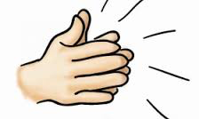
The CLAP Song
Notes:
https://www.youtube.com/watch?v=cdvDMpIUMpo
Try to get the students to do the actions along with the video.

Slide 33

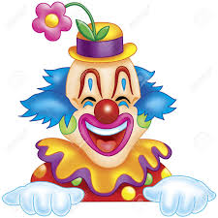
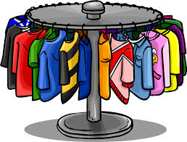
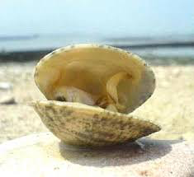
Words with the sound “CL”
cl_______ | cl_______
cl_______ | cl_______
Notes:
See is they can pronounce the words on their own. You may discuss some of the images with them, especially “clam” and “clover”.

Slide 34
Words with the sound “CL”
clouds | clown
clothes | clam
Notes:
See is they can pronounce the words on their own. You may discuss some of the images with them, especially “clam” and “clover”.

Slide 35


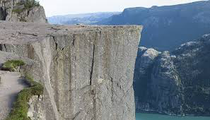
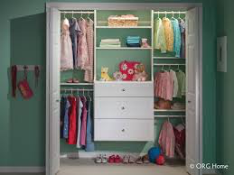
Words with the sound “CL”
cl_______ | cl______
cl_______ | cl_______
Notes:
See is they can pronounce the words on their own. You may discuss some of the images with them, especially “clam” and “clover”.

Slide 36
Words with the sound “CL”
clover | clock
cliff | closet
Notes:
See is they can pronounce the words on their own. You may discuss some of the images with them, especially “clam” and “clover”.

Slide 37
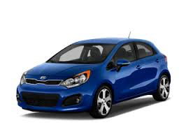
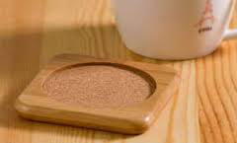

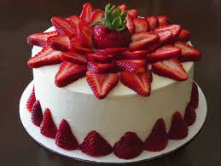
Circle the pictures that have
the letters CL in them
Notes:
Use the stylus to circle the words. If you have multiple students, be sure to have them use different colours.

Slide 38
What did I just learn?
Sound of the letters ‘CL’

Slide 39
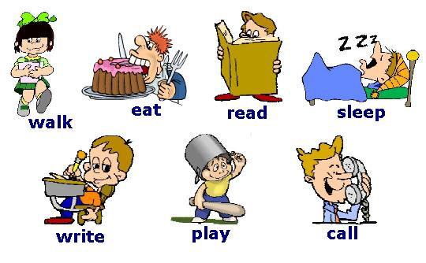
Simple past verbs
Review: A verb is an action
Notes:
Be sure to review these terms with them. Depending on your students, you may want to ask them to MIME/PANTOMIME the actions along with you. Focus on the past terms for EAT, SLEEP and WRITE. This is a review from the last lesson.

Slide 40
Simple past verbs
Review: A verb is an action
Notes:
Be sure to review these terms with them. Depending on your students, you may want to ask them to MIME/PANTOMIME the actions along with you. Focus on the past terms for EAT, SLEEP and WRITE. This is a review from the last lesson.

Slide 41
Simple past verbs
Review: A verb is an action
ate
slept
wrote
Notes:
Be sure to review these terms with them. Depending on your students, you may want to ask them to MIME/PANTOMIME the actions along with you. Focus on the past terms for EAT, SLEEP and WRITE. This is a review from the last lesson.

Slide 42
Simple past verbs
Circle and write in the correct word in the past
Yesterday, I ____ my birthday cake!
wrote
ate
slept
Notes:
Be sure to review these terms with them. Depending on your students, you may want to ask them to MIME/PANTOMIME the actions along with you. Focus on the past terms for EAT, SLEEP and WRITE. This is a review from the last lesson.

Slide 43
Simple past verbs
Circle and write in the correct word in the past
Yesterday, I _ate___ my birthday cake!
wrote
ate
slept
Notes:
Be sure to review these terms with them. Depending on your students, you may want to ask them to MIME/PANTOMIME the actions along with you. Focus on the past terms for EAT, SLEEP and WRITE. This is a review from the last lesson.

Slide 44
Simple past verbs
Circle and write in the correct word in the past
Yesterday, I _____ a test!
wrote
ate
slept
Notes:
Be sure to review these terms with them. Depending on your students, you may want to ask them to MIME/PANTOMIME the actions along with you. Focus on the past terms for EAT, SLEEP and WRITE. This is a review from the last lesson.

Slide 45
Simple past verbs
Circle and write in the correct word in the past
Yesterday, I _wrote_____ a test!
wrote
ate
slept
Notes:
Be sure to review these terms with them. Depending on your students, you may want to ask them to MIME/PANTOMIME the actions along with you. Focus on the past terms for EAT, SLEEP and WRITE. This is a review from the last lesson.

Slide 46
Simple past verbs
Circle and write in the correct word in the past
Yesterday, I _______ until 11 am!
wrote
ate
slept
Notes:
Be sure to review these terms with them. Depending on your students, you may want to ask them to MIME/PANTOMIME the actions along with you. Focus on the past terms for EAT, SLEEP and WRITE. This is a review from the last lesson.

Slide 47
Simple past verbs
Circle and write in the correct word in the past
Yesterday, I __slept__ until 11 am!
wrote
ate
slept
Notes:
Be sure to review these terms with them. Depending on your students, you may want to ask them to MIME/PANTOMIME the actions along with you. Focus on the past terms for EAT, SLEEP and WRITE. This is a review from the last lesson.

Slide 48
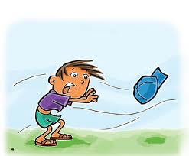
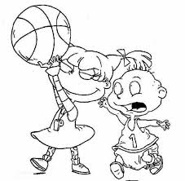
Fill in the past verbs…
blow ________ | take _______ | sweep ________
took
swept
blew
Notes:
Use the TEXT tool.

Slide 49
Fill in the past verbs…
blow blew | take took | sweep swept
Notes:
Use the TEXT tool.

Slide 50
Fill in the past verbs…
rise ________ | find _______ | Throw ________
threw
rose
found
Notes:
Use the TEXT tool.

Slide 51
Fill in the past verbs…
rise rose | find found | Throw threw
Notes:
Use the TEXT tool.

Slide 52
Writing Sentences
1. I watched the sun _________ (rose/rise).
2. Jess ________ (find/found) her moms cell phone.
Notes:
Have students circle the appropriate word or use the TEXT tool to type in their answers.

Slide 53
Writing Sentences
1. I watched the sun rose
2. Jess found her moms cell phone.
Notes:
Have students circle the appropriate word or use the TEXT tool to type in their answers.

Slide 54
Writing Sentences
3. Suzy _______ (sweep/swept) the floor.
4. The pitcher _______ (threw/throw) the baseball.
Notes:
Have students circle the appropriate word or use the TEXT tool to type in their answers.

Slide 55
Writing Sentences
3. Suzy swept the floor.
4. The pitcher threw the baseball.
Notes:
Have students circle the appropriate word or use the TEXT tool to type in their answers.

Slide 56
Writing Sentences
5. My brother _____ (take/took) my toy.
Notes:
Have students circle the appropriate word or use the TEXT tool to type in their answers.

Slide 57
Writing Sentences
5. My brother took my toy.
Notes:
Have students circle the appropriate word or use the TEXT tool to type in their answers.

Slide 58
What did I just learn?
Simple and past irregular verbs

Slide 60
Who do you want to make a birthday card for?

Slide 61
I want to make a birthday card for
_____________________

Slide 63
What did I learn today?
Sounds of the letters ‘cl’

Slide 64
What did I learn today?
Simple and past irregular verbs

Slide 65
What did I learn today?
Retelling a story we have read in our own words

Slide 66
What did I learn today?
New Birthday words

Slide 67
Great Job Today!!
Do you have any questions?
Do you understand the handout?

Slide 68

Writing a Summary
A summary is telling someone what happened in a story. It is short.

Slide 69
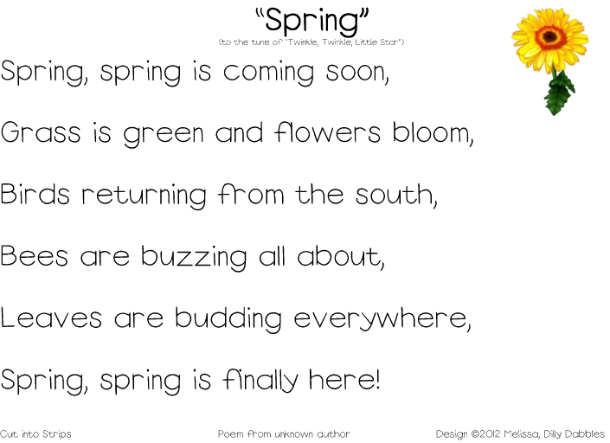

Slide 70
What happened in the story?
Writing a Summary

Slide 71

What happened in the poem?
Writing a Summary

