Slide 1
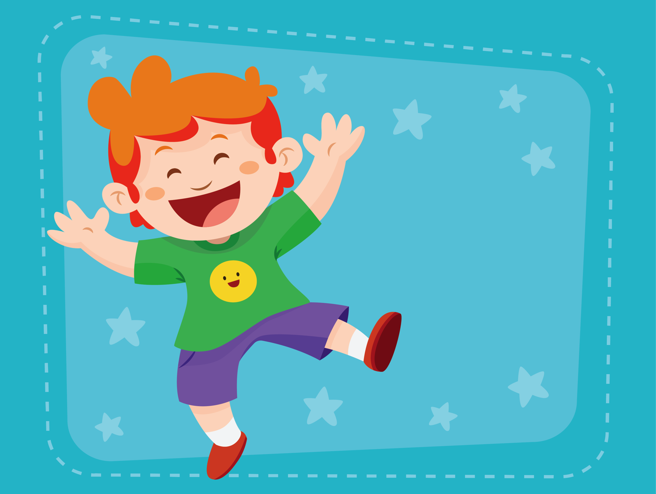
Holiday
ESL B (Level 2)
Lesson 3, Unit 2

Slide 2


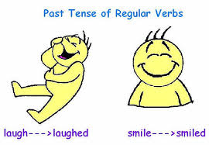

What did I learn last class?
The consonant sound CL
More simple past irregular verbs
Reading focus: oral summary

Slide 3
What will I learn today?
Review ing/ng sounds
Transition words: like/ unlike, similar to/different from
Making connections between ourselves and the world
Valentine’s Day Vocabulary

Slide 4

What day are we
celebrating today?

Slide 5

Notes:
Ask the students to describe what is happening in the picture? What do they see? Describe what the women are wearing? What colour are the flowers? What season do they think it takes place? What is the name of Chinese festival where a photo like this would be taken?

Slide 6
Valentine’s Day!
Notes:
Ask the students to describe what is happening in the picture? What do they see? Describe what the women are wearing? What colour are the flowers? What season do they think it takes place? What is the name of Chinese festival where a photo like this would be taken?

Slide 7
What is Valentine’s Day?
Valentine’s Day is celebrated on February 14th.
It is to celebrate the people we love!
Notes:
Ask the students to describe what is happening in the picture? What do they see? Describe what the women are wearing? What colour are the flowers? What season do they think it takes place? What is the name of Chinese festival where a photo like this would be taken?

Slide 8
What is Valentine’s Day?
On Valentine’s Day we do nice things for the people we love!
Notes:
Ask the students to describe what is happening in the picture? What do they see? Describe what the women are wearing? What colour are the flowers? What season do they think it takes place? What is the name of Chinese festival where a photo like this would be taken?

Slide 9
The Story of Cupid
Who is Cupid?
Cupid comes on Valentine’s Day and makes people fall in love.
He uses his arrows to make people fall in love.
Notes:
Ask the students to describe what is happening in the picture? What do they see? Describe what the women are wearing? What colour are the flowers? What season do they think it takes place? What is the name of Chinese festival where a photo like this would be taken?

Slide 10


Slide 11
Valentine’s Day Chocolates
In the video, the boy does not like Valentine’s Day.
What is he doing with his chocolates?
Notes:
Ask the students to describe what is happening in the picture? What do they see? Describe what the women are wearing? What colour are the flowers? What season do they think it takes place? What is the name of Chinese festival where a photo like this would be taken?

Slide 12
Do you like Valentine’s Day?
I (like / do not like) Valentine’s Day because
_______________________________________
_______________________________________
_______________________________________
_______________________________________

Slide 13
Let’s Talk!
The boy in the video did not want to celebrate Valentine’s Day.
Tell us about when you had to do something you did not want to do.

Slide 14
Let’s Talk!
What are some ways we can turn a bad day into a good day?
How to have
a good day!
Sing a song
Call a friend

Slide 15
What did I just learn?
Making connections between ourselves and the world

Slide 17
Skidamarink
Skidamarink ka dink ka dink
Skidamarink ka doo
I Love You
I love you in the morning
and in the afternoon
I love you in the evening
and underneath the moon ow
Skidamarink ka dink ka dink
Skidamarink ka doo
I Love You

Slide 18
Skidamarink
I love you in the ______________ .
and in the afternoon
I love you in the evening
and underneath the moon ow

Slide 19
Skidamarink
I love you in the morning
and in the afternoon
I love you in the evening
and underneath the moon ow

Slide 20
Skidamarink
I love you in the morning
and in the ___________.
I love you in the evening
and underneath the moon ow

Slide 21
Skidamarink
I love you in the morning
and in the afternoon
I love you in the evening
and underneath the moon ow

Slide 22
Skidamarink
I love you in the morning
and in the afternoon
I love you in the _____________
and underneath the moon ow

Slide 23
Skidamarink
I love you in the morning
and in the afternoon
I love you in the evening
and underneath the moon ow

Slide 24
Skidamarink
I love you in the morning
and in the afternoon
I love you in the evening
and underneath the ___________ ow

Slide 25
Skidamarink
I love you in the morning
and in the afternoon
I love you in the evening
and underneath the moon ow

Slide 26
What did I just learn?
Valentine’s Day Vocabulary

Slide 27
Today’s letters

Slide 28
This is a _______
king soldier

Slide 29
This is a _______
necklace ring

Slide 30
This is a _______
wing sing

Slide 31
They like to _______
wing sing

Slide 32
He is _______
strong ping-pong

Slide 33
This game is called _____________
strong ping-pong

Slide 34
Her hair is ________
long lung

Slide 35
We breathe with two ________ !
long lungs

Slide 36
What did I just learn?
Sounds of the letters ing and ng

Slide 37
Transition Words
Review: Transition words help bring two ideas together
Like
Unlike
Similar to
Different from

Slide 38
Transition Words: Like / Unlike
If something is the same as another it is like them
If something is different than another it is unlike them

Slide 39
Transition Words: Like / Unlike
<- This heart is red unlike the other heart

Slide 40
Transition Words: Like / Unlike
<- This heart is red like the other heart

Slide 41
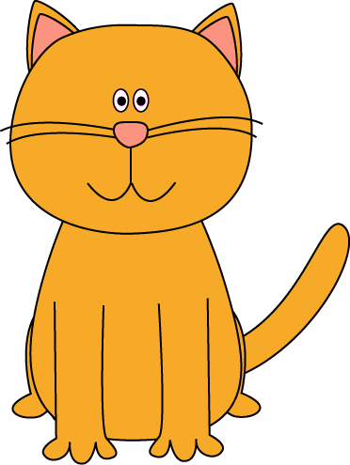
Are they like or unlike ?
Transition Words: Like / Unlike

Slide 42
Are they like or unlike ?
Transition Words: Like / Unlike

Slide 43
Are they like or unlike ?
Transition Words: Like / Unlike

Slide 44
Are they like or unlike ?
Transition Words: Like / Unlike

Slide 45
Are they like or unlike ?
Transition Words: Like / Unlike

Slide 46
Transition Words: Similar to / Different from
If something is almost the same as another it is similar to them
If something is not the same as another it is different from them

Slide 47
Are they similar to or different from each other ?
Similar to / Different from

Slide 48
Are they similar to or different from each other ?
Similar to / Different from

Slide 49
Are they similar to or different from each other ?
Similar to / Different from

Slide 50
Are they similar to or different from each other ?
Similar to / Different from

Slide 51
What did I just learn?
Transition Words

Slide 52
Happy
Valentine’s Day!

Slide 53
What did I just learn?
Transition words

Slide 54
What did I just learn?
Making connections between ourselves and the world

Slide 55
What did I just learn?
Valentine’s Day Vocabulary

Slide 56
What did I just learn?
Review ing/ng sounds

Slide 57

Great Job Today!!
Do you have any questions?
Do you understand the handout?

Slide 58


