Slide 1
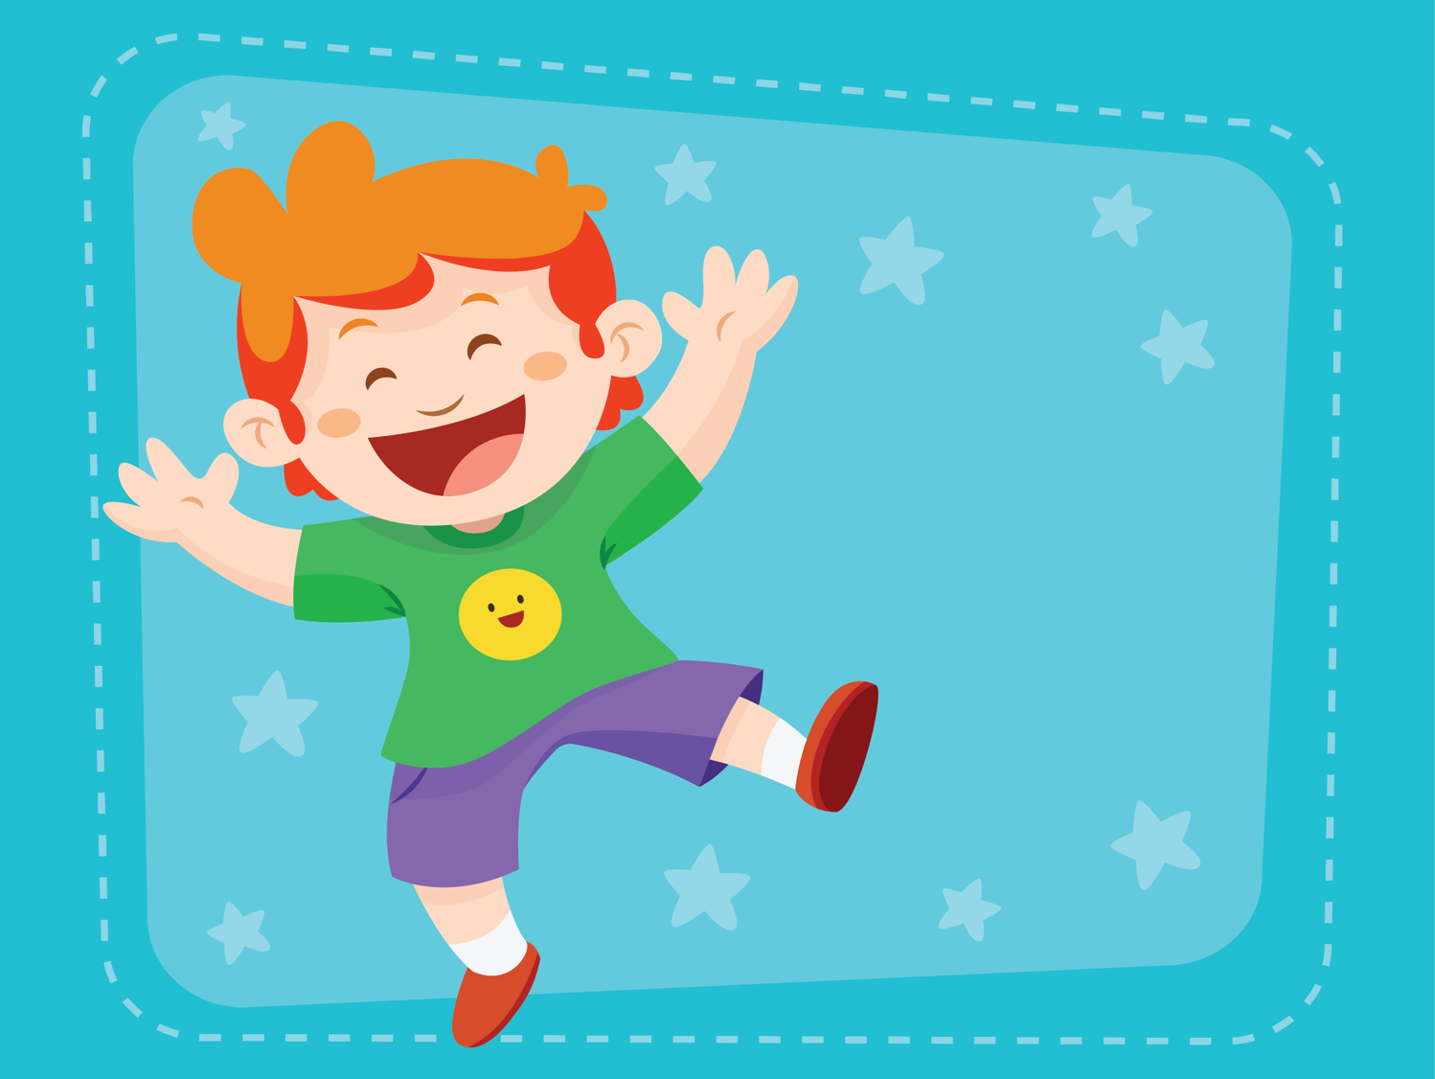
Holiday
ESL B (Level 2)
Lesson 5, Unit 2

Slide 2

What did I learn last class?
Review ‘DR’ sounds
Asking for information using ‘W’ questions
Telling each other what we just read in our own words
New St. Patrick’s Day Words

Slide 3
What will I learn today?
Sounds of the letters ‘TR’
Read and then sing a poem together
Making connections between ourselves and the world
New Easter Words

Slide 4

What holiday are we
celebrating today?

Slide 5
We are celebrating Easter!
Notes:
Ask the students to describe what is happening in the picture? What do they see? Describe what the women are wearing? What colour are the flowers? What season do they think it takes place? What is the name of Chinese festival where a photo like this would be taken?

Slide 6
What is Easter?
Easter is celebrated on March 27th.
On Easter, the Easter Bunny comes to visit and hides chocolate eggs!
Notes:
Ask the students to describe what is happening in the picture? What do they see? Describe what the women are wearing? What colour are the flowers? What season do they think it takes place? What is the name of Chinese festival where a photo like this would be taken?

Slide 7
Do you celebrate Easter?
Yes,
I do
celebrate Easter
No,
I do not celebrate Easter
Notes:
Ask the students to describe what is happening in the picture? What do they see? Describe what the women are wearing? What colour are the flowers? What season do they think it takes place? What is the name of Chinese festival where a photo like this would be taken?

Slide 8
How do you celebrate Easter?
On Easter I … ________________________
____________________________________
Notes:
Ask the students to describe what is happening in the picture? What do they see? Describe what the women are wearing? What colour are the flowers? What season do they think it takes place? What is the name of Chinese festival where a photo like this would be taken?

Slide 9

What did I just learn?
Easter Vocabulary

Slide 11
This is Troy. He is excited for Easter. He is going to visit his cousins on a farm!

Slide 12
On the farm there are many baby animal.
“Can I hold a chicken?” asked Troy.

Slide 13
After the farm all of the kids paint Easter eggs for the Easter Bunny!
“This is fun!” said Troy.

Slide 14
The eggs are prepared and Mom puts the eggs in a safe place for Easter morning!

Slide 15
The kids leave carrots for the Easter bunny to eat when it stops by.

Slide 16
It is Easter morning!
‘Let’s go see if the Easter bunny came!” said Troy.

Slide 17
The Easter Bunny did come and eat the carrots!
‘Let’s go look for the Easter eggs!’

Slide 18
Troy and his cousin found lots of eggs hidden under spring flowers!

Slide 19
‘Look Grandma and Grandpa!
Look at all of the eggs we found!’

Slide 20
During Easter dinner Grandpa tells everyone about the Easter festival.
Everyone is having fun!

Slide 21
Troy likes Easter. He likes the Easter Bunny, Easter eggs and playing with his cousins!

Slide 22
What did Troy do for Easter?
For Easter Troy …

Slide 23
What did I just learn?
Making connections between ourselves and the world

Slide 24
This is the way the bunny hops

Slide 25
This is the way the bunny hops
This is the Way the Bunny Hops
This is the way the bunny hops, hop hop hop, hop
hop, hop, hop
This is the way the bunny hops on Easter day

Slide 26
This is the way the bunny hops
This is the way he wiggles his nose, wiggle. wiggle, wiggle, wiggle
wiggle, wiggle, wiggle
This is the way the bunny wiggles his nose on Easter day

Slide 27
This is the way the bunny hops
This is the way he flops his ears, flop, flop, flop. flop
flop, flop, flop
This is the way he flops his ears on Easter day

Slide 28
This is the way the bunny hops
This is the way he shakes his tail, shake, shake, shake, shake
shake, shake, shake
This is the way he shakes his tail on Easter day

Slide 29
This is the way the bunny hops
This is the way the bunny hops, hop hop, hop, hops
hop, hop, hop
This is the way the bunny hops on Easter day
On Easter day

Slide 30
What did I just learn?
Read then sing a poem together

Slide 31
Today’s letters

Slide 32
Words with ’tr’
Fill in the word and write a sentence using the new ‘tr’ word
This is Tr______ from the story.
___________________________
___________________________

Slide 33
Words with ’tr’
Fill in the word and write a sentence using the new ‘tr’ word
This is a tr_______.
____________________________________________________________

Slide 34
Words with ’tr’
Fill in the word and write a sentence using the new ‘tr’ word
This is a tr_______.
____________________________________________________________

Slide 35
Words with ’tr’
Fill in the word and write a sentence using the new ‘tr’ word
This is a tr_______.
____________________________________________________________

Slide 36
Words with ’tr’
Fill in the word and write a sentence using the new ‘tr’ word
This is a tr_______.
____________________________________________________________

Slide 37
Circle the pictures with the letters ‘tr’

Slide 38
What did I just learn?
Sounds of the letters ing/ ng

Slide 40
What did I learn today?
Sounds of the letters ‘TR’
This is a tr_____.

Slide 41
What did I learn today?
Read and then sing a poem together
This is the Way the Bunny Hops
This is the way the bunny hops, hop hop hop, hop
hop, hop, hop
This is the way the bunny hops on Easter day

Slide 42
What did I learn today?
Making connections between ourselves and the world

Slide 43
What did I learn today?
New Easter Words

Slide 44
Great Job Today!
Do have any questions ?
Do you understand the worksheet?

Slide 45
For Next Class
Read the story from the lesson to yourself and to your friends and family
Finish the class worksheet
- Review the ‘dr’ sound

