Slide 1
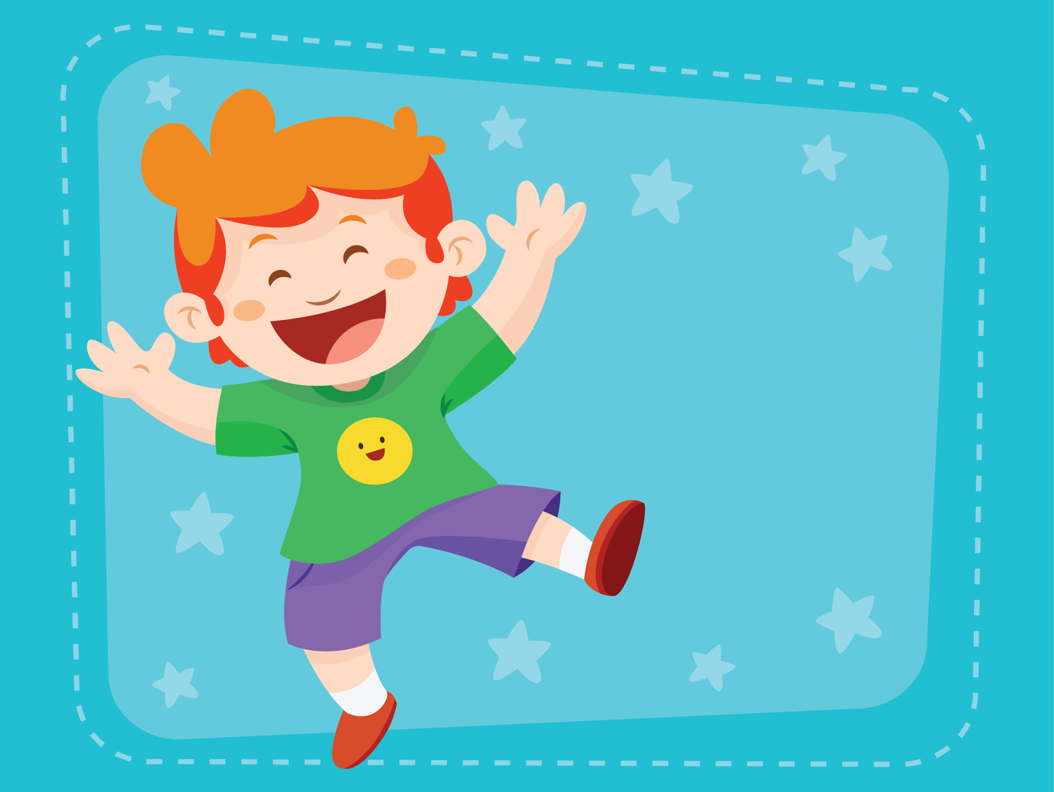
Holiday
ESL B (Level 2)
Lesson 6, Unit 2

Slide 2

What did I learn last class?
Sounds of the letters ‘TR’
Read and then sing a poem together
Making connections between ourselves and the world
New Easter Words

Slide 3
What will I review today?
Earth Day Vocabulary
Review sounds of the letters ‘KN’, ‘CL’, ‘ING/NG’, ‘DR’, ‘TR’
Making connections between ourselves and the world
Retelling a story we have read in our own words

Slide 4

What holiday are we
celebrating today?

Slide 5
We are celebrating Earth Day!
Notes:
Ask the students to describe what is happening in the picture? What do they see? Describe what the women are wearing? What colour are the flowers? What season do they think it takes place? What is the name of Chinese festival where a photo like this would be taken?

Slide 6
What is Earth Day?
Earth Day is celebrated on April 22nd.
It is to celebrate the planet we live on…. the earth!!
Notes:
Ask the students to describe what is happening in the picture? What do they see? Describe what the women are wearing? What colour are the flowers? What season do they think it takes place? What is the name of Chinese festival where a photo like this would be taken?

Slide 7
Going Green means taking care of the planet!

Slide 8
We can Go Green if we Reduce, Reuse and Recycle!

Slide 9
What does it mean to Reduce, Reuse and Recycle ?
Notes:
VIDEO

Slide 10
Earth Day every day!
What are some way we can celebrate the earth every day?
Earth Day
What can you do around your house and at school?

Slide 11
What did I just learn?
Making connections between ourselves and the world
Making connections between ourselves and the world

Slide 22
Let’s Talk!
Who are the recyclers?

Slide 23
Let’s Talk!
Why is A. Wolf taking
down the pigs houses?

Slide 24
Let’s Talk!
How does the story end?
What does A. Wolf do
instead of picking
up trash?

Slide 25
What did I just learn?
Earth Day Vocabulary
Retelling a story we have read in our own words

Slide 26
Review Game !
What two letters do the words start with ?
Notes:
http://mrnussbaum.com/twoletters/

Slide 27
Review Game !
What new words did we learn during the game?
Notes:
http://mrnussbaum.com/twoletters/

Slide 28
Today’s letters Review!
Reviewing sounds of the letters ‘kn’, ‘cl’, ‘ing/ng’, ‘dr’, ‘tr’

Slide 29
Words with ’dr’
Fill in the word and write a sentence using the new ‘dr’ word
This is a dr______.
___________________________
___________________________

Slide 30
Words with ’tr’
Fill in the word and write a sentence using the new ‘tr’ word
This is a tr_______.
___________________________
___________________________

Slide 31
Words with ’kn’
Fill in the word and write a sentence using the new ‘kn’ word
This is a kn______.
___________________________
___________________________

Slide 32
Words with ’cl’
Fill in the word and write a sentence using the new ‘cl’ word
This is a cl_______.
___________________________
___________________________

Slide 33
Words with ’ing’
Fill in the word and write a sentence using the new ‘ing’ word
This is a ___ing.
___________________________
___________________________

Slide 34
Words with ’ng’
Fill in the word and write a sentence using the new ‘ng’ word
He is _____ng.
___________________________
___________________________

Slide 35
Fill in the blanks with the correct review word
I saw a green ________ at the castle. (dr)
The boy is very _______ he can carry heavy things! (ng)
I use a ______ when I tie my shoes. (kn)

Slide 36
Fill in the blanks with the correct review word
He is the _______ if the castle. (ing)
I rode the _______ to the next city. (tr)
I saw a ________ at the circus. (cl)

Slide 37
What did I just learn?
Review sounds of the letters ‘KN’, ‘CL’, ‘ING/NG’, ‘DR’, ‘TR’

Slide 39

What did I review today?
Earth Day Vocabulary

Slide 40
What did I review today?
Review sounds of the letters ‘KN’, ‘CL’, ‘ING/NG’, ‘DR’, ‘TR’

Slide 41
What did I review today?
Make connections between ourselves and the world

Slide 42
What did I review today?
Retelling a story we have read in our own words

Slide 43
Great Job Today!
Do you have any questions?
Do you have any questions about the handout?

Slide 44
For Next Class
Read the story from the lesson to yourself and to your friends and family
Finish the class worksheet
Review the sounds of the day!

