Slide 1


Common App Ready Toolkit

Slide 2


1. Getting Started
2. Completing the Common App
3. The Recommendation Process
4. Understand the My Colleges tab
5. Learn More
Content
© 2016 The Common Application • commonapp.org
Notes:
Welcome to Common App Ready – Getting Started.
This presentation will cover the processes of creating an account, walk through the Common App layout, and review searching for and adding colleges to your My Colleges list.

Slide 3
COMMON APP READY
Getting Started
© 2016 The Common Application • commonapp.org
Notes:
Welcome to Common App Ready – Getting Started.
This presentation will cover the processes of creating an account, walk through the Common App layout, and review searching for and adding colleges to your My Colleges list.

Slide 4
GETTING
STARTED
AGENDA
Creating Your Account
Common App Layout
Searching for & Adding Colleges
^{© 2016 The Common Application}

Slide 5
CREATING
YOUR
ACCOUNT
Creating a Common App account is easy! Simply go to commonapp.org and click the Create Account or Apply Now buttons to get started.
^{© 2016 The Common Application}
Notes:
The process begins at commonapp.org where applicants can create an account and sign in to the application.

Slide 6

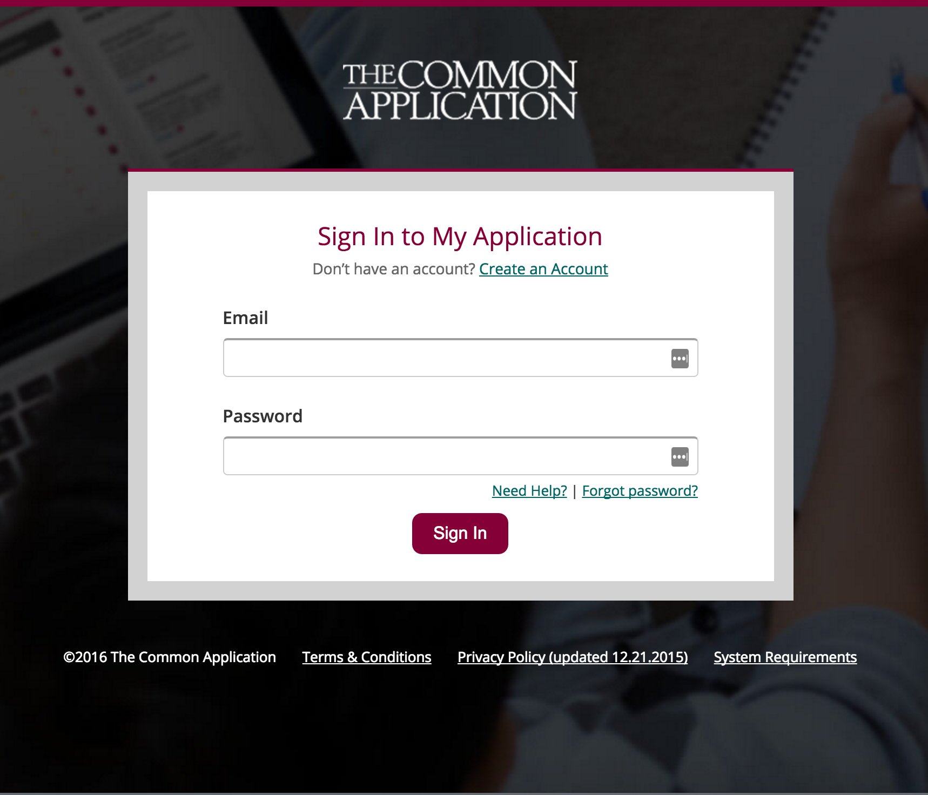
^{© 2016 The Common Application}
Notes:
There are two ways you can create an account.
Click the “Create Account” button.
Click the “Apply Now” button and then when prompted to sign in click the “Create an Account” link.
Then, follow a few quick steps and begin your application right away

Slide 7
Then follow these three simple steps to create your account.
Account Creation Steps:
Registration Type
Login Credentials
Registration Information
^{© 2016 The Common Application}
Notes:
Creating your account is an easy, 3-step process:
Select Your Registration Type
Enter Your Login Credentials
Enter Your Registration Information

Slide 8
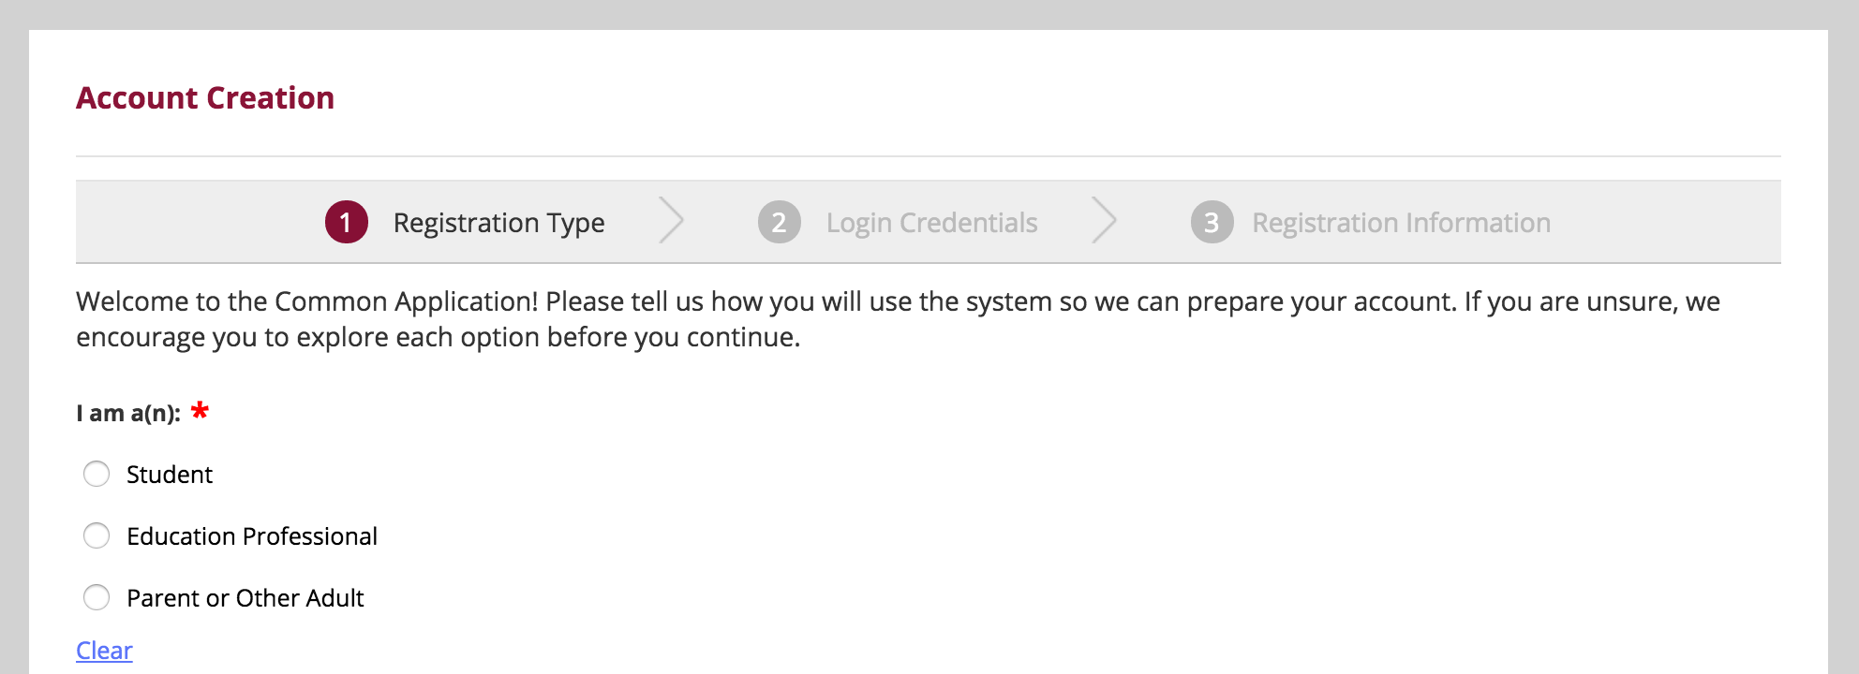
1. REGISTRATION TYPE
^{© 2016 The Common Application}
Notes:
First you need to select your registration type. The three types are:
Student: Student who plans to apply to college this year or at a later time.
Education Professional: Counselor, teacher, advisor, or other professional who works with applicants and wants to see the applicant experience without being considered for admission by colleges. This choice is not for students to plan to apply and study at college.
Parent or Other Adult: Parent or other adult who wants to see the applicant experience without being considered for admission by colleges. This choice is not for students who plan to apply and study at college.

Slide 9
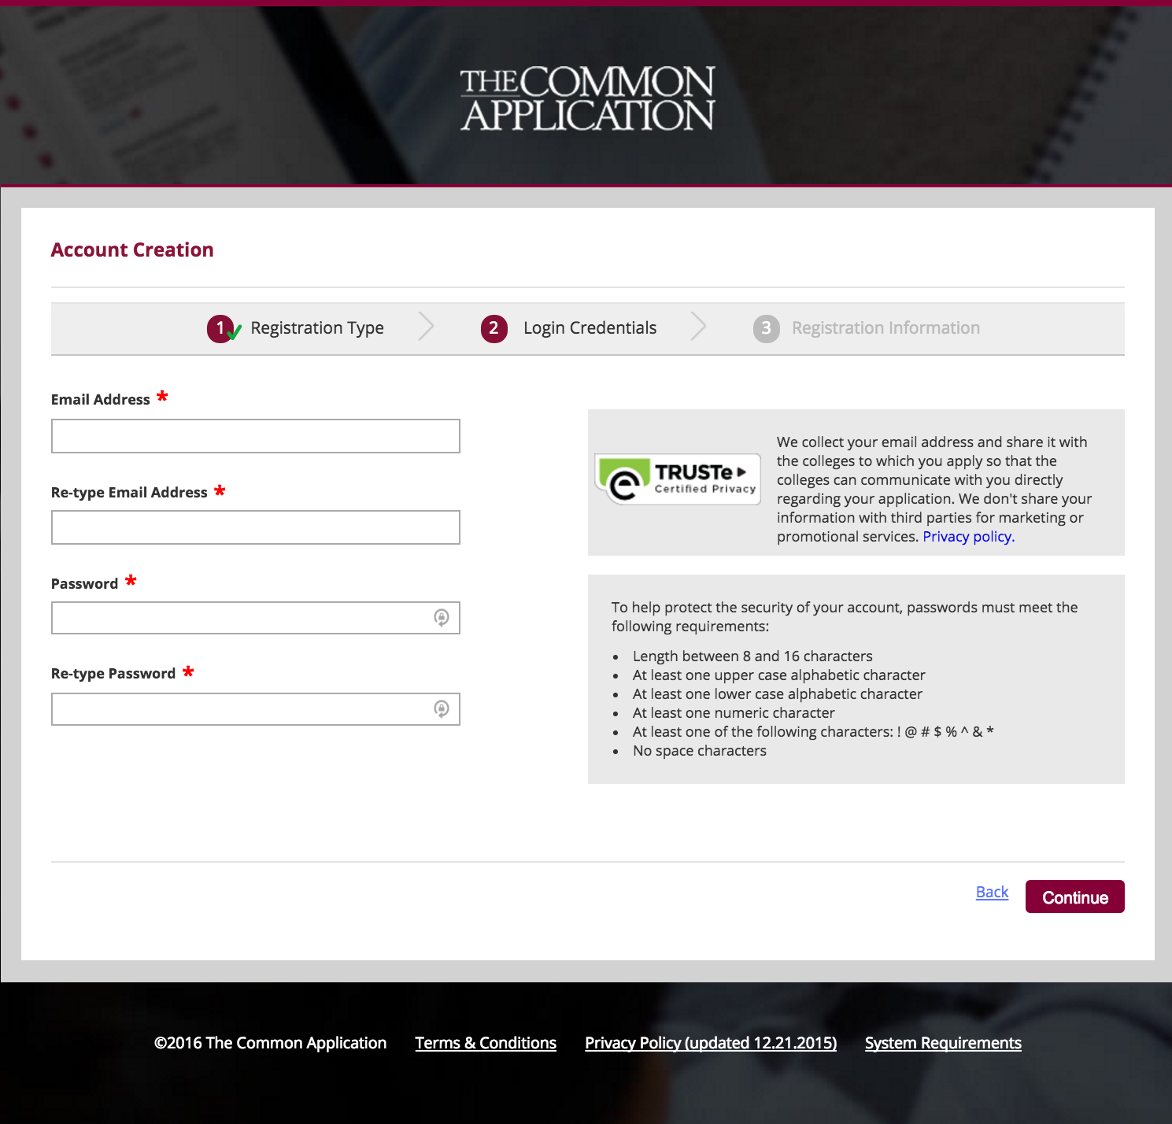
2. LOGIN
CREDENTIALS
^{© 2016 The Common Application}
Notes:
Make sure the email address you enter is one you check regularly in case the Common App and the colleges you’re applying to need to reach out to you concerning your application. Your email address will become the username you enter each time you log into the application.
It’s also a good idea to make note of your password and keep that reminder handy, since you’ll need to log in with your email address and password each time you access the Common App. If you lose your login information, the Common Application Applicant Solutions Center is always here to help, but it’s still a good idea to keep your password someplace safe so you can locate it later on if necessary.

Slide 10
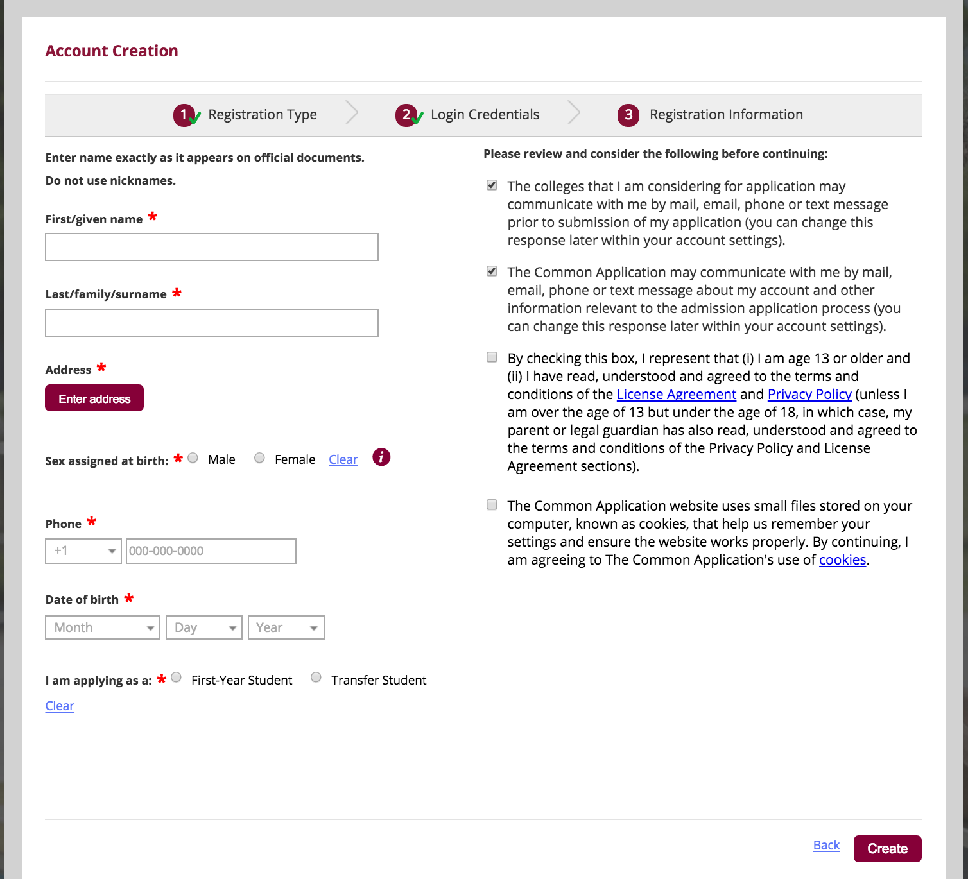
3. REGISTRATION
INFORMATION
^{© 2016 The Common Application}
Notes:
Applicants will need some basic profile information – like name, date of birth, address and phone number.
Students should use their legal name as it appears on official school documents and standardized test scores. This will allow colleges to match documents with the correct
applicant.
Applicants should use the mailing address where they would like all college related materials to be sent.
By checking the box indicating that you give permission to colleges and universities that you have added to your My Colleges list, you are allowing colleges to communication
with you prior to submission of your application. This communication might include deadline reminders, scholarship opportunities or other information that will help you in the
college admissions process.

Slide 11
COMMON
APP
LAYOUT
The Common App is divided into four tabs:
Dashboard
My Colleges
Common App
College Search
^{© 2016 The Common Application}
Notes:
The Common Application is organized into four tabs:
Dashboard, My Colleges, Common App, College Search

Slide 12
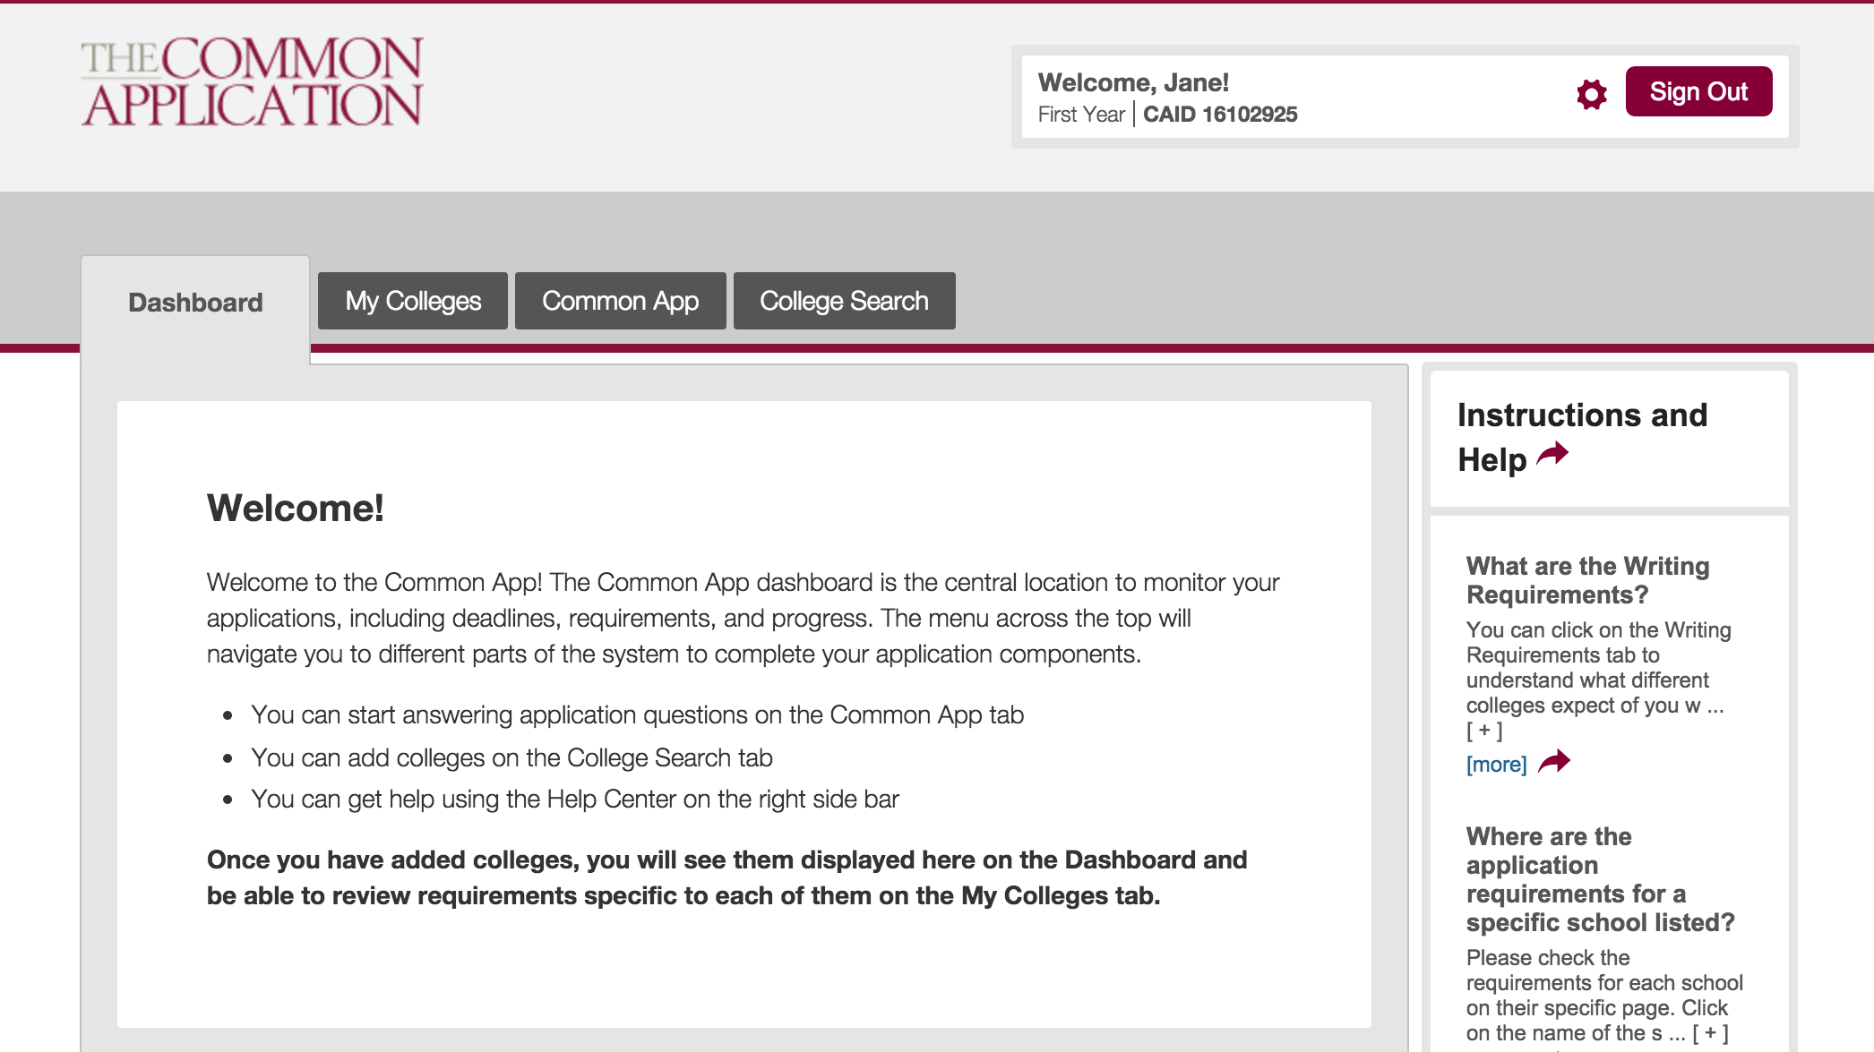
^{© 2016 The Common Application}
Notes:
Welcome to your account!
This is the welcome screen that applicants see when they first sign in to their Common App and will appear until a college or colleges are added to your My Colleges list.
The Common App ID (CAID) is the unique identifier that allows colleges to match your application with supporting documents. Write down this number with your important
college application information – it will be useful if you need to contact appsupport.commonapp.org.
Click on the gear icon to update or change your email address, password, or communication preferences.
On the right side of the screen, you will see the Instructions and Help Center link. This link appears in the same place on every page of your application. Help is available where you need it, when you need it. 24/7/365.

Slide 13
The Common App tab is where you will complete the six Common App sections. Watch these videos to learn more about them.
Search for and add colleges to your My Colleges list in the College Search tab.
In the My Colleges tab you will complete the college-specific questions for each college in your list.
The Dashboard is your home base where you can keep an eye on your requirements and upcoming deadlines.
Check out our Common App Tour video for more info!
^{© 2016 The Common Application}
Notes:
The Dashboard provides a snapshot of all of your colleges, including information on deadlines, requirements, and the submission status of your applications.
The My Colleges tab will list detailed informa8on about the colleges you have added to the list and requirements for all of your colleges.
The Common App tab is where you will go to complete the main sections of your application.
The College Search tab is used to search for colleges that you would like to add to your My Colleges list.

Slide 14
SEARCHING FOR &
ADDING
COLLEGES
With nearly 700 colleges in the Common Application, there’s one that’s right for you! Use the College Search tab to explore, learn, and add colleges to your list.
^{© 2016 The Common Application}
Notes:
Searching for and adding colleges to your My Colleges list is a great place to start your Common App.
There are almost 700 colleges in the Common Application.
You can add up to 20 schools / add and remove up until you submit.

Slide 15
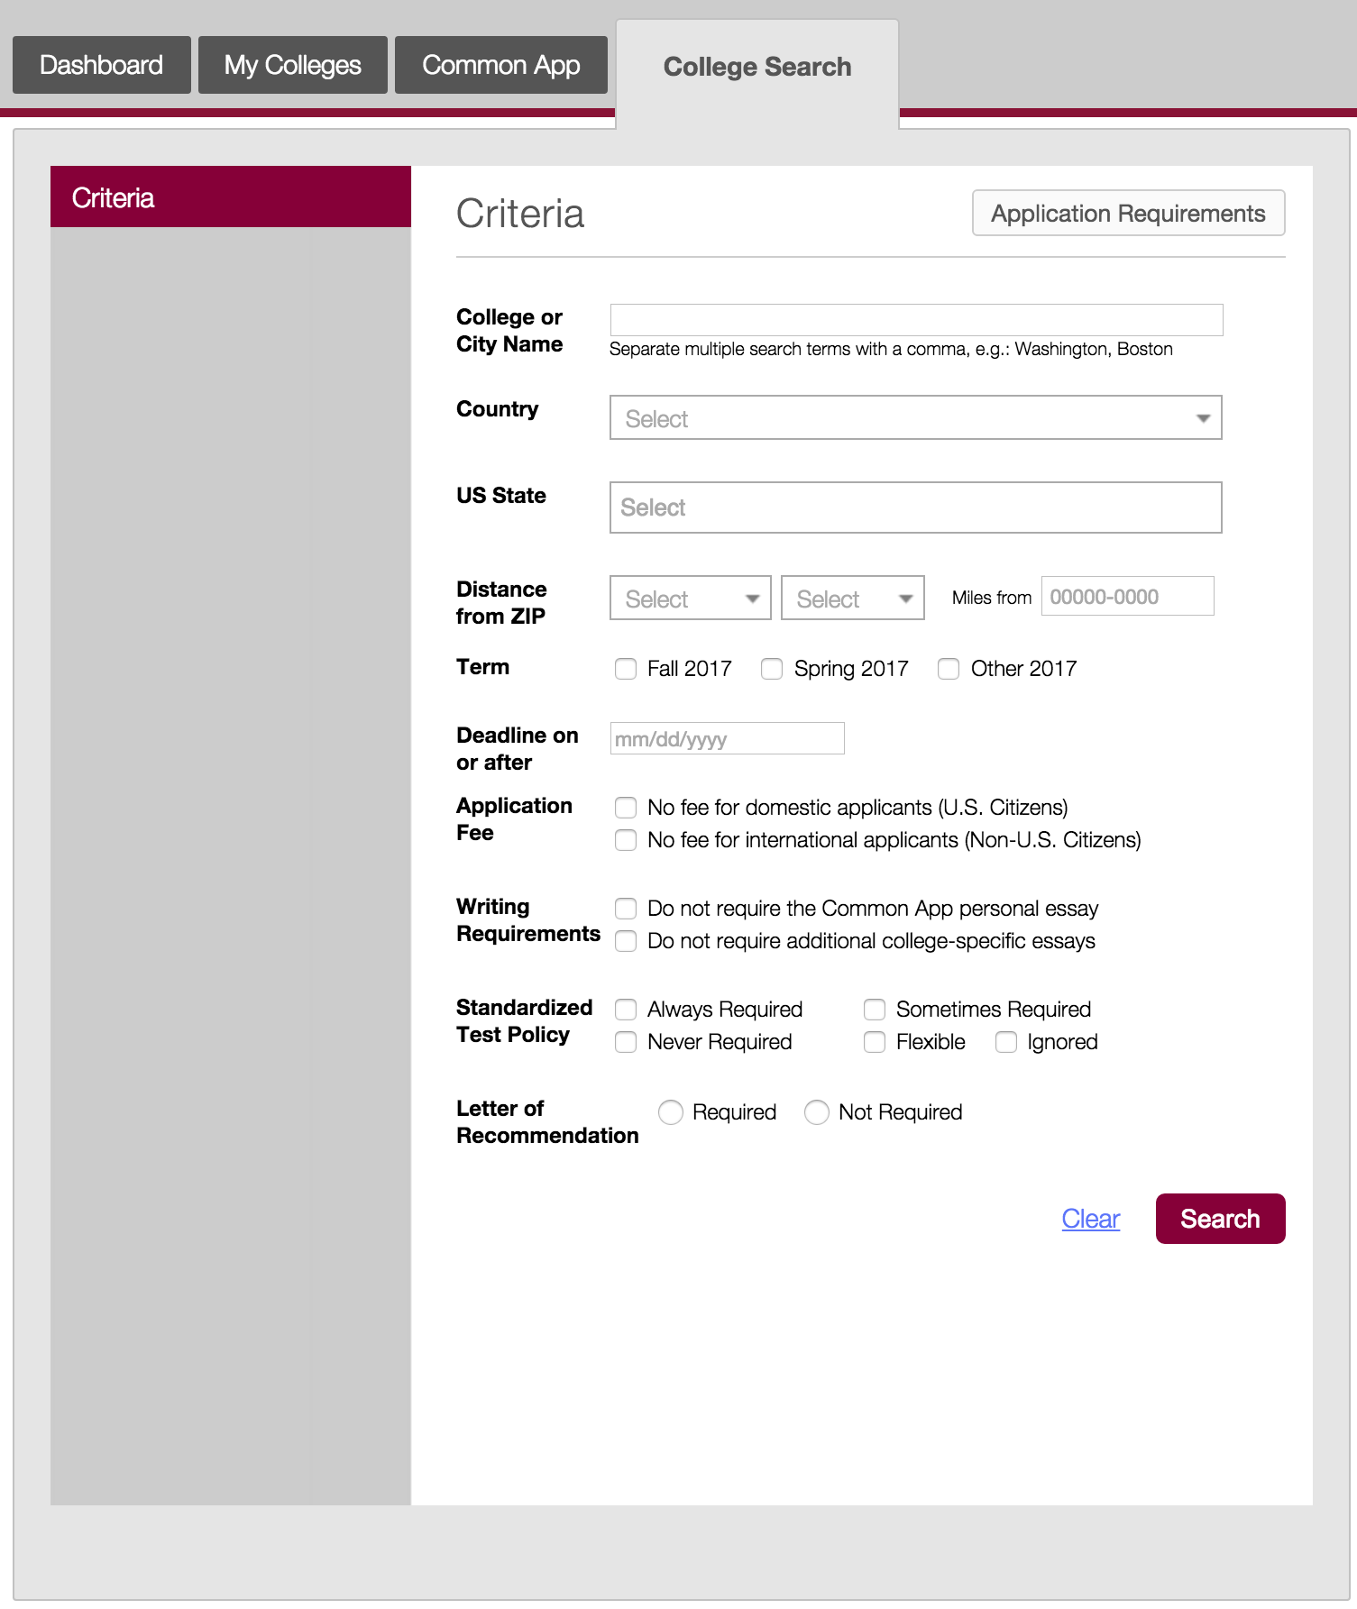
THE COLLEGE SEARCH TAB
^{© 2016 The Common Application}
Notes:
Search by a number of different criteria, including College or City Name, Country, US State, Deadline. You can also search by whether or not a school requires an application fee, as well as their writing requirements and testing policy.
Click on the Application Requirements button to download a full list of requirements for all schools that are a part of the Common Application.

Slide 16
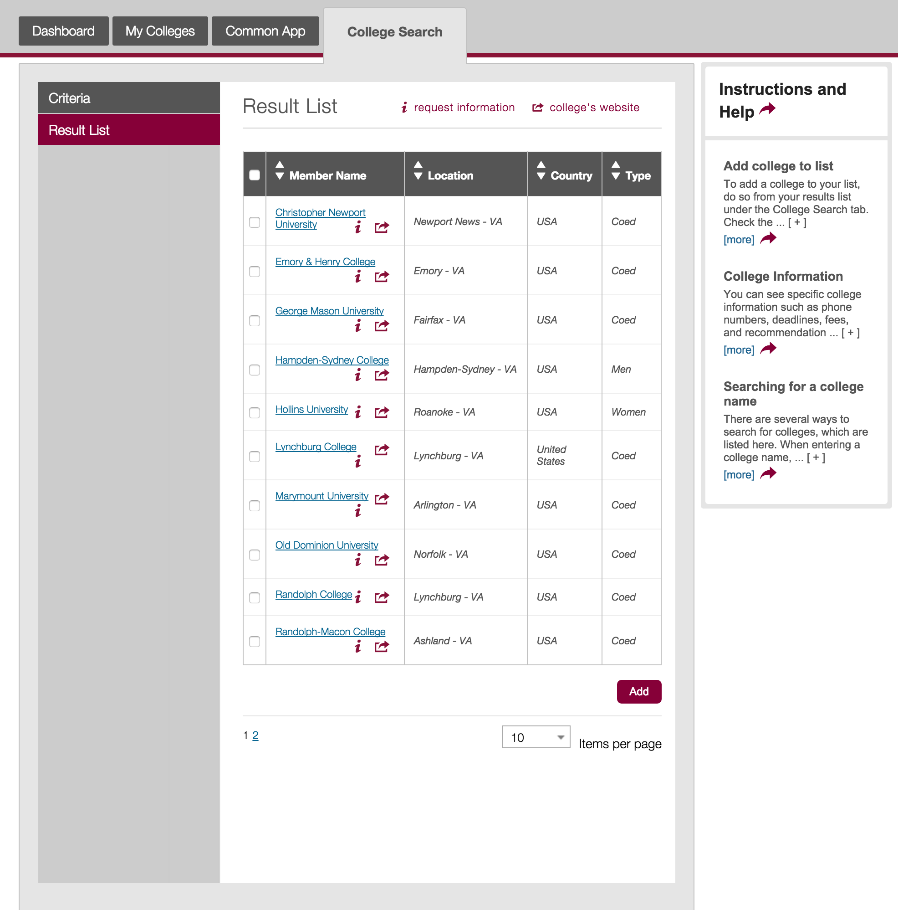
RESULTS LIST
^{© 2016 The Common Application}
Notes:
The results list shows all the colleges based on the criteria selected.
You can sort the results based on the Name, Location, Country, and Type.
You can also find more information about the colleges in the results list:
Click on the name of the school – this will open a page listing information about the school like their contact details and application requirements
Click the “i” icon to request more information from the school
The college’s website icon will take you to the school’s specific website to learn more about that particular school

Slide 17
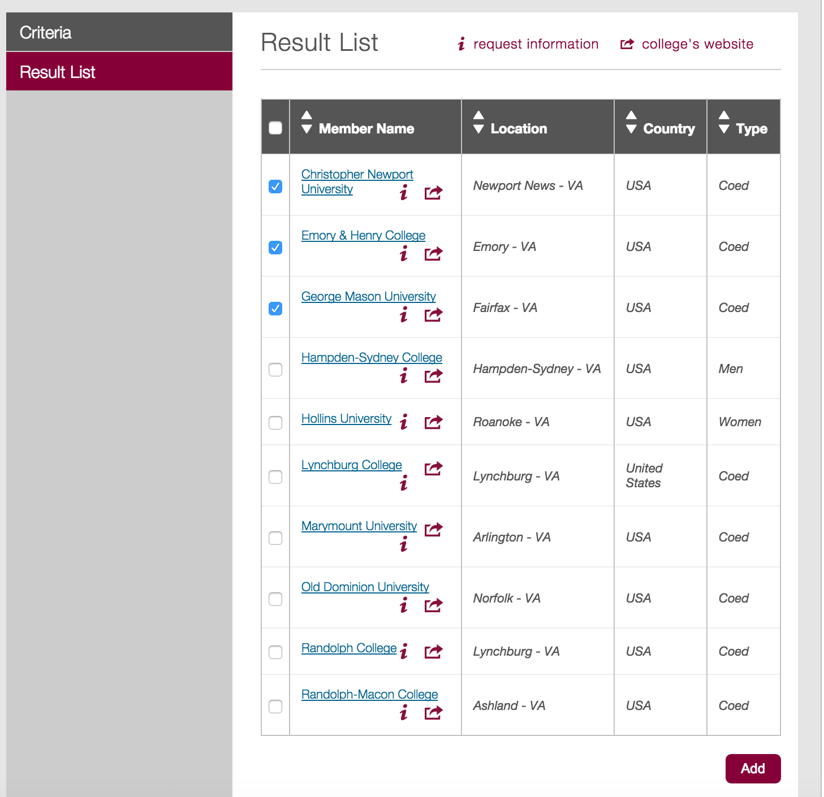
ADDING
SCHOOLS
^{© 2016 The Common Application}
Notes:
Adding schools to your My Colleges list is easy. Simply select the school(s) you want to add and then click the “Add” button. You can select multiple schools at once and add them all at the same time.

Slide 18
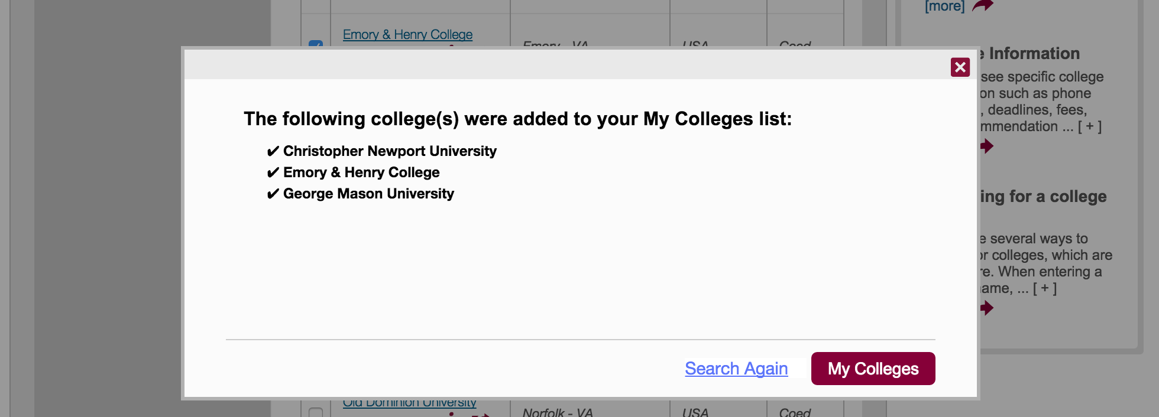
SUCCESS!
^{© 2016 The Common Application}
Notes:
And that’s it! Navigate to My Colleges to see the colleges you added or click “Search Again” to continue searching for and adding schools.

Slide 19


COMMON APP READY
Completing the Common App
© 2016 The Common Application • commonapp.org
Notes:
Welcome to Common App Ready – Completing the Common App.
This presentation will review the different sections of the Common App tab and what information you’ll be asked to enter, as well as providing some useful tips and best practices.

Slide 20
COMPLETING THE
COMMON APP
AGENDA
Layout & Features
Profile Section
Family Section
Education Section
Testing Section
Activities Section
Writing Section
^{© 2016 The Common Application}

Slide 21
LAYOUT &
FEATURES
Completing and navigating your application will be a breeze with these tips.
^{© 2016 The Common Application}
Notes:
Before we review each section of the Common App tab, let’s take a get acquainted with some important features.

Slide 22
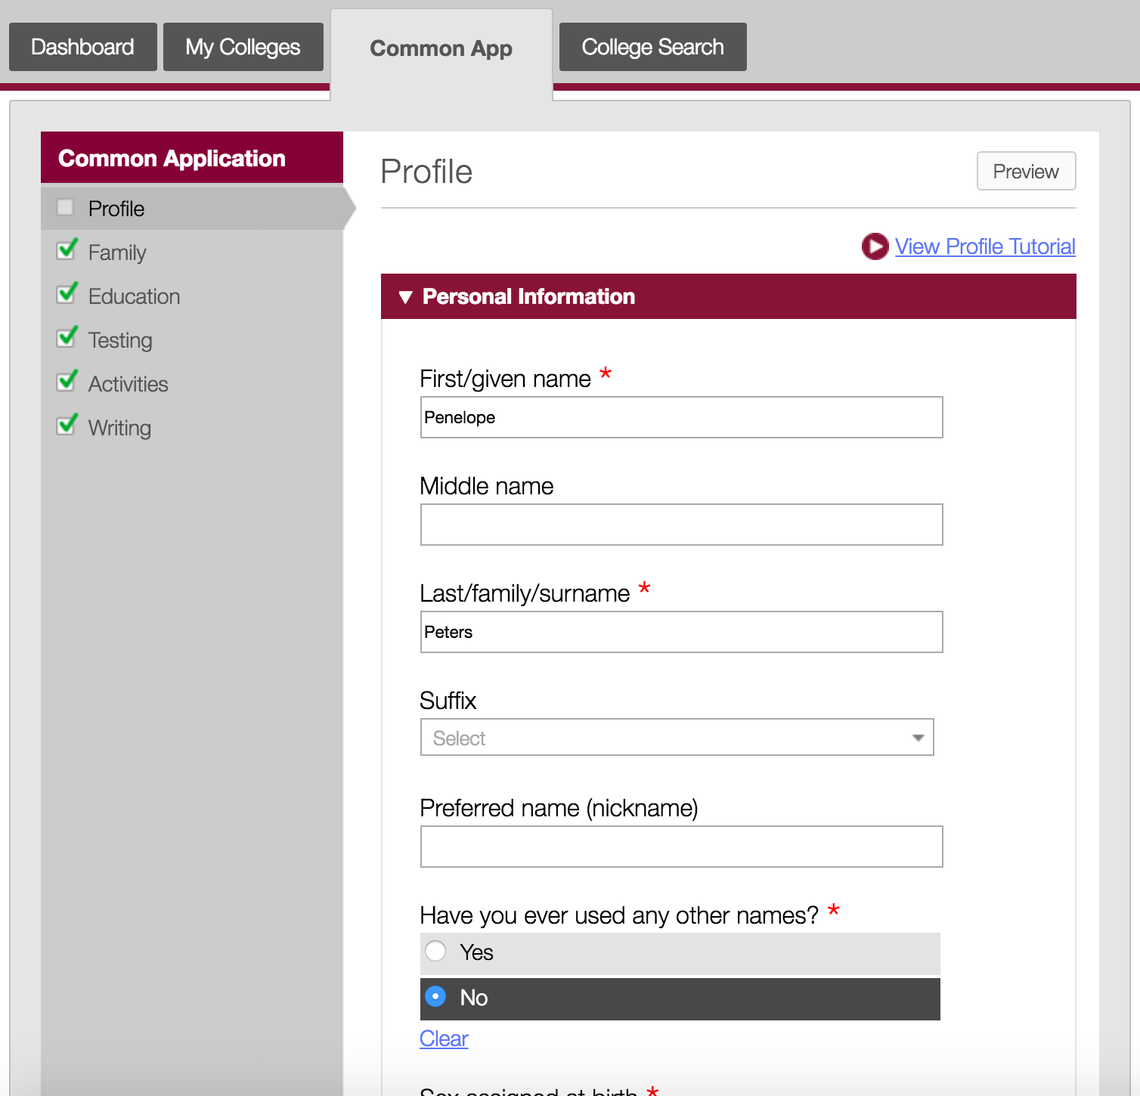
The Common App tab is where you will complete the main sections of your application.
^{© 2016 The Common Application}
Notes:
The Common App tab is organized into 6 different sections, each with their own specific set of questions. Those main sections are: Profile, Family, Education, Testing, Activities, and Writing.

Slide 23
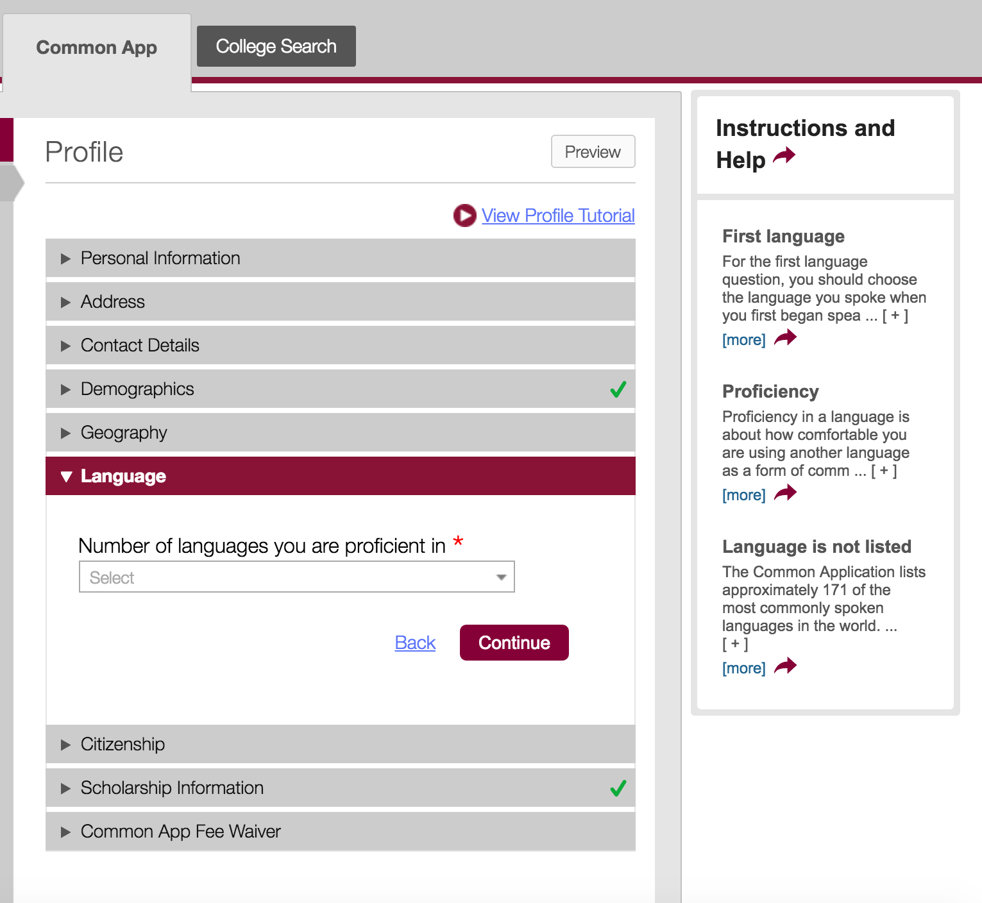
Click the Preview button to review each section in PDF.
Video tutorials help you navigate each section.
The Instructions and Help will display FAQs related to the page you’re on and will take you to our Solutions Center, where you can contact us with questions.
Green check marks indicate you’ve completed a section.
Red asterisks indicate a response is required.
Click Continue to move from one section to the next.
Notes:
There are several things to keep in mind as you work through the Common App.
Don’t wait until you’re submitting your application to preview your application! You can preview each section by clicking on the Preview button.
At the top of each section you can find helpful video tutorials that will guide you through each section.
On the right hand side of the page you will find Instructions and Help that will display FAQs related to the section you are currently working on.
As you complete each section you will see a green check mark appear to indicate that all required questions in that section have been completed.
All required questions are marked with a red asterisk.
Click the Continue button to move from one section to the next.

Slide 24
THE
PROFILE
SECTION
In the Profile section you will provide some more detailed information about yourself.
^{© 2016 The Common Application}
Notes:
Now let’s a look at the different sections of the Common App, starting with the Profile section.

Slide 25
“
The Profile section is one of the most critically important areas of the application as it provides us with the basic essentials of contact and personal information. Your name, phone number, and email address are our only avenues to contact you directly, so any errors here could result in our inability to reach you with important updates…potentially even your acceptance letter!
Champlain College (Burlington, VT)
The Profile section is what we use to reach out to and notify you of your acceptance or scholarships! Make sure you are accurate in this section and provide updates if anything changes.
Binghamton University (Binghamton, NY)
^{© 2016 The Common Application}

Slide 26
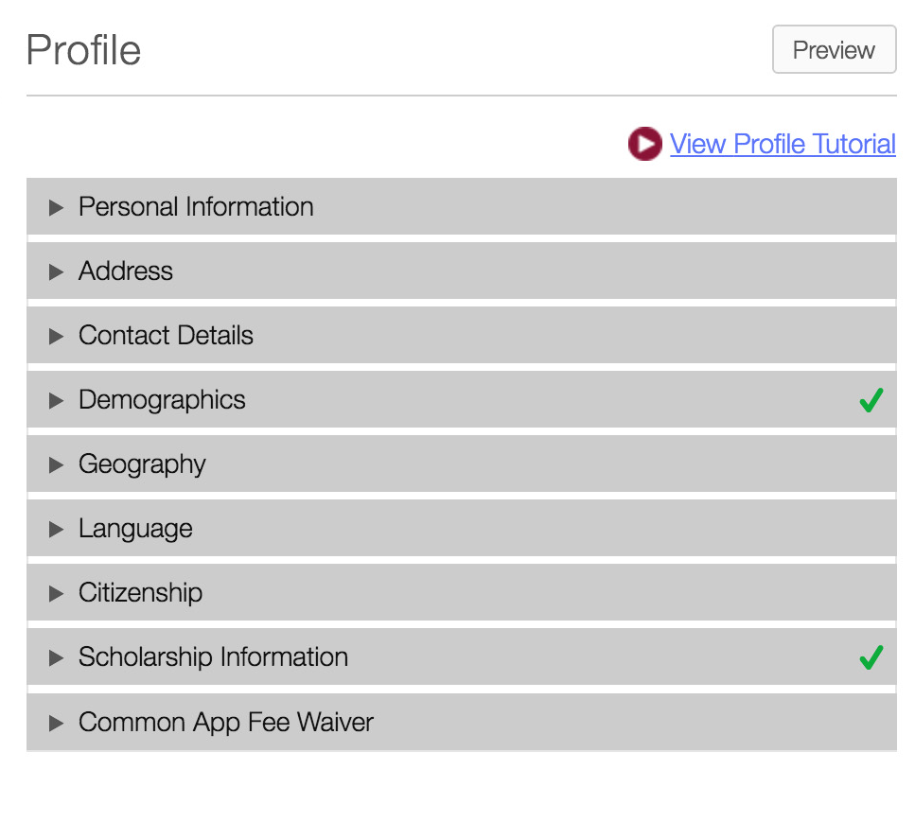
There are nine sections within the Profile section to complete.
^{© 2016 The Common Application}
Notes:
Some of the information in the Profile section will be carried over from details you provided when you created your account. It’s always a good idea to review the information here and update any new or changed details.

Slide 27
Use your legal name so that colleges can match your application with standardized test scores and other documents.
You will have the opportunity to share more about your gender identity.
Make sure the email address you enter is one you check regularly.
TIPS & BEST PRACTICES
^{© 2016 The Common Application}

Slide 28
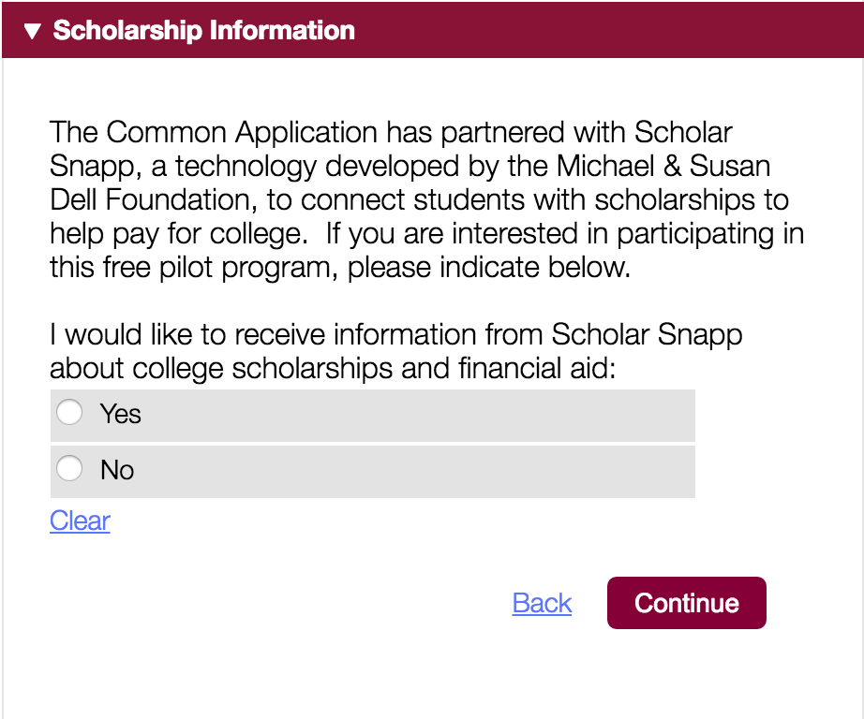
SCHOLAR SNAPP
Scholar Snapp connects you with scholarships to help pay for college.
If you are interested in learning more about Scholar Snapp, select “Yes”.
^{© 2016 The Common Application}
Notes:
One important section to take note of in the Profile section is ”Scholarship Information”. Here you can indicated your interest in learning more about Scholar Snapp. Scholar Snapp is a technology developed by the Michael & Susan Dell Foundation to connect students with scholarships to help pay for college.

Slide 29
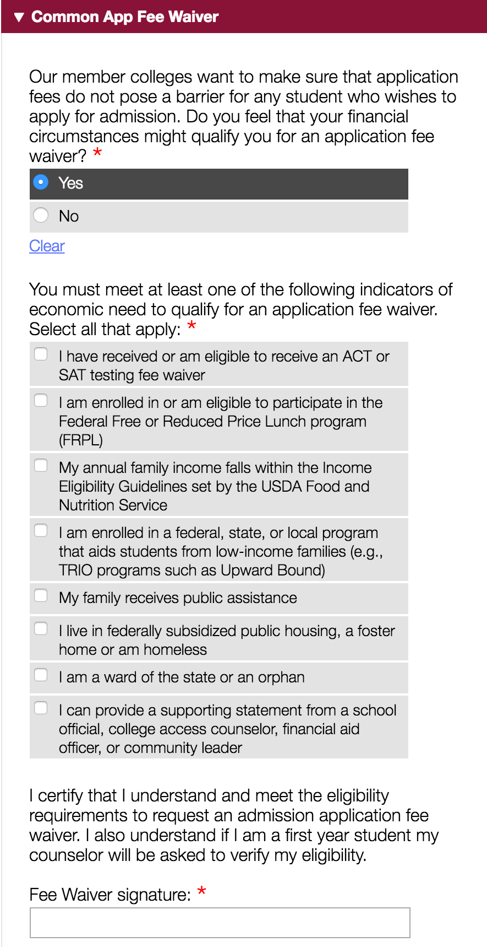
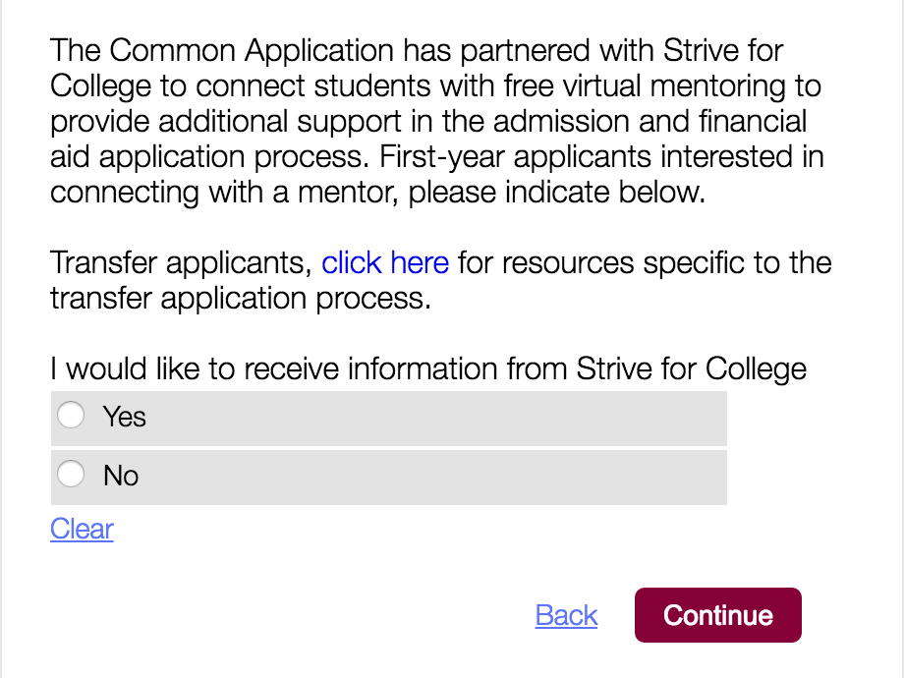
THE COMMON APP FEE WAIVER
Indicate whether you feel you qualify for an application waiver
Select the indicator(s) that best apply to you
Provide your signature
STRIVE FOR COLLEGE
Students who qualify for a fee waiver are invited to connect with a Strive for College mentor.
^{© 2016 The Common Application}
Notes:
Another important section in the Profile section is the ”Common App Fee Waiver”. If you feel your financial circumstances might qualify you for an application fee waiver you can select the appropriate indicator(s) and provide your signature. Doing so will then waive your application fee for all the schools to which you apply through the Common App.
After applying for a Common App Fee Waiver, your counselor will be able to review and affirm the information within the recommender system.
Additionally, students who apply for a fee waiver are also invited to connect with a Strive for College mentor. Strive for College connects students with free virtual mentoring to provide additional support in the admission and financial aid process.

Slide 30
THE
FAMILY
SECTION
The Family section of the Common App provides you with the opportunity to share information about your family.
^{© 2016 The Common Application}
Notes:
In the Family section you’ll be asked to share some information about your household, your parents, and any siblings that you have.

Slide 31
“
We look at family information to get a full understanding of who the student is, where they are coming from and what background and foundation they have that brought them to the point of applying to our school.
Nazareth College (Rochester, NY)
The Family section gives us insight into a student’s current community at home and how that may have shaped his/her experiences. Beyond the basic pieces, we will also consider legacy – if a family member attended our institution – as some part of our evaluation. Whether it’s a parent, guardian, or sibling, we like to be aware if someone who has had direct experience with our school and culture is connected to a student’s candidacy.
Champlain College (Burlington, VT)
^{© 2016 The Common Application}

Slide 32
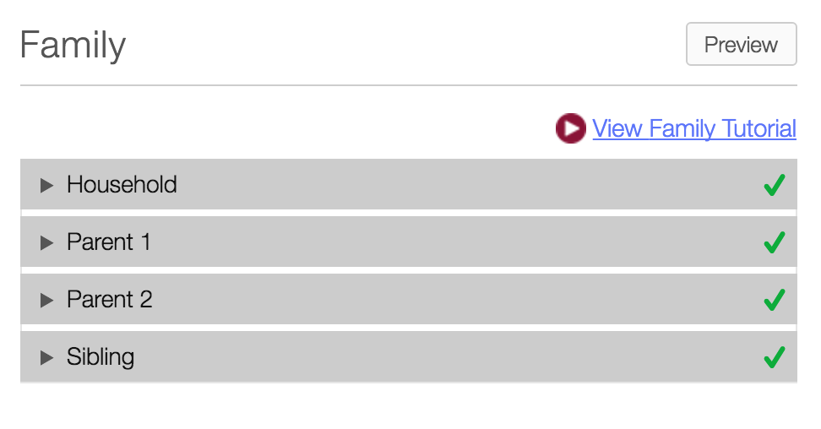
There are four sections to complete within the Family section.
^{© 2016 The Common Application}

Slide 33
You can list up to 5 siblings in the Family section (you can list additional siblings in the Additional Information section located in the Writing section).
For Parent 1 you have the option to indicate that you have limited information about this parent, which will make the resulting fields for that parent not required.
The options for Parent 2 also include the ability to indicate that you do not have another parent to list.
TIPS & BEST PRACTICES
^{© 2016 The Common Application}
Notes:
Get a head start and save yourself time by collecting information about your parent(s) or legal guardian before you fill out the application. Gather information about their educational background, occupational information, employer information, etc.

Slide 34
THE
EDUCATION
SECTION
In the Education section you’ll share information about your current school and coursework.
^{© 2016 The Common Application}
Notes:
The Education section is where you share information about your current school and coursework along with any Academic Honors you’ve achieved as well as your future education plans.

Slide 35
“
The information that’s provided in the Education section – such as education interruptions, college courses, and/or college assistance programs – provides insight into aspects of a student’s education that can’t be explained by the transcript alone.
Merrimack College (North Andover, MA)
While we take a holistic approach to our admissions review, the most critical piece of information about an applicant is their educational background and transcript. The Common Application provides students with an opportunity to showcase their academic achievements. This is not a time to be shy; tell us about your honors and awards. We enjoy seeing the perfect attendance or honor roll awards as they show how dedicated you are to school!
Binghamton University (Binghamton, NY)
^{© 2016 The Common Application}

Slide 36
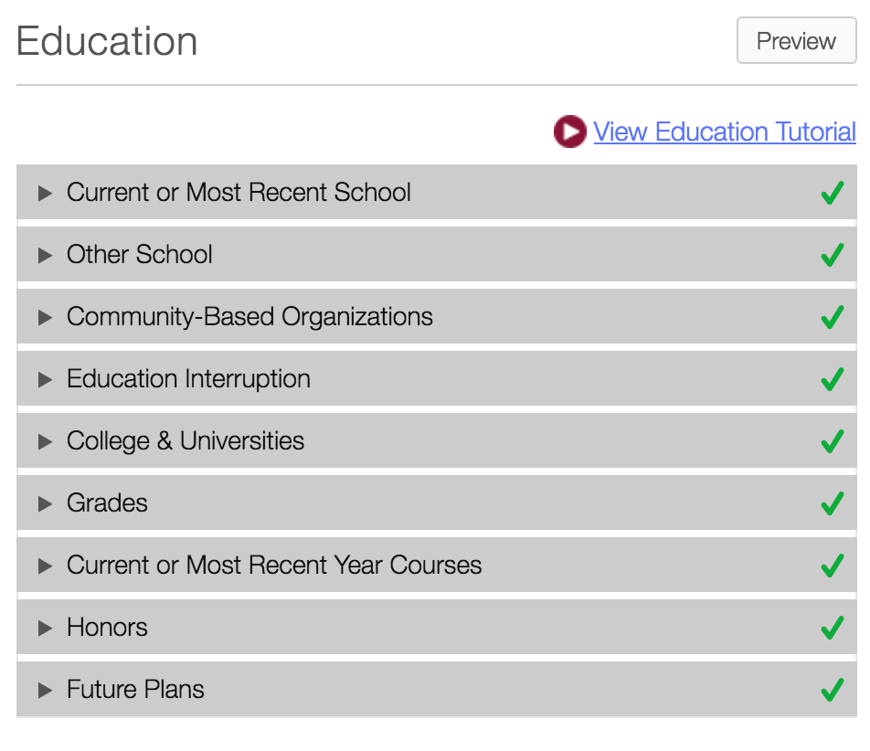
There are nine sections to complete within the Education section.
^{© 2016 The Common Application}

Slide 37
Ask your counselor for an unofficial copy of your transcript to help with filling out the Education section.
Selecting the correct high school ensures that the correct path is followed for your recommendation letter submissions.
If you are homeschooled, you can search for your homeschool program or association or manually enter the name.
It’s okay to select “Other” or “Undecided” for your Future Plans and Career Interests.
TIPS & BEST PRACTICES
^{© 2016 The Common Application}

Slide 38
THE
TESTING
SECTION
In the Testing section you have the option to self-report any scores or future test dates for standardized test you have taken.
^{© 2016 The Common Application}
Notes:
In the Testing section you have the option to self-report any scores or future test dates for standardized test you have taken.

Slide 39
“
If a student is planning to submit official scores to us, seeing the dates of when a student has taken different tests – or if the student has planned future test dates – is extremely helpful because we can compare if we have all of the results from their tests in order to make a decision.
Nazareth College (Rochester, NY)
This section allows us inside knowledge of an applicant’s intentions. We are purposeful about referencing this section to determine if an applicant has divulged information about future testing dates or planned exams. This becomes particularly important for applicants who wish to have future tests considered as part of their application portfolio. Without this knowledge, we can only assume that an applicant has submitted a complete portfolio that is ready for review.
Adelphi University (Garden City, NY)
^{© 2016 The Common Application}

Slide 40
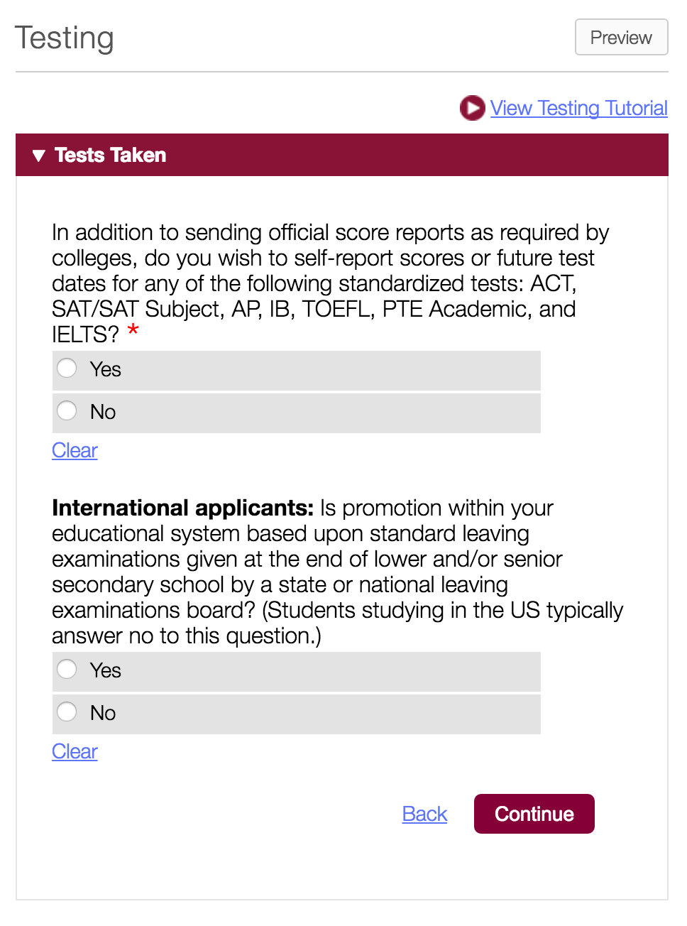
In the Testing section you can self-report scores from a variety of standardized tests.
International applicants may also report standard leaving examinations.
^{© 2016 The Common Application}
Notes:
In the Testing section you can self-report scores from a variety of standardized tests. Please note, though, that even if you self-report scores in the Common App, you will still need to send your official score reports through the testing agency.
International applicants may also report standard leaving examinations.

Slide 41
The testing section allows you to list tests you plan to take in the future.
If you are an international applicant and are required to take senior secondary leaving examinations for graduation, you will be able to add actual or predicted scores.
If you do not want to self-report scores to a school, you can change your answer to say you have no scores you wish to report. By clicking “No”, your tests and scores will disappear. Change it back to “Yes”, and they reappear.
While the Testing section allows you to self-report your scores, you must also send official score reports from the testing agencies to each college you are applying to.
TIPS & BEST PRACTICES
^{© 2016 The Common Application}

Slide 42
THE
ACTIVITIES
SECTION
The Activities section gives you the opportunity to share with colleges any activities you participated in throughout high school.
^{© 2016 The Common Application}

Slide 43
“
The Activities section is one of our team’s favorite sections of the application. Activities add persona to an application; they demonstrate an applicant’s interests outside of the classroom and allow us a glimpse into that applicant’s passions, further demonstrating how that individual may enhance our student community.
Adelphi University (Garden City, NY)
A student’s activities outside of the classroom give us insight as to what they’re interested in and how they choose to spend their time. This type of context can mean a world of difference for an applicant to our school. It’s helpful to know if a student is a captain of a varsity sport, a volunteer in their community, or if they work part-time to provide for their family. Each of these activities demonstrate valuable characteristics for a college’s potential community members.
Willamette University (Salem, OR)
^{© 2016 The Common Application}

Slide 44
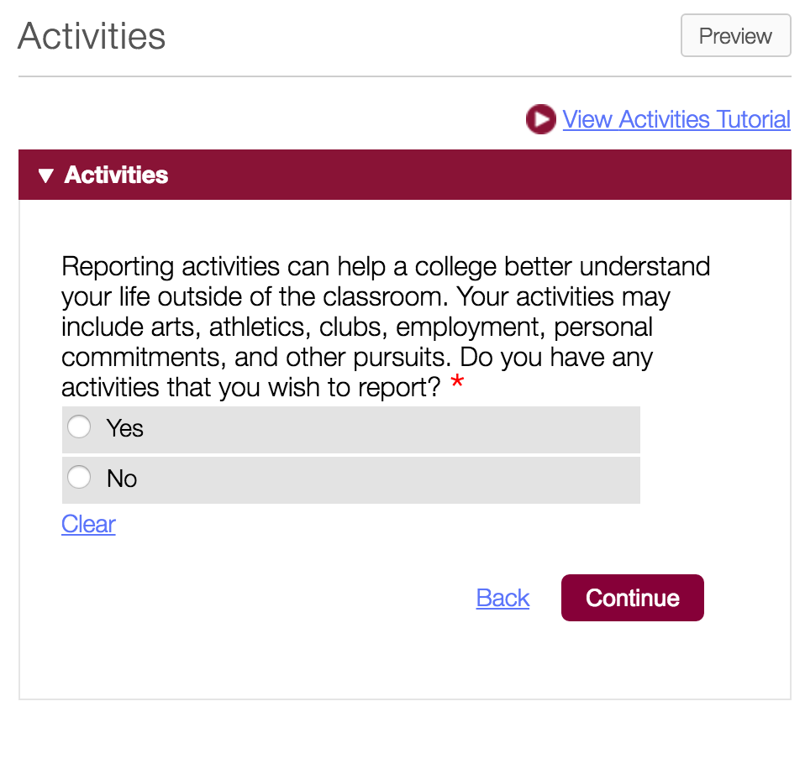
You can report up to ten activities within the Activities section.
^{© 2016 The Common Application}
Notes:
The Activities Section helps a college better understand your life outside of the classroom. Your activities may include arts, athletics, clubs, employment, personal commitments, and other pursuits.
The Activities section will give you the opportunity to tell schools more about who you are and the activities you’re involved in outside of the classroom, including things like family and job or work responsibilities. You will have the option to list up to 10 activities in this section, so think about those that are the most meaningful to you. The first question will ask you whether or not you want to report on your activities, and by choosing “Yes” you will then be able to start providing details on the activities you participate in.

Slide 45
You can change the display order by using the up and down arrows on each activity.
While you can add up to 10 activities, but you should not feel obligated to list 10 activities.
You can also list family responsibilities and jobs within this section.
If you wish to delete an activity, move it to the bottom of your activity list. Once it is the last activity listed, you will see the icon to delete it.
TIPS & BEST PRACTICES
^{© 2016 The Common Application}

Slide 46
THE
WRITING
SECTION
The Writing section contains the Common App personal essay, as well as your disciplinary history and any additional information you may want to provide to colleges.
^{© 2016 The Common Application}

Slide 47
“
The Writing section is the student’s opportunity to shine. In every other section of the Common Application, there’s a specified format, with boxes to check and numbers to enter. The Writing section gives each student the creative freedom to express her/himself in an authentic and insightful manner. It gives us something that we wouldn’t glean from the other parts of the application: a depth of personal character. To expect students to come to us as fully formed human beings is antithetical to the mission of higher education. Often, the best writing sections showcase a student’s willingness to be challenged to become a more engaged learner and citizen.
Ursinus College (Collegeville, PA)
^{© 2016 The Common Application}

Slide 48
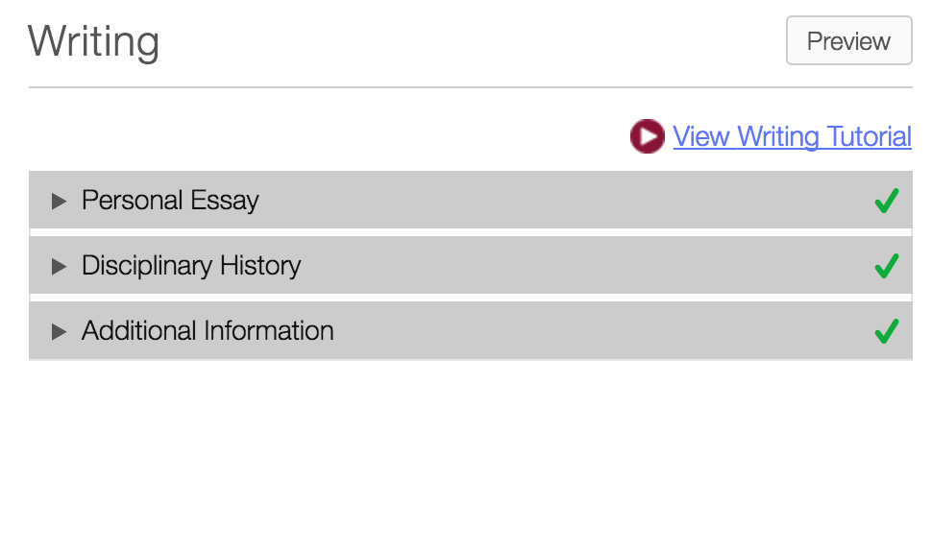
There are three sections to complete within the Writing section.
^{© 2016 The Common Application}
Notes:
There are three sections to Complete within the Writing section: Personal Essay, Disciplinary History, and Additional Information.
In the Personal Essay section you can complete the Personal Essay. Some, but not all colleges, require the Personal Essay to be included in your application for submission.
In the Disciplinary History section you’ll be asked two questions regarding any disciplinary actions. The first is in relation to any schools you’ve attended since the 9th grade. The second involves any misdemeanor or felony convictions. If you answer Yes to either of these questions, you'll need to provide some additional information in the fields provided.
In the Additional Information section you can list any information that is not captured elsewhere in the application.

Slide 49
THE
COURSES AND GRADES
SECTION
Self-Reported Transcript
Your complete academic record for grades 9-12. Required by some colleges.
^{© 2016 The Common Application}

Slide 50
THE
COLLEGE-SPECIFIC QUESTIONS
SECTION
General Entry term, degree status, housing preference, test-optional preference, scholarship and financial aid preference Academics Academic interest, program(s) applying to (Some colleges may also ask additional questions about your family, state of residence, activities, and general interests.)
^{© 2016 The Common Application}

Slide 51
THE
COLLEGE WRITING SUPPLEMENTS
SECTION
Writing Supplement Additional short answer or essay responses if requested by institution
^{© 2016 The Common Application}

Slide 52
You may submit the Personal Essay to any college, even if it is not required by that college.
Carefully review each prompt before selecting one.
Proofread your essay before submitting your application.
If you are unsure how to answer the Disciplinary History questions, talk to your parents or counselor.
Use the Additional Information section to share information about yourself that is not captured elsewhere in your application.
TIPS & BEST PRACTICES
^{© 2016 The Common Application}

Slide 53

COMMON APP READY
The Recommendation Process
© 2016 The Common Application • commonapp.org

Slide 54
RECOMMENDATION
PROCESS
AGENDA
FERPA Release Authorization
Invite & Assign Recommenders
Status & Management
^{© 2016 The Common Application}

Slide 55
FERPA RELEASE
AUTHORIZATION
The FERPA Release Authorization is the first step you need to take to start inviting and assigning your recommenders.
^{© 2016 The Common Application}
Notes:
Don’t forget: You’ll need to enter your current or most recent school in the Education screen of the Common App before you can access and complete the Recommenders and FERPA area.

Slide 56
WHAT IS FERPA?
FERPA stands for The Family Educational Rights and Privacy Act, a federal law that protects the privacy of student education records.
First step toward completing the recommendation process for your applications.
The FERPA release needs to be completed only once and will be applied to all schools on your My Colleges list.
^{© 2016 The Common Application}
Notes:
How does FERPA relate to your college application? Two ways.
You need to give consent for the schools you have attended to release your education records (grades, transcripts, test scores) to the colleges and universities to which you are applying.
After you enroll at a college, FERPA gives you the right to access your education records, including confidential letters of recommendation submitted to that college on your behalf (if you enroll at an institution that maintains such records post-enrollment).

Slide 57
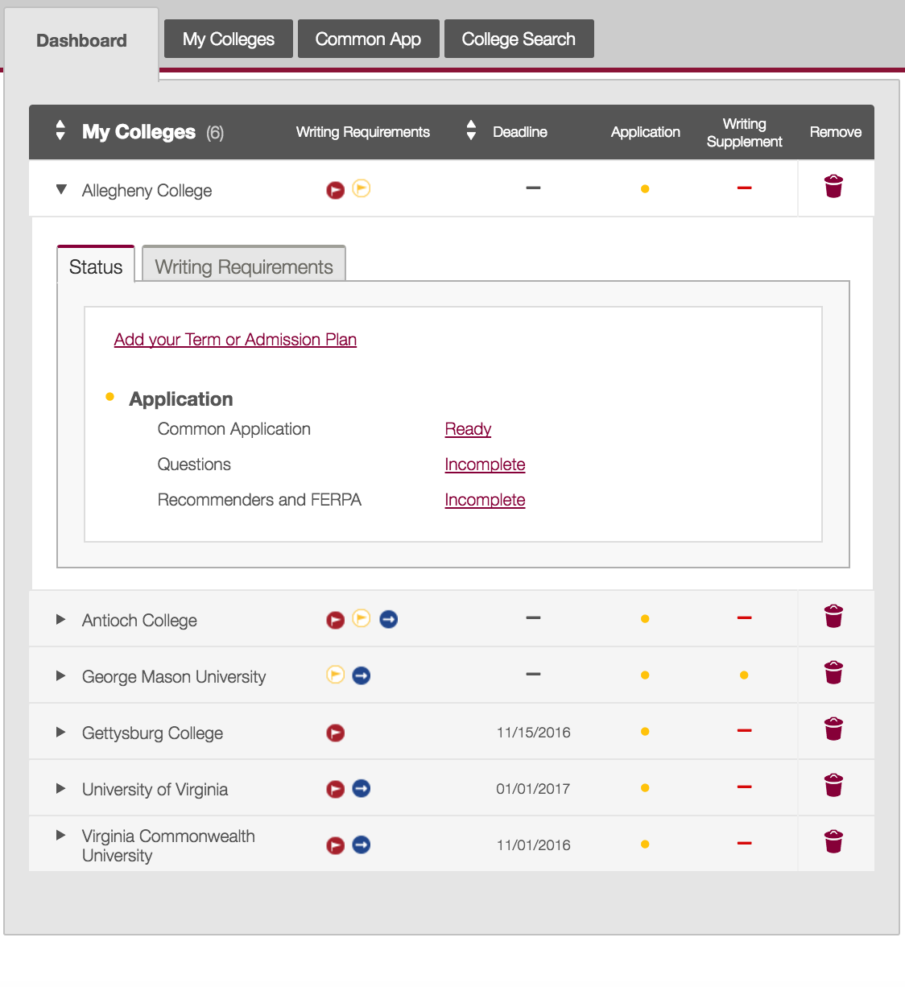
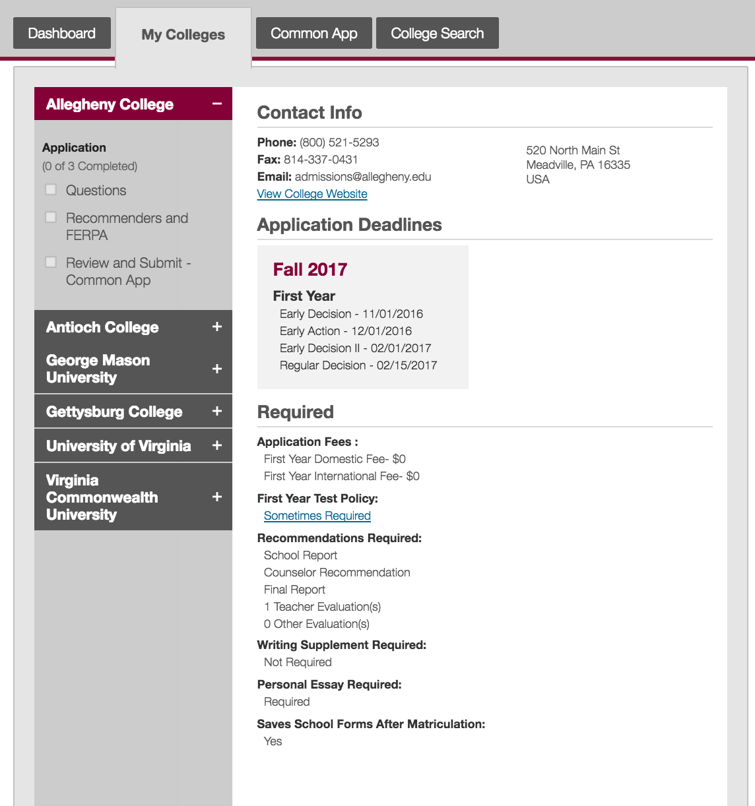
or
^{© 2016 The Common Application}
Notes:
Access the FERPA Release Authorization two ways.
Click on the name of a school from your Dashboard and then click the ‘Incomplete’ link next to Recommenders and FERPA.
Select a school from your My Colleges tab and click the Recommenders and FERPA section.

Slide 58
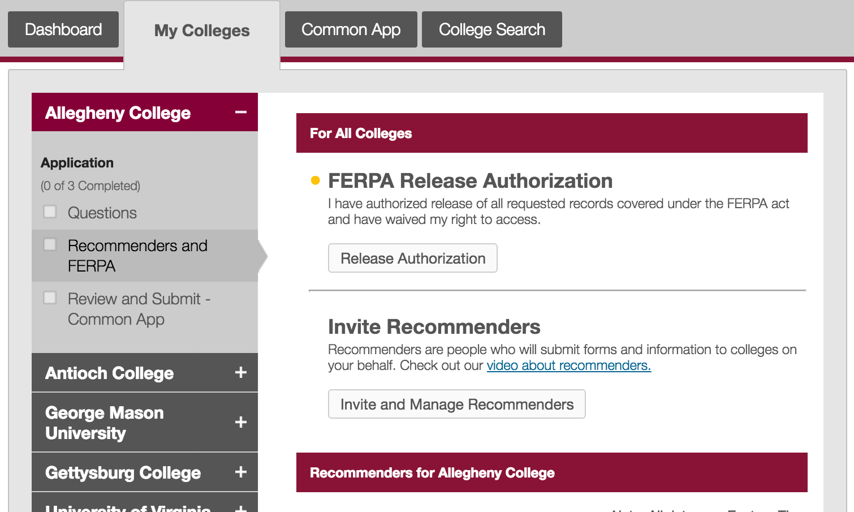
^{© 2016 The Common Application}
Notes:
Then click the “Release Authorization” button.

Slide 59
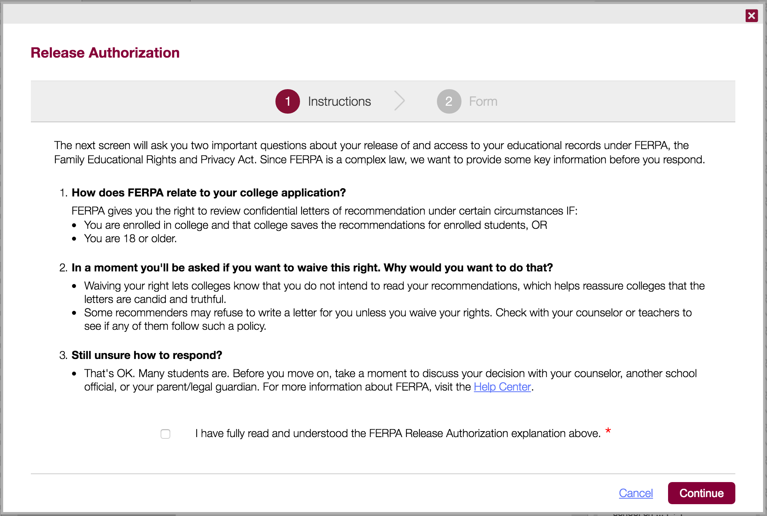

^{© 2016 The Common Application}
Notes:
The first step will provide you with some information about FERPA and how it relates to your college applications.
Be sure to read and understand these instructions completely before you proceed. Once you’ve done so, check the affirmation box and continue to the next step.

Slide 60
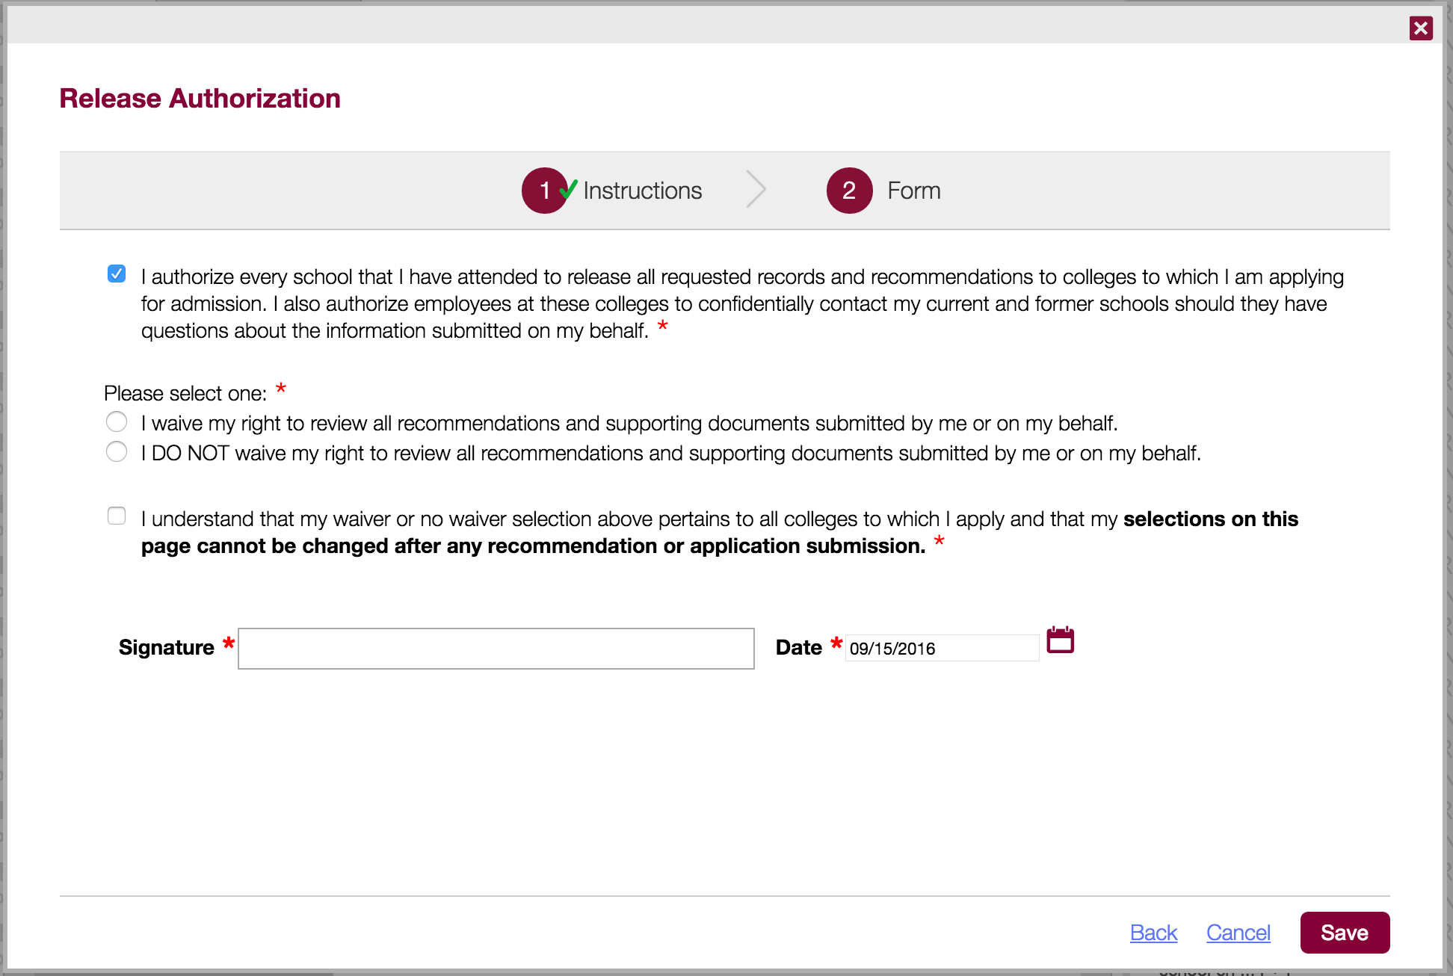
^{© 2016 The Common Application}
Notes:
You’ll be asked to:
Authorize the release of any pertinent school records to the colleges and universities that you plan on applying to through the Common App.
Whether you want to waive or not waive your right to review the recommendations and supporting documents submitted to a college on your behalf after you enroll in that college.
Check the affirmation box at the bottom and provide your electronic signature.
After you complete the release authorization you can proceed to invite your counselor, teachers, and other recommenders.

Slide 61
SHOULD I WAIVE MY RIGHTS?
Waiving your rights lets colleges know that you do not intend to read your recommendations, which helps reassure colleges that the letters are candid and truthful.
Some recommenders may not want to write a letter for you unless you waive your rights. Check with your counselor or teachers to see if any of them follow such a policy.
Before you respond to the FERPA waiver question, take a moment to discuss your decision with your counselor, school official, or your parent or legal guardian.
^{© 2016 The Common Application}
Notes:
Your selection to waive or not waive your right to review all recommendations and supporting documents cannot be changed once you submit your first application within the Common App, or once a recommender submits a form on your behalf.

Slide 62
INVITE & ASSIGN
RECOMMENDERS
Recommenders are the people who will submit forms and information to colleges on your behalf.
^{© 2016 The Common Application}
Notes:
In the Common App you can assign your counselor, teachers, and other recommenders to submit recommendations to the colleges and universities to which you are applying.
The required recommendations are determined by each specific college, so be sure to double check each college’s recommendation requirements.

Slide 63
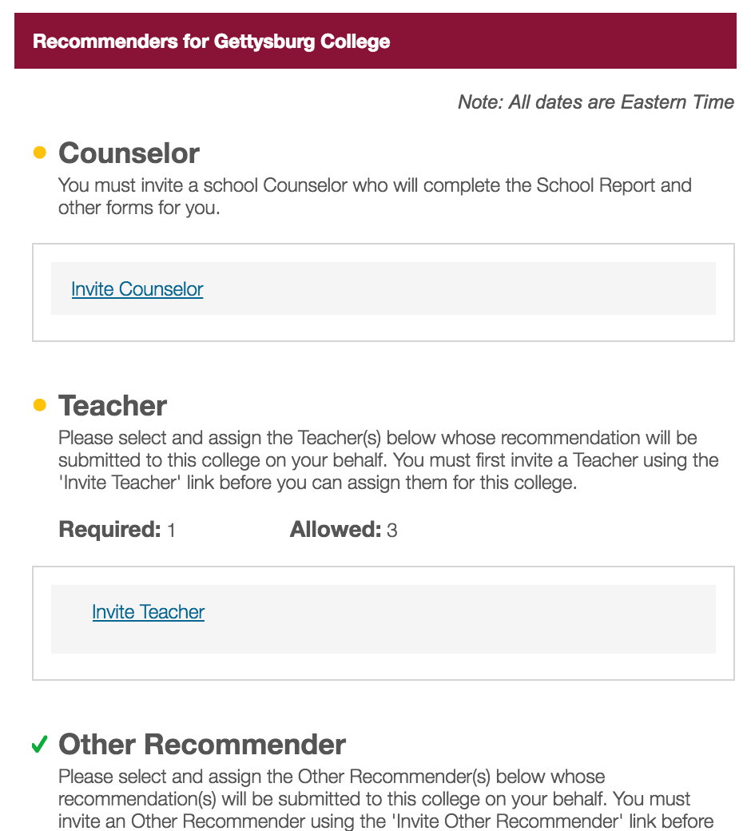
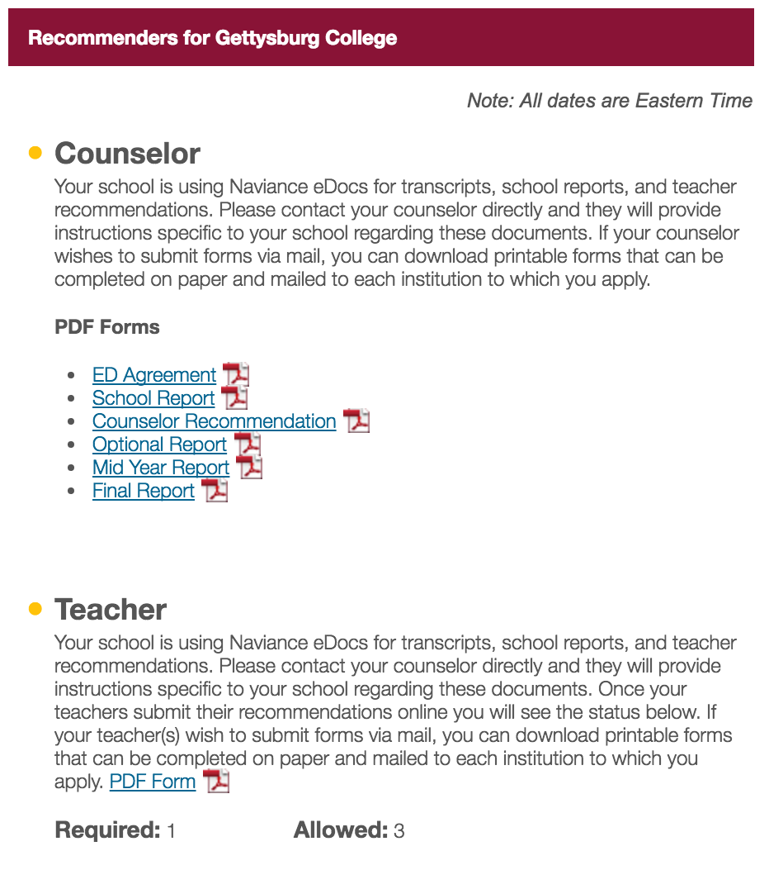
There are two commonly used systems to submit recommendations and school forms:
^{Common App}
^{Naviance eDocs}
Notes:
There are two commonly used systems to submit recommendations and school forms: The Common App and Naviance.
If your high school uses the Common App to submit recommender forms you will invite your recommenders in the Recommenders and FERPA section, which we will review.
If your high school submits recommender forms through Naviance, you invite your counselor and teachers through Naviance. (You will still invite your Other Recommenders through the Common App though.)

Slide 64
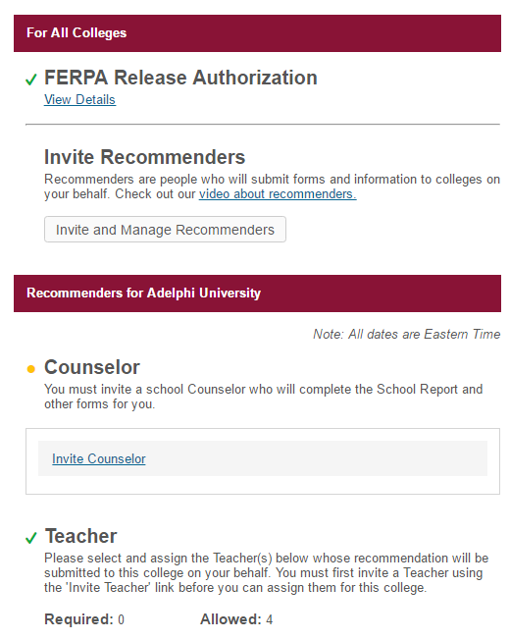

Once you’ve completed your FERPA release authorization, you can start inviting and assigning recommenders using the “Invite and Manage Recommenders” link.
Pro tip: It’s a good idea to speak to your teachers in person before sending them an invitation.
^{© 2016 The Common Application}

Slide 65
RECOMMENDER
TYPES
1. Counselor
2. Teacher
Math, English, Science, Foreign Language, Social Studies, Other
3. Other Recommender
Arts Teacher, Clergy, Coach, College Access Counselor, Employer, Family Member, Peer, Other
There are three types of recommenders you can invite:
^{© 2016 The Common Application}

Slide 66
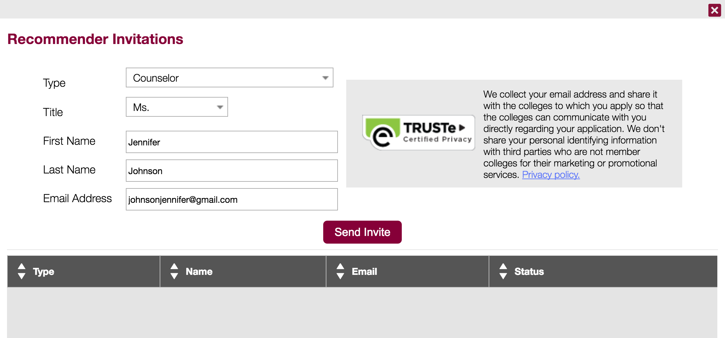

Select the Recommender Type and fill out some basic information like first name, last name, and email address.
^{© 2016 The Common Application}
Notes:
You’ll be asked to select the Recommender type: Counselor, Teacher, Other Recommender, Parent.
If you do not enter an email address, the Recommender will be marked as an ‘offline recommender’ and you will be given instructions for how to download pdf forms for them to complete and send to the colleges on your behalf.

Slide 67
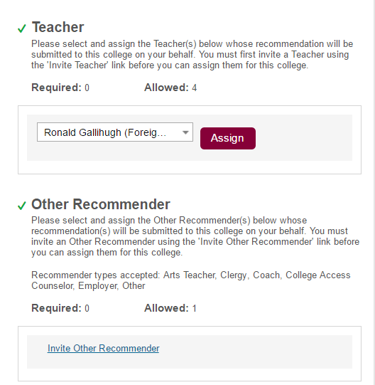
DON’T FORGET!
In addition to adding your
recommenders on the Manage Recommenders screen, you will also need to assign them to each
school on your My Colleges list.
Pro tip: Each school chooses the number of recommendations they wish to receive. Double check those requirements!
^{© 2016 The Common Application}
Notes:
After you enter information for your recommender, you will need to assign that recommender to the schools to which they’ll be providing a letter of recommendation. Once the recommender is assigned, you will see “assigned” next to their name.
You do not need to assign your counselor to every school. We assign your counselor automatically.

Slide 68
STATUS &
MANAGEMENT
Always contact the recommendation provider if you are changing their invitation or have questions about their progress.
^{© 2016 The Common Application}

Slide 69
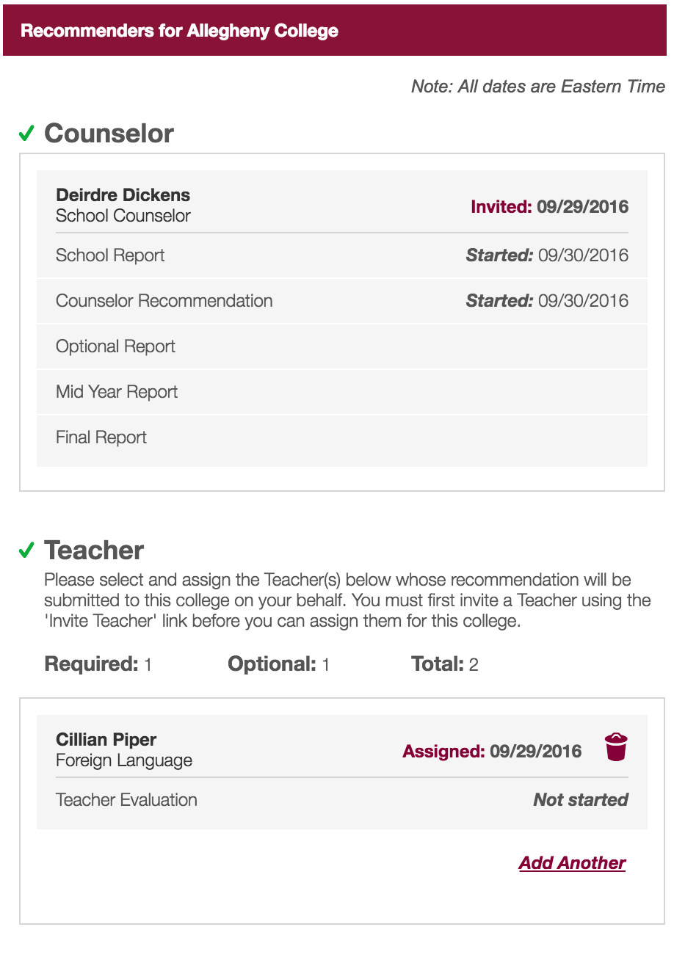
Once you’ve added and assigned Recommenders, you can see some basic information about the status of the forms they are submitting on your behalf.
As your recommenders complete these forms, you will see the status of the forms change here.
^{© 2016 The Common Application}

Slide 70
RECOMMENDATION STATUSES
Not Started - the recommender has not yet begun your recommendation.
Started - your recommender has opened your recommendation file, but has not yet submitted it.
Submitted - your recommender has fully submitted your recommendation, and there is no further action required on their part.
Downloaded - the college's admission office has downloaded a copy of the recommendation from our server.
Pro tip: Be sure to communicate regularly with your recommenders, especially when deadlines approach!
^{© 2016 The Common Application}

Slide 71
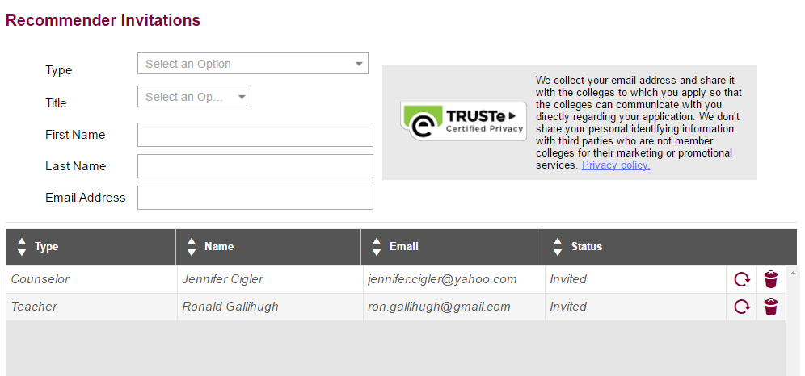
You will be able to remove a recommender only if the form has not already been submitted.
Click on the refresh circle to
resend a recommender invite.
^{© 2016 The Common Application}
Notes:
You can resend a recommender invite from the Manage Recommenders screen by clicking the refresh circle.

Slide 72
COMMON APP READY
Understanding the
My Colleges Tab
© 2016 The Common Application • commonapp.org

Slide 73
UNDERSTANDING THE
MY COLLEGES TAB
AGENDA
The My Colleges Tab
College-Specific Questions
The Writing Supplement
^{© 2016 The Common Application}

Slide 74
THE
MY COLLEGES
TAB
Before beginning your applications, it’s a good idea to familiarize yourself with each school’s requirements to help you stay organized.
^{© 2016 The Common Application}
Notes:
The My Colleges tab is where you will complete each school’s college-specific questions, assign your recommenders, and submit your applications.

Slide 75
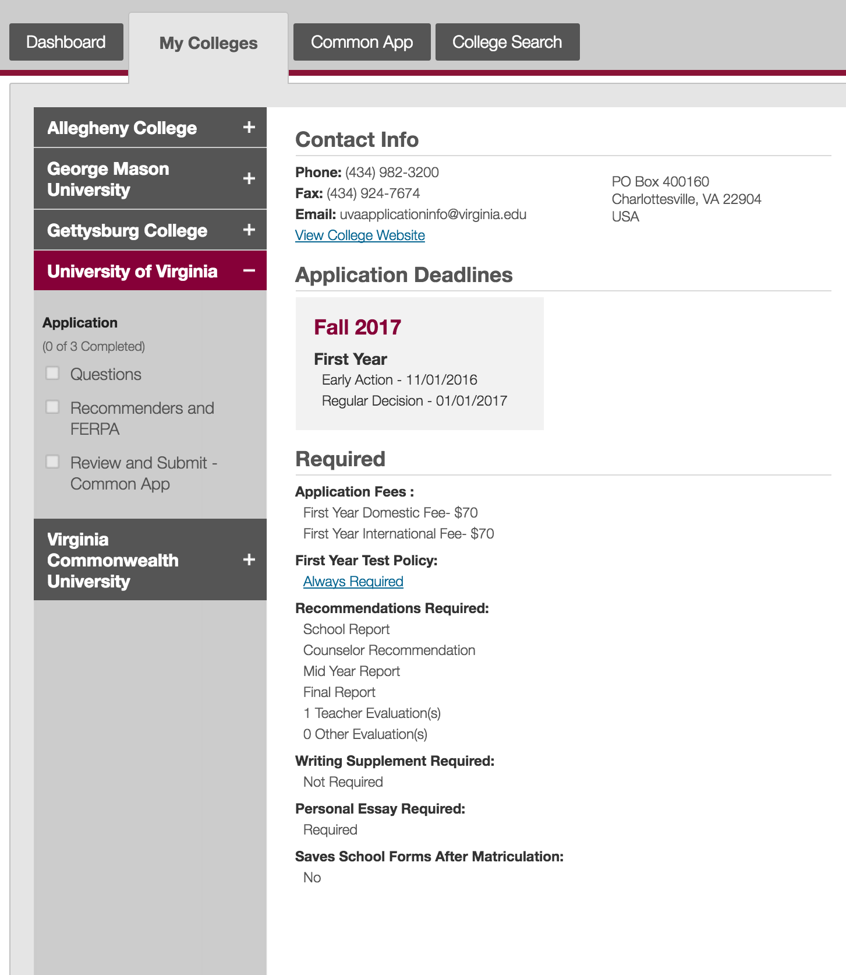
Click the name of each school in your My Colleges tab to see their requirements.
^{© 2016 The Common Application}

Slide 76
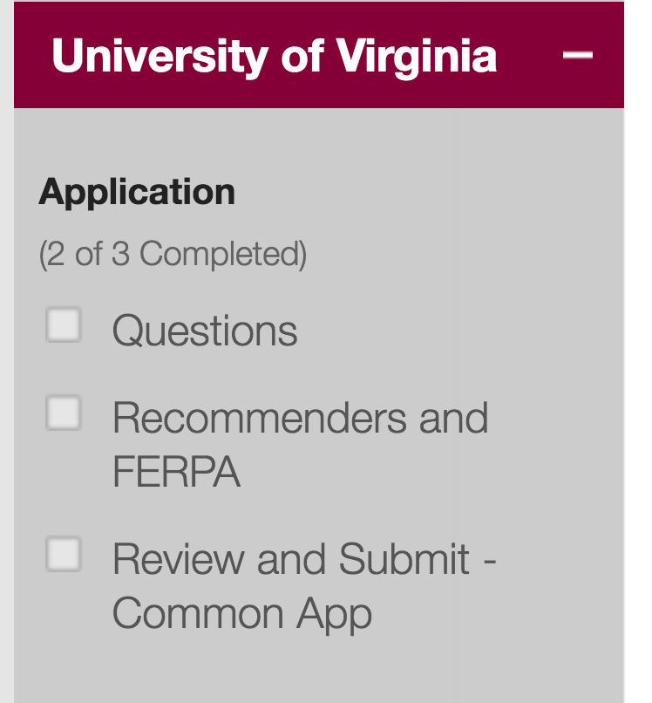
Each school in your My Colleges tab will have three sections under “Application”.
76
^{© 2016 The Common Application}

Slide 77
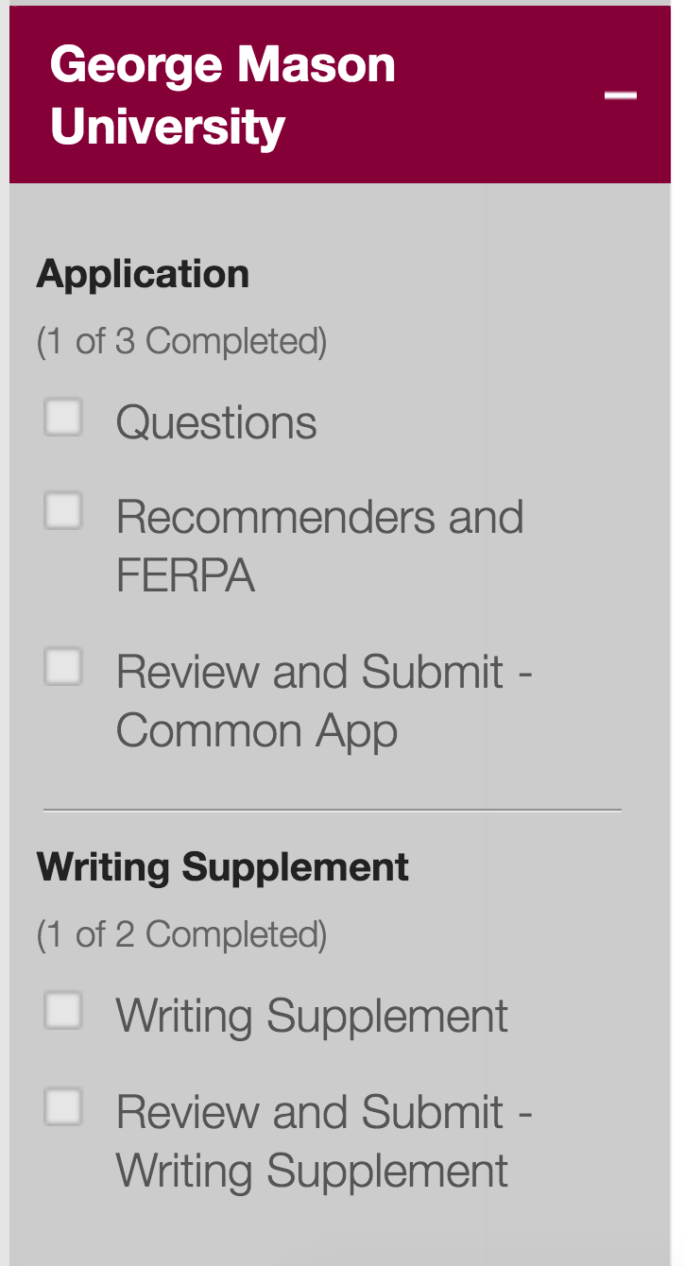
Some schools may have a “Writing Supplement” section in addition to the “Application” section.
77
^{© 2016 The Common Application}

Slide 78
THE
APPLICATION
SECTION
The Application section is organized into three subsections: Questions, Recommenders & FERPA, and Review and Submit – Common App
^{© 2016 The Common Application}

Slide 79
SCHOOL-SPECIFIC QUESTIONS
Each school can determine what types of questions they want to ask, so every Questions section will look a little different.
However, each school will always ask you to select a start term and admission plan.
WHY?
Because the start term and admission plan let schools know when you would like to apply. It is also how submission deadlines are set and displayed in the Common App.
^{© 2016 The Common Application}

Slide 80
RECOMMENDERS
& FERPA
In this section you will assign your recommenders and complete the FERPA Release Authorization.
Be sure to double check each school’s recommendation requirements!
If your school uses Naviance to submit transcripts and recommendations, you will assign your counselor and teachers in Naviance, not the Common App.
^{© 2016 The Common Application}

Slide 81
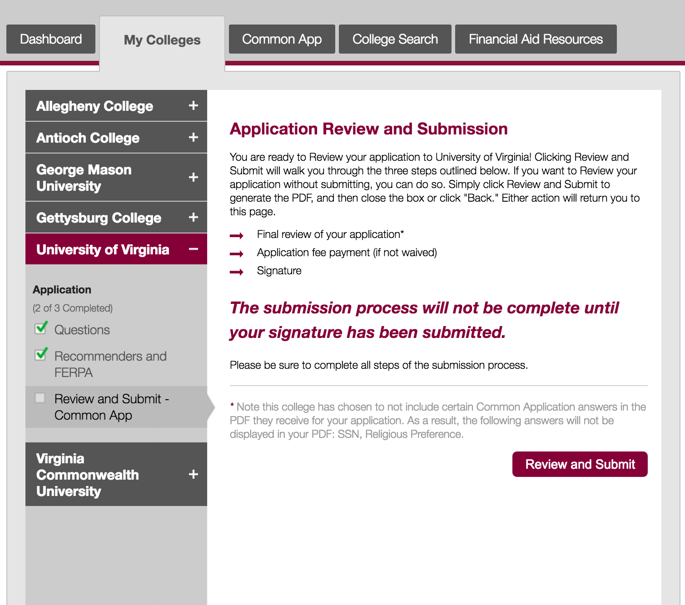
REVIEW & SUBMIT
When you have completed the Common App, assigned your recommenders, and answered all college-specific questions you can start the submission process.
^{© 2016 The Common Application}
Notes:
Submitting your application is a 3 step process:
Review the PDF of your application
Pay the application fee (if applicable)
Provide your signature and click submit

Slide 82
THE
WRITING SUPPLEMENT
SECTION
Some, but not all schools, may require a Writing Supplement in addition to their college-specific questions.
^{© 2016 The Common Application}

Slide 83
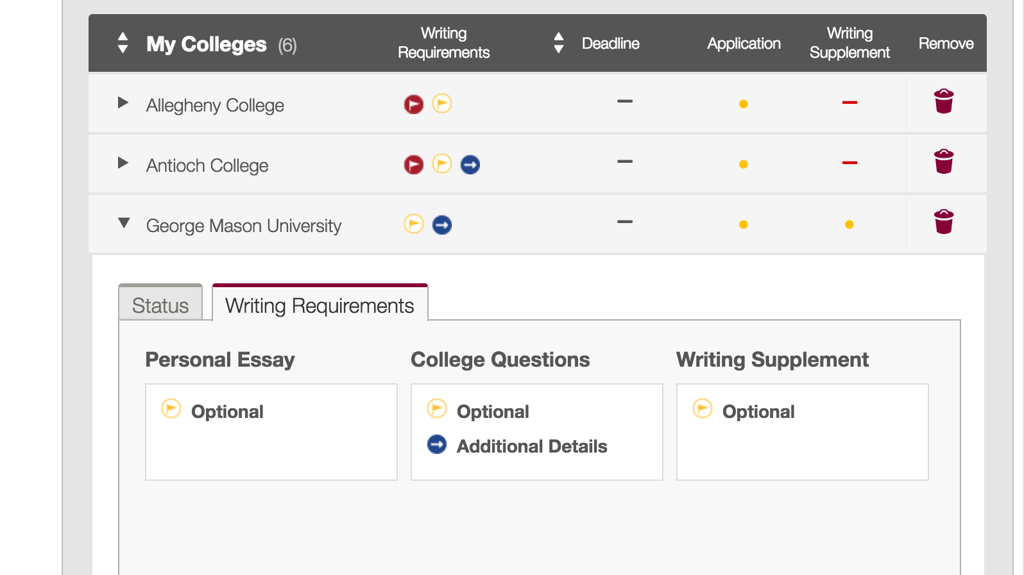
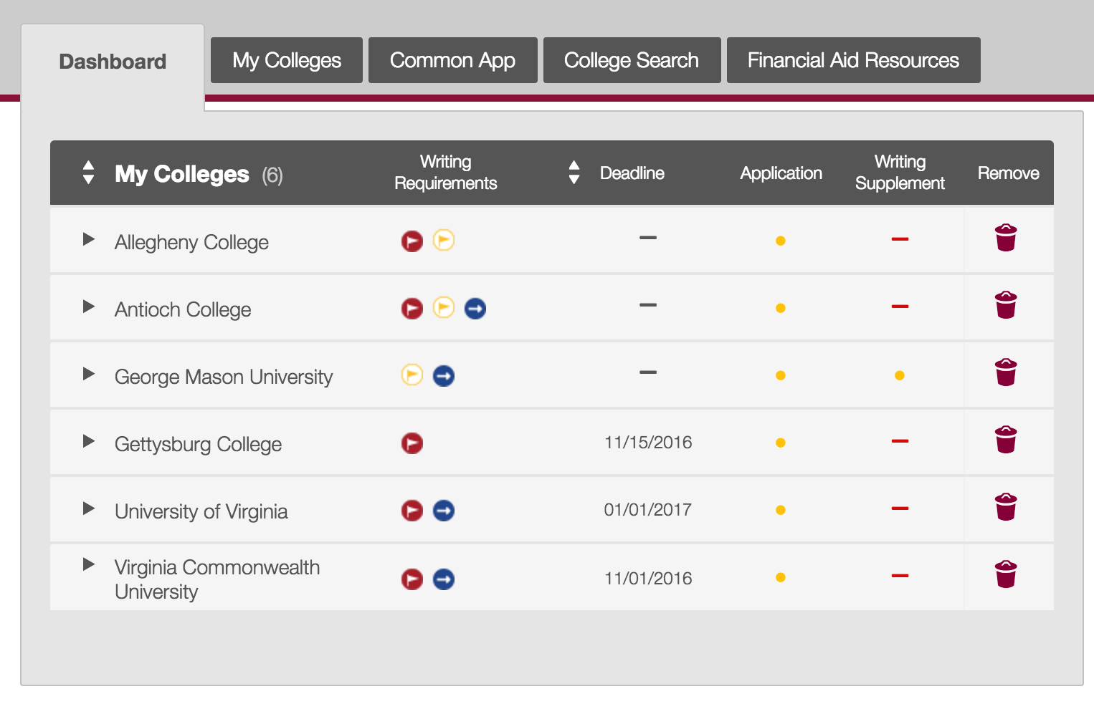
You can see which schools require a Writing Supplement from the Dashboard.
Check each school’s writing requirements to learn more.
^{© 2016 The Common Application}

Slide 84
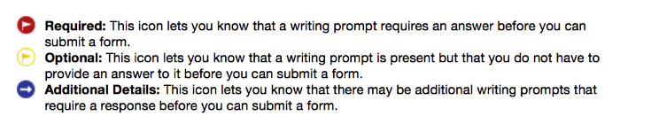
WRITING REQUIREMENTS ICONS
Three status icons will help you plan out your essay responsibilities.
Use these as a preparation and planning tool so you can stay on track with your applications.
^{© 2016 The Common Application}

Slide 85
SUBMITTING THE WRITING SUPPLEMENT
The Writing Supplement is submitted separately from the Application. You can submit the Writing Supplement only after you have submitted your application.
WHY?
Not every school requires a Writing Supplement, and some schools only require a supplement based on your answers to previous questions.
^{© 2016 The Common Application}

Slide 86

LEARN MORE
GATHER YOUR MATERIALS
TIPS & BEST PRACTICES
COMMON APP TOUR
Important information you’ll need for your application.
Best practices to keep in mind as you complete your applications.
Learn how to navigate the Common App.
^{© 2016 The Common Application}

