Slide 1
Lesson 1 FOOD

Slide 2
All About Me
My name is:
I live in:
I like to:
My favourite subject in school was:
My favourite type of music is:
My favourite type of food is:

Slide 3
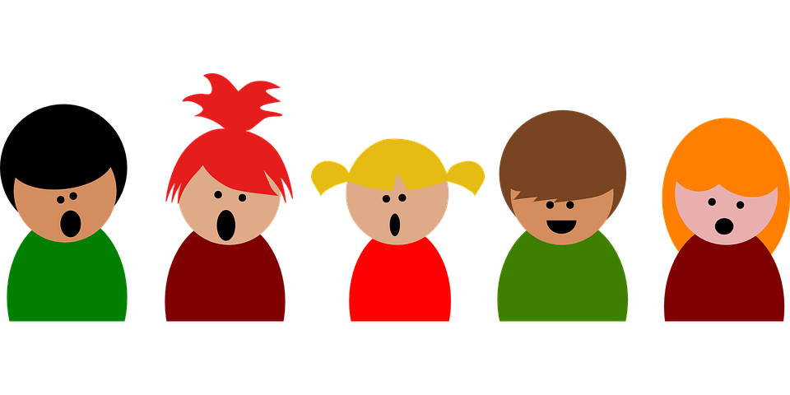
All About You
What is your name?
How old are you?
When is your birthday?
Where do you live?
What is your favourite subject at school?
What is your favourite hobby?

Slide 4
What we will learn today
New food words
Using the ‘sh’ sound
Using “and”, capitalization and periods

Slide 5
The SH Sound

Slide 6
Let’s practice pronouncing the SH sound
Notes:
Say each word, articulating it clearly. Then say the word again, in a more natural way. Read the sentence accompanying the word. Instruct the students to repeat the word, chorally and then individually. Then, instruct the students to repeat each sentence, chorally and then individually.

Slide 7
Let’s practice pronouncing the SH sound

Slide 8
Foods with the SH Sound

Slide 9
Saying the SH sound

Slide 10
Funny Vegetables
Notes:
Play “Fruits and Vegetables that Evolved Into Different Creatures.mp4” Make sure to stop video for discussion. Talk to the students about the type of vegetables featured in the video.

Slide 11
Using CAPITALS
They are used in:
first letter of the first word of a statement or question
His birthday was last week.
capitals for the first letter of a name, place, language, or saying “I”
I went to the Great Wall of China.

Slide 12
Using CAPITALS
They are also used in:
first letter of the days of the week
Sunday, Monday, Tuesday, Wednesday, Thursday, Friday, Saturday
first letter of the months of the year
January, February, March, April, May, June, July, August, September, October, November, December

Slide 13
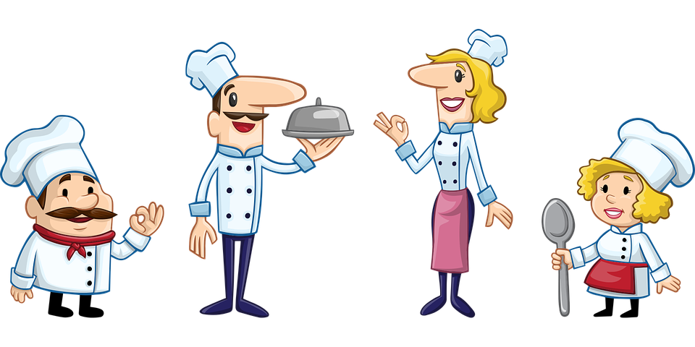
Correct the Capitals Worksheet
once upon a Time, there was a boy named frank. frank wanted to Be a chef and visit france. he hoped one day he would be a famous Chef in paris.

Slide 14
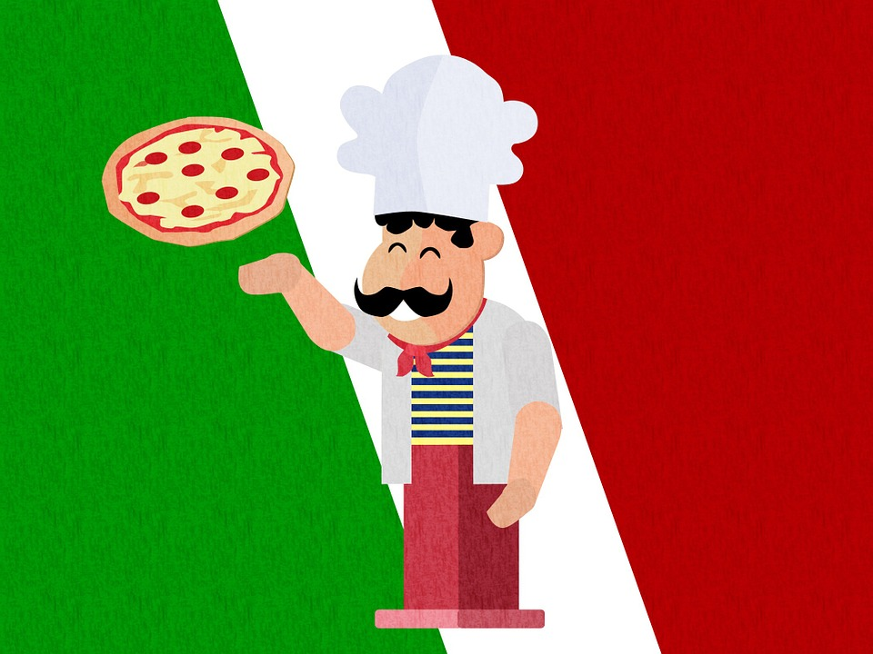
Using periods
Periods are used to end a complete sentence. When reading English with a period, it shows you need to make a full stop when speaking.
Here are some examples:
Rome is the capital of Italy. In Italy,
they have delicious food.
They are also used to separate dollars/yuan and cents/jiao in money.
$10.43 = ten dollars and 43 cents
¥5.39 = Five yuan and 39 jiao

Slide 15
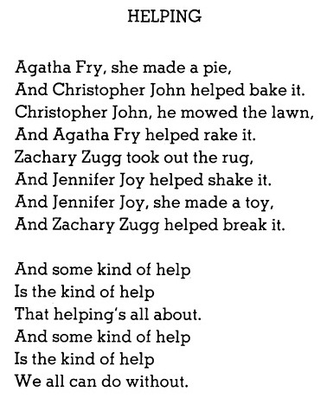
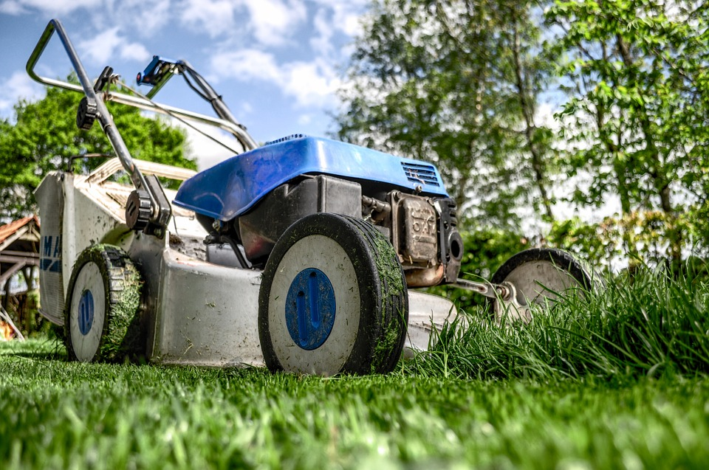
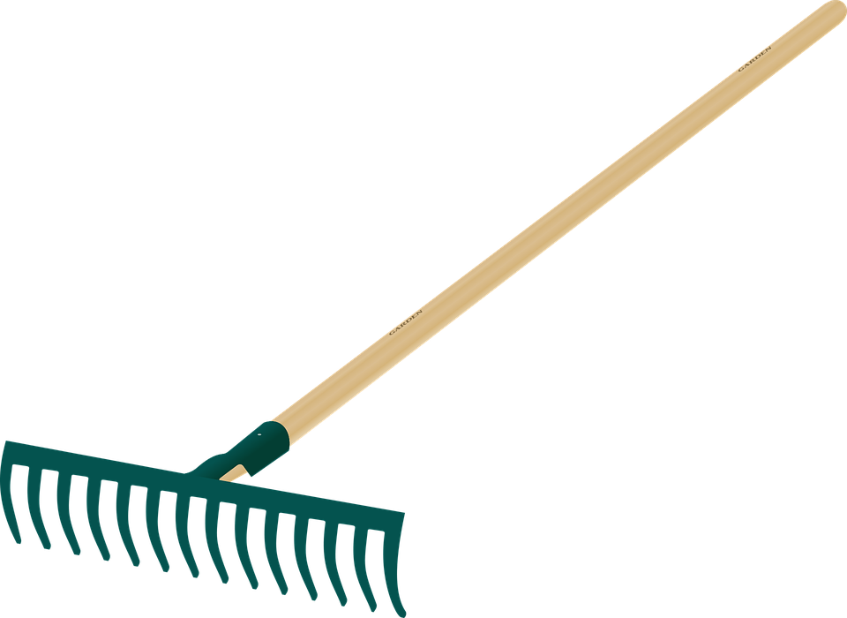
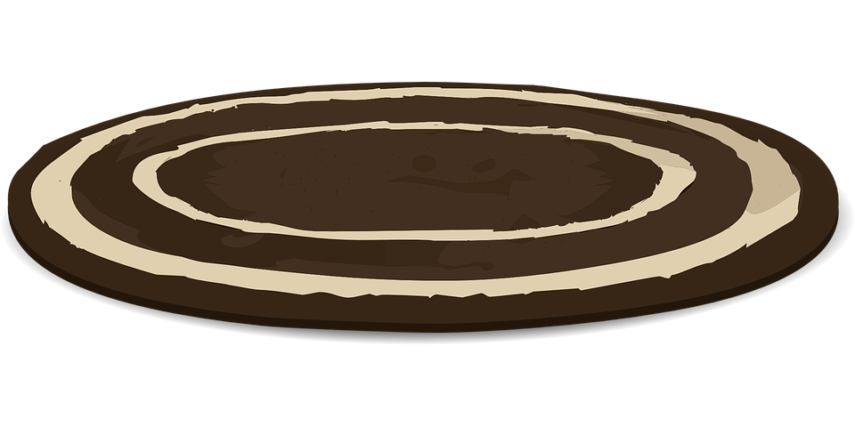
Circle all the capitals in the following poem
pie
lawn
rake
rug
Notes:
Read the poem with the students first. Then have them circle all the capital letters.

Slide 16
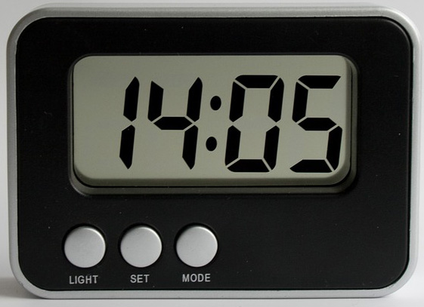
Using periods
They are also used when telling time.
a.m.=morning
p.m.=afternoon
I will arrive between 6 a.m. and 7 a.m.
1:00 p.m. = 13:00

Slide 17
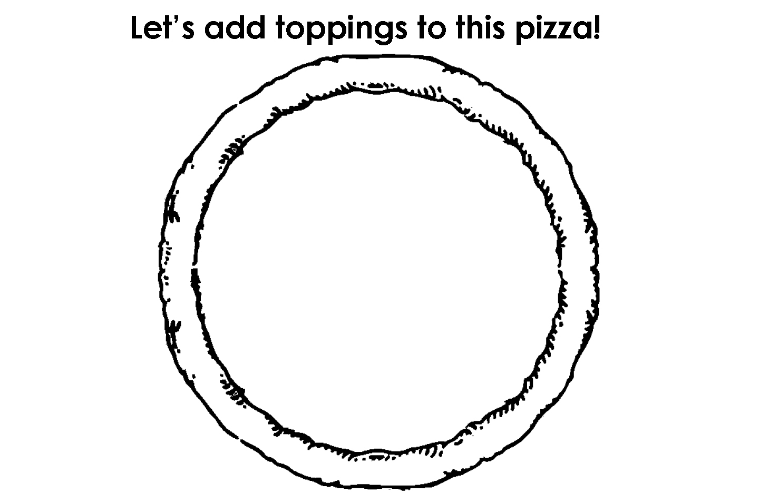
Decorate the pizza!

Slide 18
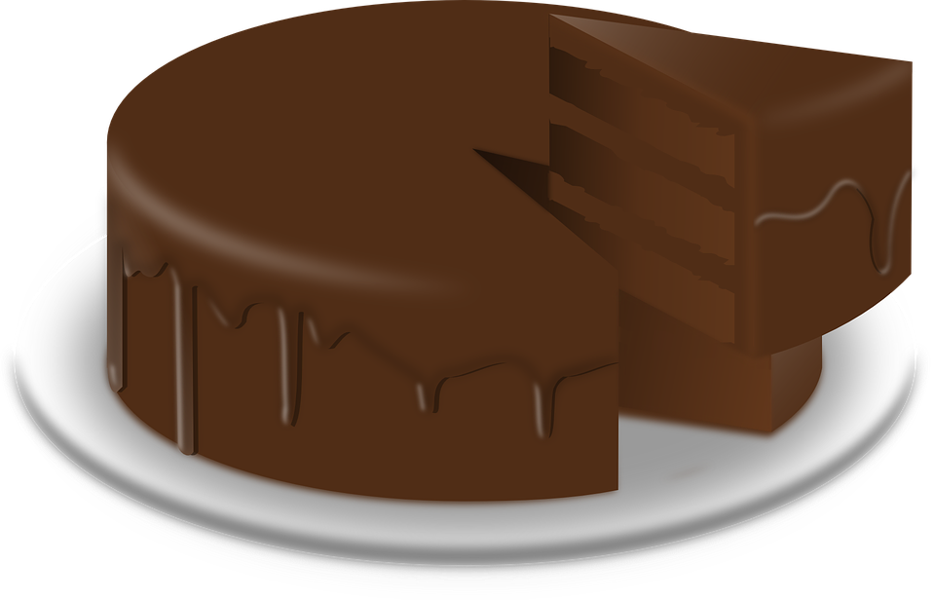
Sentences with two clauses need a connector
The word “and” is used to join a group of words.
Here are some examples:
We have ice cream and cake for dessert.
He's feeling tired and hungry.
She eats and eats.
The recipe needs flour, eggs and sugar.

Slide 19
Using “and”
Join two sentences with “and” to make a compound sentence.
Here is an example:
We have ice cream. We have cake.
= We have ice cream, and we have cake.
He feels tired. He feels hungry.
= He feels tired, and he feels hungry.

Slide 20
Practice “and”
Add “and” where it is missing in the following sentences.
I have to bring my glasses, keys wallet.
He likes chocolate vanilla.
She has cake presents for her birthday.
He rides his bike. He rides to the park.

Slide 21
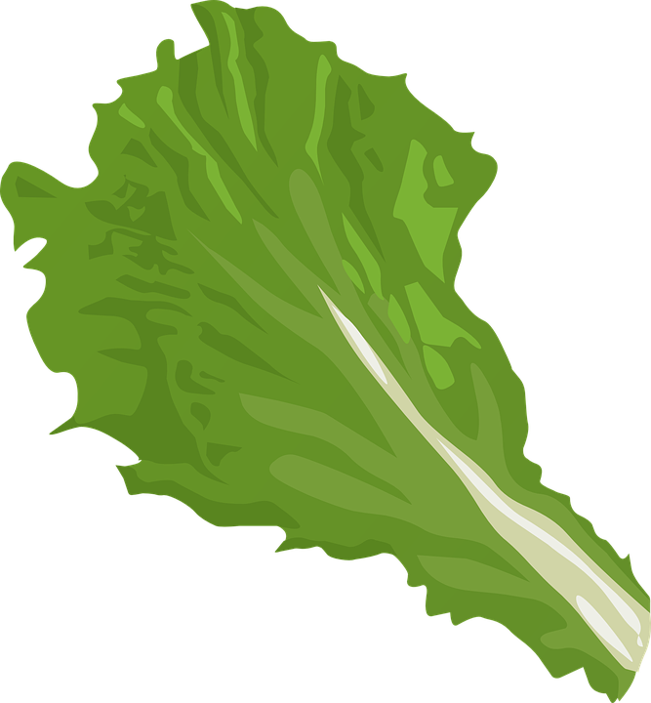
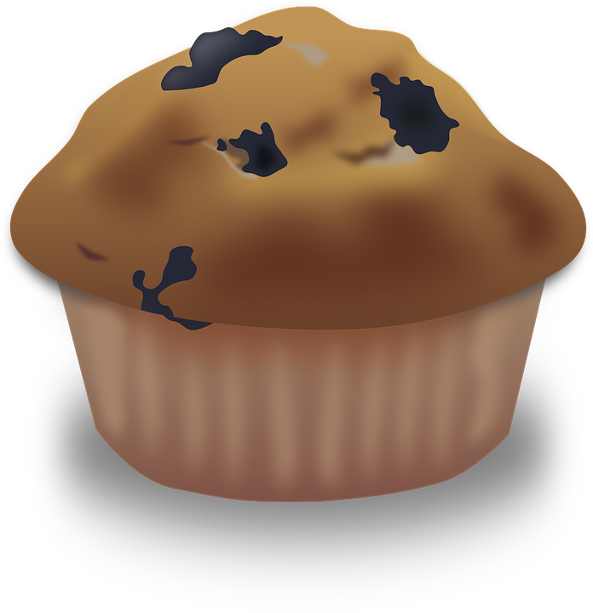
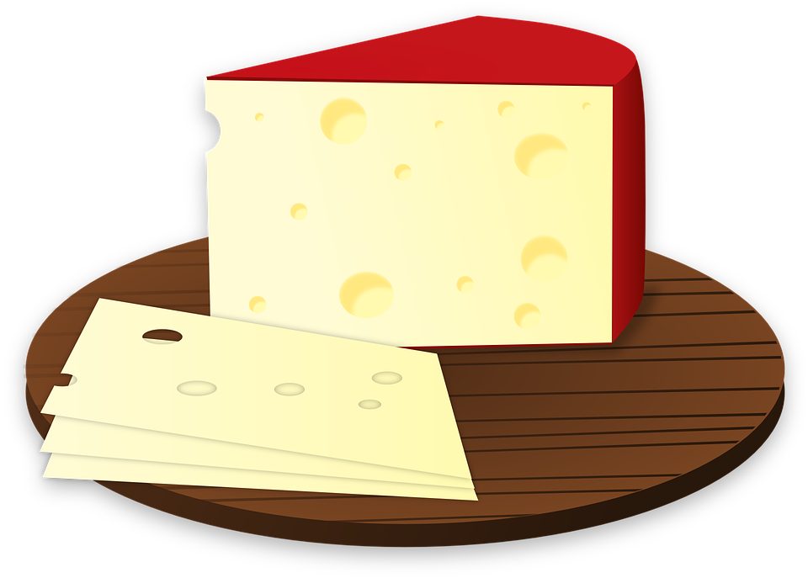
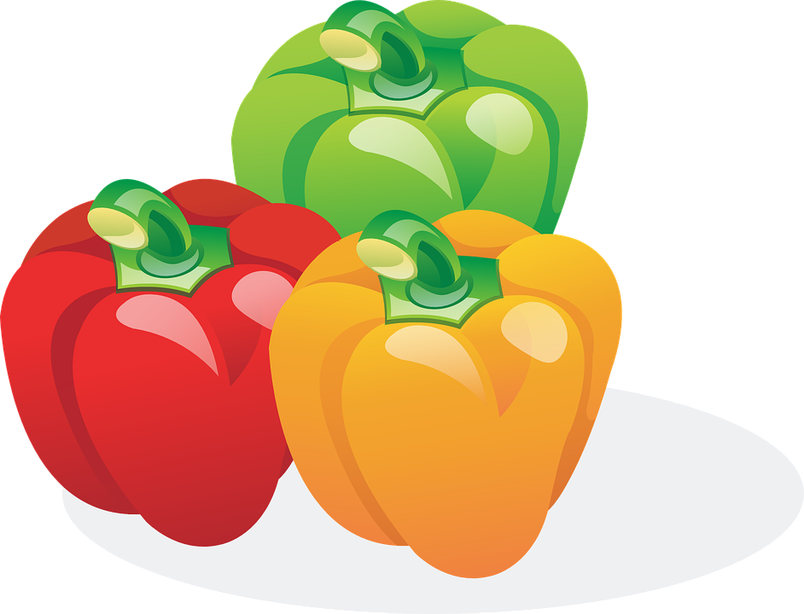
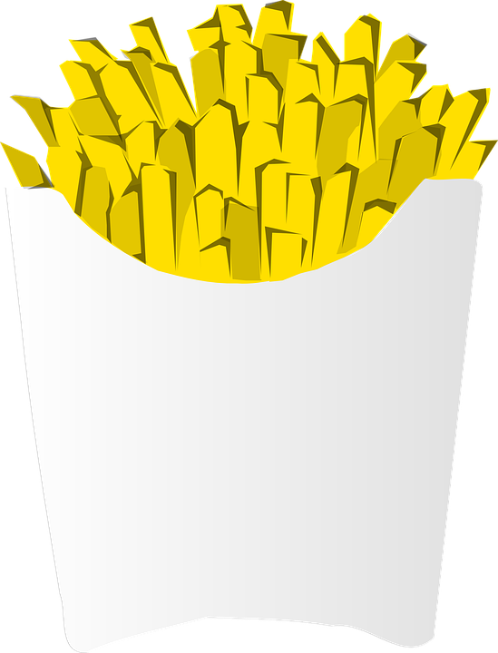
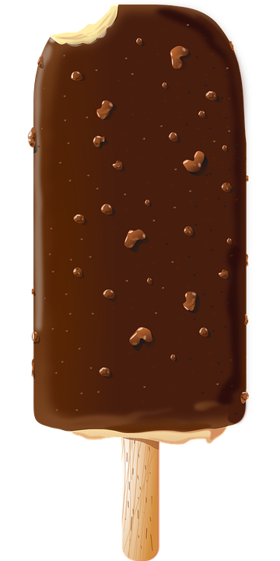
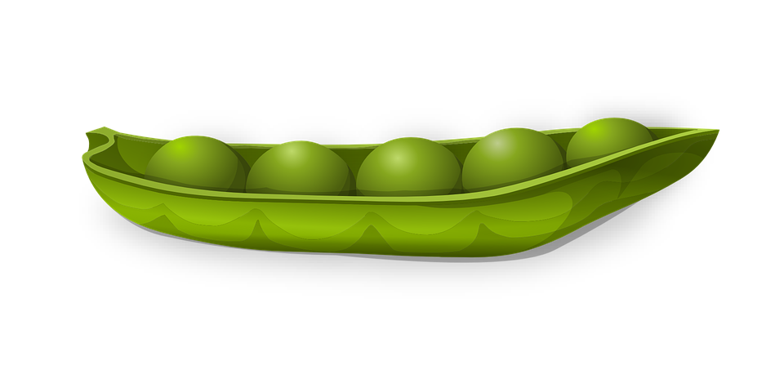
Circle all unhealthy food
Notes:
Explain what “desserts” means (a sweet course usually served at the end of a meal). Have students circle the desserts. Then, go over each of the foods and give the English word for each graphic.

Slide 22
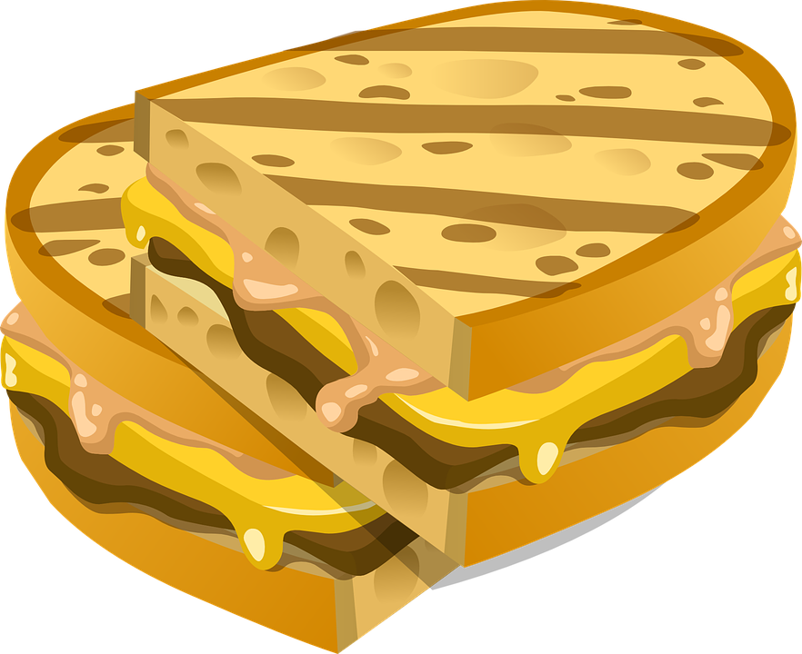
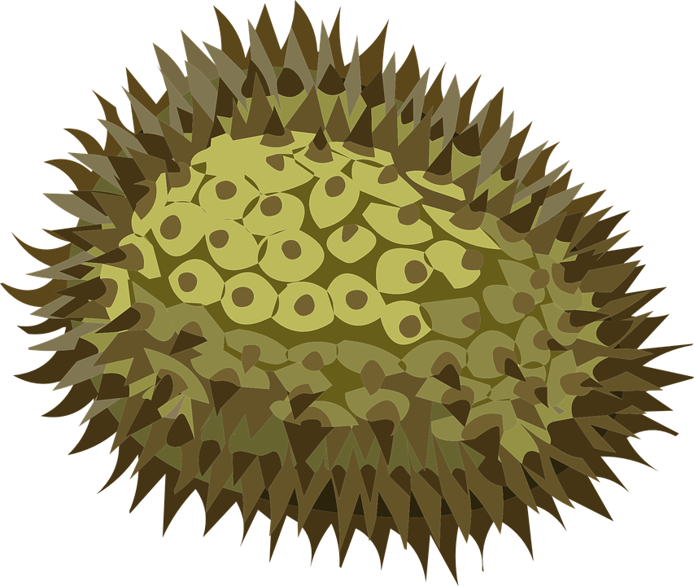
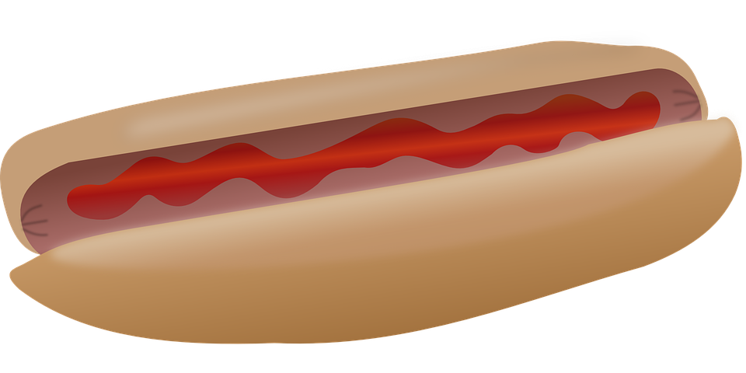
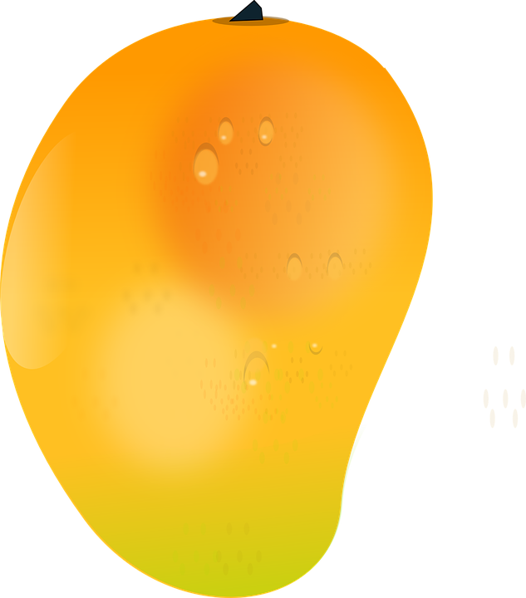
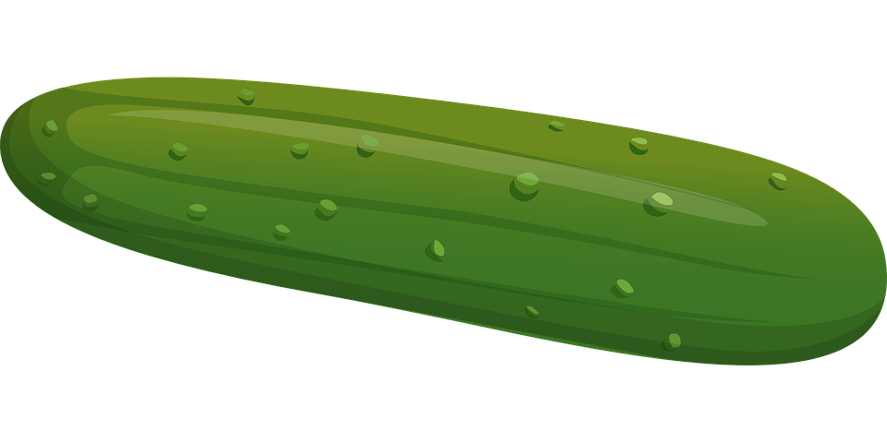
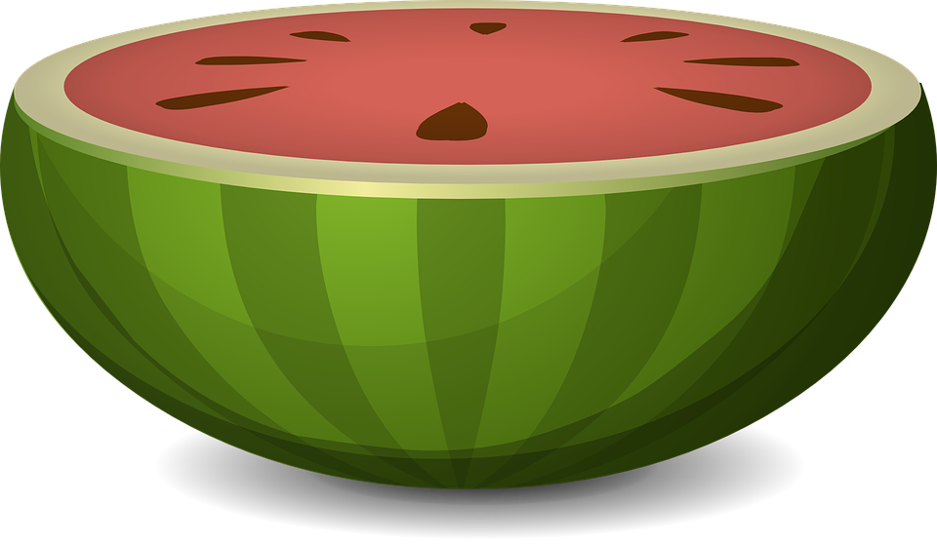
Circle all the fruits

Slide 23
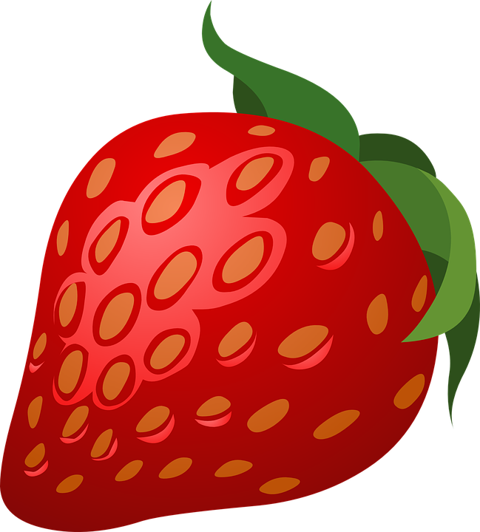
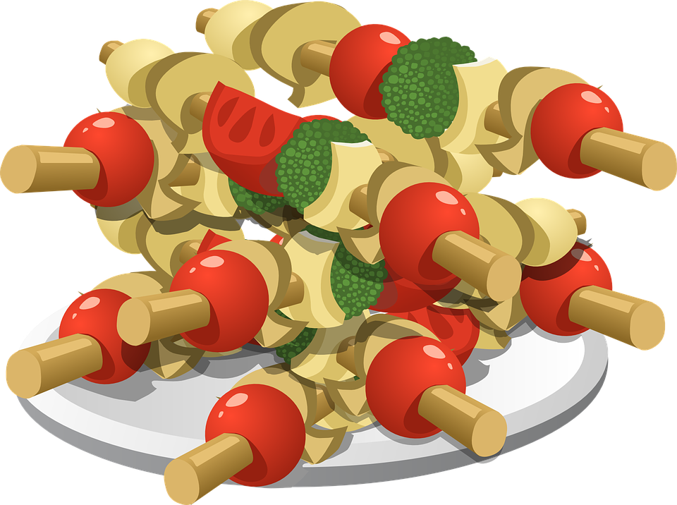
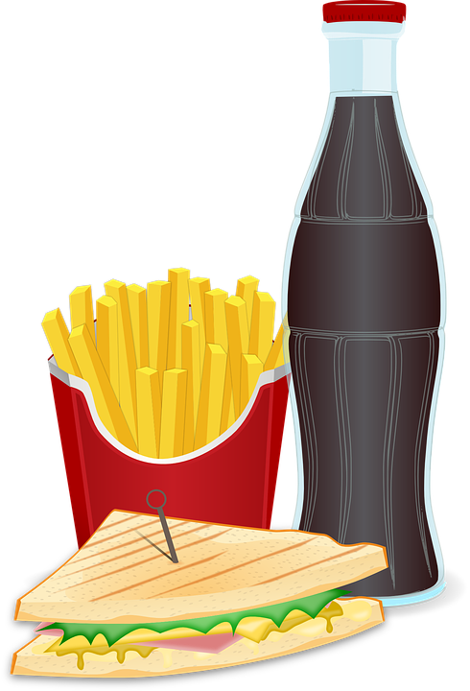
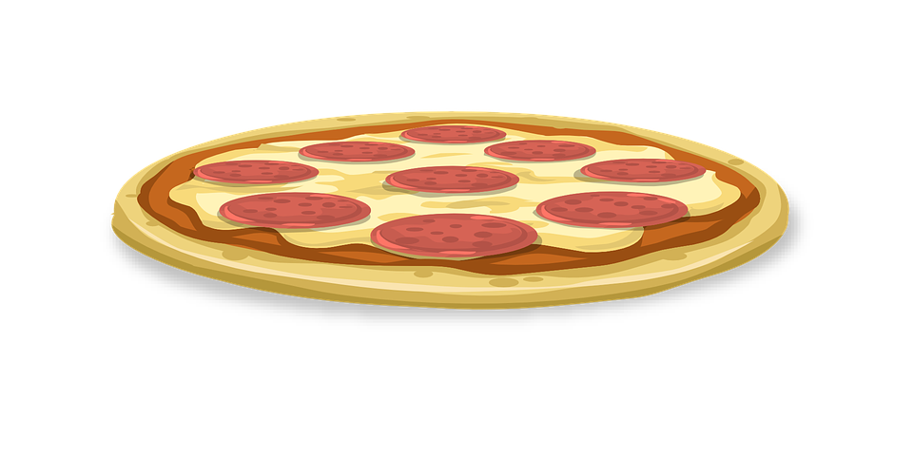
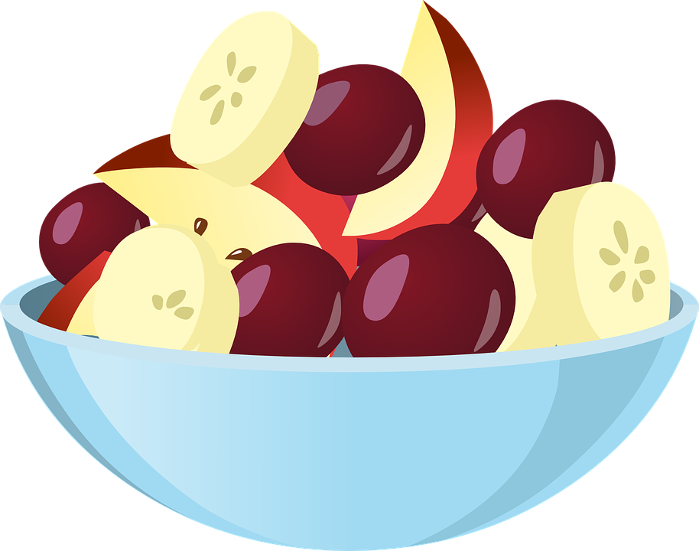
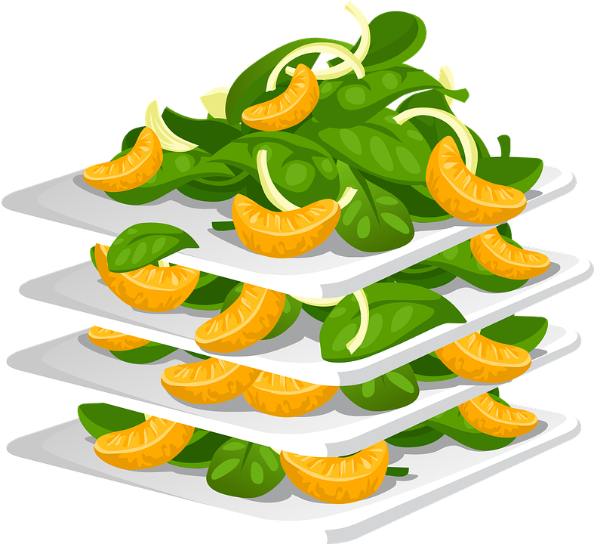
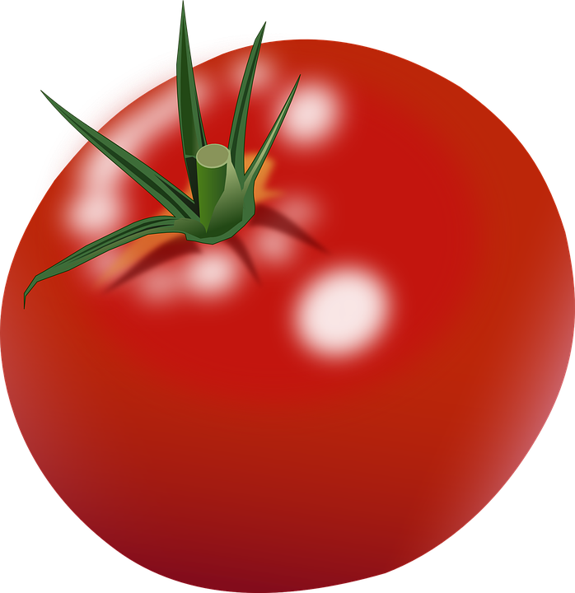
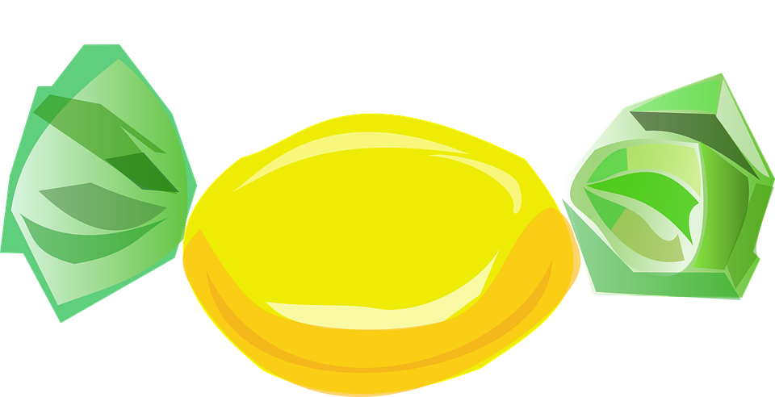
Circle all the healthy food
Notes:
Explain what “healthy eating” means (foods that are good for you including fresh fruits and vegetables, whole grains). Emphasize the importance of healthy choices abd eating natural foods. Have students circle the healthy food. Then, go over each of the foods and give the English word for each graphic.

Slide 24
What did I learn today?
How to pronounce the SH sound
How to find and use“and”, capital letters, a period and compound sentences
New food vocabulary

Slide 25
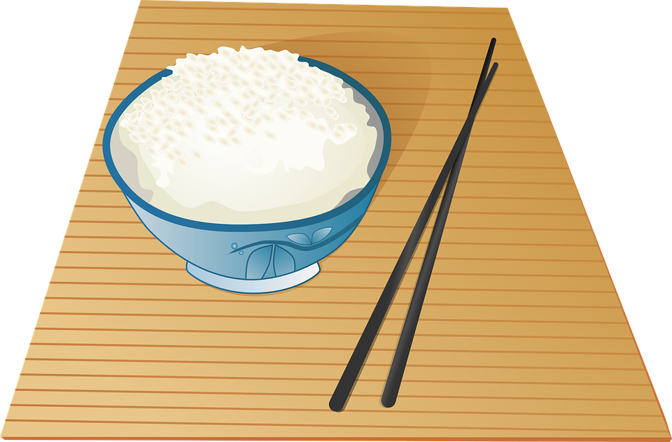
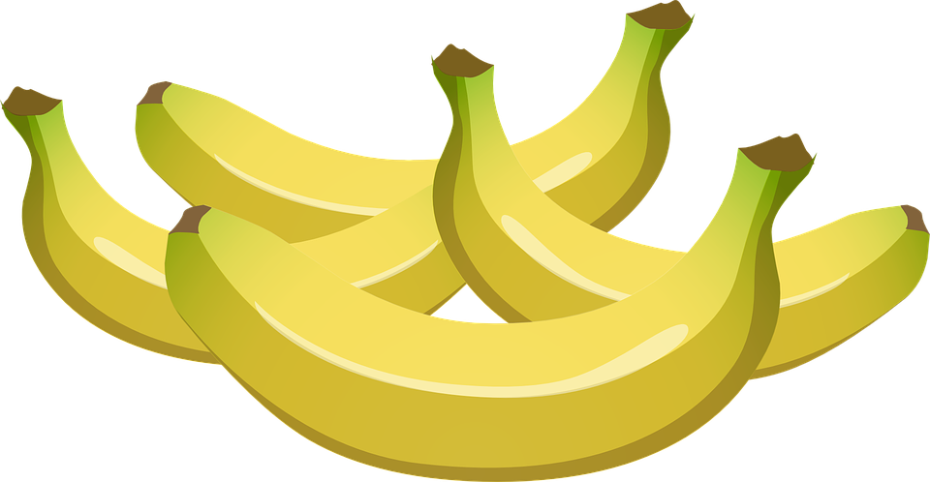
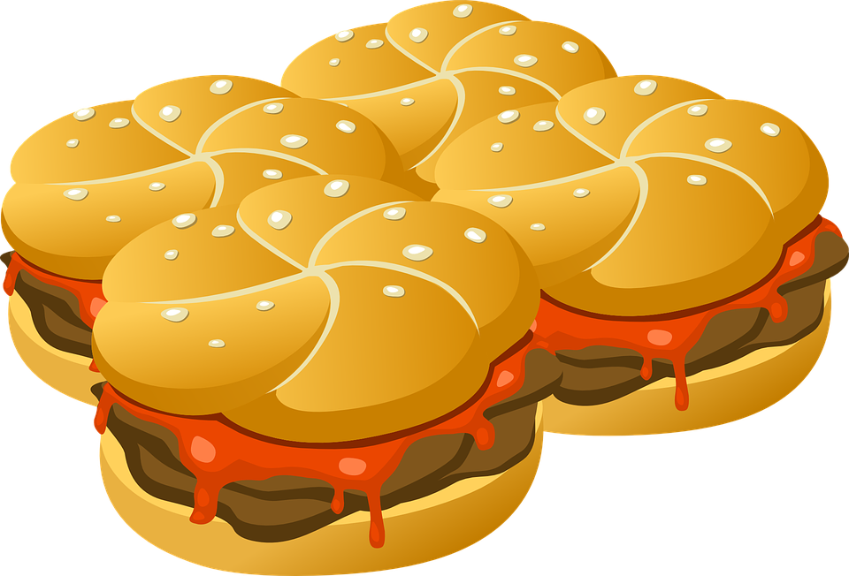
Homework
What is your favourite food? Save a photo you find online of this food.
Write down 5 adjectives about this food, and share it with the class.
Write 4 sentences about why it is your favourite food, and share it with the class.

