Slide 1


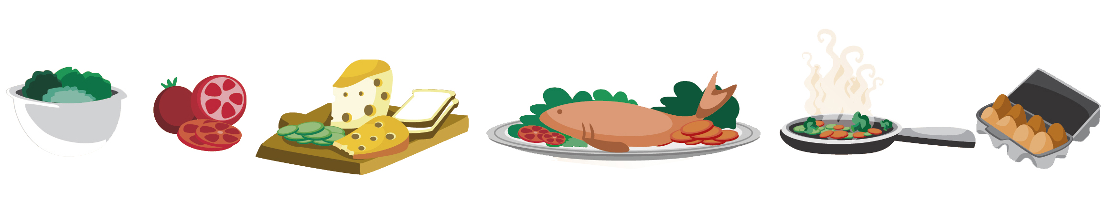
Lesson 1
FOOD

Slide 2

All About Me
My name is:
I live in:
I like to:
My favourite subject in school was:
My favourite type of music is:
My favourite type of food is:
Notes:
Introduce yourself to the students. These are some prompts, but feel free to add more so the class can get to know you better.

Slide 3
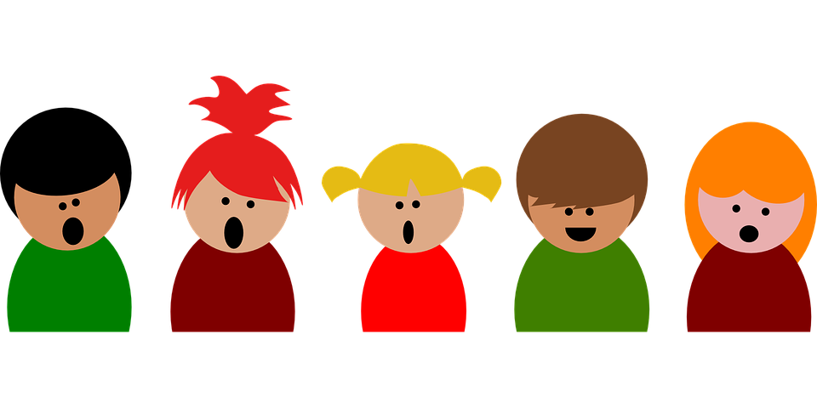
All About You
What is your name?
How old are you?
When is your birthday?
Where do you live?
What is your favourite subject at school?
What is your favourite hobby?
Notes:
Pose these questions to the students.

Slide 4

What we will learn today
New food words
Using the ‘sh’ sound
Using “and”, capitalization and periods
Notes:
Go over the learning goals.

Slide 5

The SH Sound
Notes:
Demonstrate how to pronounce the SH sound. Really emphasize your mouth movement so the students can see it in the video. Put out your lips a little. Put air out of your mouth to make the “sh” sound. Have students make the sound individually.

Slide 6
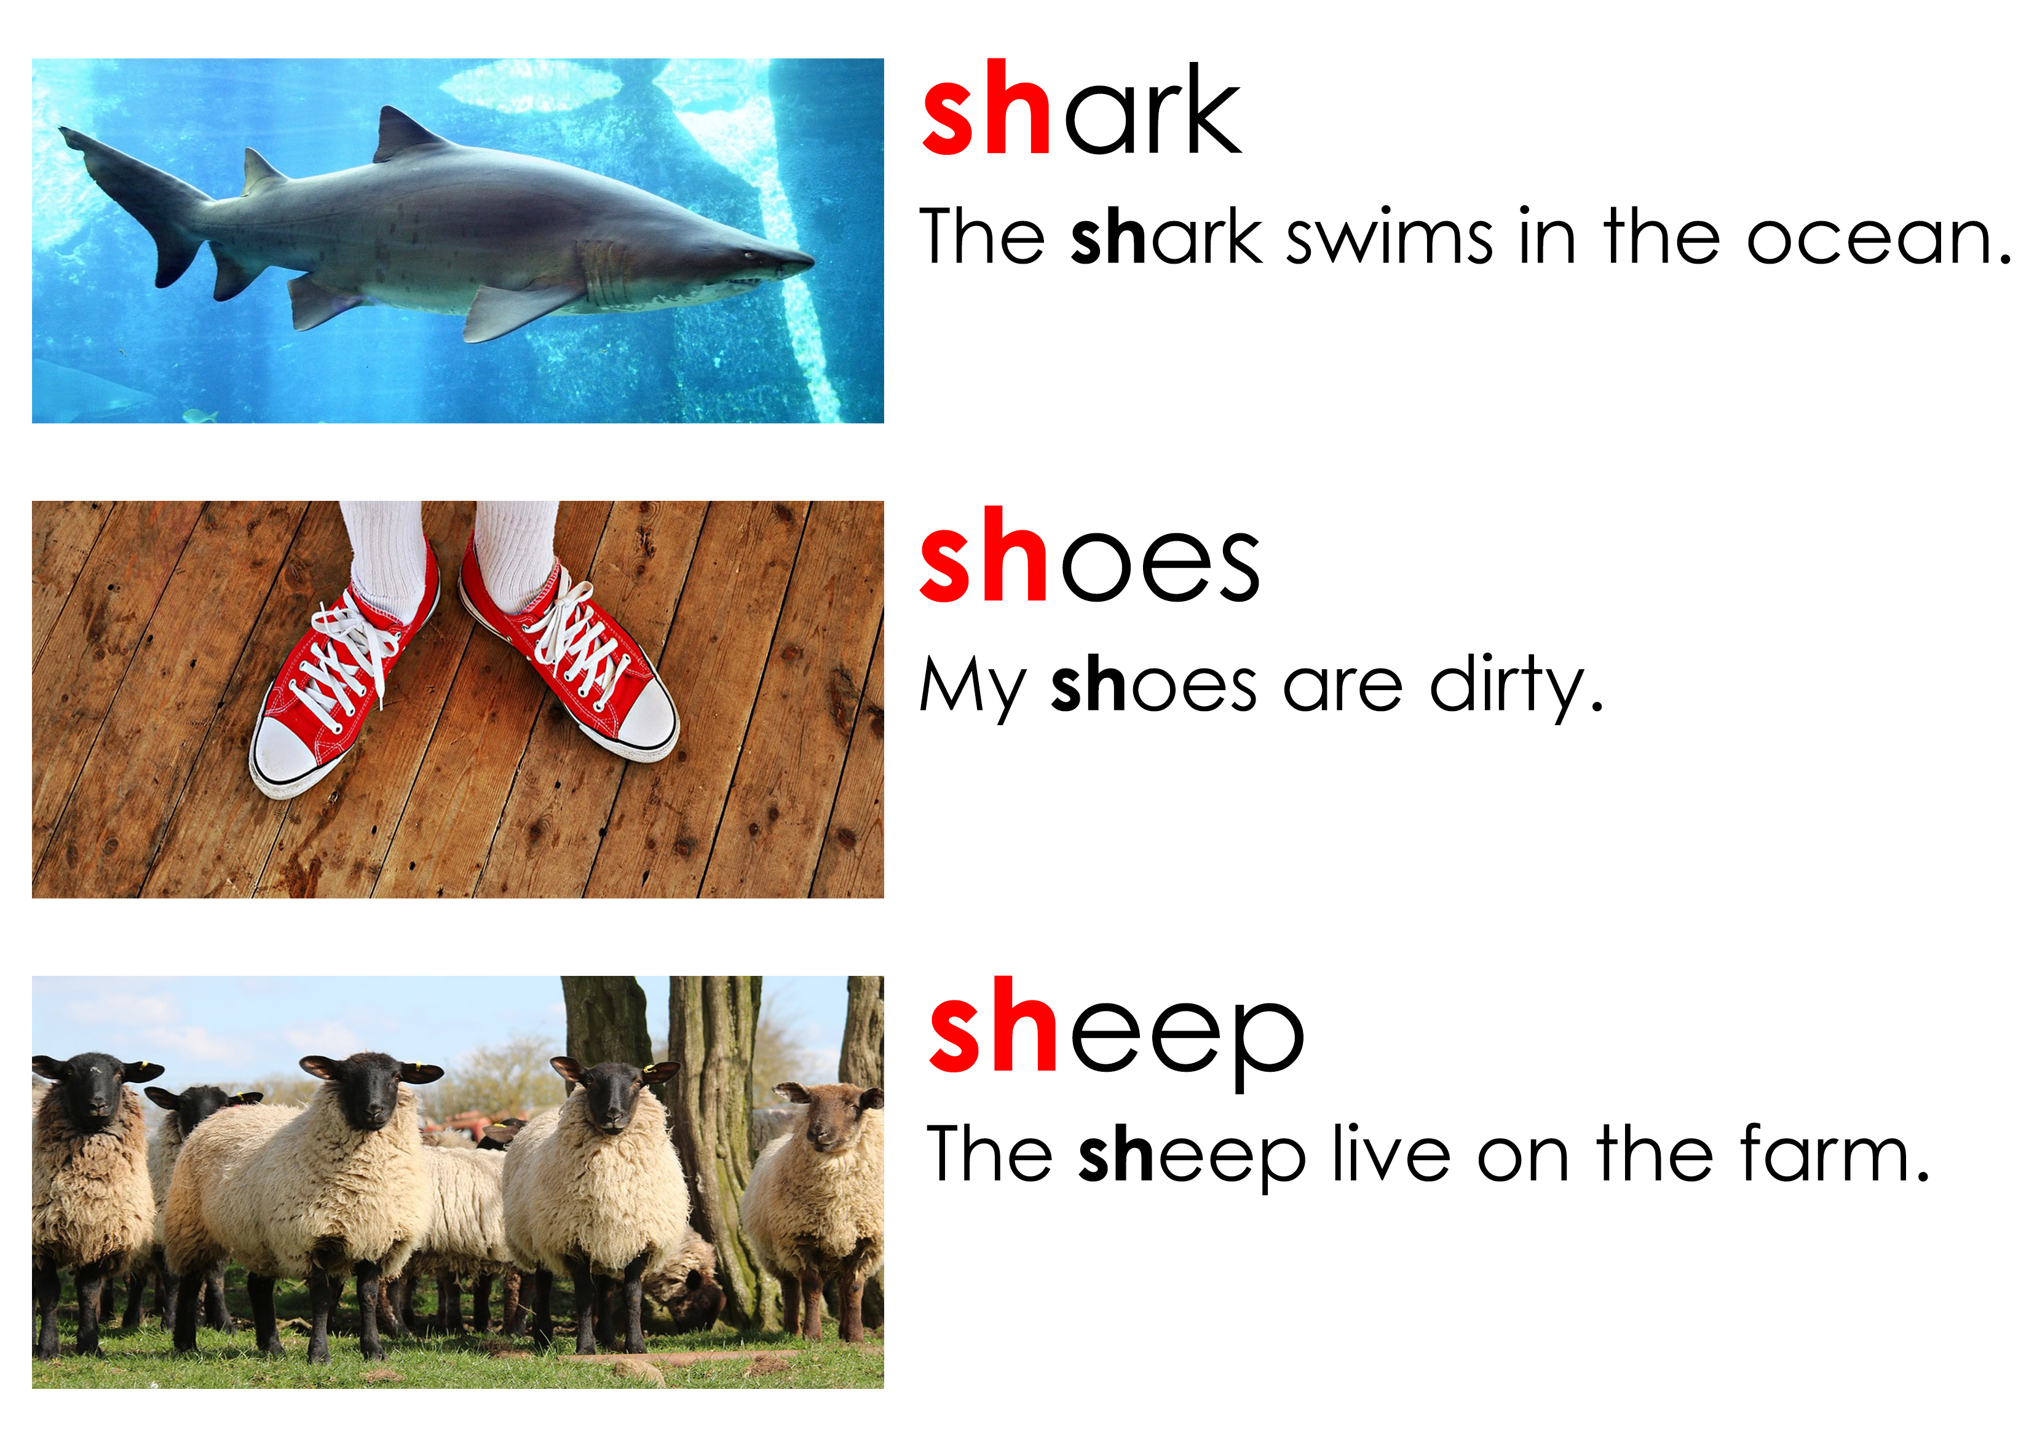
Let’s practice pronouncing the SH sound
Notes:
Say each word, articulating it clearly. Then say the word again, in a more natural way. Read the sentence accompanying the word. Instruct the students to repeat the word, chorally and then individually. Then, instruct the students to repeat each sentence, chorally and then individually.

Slide 7
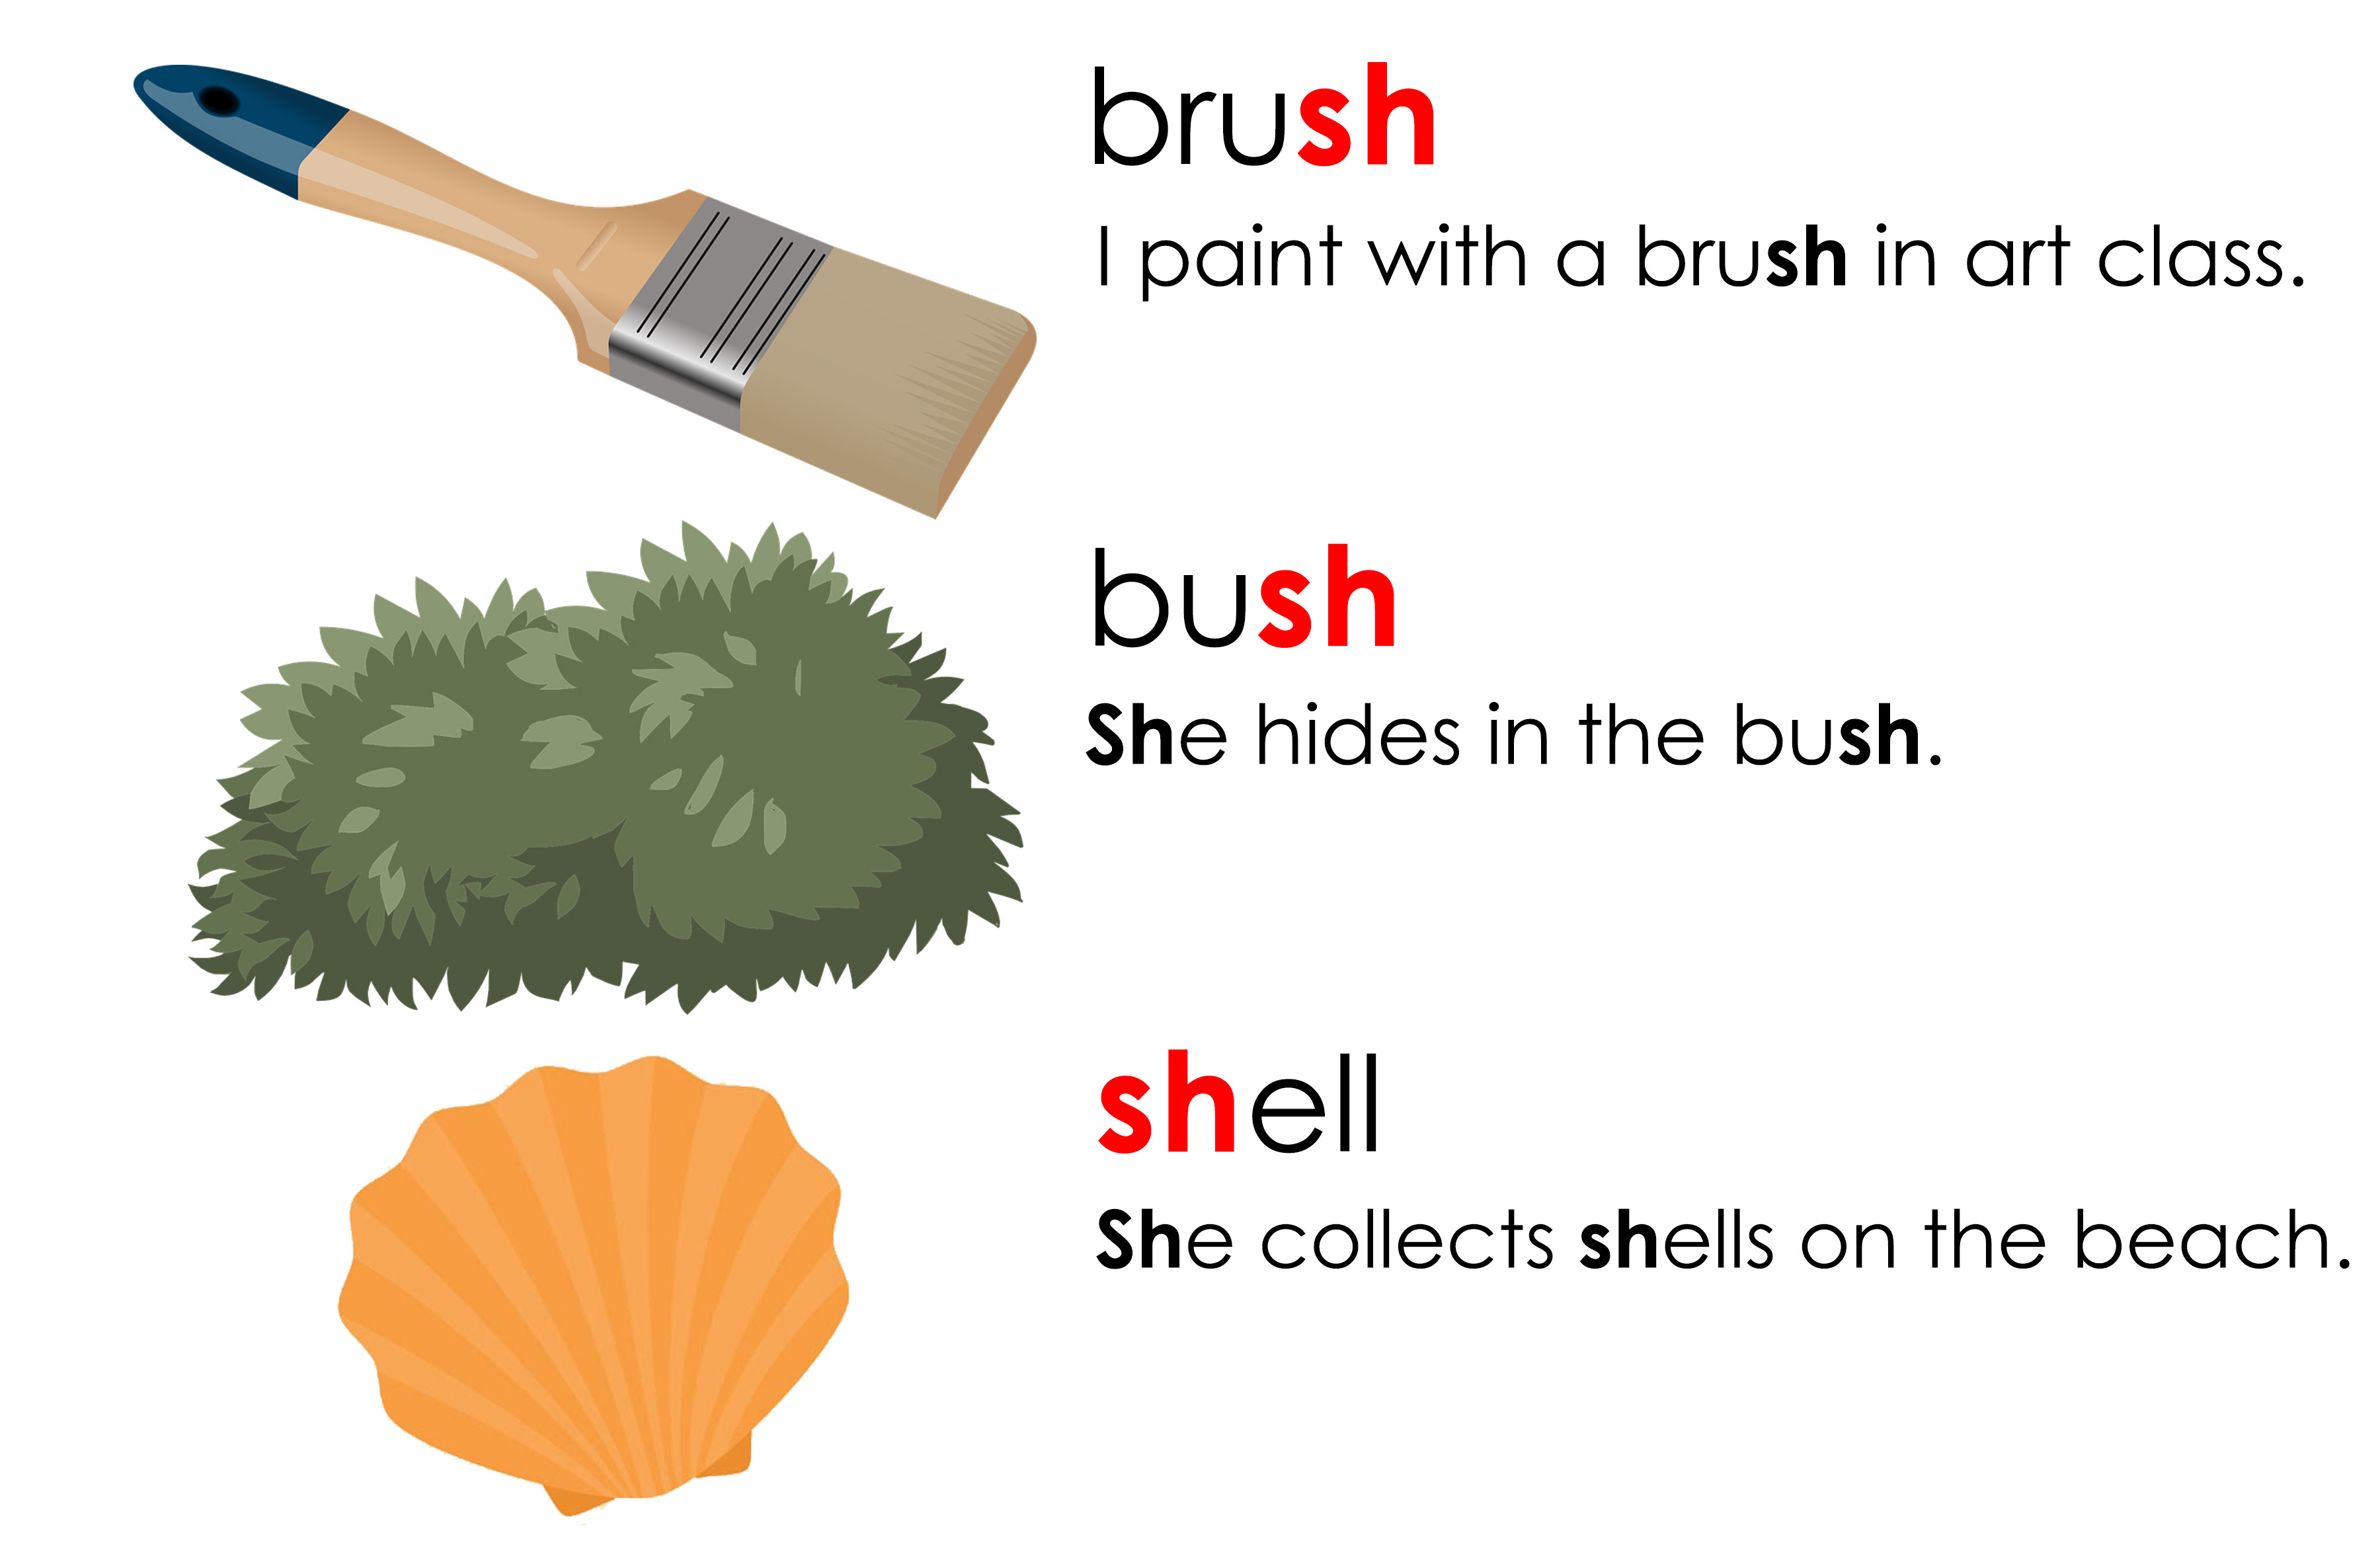
Let’s practice pronouncing the SH sound
Notes:
Say each word, articulating it clearly. Then say the word again, in a more natural way. Read the sentence accompanying the word. Instruct the students to repeat the word, chorally and then individually. Then, instruct the students to repeat each sentence, chorally and then individually.

Slide 8
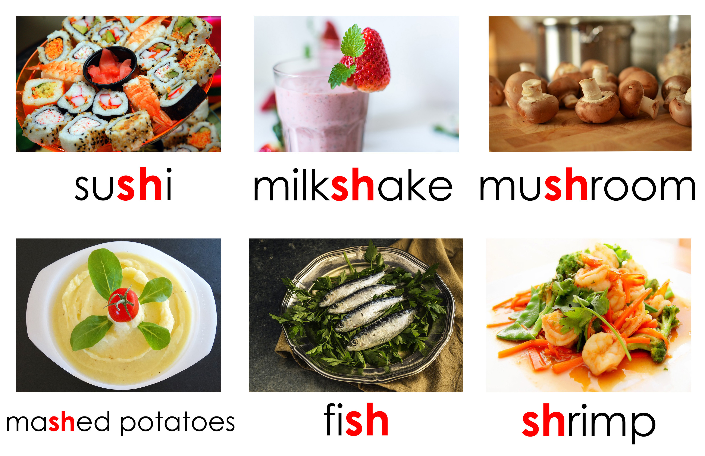
Foods with the SH Sound
Notes:
Say each word, articulating it clearly. Then say it again, pointing to each syllable, emphasizing the main stress on the polysyllabic words. Say the word again, in a more natural way. Instruct the students to repeat the word, chorally and then individually.
If you have time, you can ask critical thinking questions about the food.
i.e. How do you make sushi? What is inside sushi? Where do mushrooms grow? Where do you get shrimp?

Slide 9
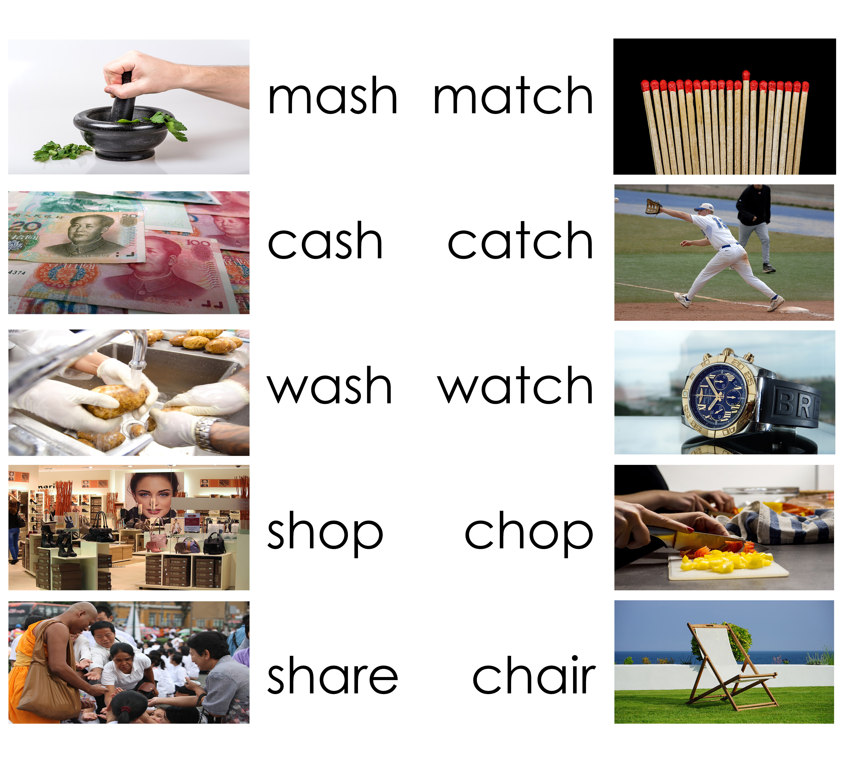
Saying the SH sound
Notes:
Read aloud the minimal pairs and enunciate the words so the students can hear the difference in pronunciation.

Slide 10

Funny Vegetables
Notes:
Play “Fruits and Vegetables that Evolved Into Different Creatures.mp4” Make sure to stop video for discussion. Talk to the students about the type of vegetables featured in the video.

Slide 11

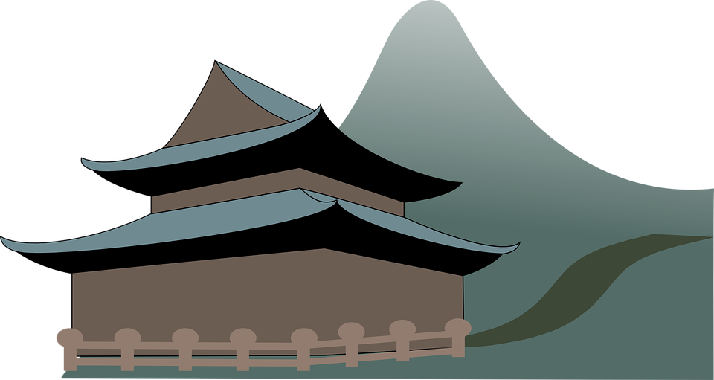
Using CAPITALS
They are used in:
first letter of the first word of a statement or question
  His birthday was last week.
  capitals for the first letter of a name, place, language, or saying “I”
  I went to the Great Wall of China.
Notes:
Read over and explain the slide.

Slide 12

Using CAPITALS
They are also used in:
first letter of the days of the week
Sunday, Monday, Tuesday, Wednesday,
Thursday, Friday, Saturday
first letter of the months of the year
January, February, March,
April, May, June,
July, August, September,
October, November, December

Slide 13
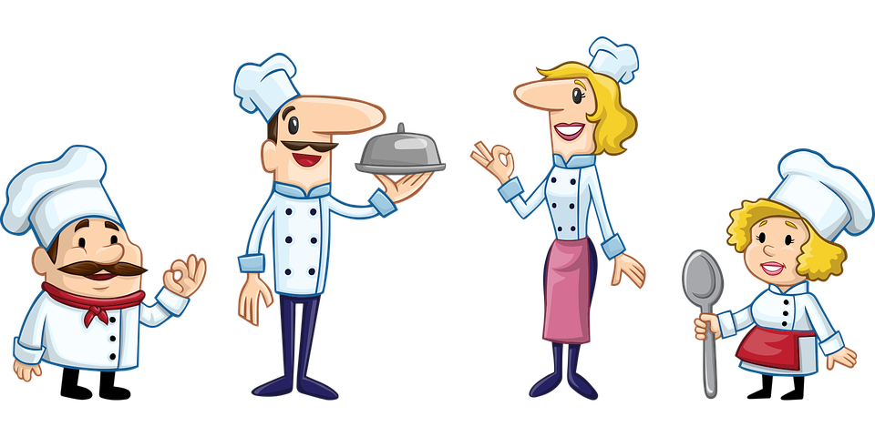
Correct the Capitals Worksheet
once upon a Time, there was a boy named frank. frank wanted to Be a chef and visit france. he hoped one day he would be a famous Chef in paris.
Notes:
Read this passage over to the students. Give students time to complete the worksheet. Ask students to volunteer the corrections. Ask them why they made the specific capitalizations.

Slide 14
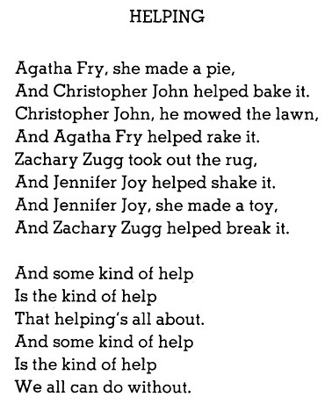

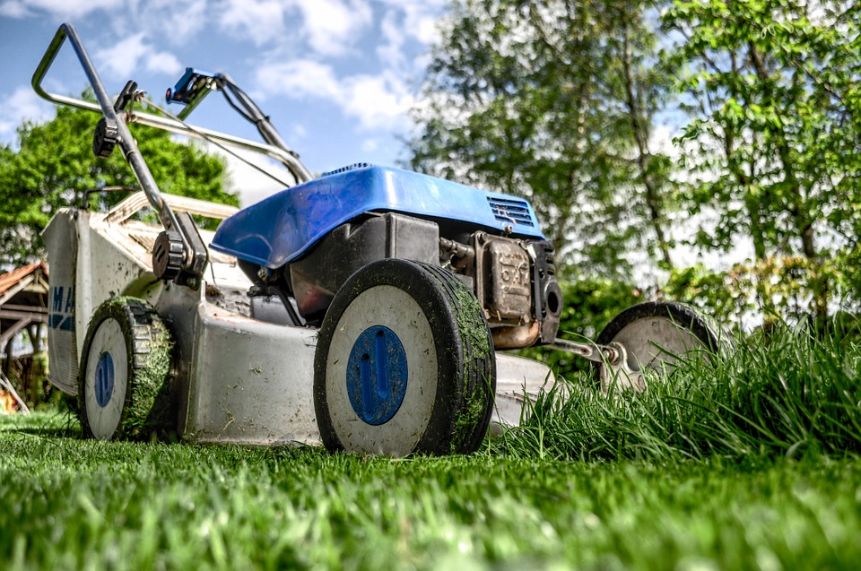
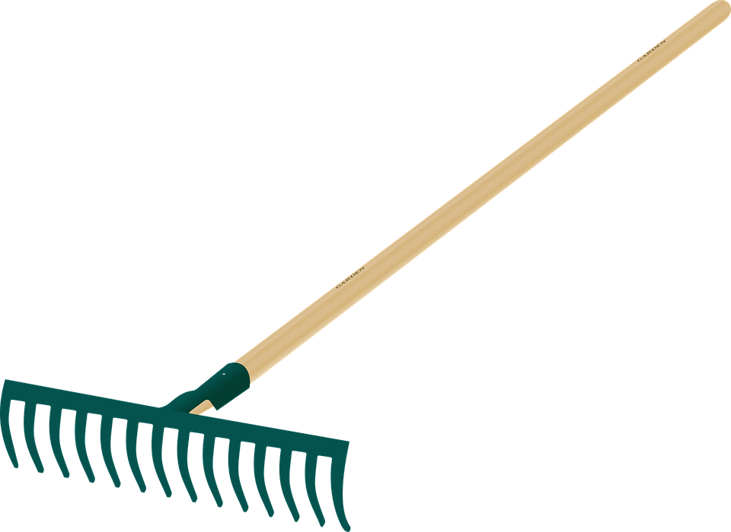


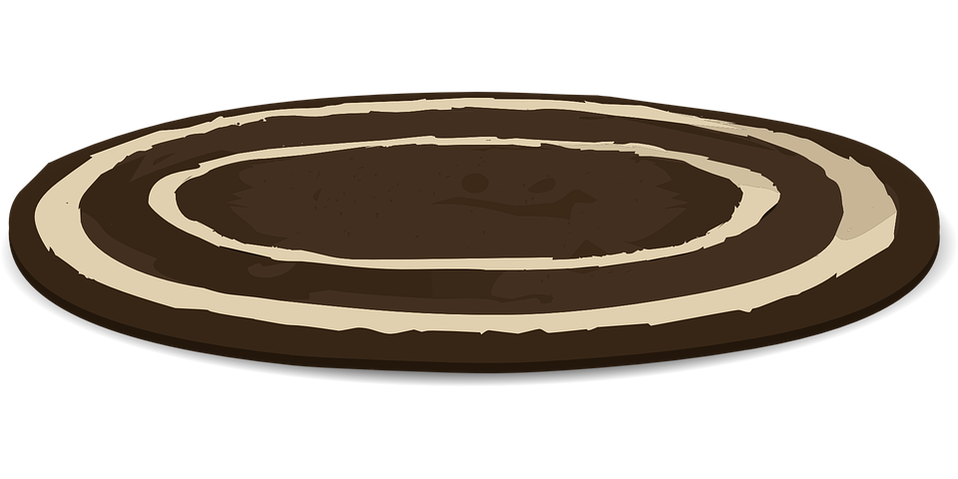
Circle all the capitals in the following poem
pie
lawn
rake
rug
Notes:
Read the poem with the students first. Then have them circle all the capital letters.

Slide 15
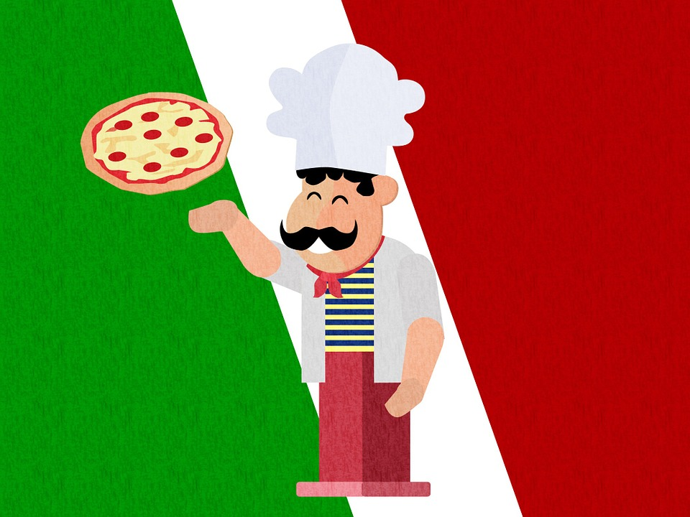

Using periods
Periods are used to end a complete sentence. When reading English with a period, it shows you need to make a full stop when speaking.
Here are some examples:
Rome is the capital of Italy. In Italy,
they have delicious food.
They are also used to separate dollars/yuan and cents/jiao in money.
$10.43 = ten dollars and 43 cents
¥5.39 = Five yuan and 39 jiao

Slide 16

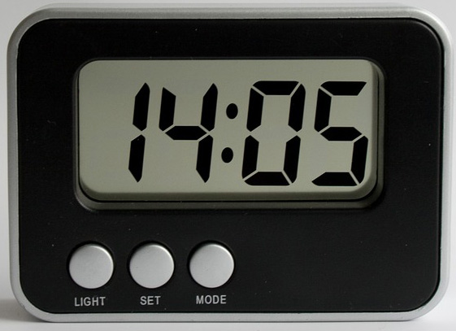

Using periods
They are also used when telling time.
a.m.=morning
p.m.=afternoon
I will arrive between 6 a.m. and 7 a.m.
1:00 p.m. = 13:00

Slide 17
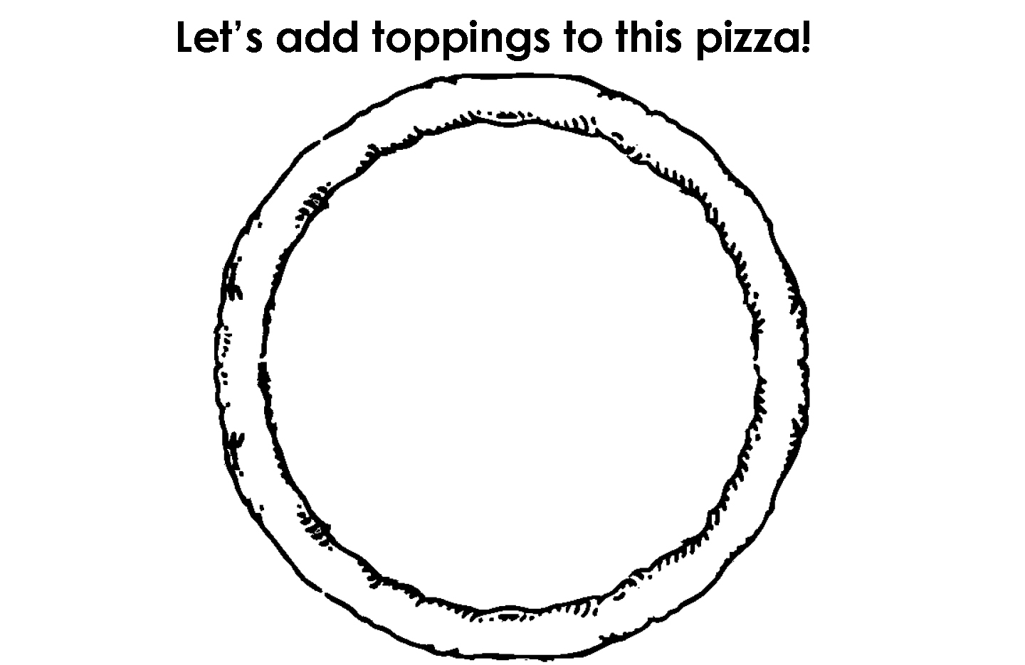
Decorate the pizza!
Notes:
Discuss what toppings will be put on the pizza using the whiteboard. Have students draw the toppings on the pizza.

Slide 18




Using “and”
Sentences with two clauses need a connector.
The word “and” is used to join a group of words.
Here are some examples:
We have ice cream and cake for dessert.
He's feeling tired and hungry.
She eats and eats.
The recipe needs flour, eggs and sugar.

Slide 19
Using “and”
It is also used to join two sentences. To do this, you remove the period, make it a comma and add “and”. This is called a compound sentence.
Here is an example:
We have ice cream. We have cake.
= We have ice cream, and we have cake.
He feels tired. He feels hungry.
= He feels tired, and he feels hungry.

Slide 20
Practice “and”
Add “and” where it is missing in the following sentences.
I have to bring my glasses, keys wallet.
He likes chocolate vanilla.
She has cake presents for her birthday.
He rides his bike. He rides to the park.
Notes:
Read each statement. Remind the students when “and” is required. Alternate between each student for the questions. Have them do it orally.

Slide 21
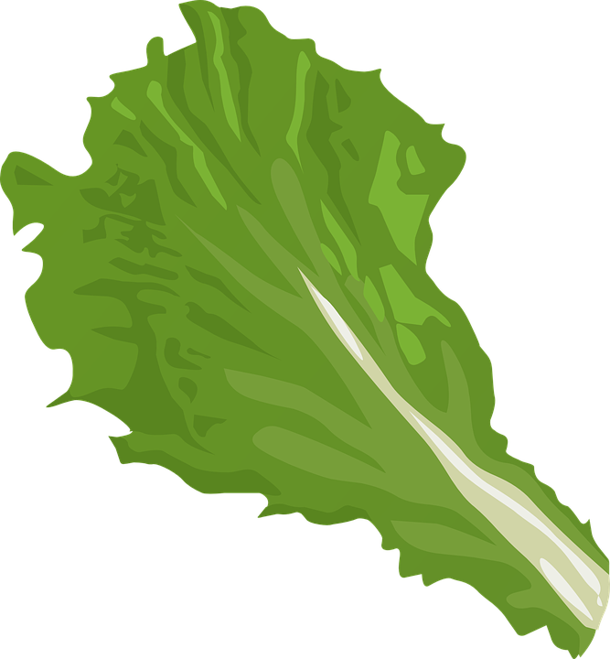
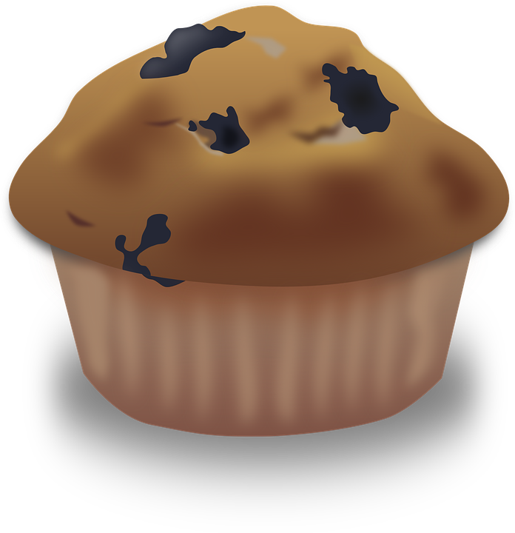
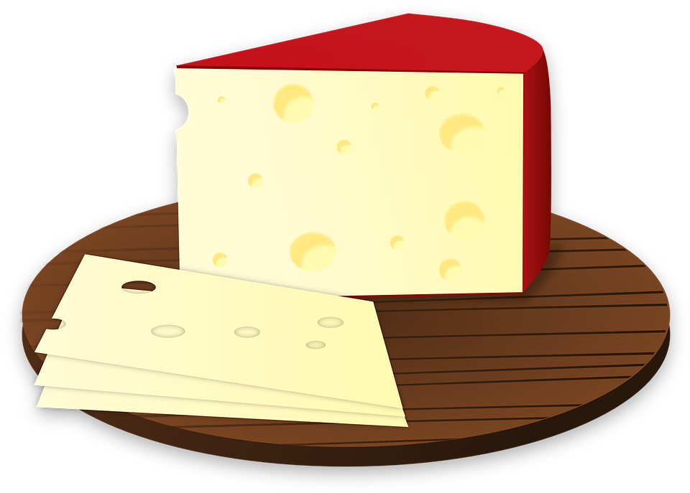

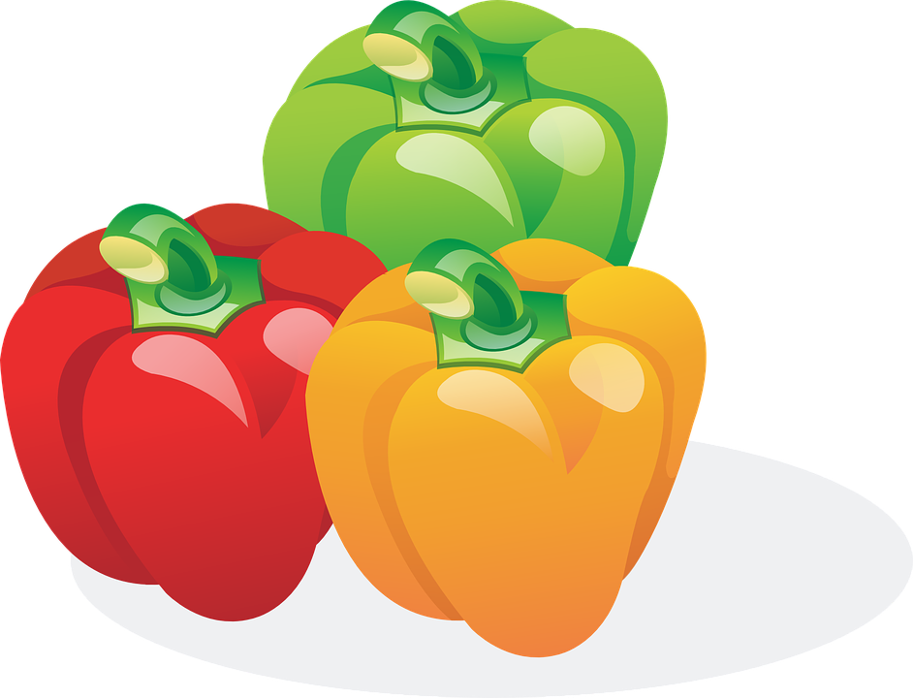
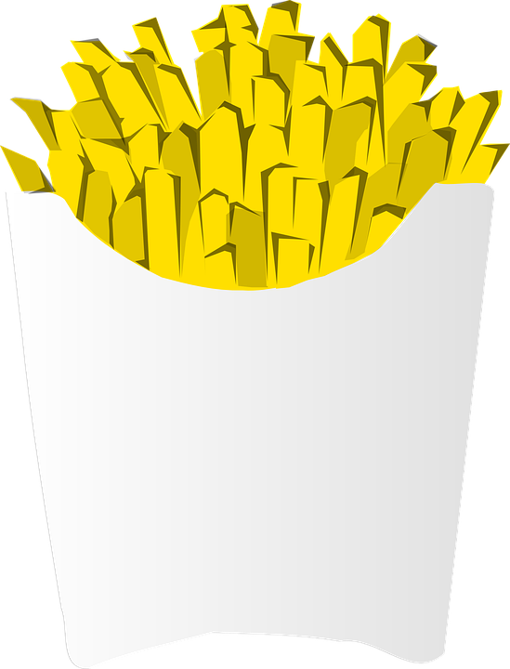


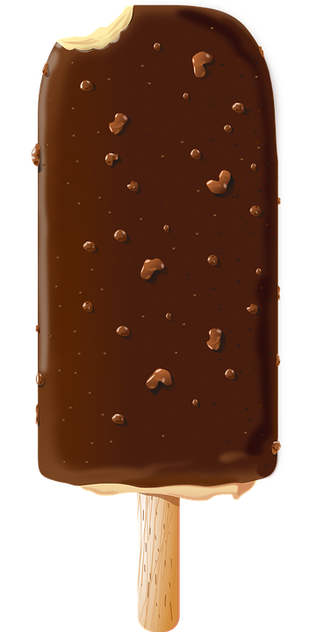

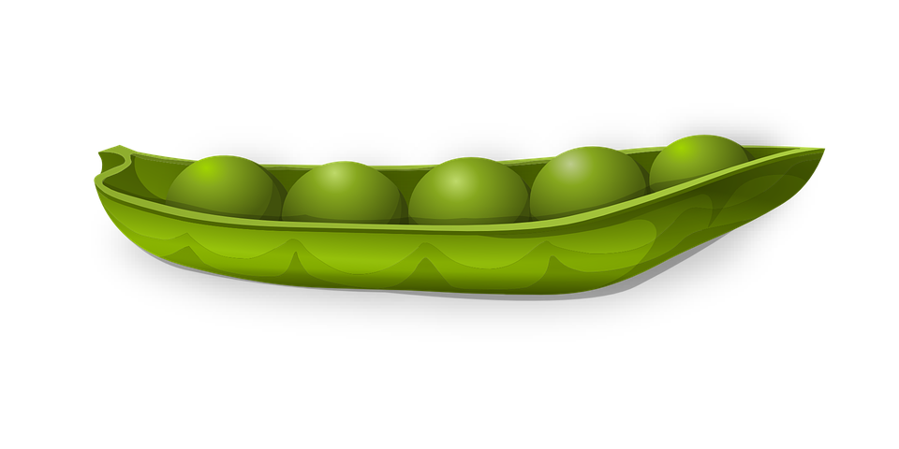
Circle all unhealthy food
Notes:
Explain what “desserts” means (a sweet course usually served at the end of a meal) and junk food (food that has low nutritional value, typically produced in the form of packaged snacks needing little or no preparation). Have students circle the unhealthy food. Then, go over each of the foods and give the English word for each graphic.

Slide 22

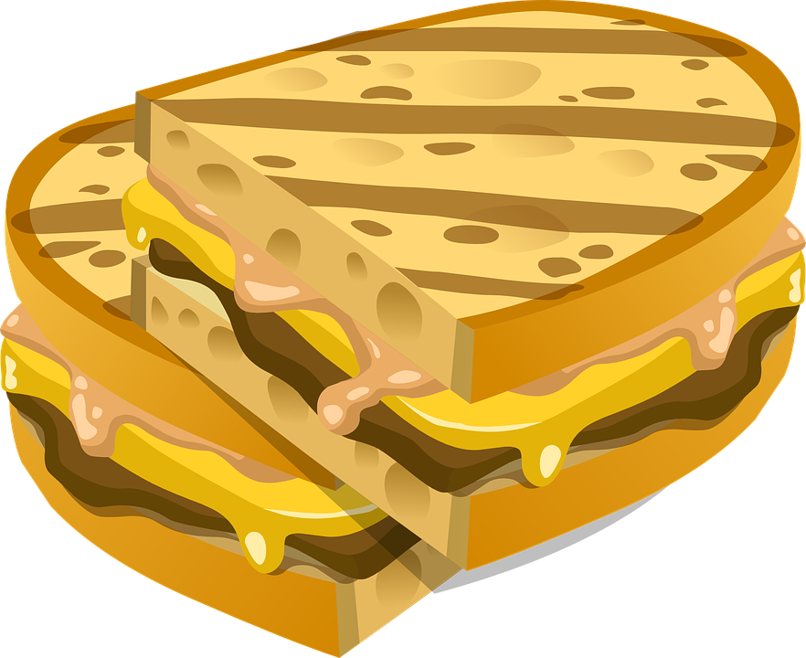
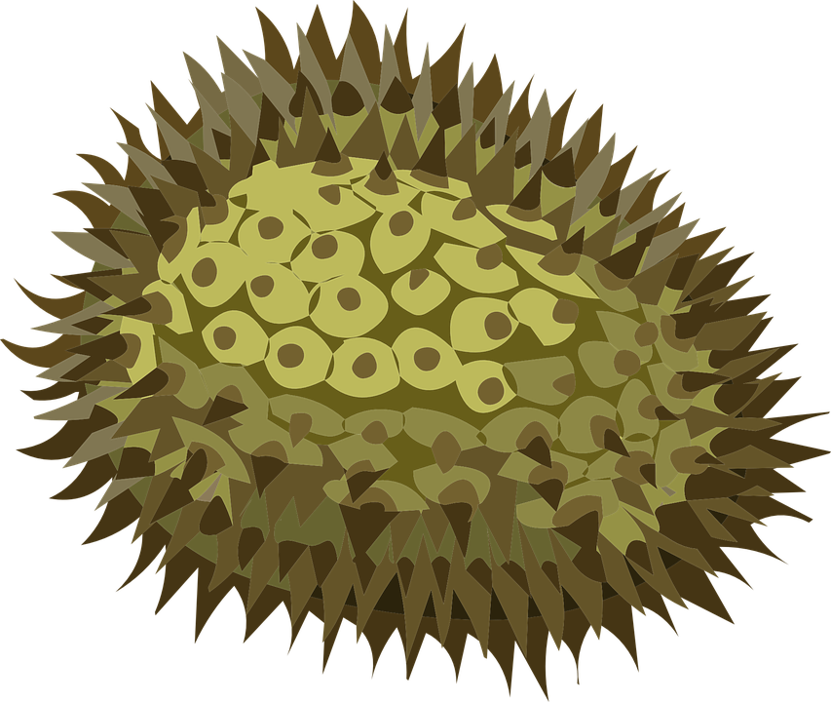


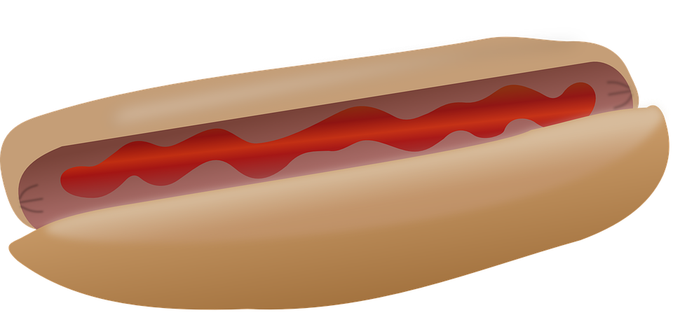
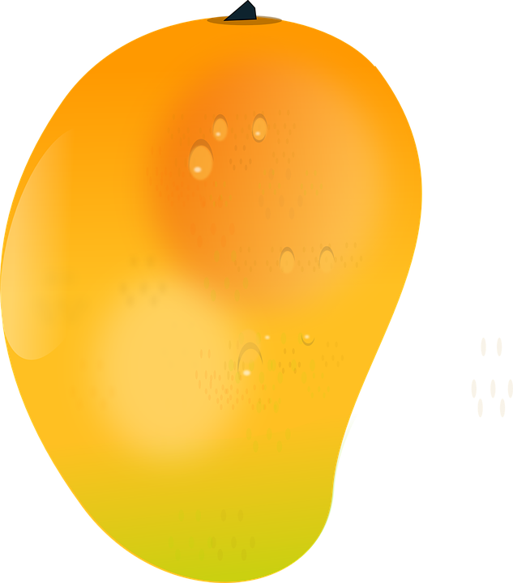
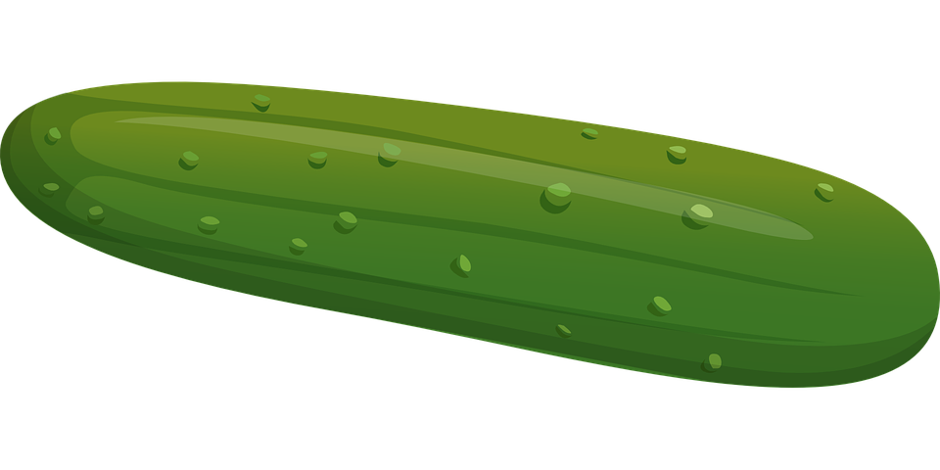
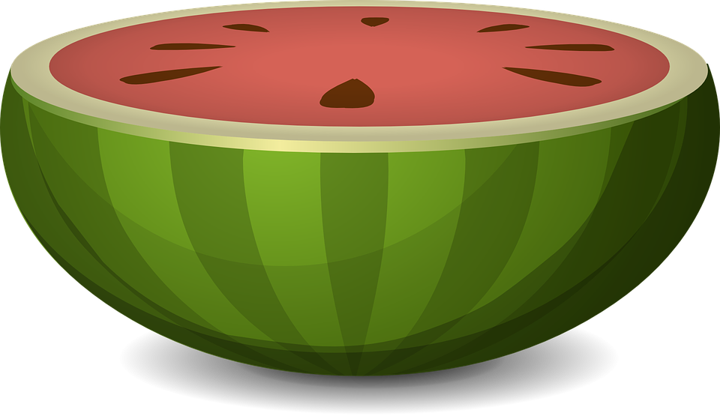
Circle all the fruits
Notes:
Explain what “fruits” means (a sweet product of a tree or other plant that can be eaten as food). Have students circle the fruits. Then, go over each of the foods and give the English word for each graphic.

Slide 23



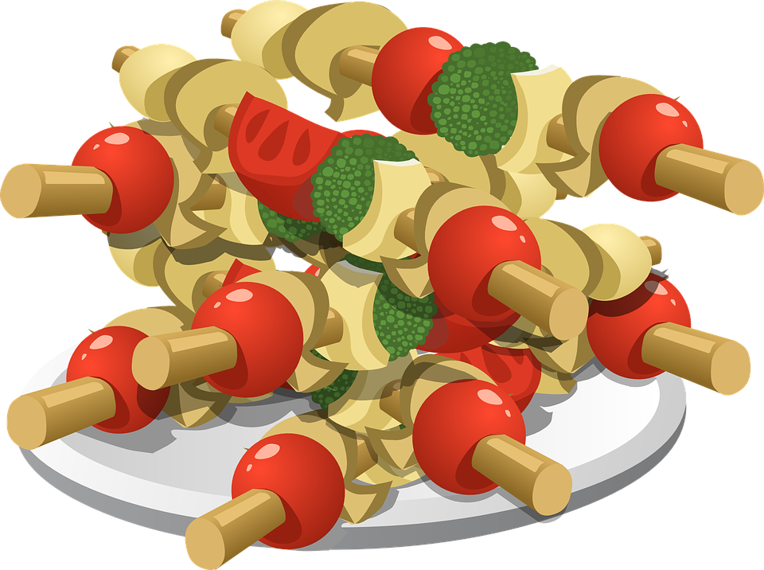
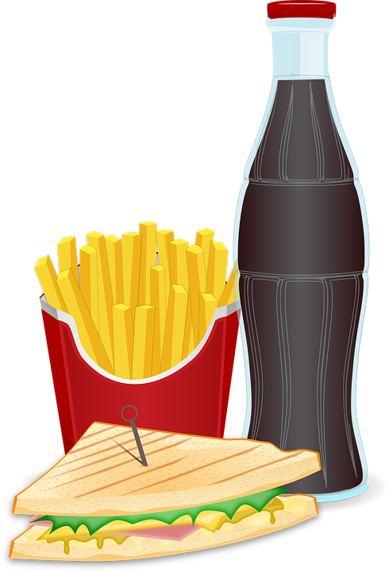
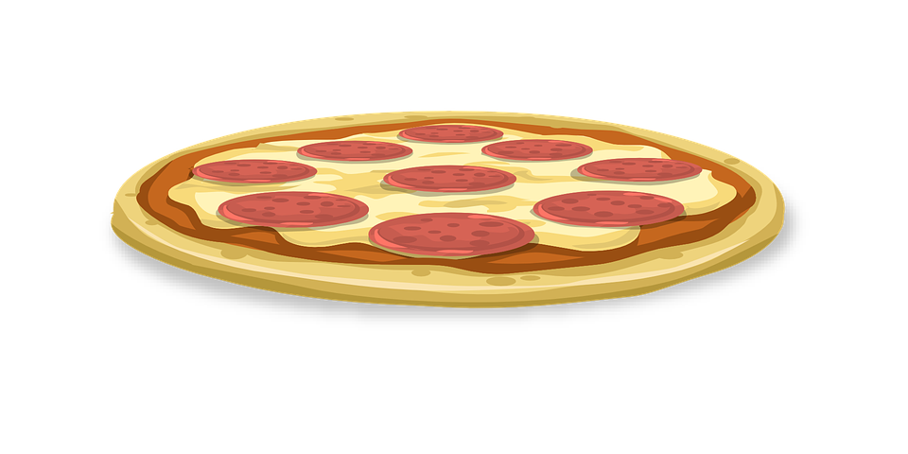
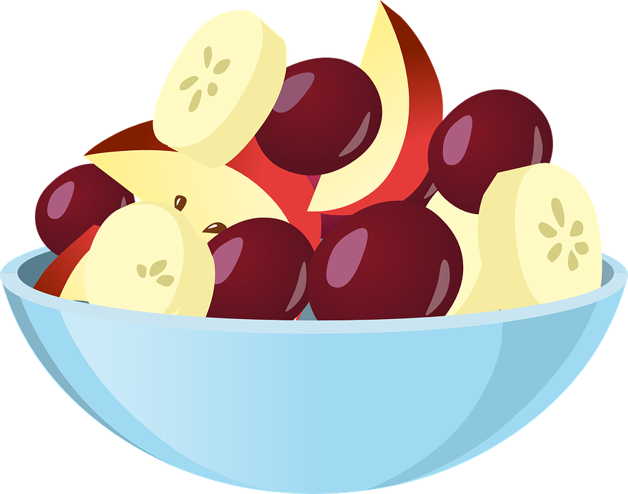
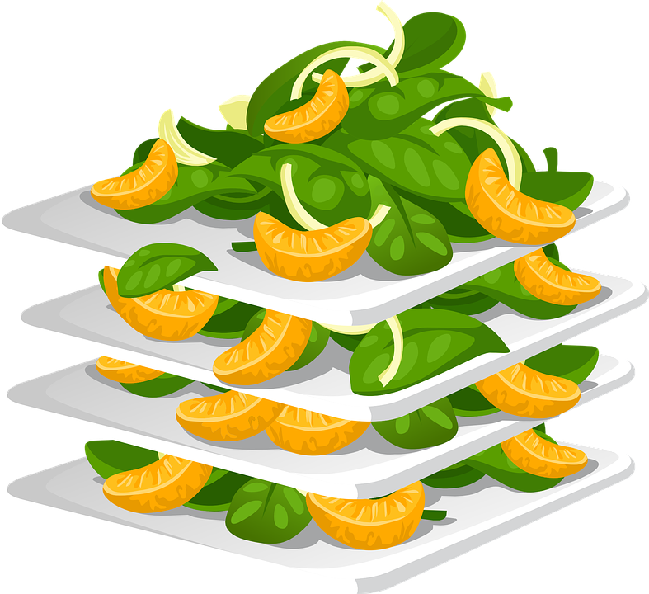

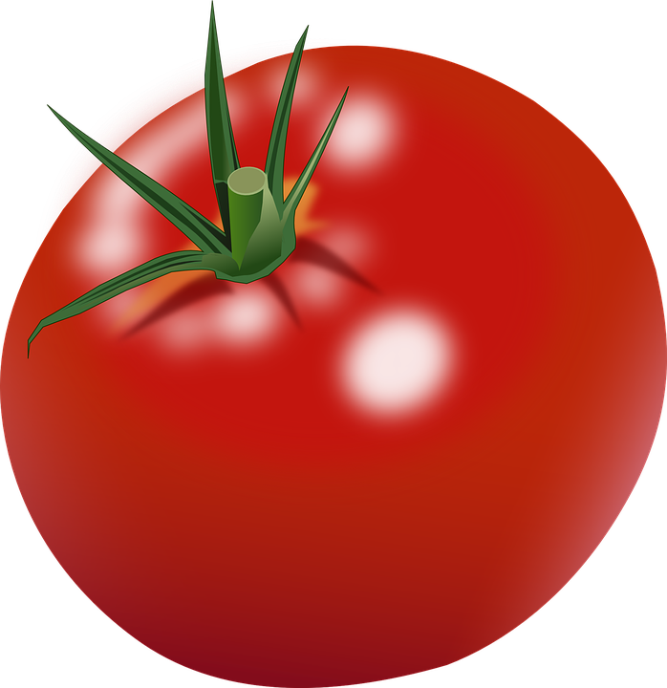
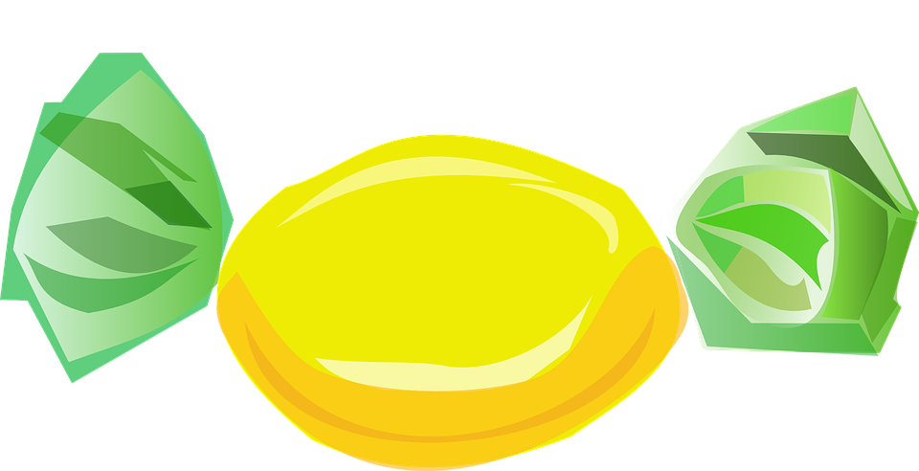
Circle all the healthy food
Notes:
Explain what “healthy eating” means (foods that are good for you including fresh fruits and vegetables, whole grains). Emphasize the importance of healthy choices and eating natural foods. Have students circle the healthy food. Then, go over each of the foods and give the English word for each graphic.

Slide 24

What did I learn today?
How to pronounce the SH sound
How to find and use “and”, capital letters, a period and compound sentences
New food vocabulary

Slide 25
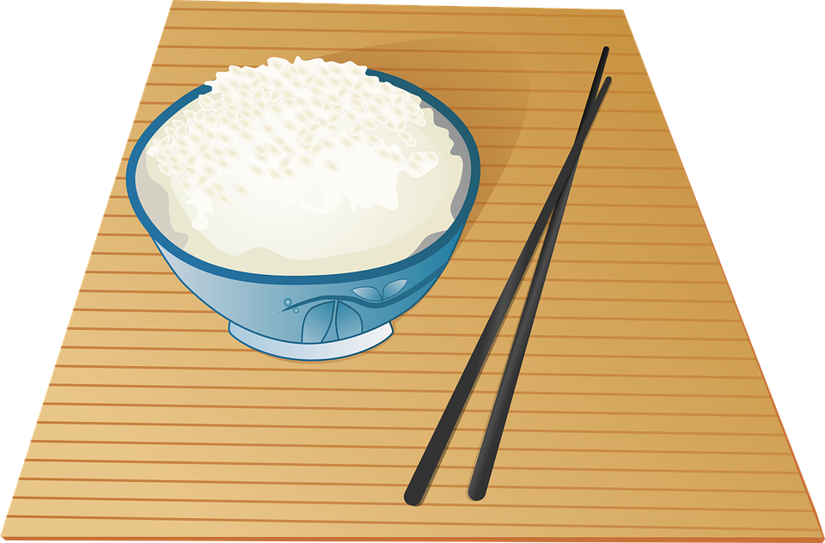
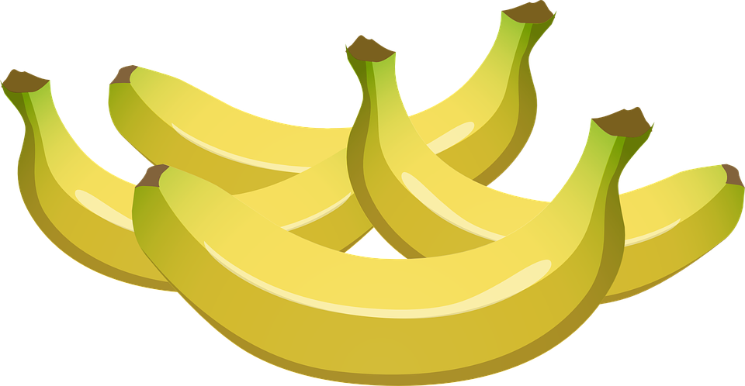
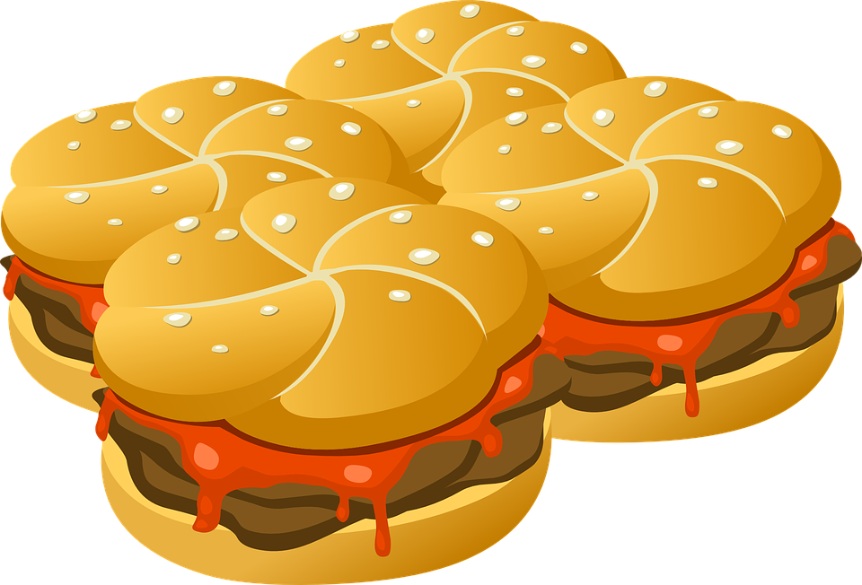
Homework
What is your favourite food? Save a photo you find online of this food.
Write down 5 adjectives about this food, and share it with the class.
Write 4 sentences about why it is your favourite food, and share it with the class.
Notes:
Go through the individual questions, and answer each to model answers for the students. Pose the question to each student. Remind students that adjectives are describing words for nouns for question. Ask students to write down the answers before the next class.

