Slide 1
Lesson 1: Tutoring FOOD

Slide 2
Watch this video for review

Slide 3
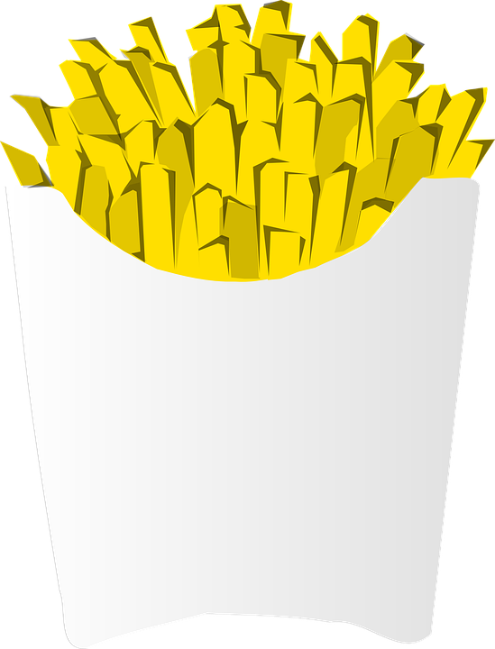
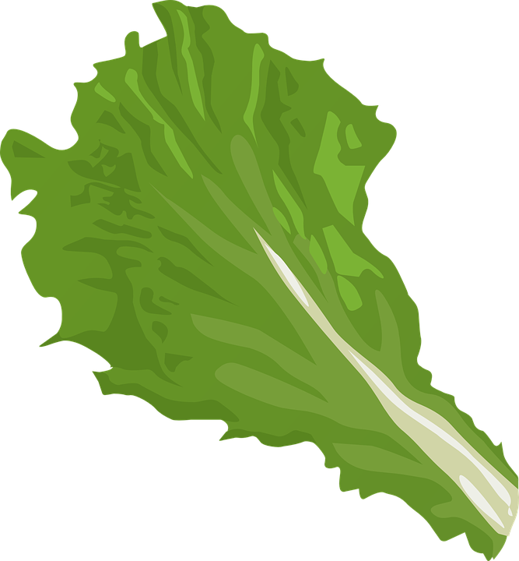
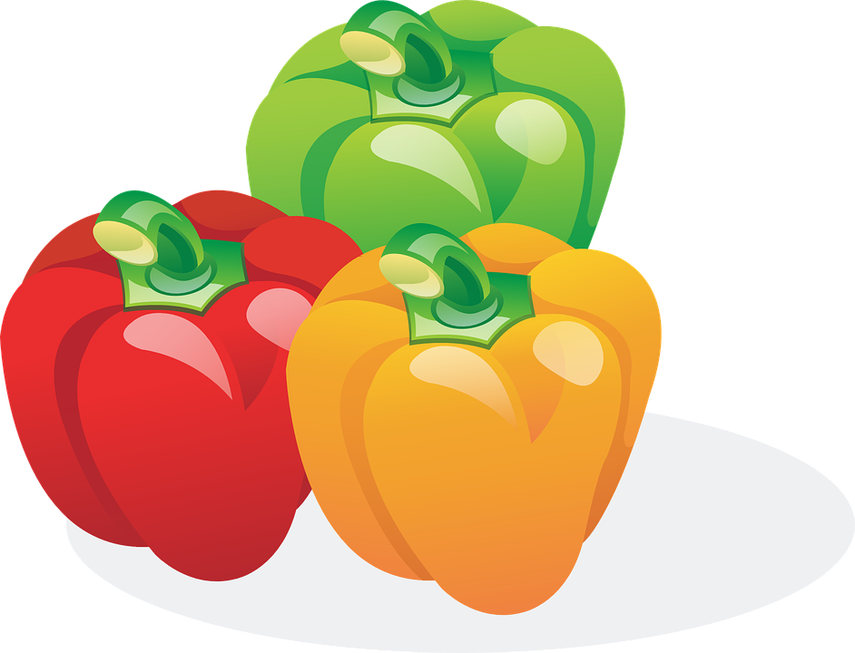
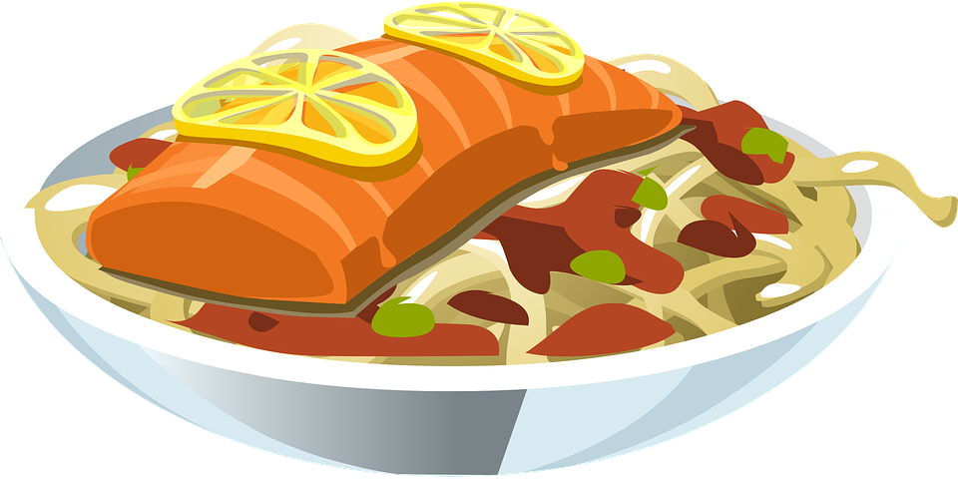
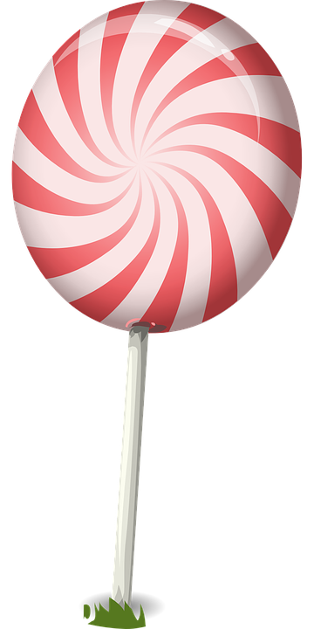
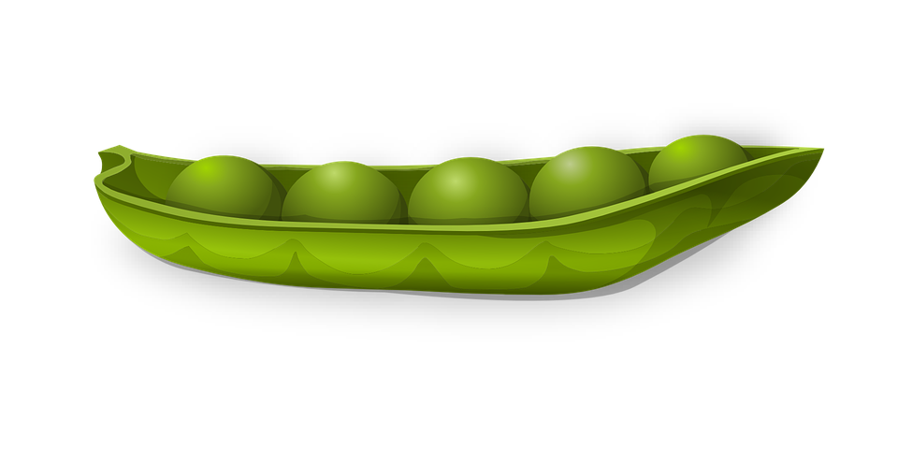
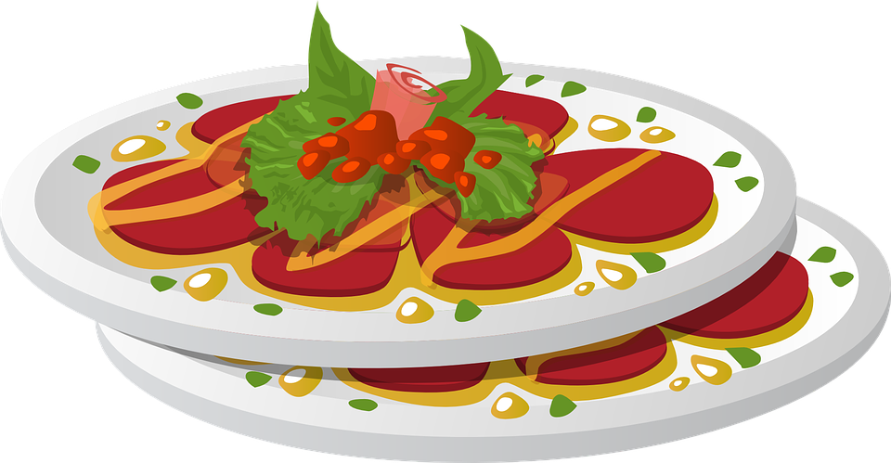
Circle all the vegetables
Notes:
Explain what “vegetables” means (part of a plant that is consumed by humans as food). Have students circle the vegetables. Then, go over each of the foods and give the English word for each graphic.

Slide 4
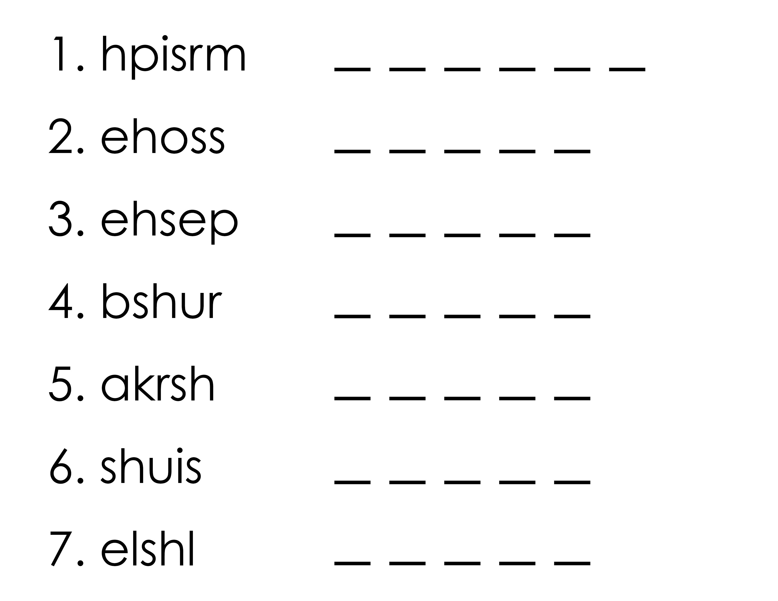
Unscramble the food vocabulary from the lesson
Notes:
Shrimp
Shoes
Sheep
Brush
Shark
Sushi
Shell

Slide 5
Practice “and”
Add “and” and a comma to make the sentences a compound sentence.
The weather is very bad. He went out for a walk to get snacks.
She finishes her homework. She is studying for a test.
I lost my wallet. I can‘t buy lunch.
Tom is tired. He needs to sleep.
Notes:
Read each statement. Remind the students when “and” is required. Alternate between each student for the questions. Do the first question.

Slide 6
Now you practice capitalization
my family is in spain.
we finish school in june.
i learned to speak english in school.
on wednesday i have basketball practice.
i am at the zoo.
i learned to bike when i was young.
my birthday is in the month of june.
my family lives on gloria road.
Notes:
Read each statement. Remind the students where and when capitals are required. Alternate between each student for the questions.

Slide 7
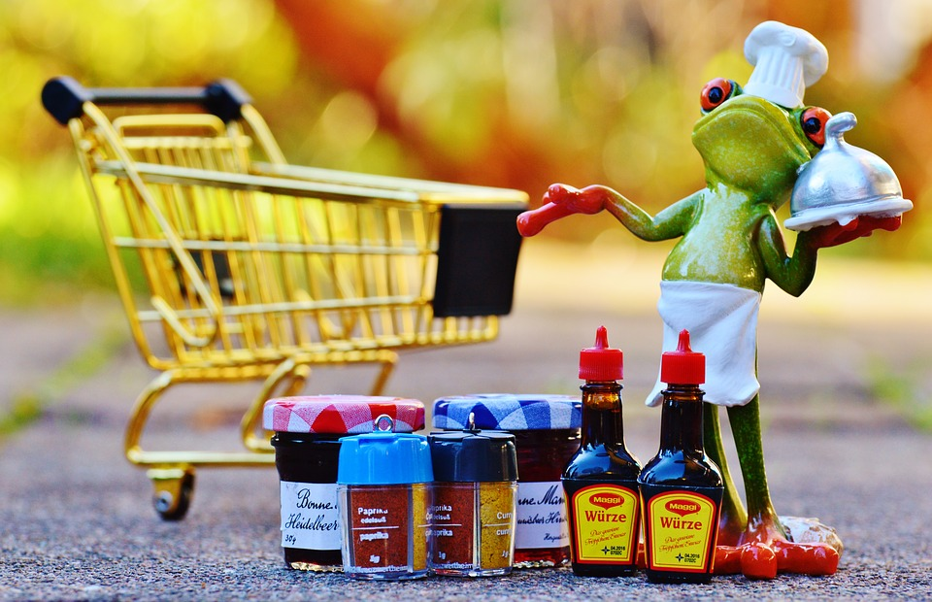
Let’s write some sequence captions

Slide 8
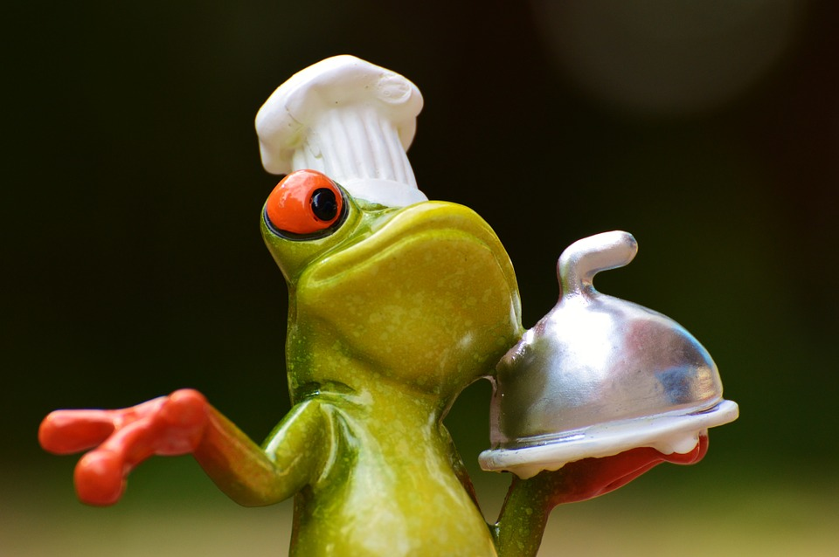
What’s the frog doing now?

Slide 9
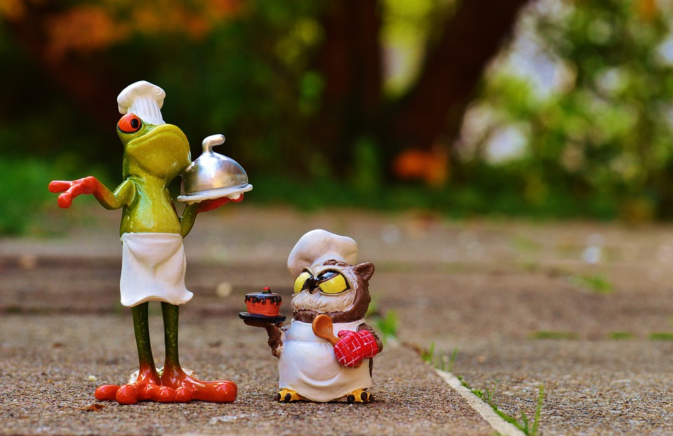
What are they talking about?

Slide 10
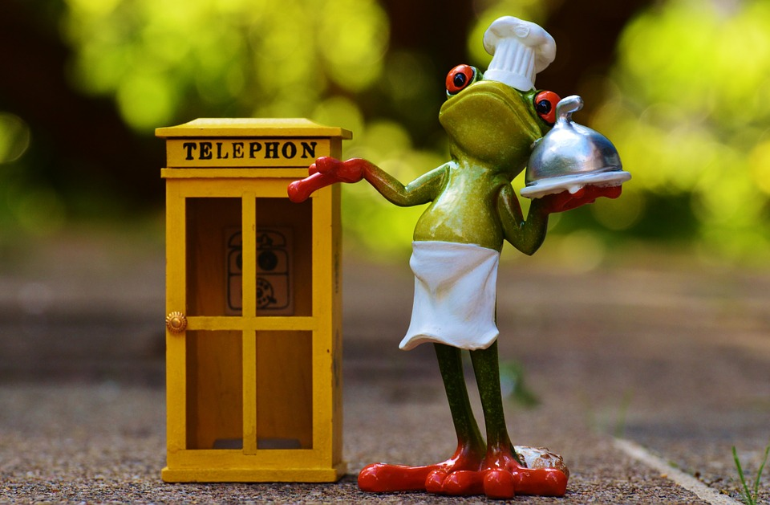
Who is he going to call?

Slide 11
Here is a song
Notes:
Play SH song file

Slide 12
You practiced:
The SH sound
Using “and”, identifying capital letters, a period and compound sentences
Finding vegetables
Telling a story

