Slide 1
Lesson 10 FOOD

Slide 2
What we will learn today
The ‘ur’ sound
Pronouncing ‘ur’ words
Compound words
Reading poems
Singing songs
Notes:
Go over the learning goals.

Slide 3
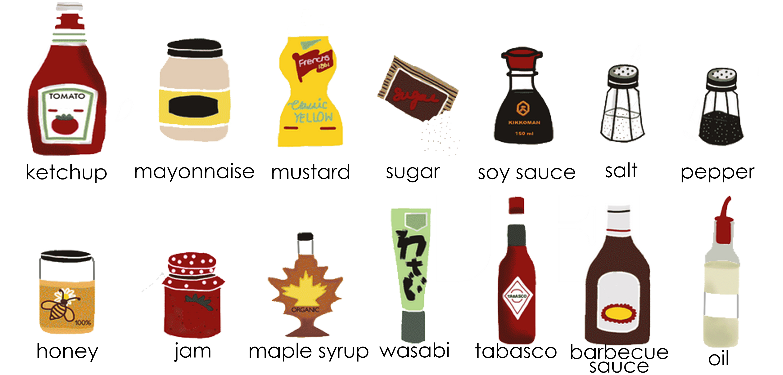
Homework
Notes:
Take up the homework, and go through each condiment. Talk about what these condiments are used for (i.e. maple syrup on pancakes).

Slide 4
The UR Sound
Notes:
To make this sound, the corners of the lips come in, pushing the lips away from the face. The middle part of the tongue lifts towards the roof of the mouth in the middle. The front of the tongue hangs down, but it’s drawn back a bit. So, it’s not touching anything.
As the tongue lifts in the middle, it may be close to the roof of the mouth without touching it, or it may touch the sides of the roof of the mouth, or the insides or bottom of the top teeth. Demonstrate the sound for the students and have them repeat.

Slide 5
Let’s practice pronouncing the “ur” sound
Notes:
Say each word, articulating it clearly. Then say the word again, in a more natural way. Read the sentence accompanying the word. Instruct the students to repeat the word, chorally and then individually. Then, instruct the students to repeat each sentence, chorally and then individually.

Slide 6
Let’s practice pronouncing the “ur” sound
Notes:
Say each word, articulating it clearly. Then say the word again, in a more natural way. Read the sentence accompanying the word. Instruct the students to repeat the word, chorally and then individually. Then, instruct the students to repeat each sentence, chorally and then individually.

Slide 7
How do you eat your eggs?
Notes:
Play “Around The World In 20 Eggs.mp4”
Make sure to pause video for discussion.
Follow up questions: Do you like eggs? How do you eat your eggs? Why do you think eggs are so popular in the world? What is so good about eggs? Do you know how often chickens produce eggs? Do you think people eat eggs all over the world?

Slide 8
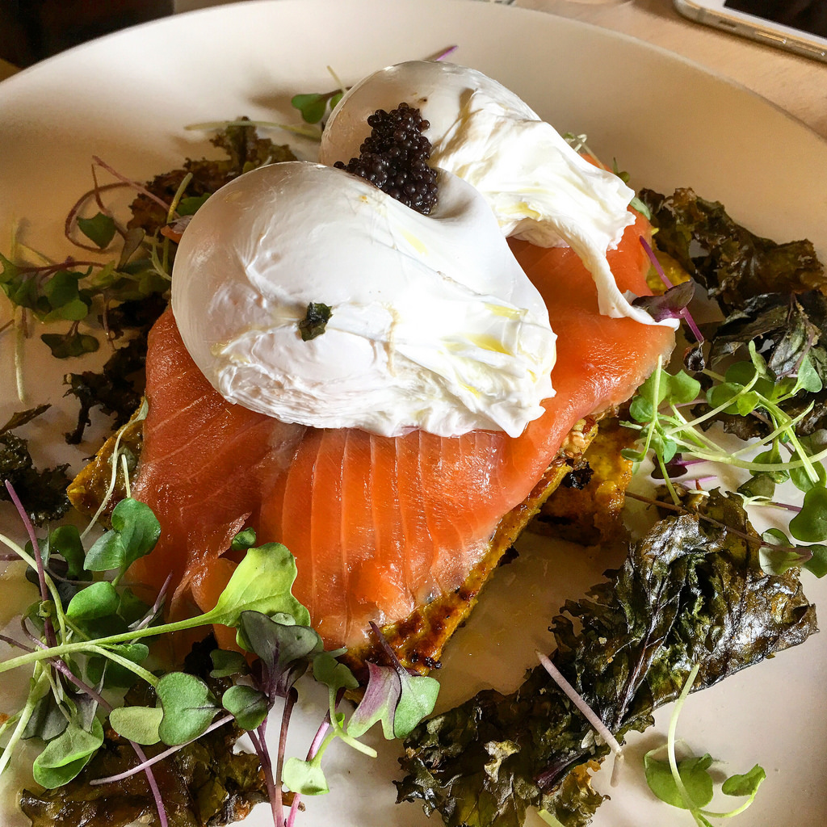
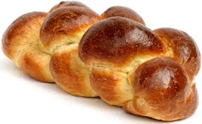
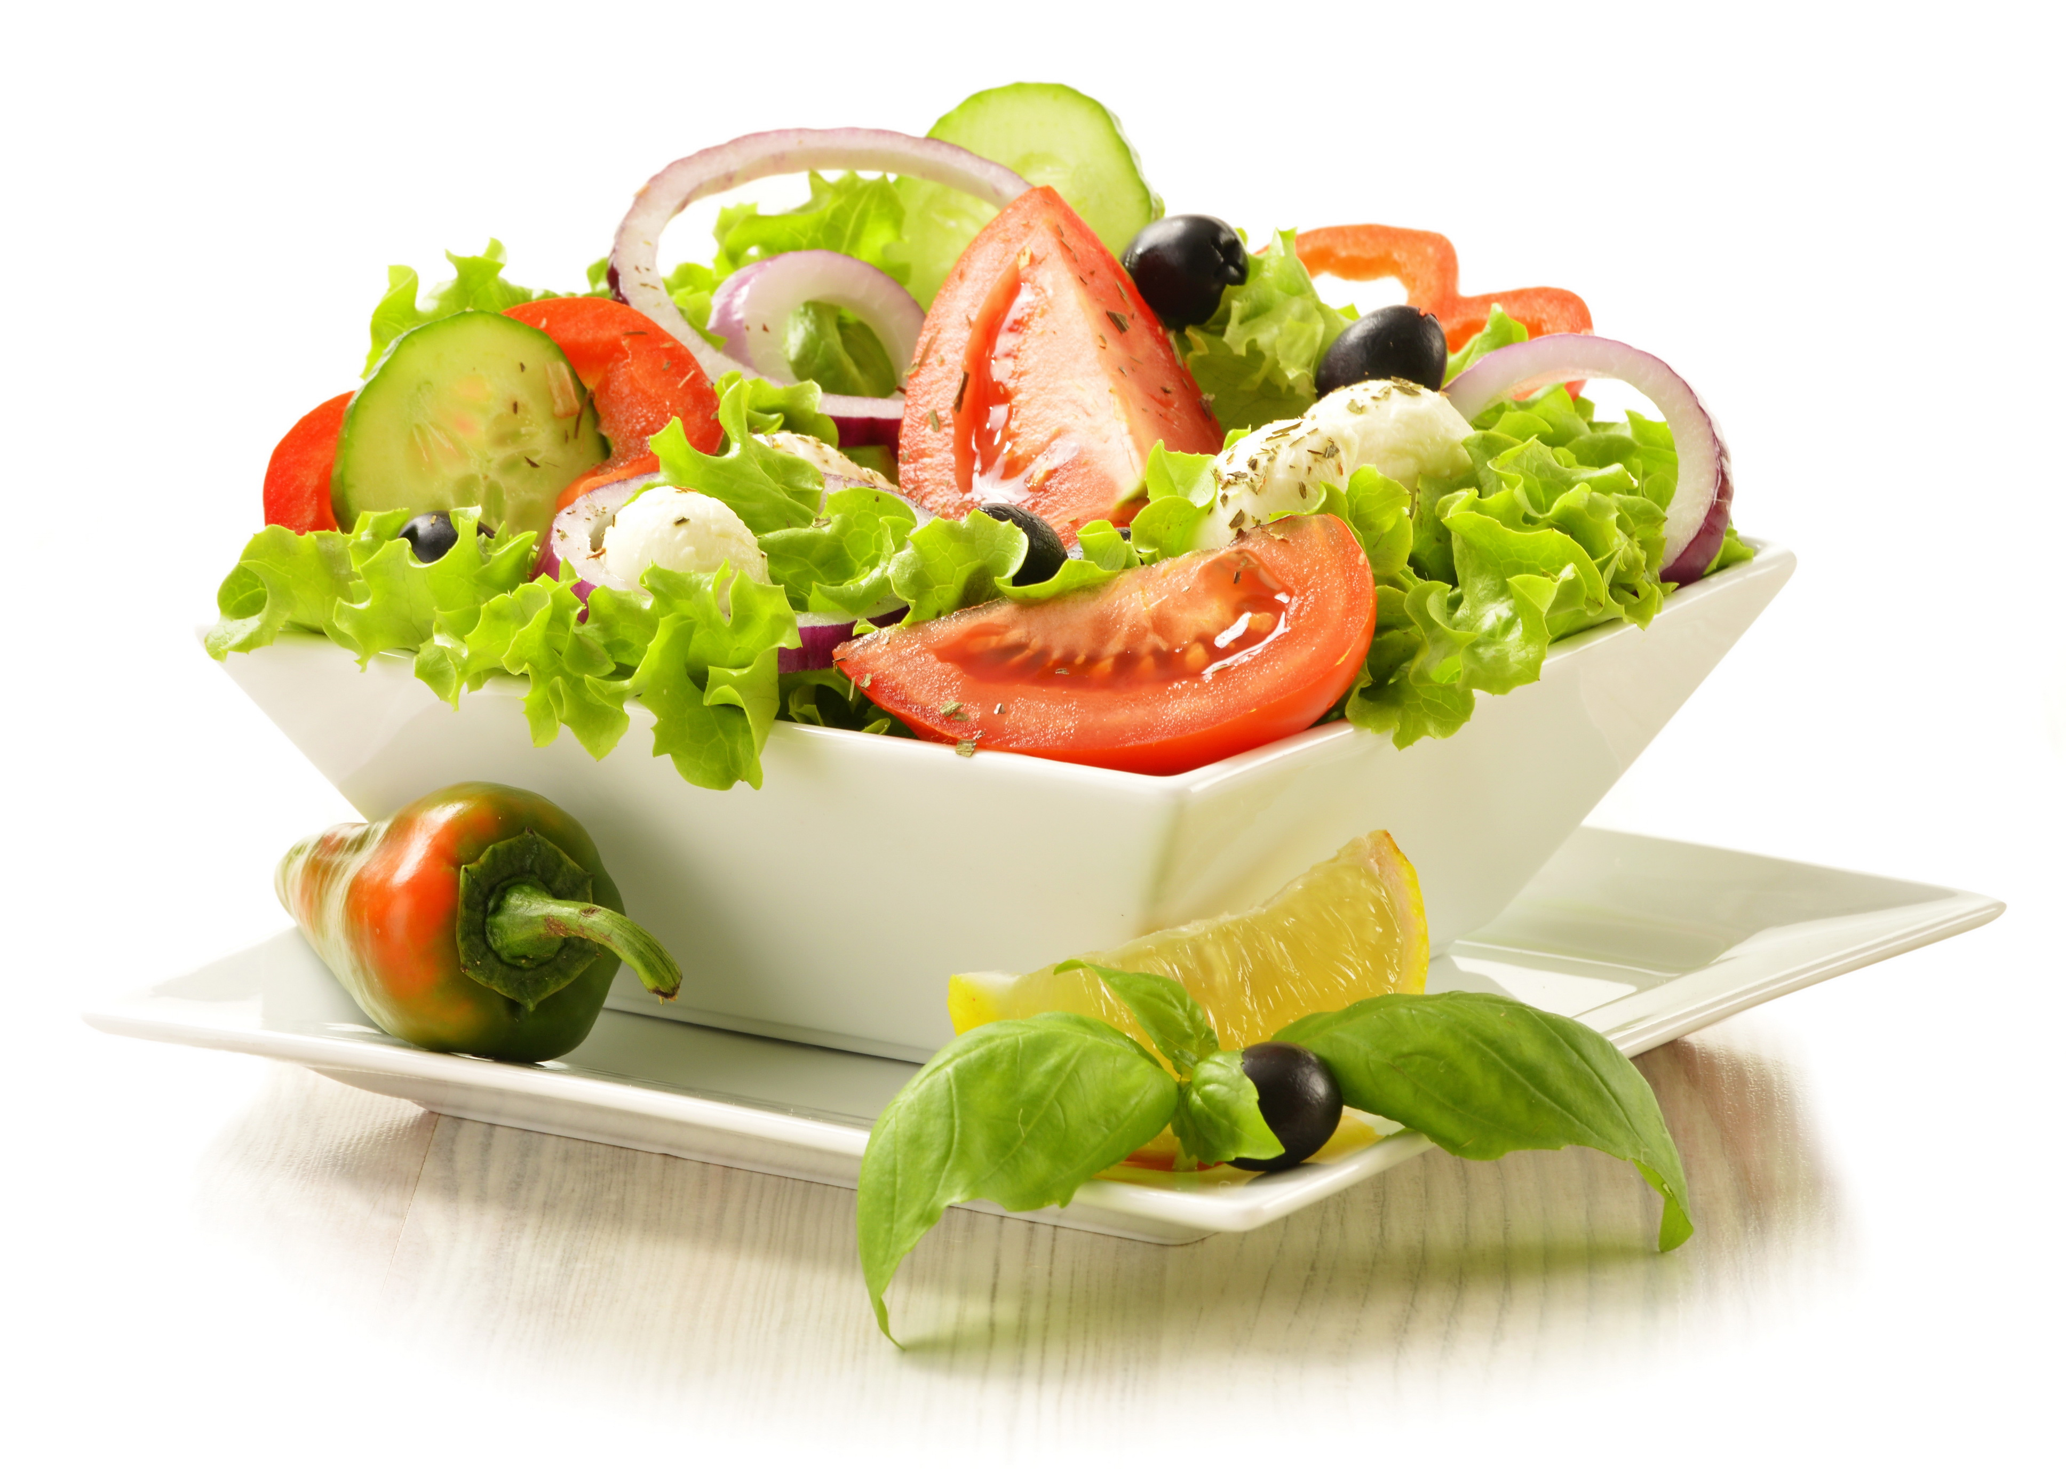
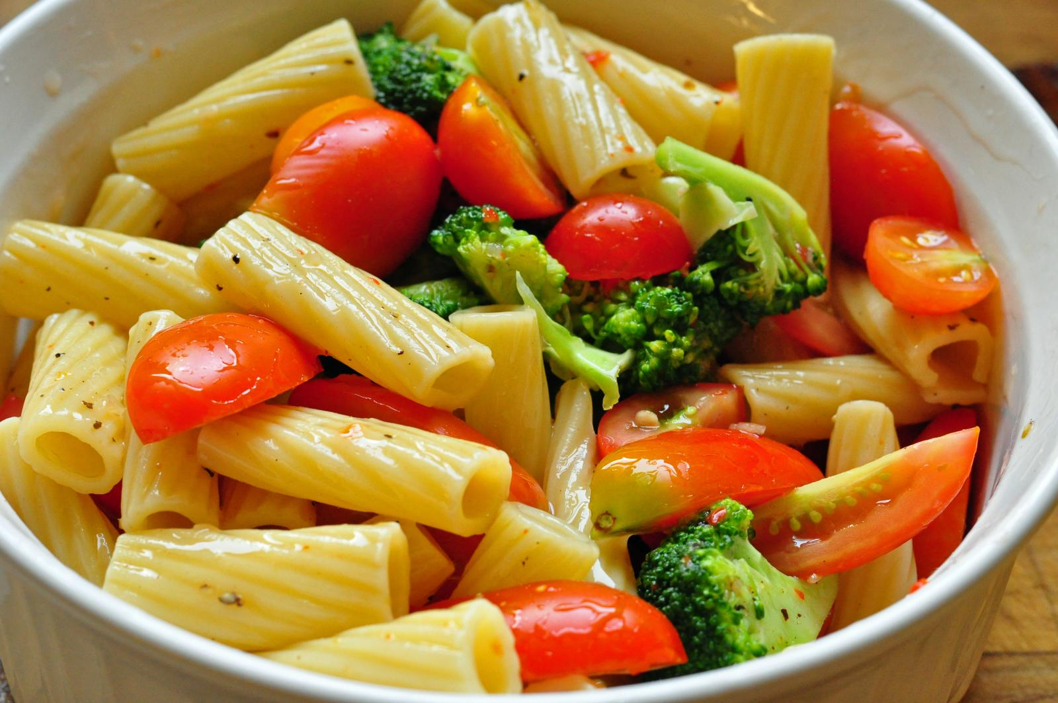
Which of these foods uses eggs?
Notes:
Salmon poached eggs
Egg bread
Egg drop soup

Slide 9
Compound nouns
A compound noun is a noun made up of two or more words.
bed + room = bedroom
Notes:
Explain slide

Slide 10
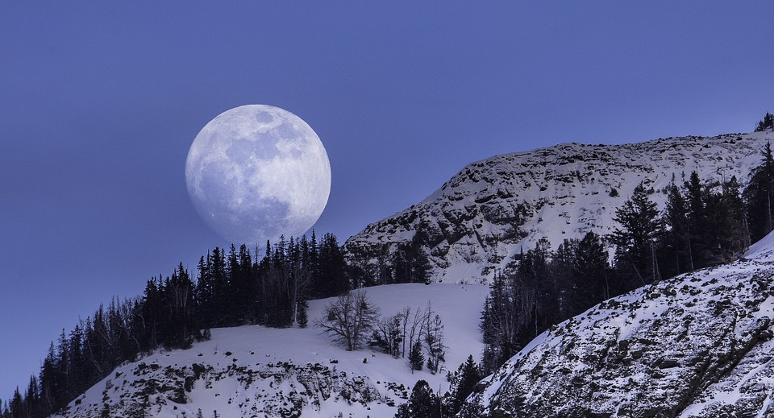
coffee mug
full moon
Notes:
Read each example. Explain the meaning of both words.

Slide 11
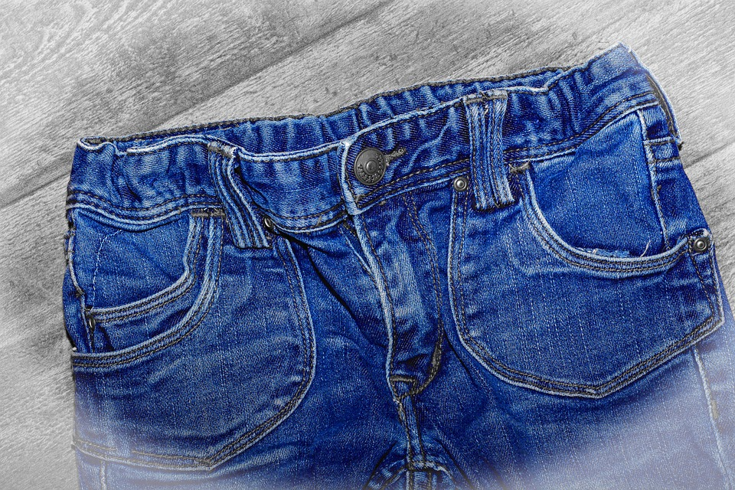
hair cut
blue jeans
Notes:
Read each example. Explain the meaning of both words.

Slide 12
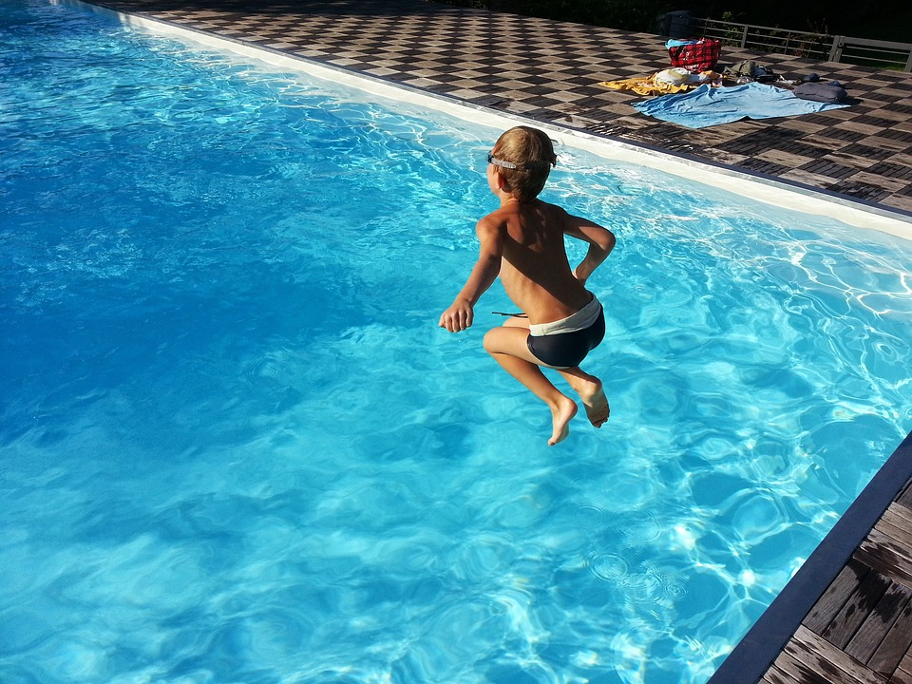
living room
swimming pool
Notes:
Read each example. Explain the meaning of both words.

Slide 13
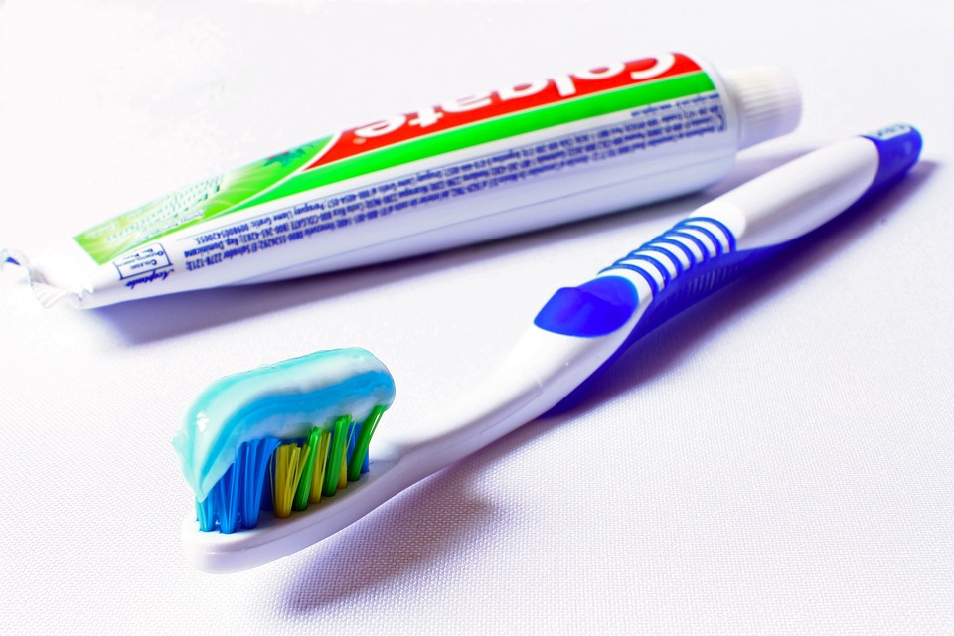
toothpaste
toothbrush
Notes:
Read each example. Explain the meaning of both words.

Slide 14
Can you find any of these compound words in your house?
Go look for it! Bring it back to show the class if possible.

Slide 15
I’m a Little Teapot
I'm a little teapot
Short and stout
Here is my handle
Here is my spout
When I get all steamed up
I just shout
Tip me over and pour me out
I am a very special pot
It is true
Here is an example of what I can do
I can turn my handle into a spout
Tip me over and pour me out
Notes:
Play “I’m a Little Tea Pot.mp4”

Slide 16
Perform!
Choose one of the following poems or songs. For lesson 12, you will create a video of you singing the song or reading the poem.
Twinkle Twinkle Little Star
Black Socks
Mary Had a Little Lamb
Baa, Baa Black Sheep
The Wheels on the Bus
Notes:
Explain the portfolio piece to the students. Tell them if they can find an alternative English song or poem, they may choose that. Examples of the songs are in the “Songs” folder.

Slide 17
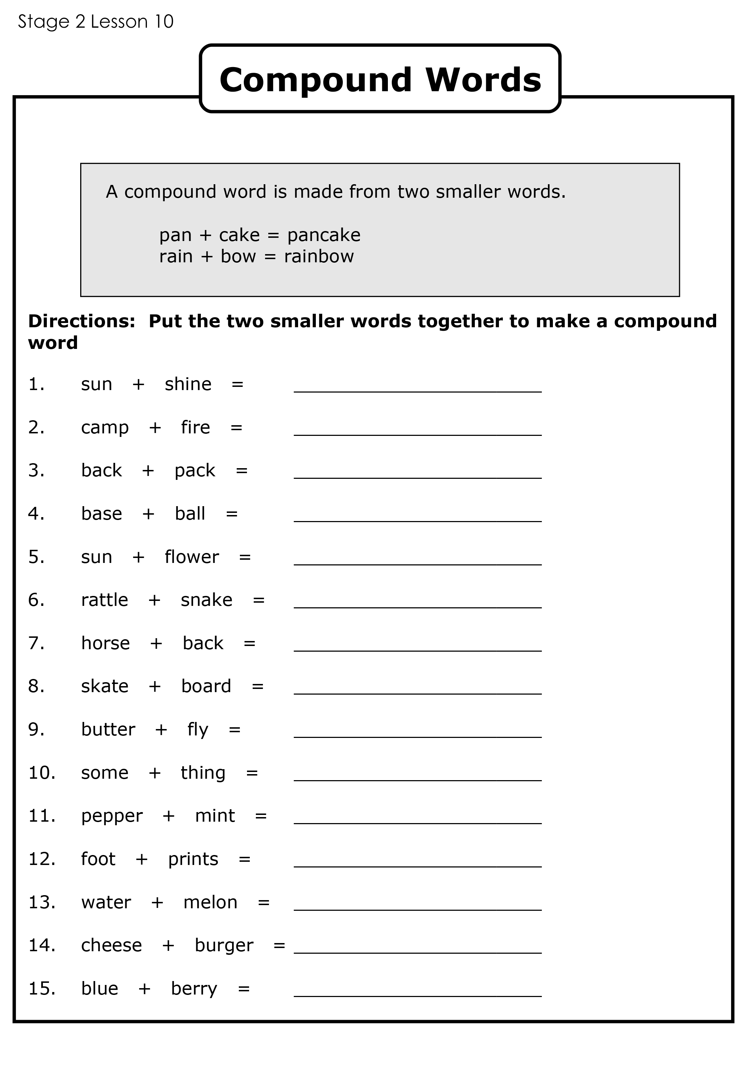
Compound nouns practice
Notes:
Get students to work on “Compound Nouns Worksheet.pdf”

Slide 18
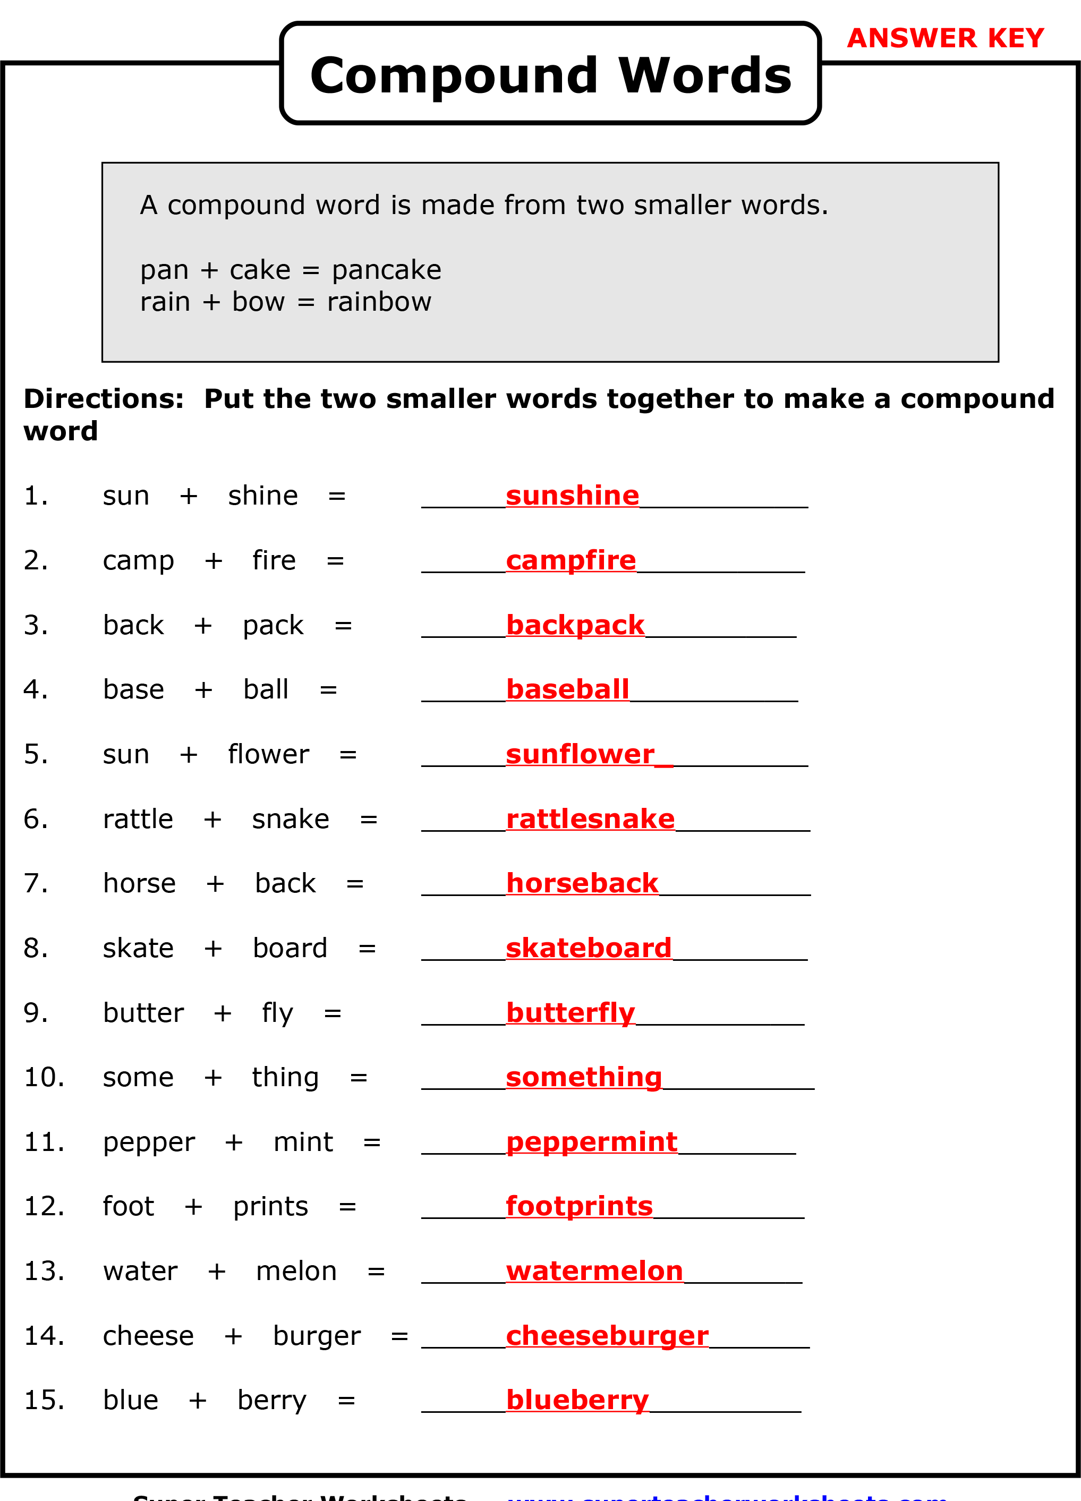
Answers
Notes:
Get students to work on “Compound Nouns Worksheet.pdf”

Slide 19
Notes:
Get students to draw a line from the word to the picture on their handout.

Slide 21
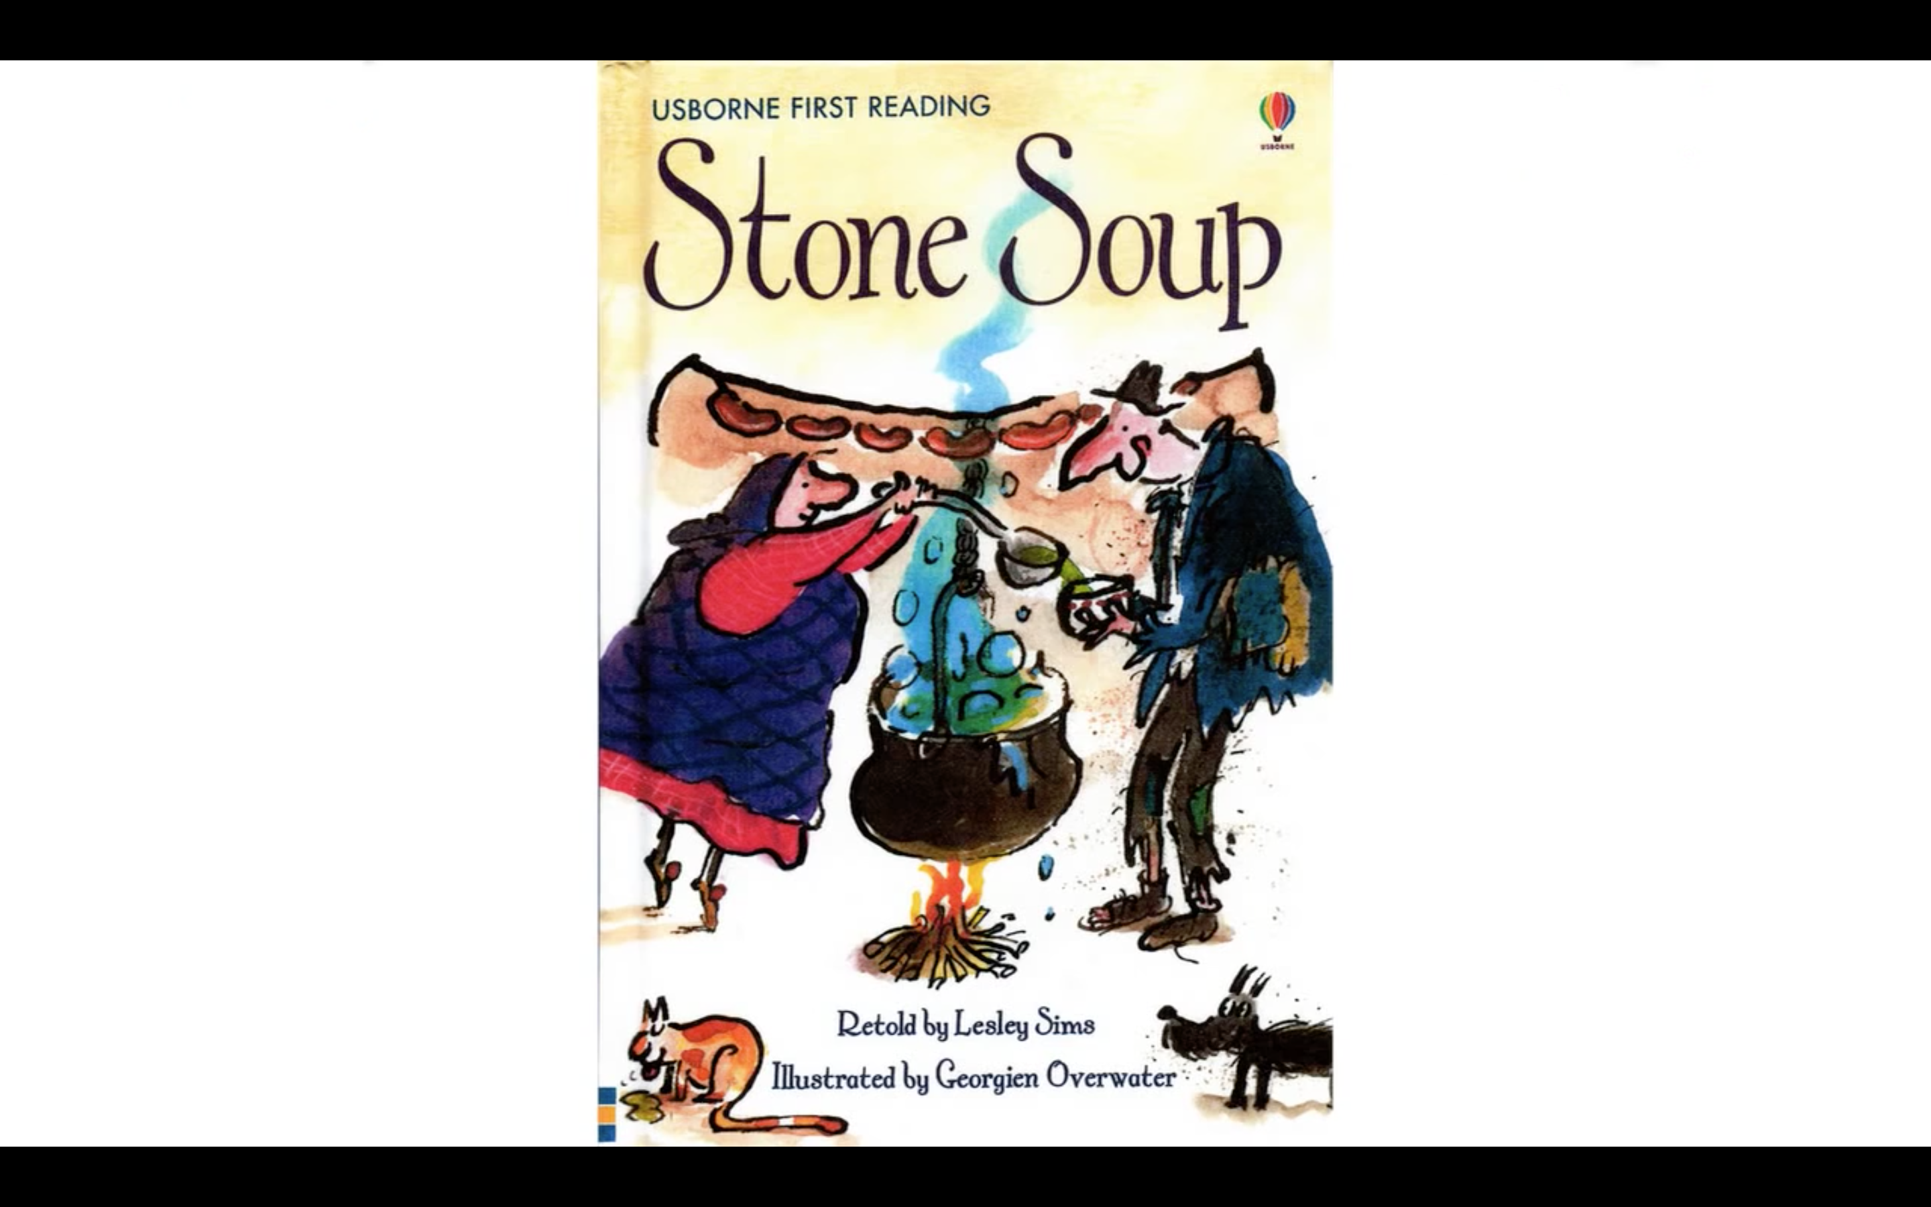

Slide 22
Notes:
Read each line and alternate between each student for an echo reading.

Slide 23
Notes:
Read each line and alternate between each student for an echo reading.

Slide 24
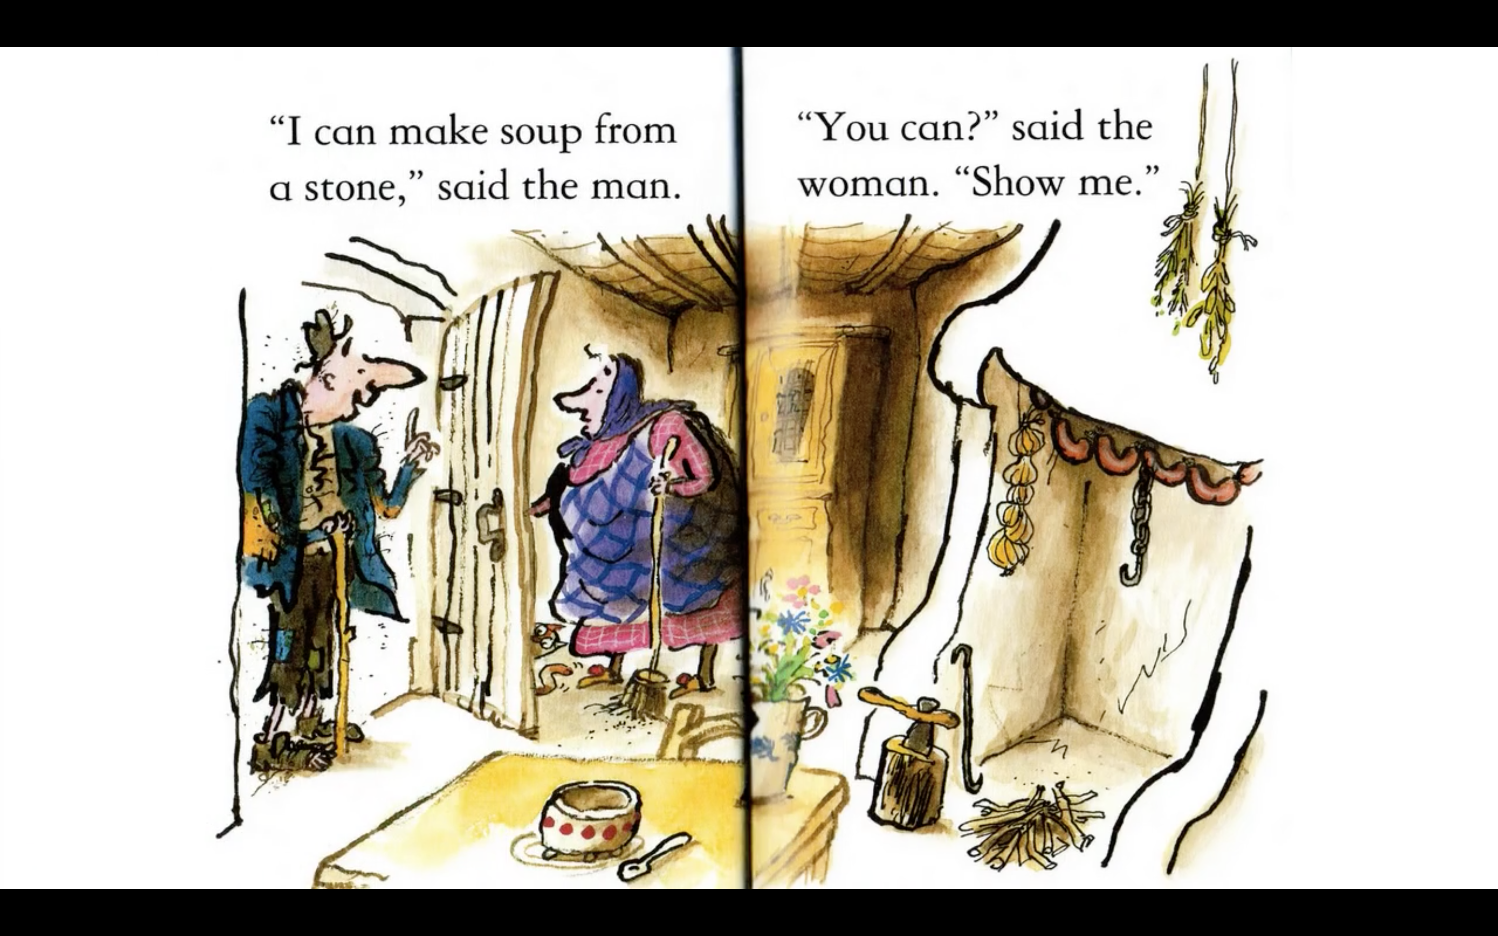
Notes:
Read each line and alternate between each student for an echo reading.

Slide 25
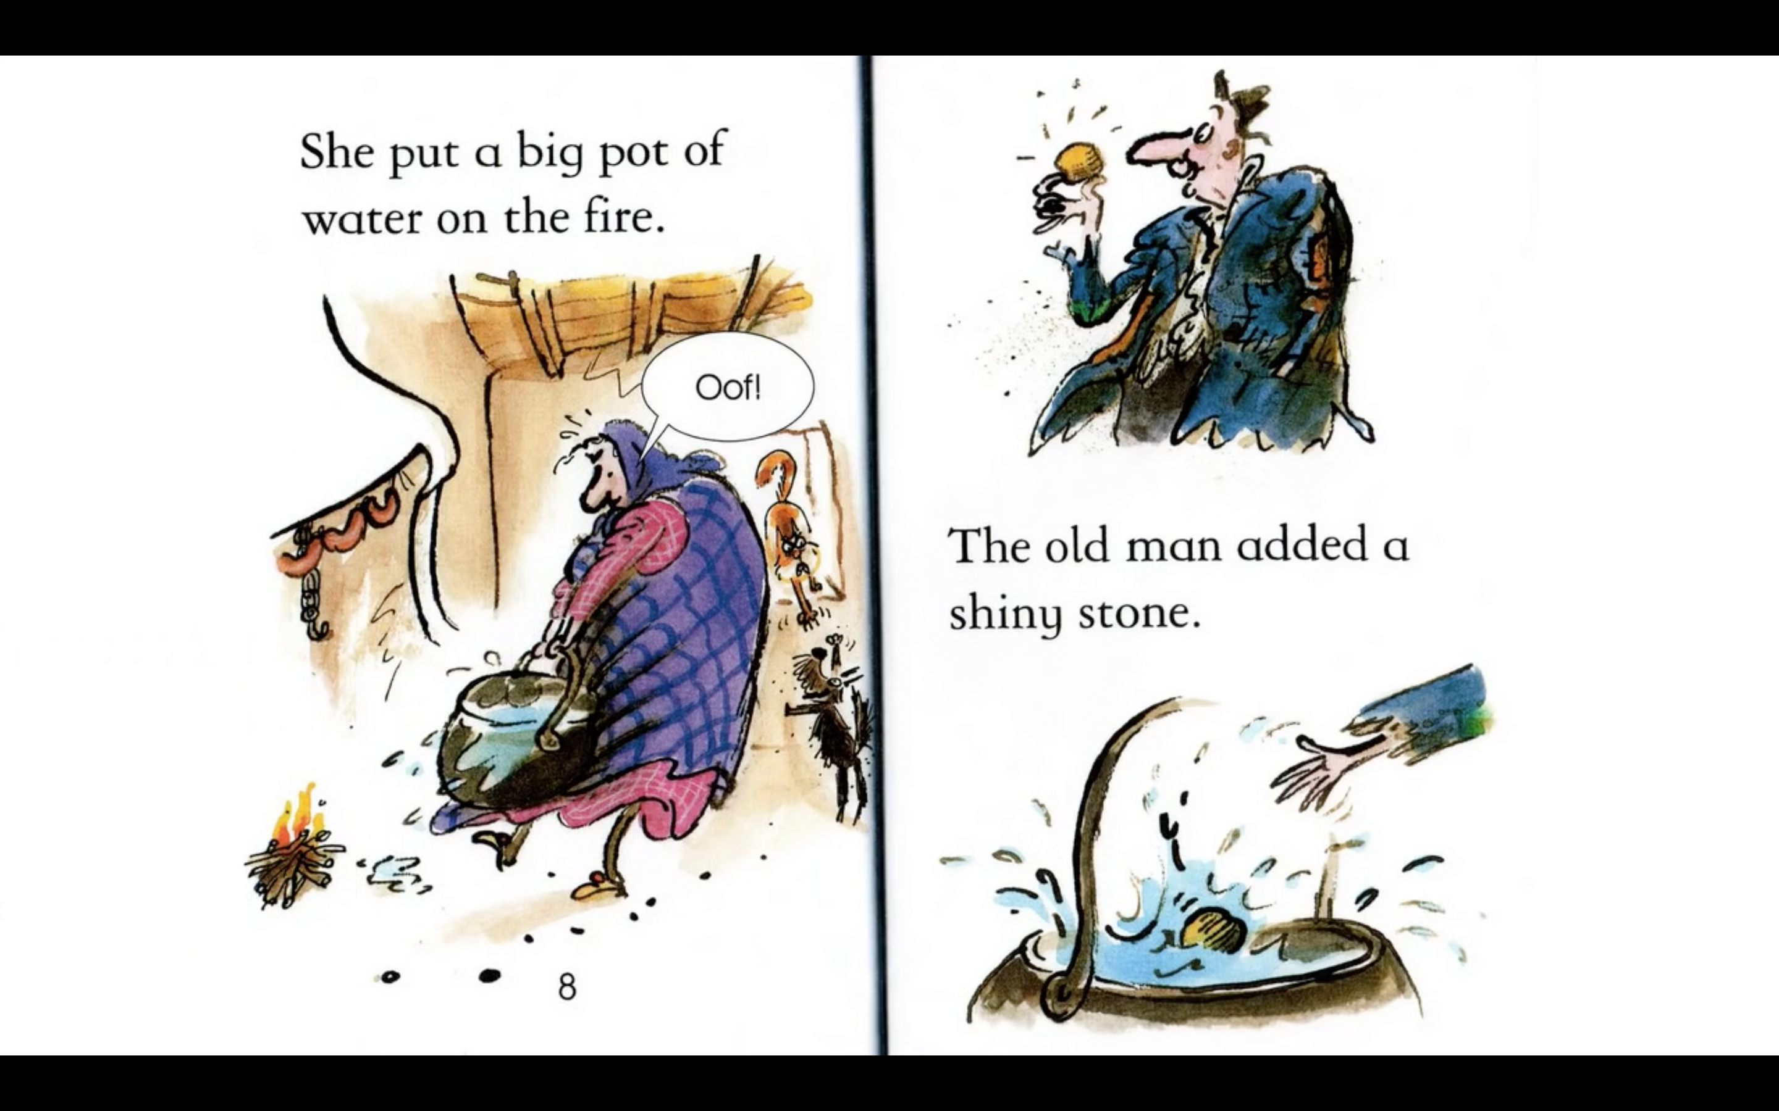
Notes:
Read each line and alternate between each student for an echo reading.

Slide 26
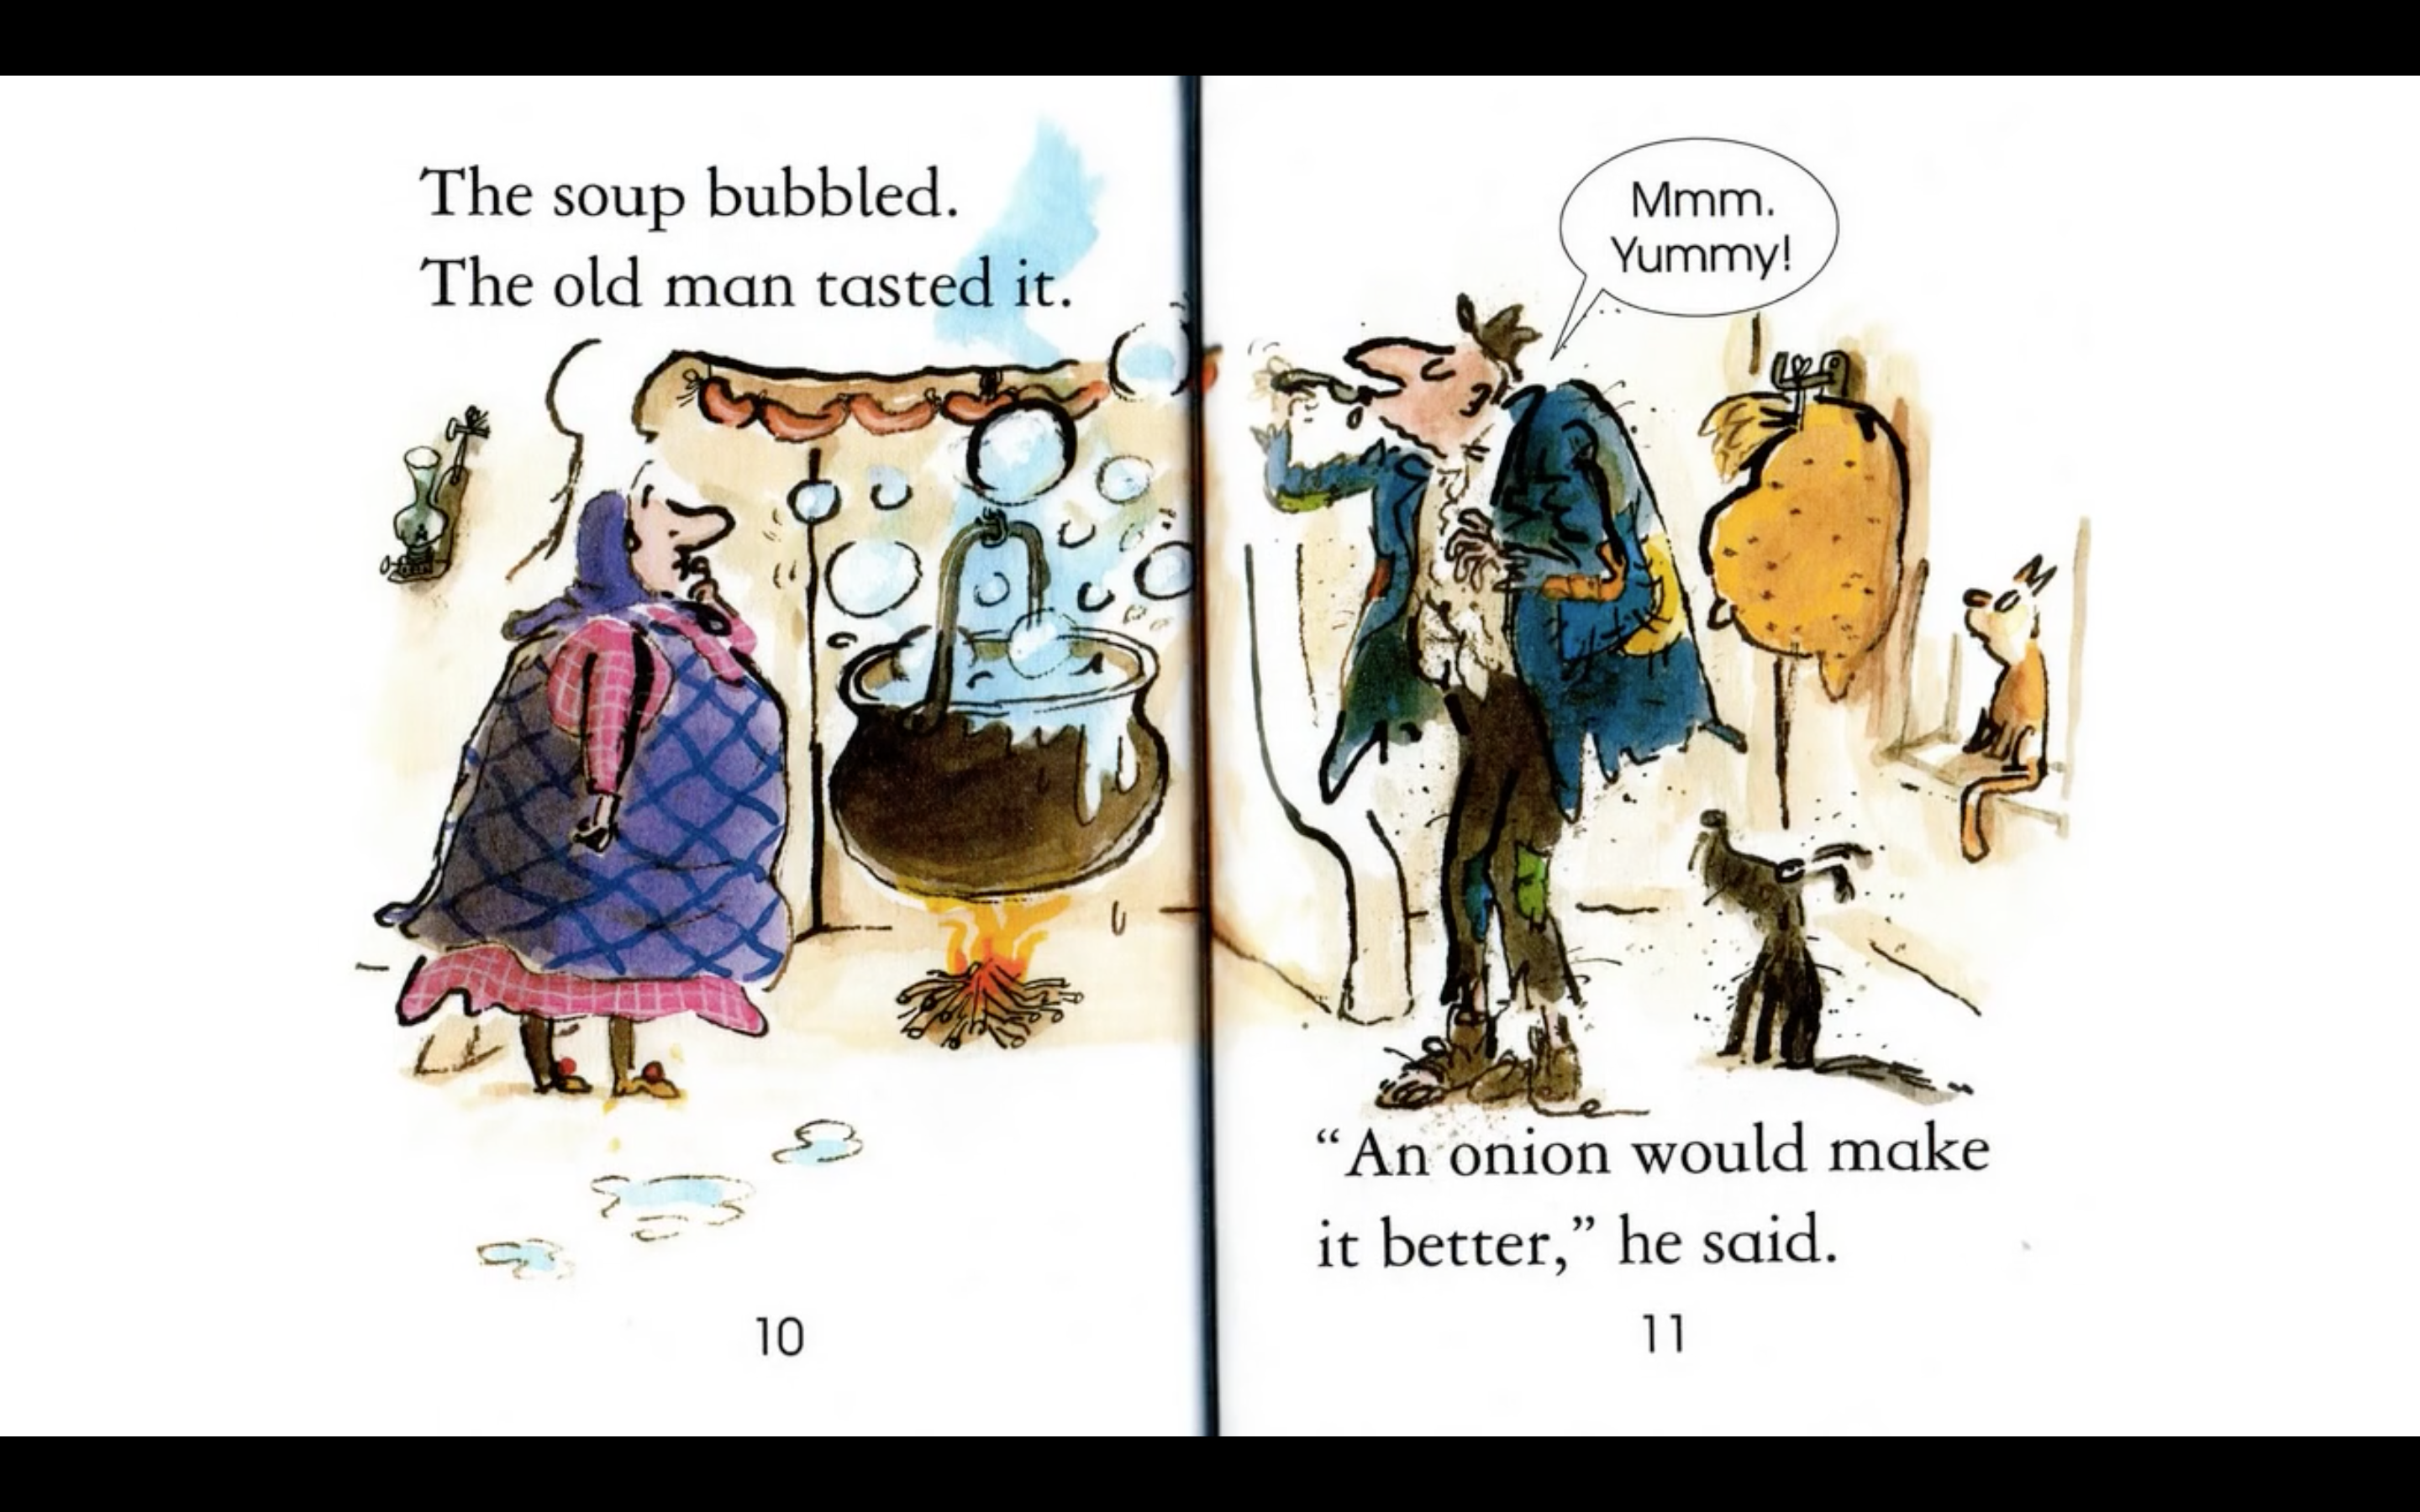
Notes:
Read each line and alternate between each student for an echo reading.

Slide 27
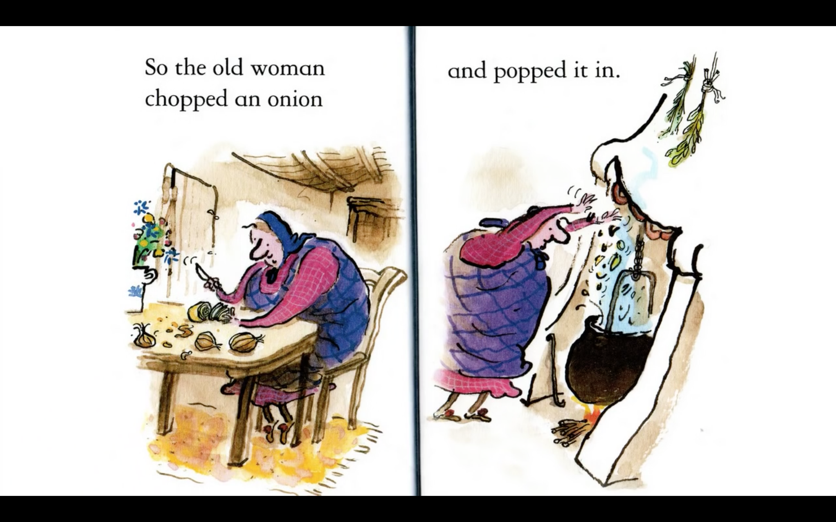
Notes:
Read each line and alternate between each student for an echo reading.

Slide 28
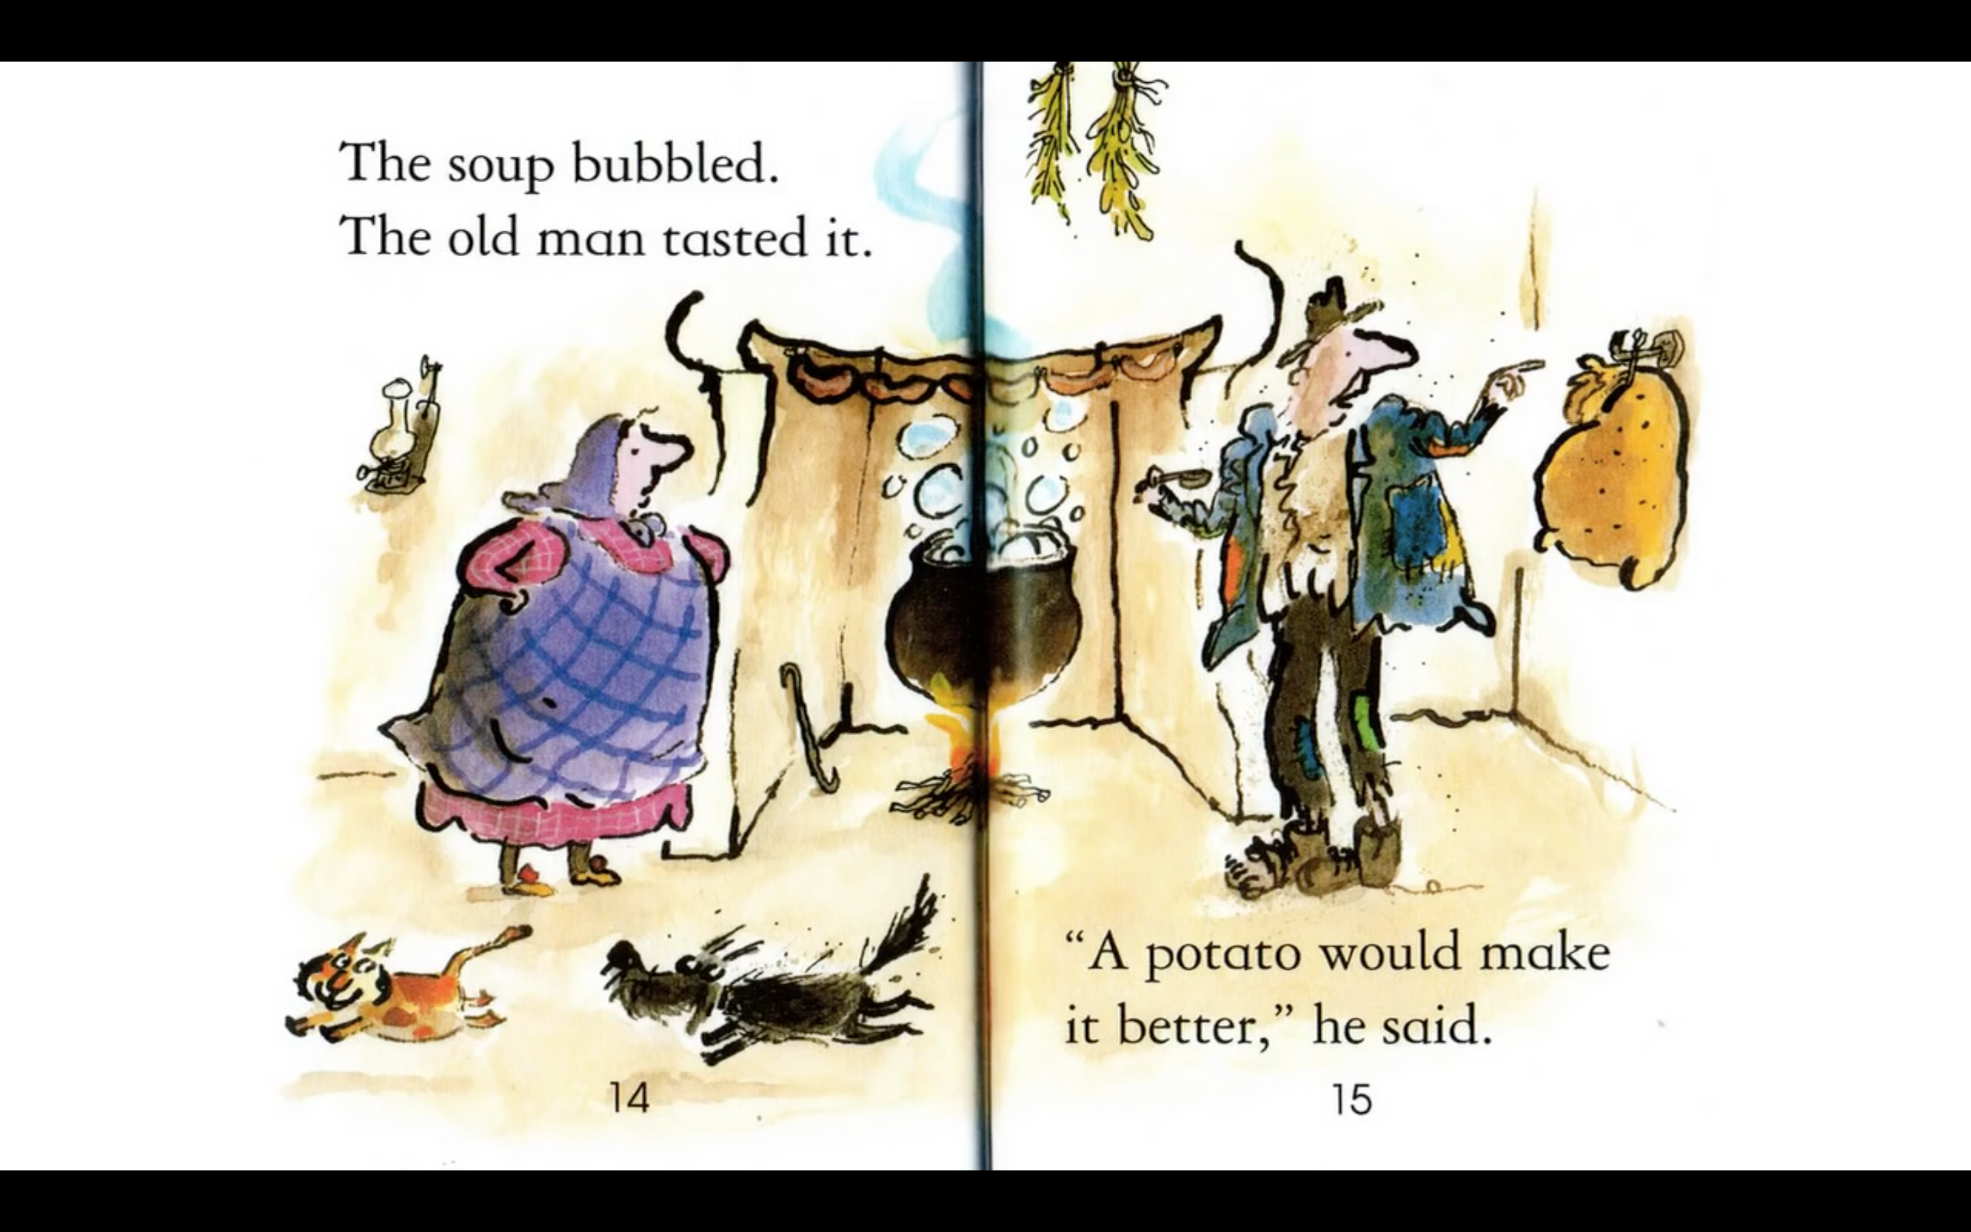
Notes:
Read each line and alternate between each student for an echo reading.

Slide 29
Notes:
Read each line and alternate between each student for an echo reading.

Slide 30
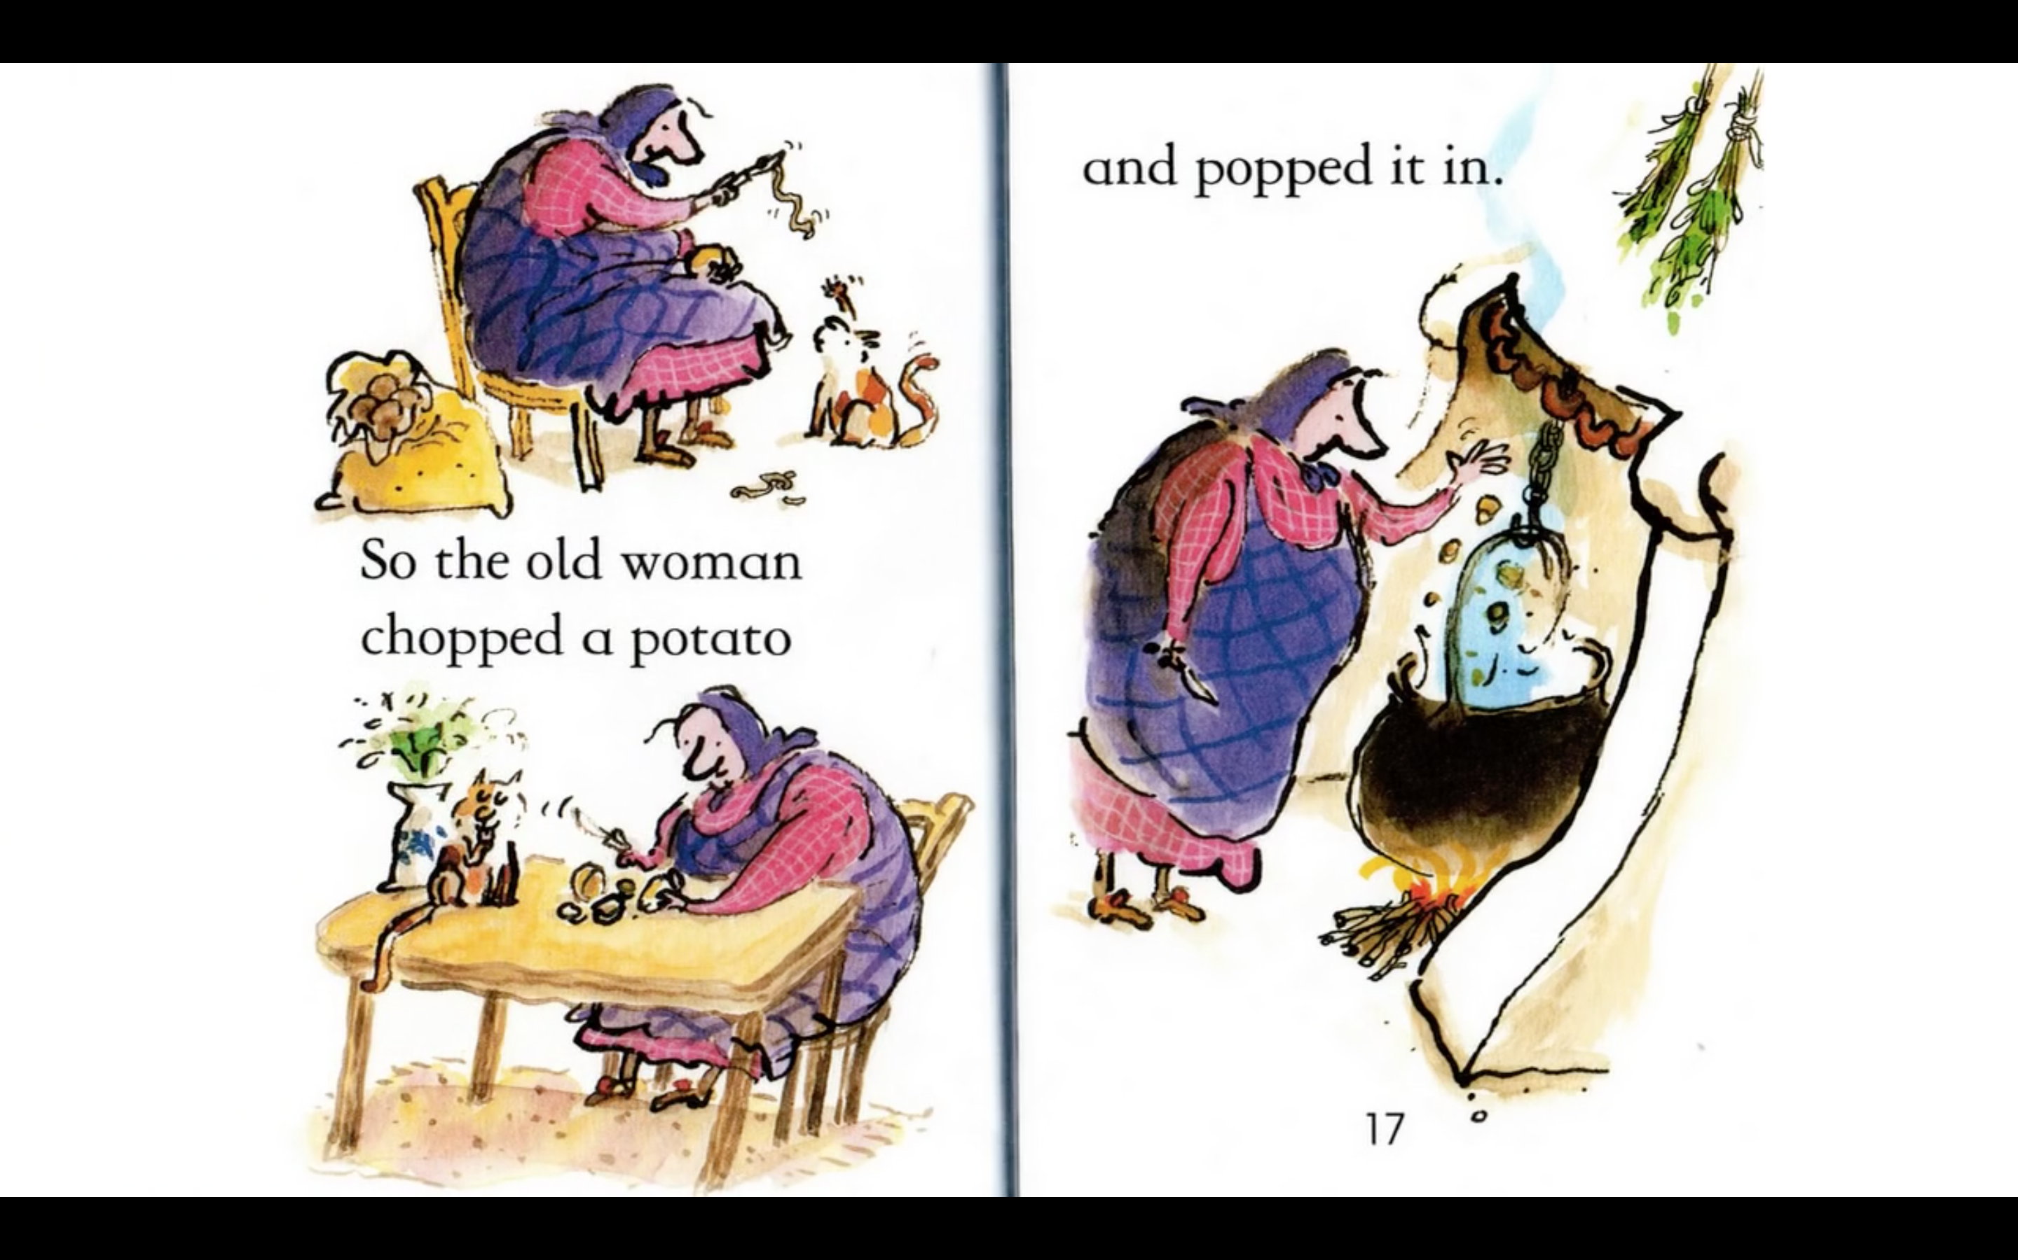
Notes:
Read each line and alternate between each student for an echo reading.

Slide 31
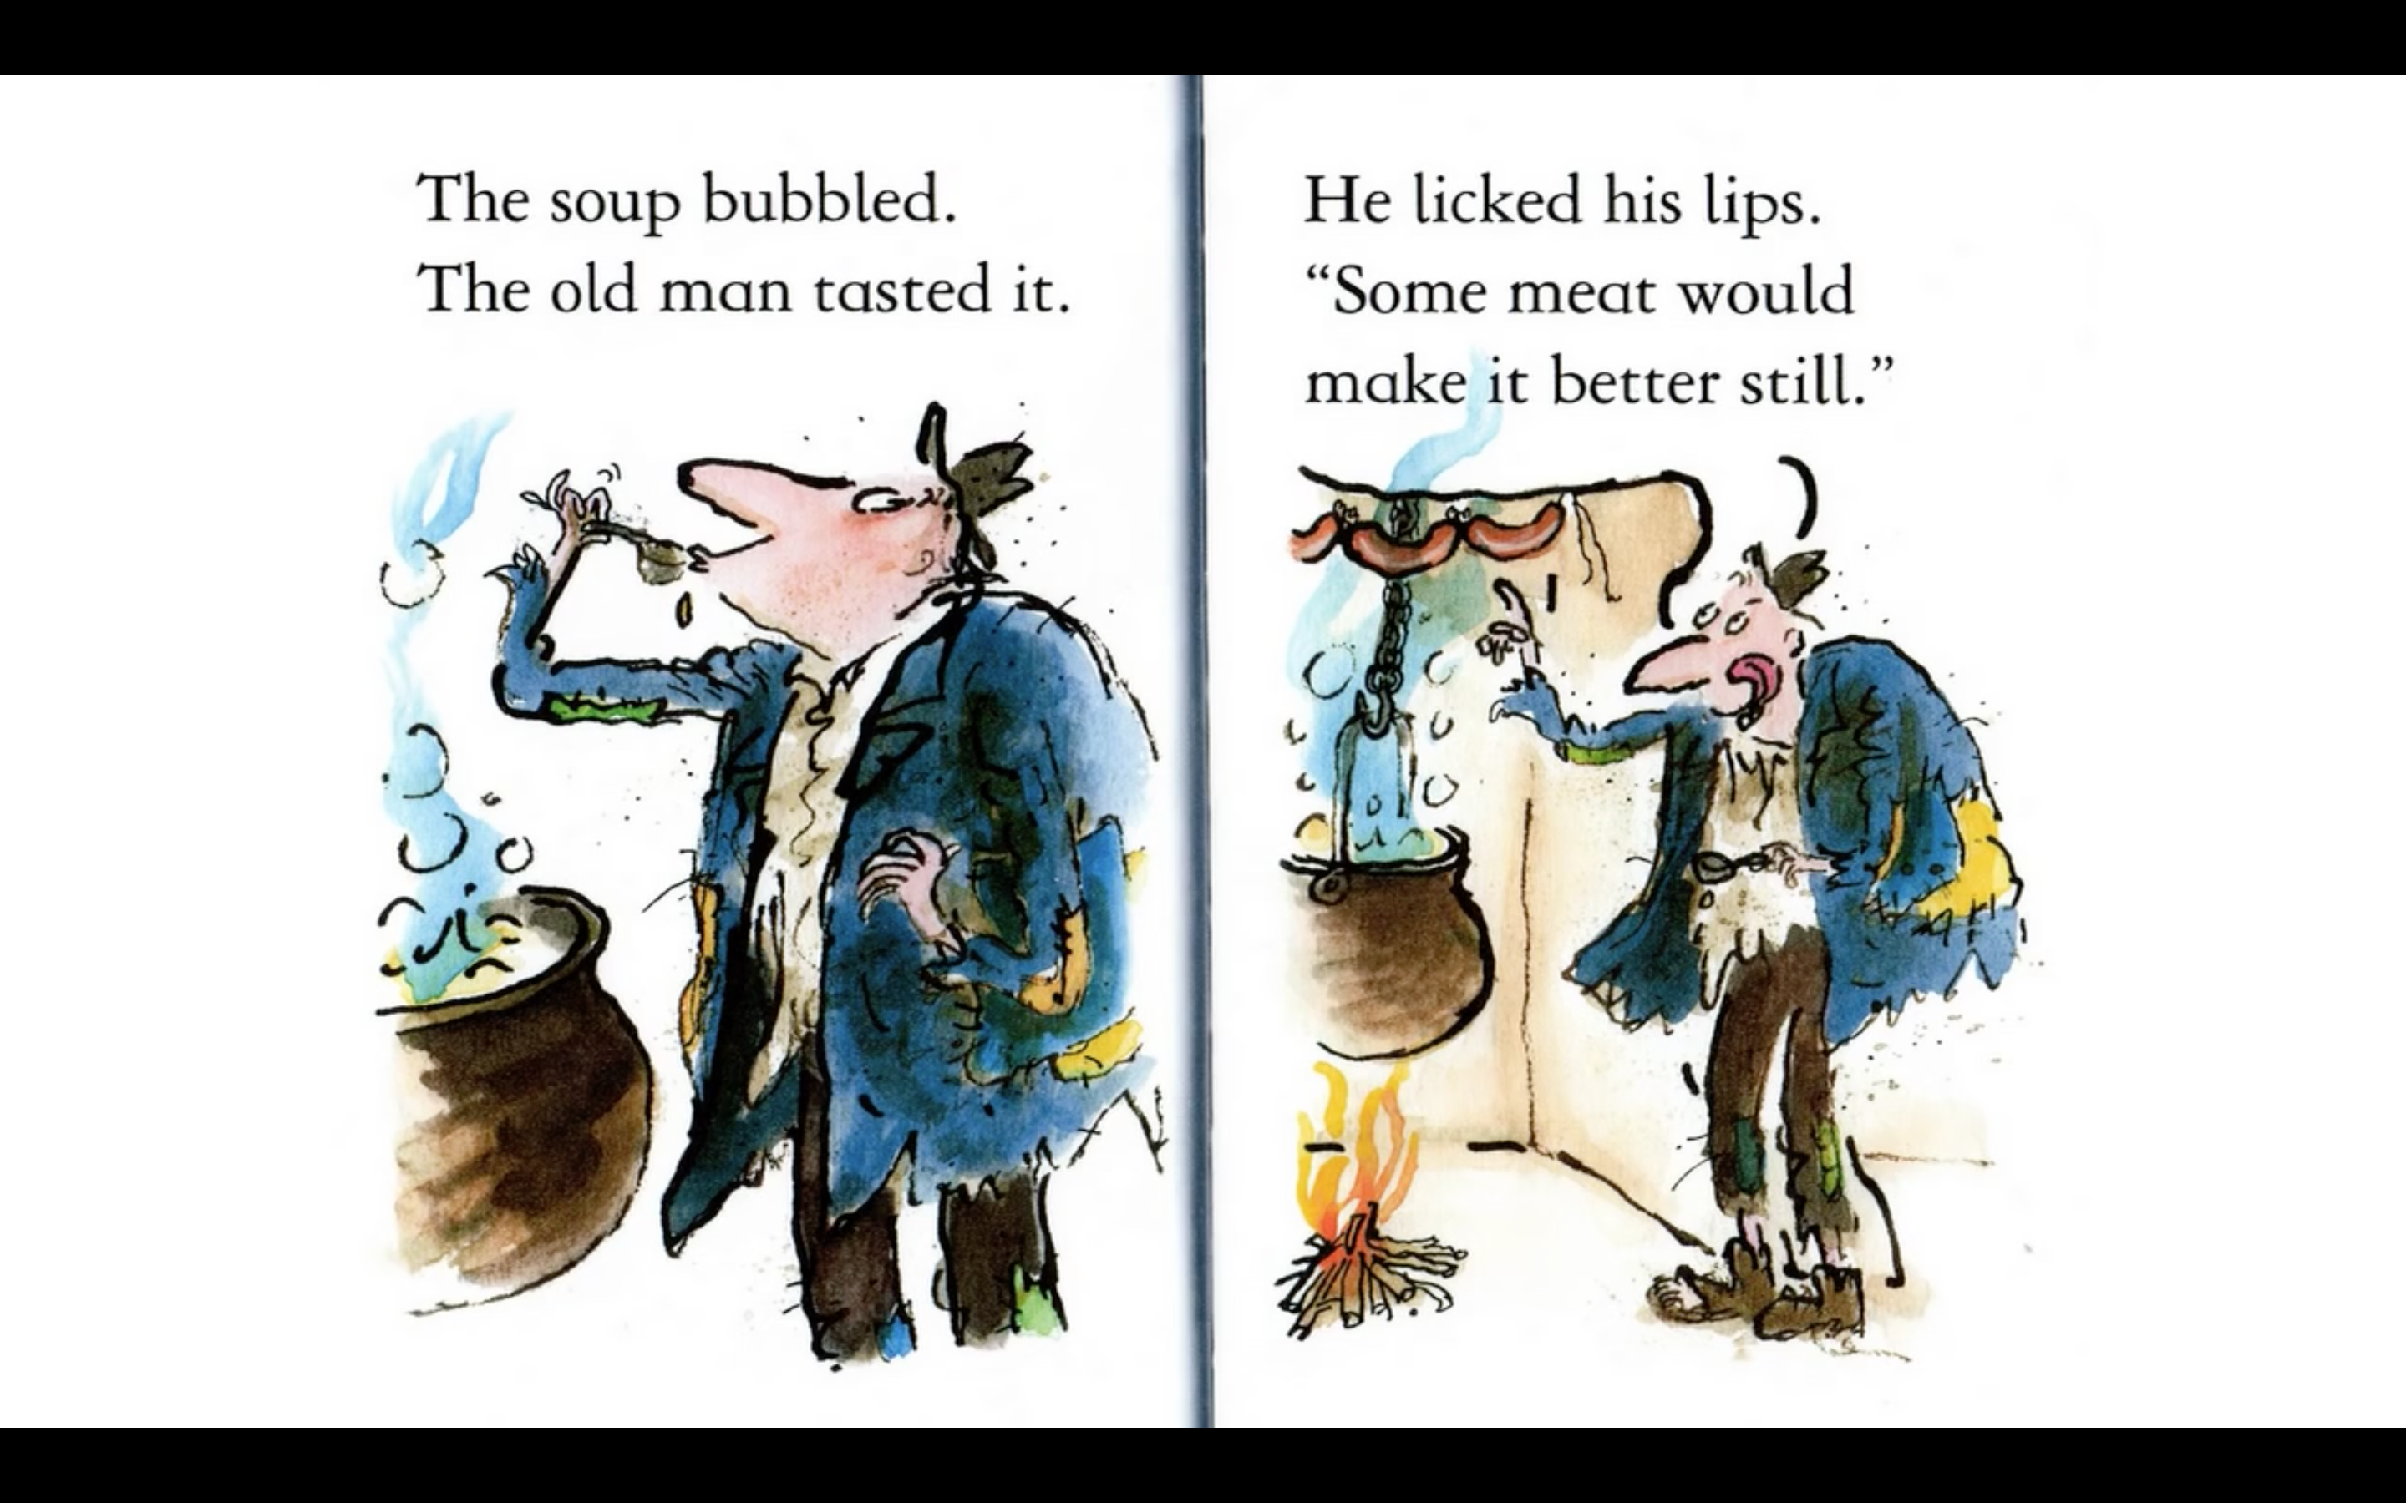
Notes:
Read each line and alternate between each student for an echo reading.

Slide 32
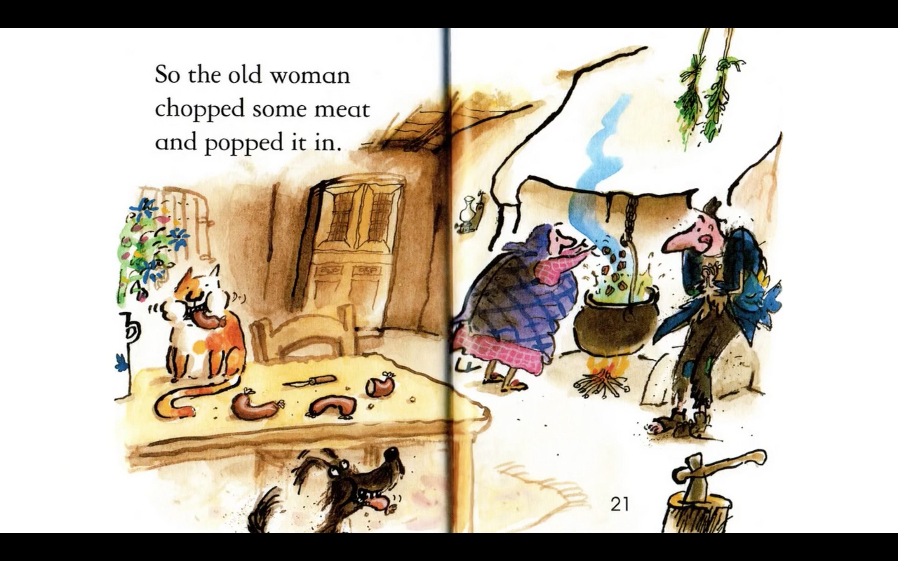
Notes:
Read each line and alternate between each student for an echo reading.

Slide 33
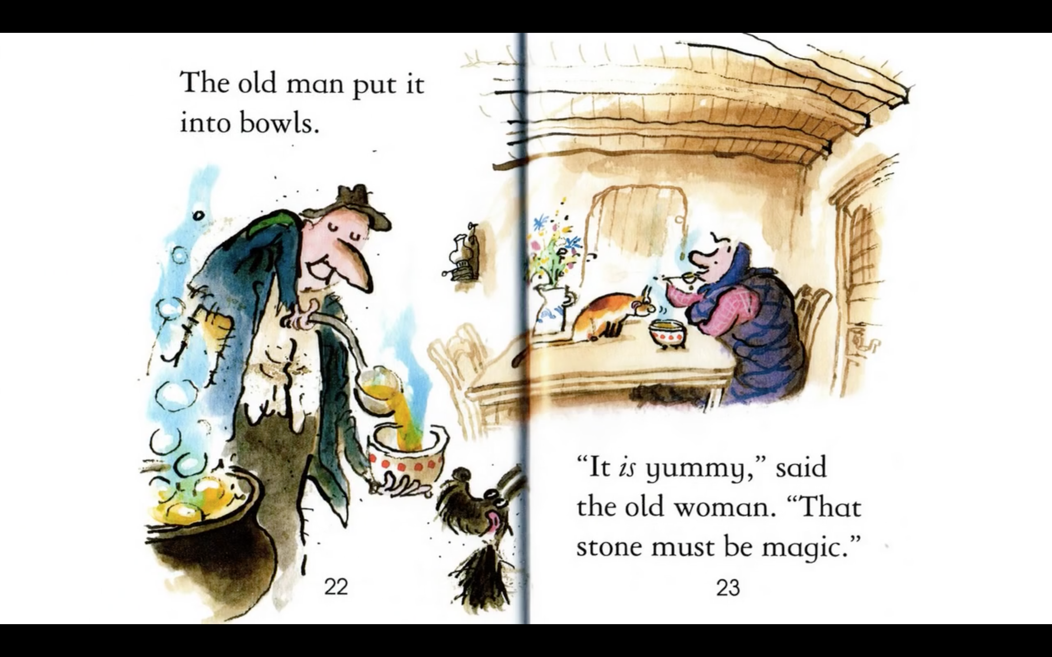
Notes:
Read each line and alternate between each student for an echo reading.

Slide 34
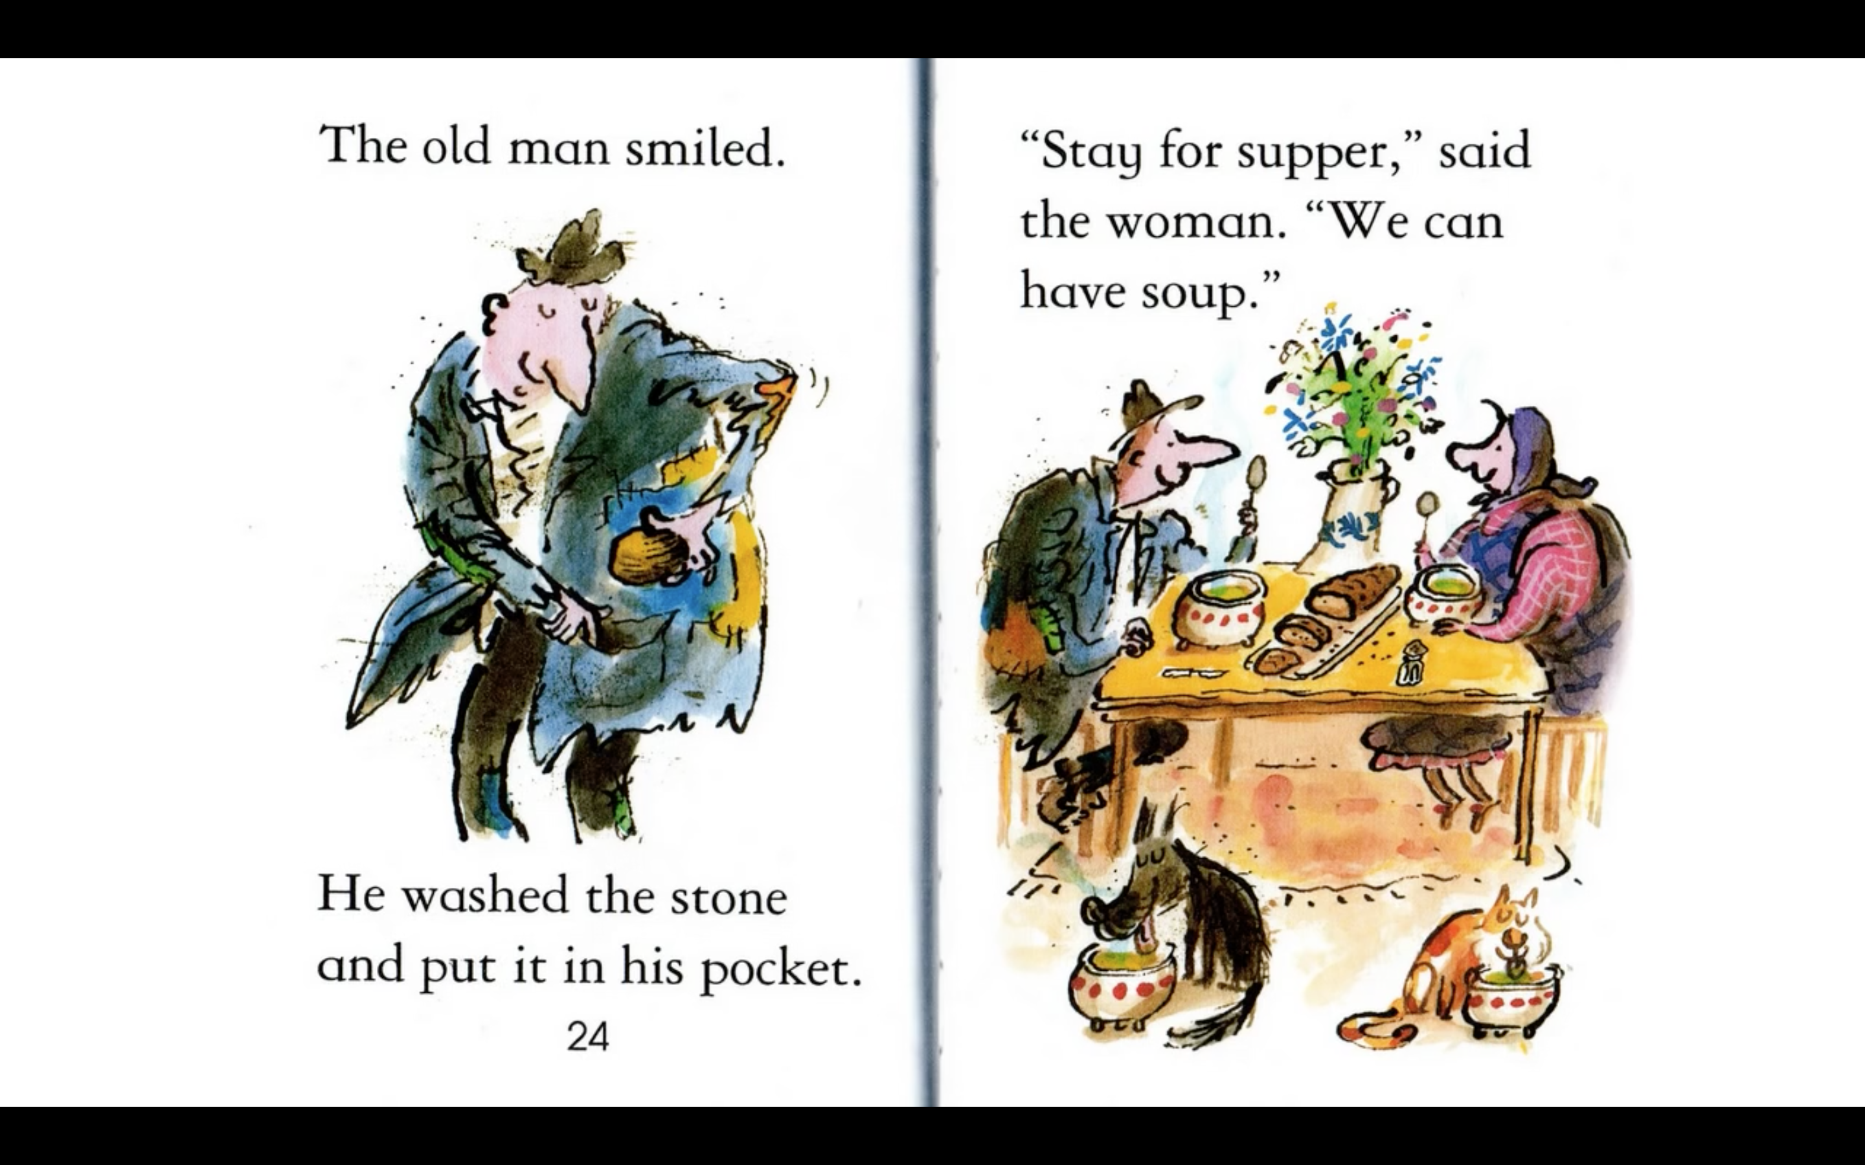
Notes:
Read each line and alternate between each student for an echo reading.

Slide 35
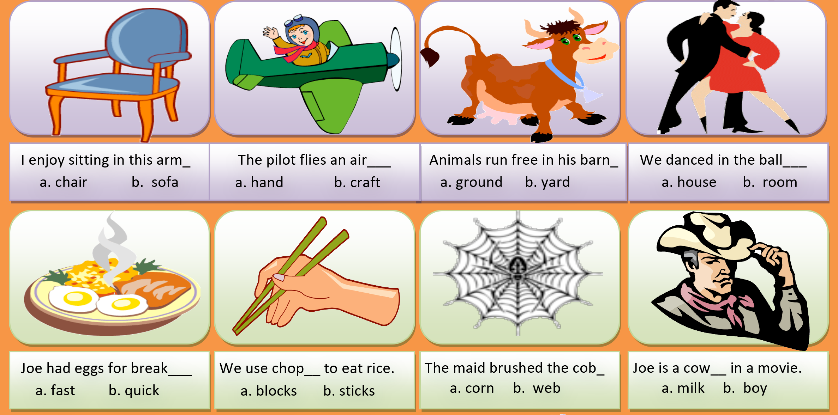
Which compound word?
Notes:
Get the students to answer the questions verbally. Alternate between each student.
chair b. craft b. yard b. room
a. fast b. sticks b. web b. boy

Slide 36
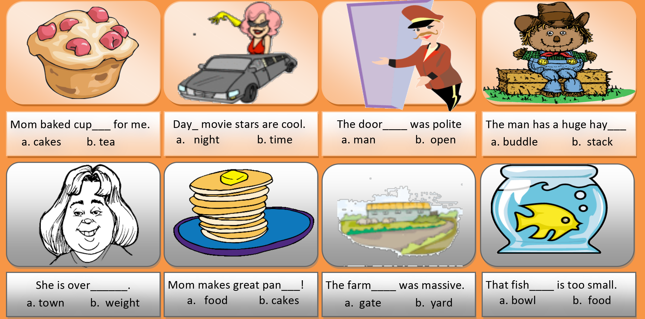
Which compound word?
Notes:
Get the students to answer the questions verbally. Alternate between each student.
a. cakes b. time a. man b. stack
b. weight b. cakes b. yard a. bowl

Slide 37
Let’s practice!
Notes:
Get the students to read/sing their chosen song/poem.

Slide 38
FRUIT MANIA
What is it?
apricot
apple
lemon
pear

Slide 39
FRUIT MANIA
What is it?
plum
lemon
peach
pear

Slide 40
FRUIT MANIA
What are they?
plums
cherries
berries
apricots

Slide 41
FRUIT MANIA
What is it?
pear
apricot
lemon
banana

Slide 42
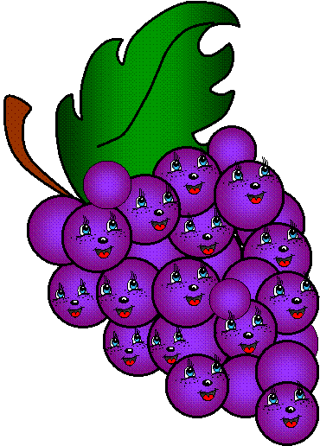
FRUIT MANIA
What are they?
plums
berries
pears
grapes

Slide 43
What did we learn?
Saying the ‘ur’ sound
New “ur’ words
Practiced reading and singing
Compound words

Slide 44
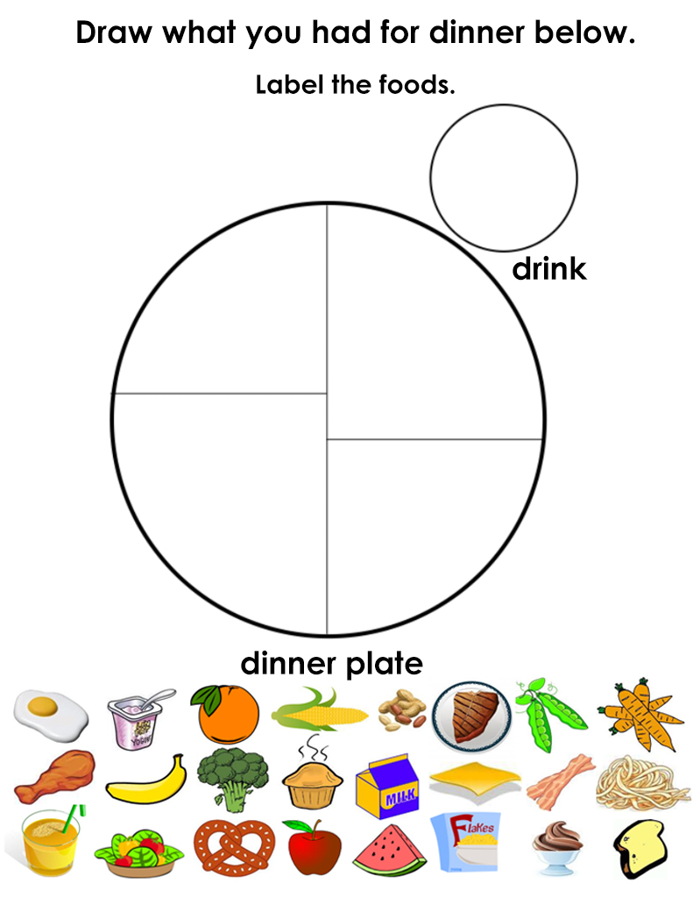
Homework
Notes:
Download “My Plate Worksheet.pdf”. The students are to draw what they ate and drank for dinner one night.

