Slide 1
Lesson 10: Tutoring FOOD

Slide 2
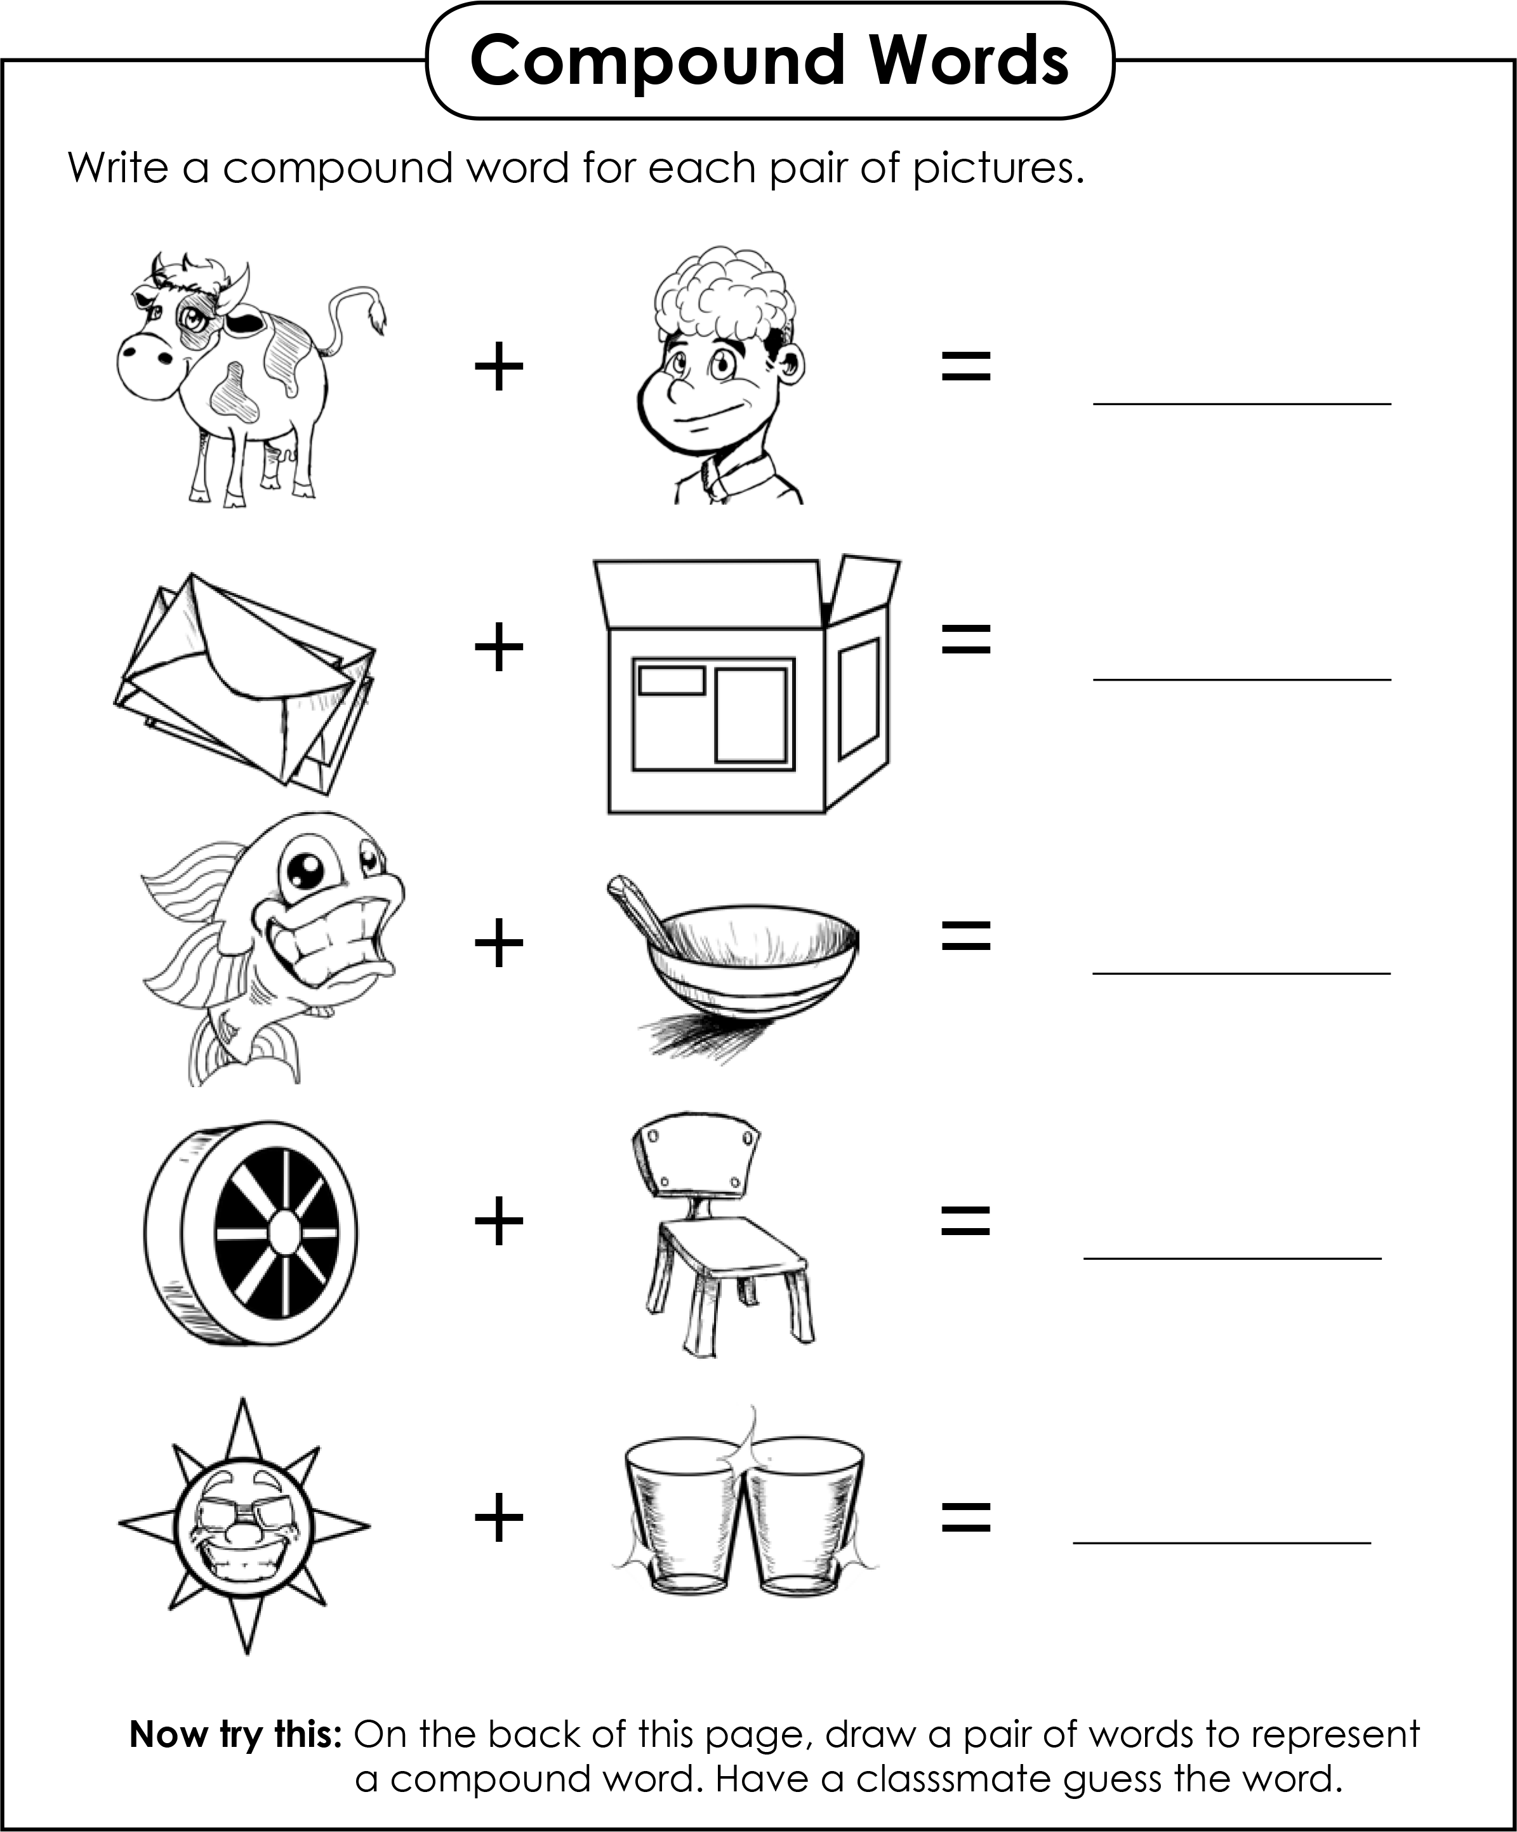
Look up the words, and combine them.
chair
bowl
Box
glasses
boy
mail
fish
sun
cow
wheel

Slide 3
Notes:
Explain what “desserts” means (a sweet course usually served at the end of a meal). Have students circle the desserts. Then, go over each of the foods and give the English word for each graphic.

Slide 4
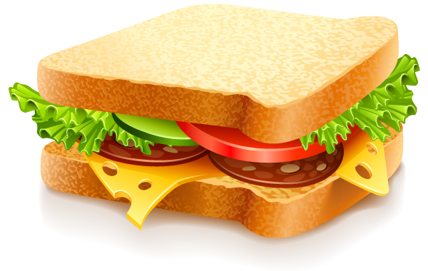
What is inside this sandwich?
Notes:
Pose question to students. Ask them what each topping is. (tomato, cheese, meat, bread, cucumber) s

Slide 5
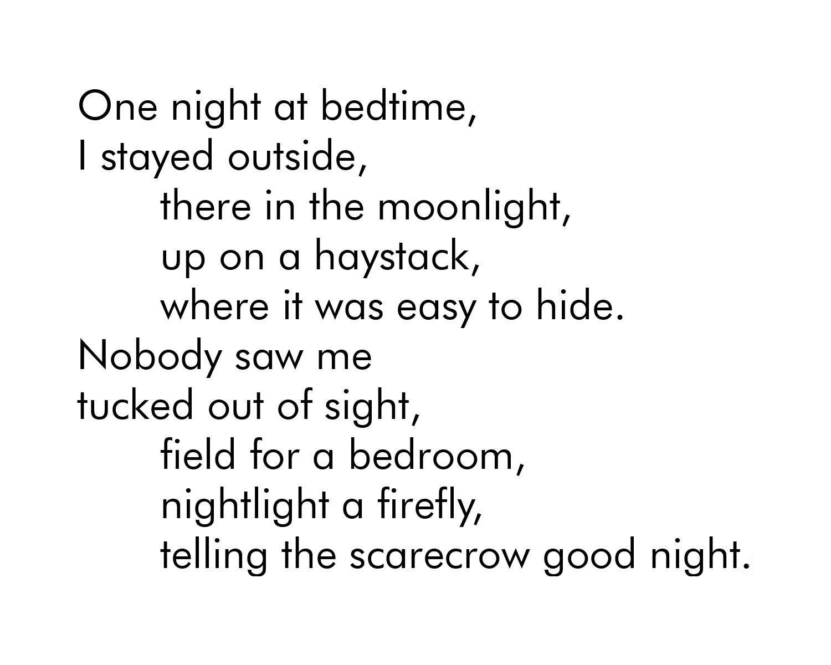
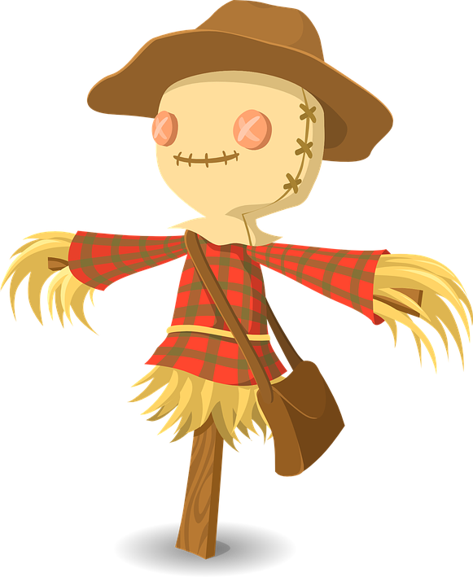
Outdoor Bedtime
Notes:
Read the poem. Have students each the reading.

Slide 6
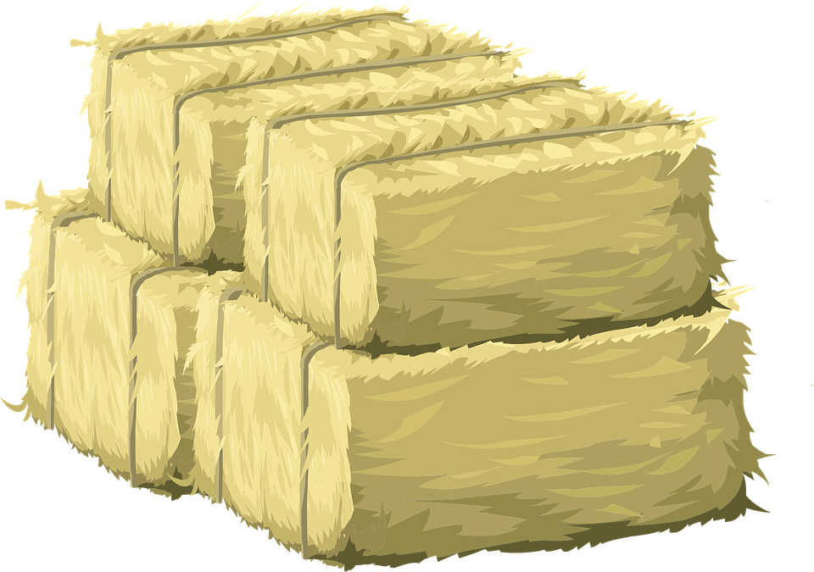
New Words
Define the words from the poem.
bedtime, outside, moonlight, haystack, bedroom, firefly, scarecrow, goodnight
Notes:
Read the poem. Have students each do the reading.

Slide 7
Choose one of the compound words in the poem and write a sentence.
bedtime, outside, moonlight, haystack, bedroom, firefly, scarecrow, goodnight
Notes:
Read the poem. Have students each do the reading.

Slide 8
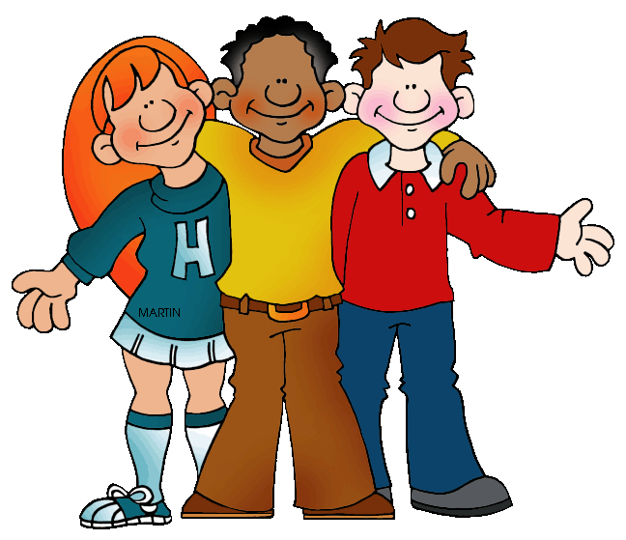
…… school is big and blue
their
___ school is big and blue.
our

Slide 9
…… school is big and blue
their
Our school is big and blue.
our

Slide 10
…… school is small and red.
their
___ school is small and red.
our

Slide 11
…… school is small and red.
their
Their school is small and red.
our

Slide 12
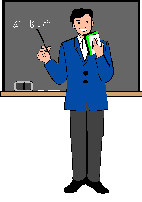
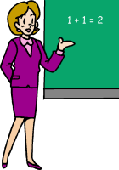
…… teacher is a woman.
their
_____ teacher is a woman.
our

Slide 13
…… teacher is a woman.
their
Our teacher is a woman.
our

Slide 14
…… teacher is a man.
their
_____ teacher is a man.
our

Slide 15
…… teacher is a man.
their
Their teacher is a man.
our

Slide 16
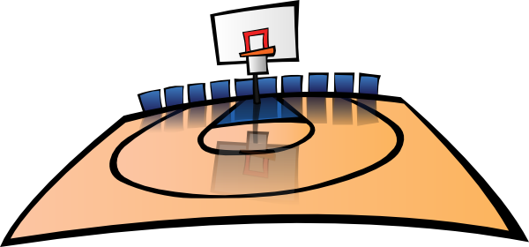
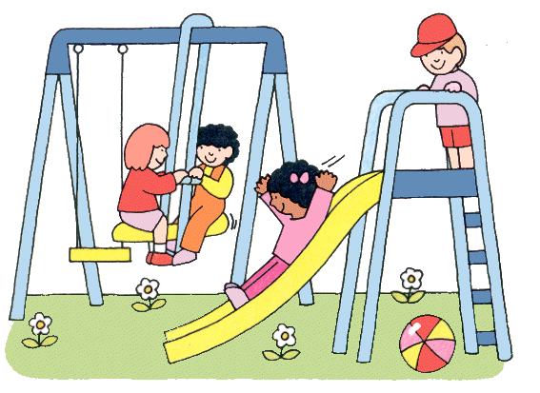
…… school has a playground.
their
_____ school has a playground.
our

Slide 17
…… school has a playground.
their
Our school has a playground.
our

Slide 18
…… school has a basketball court.
their
_____ school has a basketball court.
our

Slide 19
…… school has a basketball court.
their
Their school has a basketball court.
our

Slide 20
Compound Words
Complete each compound word by
adding a word from the list.
1. We went to the sea_______ at Easter.
2. She only wears leather _______.
3. Her book______ is full of English books.
4. How much pocket _______ do you get?
5. We’re lost. And I forgot the road ________ at home.
● case ● money ● side ● shoes ● market ● map ● singer

Slide 21
Answers
Complete each compound word by
adding a word from the list.
1. We went to the seaside at Easter.
2. She only wears leather shoes.
3. Her bookcase is full of English books.
4. How much pocket money do you get?
5. We’re lost. And I forgot the road map at home.
● case ● money ● side ● shoes ● map

Slide 22
Compound Words
Complete each compound word by
adding a word from the list.
6. It’s so hot. I’ll have an ice _______.
7. I love chocolate cup_______ , don’t you?
8. He’s a famous rock _______, isn’t he?
9. Let’s go to the street_______, shall we?
10. Her boy_______ is late. As always.
● case ● cake ● friend ● market ● cream ● singer

Slide 23
Answers
Complete each compound word by
adding a word from the list.
6. It’s so hot. I’ll have an ice cream.
7. I love chocolate cupcake , don’t you?
8. He’s a famous rock singer, isn’t he?
9. Let’s go to the street market, shall we?
10. Her boyfriend is late. As always.
● case ● cake ● friend ● market ● cream ● singer

