Slide 1


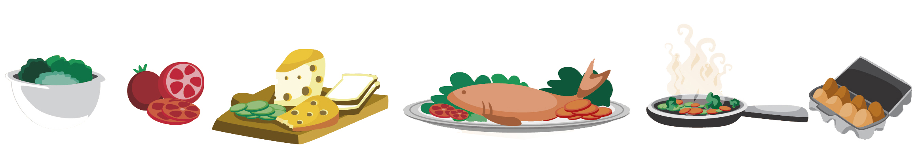
Lesson 11
FOOD

Slide 2

What we will learn today
Saying the ‘st’ sound
Using the ‘st’ sound in sentences
How to use “more”, “most”, “there was” and “there were”
Practice our song/poem

Slide 3
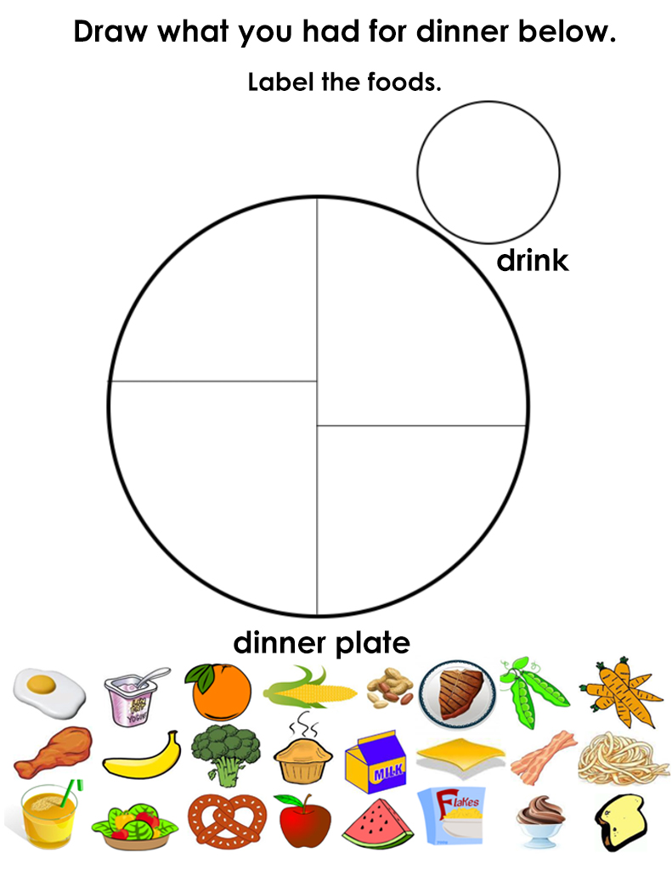
Show your drawings!

Slide 4


The ST Sound

Slide 5
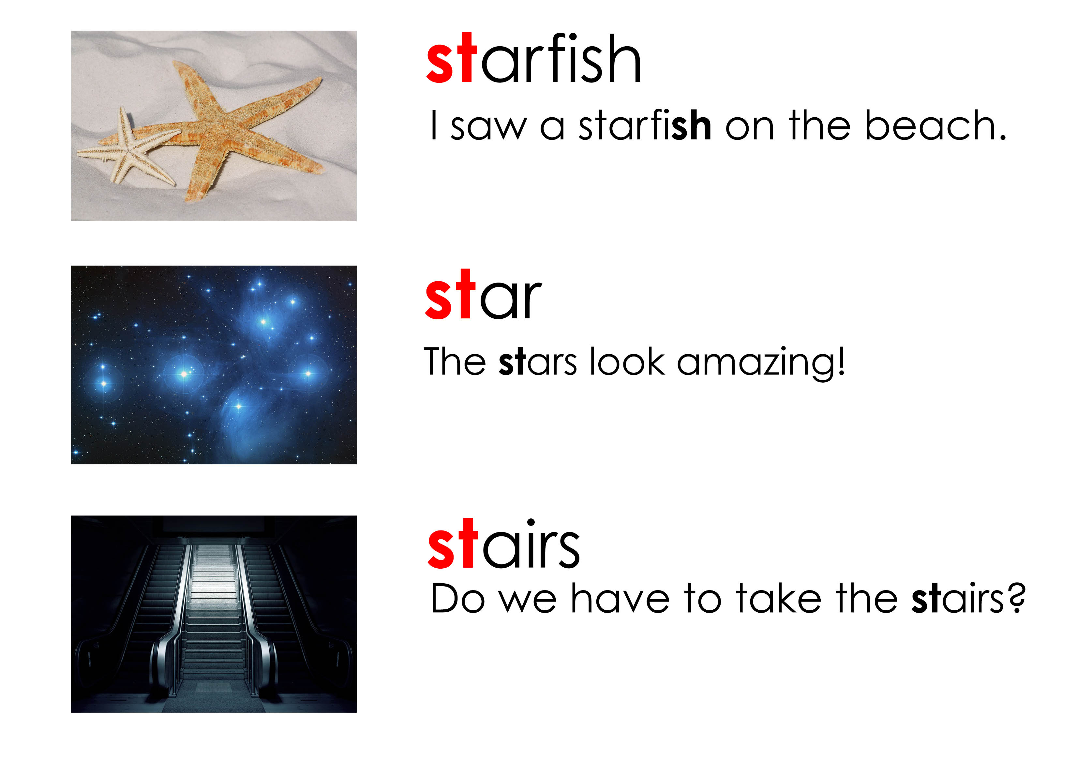
Using “st”

Slide 6
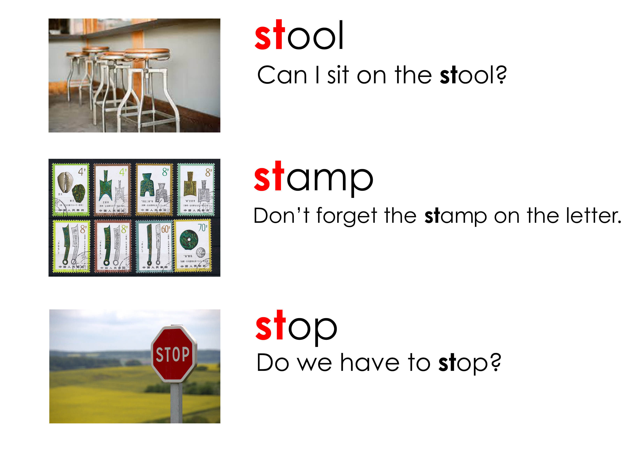
Using “st”

Slide 7
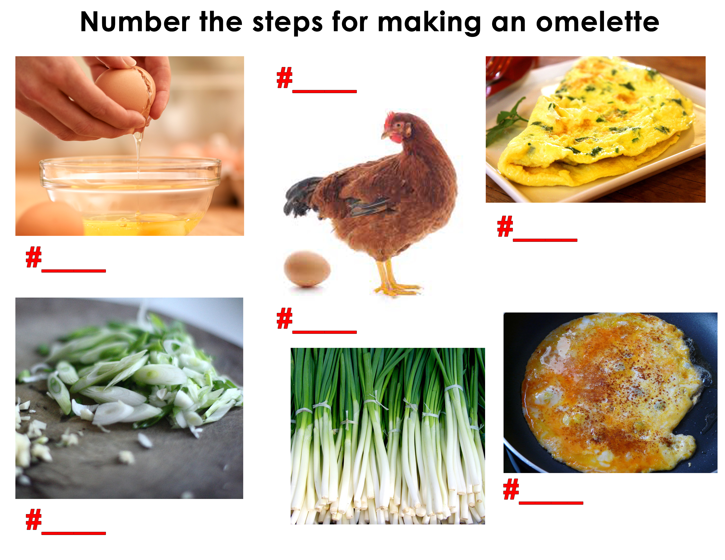
How do you make…

Slide 8
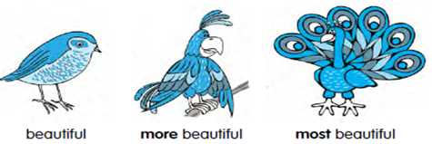
More and most
When we compare two things, we use the comparative adjective “more”.
When we compare one thing or a few things with many other things, we use “most”.

Slide 9
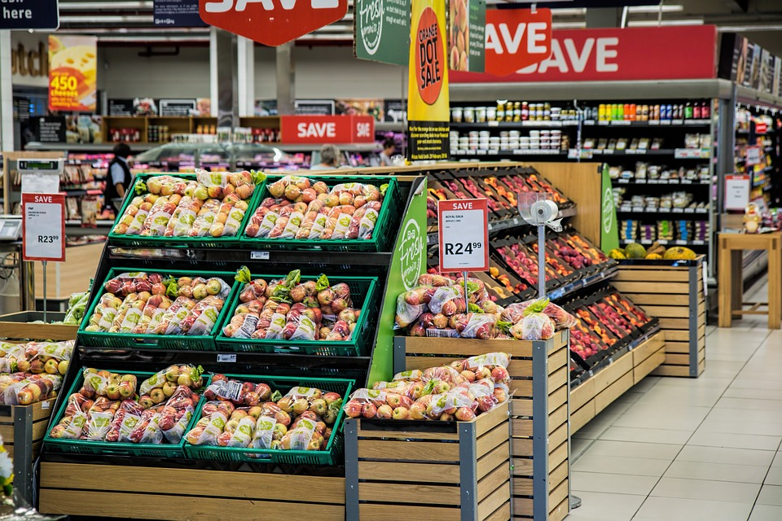
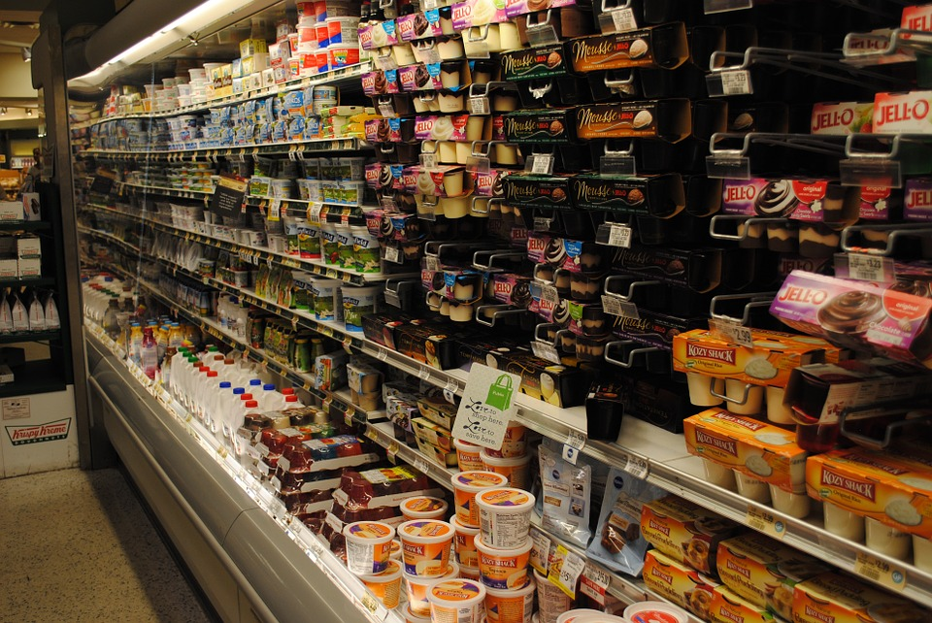
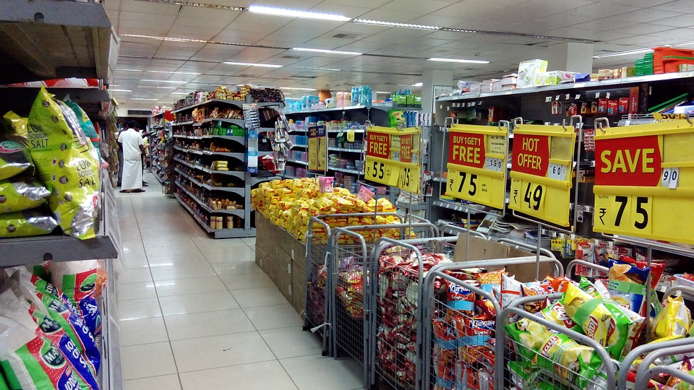
More and most
Examples:
This grocery store is more expensive than the one by my house.
This grocery store is the most expensive store in the city.

Slide 10
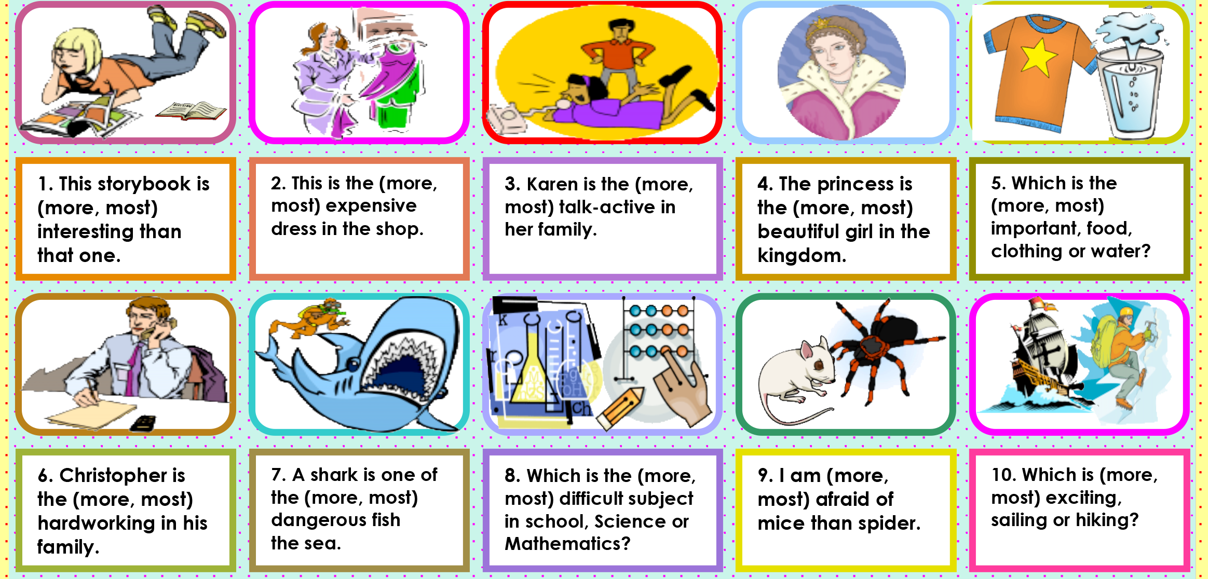
More or most?

Slide 11
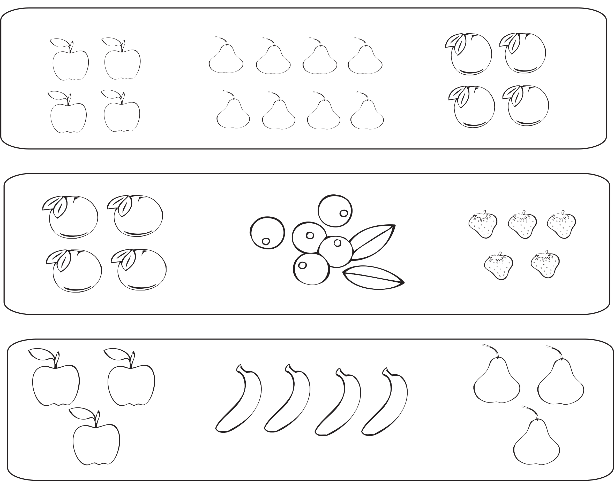
Which group has the most fruit?

Slide 12
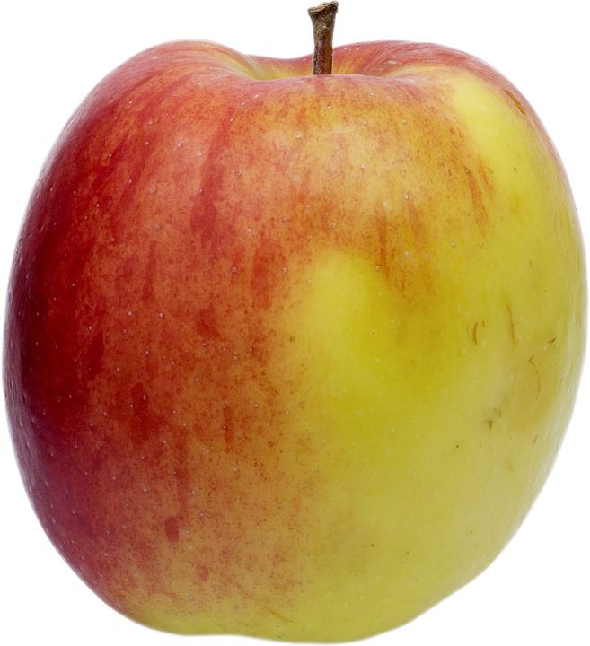
There was/there were
We use there was when we want to name only one thing.
There was an apple on the tree.
We use there were when we want to name two or more things.
There were apples on the tree.

Slide 13
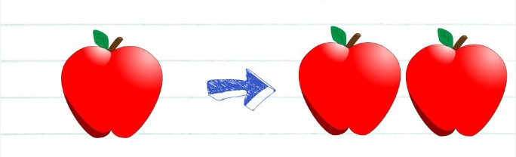
Remember:
There was → Singular
Past tense of “there is”
There were→ Plural
Past tense of “there are”

Slide 14
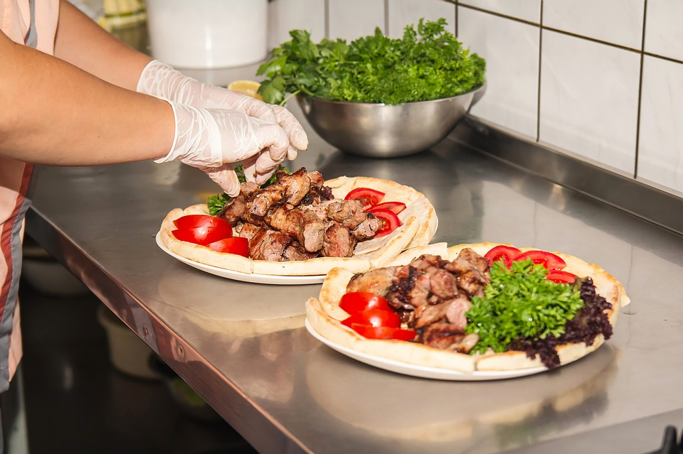
Let’s practice
Use “There was” or “There were”.
____________ two tables.
____________ a kitchen.
____________ three men.
____________ some boxes.
____________ a man with a hat.
____________ a girl in the park.

Slide 15
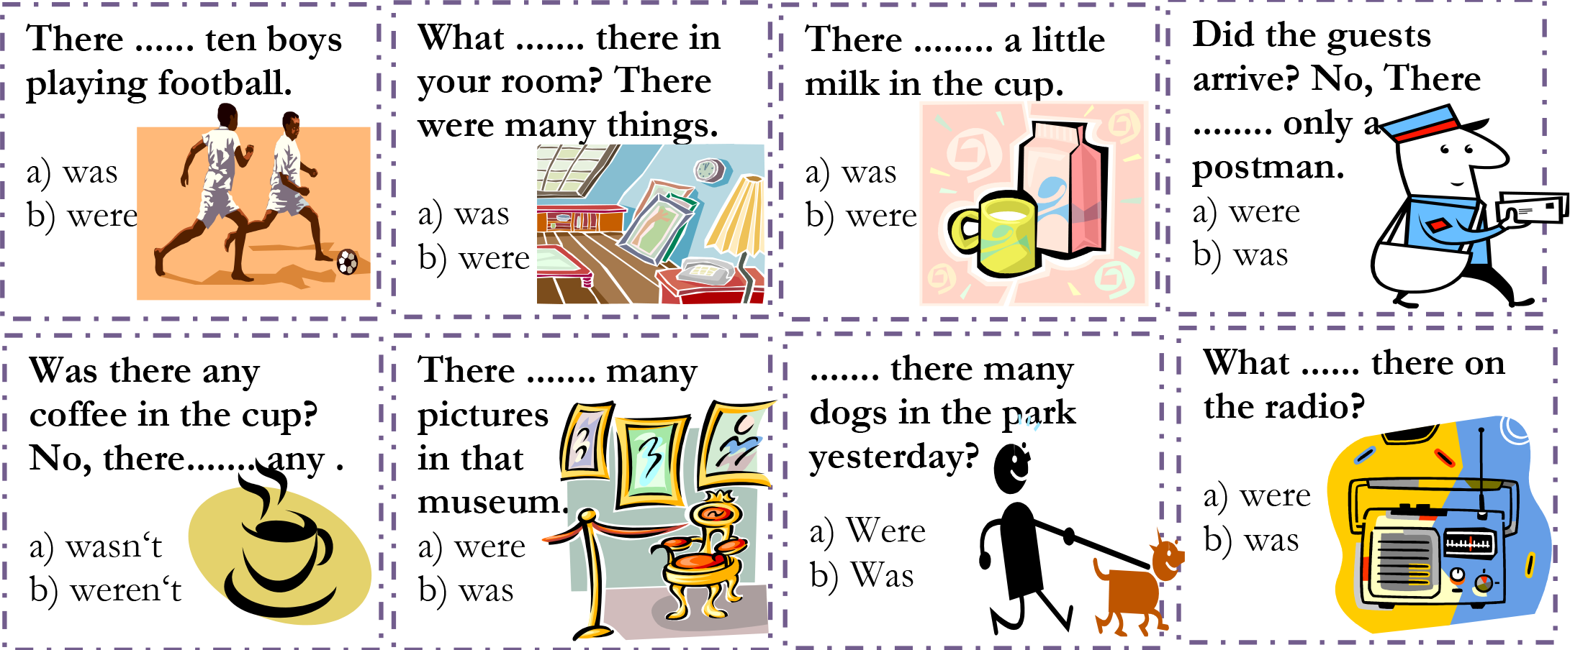
There was or there were?

Slide 16
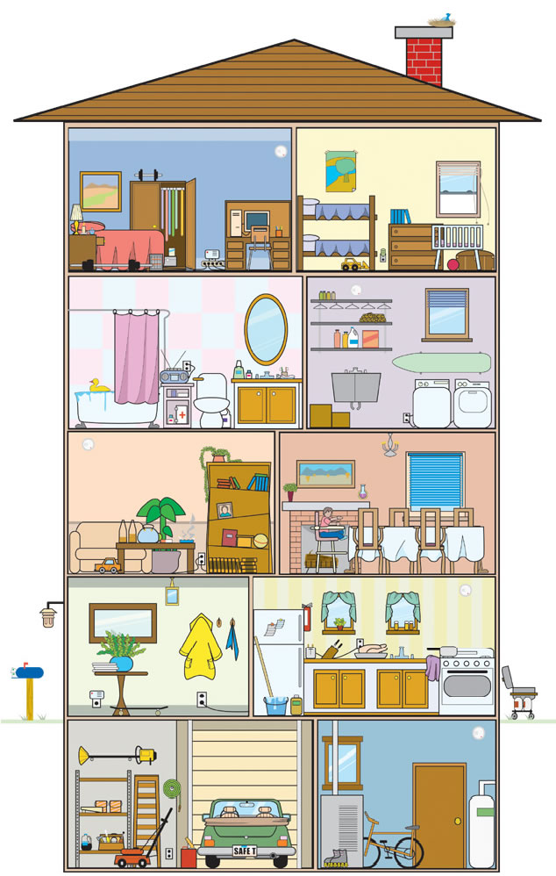
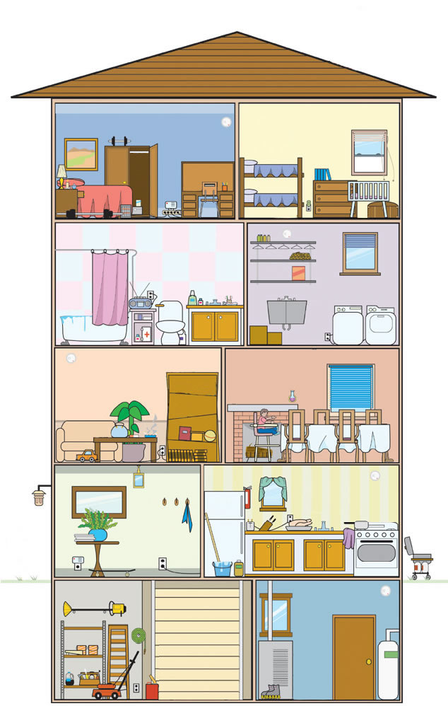
Say what is missing from the house.
Use
there was
there were
(eg.: There was a mirror on the wall in the bathroom.)

Slide 17
Look carefully at the following objects and try to remember as much as you can

Slide 18
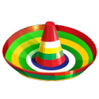

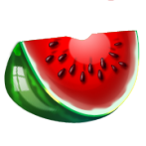

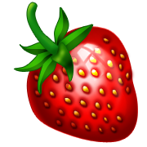


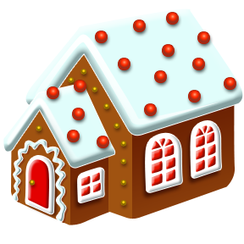
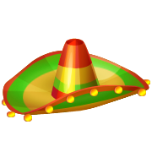
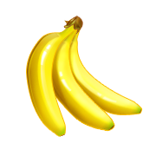



Slide 19


Make 2 lists :
Singular Plural
1) There was… 2) There were…
There was… There were…
There was… There were…
There was… There were…

Slide 21
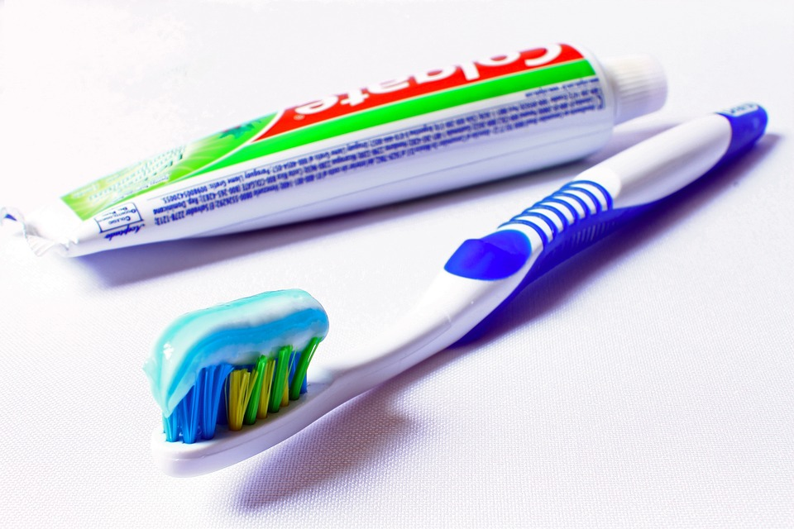
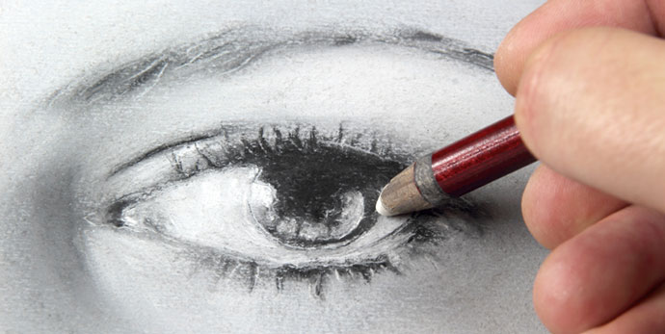
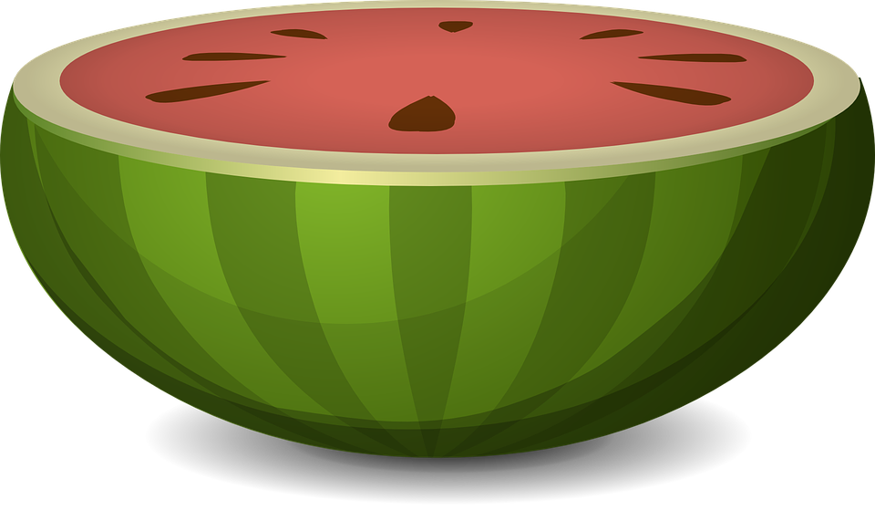
There was 1 clock
There was 1 eye
There was 1 table
There was 1 bag
There was 1 rug
There was 1 flag
There was 1 bed
There was 1 key
There was 1 watermelon
There was 1 toothbrush

Slide 22
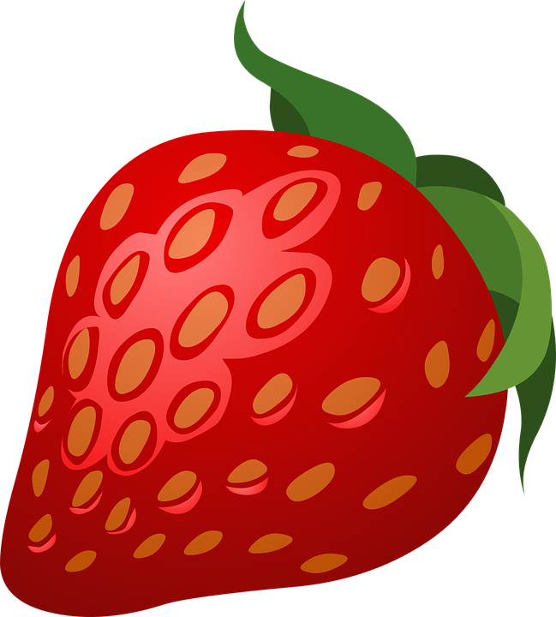
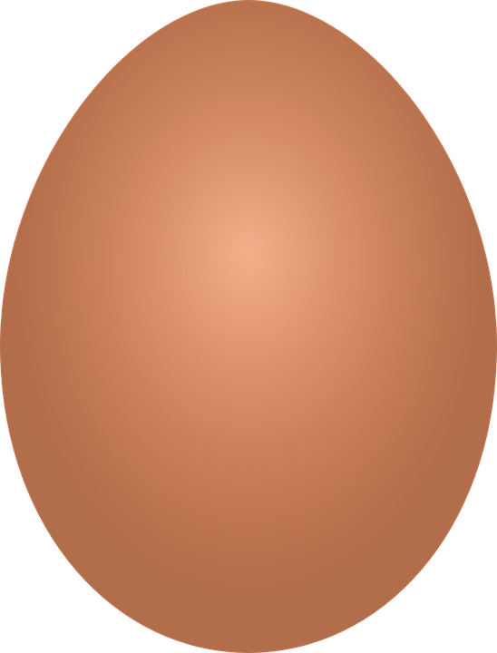
There were 2 hats
There were 3 bananas
There were 2 chairs
There were 3 balls
There were 2 houses
There were 4 books
There were 3 bikes
There were 4 eggs
There were 3 bottles
There were 3 strawberries

Slide 23
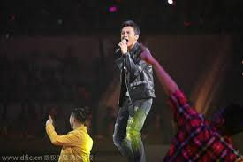


Let’s practice!

Slide 24
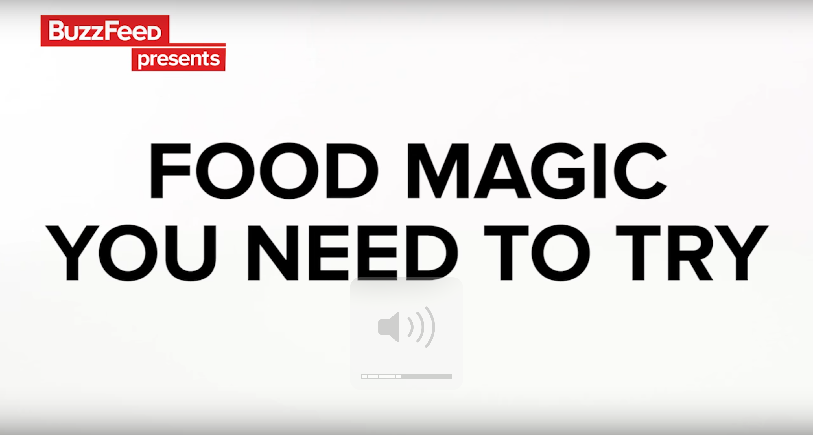
Food Magic Tricks

Slide 25
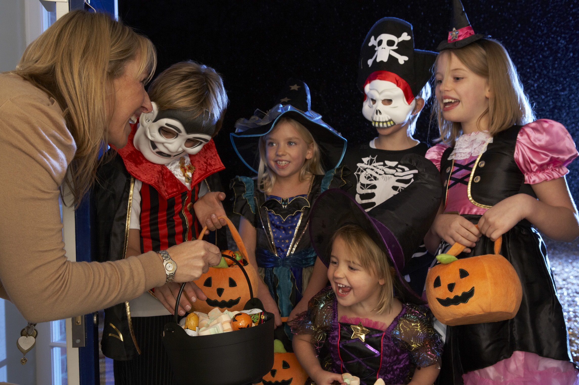
What is happening in this photo?

Slide 26
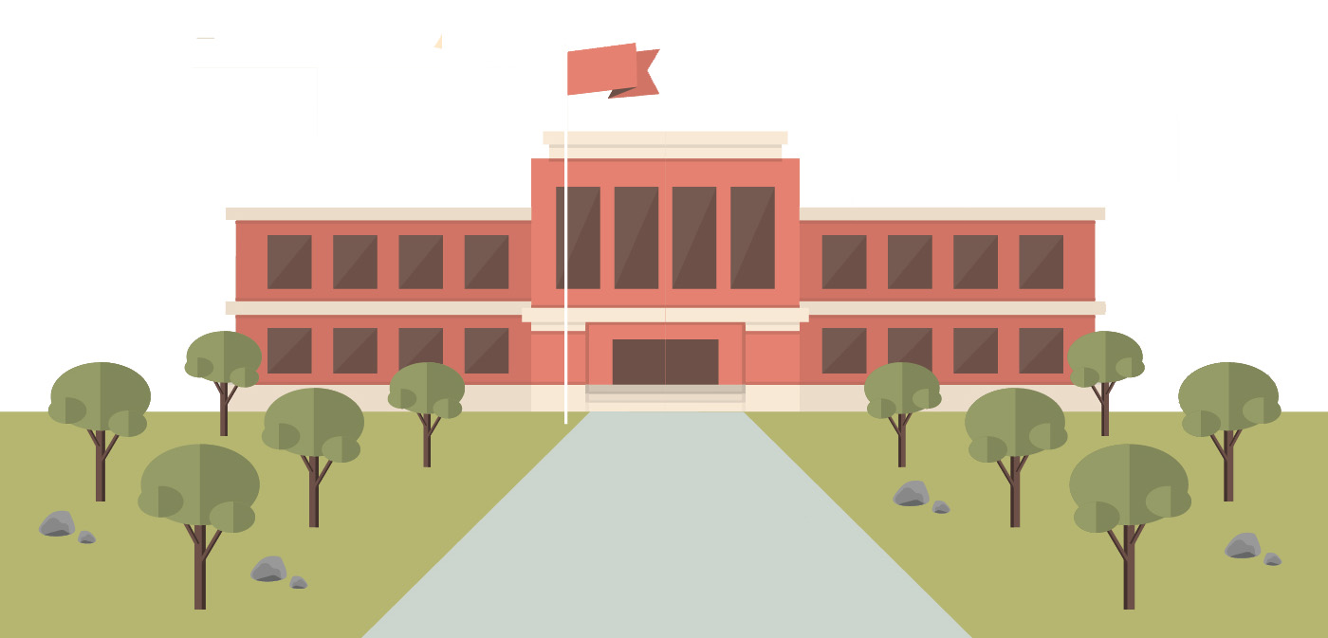
What did we learn?
Saying the ‘st’ sound
New “st” words
How to use “more”, “most”, “there was” and “there were”
How to make an omelette

Slide 27
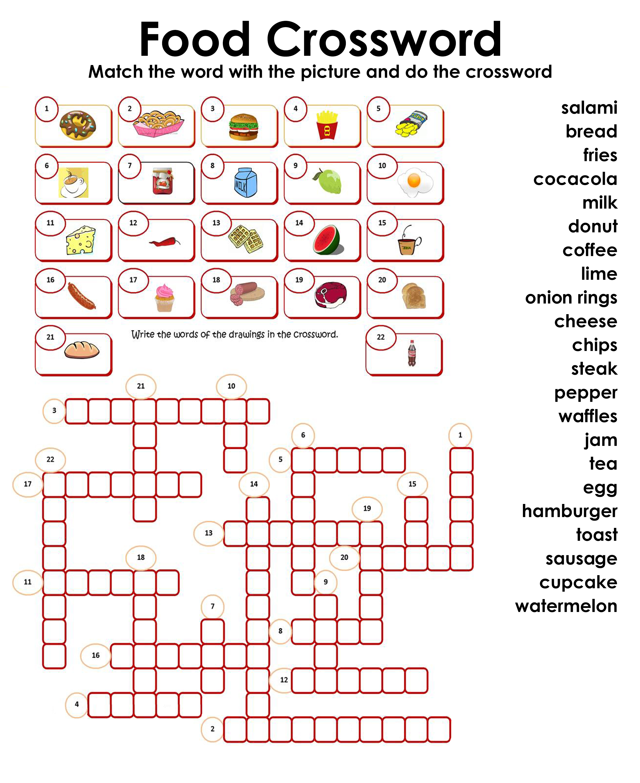
Homework

