Slide 1


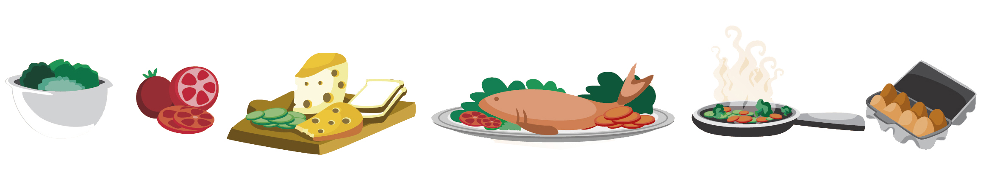
Lesson 11 FOOD

Slide 2

What we will learn today
Saying the ‘st’ sound
Using the ‘st’ sound in sentences
How to use “more”, “most”, “there was” and “there were”
Practice our song/poem
Notes:
Go over the learning goals.

Slide 3
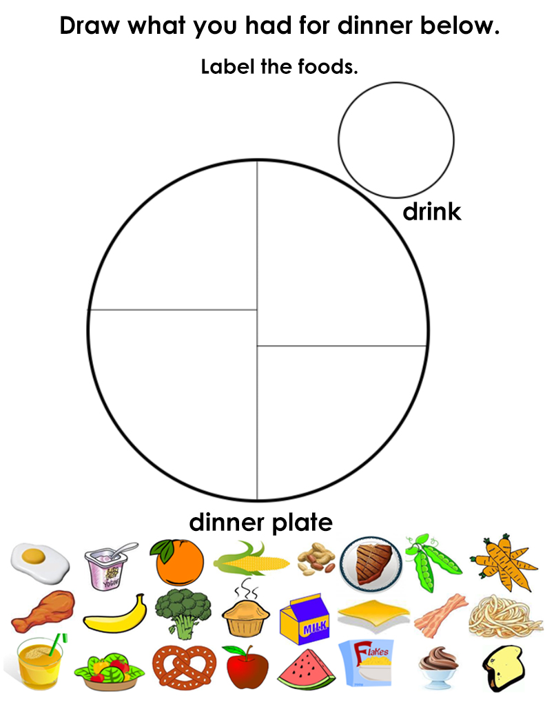
Show your drawings!
Notes:
Get students to show their drawings and explain what they ate for dinner.

Slide 4


The ST Sound
Notes:
To say ‘S’ place the tip of the tongue just off the ridge behind the teeth. To say ‘T’, have the tip of your tongue pressed against the top of your mouth right behind the front tooth. Then slightly push air separating your tongue and upper mouth. Demonstrate this for students and have them practice.

Slide 5
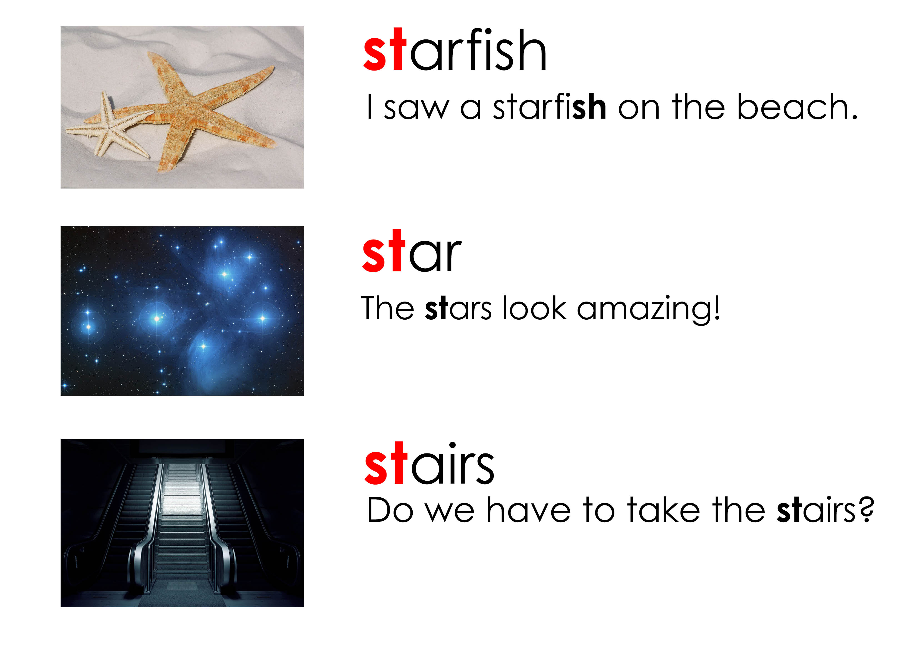
Using “st”
Notes:
Say each word, articulating it clearly. Then say it again, pointing to each syllable, emphasizing the main stress on the polysyllabic words. Say the word again, in a more natural way. Instruct the students to repeat the word, chorally and then individually.

Slide 6
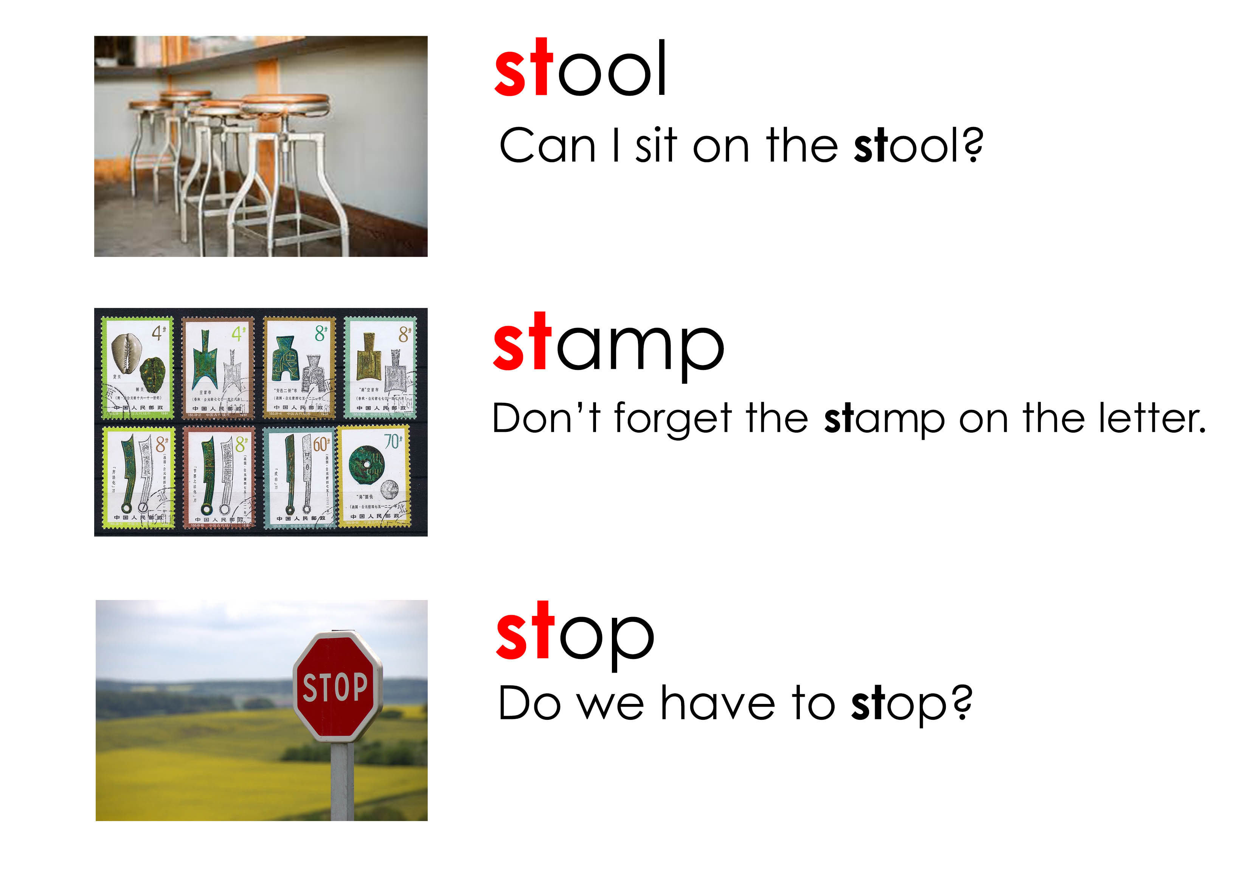
Using “st”
Notes:
Say each word, articulating it clearly. Then say it again, pointing to each syllable, emphasizing the main stress on the polysyllabic words. Say the word again, in a more natural way. Instruct the students to repeat the word, chorally and then individually.

Slide 7
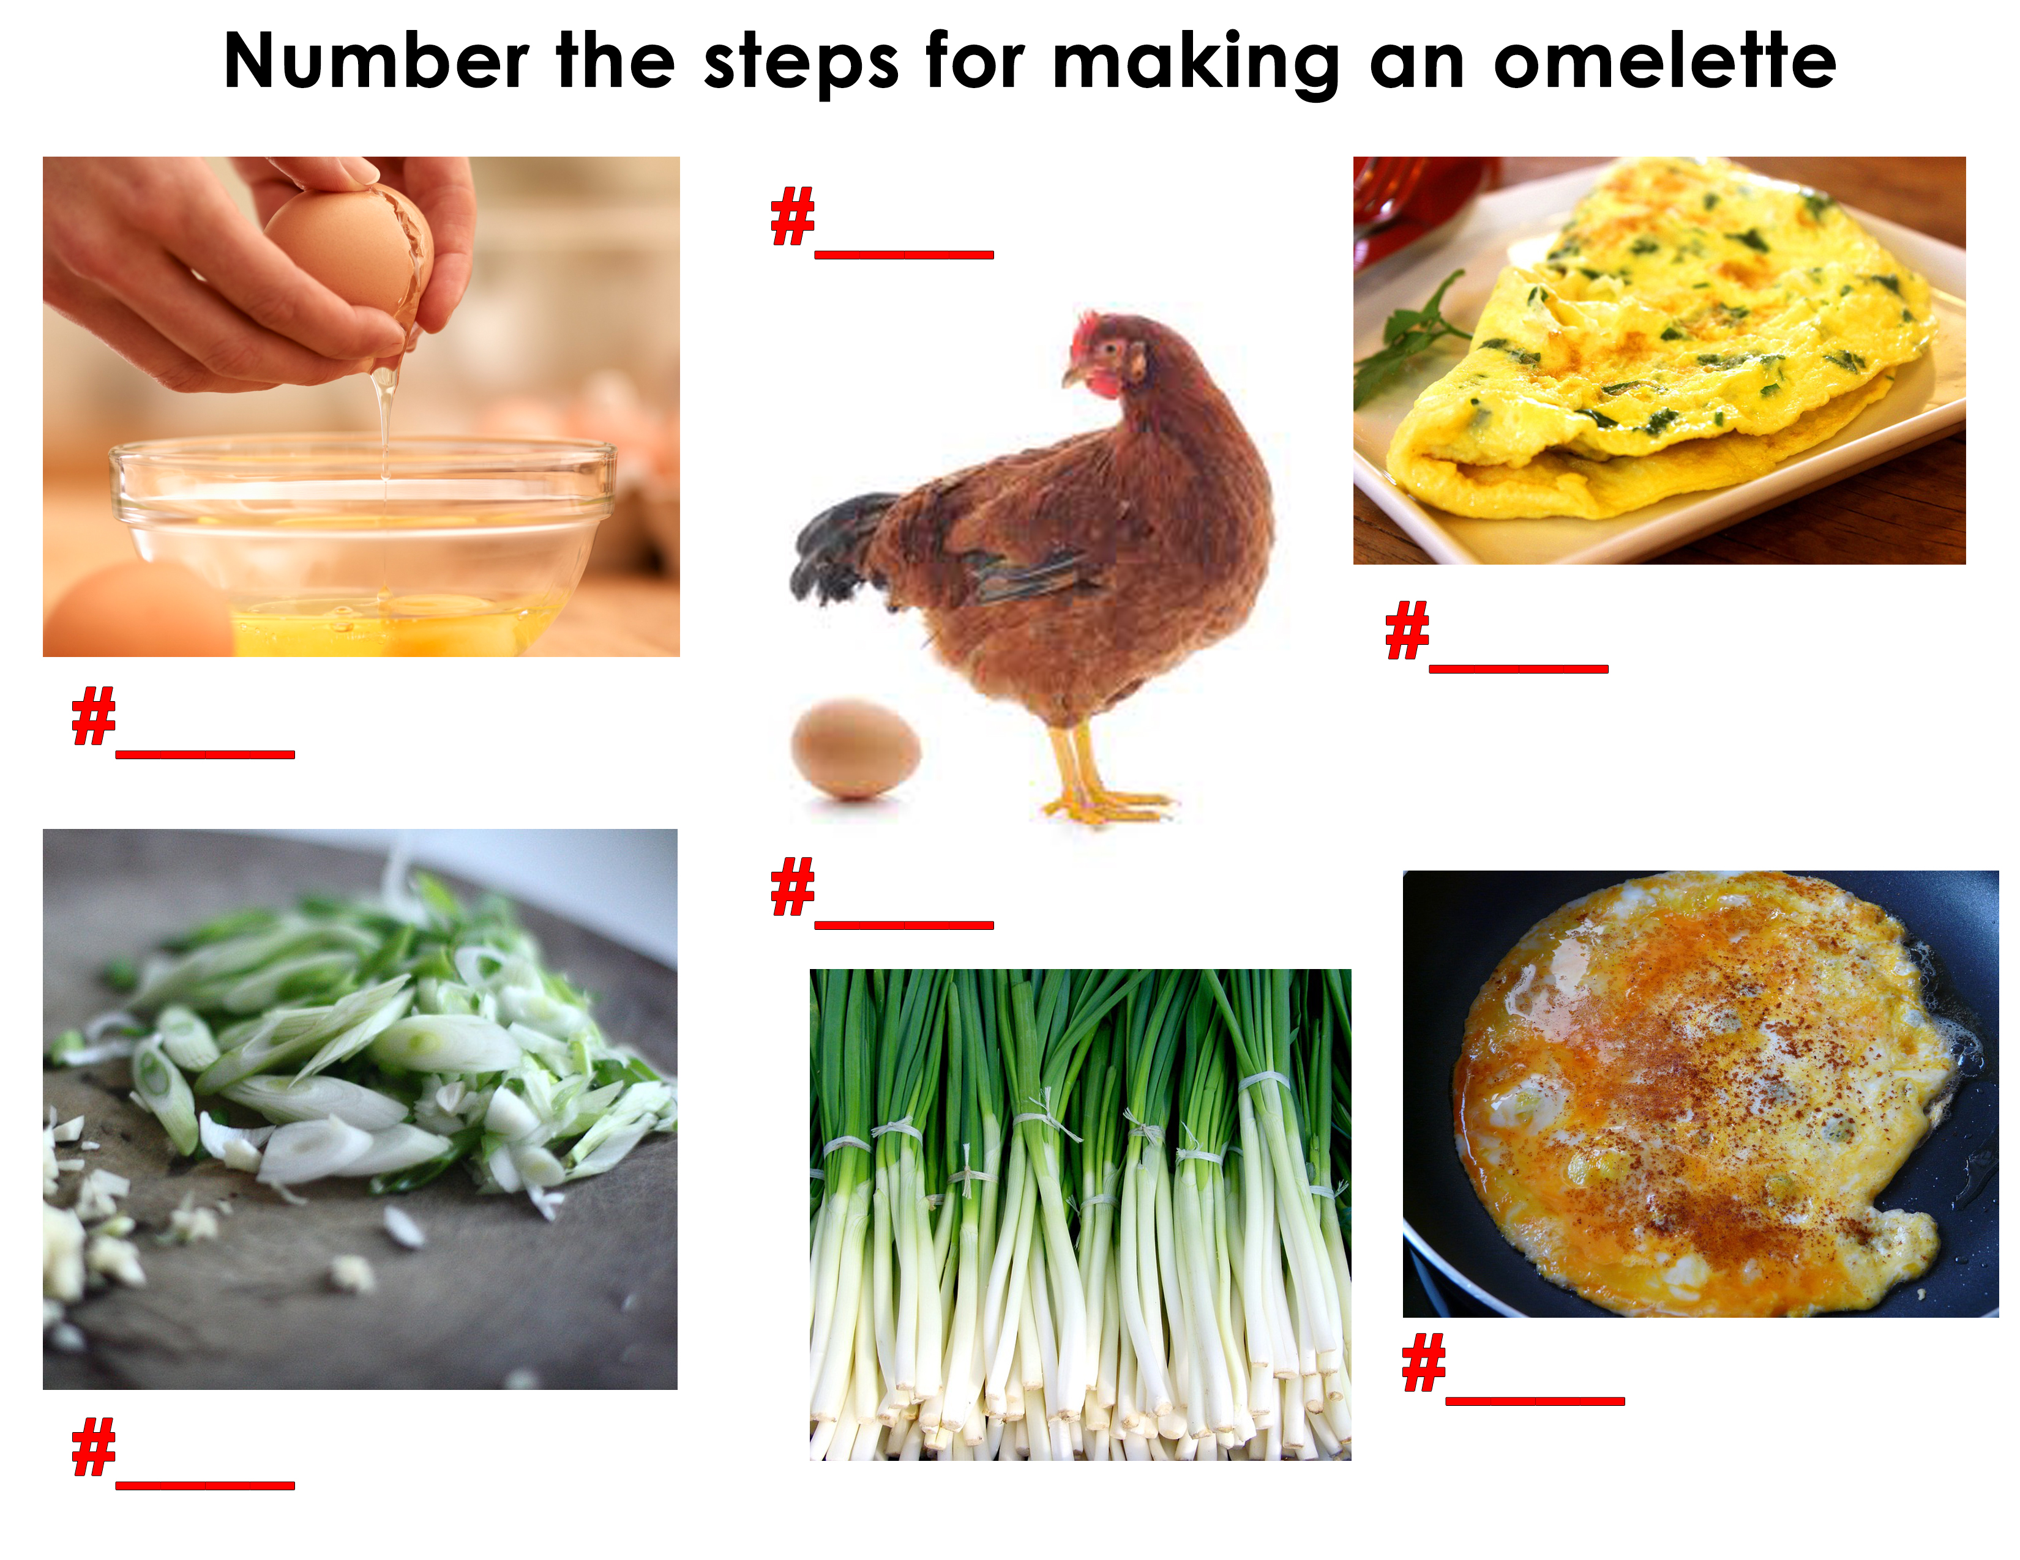
How do you make…
Notes:
Get students to number the steps for each photo. Ask them why they numbered it the way they did. The egg cracking and the chopped green onion are interchangeable.

Slide 8
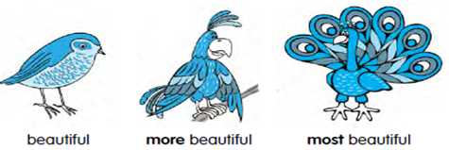
More and most
When we compare two things, we use the comparative adjective “more”.
When we compare one thing or a few things with many other things, we use “most”.
Notes:
Explain slide

Slide 9
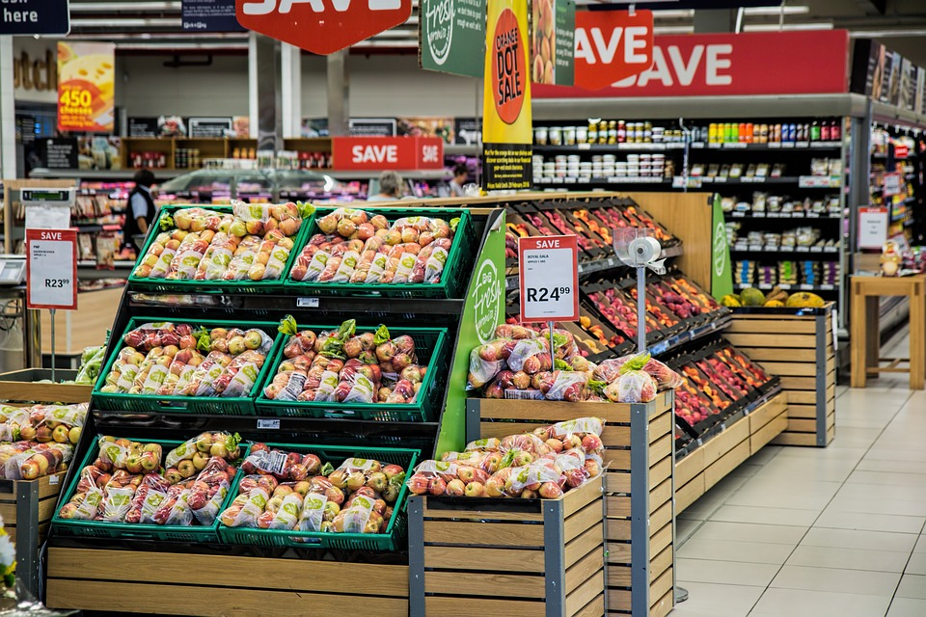
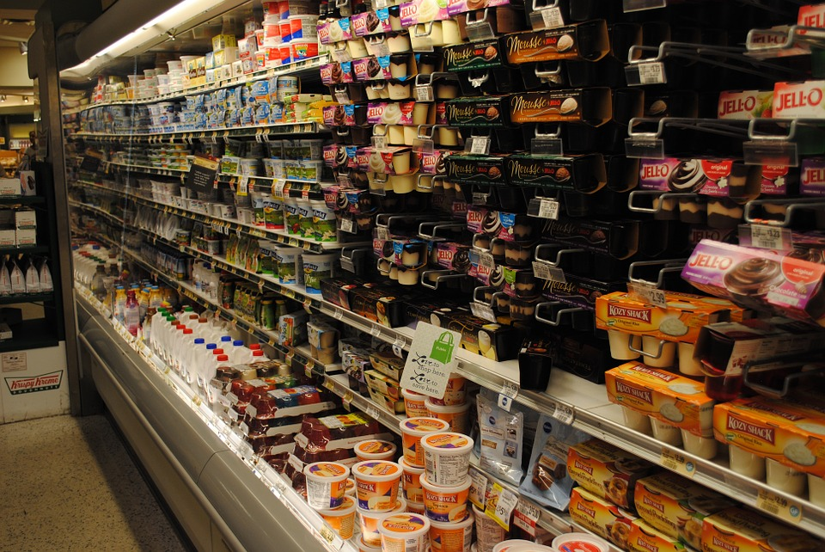
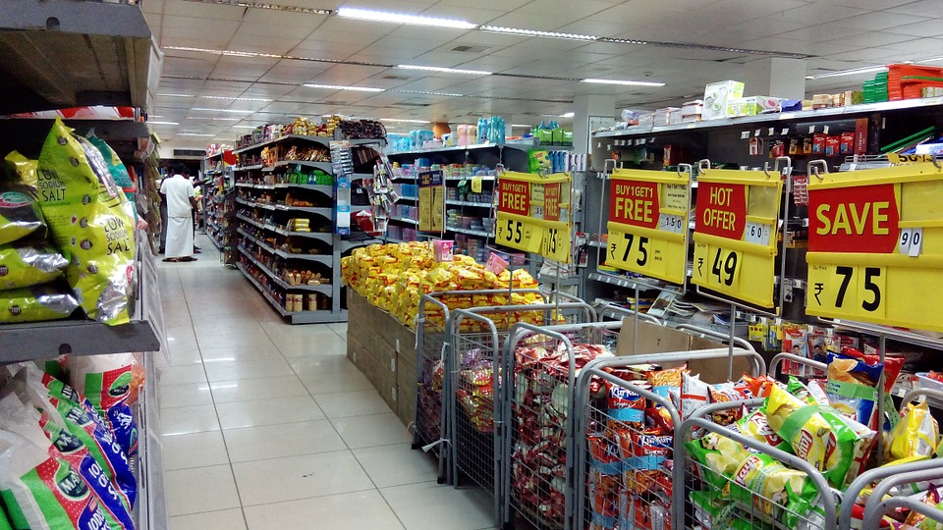
More and most
Examples:
This grocery store is more expensive than the one by my house.
This grocery store is the most expensive store in the city.
Notes:
Explain slide

Slide 10
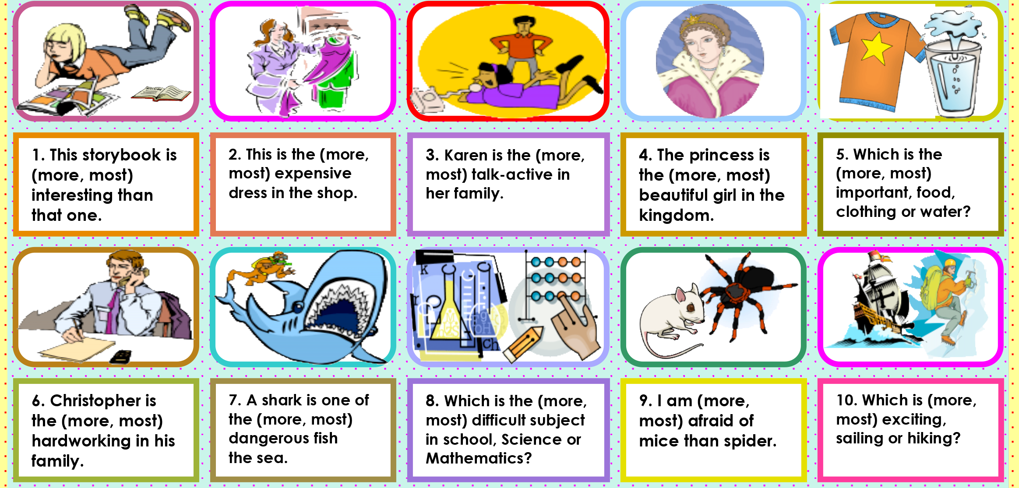
More or most?
Notes:
Go over each example and ask the students if it’s more or most
1. more 2. most 3. most 4. most 5. most 6. most 7. most 8. most 9. more 10. most

Slide 11
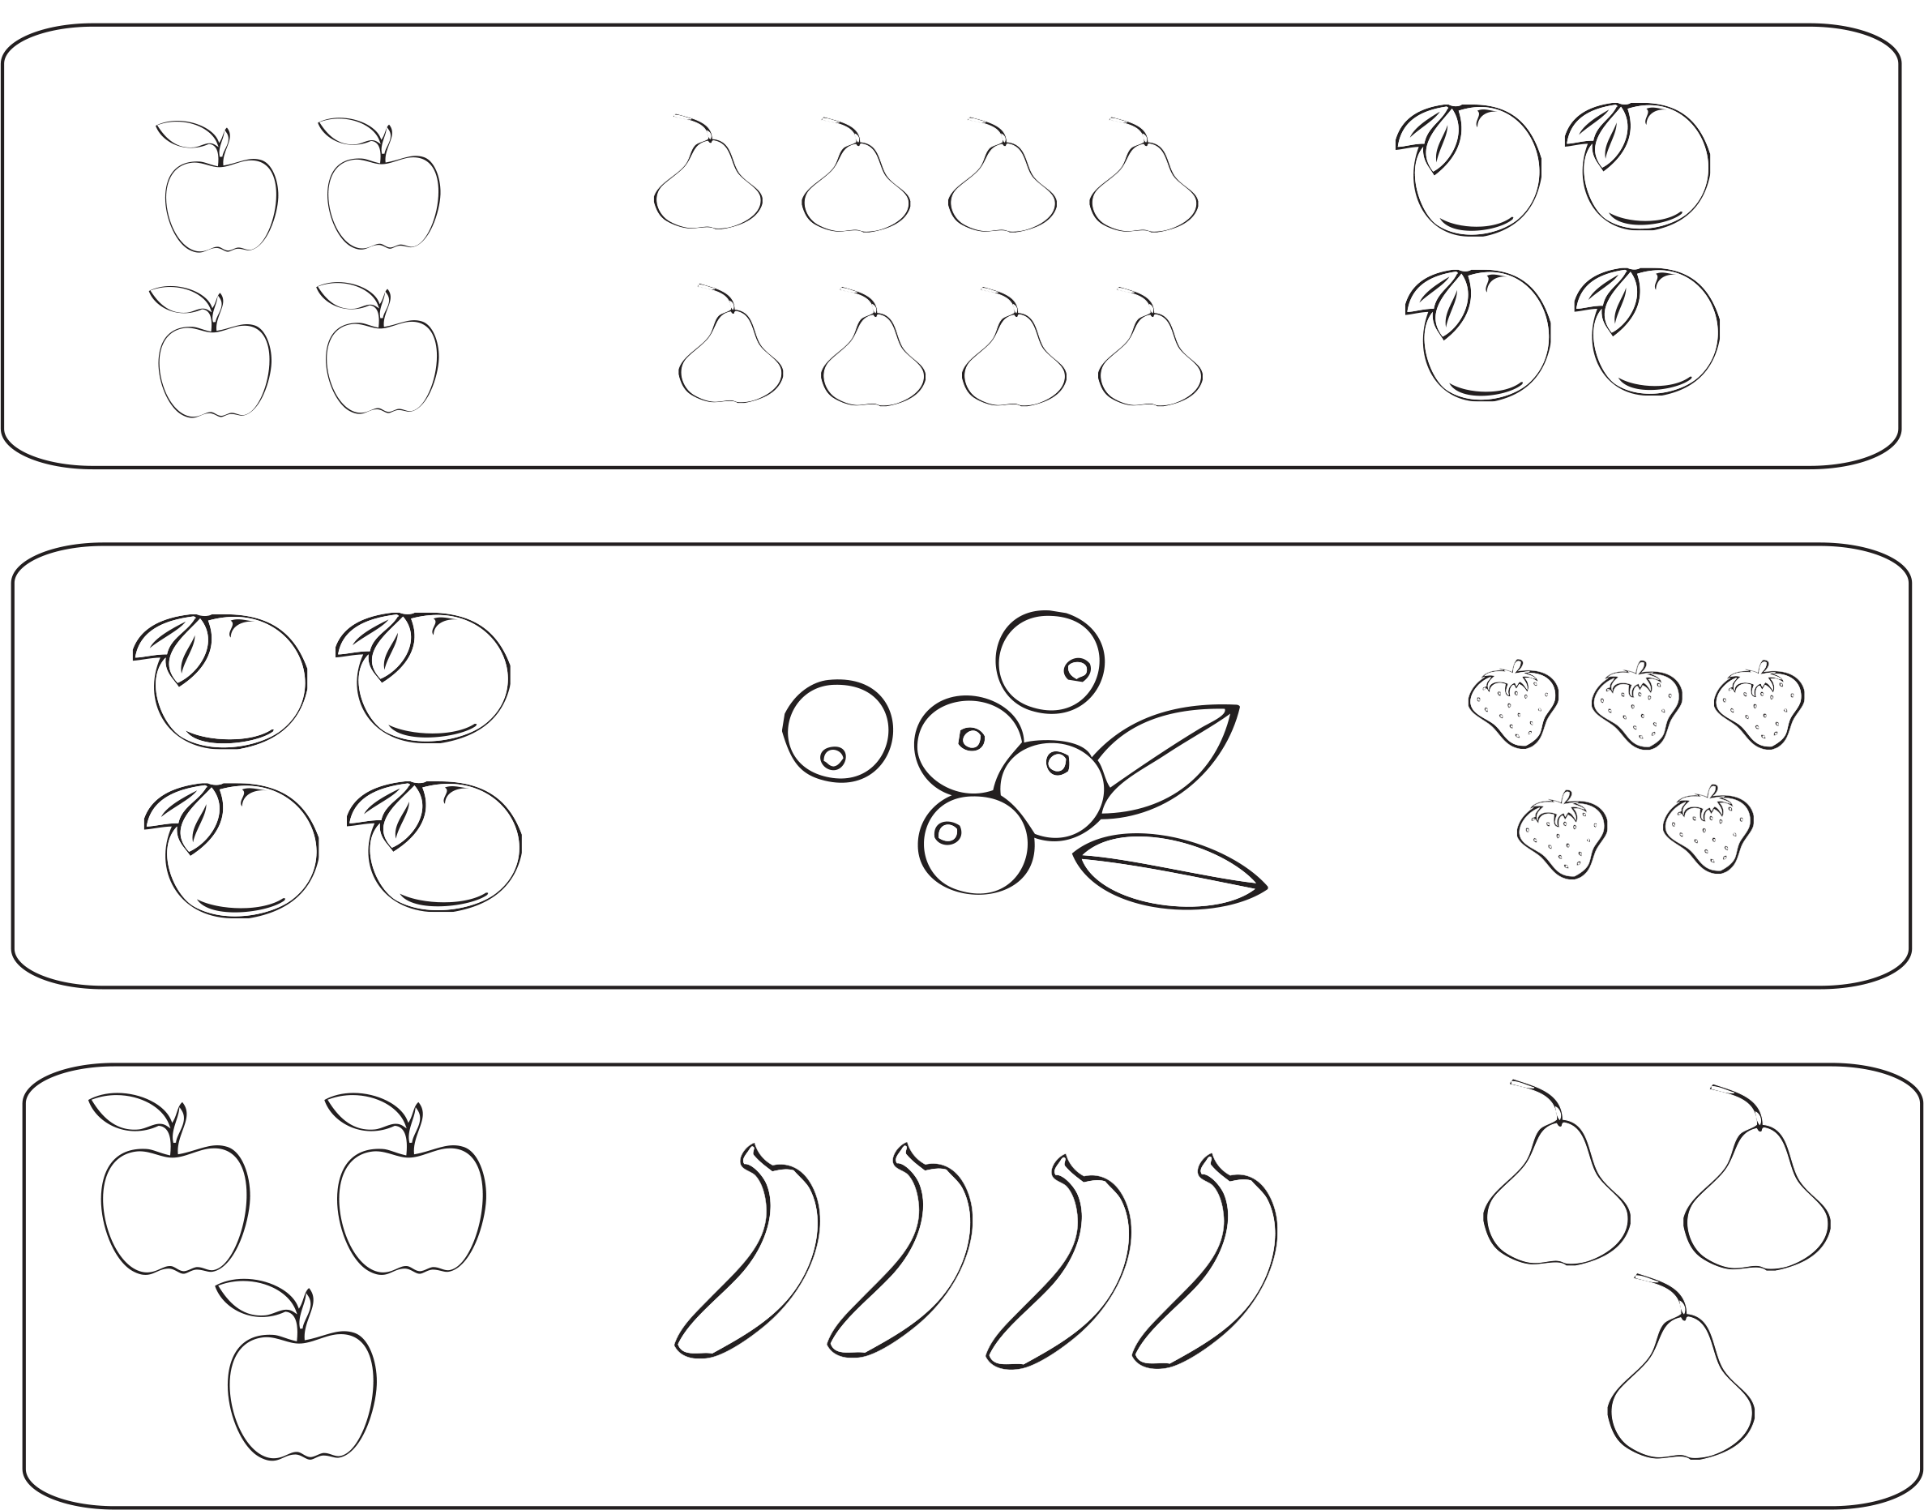
Which group has the most fruit?
Notes:
Ask students which which has the most fruit.

Slide 12
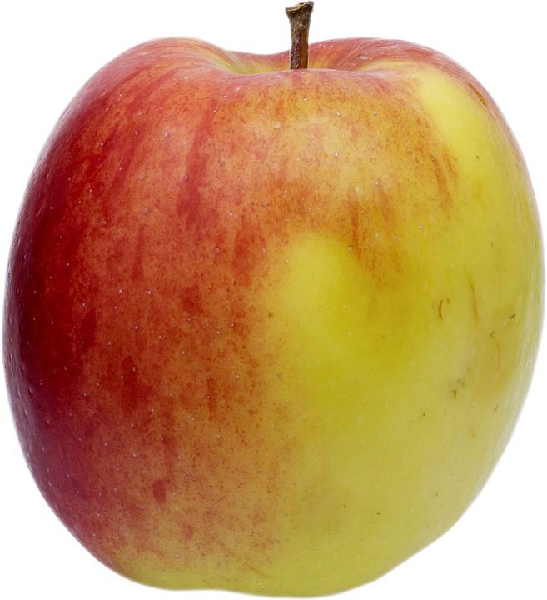
There was/there were
We use there was when we want to name only one thing.
There was an apple on the tree.
We use there were when we want to name two or more things.
There were apples on the tree.
Notes:
Explain slide

Slide 13
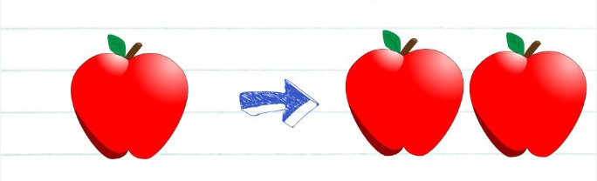
Remember:
There was → Singular
Past tense of “there is”
There were→ Plural
Past tense of “there are”
Notes:
Explain slide

Slide 14
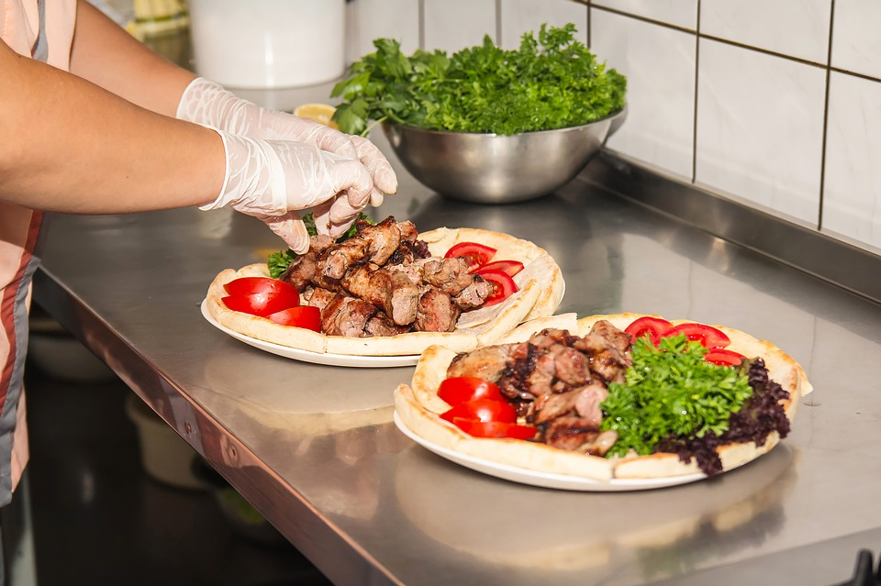
Let’s practice
Use “There was” or “There were”.
____________ two tables.
____________ a kitchen.
____________ three men.
____________ some boxes.
____________ a man with a hat.
____________ a girl in the park.
Notes:
Do this activity verbally alternating between the students.
1. There were 2. There was 3. There were 4. There were 5. There was 6. There was

Slide 15
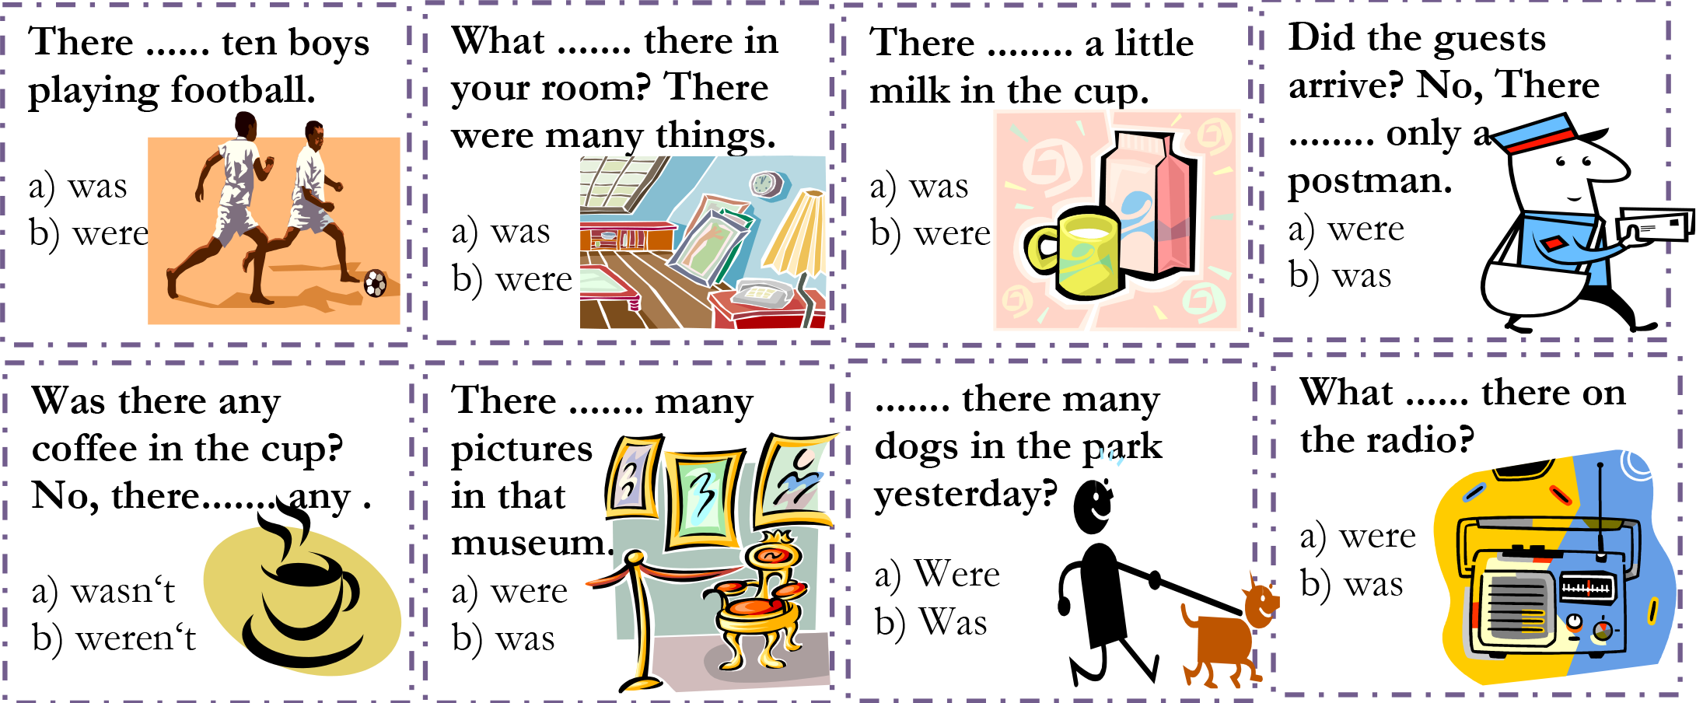
There was or there were?
Notes:
Do this activity verbally alternating between the students.

Slide 16
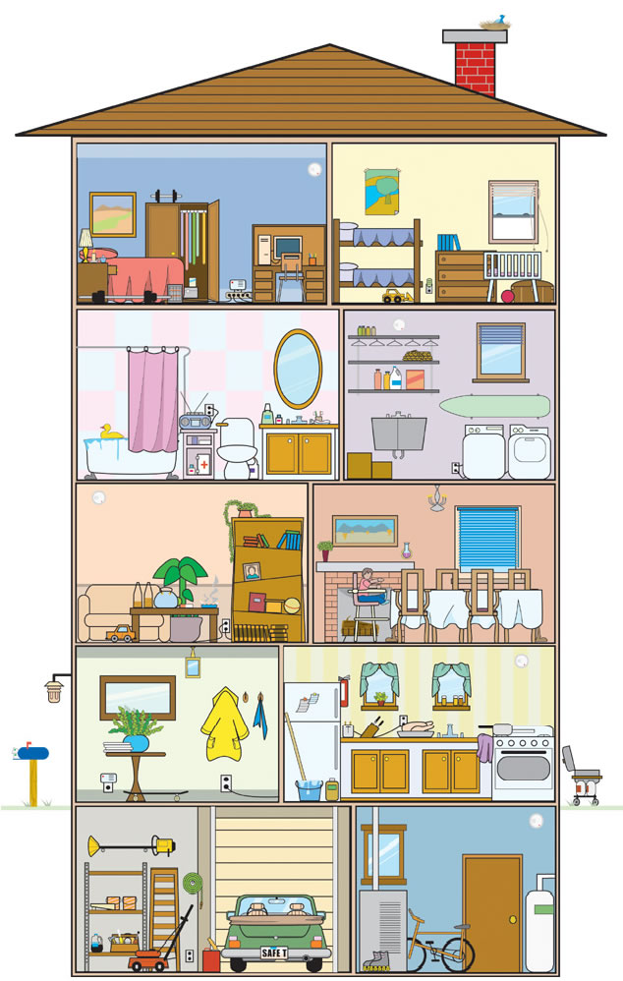
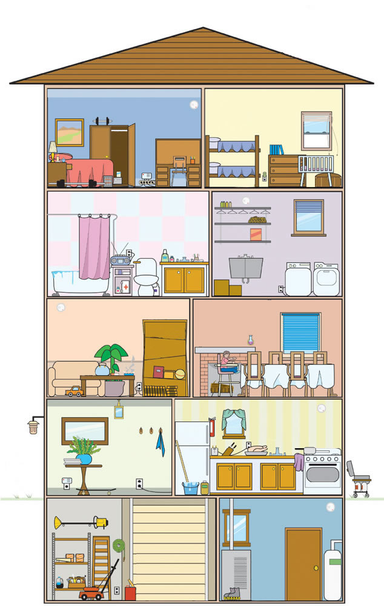
Say what is missing from the house.
Use
there was
there were
(eg.: There was a mirror on the wall in the bathroom.)
Notes:
Get students to compare two pages and state the differences between the two houses. What’s missing in the second one? (i.e. There was a mirror in the bathroom.)

Slide 17
Look carefully at the following objects and try to remember as much as you can

Slide 18
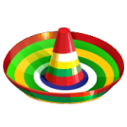

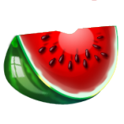

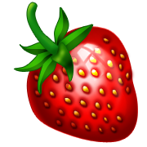



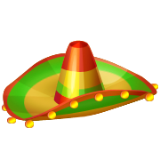
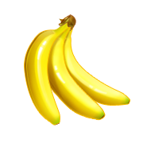


Notes:
Tell the students to try and remember as much as they can in the picture for 1 minute

Slide 19


Make 2 lists : Singular Plural 1) There was… 2) There were… There was… There were… There was… There were… There was… There were…
Notes:
Tell students to make two lists on a piece of paper.

Slide 20
Notes:
Tell the students to look at it one more time for 1 minute. They should add to their list.

Slide 21
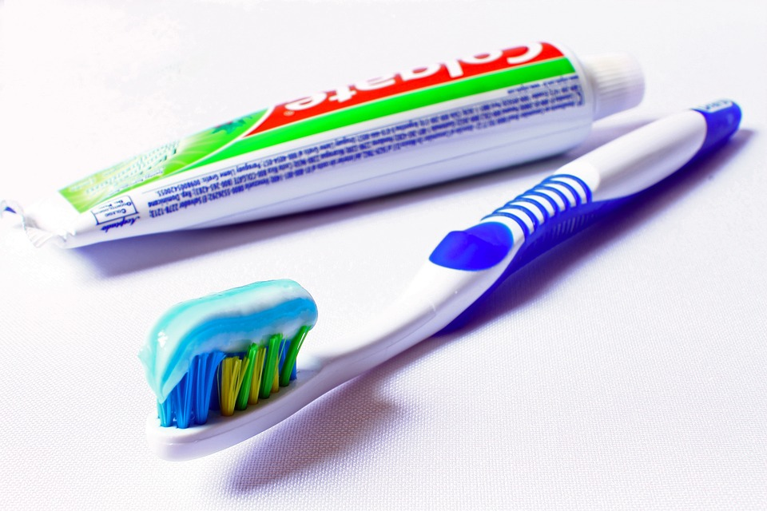
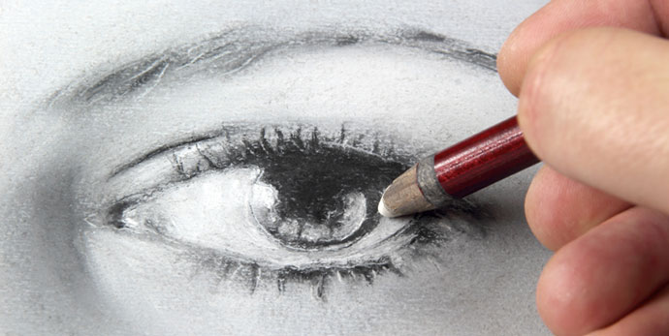
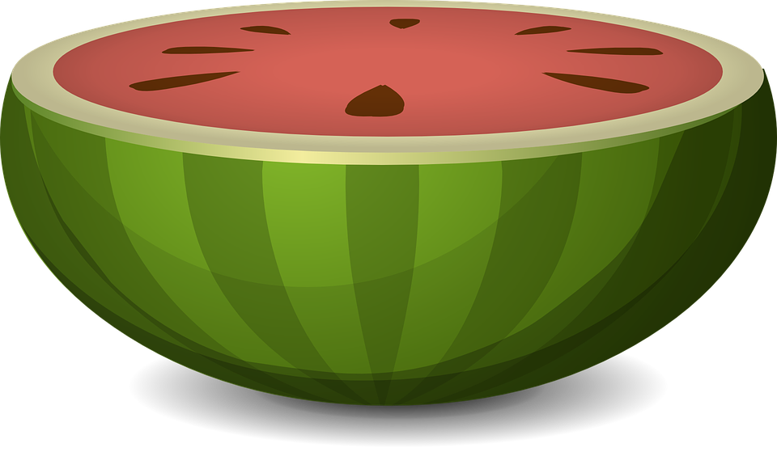
There was 1 clock
There was 1 eye
There was 1 table
There was 1 bag
There was 1 rug
There was 1 flag
There was 1 bed
There was 1 key
There was 1 watermelon
There was 1 toothbrush

Slide 22
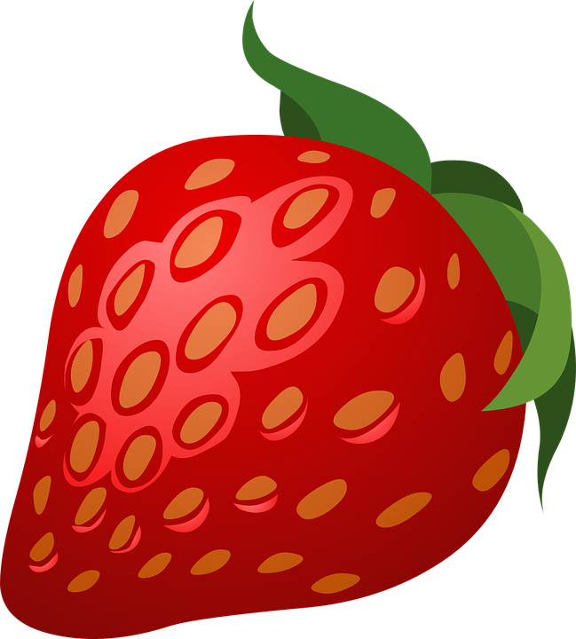
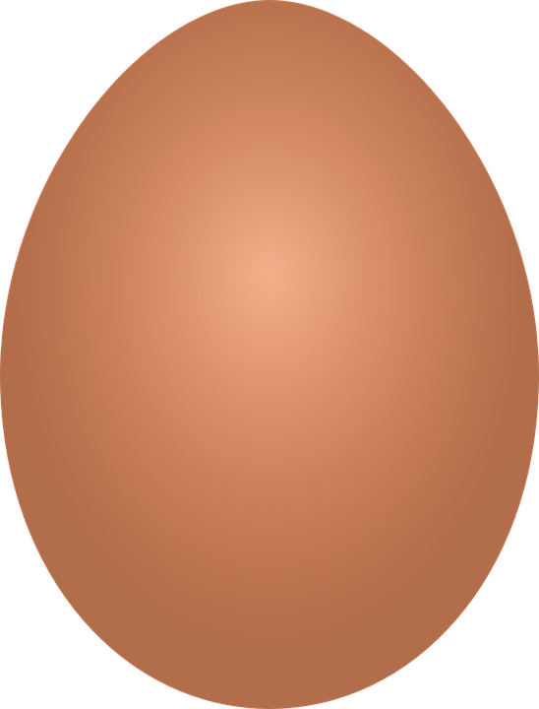
There were 2 hats
There were 3 bananas
There were 2 chairs
There were 3 balls
There were 2 houses
There were 4 books
There were 3 bikes
There were 4 eggs
There were 3 bottles
There were 3 strawberries

Slide 23
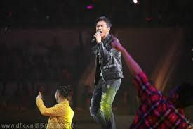


Let’s practice!
Notes:
Get the students to read/sing their chosen song/poem. Ask them if they have been practicing, and remind them their recording is due next class.

Slide 24
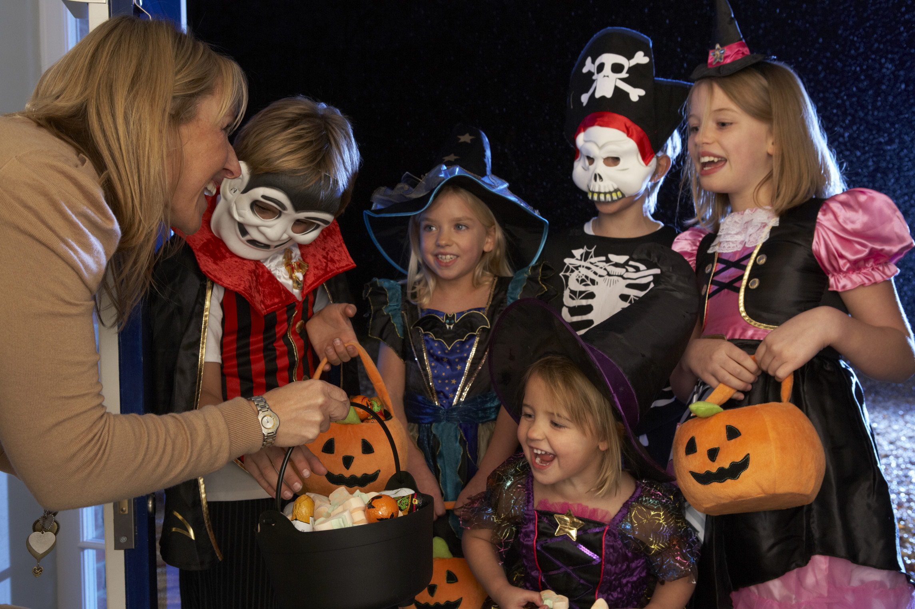
What is happening in this photo?
Notes:
Explain to the students the tradition of Halloween.

Slide 25
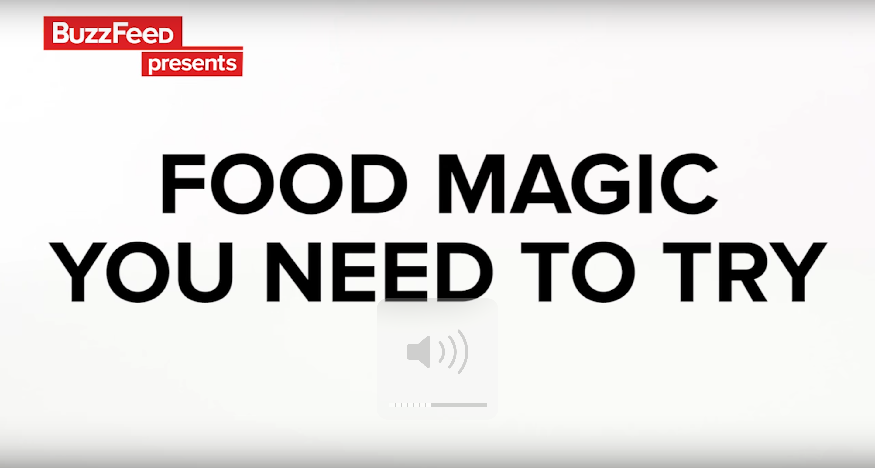
Food Magic Tricks
Notes:
Play “Food Magic Tricks.mp4”. If you are able, demonstrate the boiled egg trick for the students. Make sure to stop the video for discussion. Questions: Do you do science experiments at your school? Do you ever use food? Did you think that food could be related to science? Would you try one of these experiments at home?

Slide 26
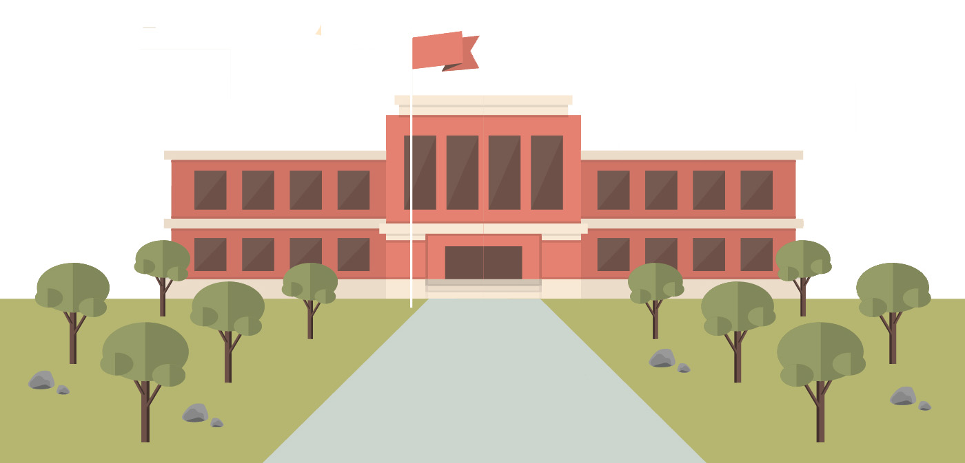
What did we learn?
Saying the ‘st’ sound
New “st” words
How to use “more”, “most”, “there was” and “there were”
How to make an omelette
Notes:
Go over the learning goals.

Slide 27
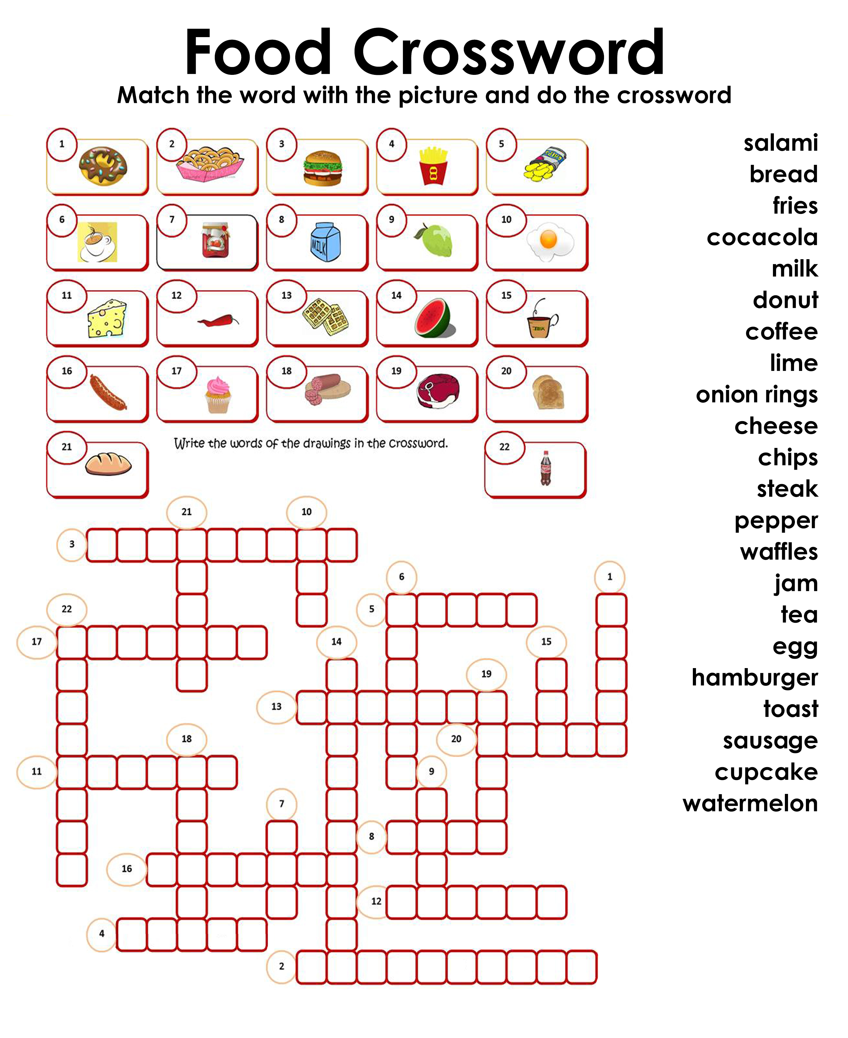
Homework

