Slide 1


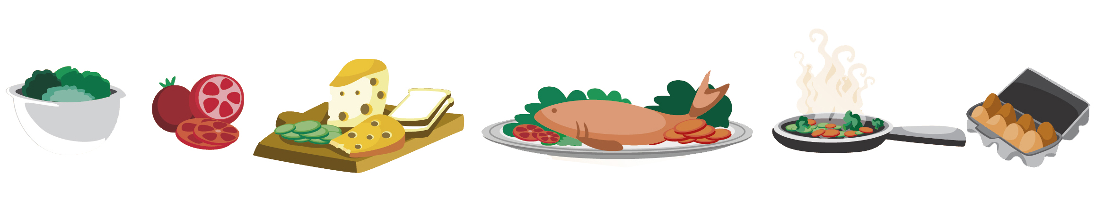
Lesson 11: Tutoring
FOOD

Slide 2

What we will learn today
Word search with ‘st’ vocabulary
Practice “more”
Reading
Compound words
Notes:
Go over the learning goals.

Slide 3
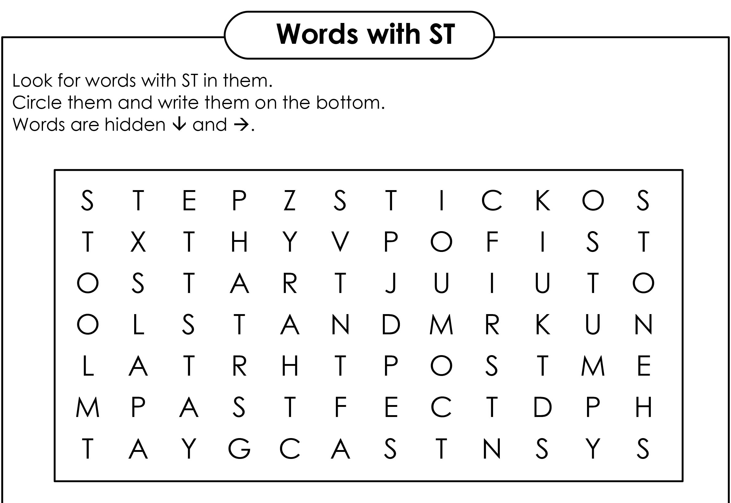
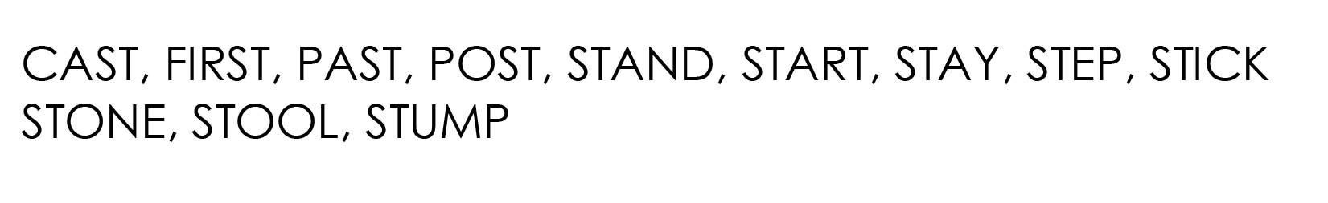
Word Search

Slide 4
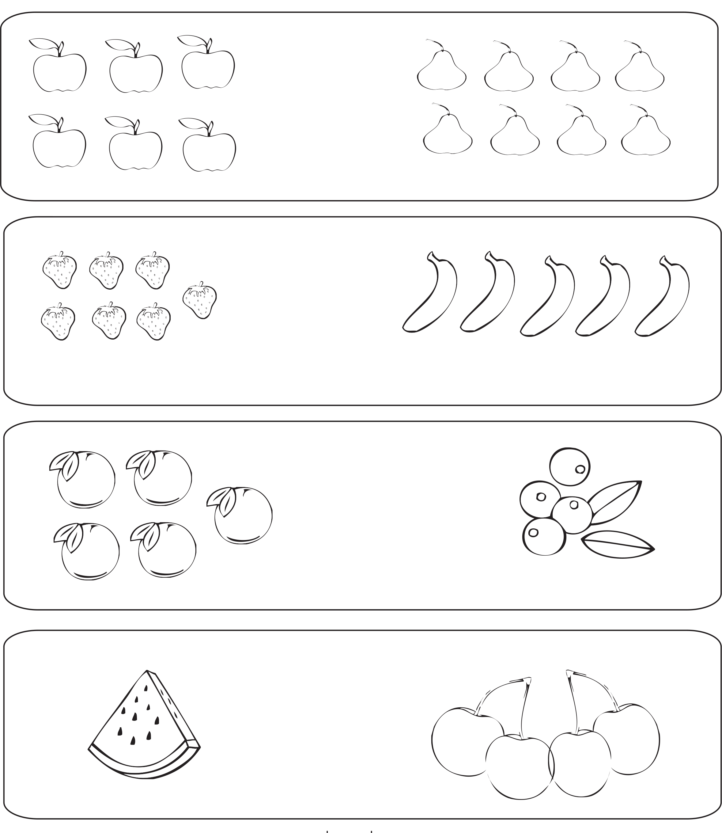
Which fruit has more?
Notes:
Explain the meaning of equal.

Slide 5
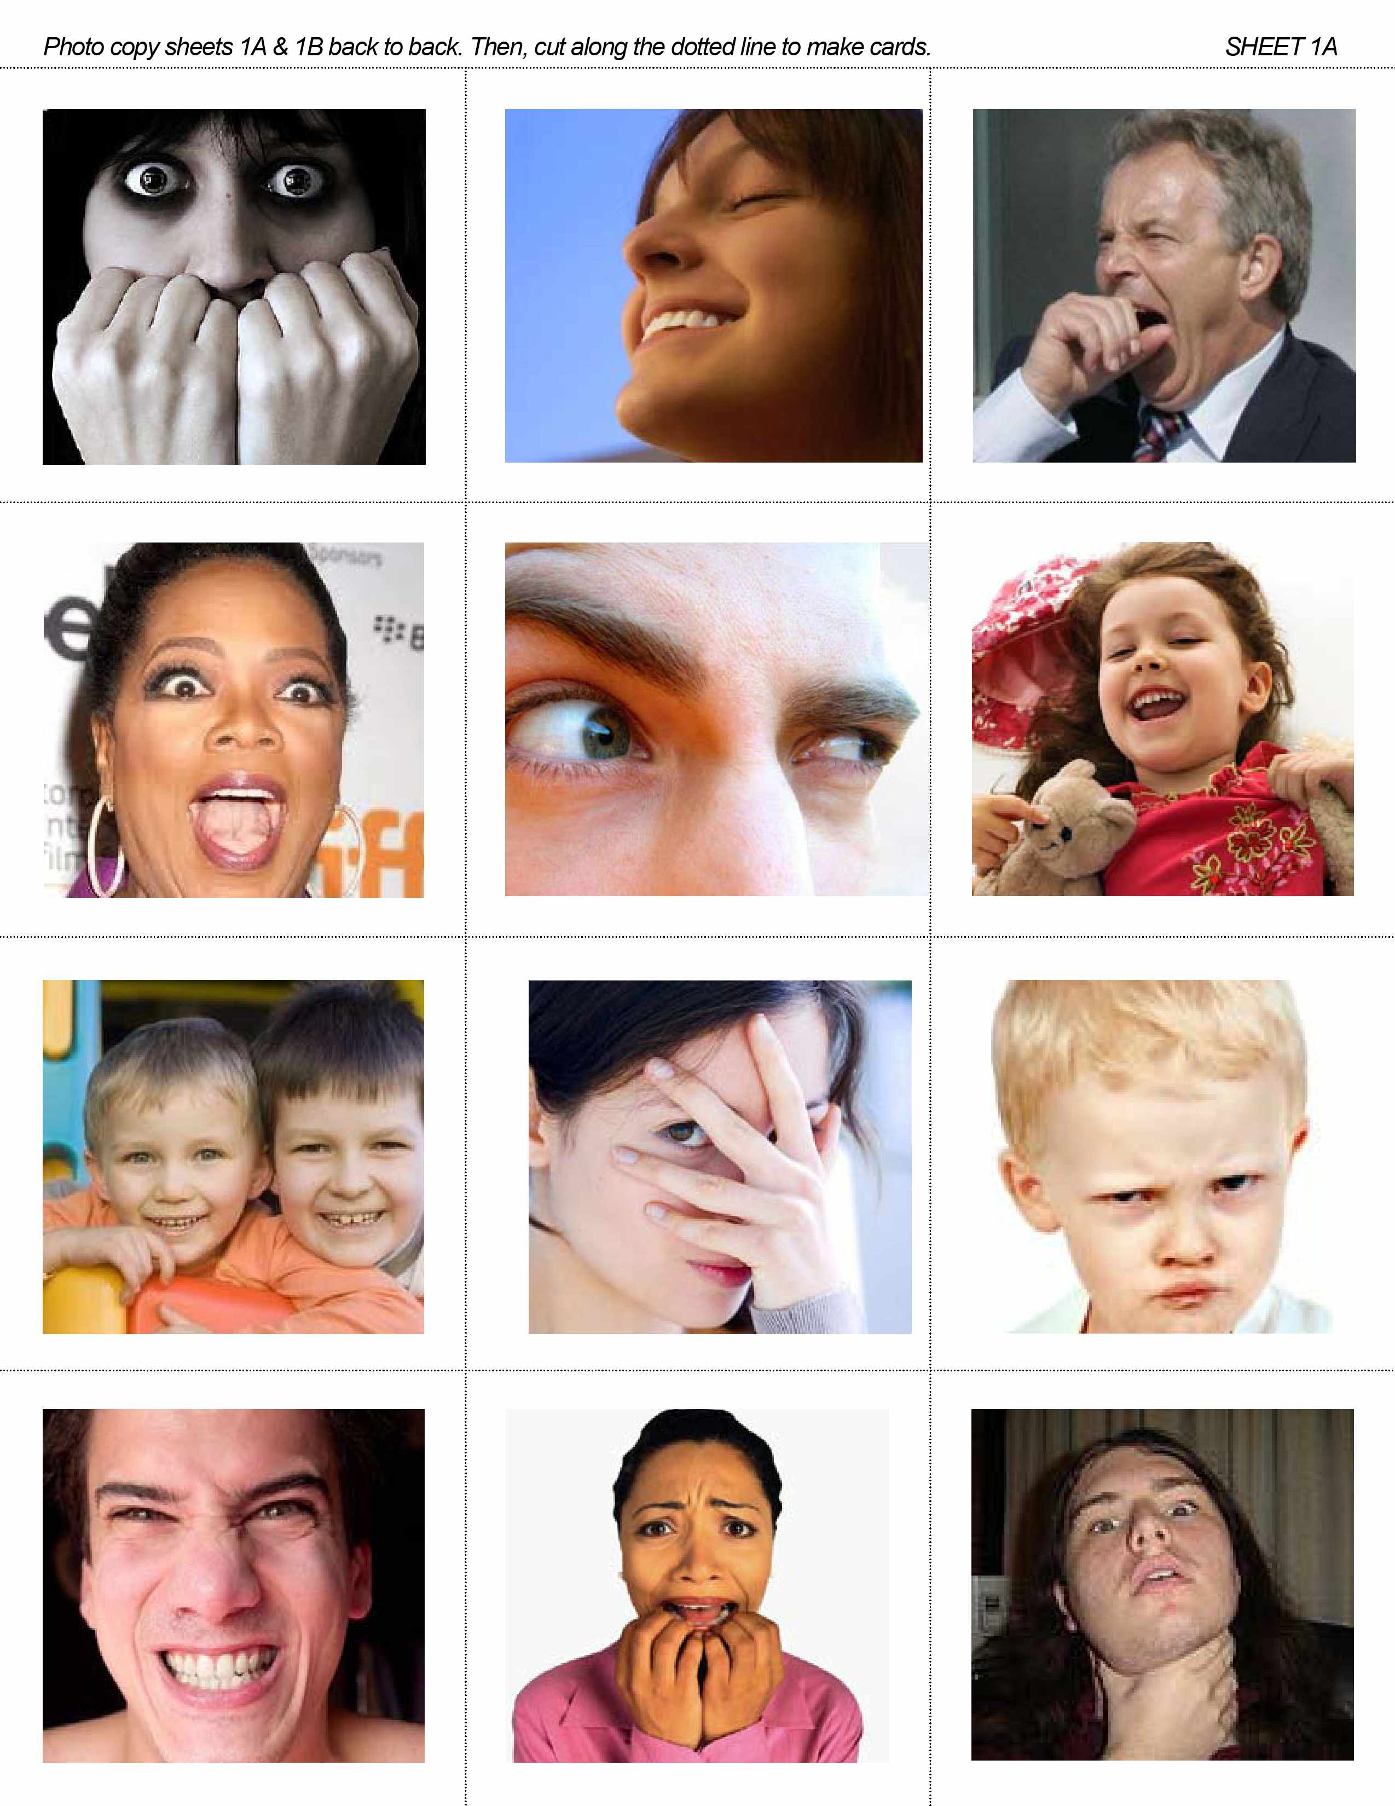
How do you think each person in the picture feels?
happy?
surprised?
angry?
tired?
afraid?
confused?
Notes:
How do you think each person in the picture feels?

Slide 6

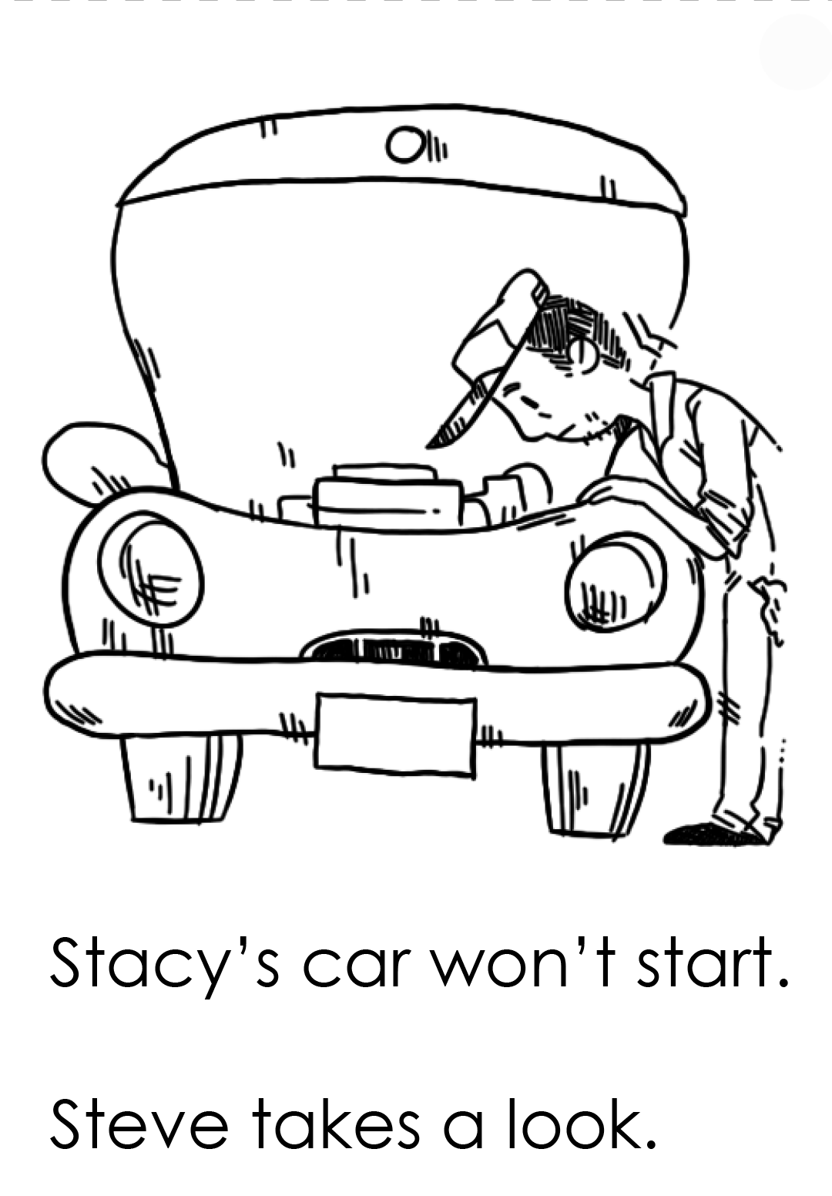
Story Time

Slide 7
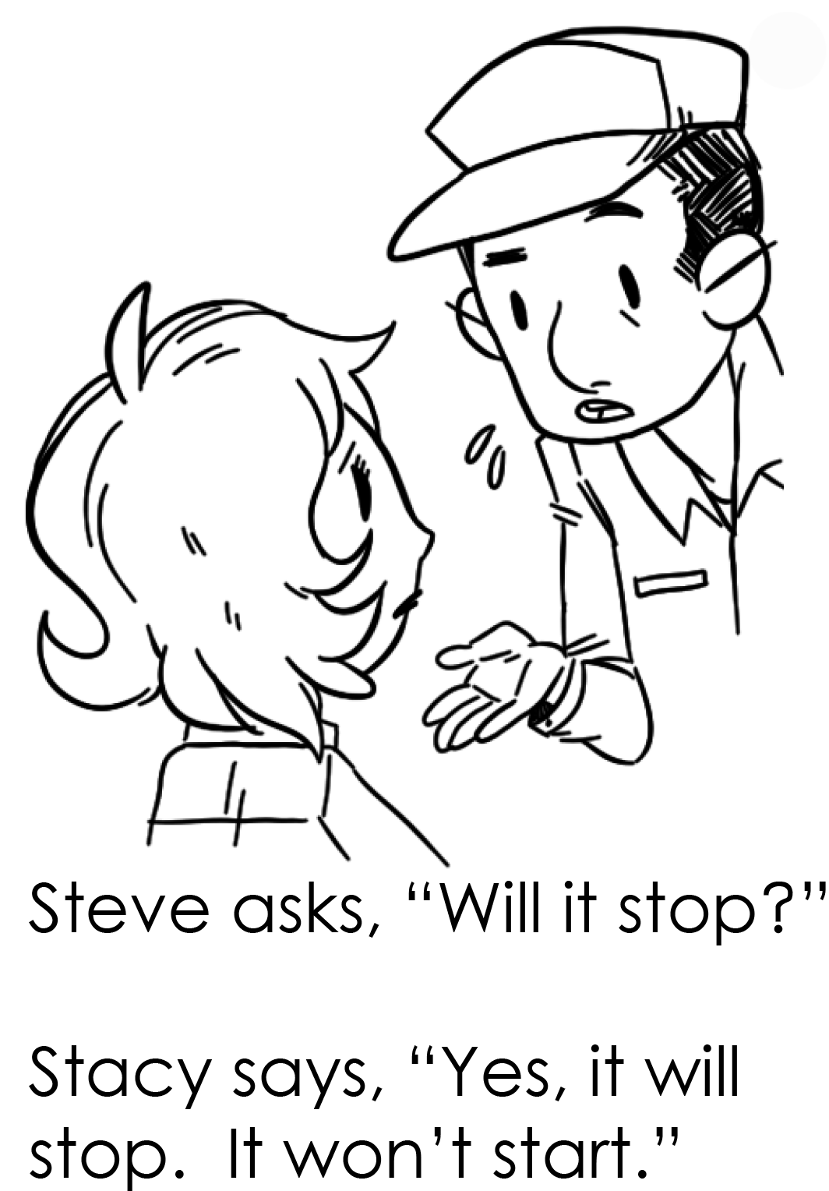
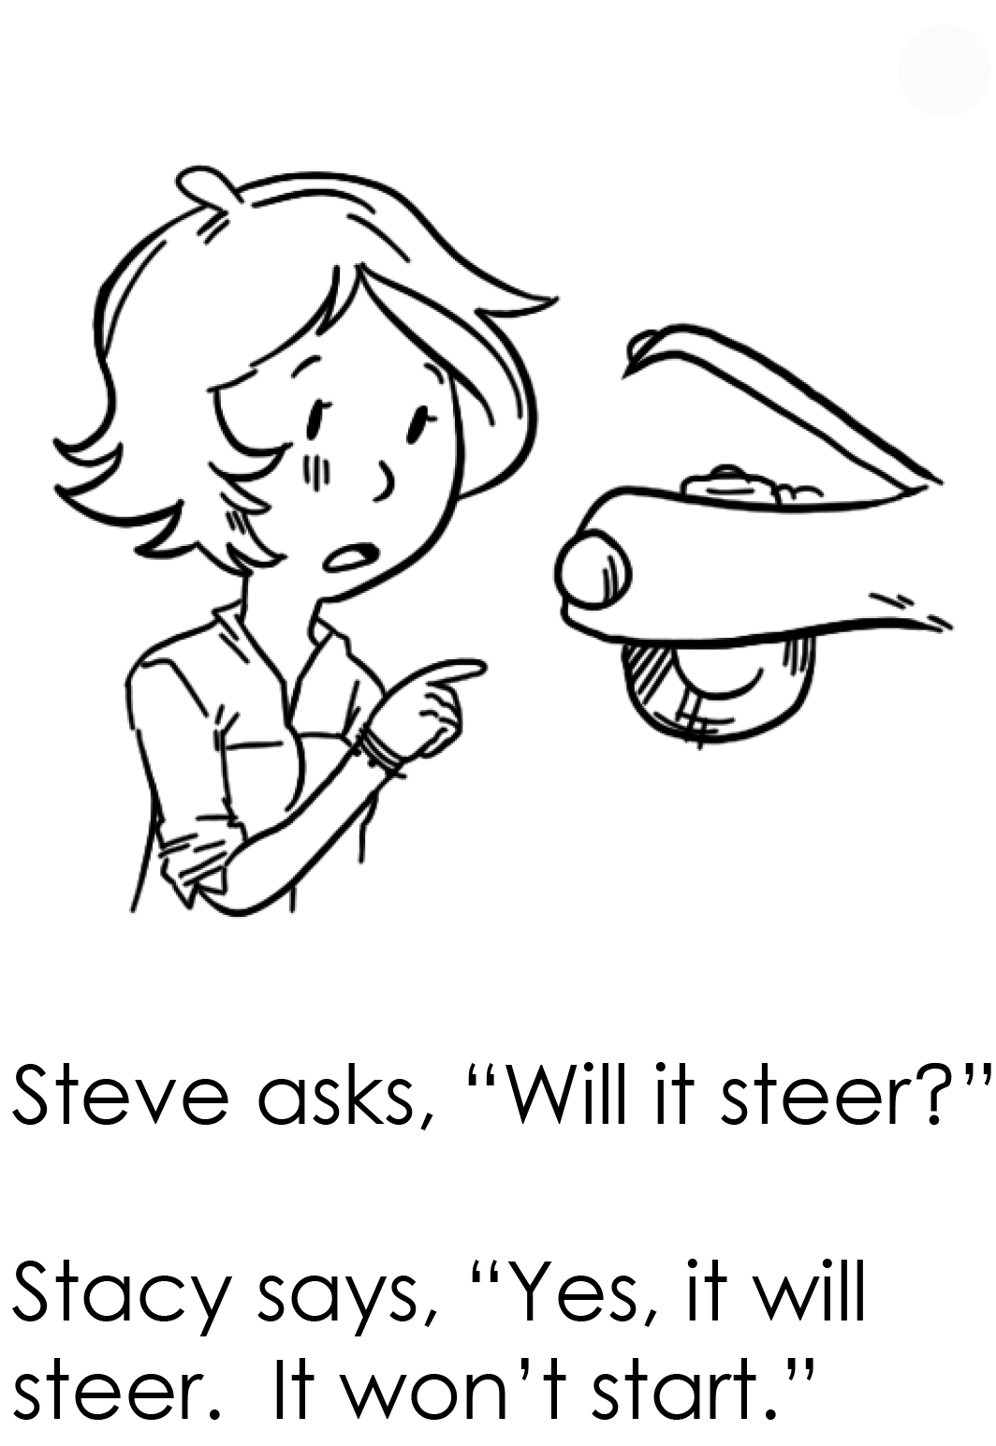

Slide 8
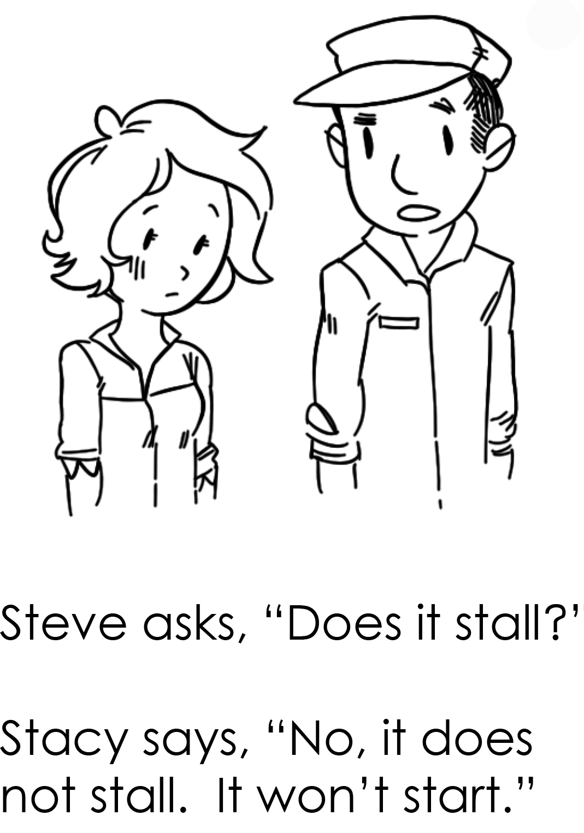
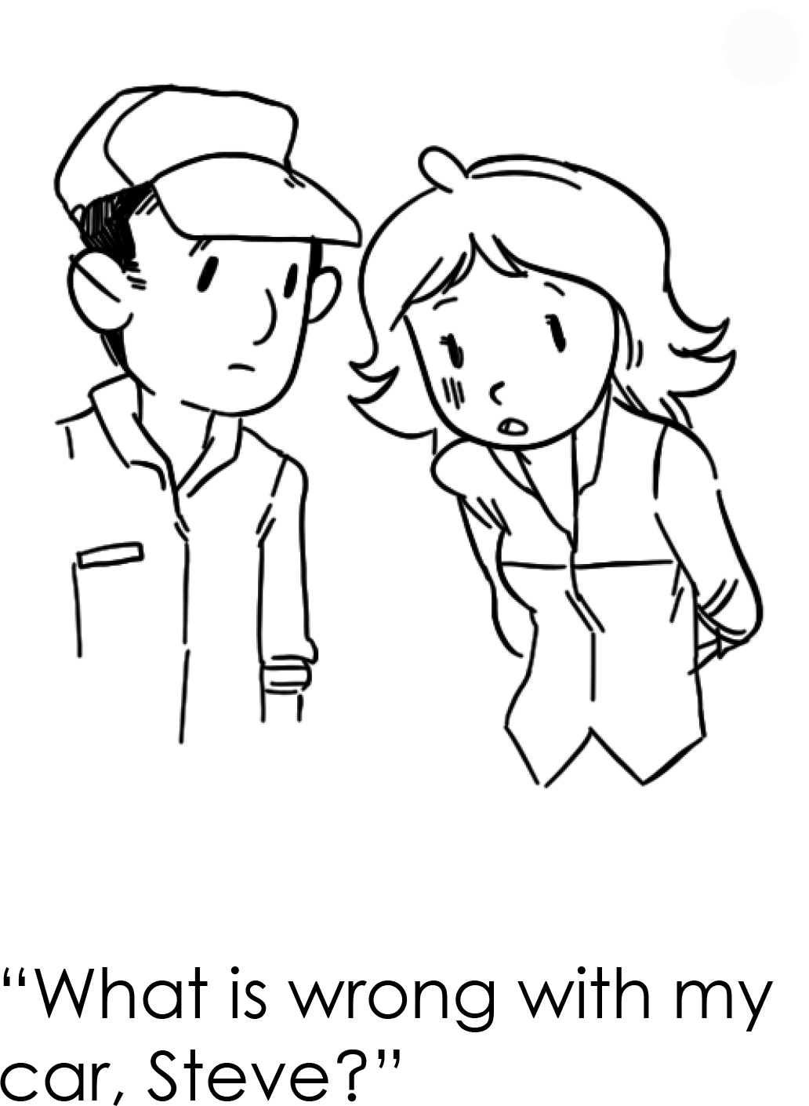

Slide 9
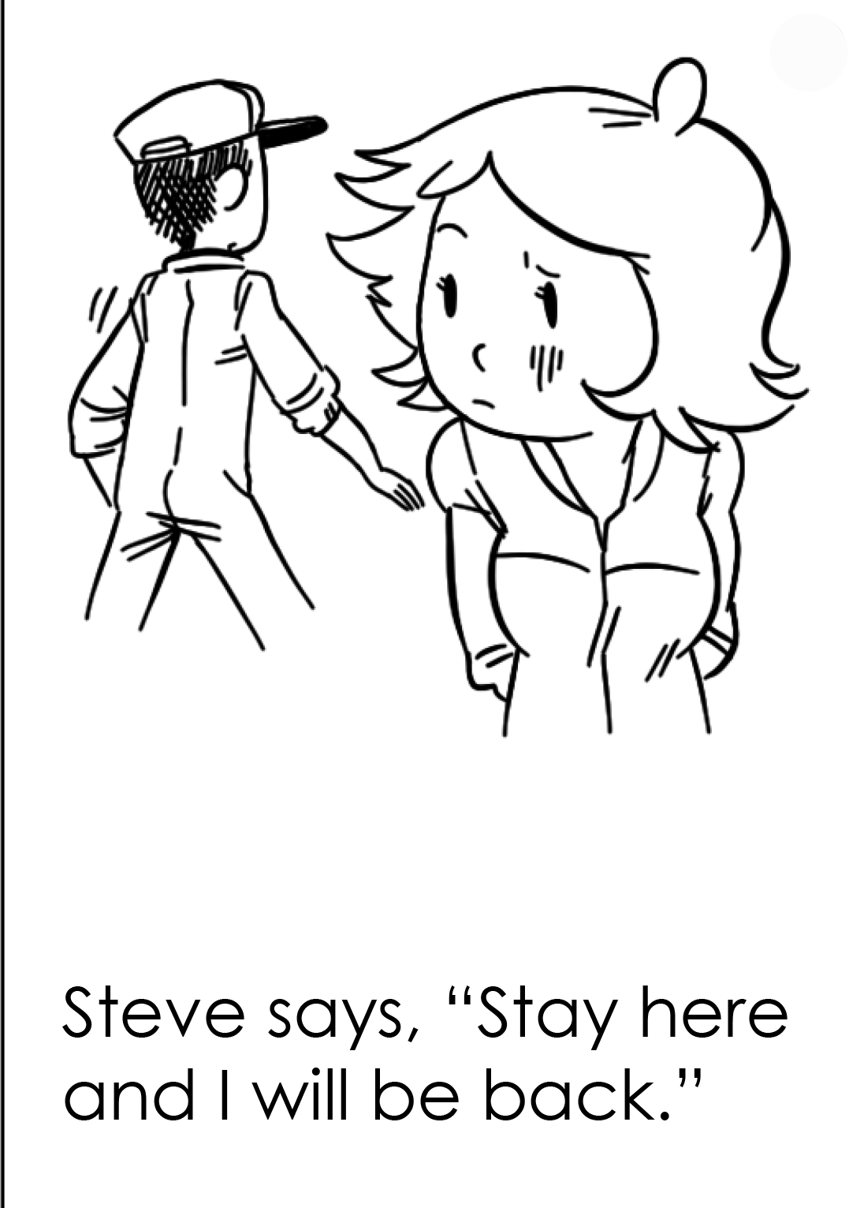
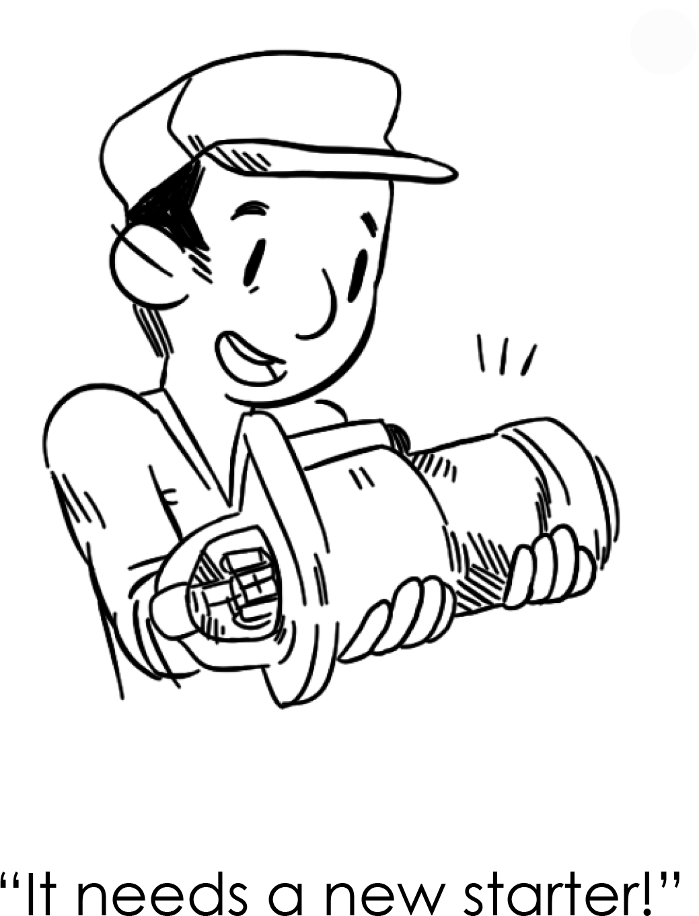

Slide 10
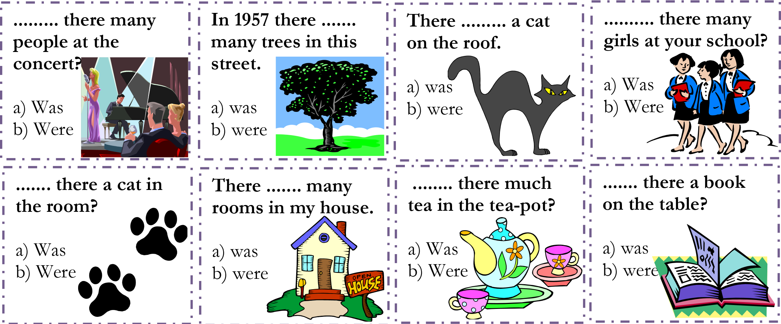
There was or there were?
Notes:
Do the first example, explain “was” is used for the singular and “were” is used for the plural.

Slide 11
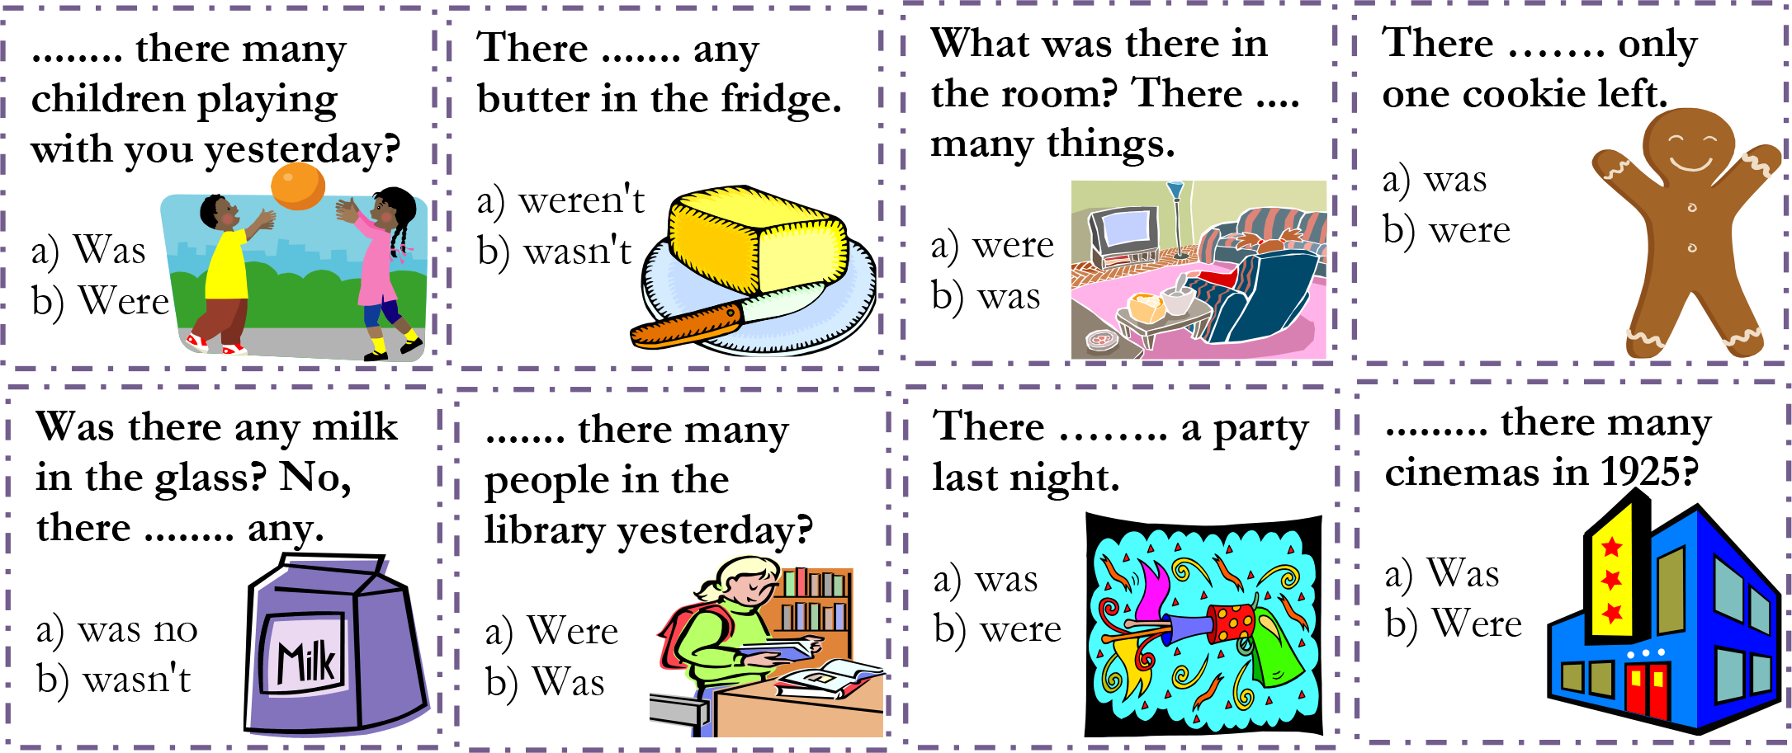
There was or there were?
t

Slide 12
Let’s practice
Choose the correct answer.
There was / There were twenty people at the restaurant.
There was / There were a computer on the desk.
There was / There were many ballons in the sky.
There was / There were a plane in the airport.
There was / There were five cats in the zoo.

Slide 13
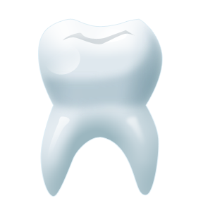
+
toothpaste

Slide 14
+
pancake

Slide 15


+
rainbow

Slide 16

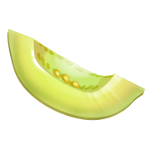
+
watermelon

Slide 17


+
sunflower

Slide 18
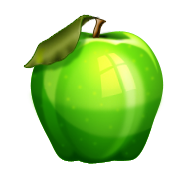
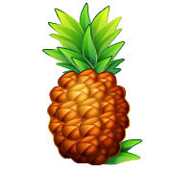
+
pineapple

Slide 19
+
horseshoe

Slide 20
+
snowman

Slide 21
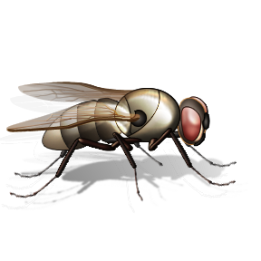

+
butterfly

Slide 22
+
keychain

Slide 23
+
eggplant

Slide 24
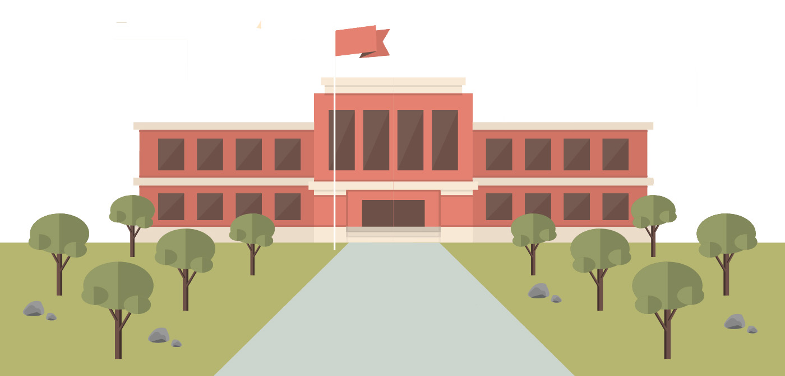
What did we learn?
Saying the ‘st’ sound
New “st” words
How to use “more”, “most”, “there was” and “there were”
How to make an omelette
New compound words
Notes:
Go over the learning goals.

