Slide 1
Lesson 12 FOOD

Slide 2
What we will learn today
Review the ‘sn’, ‘ur’ ‘ar’ and ‘st’ words
Perform our song/poem
Compound words
“His”, “hers”, “its”, “more”, “most”, “and”, “or”, “but”, “because”, “there was” and “there were”

Slide 3
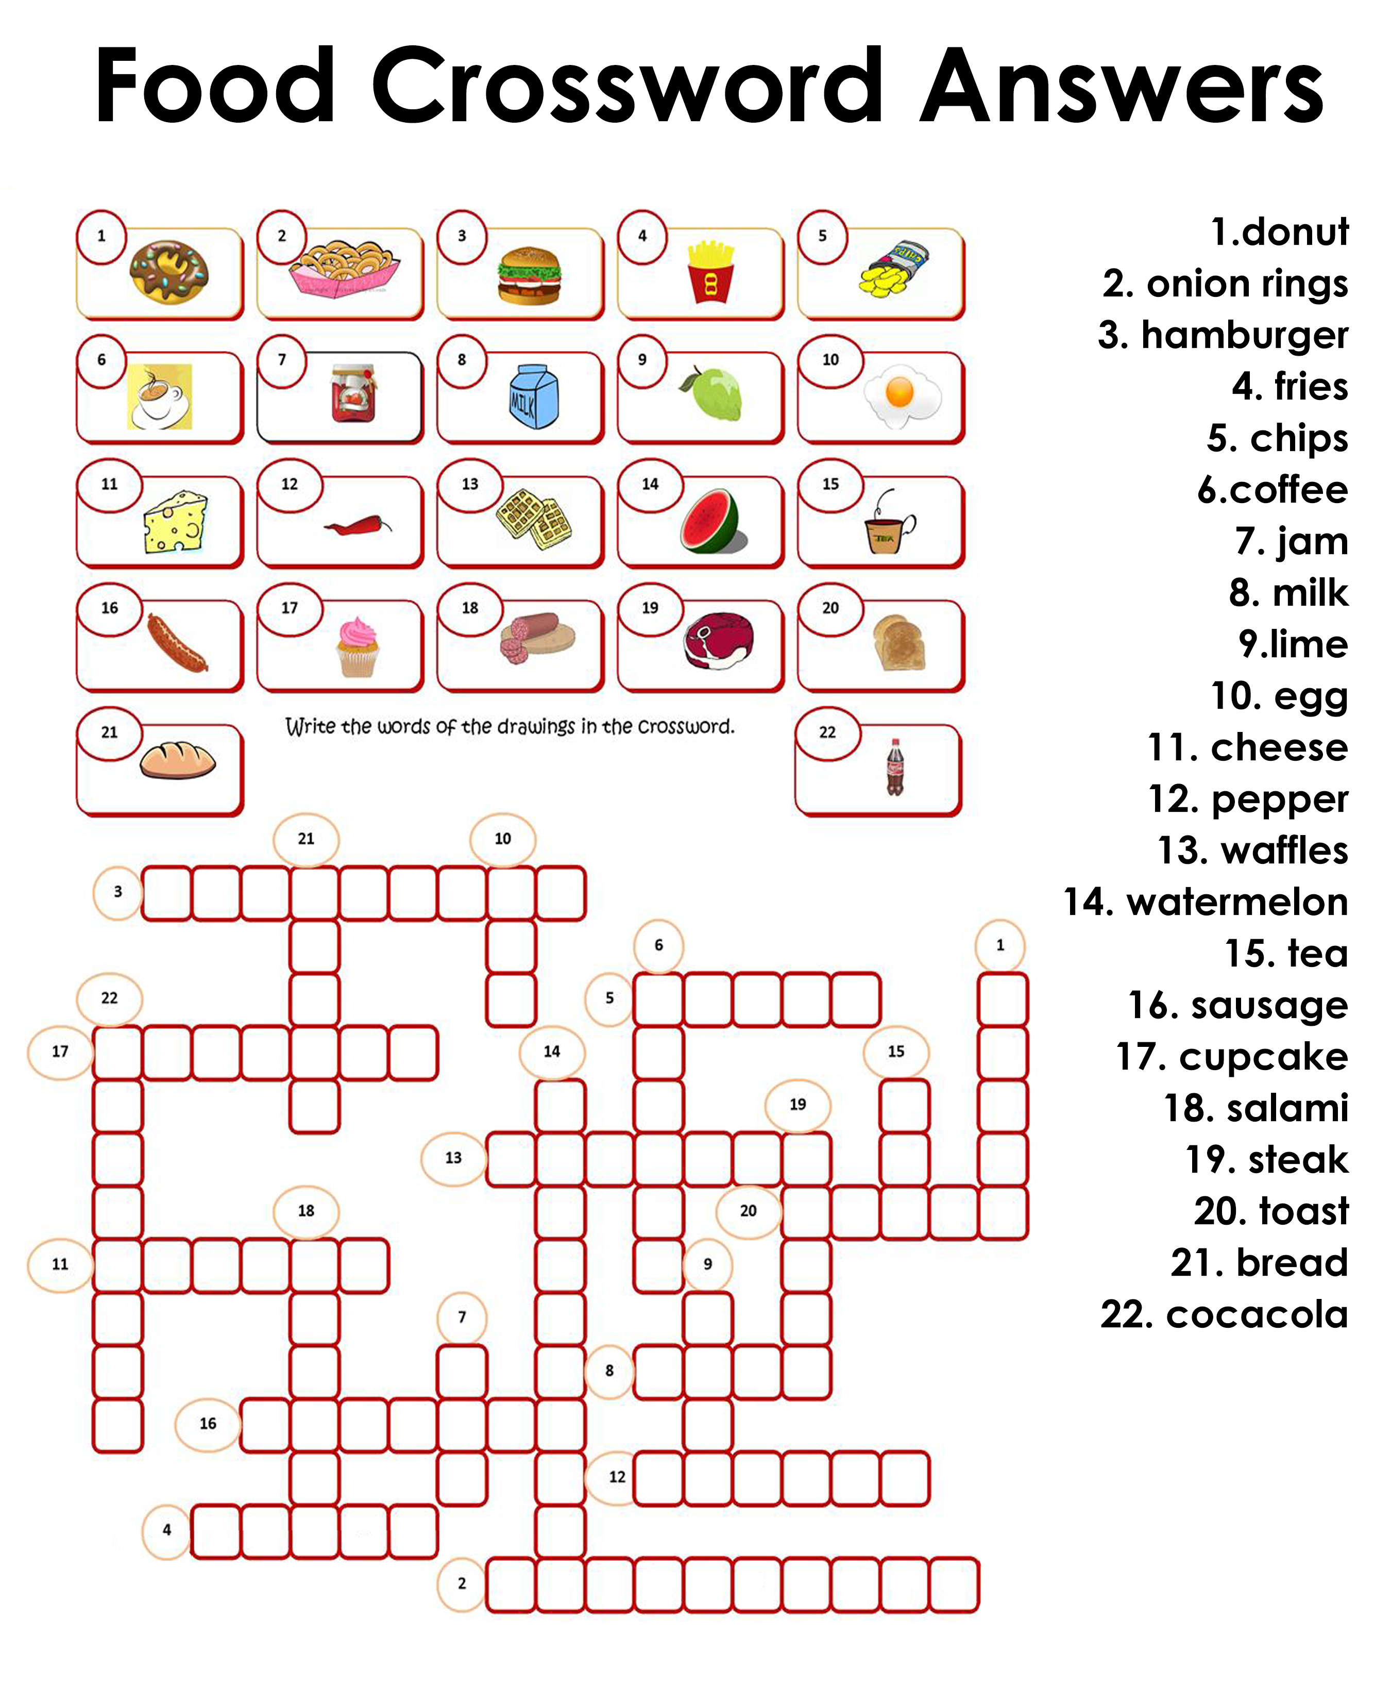
Crossword answers

Slide 4
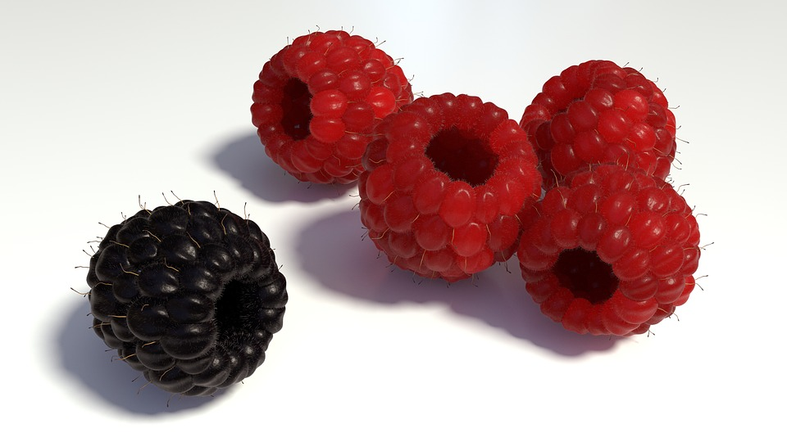
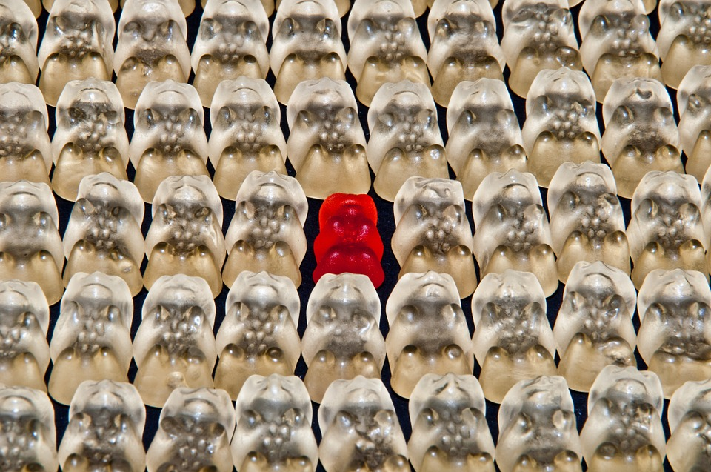
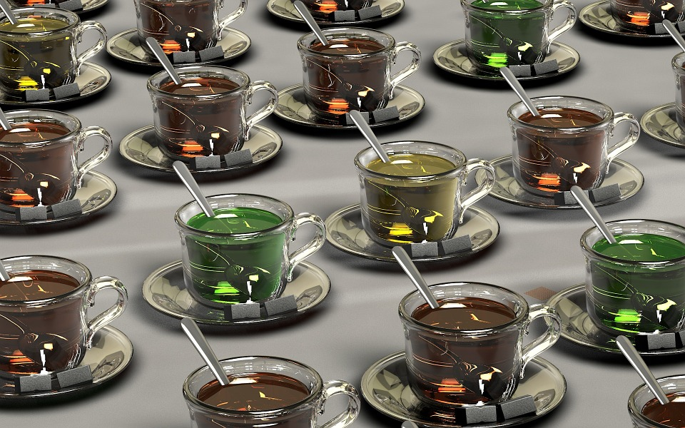
More and most
Use the word more with adjectives that compare two things.
Use the word most with adjectives that compare three or more things.

Slide 5
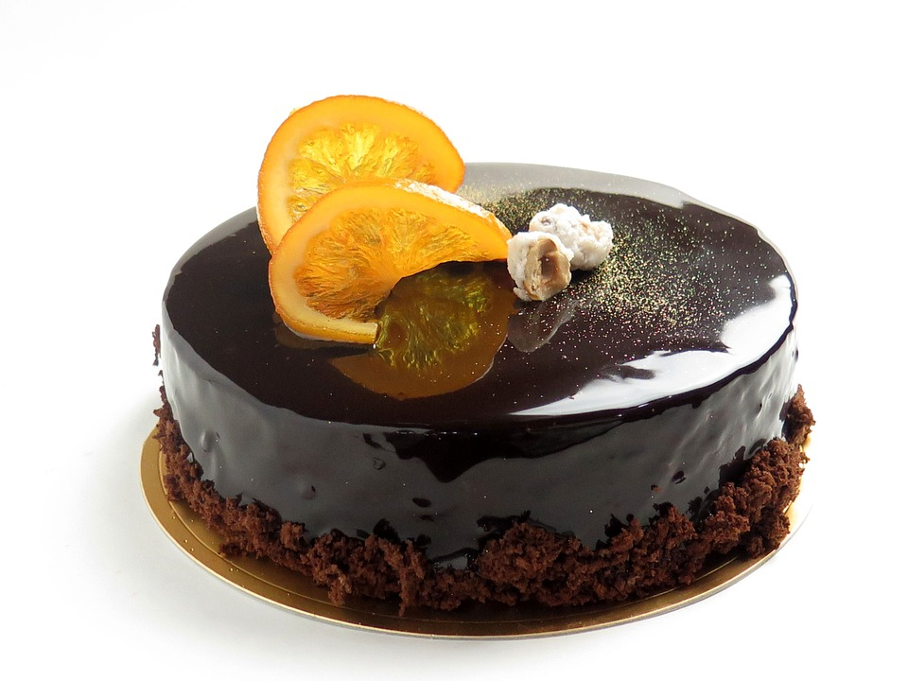
More and most
Cats are ______________ interesting than dogs.
I think that they are the ______________interesting animal.
Cherry blossoms are the___________beautiful flower.
4. The princess is ___________ beautiful than the monster.
5. That chocolate cake was the _________ delicious thing I have tasted.
Notes:
Do questions orally. Alternate between each student.
1. more 2. more 3. most 4. more 5. most

Slide 6
There was/there were was=is (singular) were=are (plural)
1. __________________ many friends at her house yesterday.
2. __________________ also a big birthday cake.
3. In the fridge __________________ many orange juice bottles.
4. But __________________ no eggs in the fridge.
5. __________________ lots of chocolate cupcakes too.
6. When he was younger, __________________ many apple trees near his house.

Slide 7
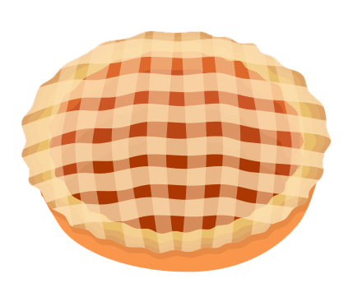
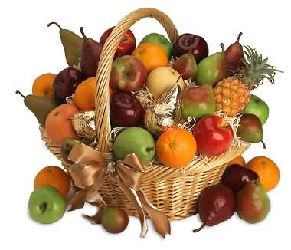
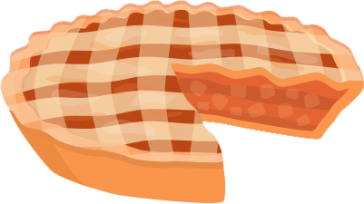
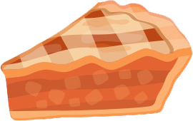
What fruit would you add to the pie?

Slide 8
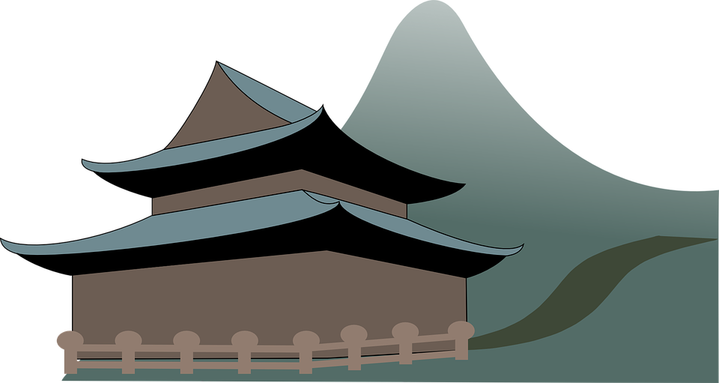
And, or, but, because
Tim is fit______ he runs everyday.
I’m from China ______ I live in the Canada.
Tina is happy ______ she has passed her test.
I must drive slowly ______ it is raining.
Would you like to drink coffee ______ tea?
I can speak English ______ Chinese fluently.
I like Bill ______ I don’t like his brother.

Slide 9
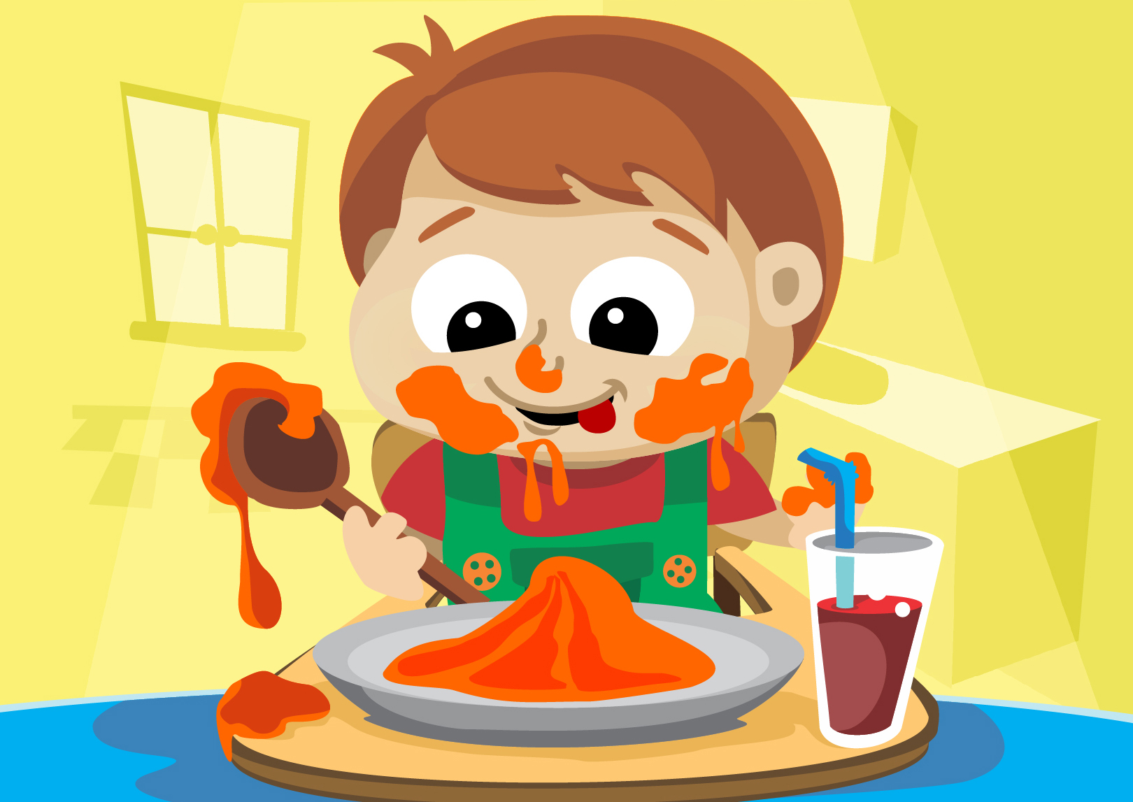
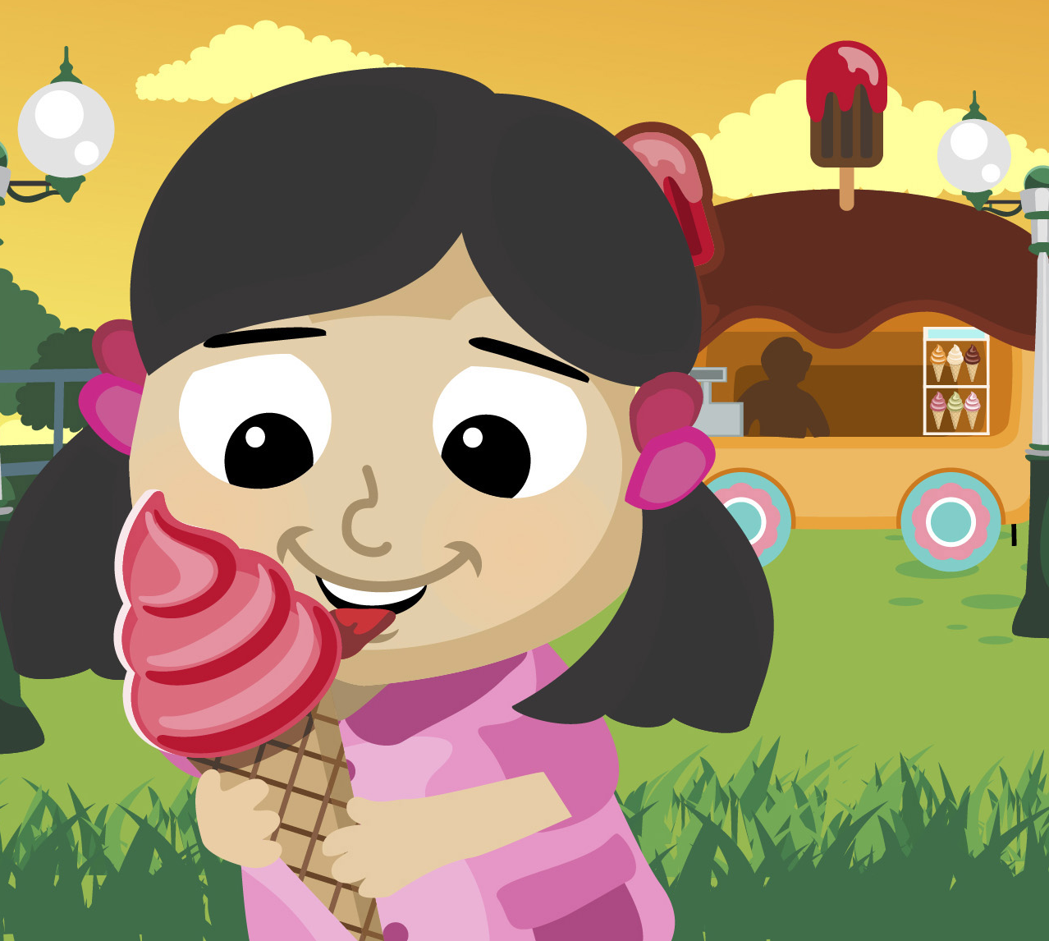
His, Hers, Its
his=males, hers=females, its=animals/objects
The juice belongs to my father. It's ___.
The cookies belong to Jane. They’re ___.
It belongs to my mother. It's ___.
It belongs to him. It's ___.
John forgot ___ book.
The dog ate ___ meal.
Princess Caroline is wearing ___ new dress.
Notes:
Do questions orally. Alternate between each student.
1. his 2. hers 3. hers 4. his 5. his 6. its 7. her

Slide 10
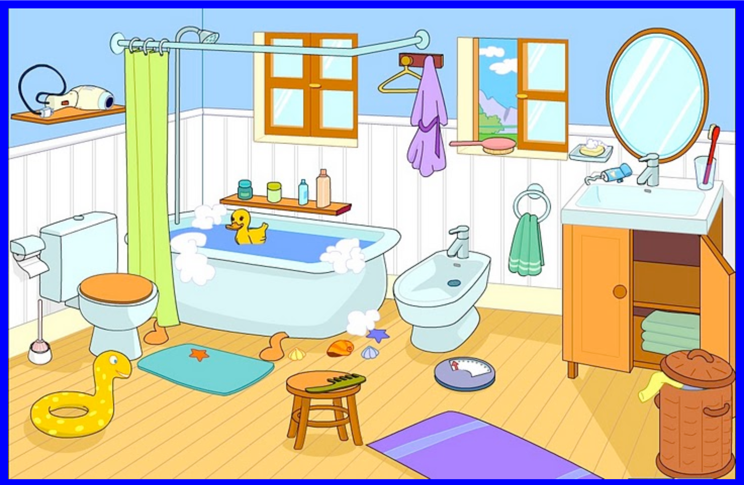
Remember this picture

Slide 11
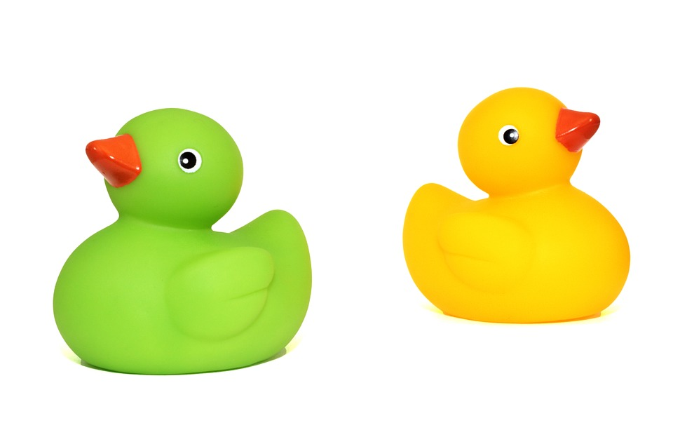
Was or were?
1-There _______ a duck.
2-There _______ a chair.
3-There_______ some towels.
4-There_______ two mats.
5-There_______ a toothbrush.
6-There_______ two windows.
7-There_______ some bottles.
8-There_______ a basket.
9-There_______ a sock.
10-There_______a mirror.

Slide 12
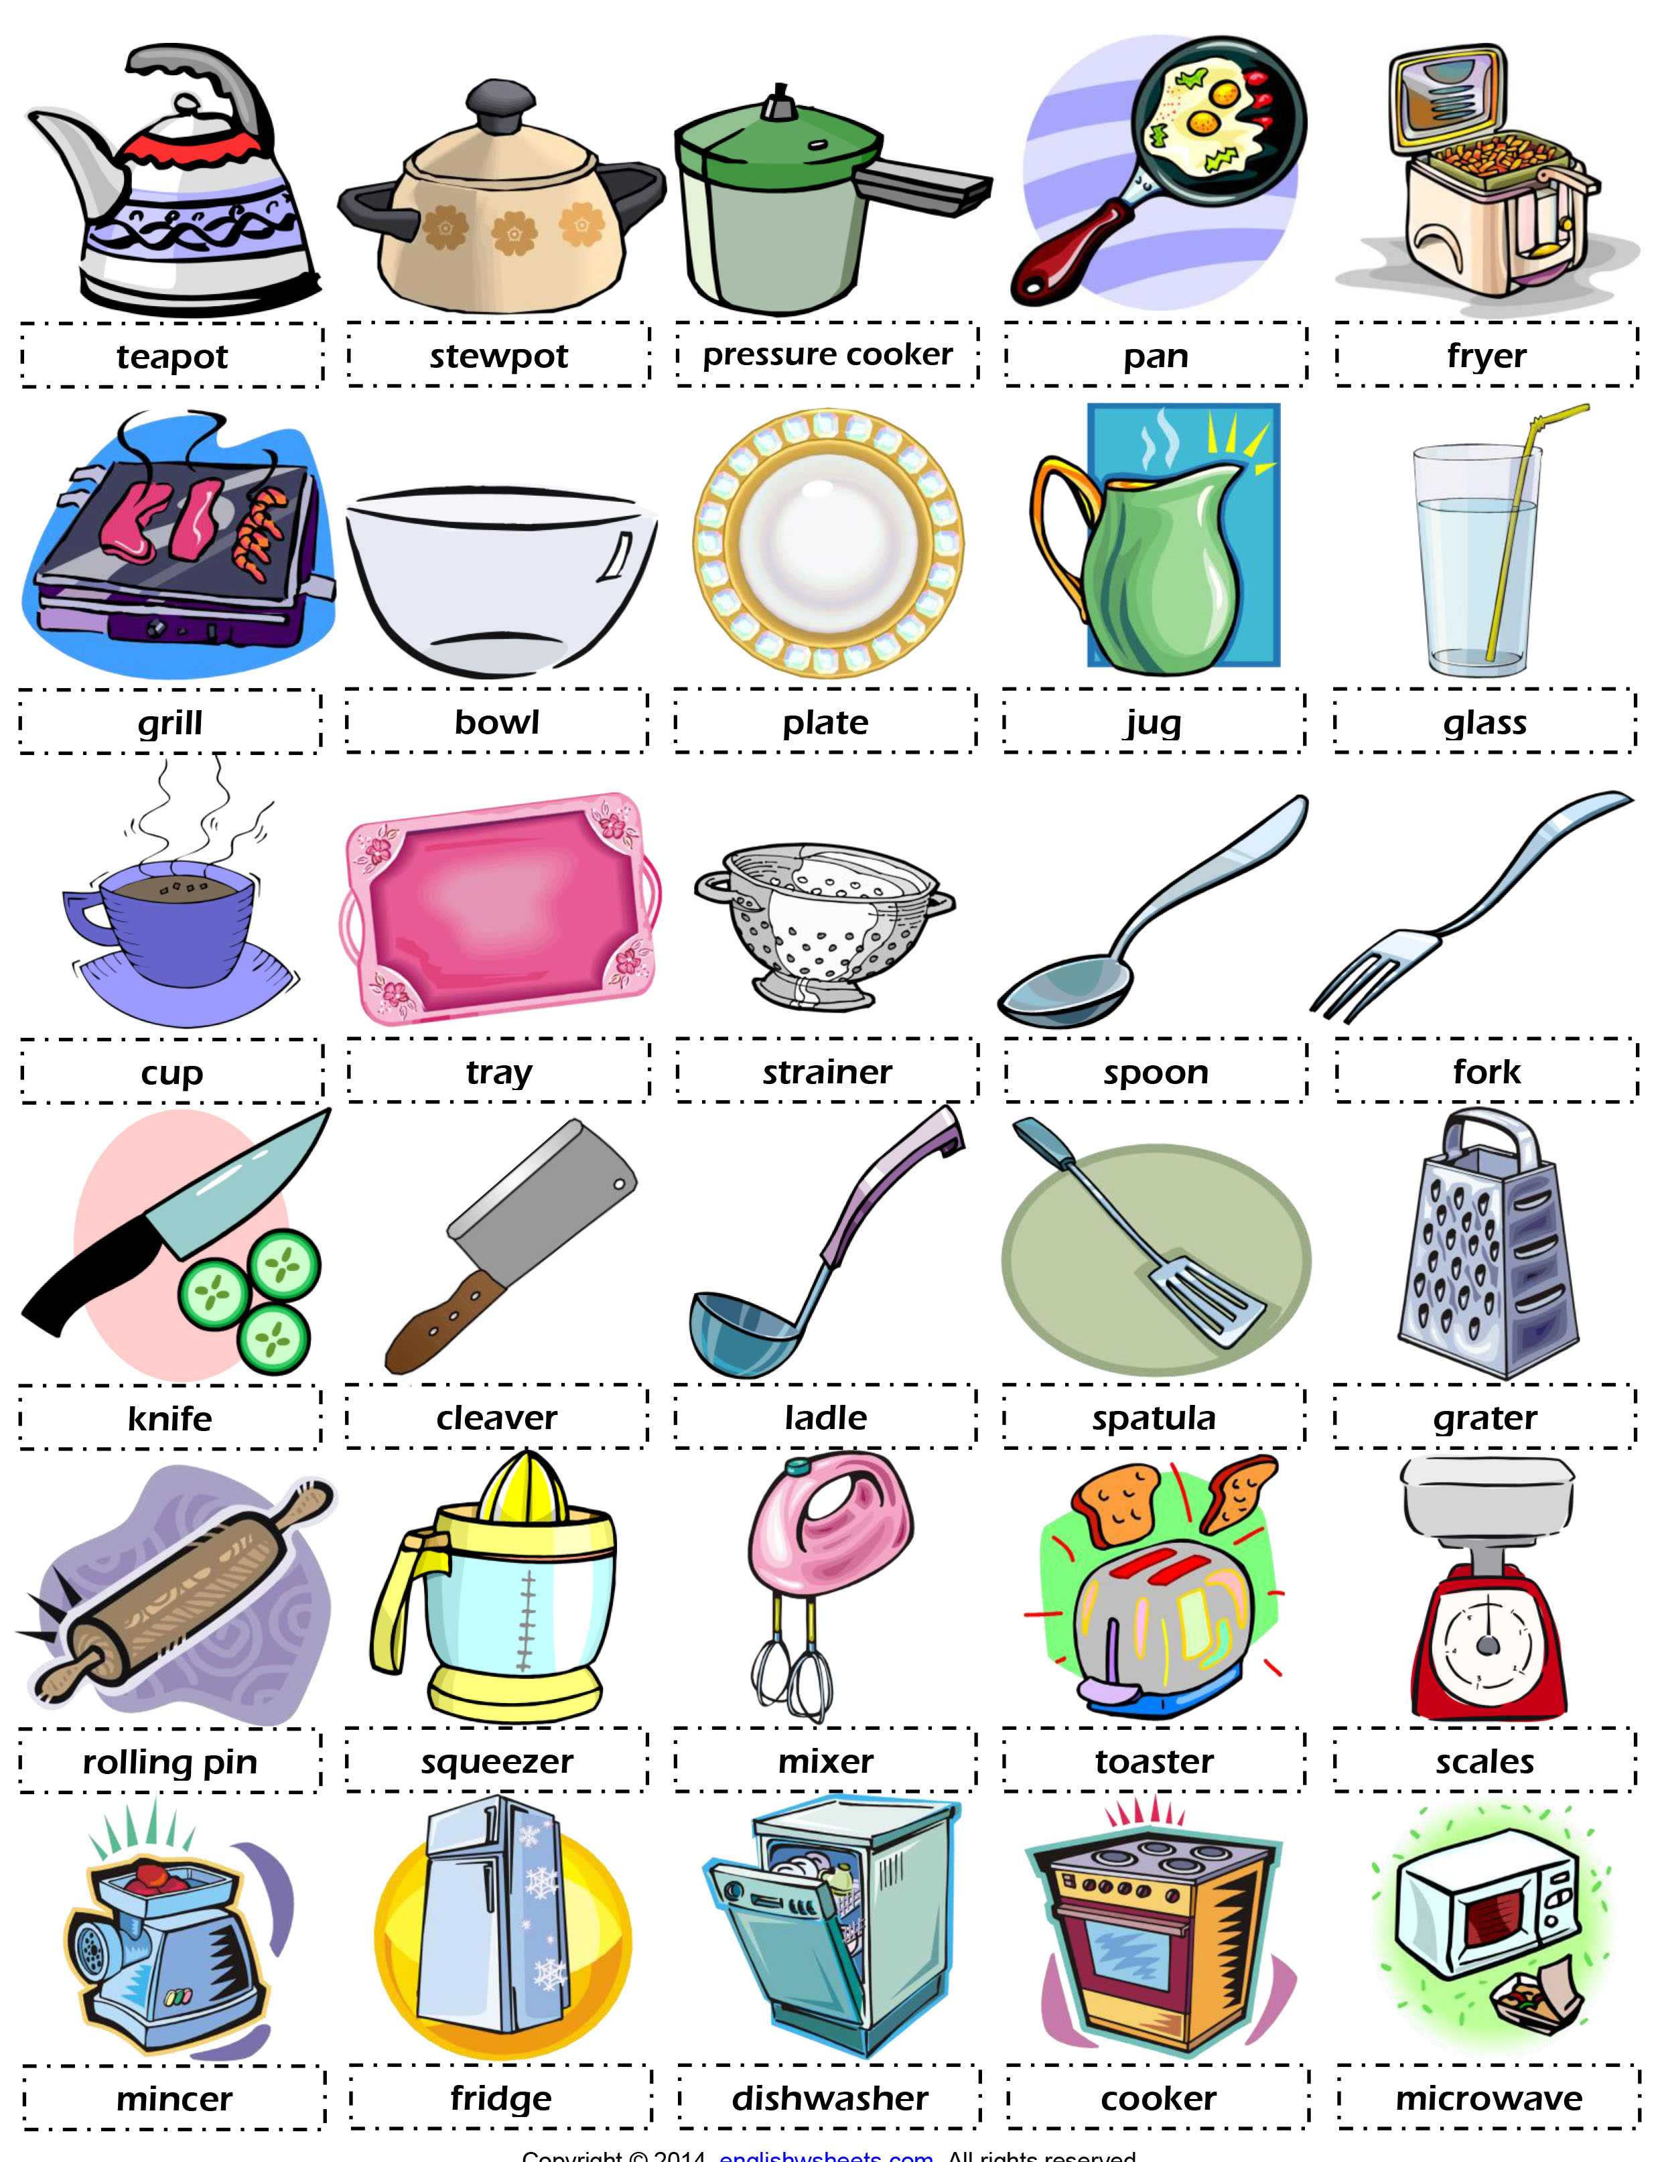
How many of these items can you find?

Slide 13
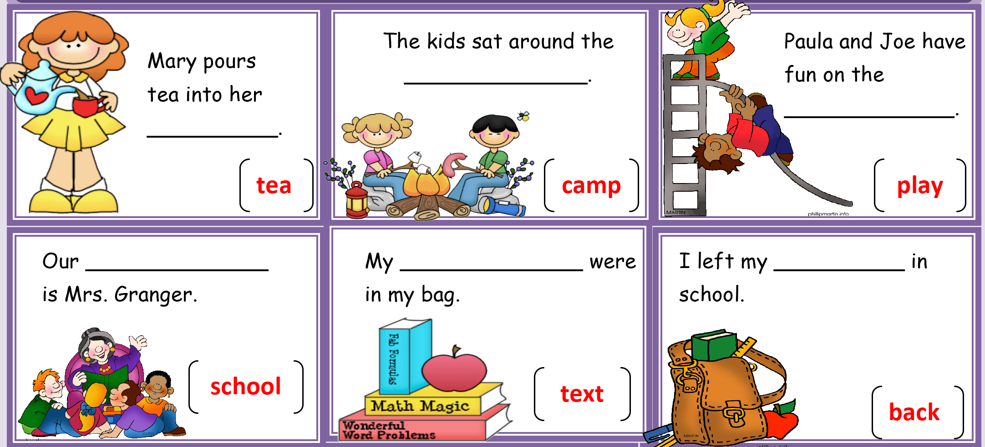
Compound Words
Word bank: teacher, books, ground, cup, pack, fire

Slide 14
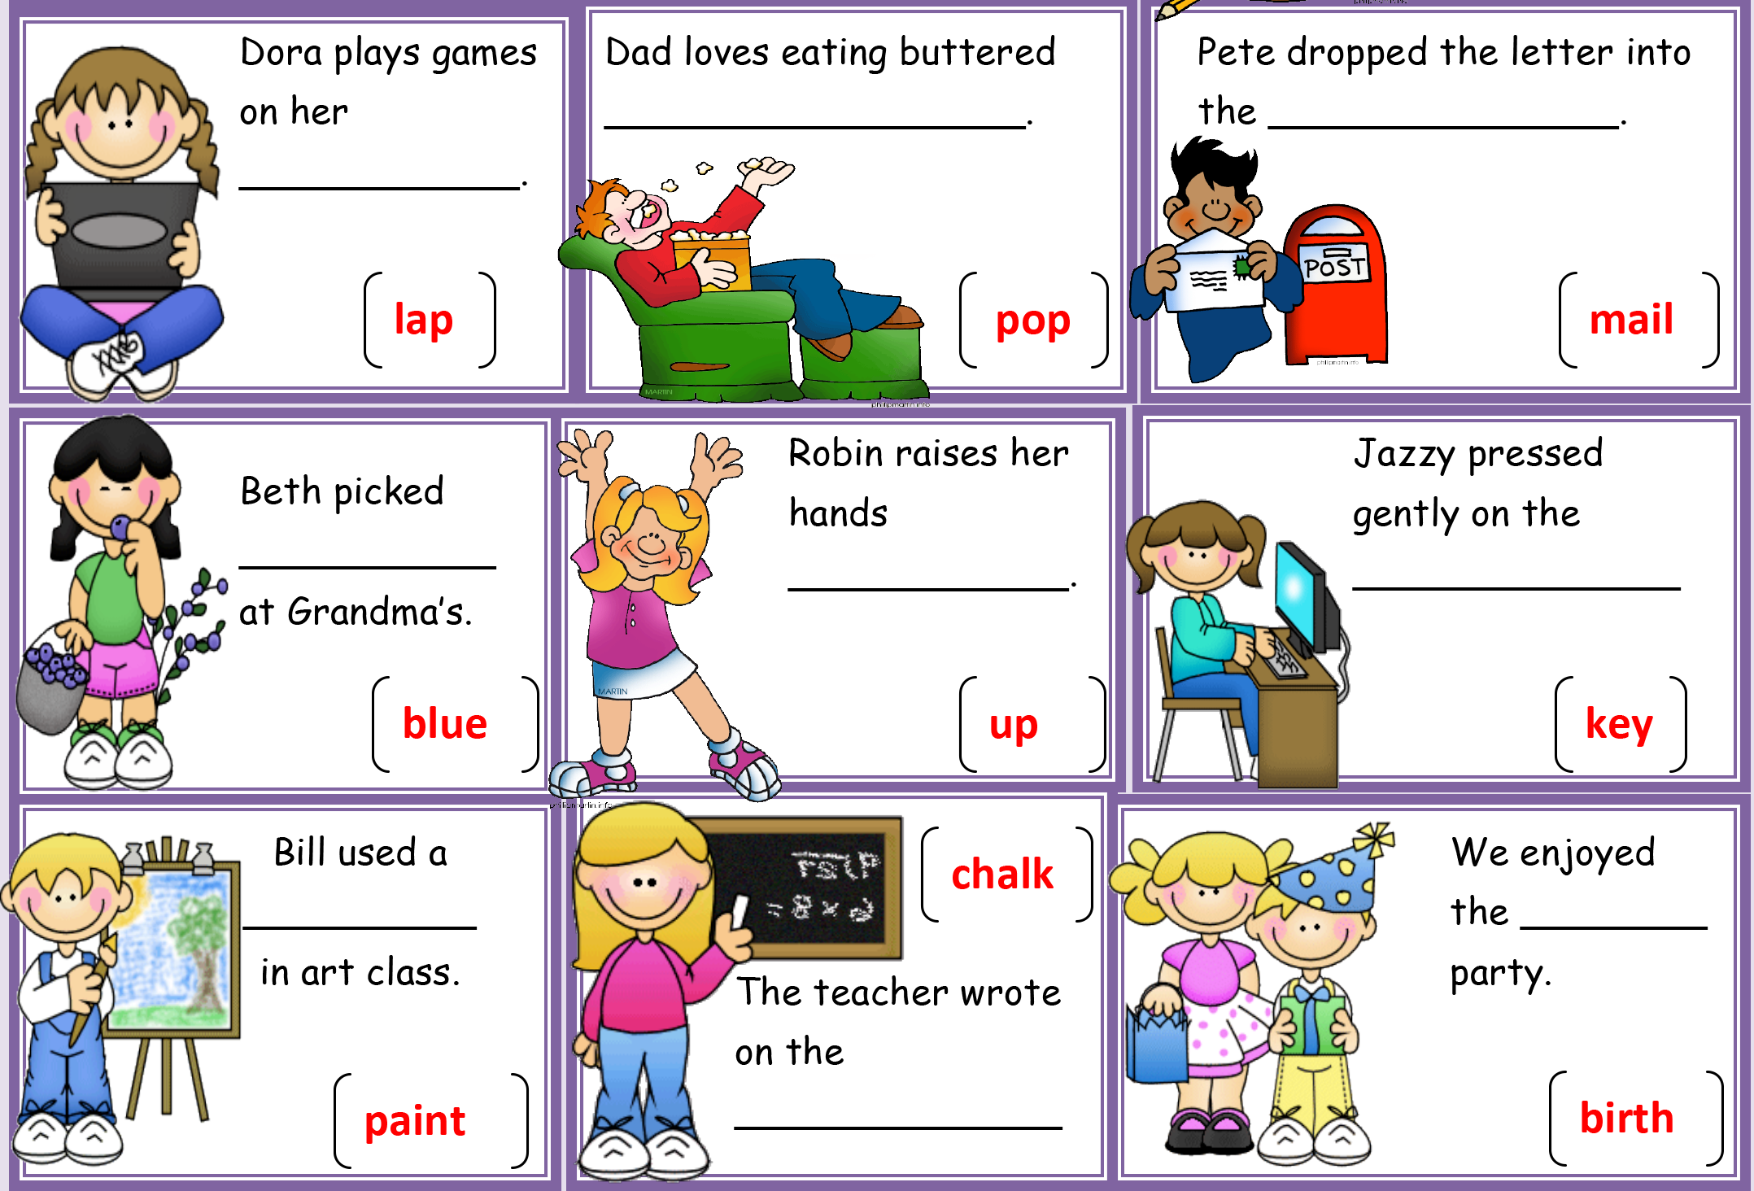
Compound Words
Word bank: box, board, berries, day, ward, board, brush, corn, top

Slide 15
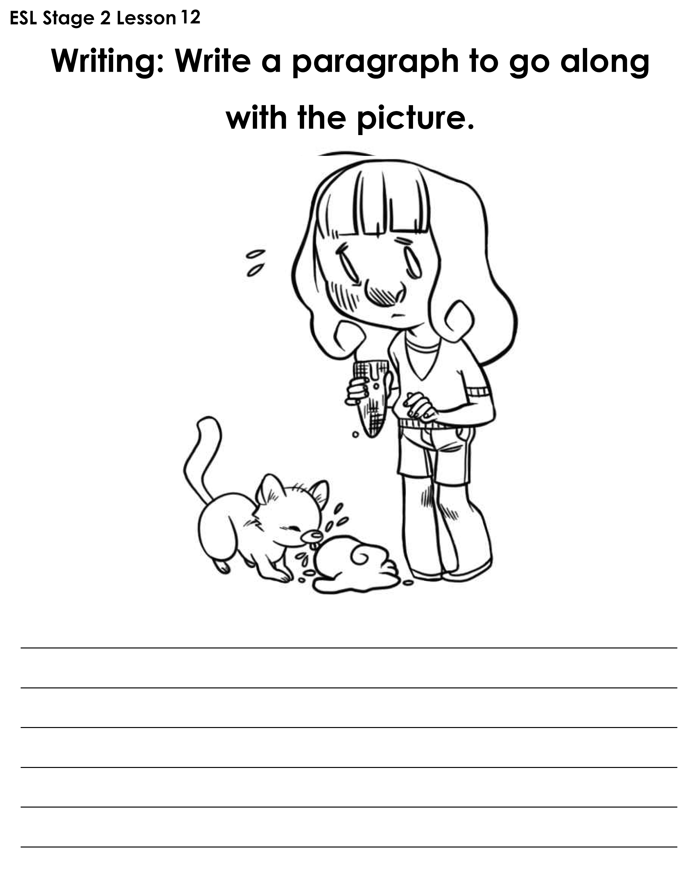
Cat + ice cream

Slide 16
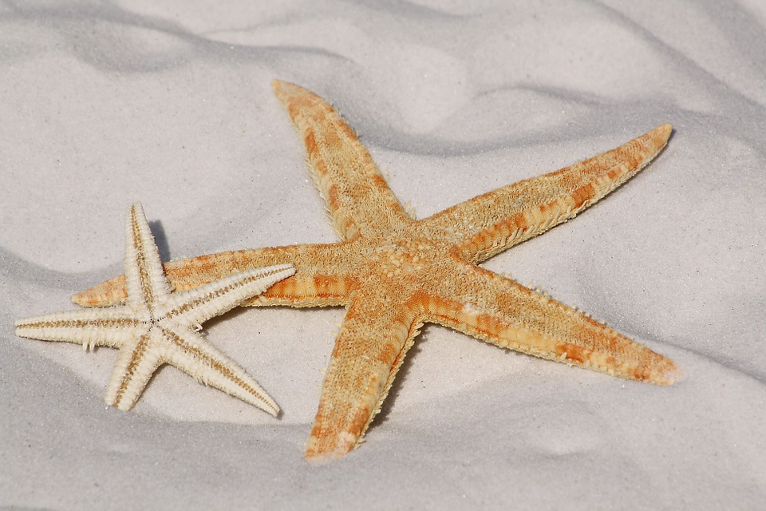
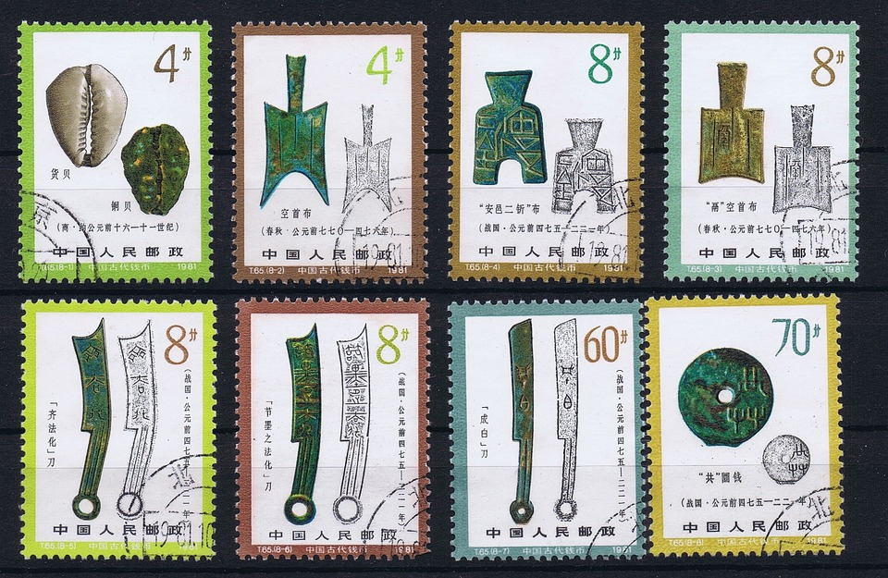
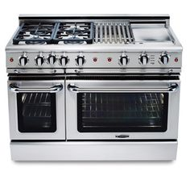
Do you remember?
s t _ _ _ _ _ _
s t _ _ _
s t _ _ _

Slide 17
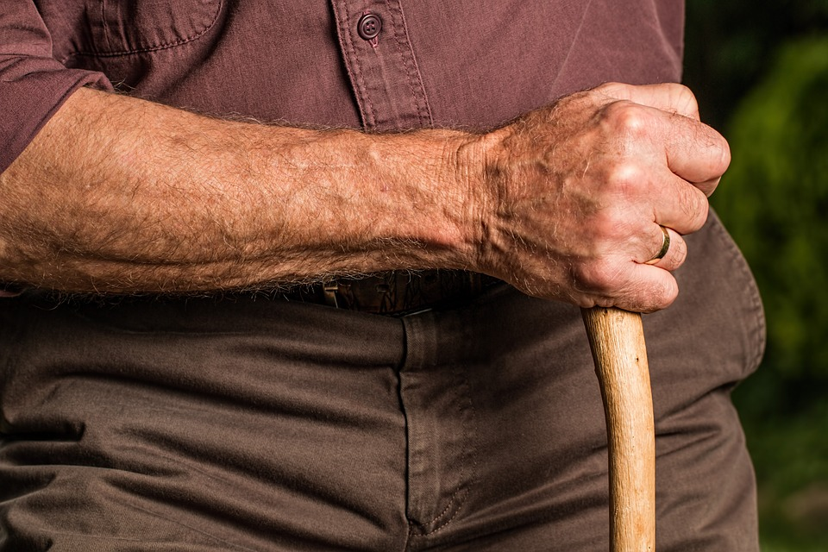
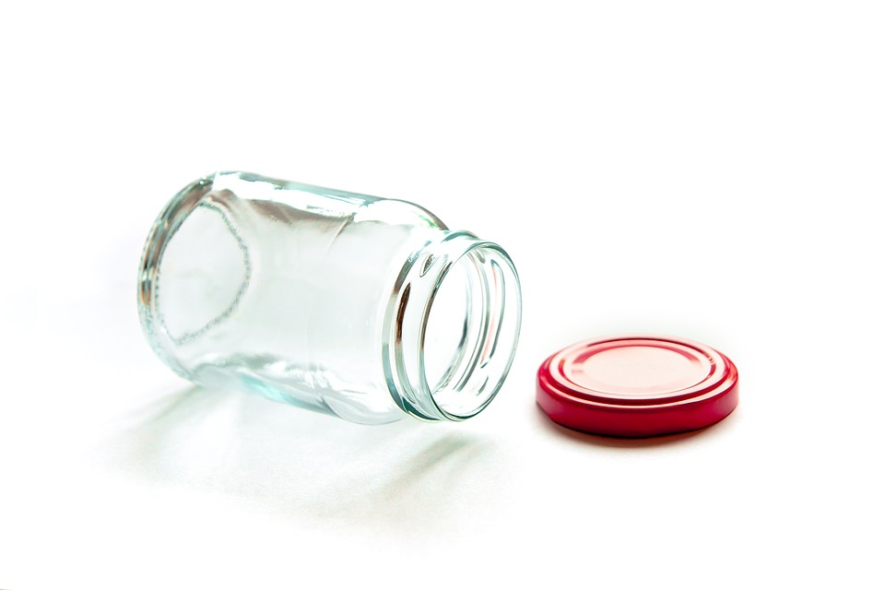
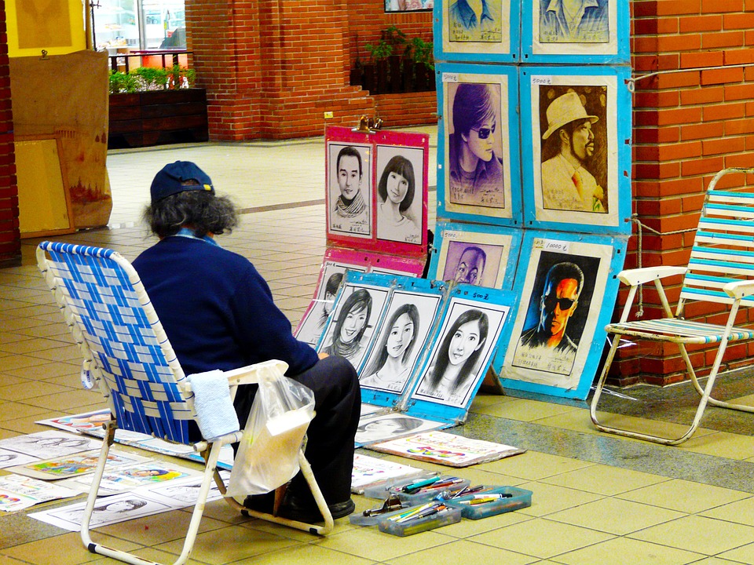
Do you remember?
a r _
_ a r
a r _

Slide 18
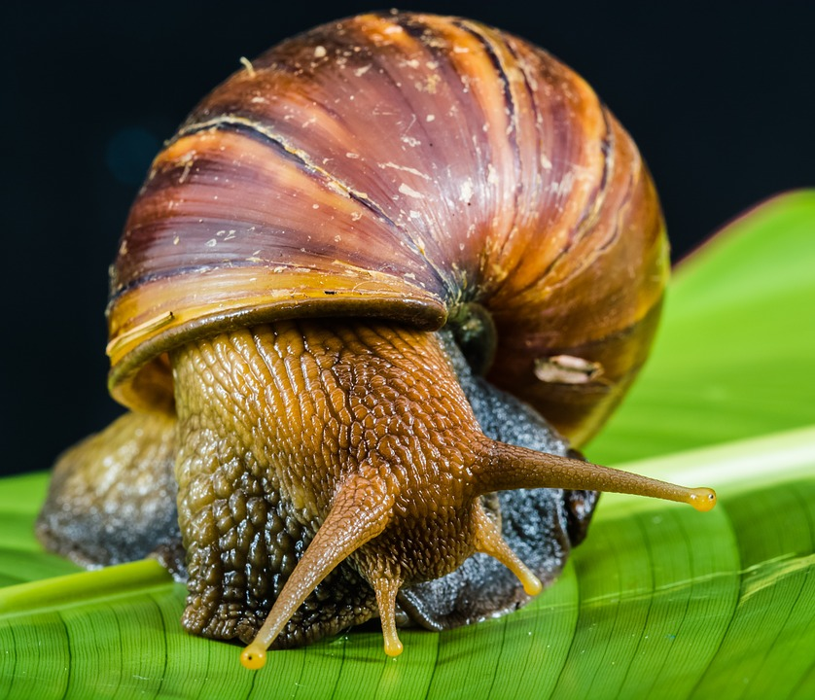
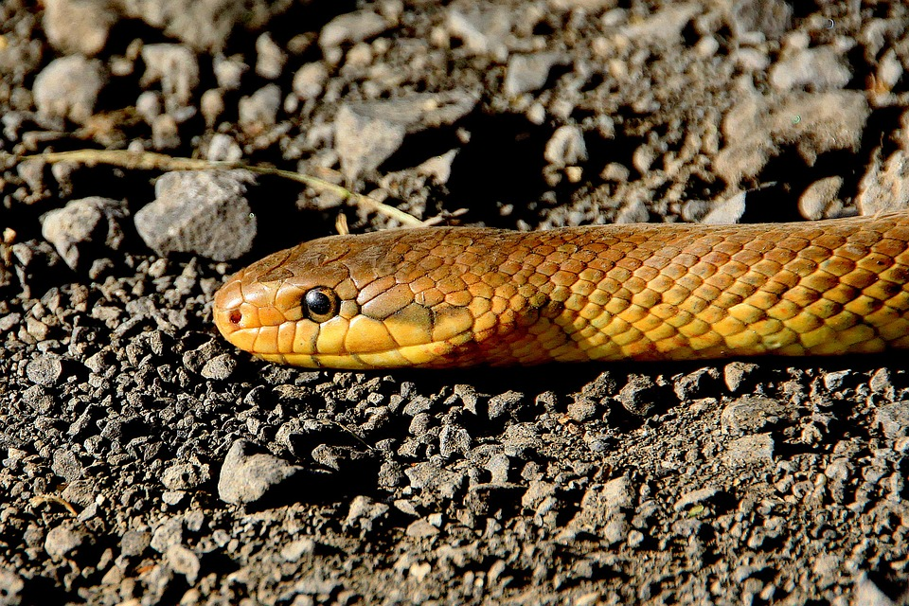
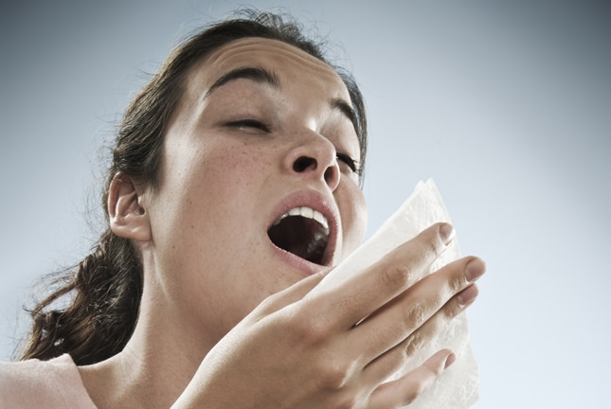
Do you remember?
s n _ _ _
s n _ _ _
s n _ _ _ _

Slide 19
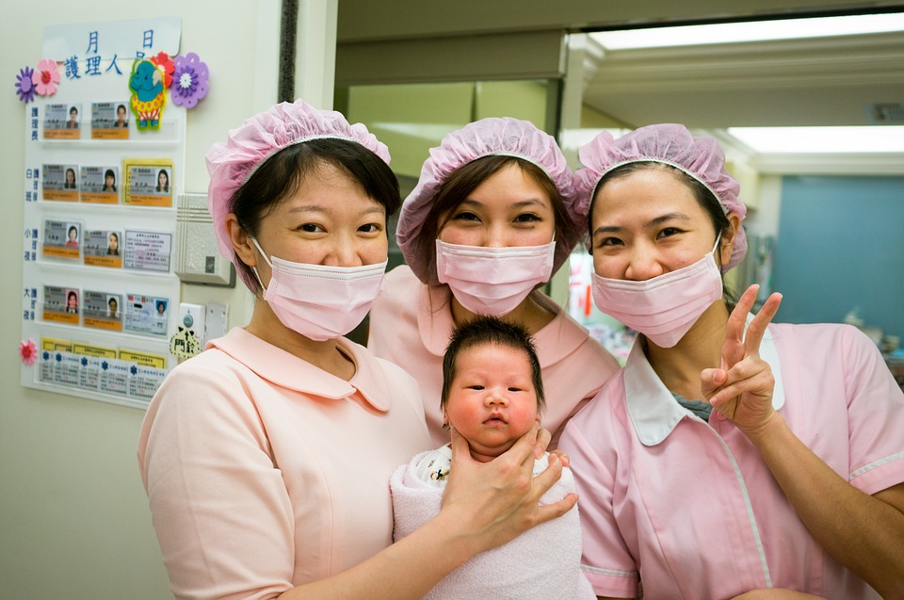
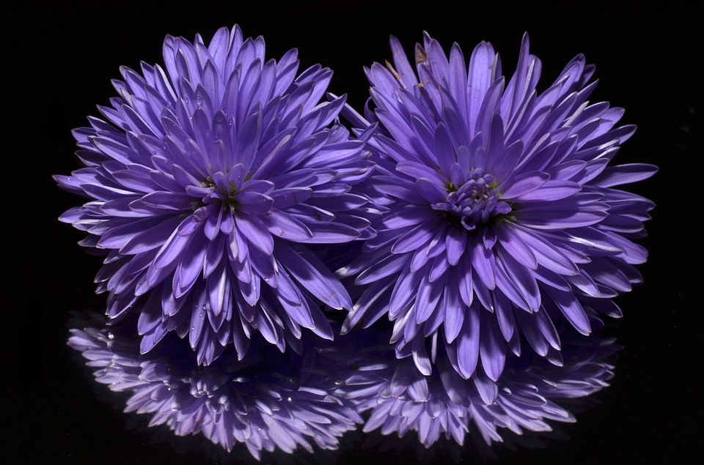
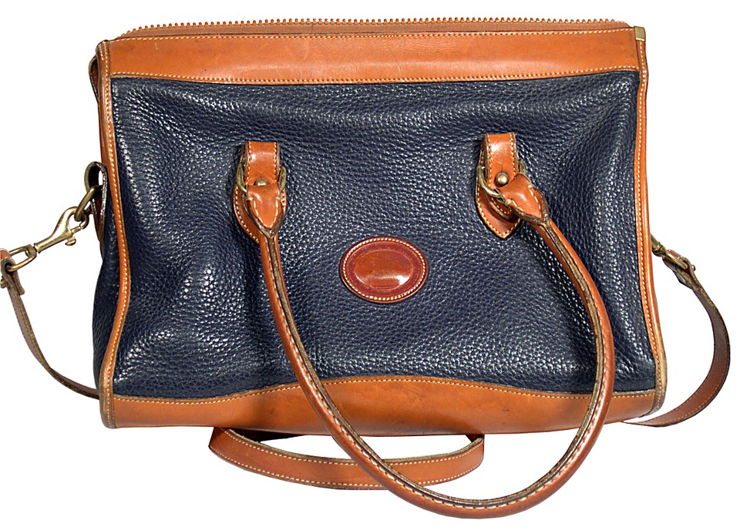
Do you remember?
_ u r _ _
_ u r _ _ _
_ u r _ _

Slide 20
I want chicken with some carrots, please.

Slide 21
I want chicken with some carrots, please.

Slide 22
I want a hotdog, some mushrooms and a tomato.

Slide 23
I want a hotdog, some mushrooms and a tomato.

Slide 24
I want fish and some mushrooms, please.

Slide 25
I want fish and some mushrooms, please.

Slide 26
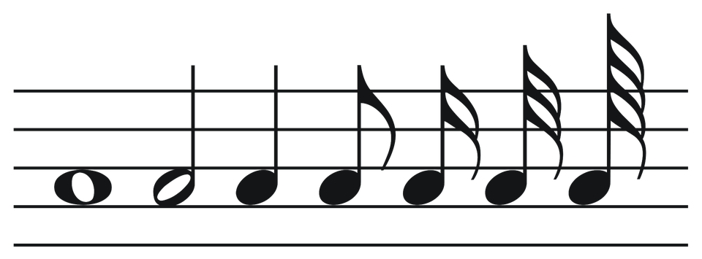
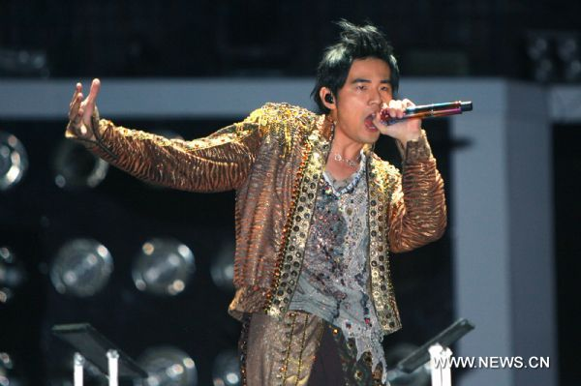
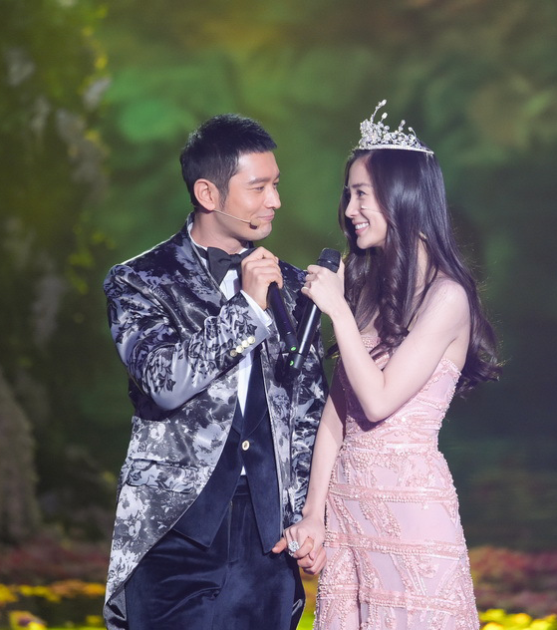
Time to perform!

Slide 27
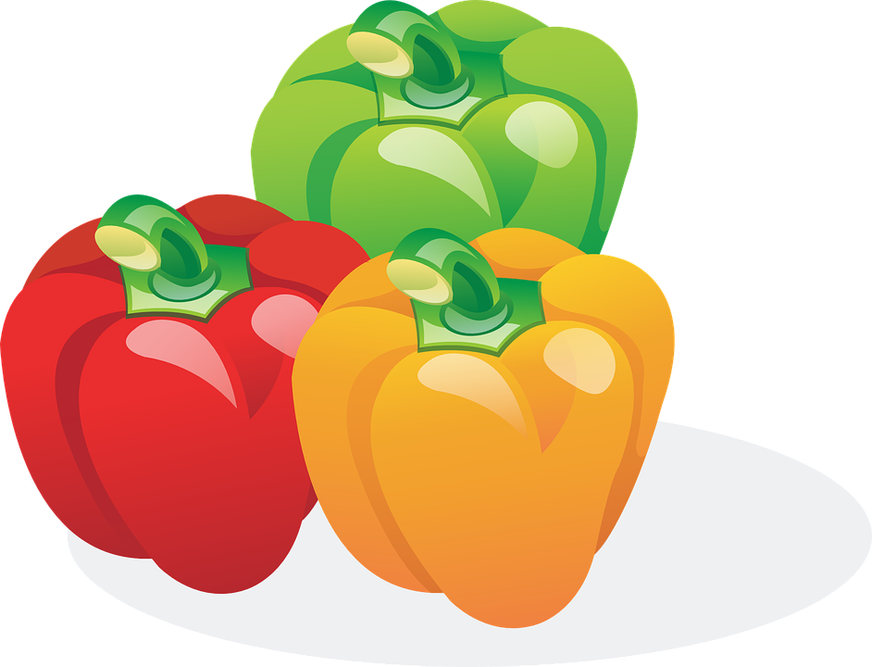
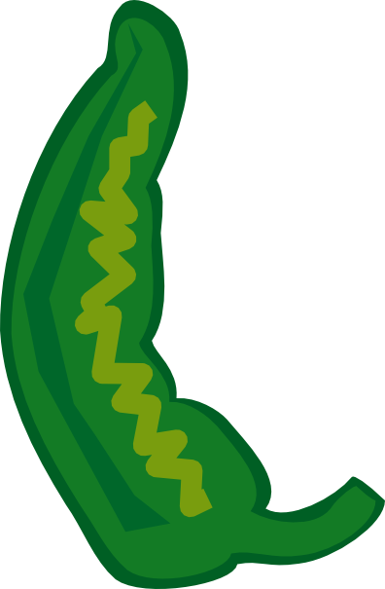
Tongue Twister!
Peter Piper picked a peck of pickled peppers.
Did Peter Piper pick a peck of pickled peppers?
If Peter Piper Picked a peck of pickled peppers,
Where's the peck of pickled peppers Peter Piper picked?
But if Peter Piper picked a peck of pickled peppers,
Were they pickled when he picked them from the vine?
Or was Peter Piper pickled when he picked the pickled peppers
Peppers picked from the pickled pepper vine?

Slide 29
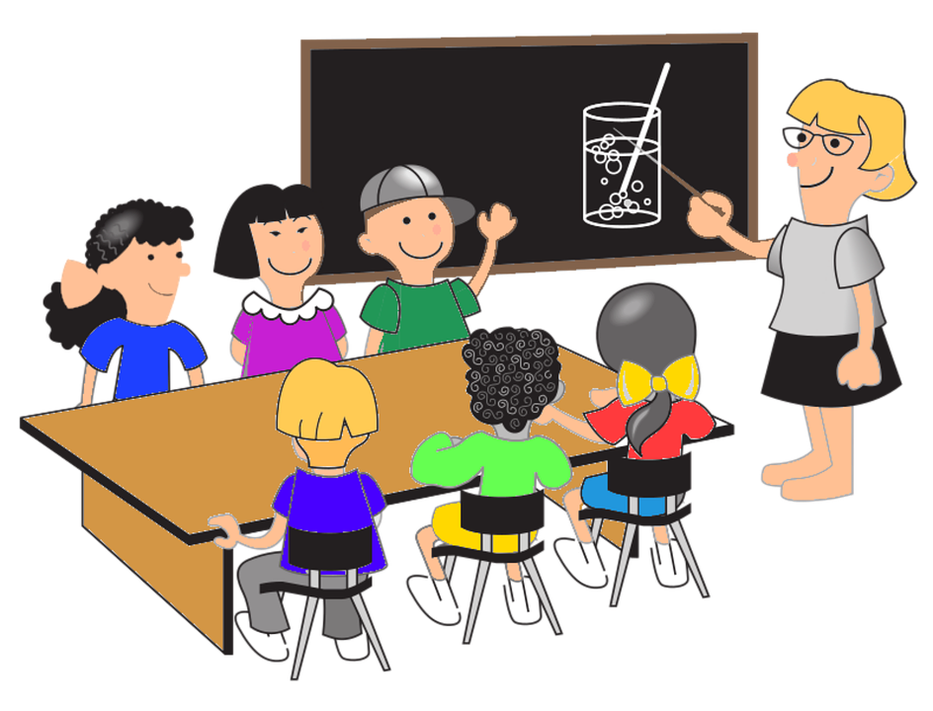
What did we learn?
Review the ‘sn’, ‘ur’ ‘ar’ and ‘st’ words
Practiced “his”, “hers”, “its”, “there was”, “there were”, “more” and “most”
Compound words
How to perform

