Slide 1
Lesson 12: Tutoring FOOD

Slide 2
What we will learn today
‘sn’, ‘ur’ ‘ar’ and ‘st’ activities
Reading
Pronouns, “there was/were” and “more/most”
Notes:
Go over the learning goals.

Slide 3
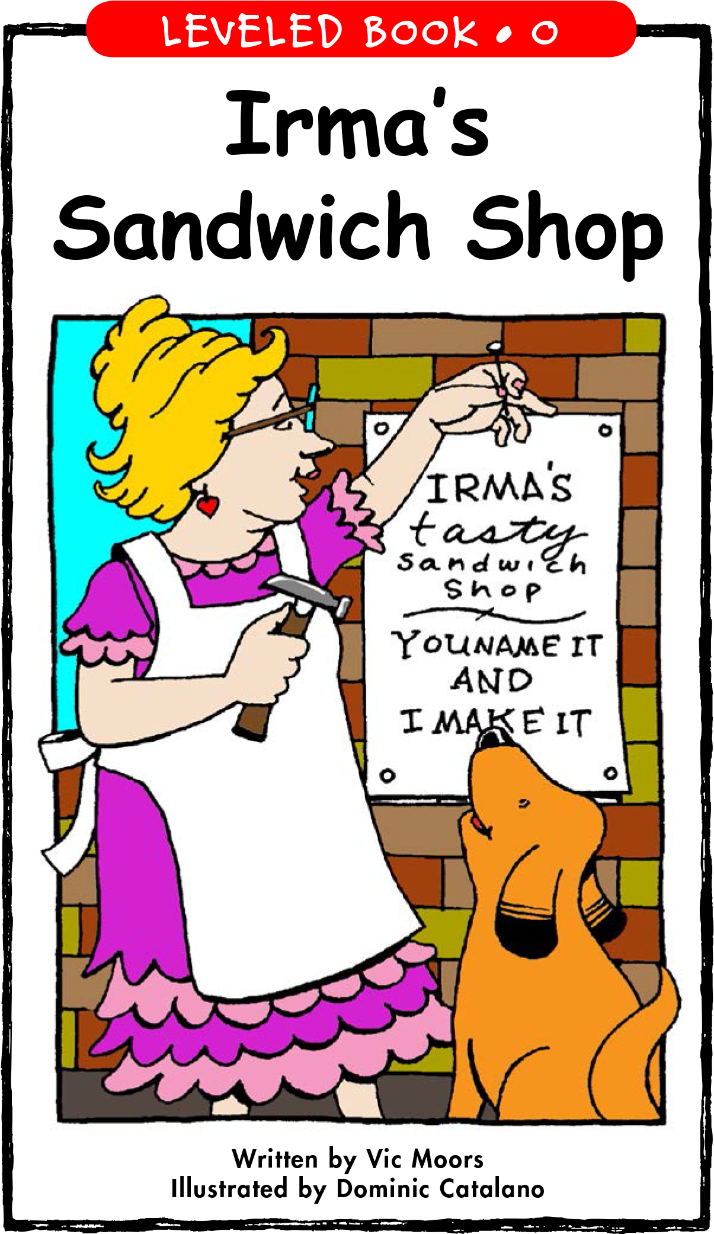
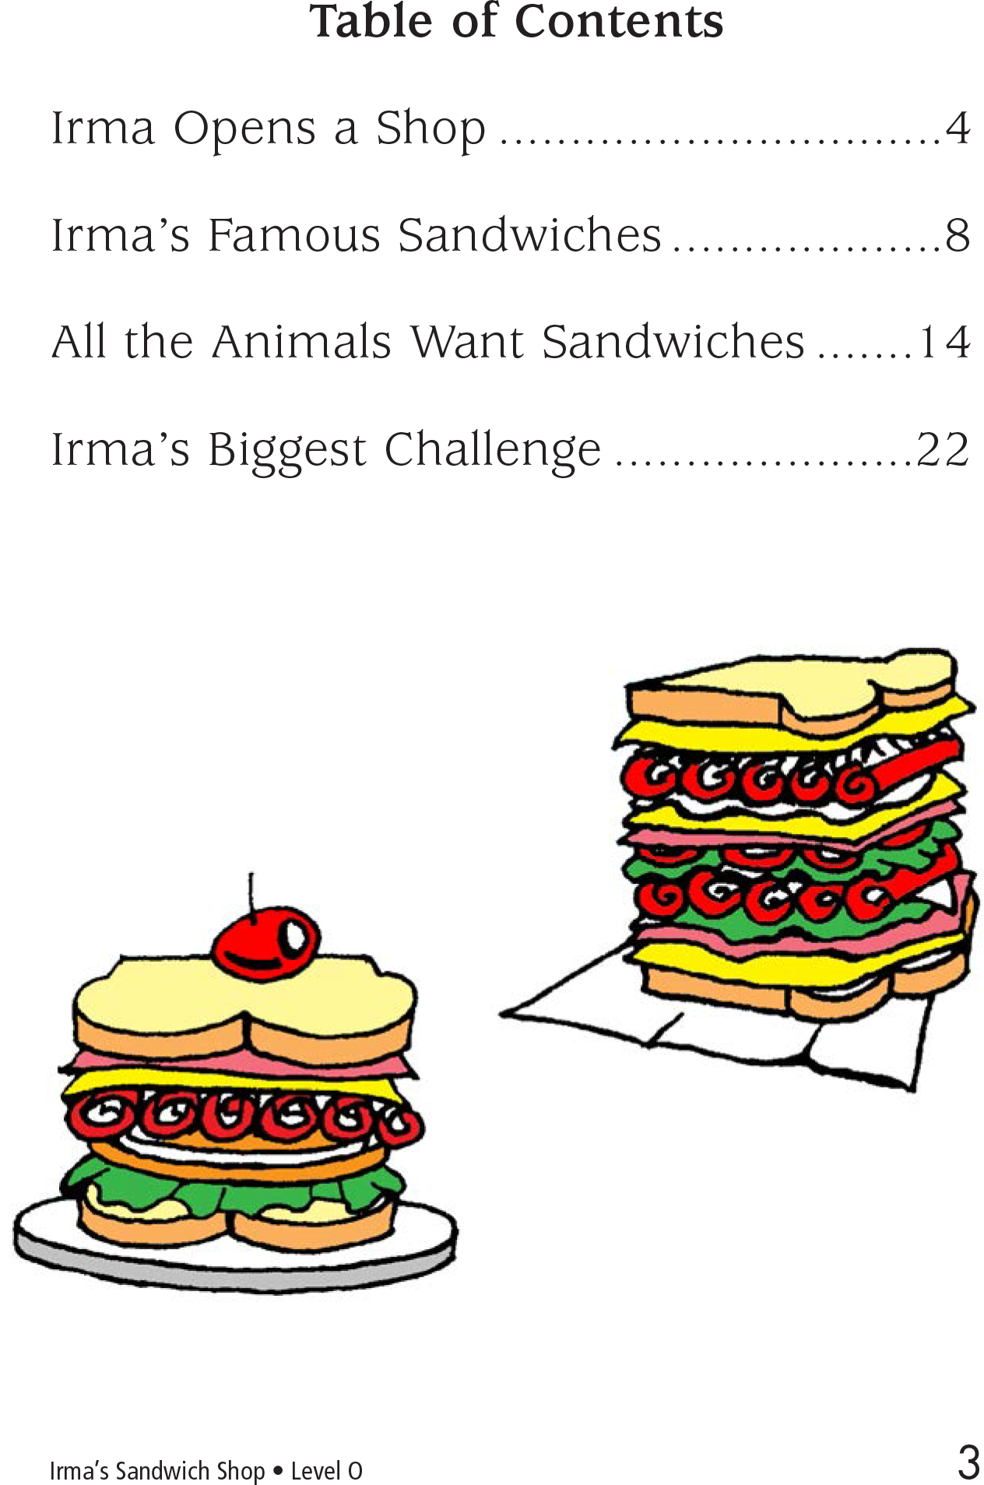
Story Time

Slide 4
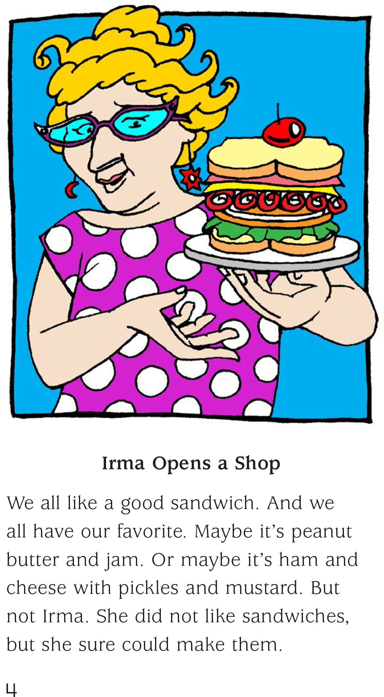
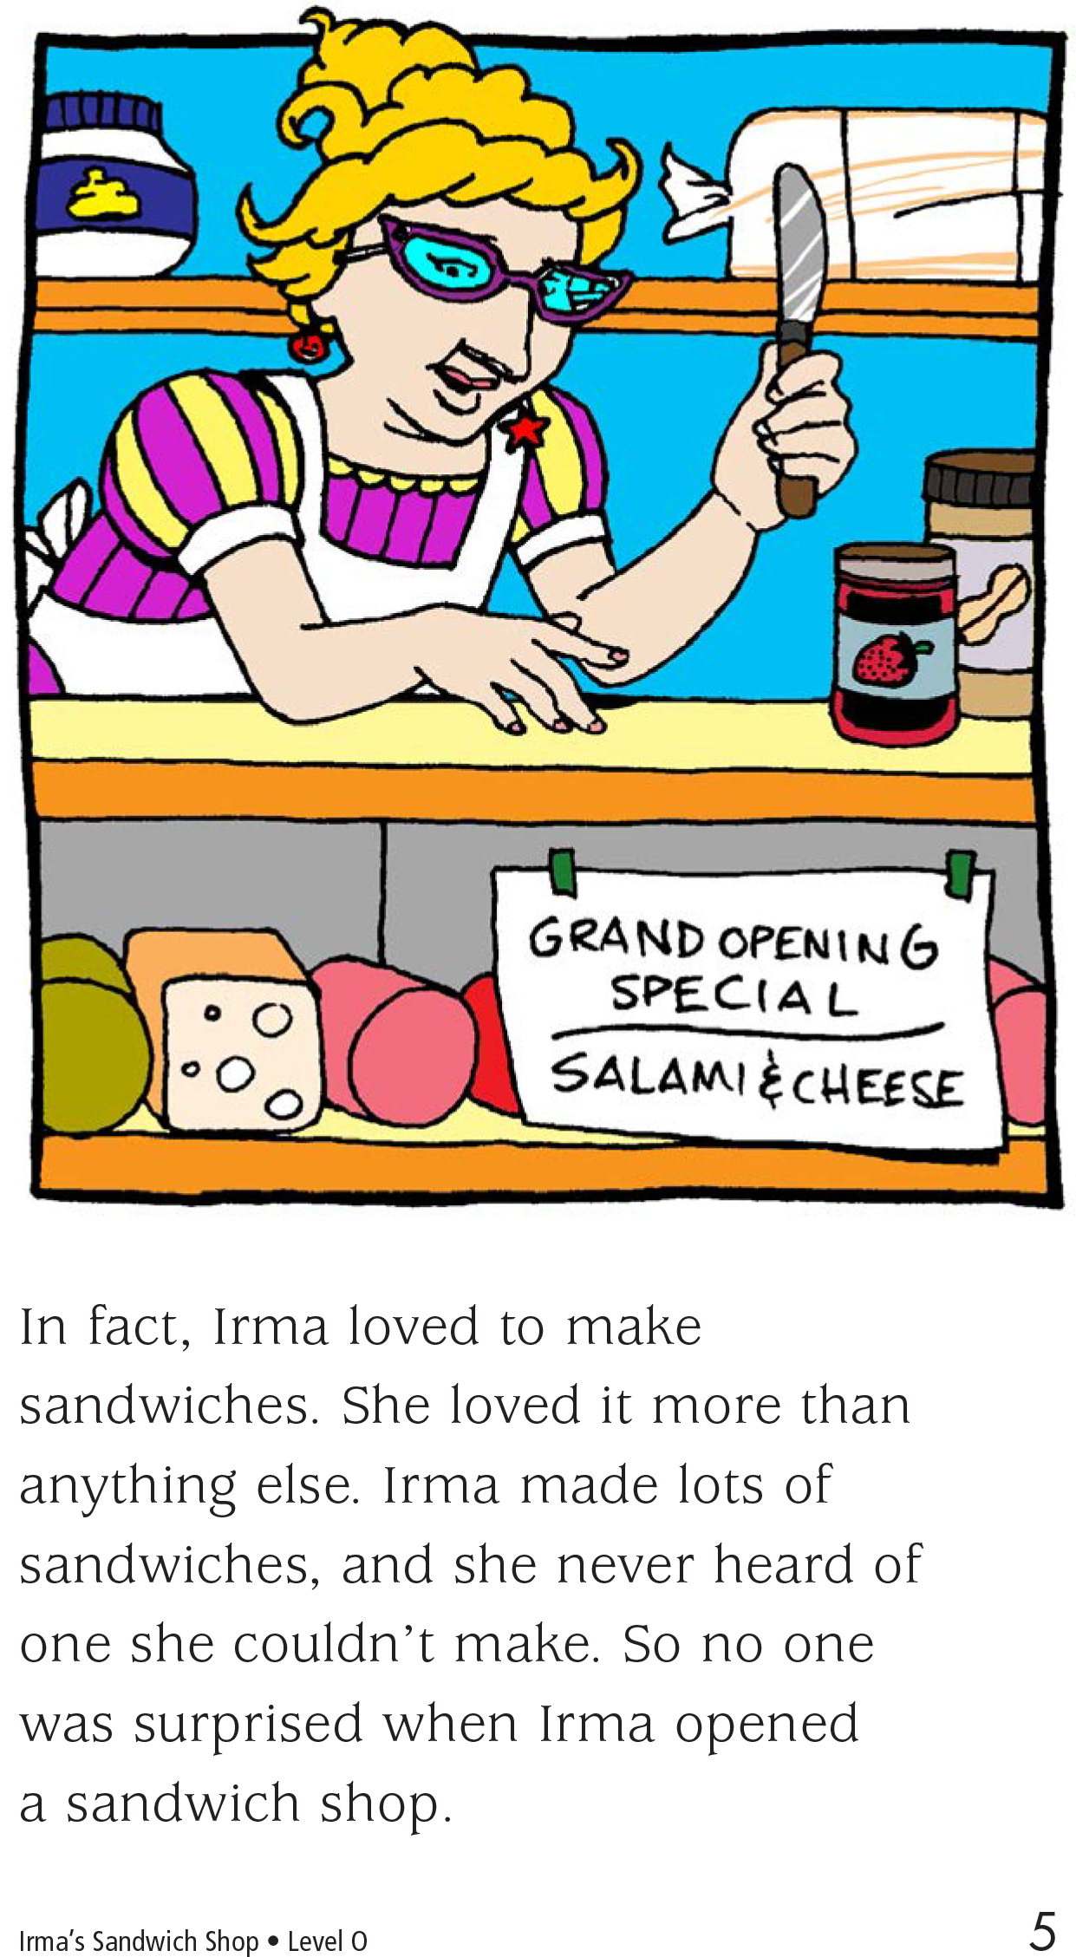

Slide 5
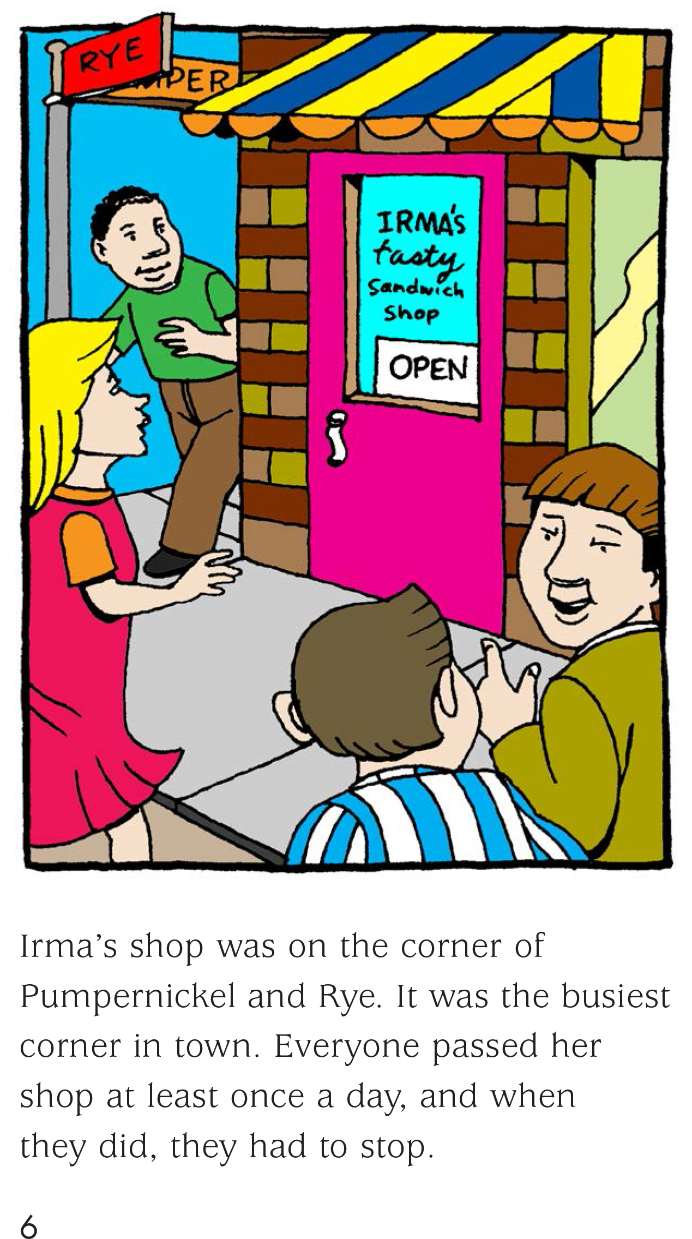
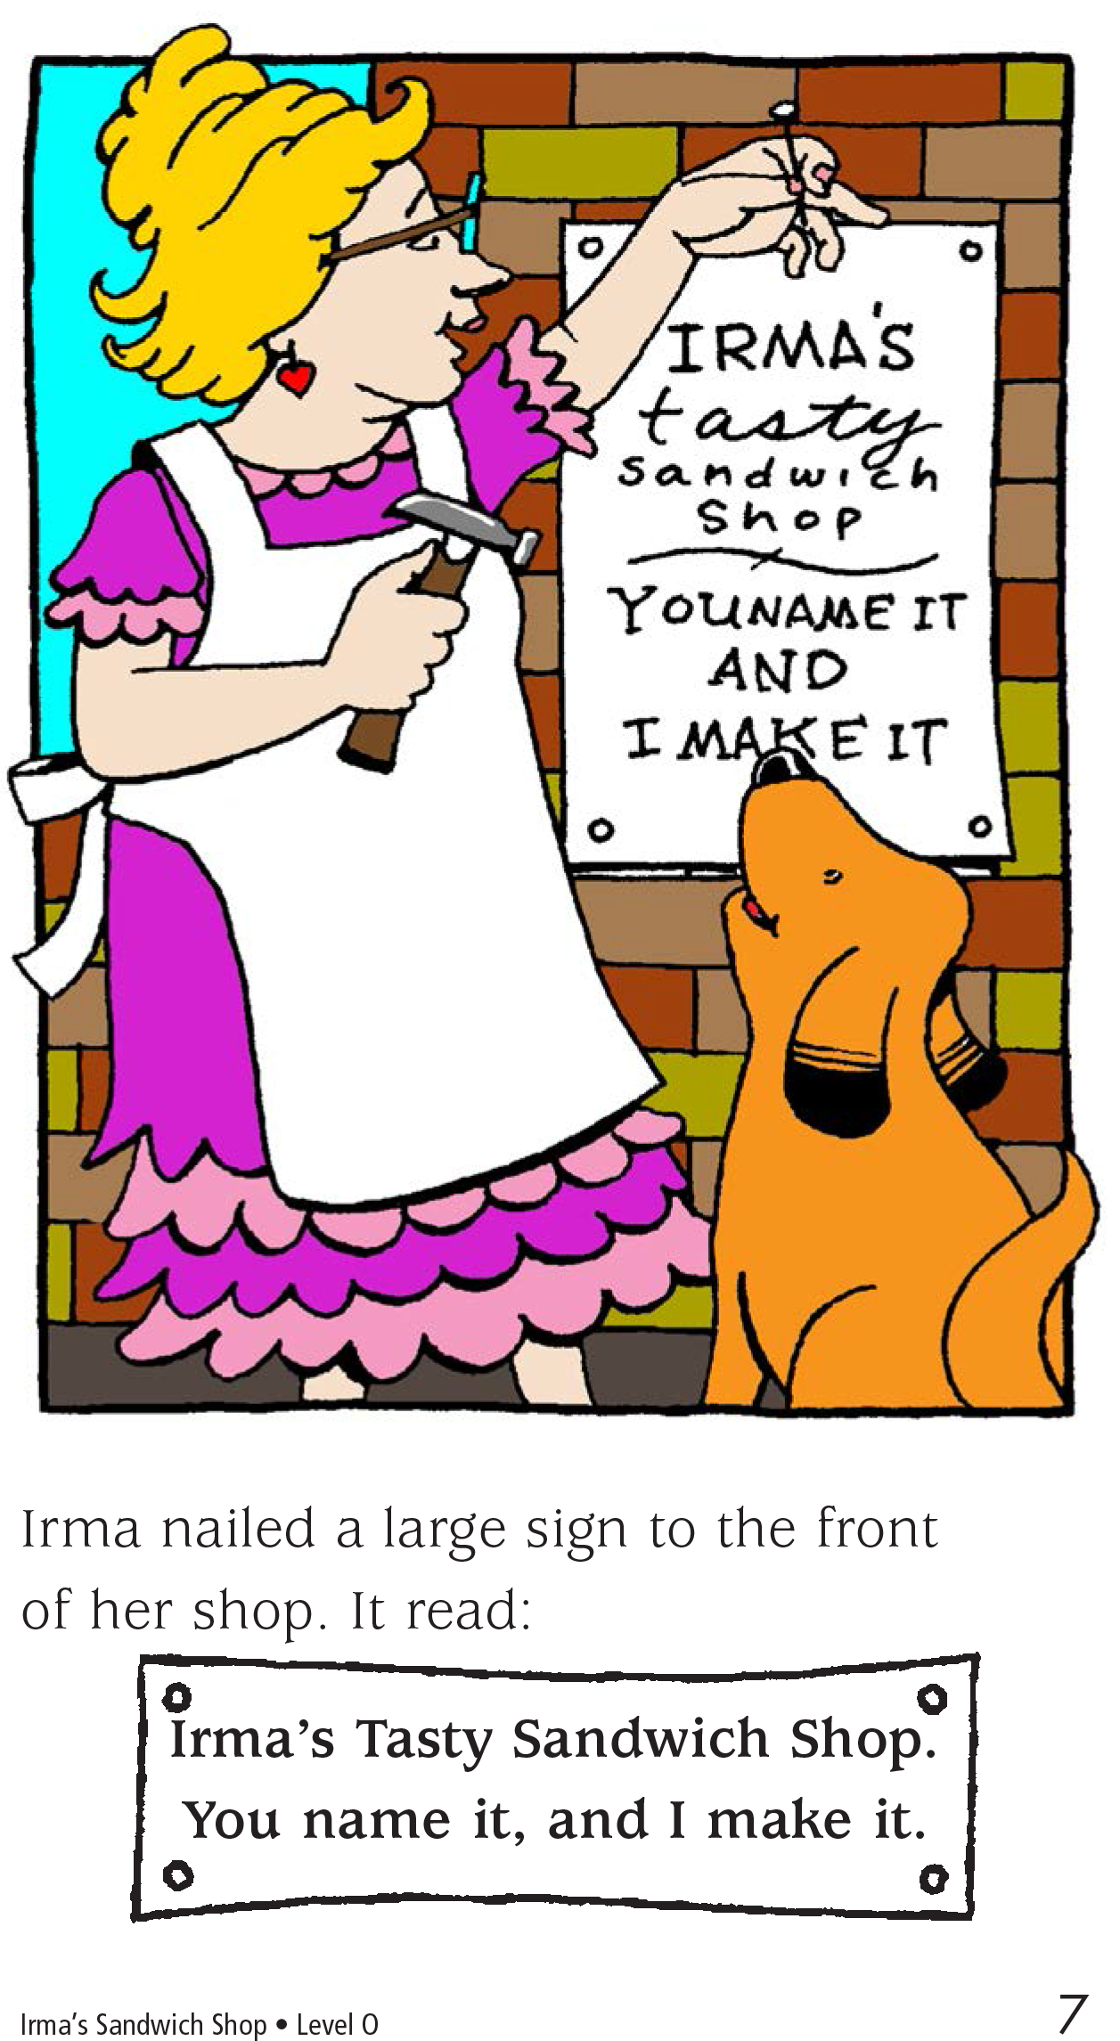

Slide 6
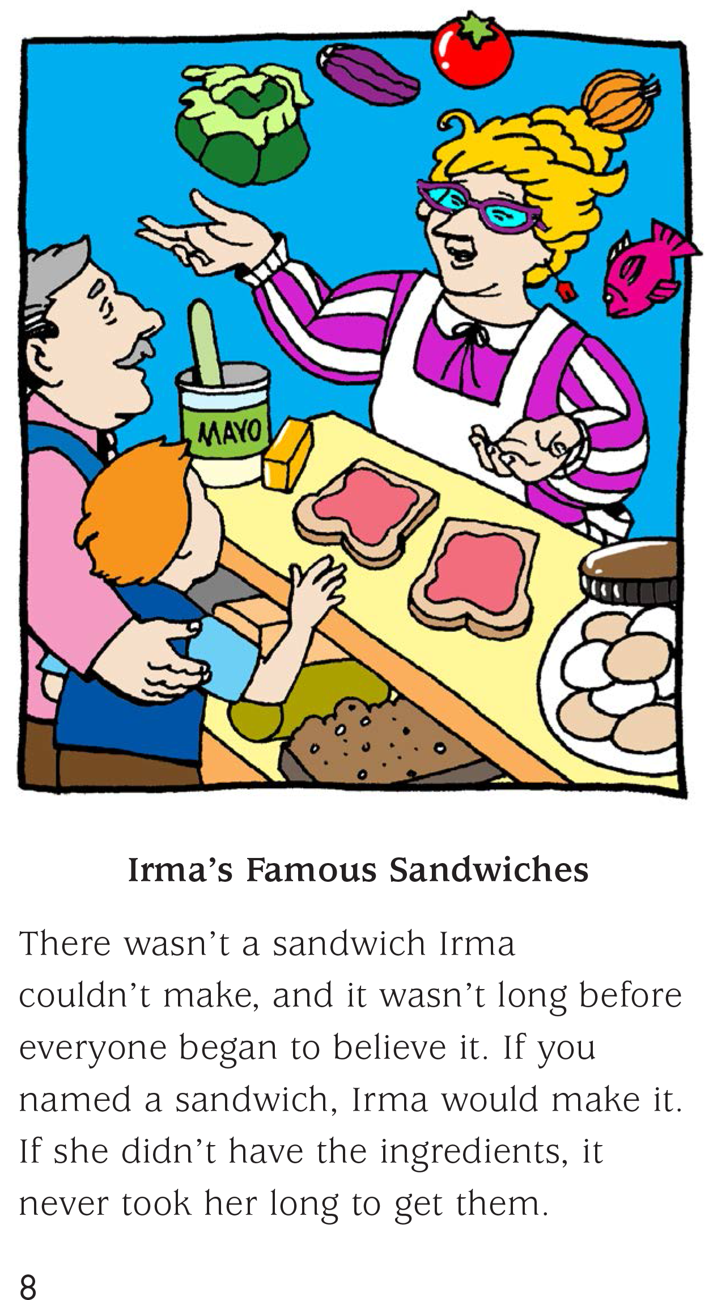
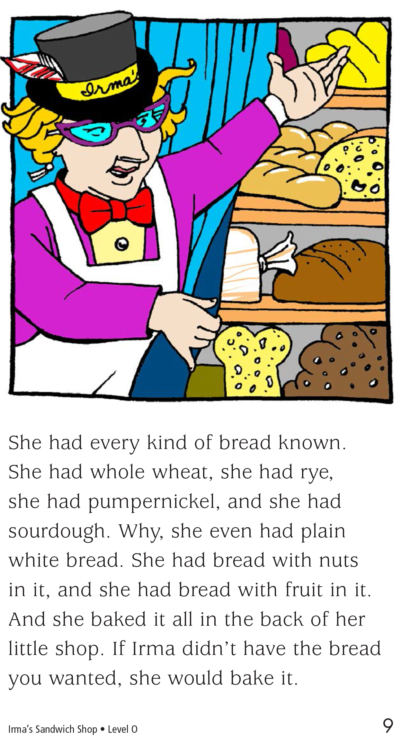

Slide 7
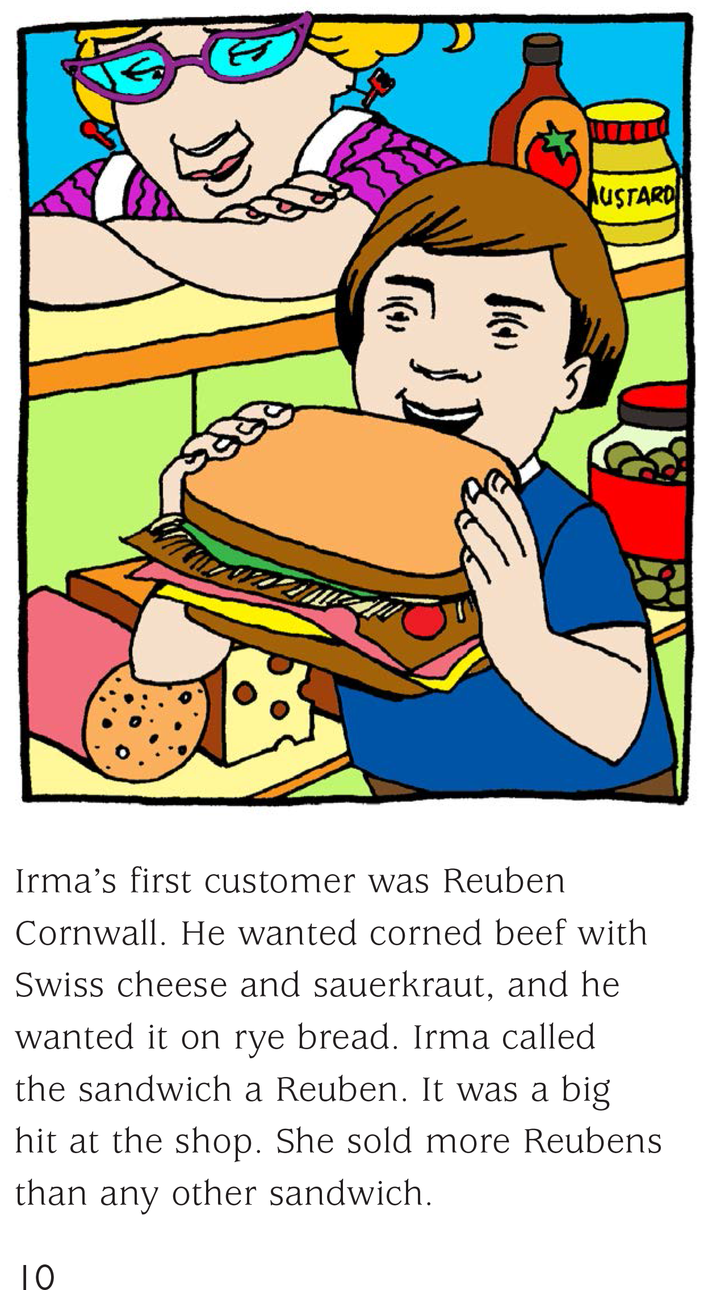
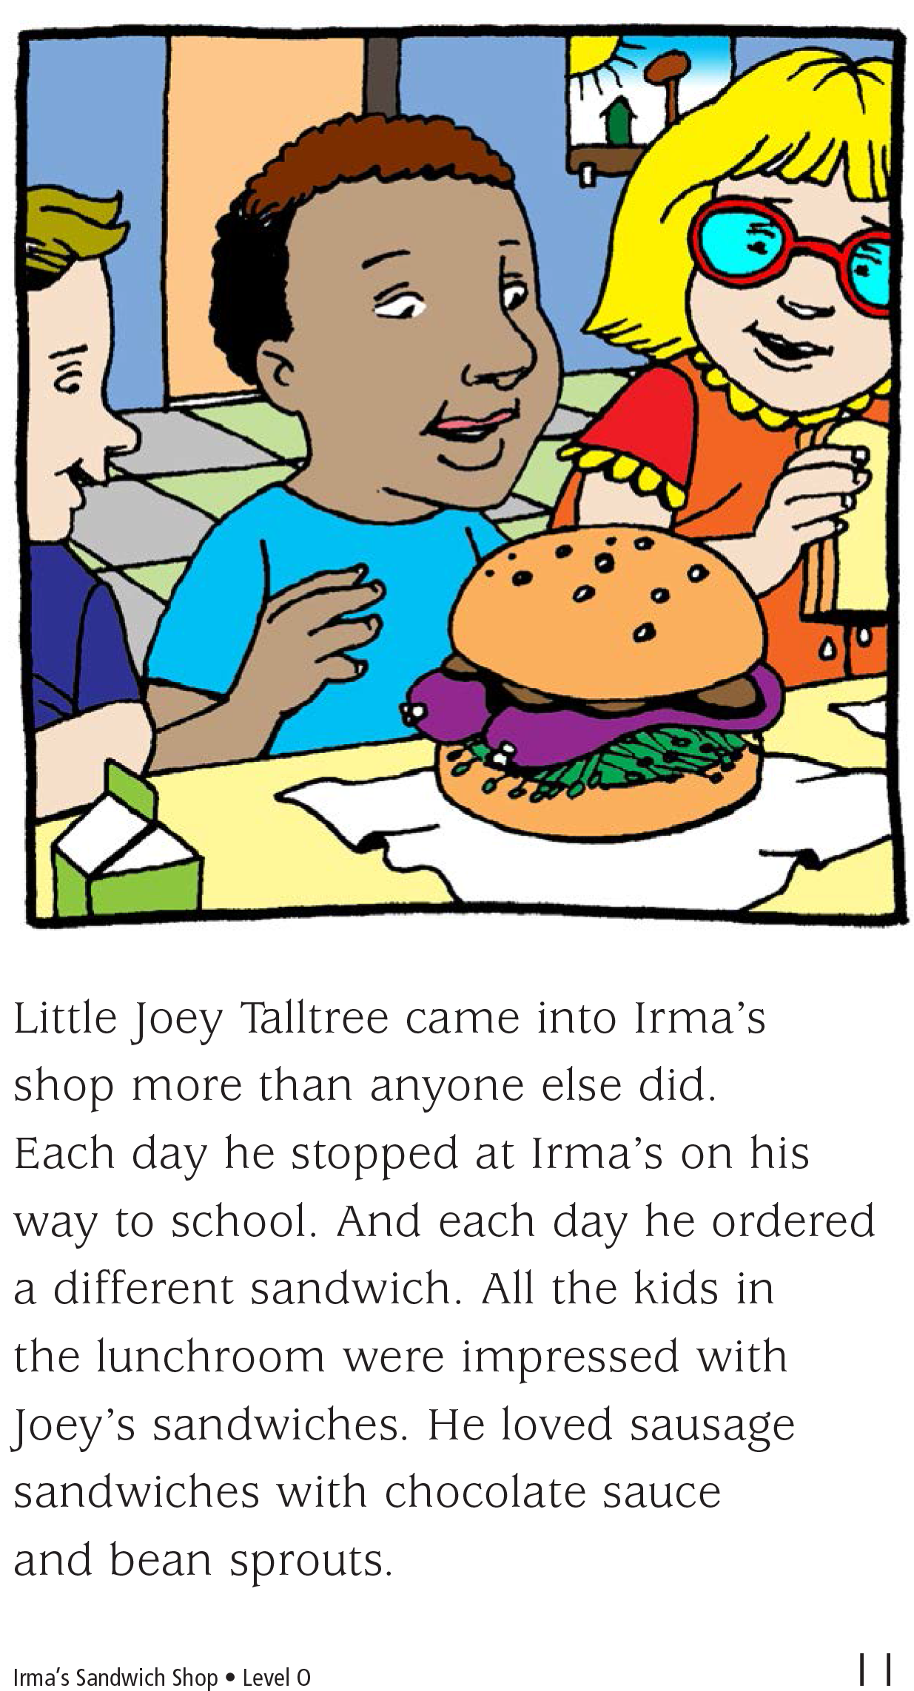

Slide 8
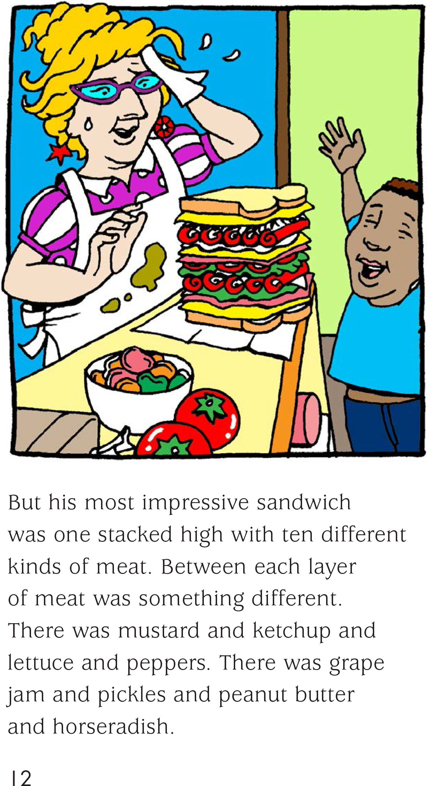
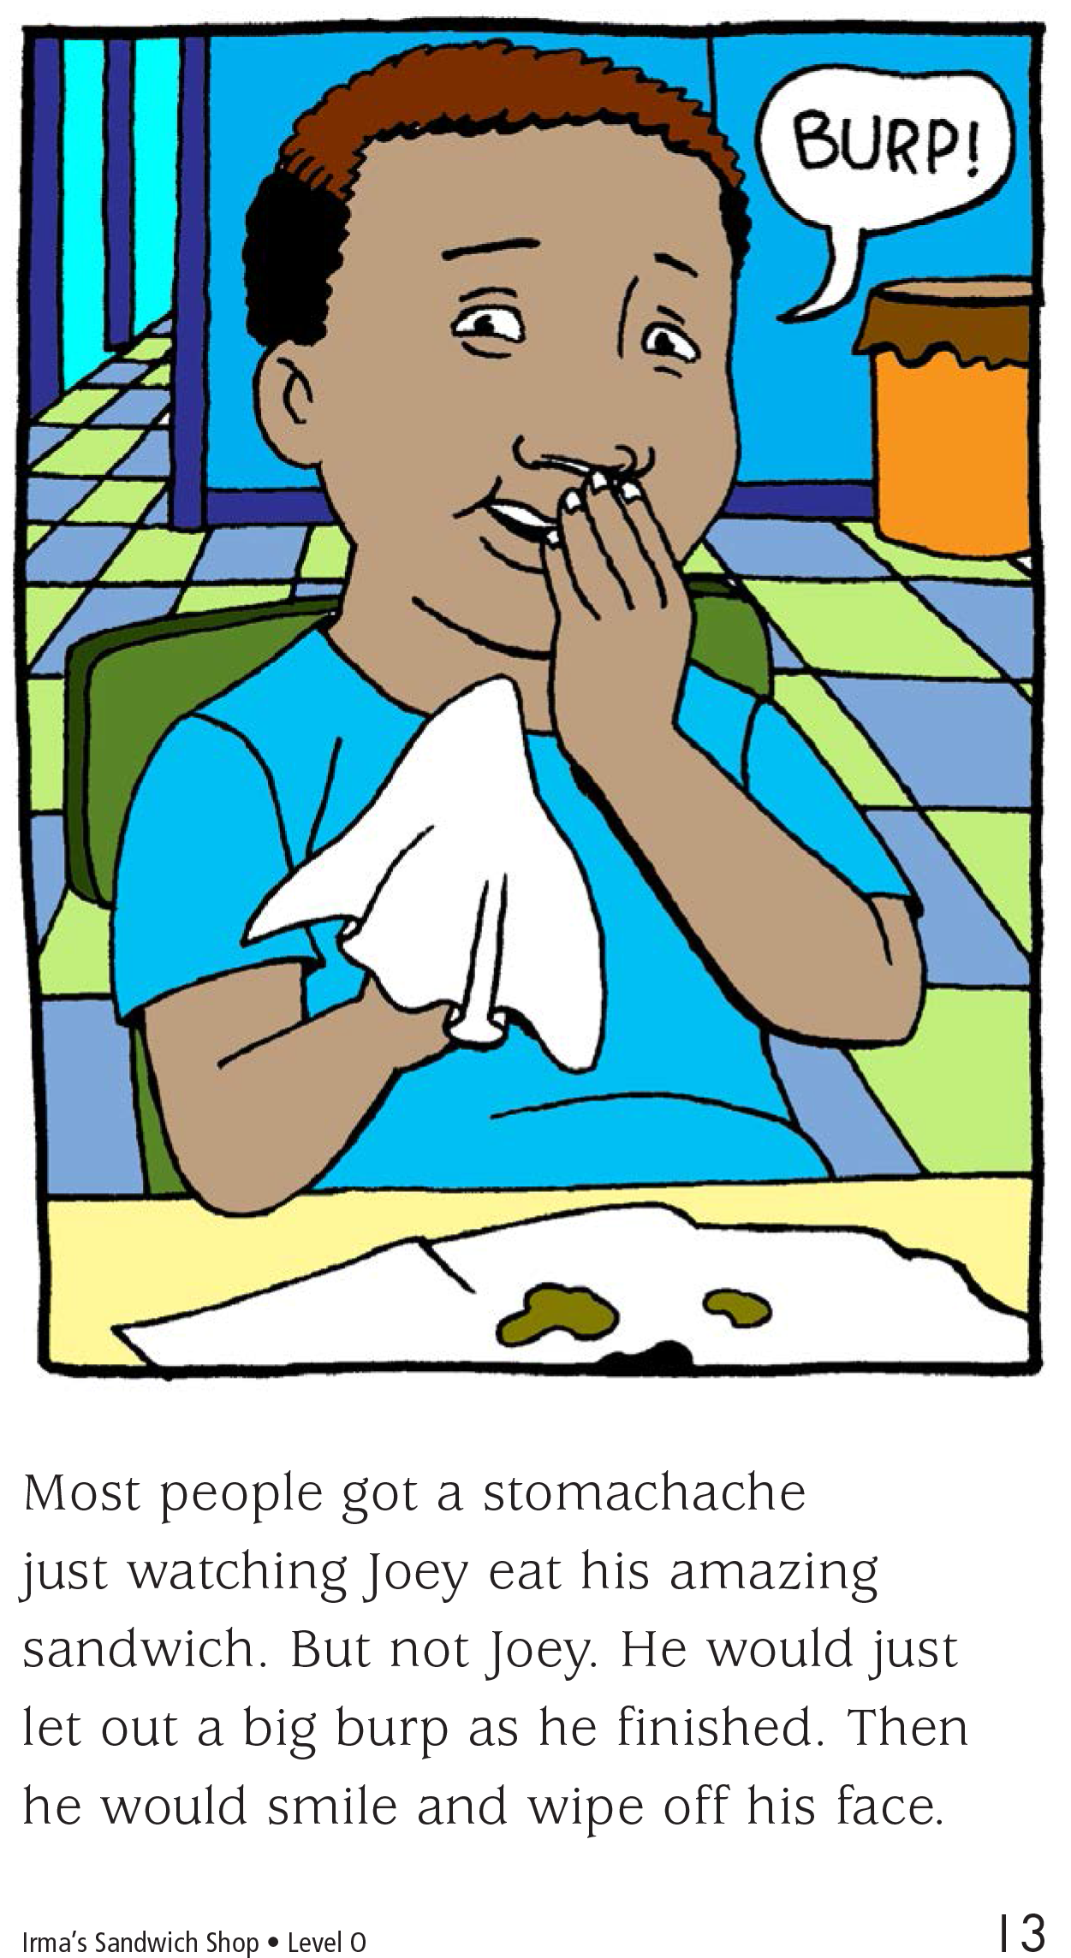

Slide 9
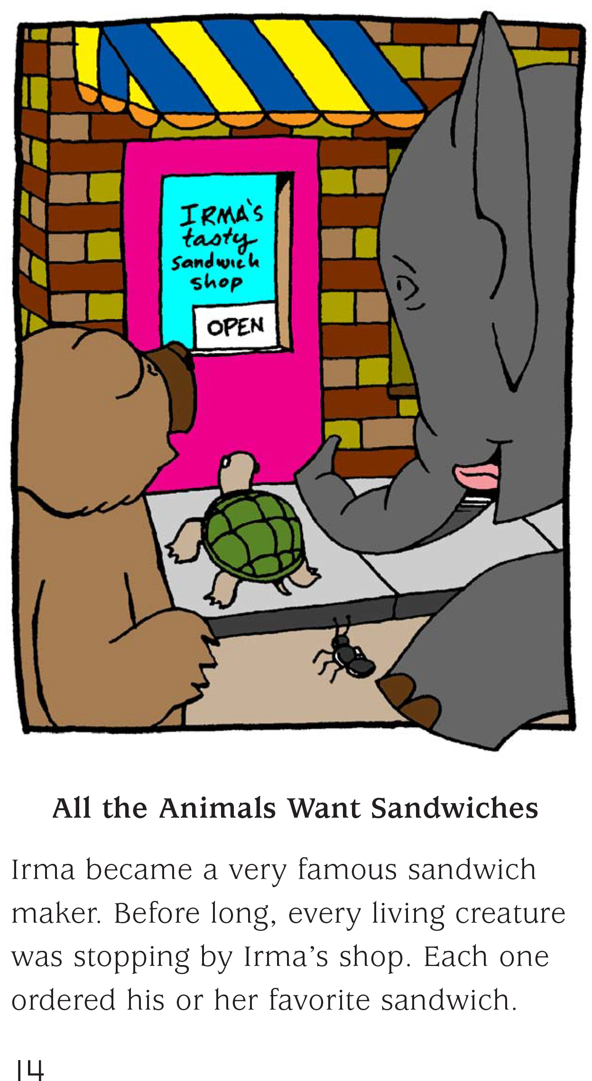
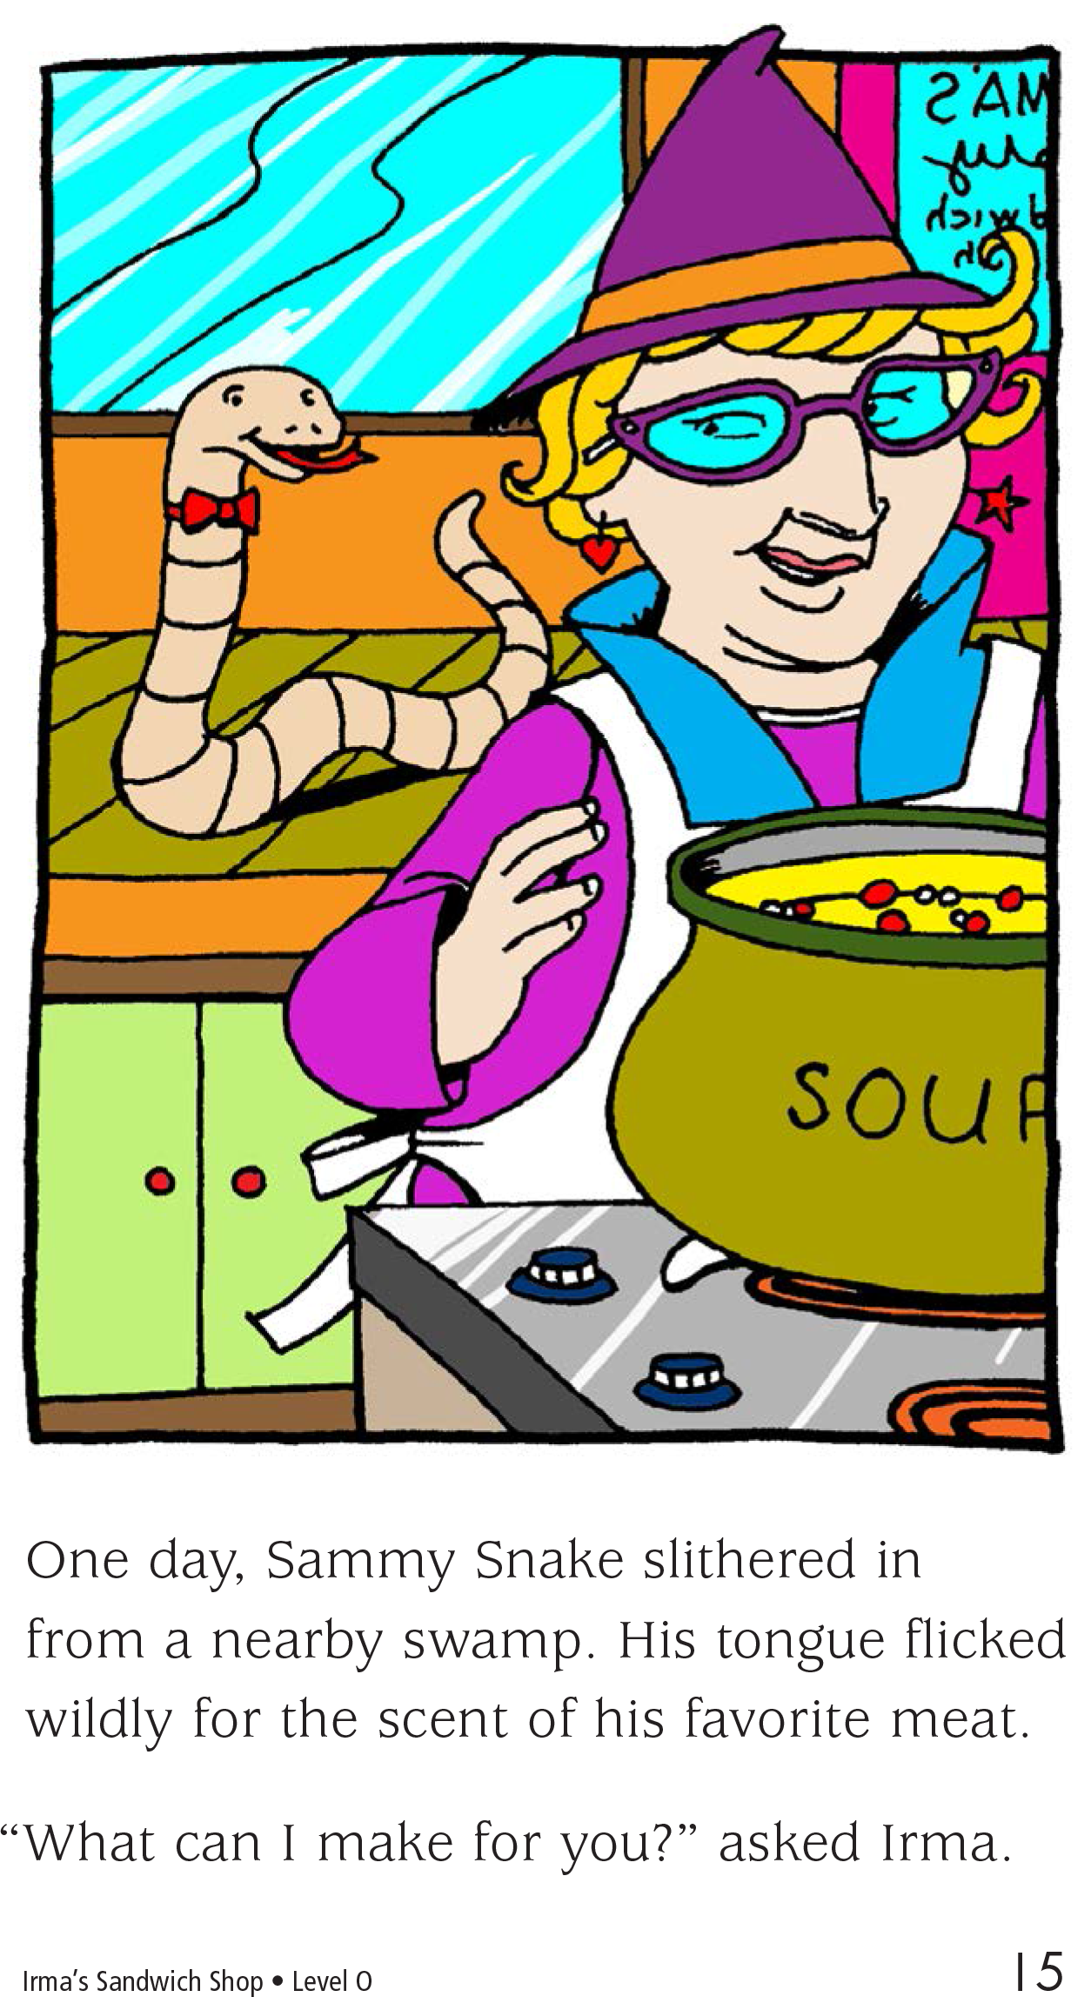

Slide 10
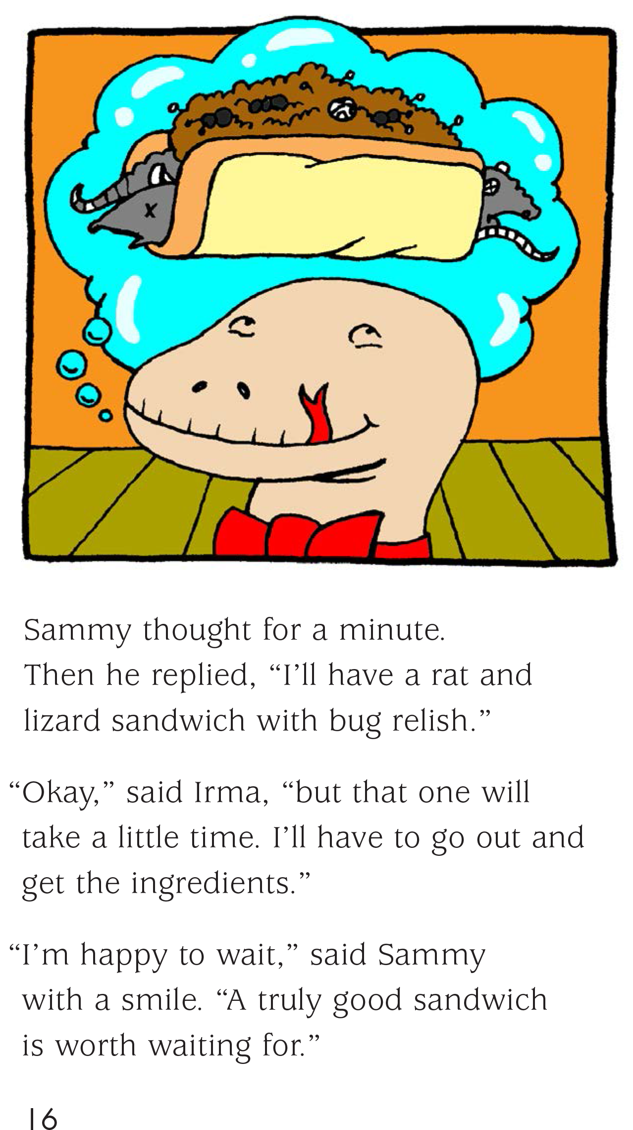
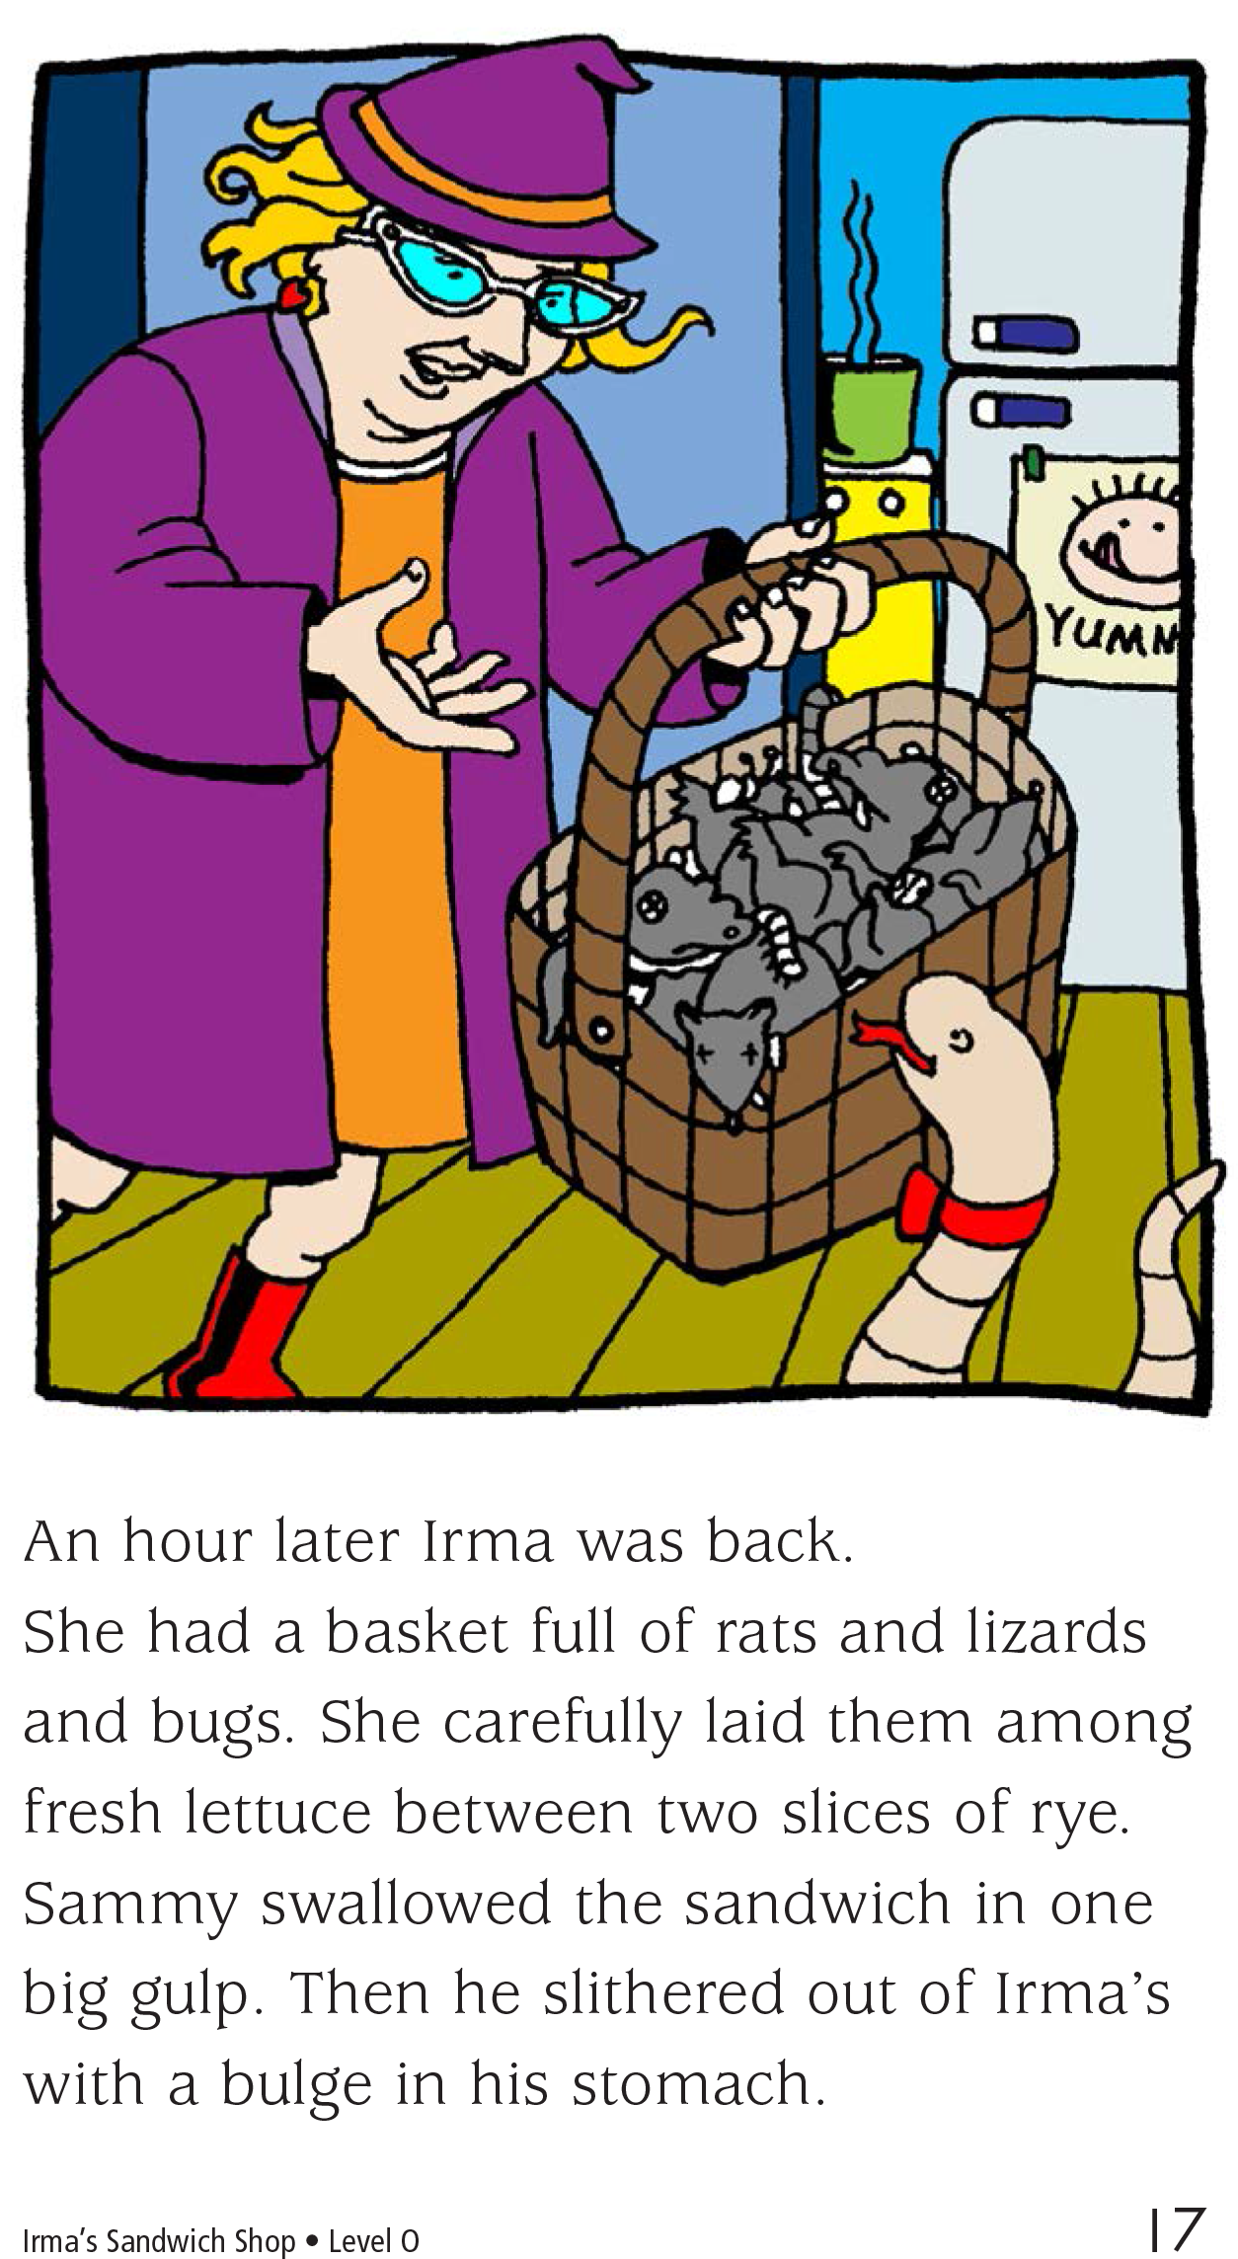

Slide 11
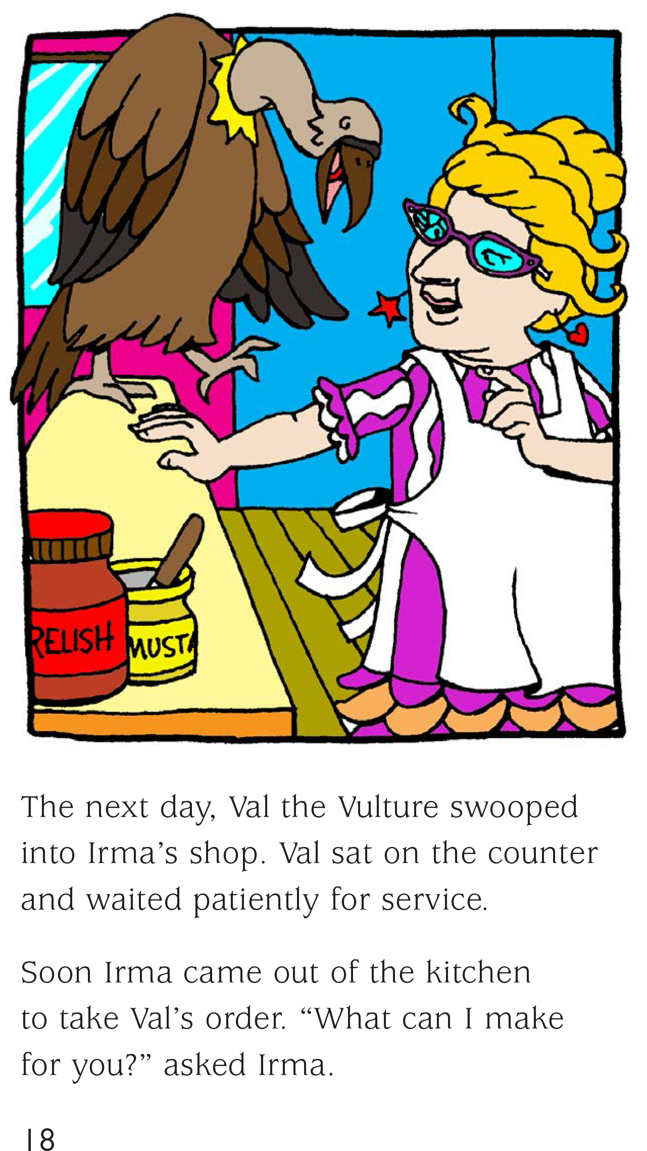
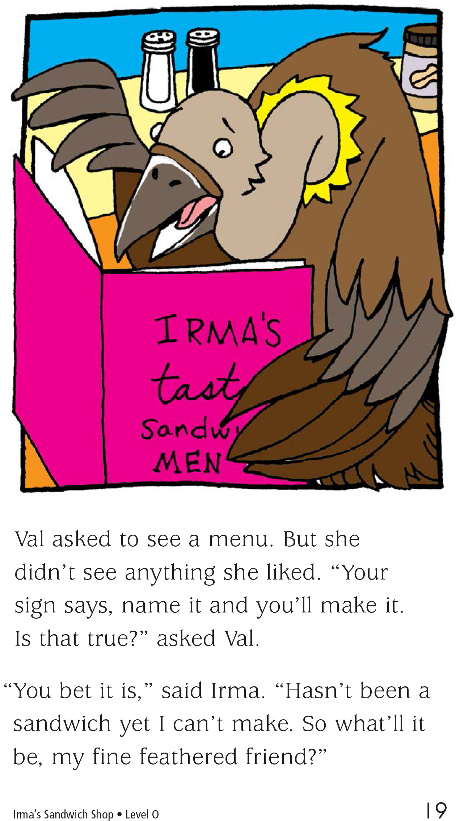

Slide 12
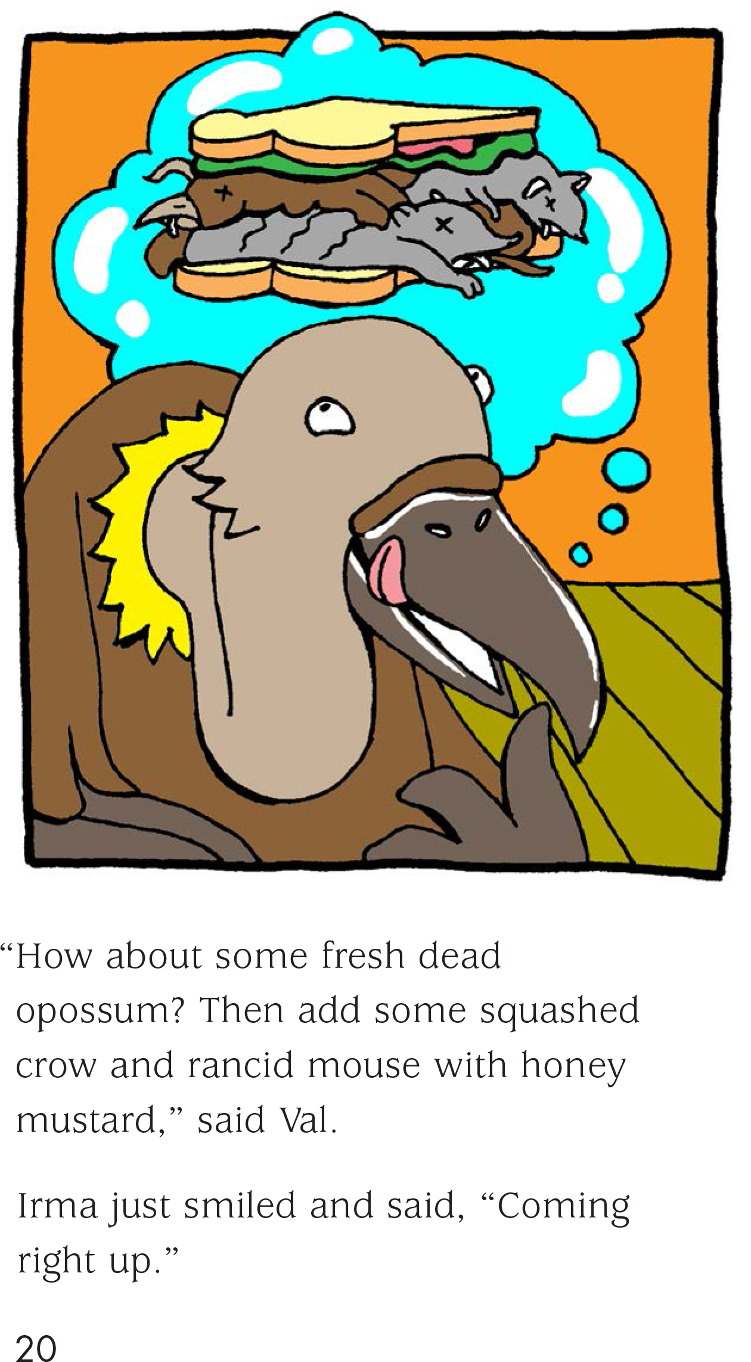
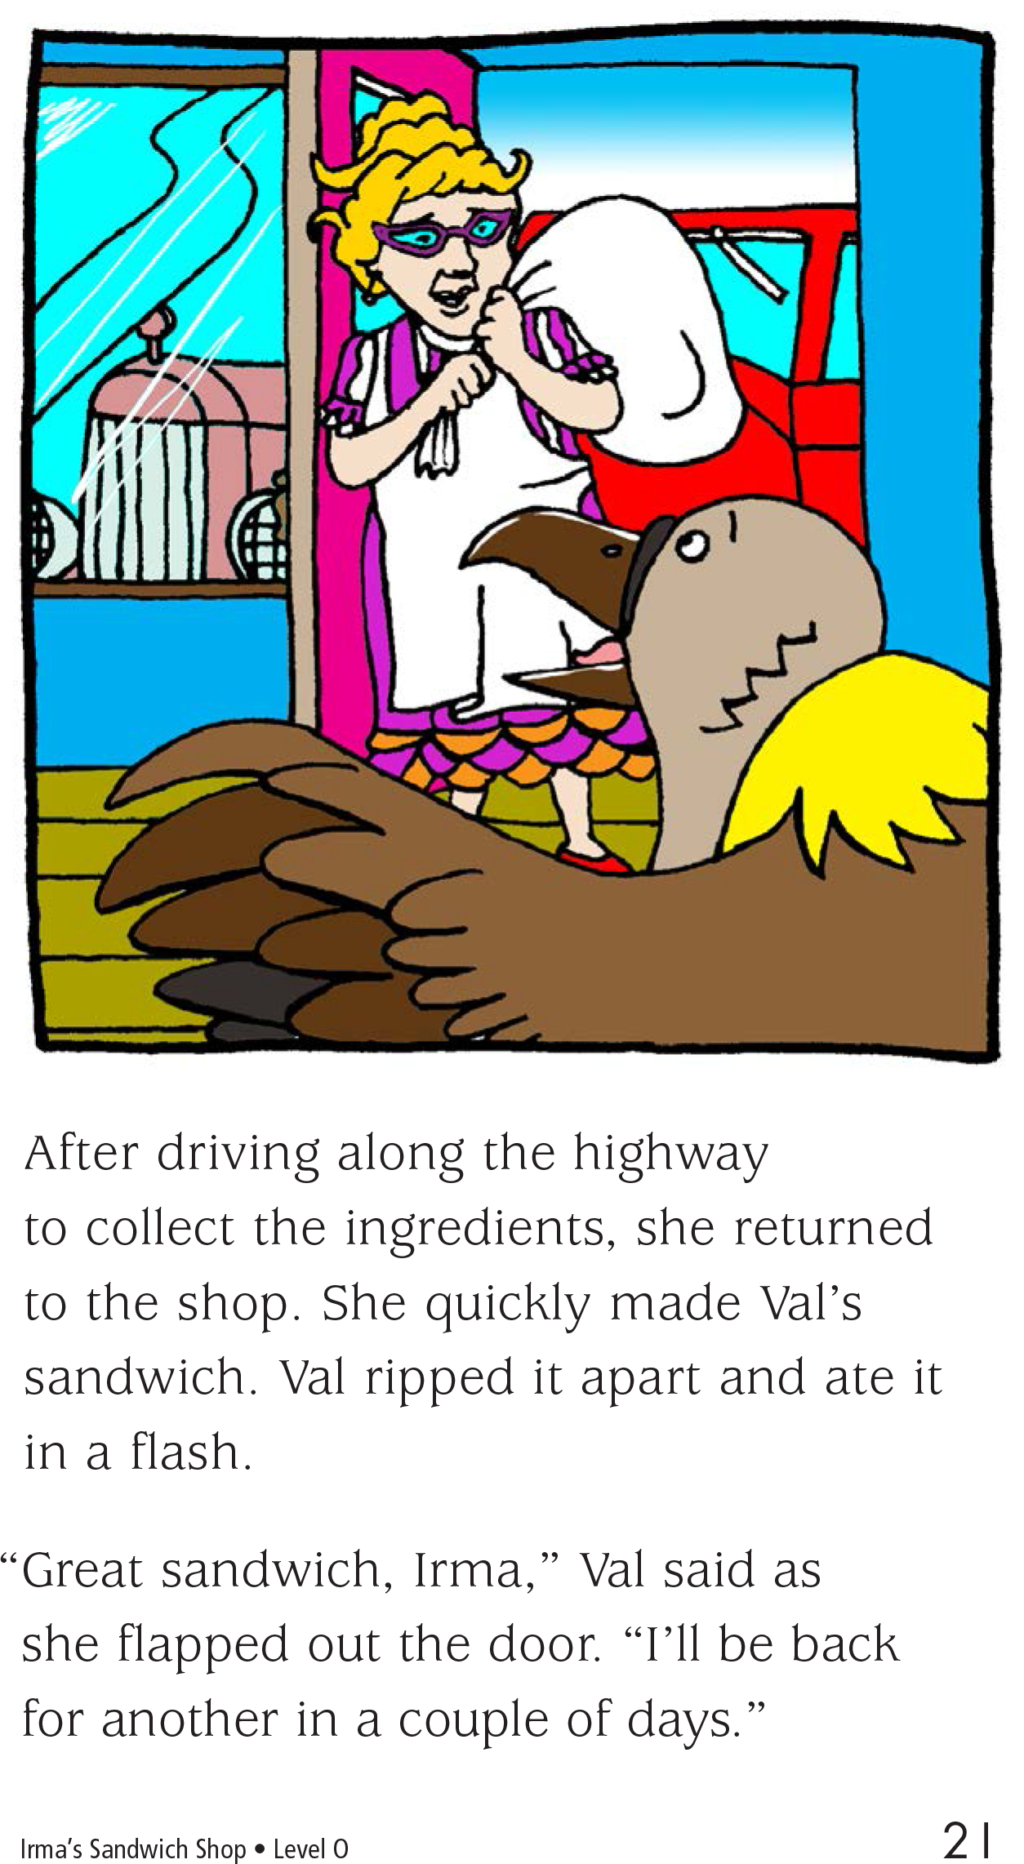

Slide 13
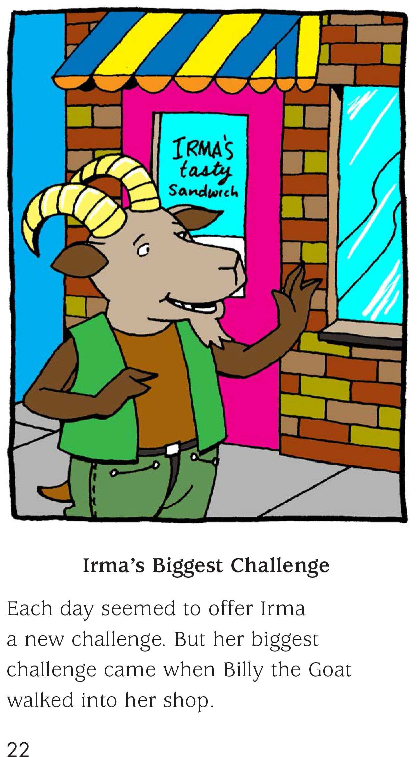
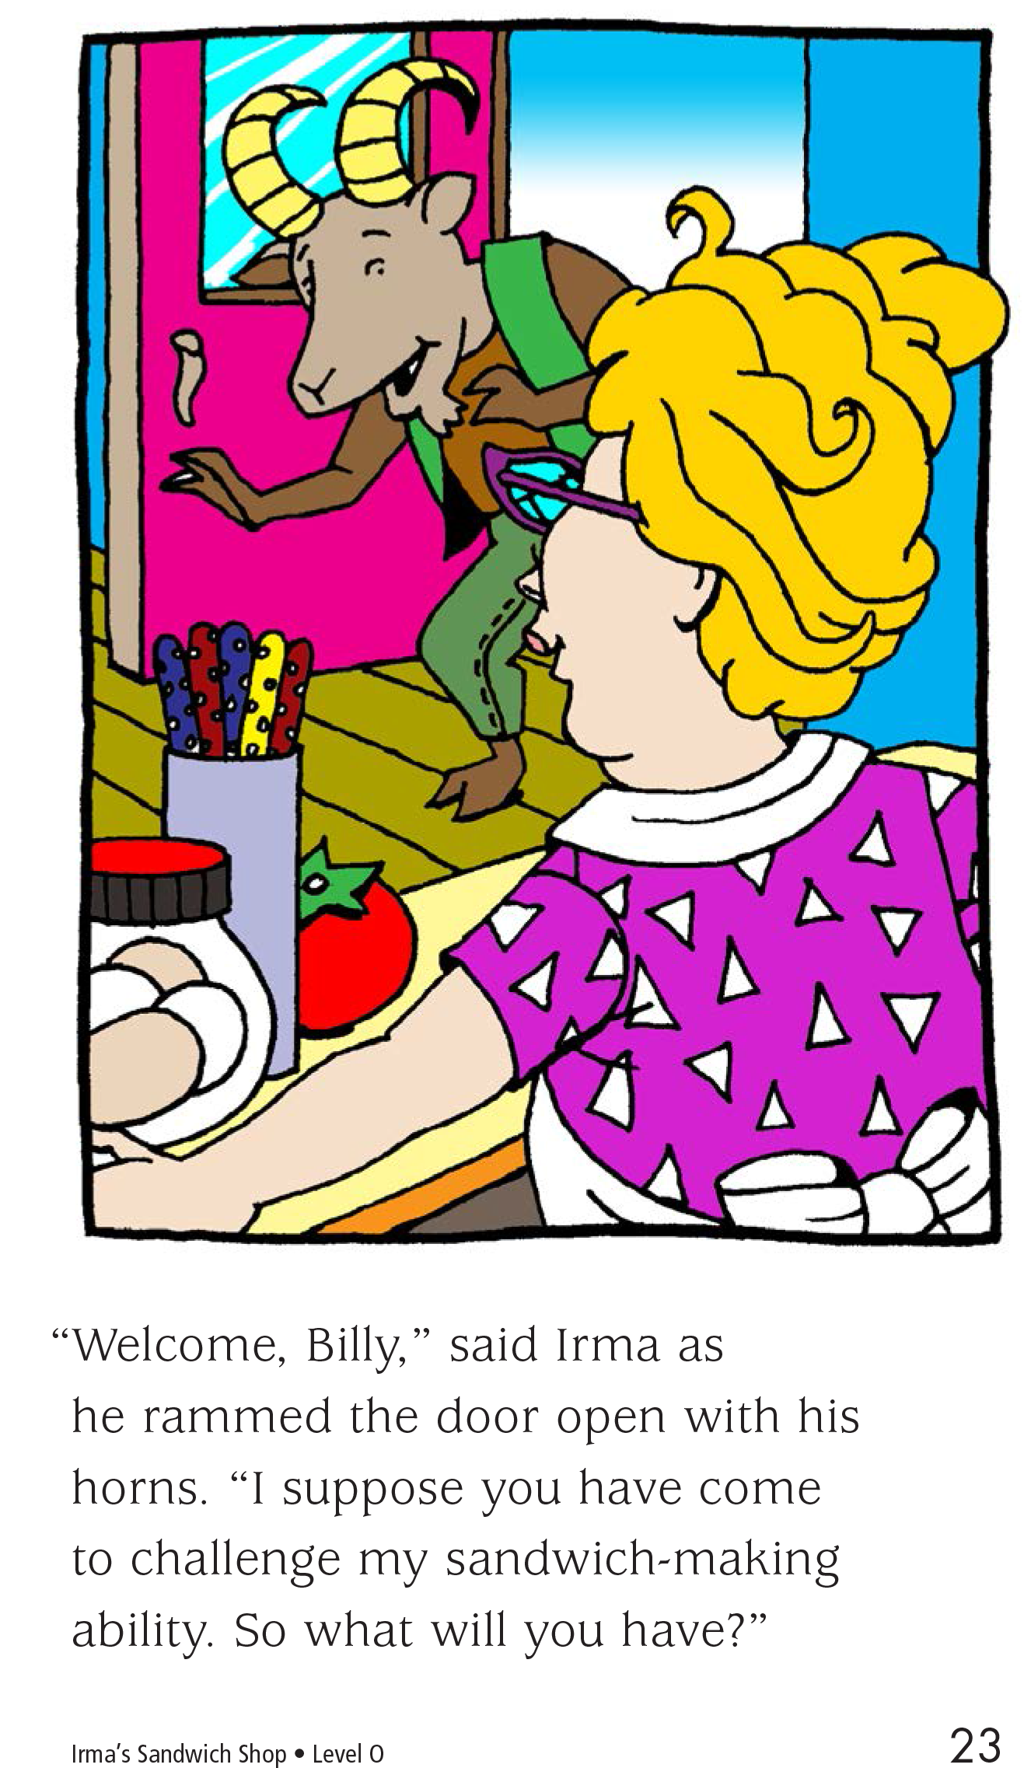

Slide 14
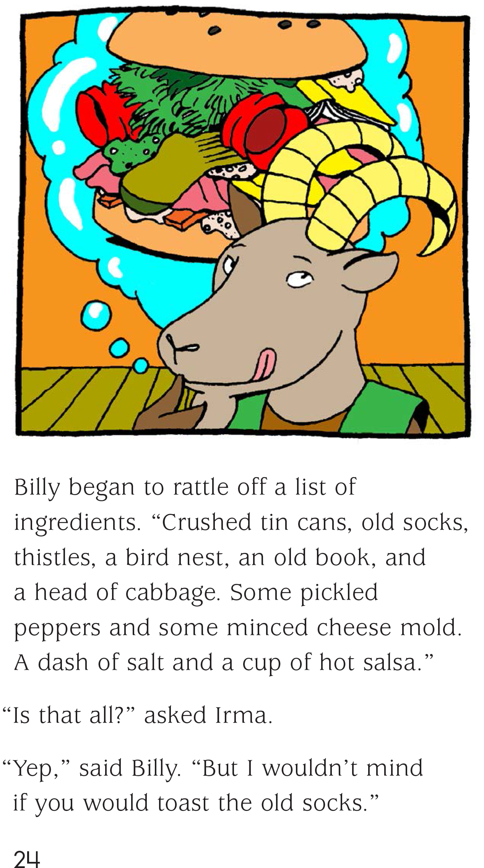
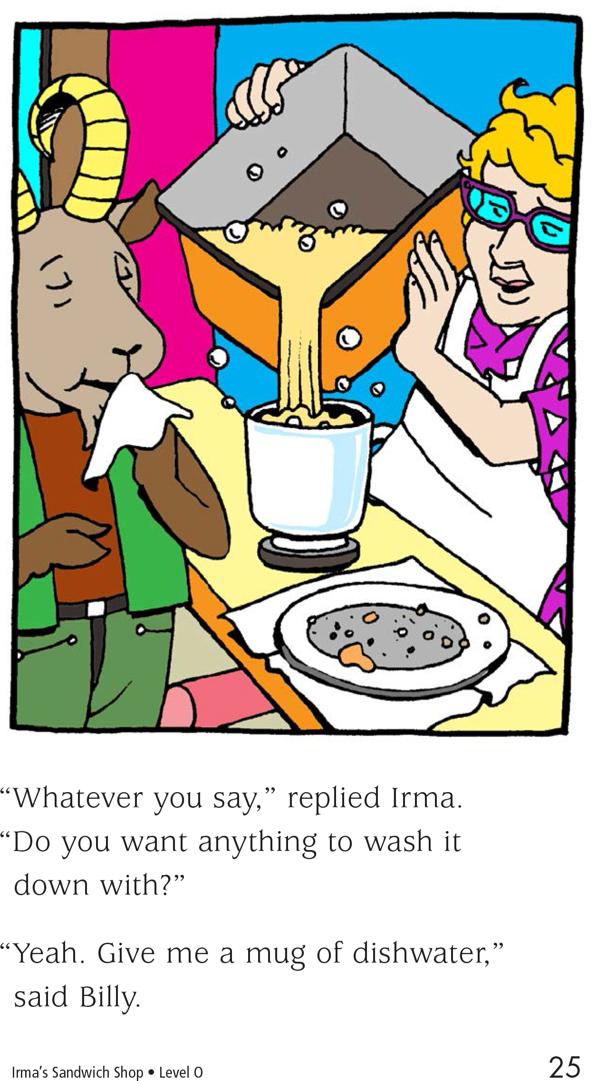

Slide 15
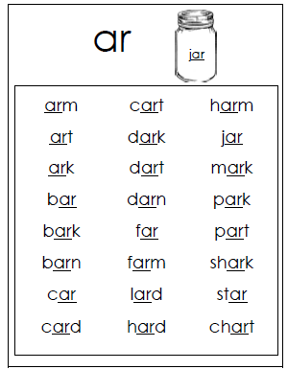
Ar words
Practice reading the ar words

Slide 16
St words

Slide 17
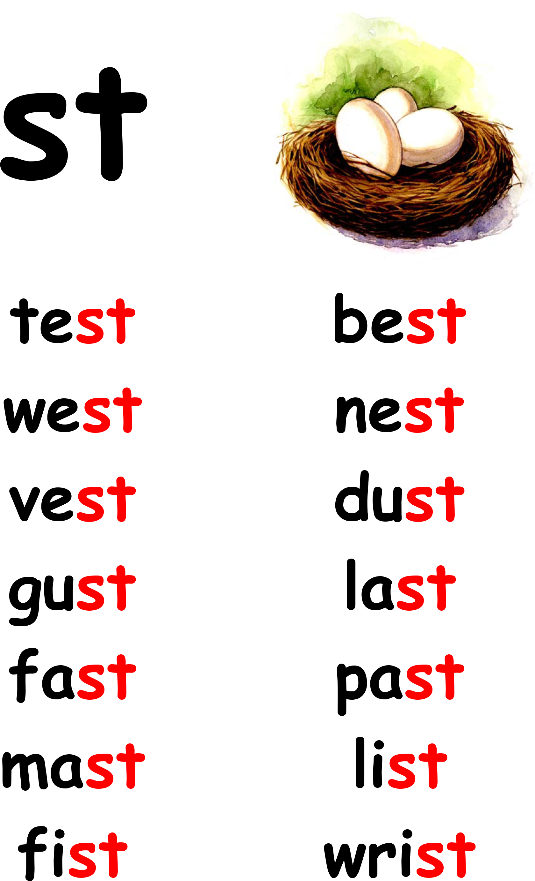
St words
Look up the definition of the following words

Slide 18
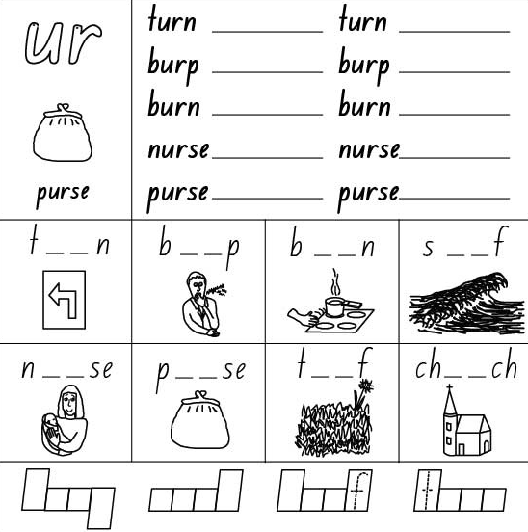
Ur activity
Define the 1st section and fill in the blanksfor the 2nd and 3rd section

Slide 19
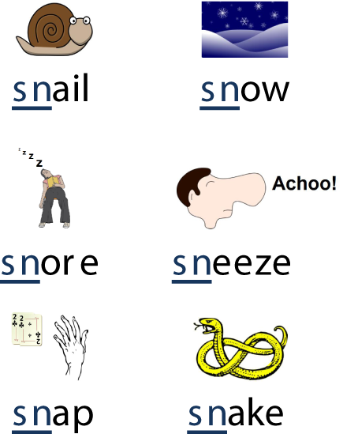
Sn words
Practice reading the sn words

Slide 20
Let’s practice there was/were
Choose the correct option. Write it in the gaps.
1. Last Christmas --------------- many presents under the Christmas tree.
a) there was b) there were
2. --------------- a present for me, too!
a) There was b) There were
3. --------------- many flowers in the garden last Spring.
a) There was b) There were
4. --------------- a carpet under the table in the dining room.
a) There was b) There were

Slide 21
Let’s practice there was/were
There was / There were a great match on TV last night.
There was / There were many pictures in my bedroom.
3. There was / There were a beautiful baby in the park.
4. Mum, there was / there were a bee in my room just now!
5. There was/there were two birds on my window this morning.
6. There was /There were a big show on TV last night

Slide 22
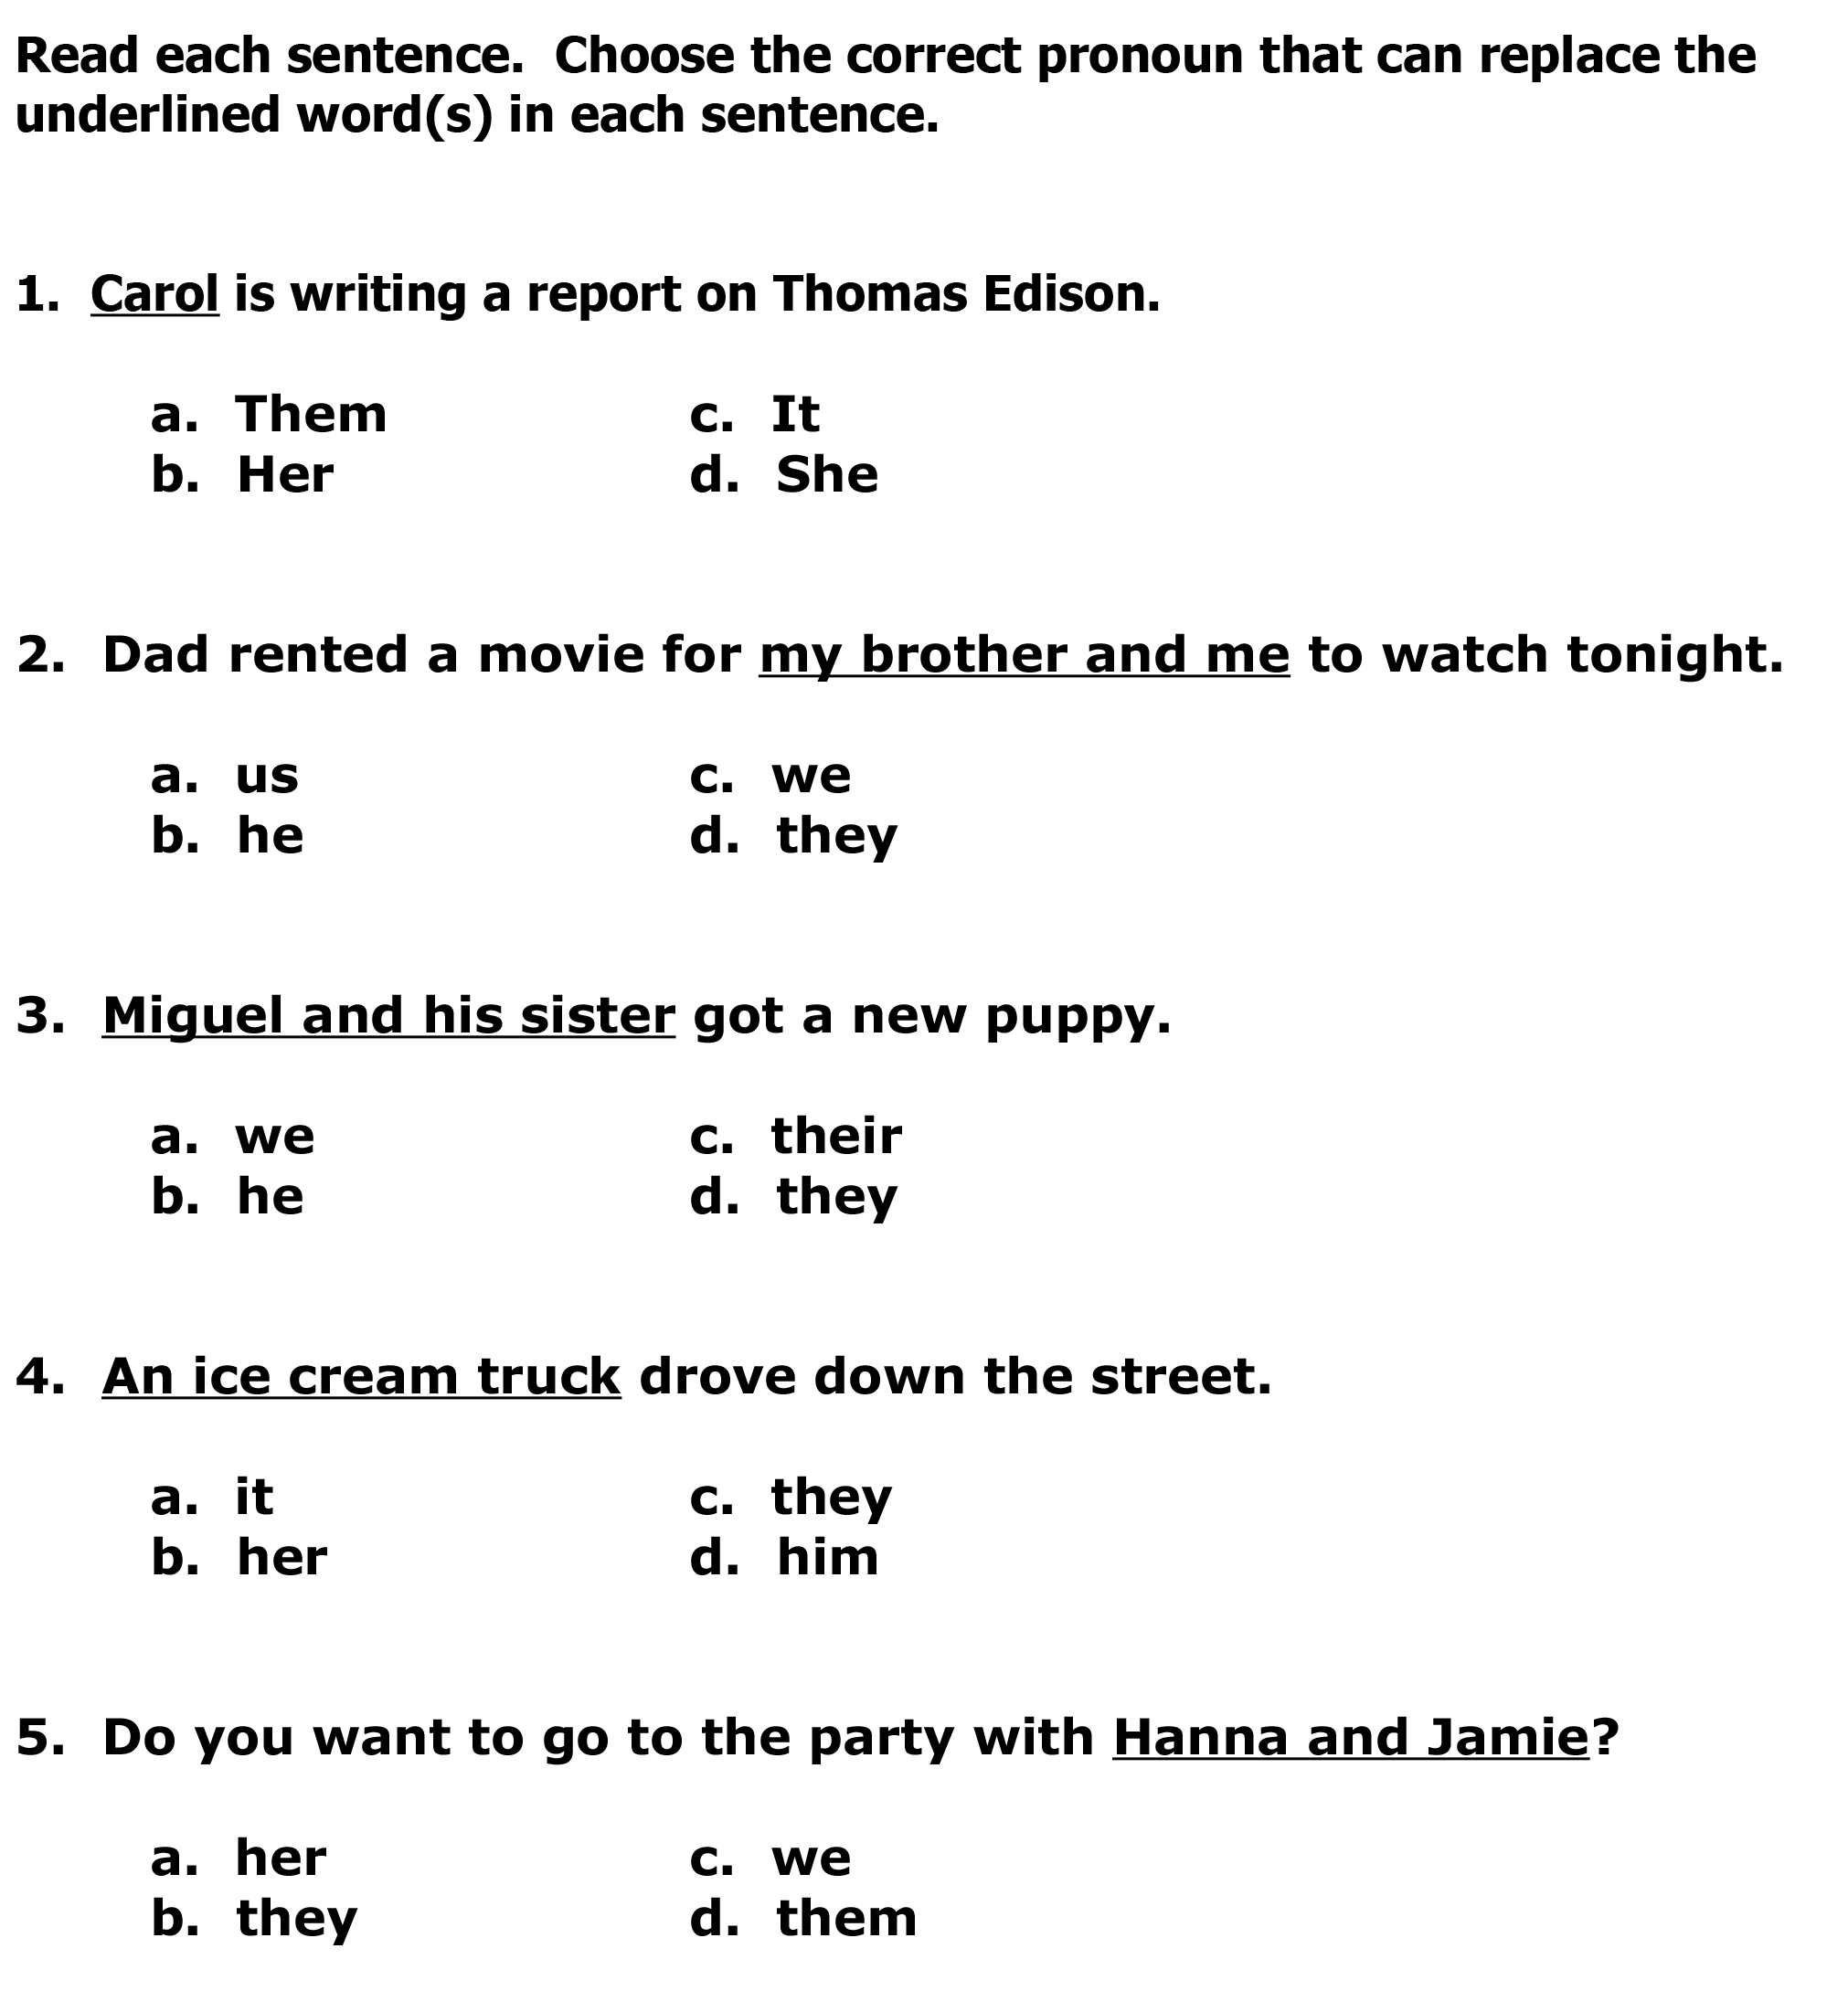
Pronouns

Slide 23
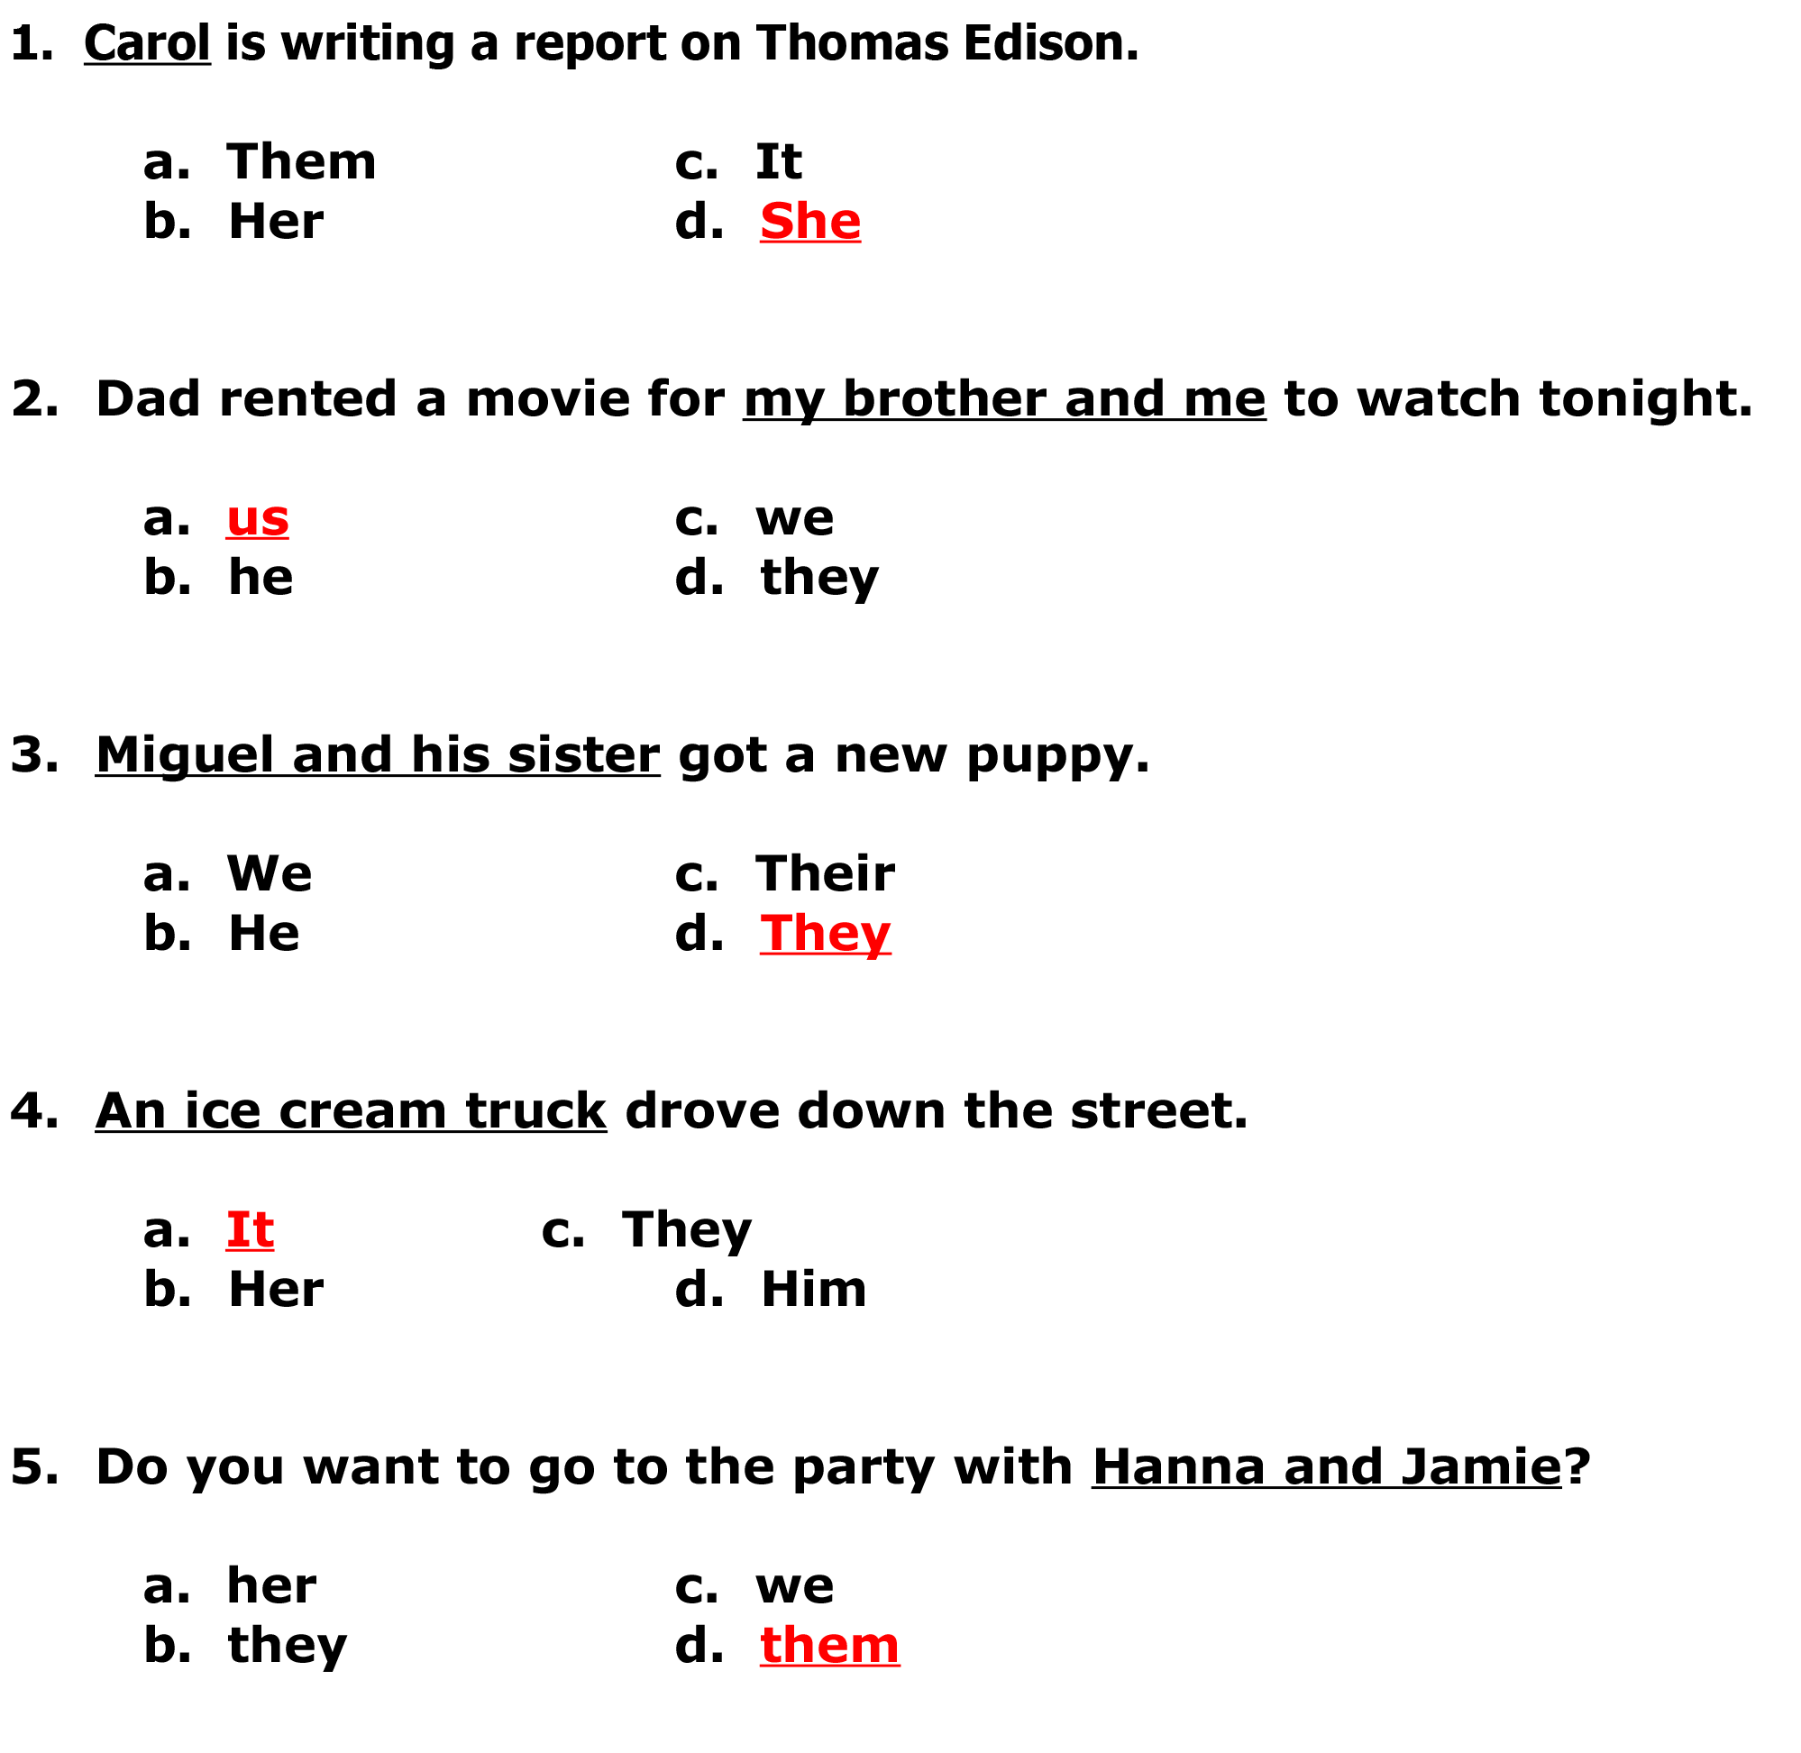
Answers

Slide 24
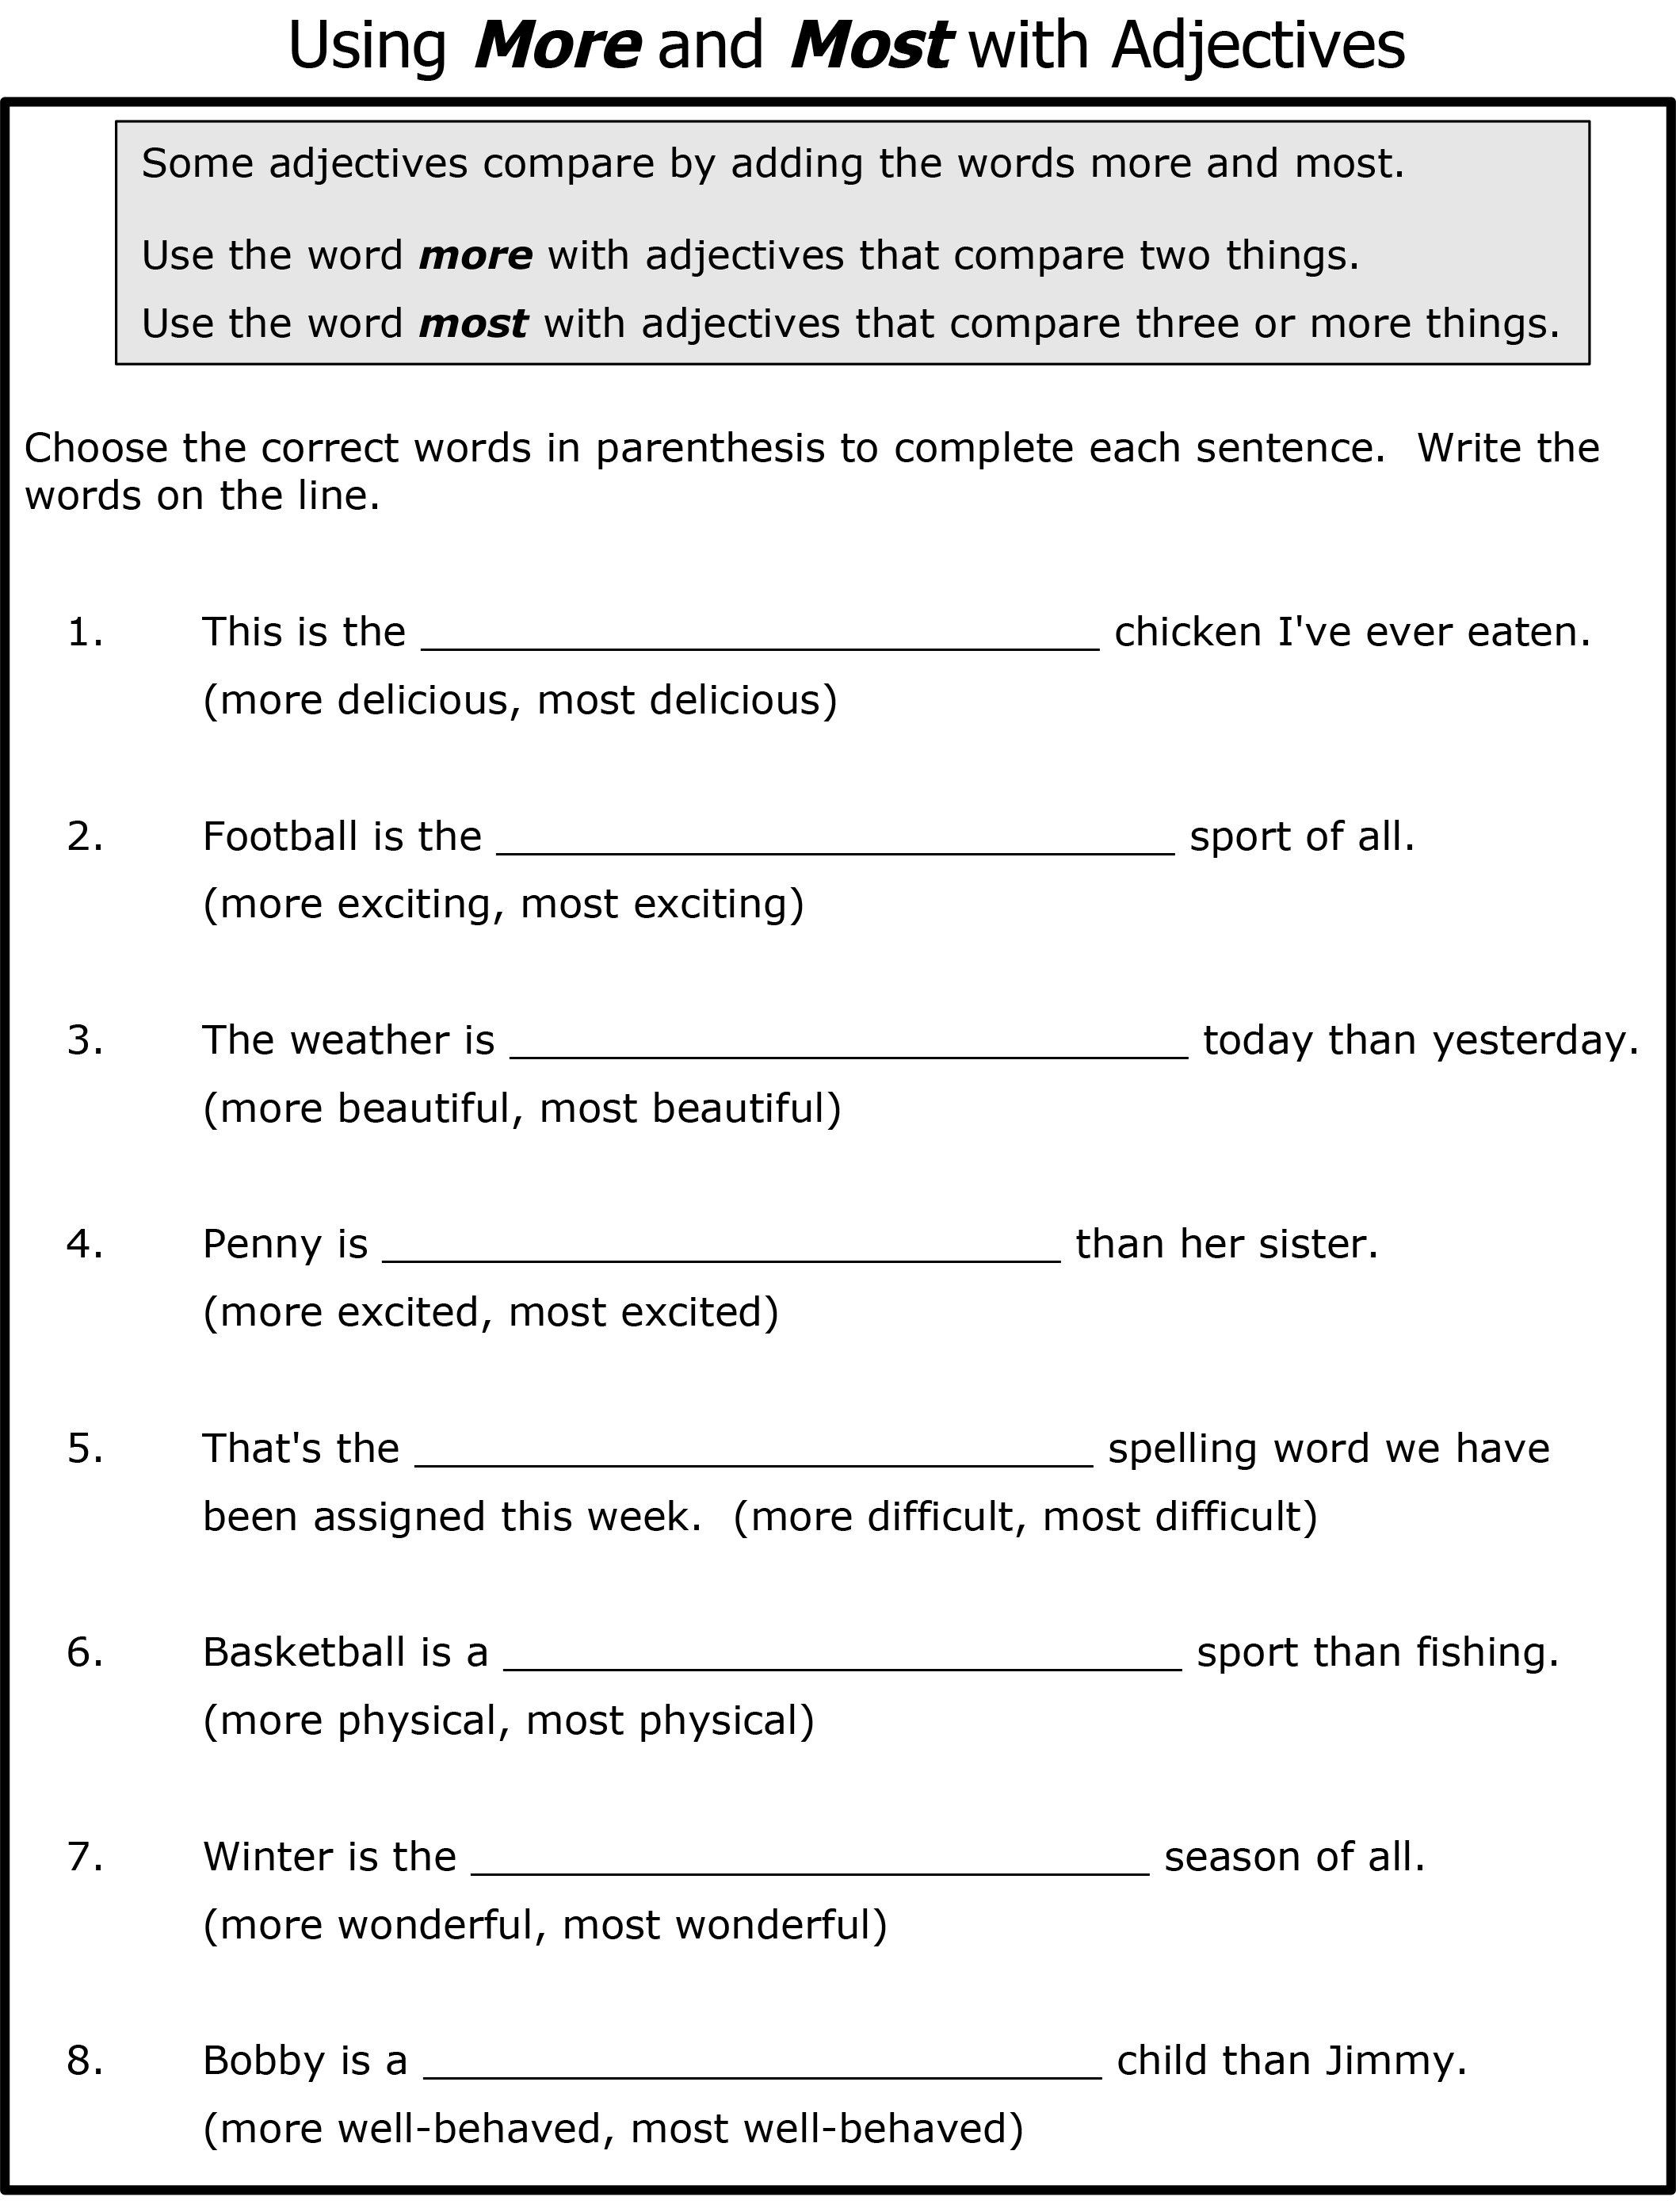
More and most

Slide 25
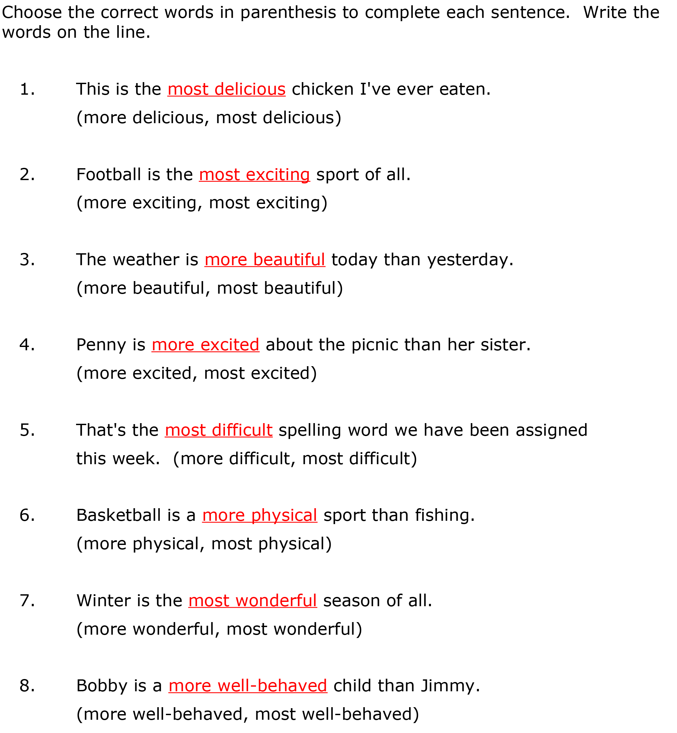
Answers

Slide 26
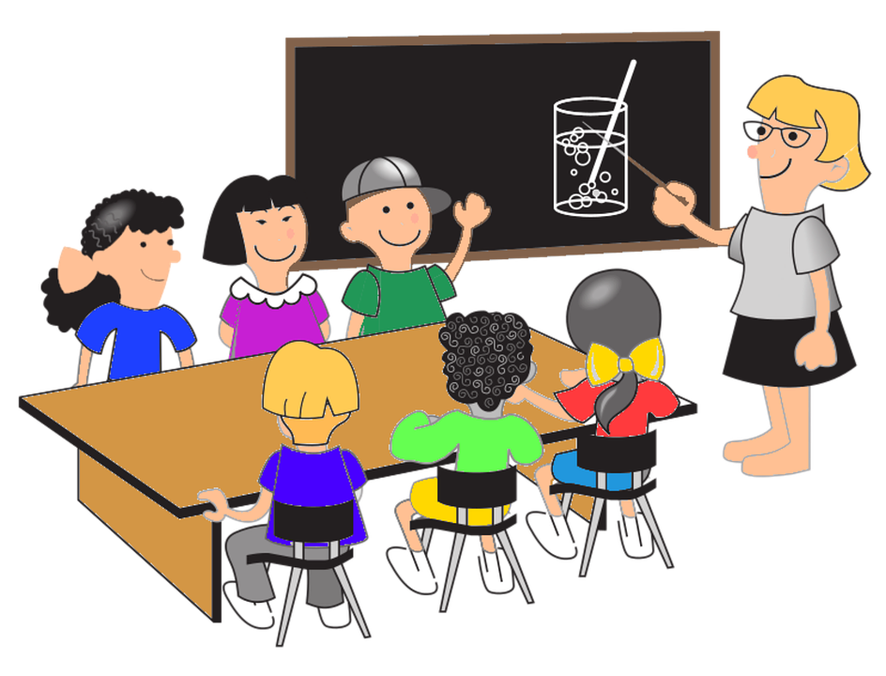
What did we learn?
New ‘sn’, ‘ur’ ‘ar’ and ‘st’ words
Practiced pronouns
Practiced “there was/were” and “more/most”
Notes:
Time to play your recording

