Slide 1


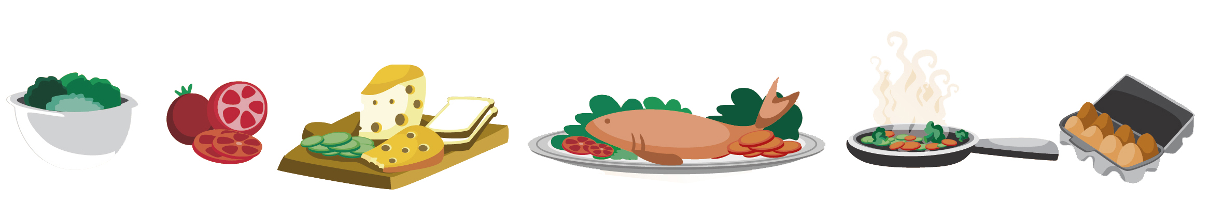
Lesson 2
FOOD

Slide 2

What we will learn today
Using the ‘kn’ sound
Learning homophones
Using capitalization, exclamation points, periods and “but”

Slide 3
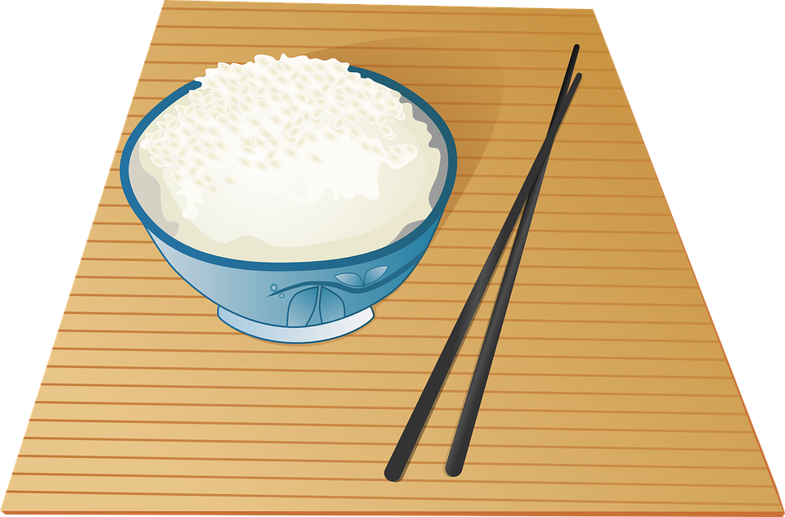
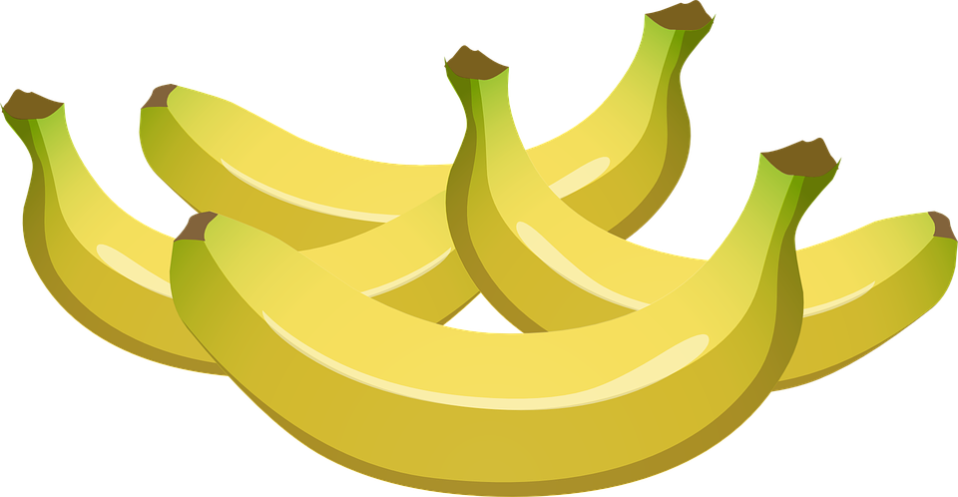
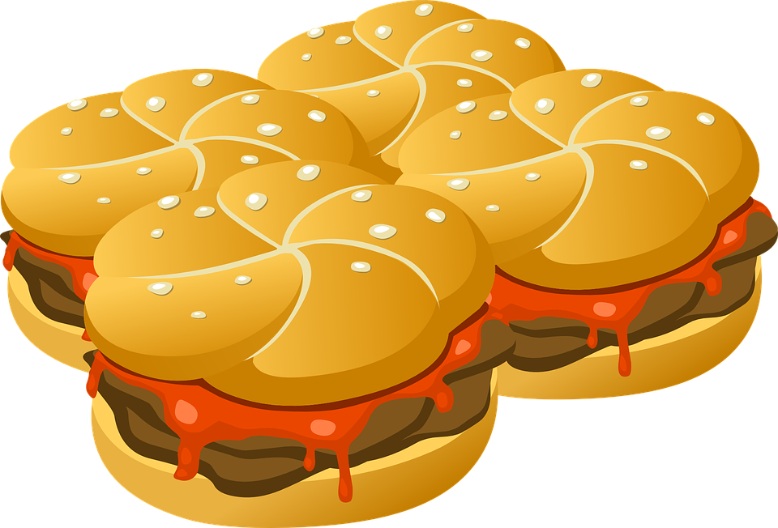
Let’s take up the homework
What is your favourite food? Share the photo with the class.
Read your 5 adjectives about your favourite food.
Read your 4 sentences about why it’s your favourite food.
Notes:
Get each student to answer questions #1-3 aloud.

Slide 4


The KN Sound
Notes:
Tell students “kn” sounds like the “n” sound. Emphasize the “k” is silent when it is in front of an “n” in English. Tell students they have to put their tongue at the top of their mouth, and it has to be spread across their mouth and hitting the back of their teeth. Their whole tongue is going to cover the entire top of their mouth, and they are going to press their tongue upward. Demonstrate this to the students in the video feed.
Play the “Silent K Song.mp4”

Slide 5

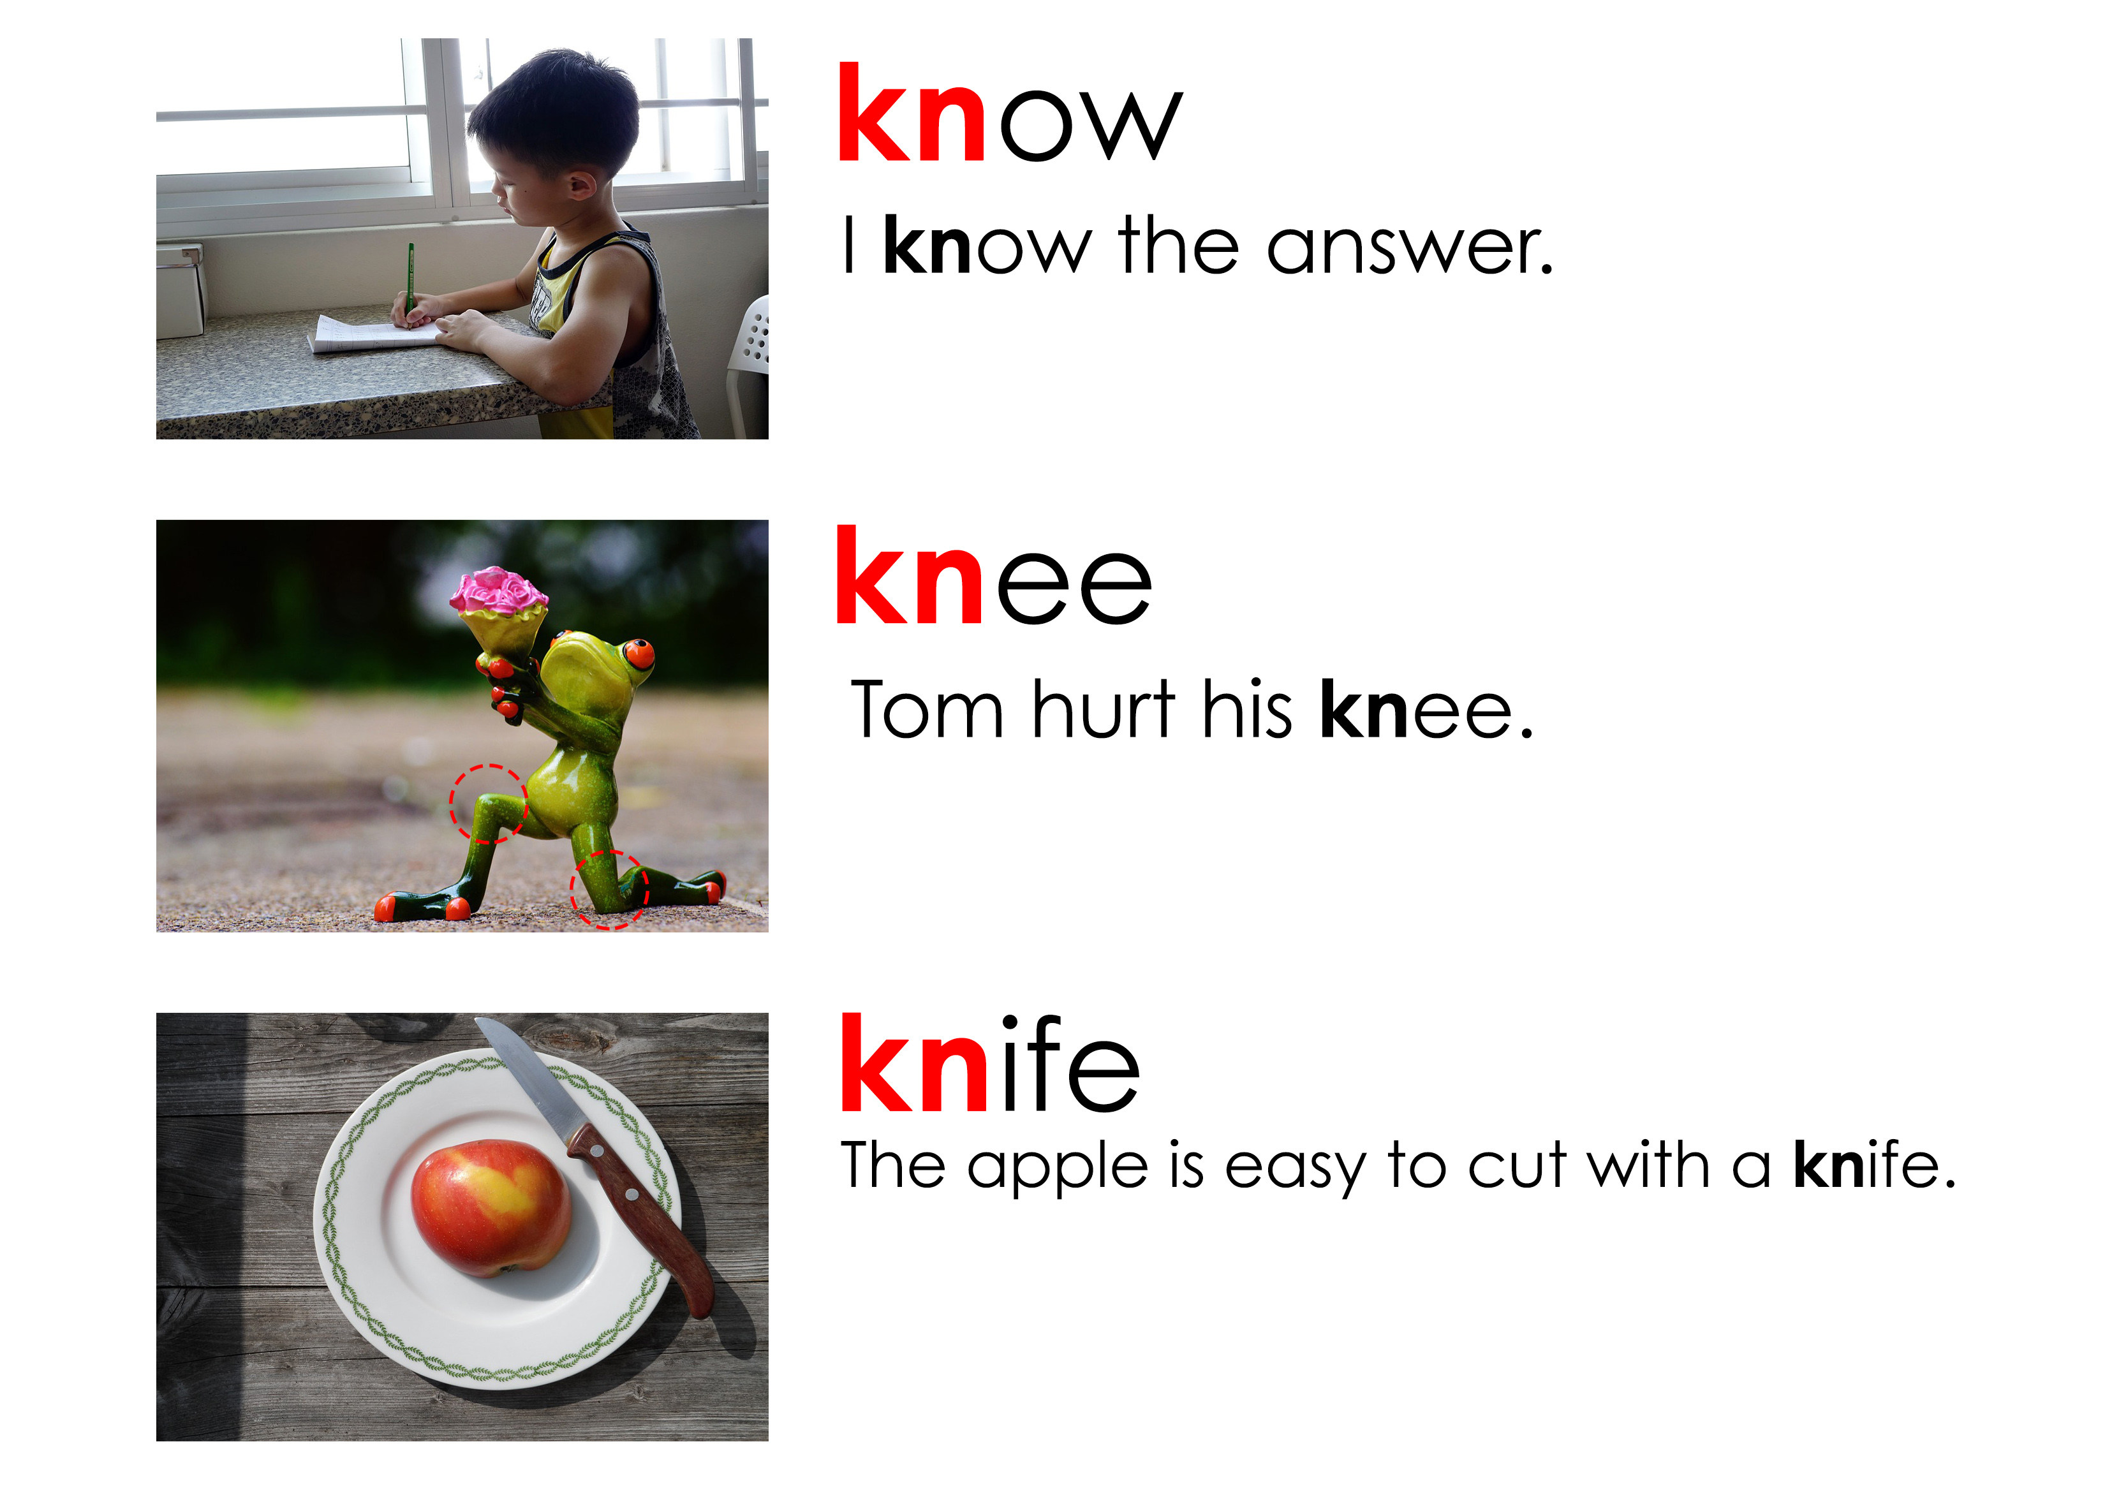
Let’s practice pronouncing the KN sound
Notes:
Say each word, articulating it clearly. Then say the word again, in a more natural way. Read the sentence accompanying the word. Instruct the students to repeat the word, chorally and then individually. Then, instruct the students to repeat each sentence, chorally and then individually.

Slide 6
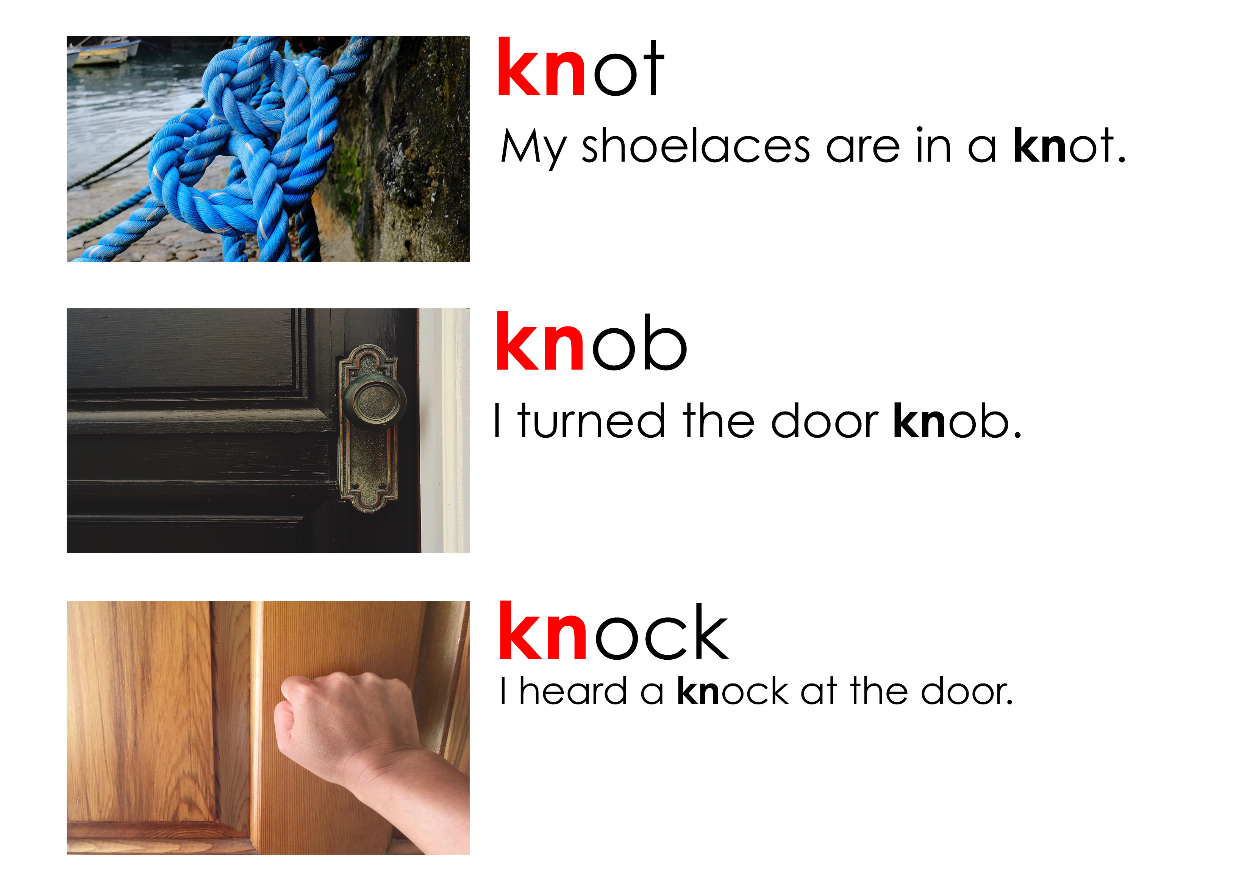
Let’s practice pronouncing the KN sound
Notes:
Say each word, articulating it clearly. Then say the word again, in a more natural way. Read the sentence accompanying the word. Instruct the students to repeat the word, chorally and then individually. Then, instruct the students to repeat each sentence, chorally and then individually.

Slide 7
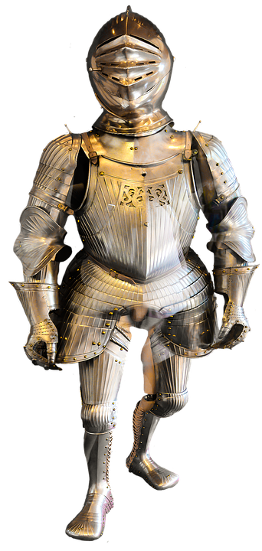

Same sound, different meaning
Some words in English sound the same, but have different meanings
Here is an example for ‘n’ and ‘kn’:
night (the darkness at the end of a day
knight (soldier in armour)
Notes:
Over go over slide. Think of other words that use “kn” or are homophones.

Slide 8
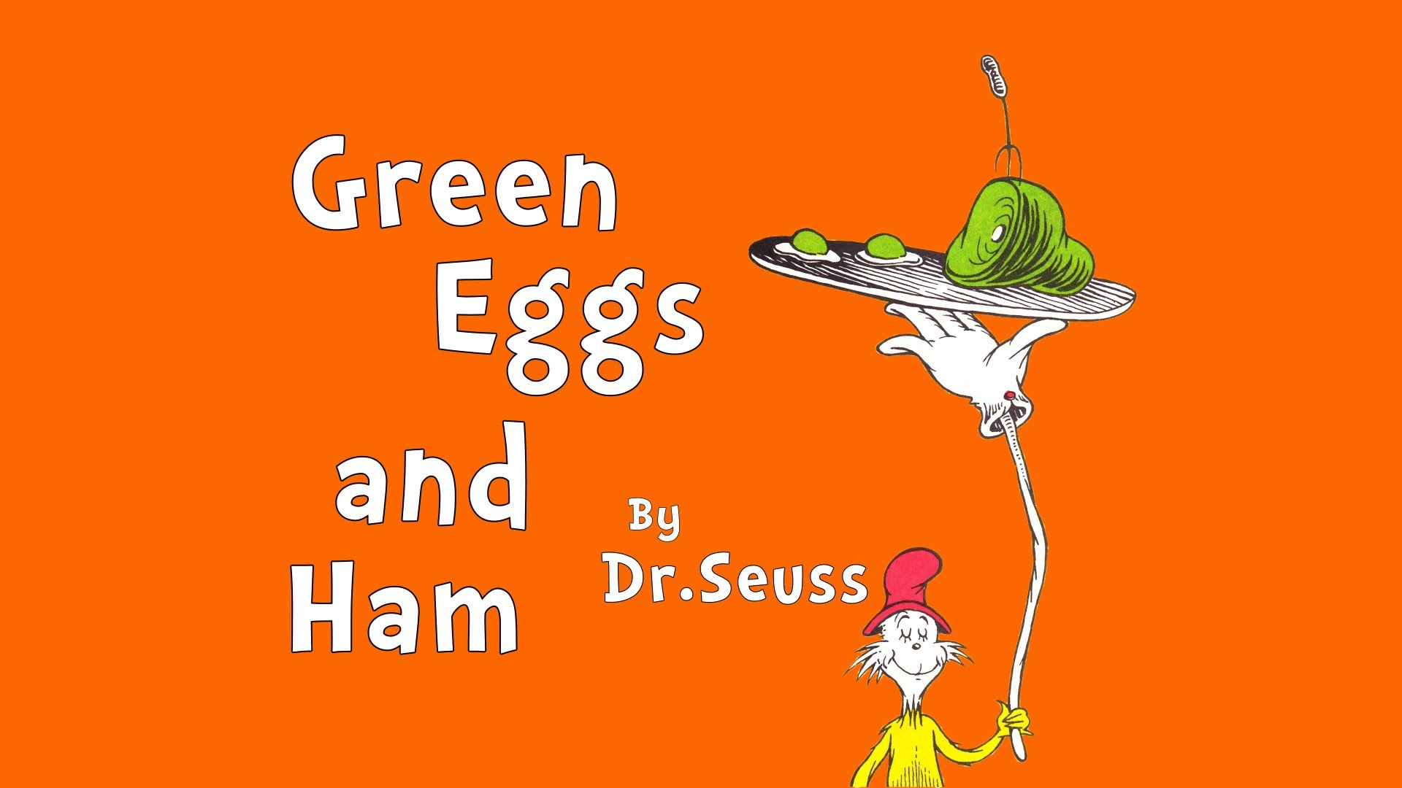
Story Time
Notes:
Play “Green Eggs and Ham No Audio.mp4” file, and read along with the video as it’s played for the students.

Slide 9
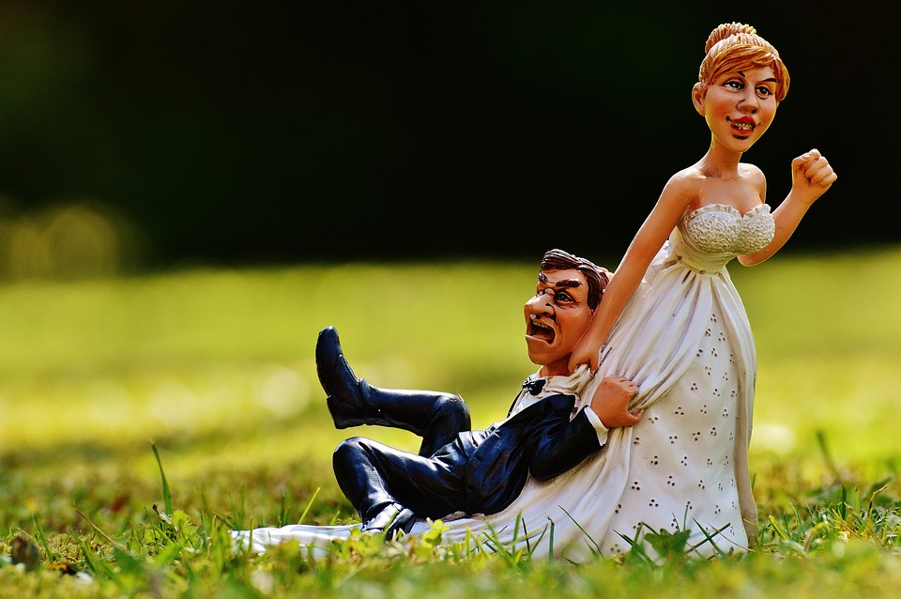
Using periods …
Periods are used to end a complete sentence. When reading English with a period, it shows you need to make a full stop when speaking.
They are also used to make words shorter.
Mister = Mr. Missis = Mrs. Miss = Ms.
Notes:
Go over slide. Emphasize the intonation of question marks and exclamation points.

Slide 10
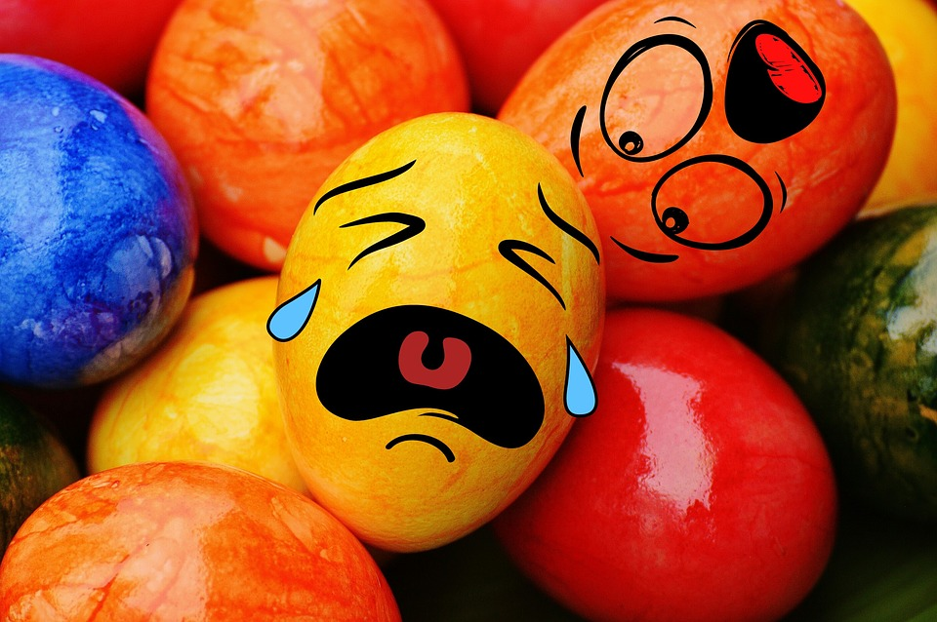
Using question marks ???
We use question marks when we are asking a question, like how are you? or why are you crying?
Notes:
Go over slide. Emphasize the intonation of question marks and exclamation points.

Slide 11
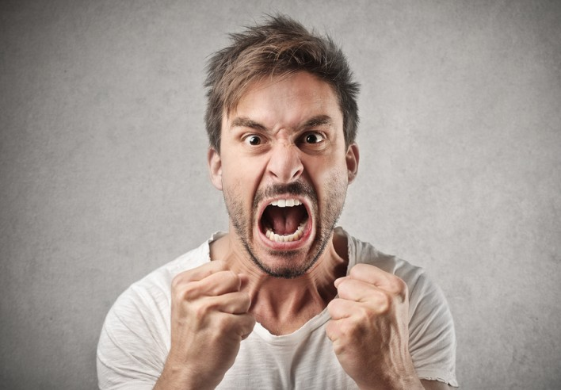
Using exclamation points !!!
We use exclamation marks when we have a strong feeling or want to be loud.
I am so angry! Look at me!
Notes:
Go over slide. Emphasize the intonation of question marks and exclamation points.

Slide 12
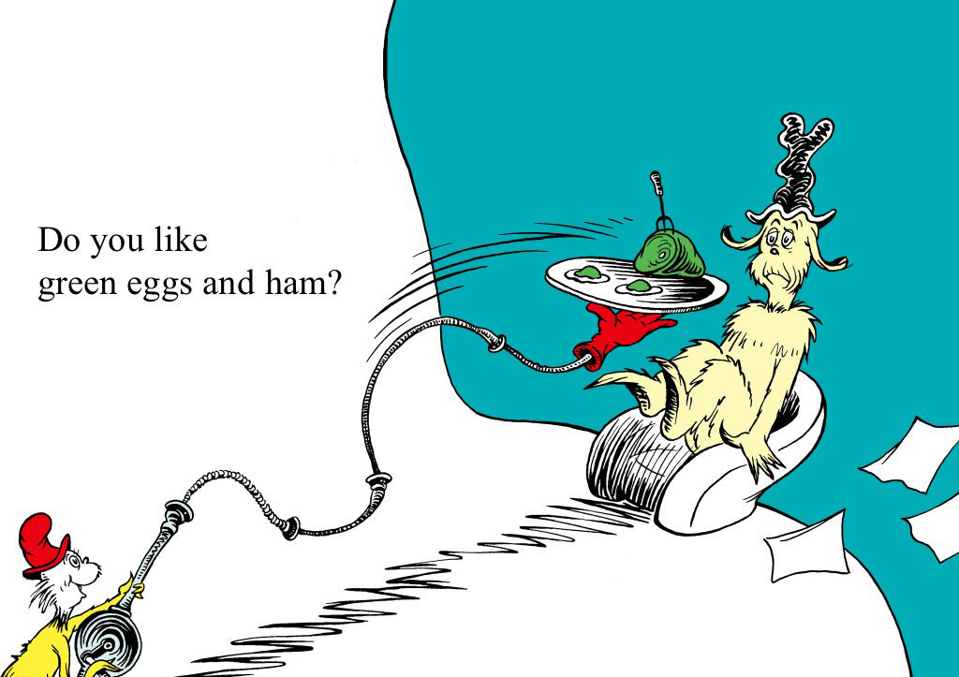
Question mark, period or exclamation point
Notes:
Ask the students to circle the punctuation mark. Get them to read “Do you like green eggs and ham?” with the proper intonation using a rising intonation question. Demonstrate this rising pitch first. Have students repeat.

Slide 13
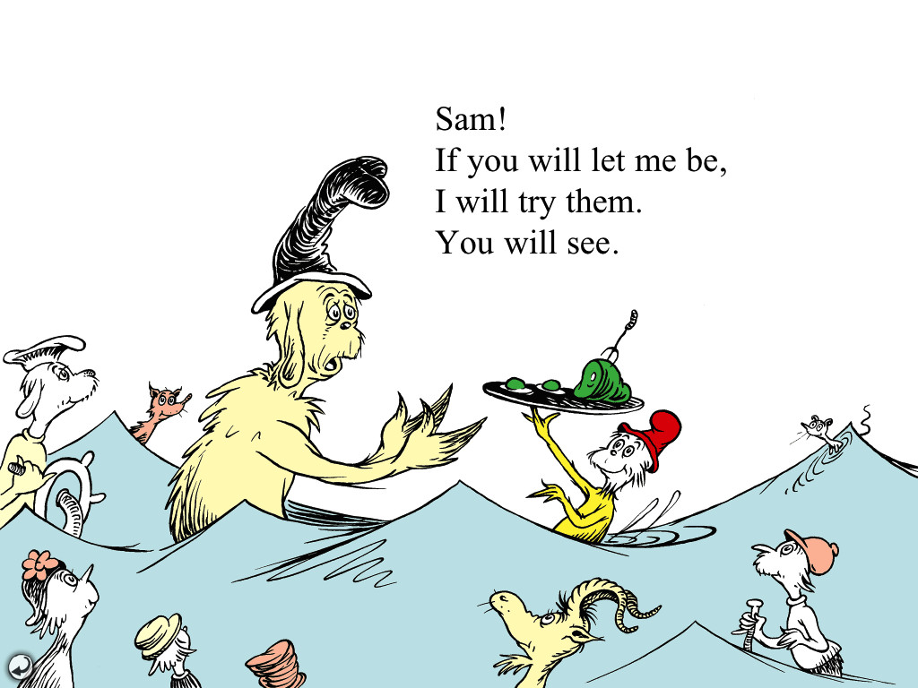
Let’s identify
Notes:
Ask the students to circle the punctuation marks. Get them to read “Sam!” with emphasis.

Slide 14
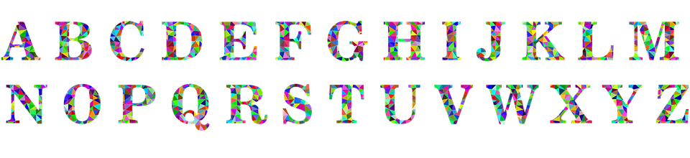
Capitals
Capitals (or upper case) are used in many situations in English.
names
places
languages
the beginning of a sentence
titles (i.e. Green Eggs and Ham)
Writing “I”
Notes:
Read the slide and elaborate on proper nouns, different languages and movie/book/song titles.

Slide 15
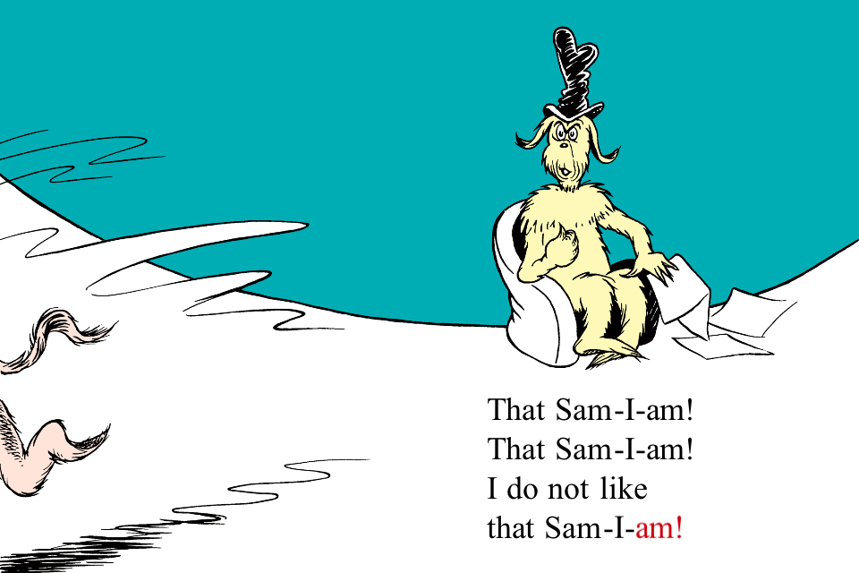
Find the capitals
Notes:
Ask the students to circle the capital letters. Ask why a capital is used in each instance (name/I/first letter of a sentence).

Slide 16
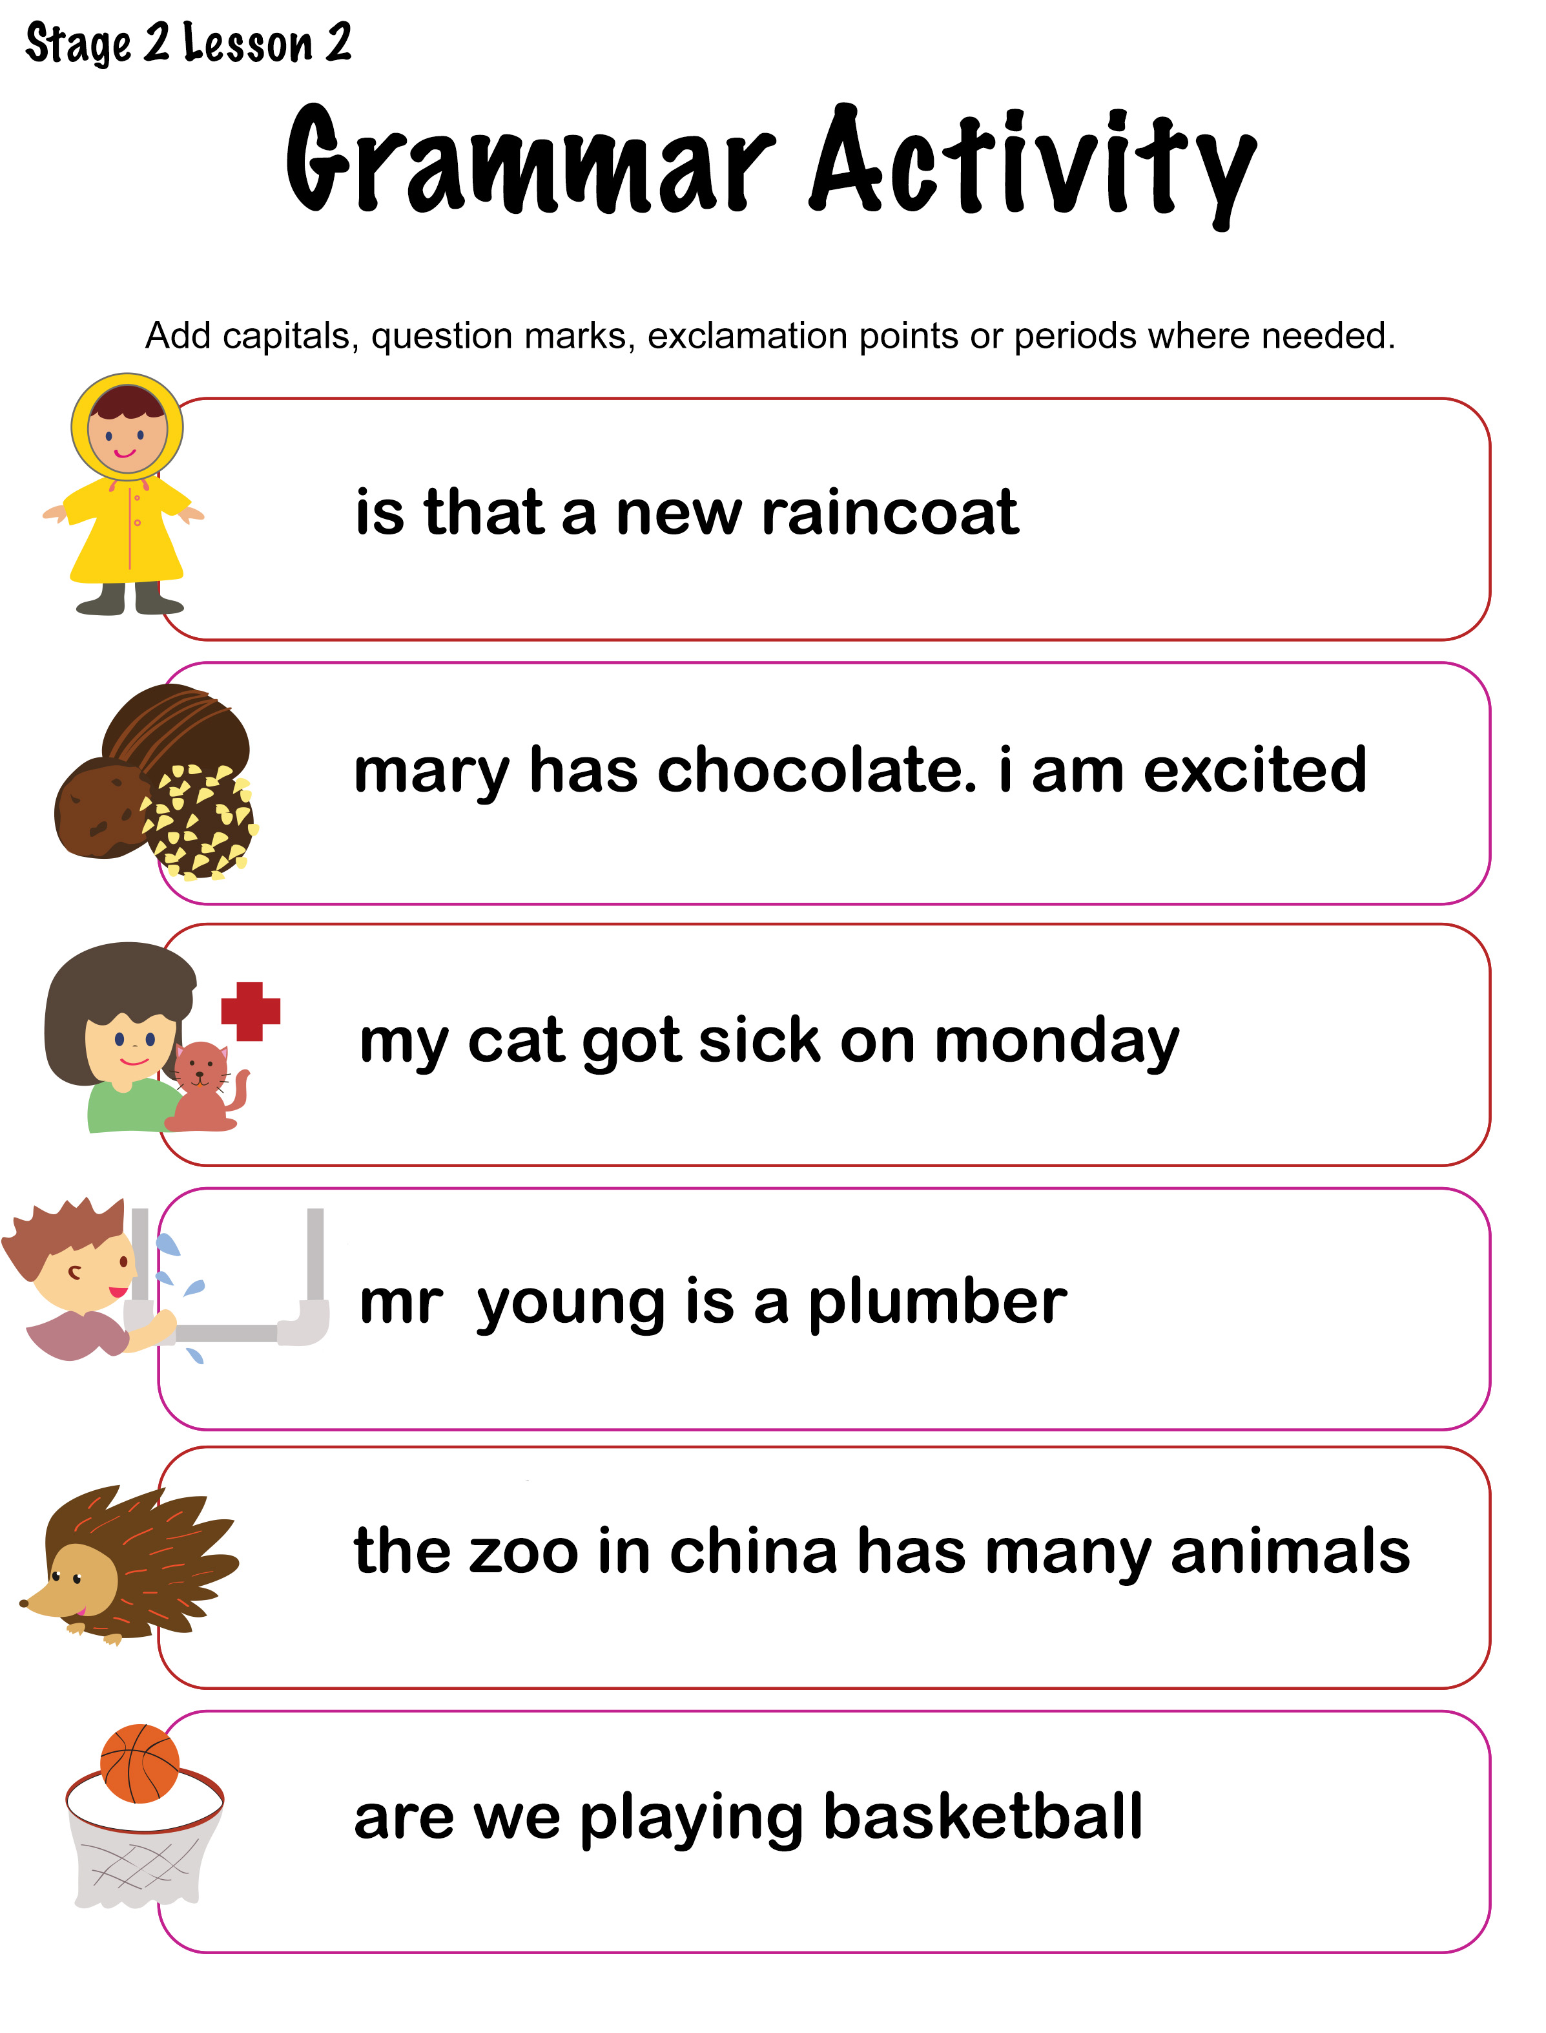
Let’s take out our worksheet
Notes:
Students should have downloaded the file before class started. Explain the worksheet.

Slide 17
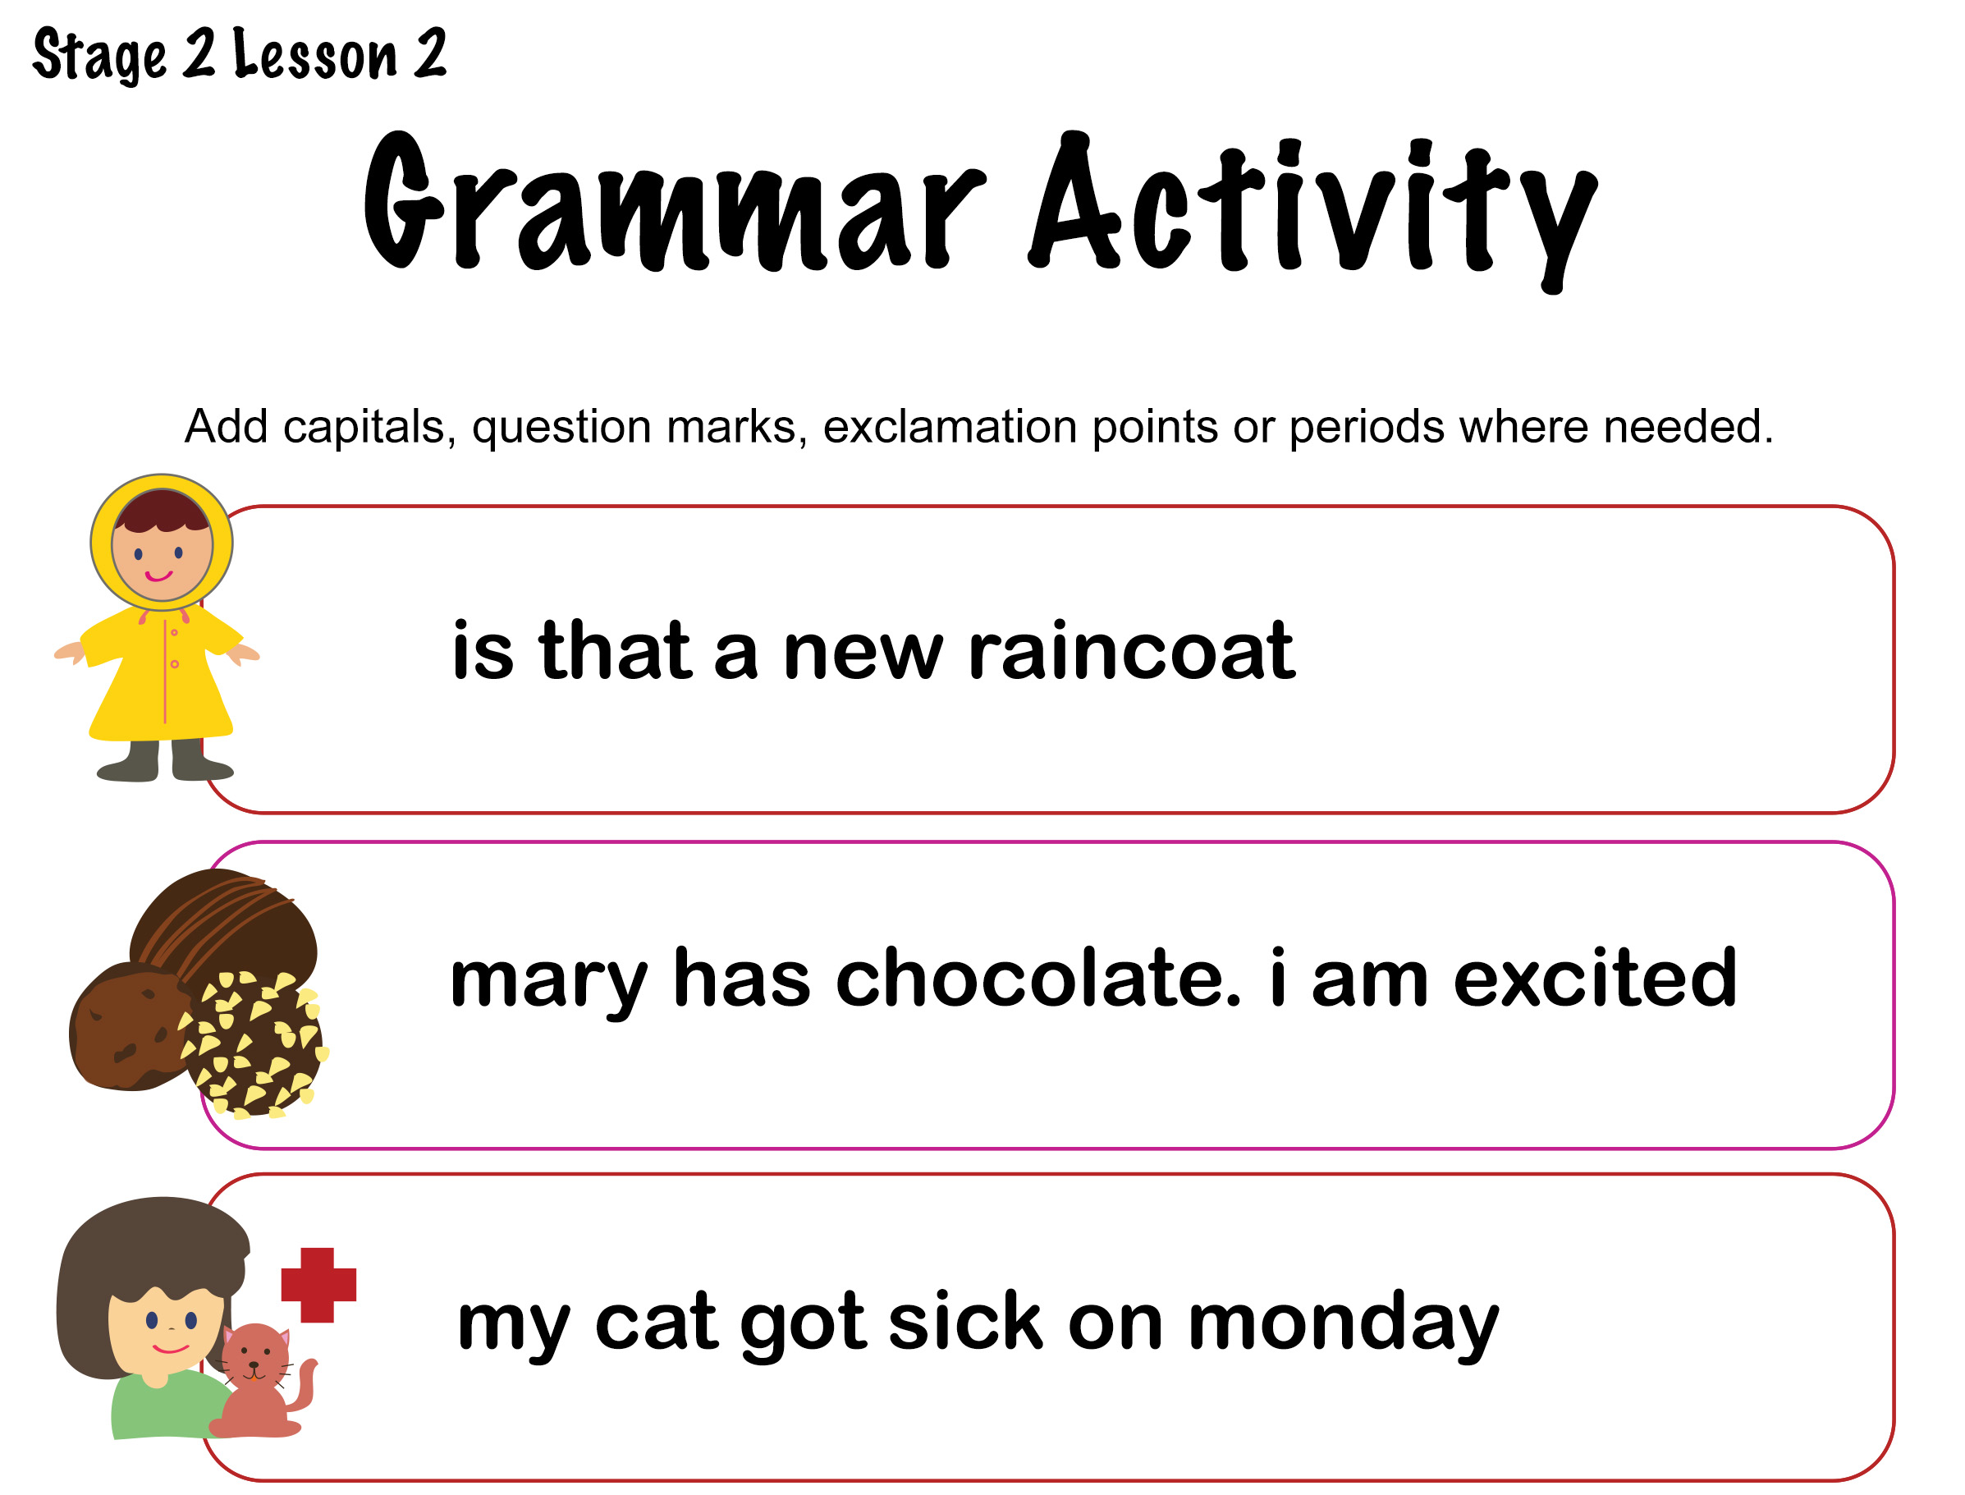
Notes:
Explain the worksheet. Do each sentence individually. Have students write their answer in large print on a blank piece of paper and hold it up for feedback.

Slide 18
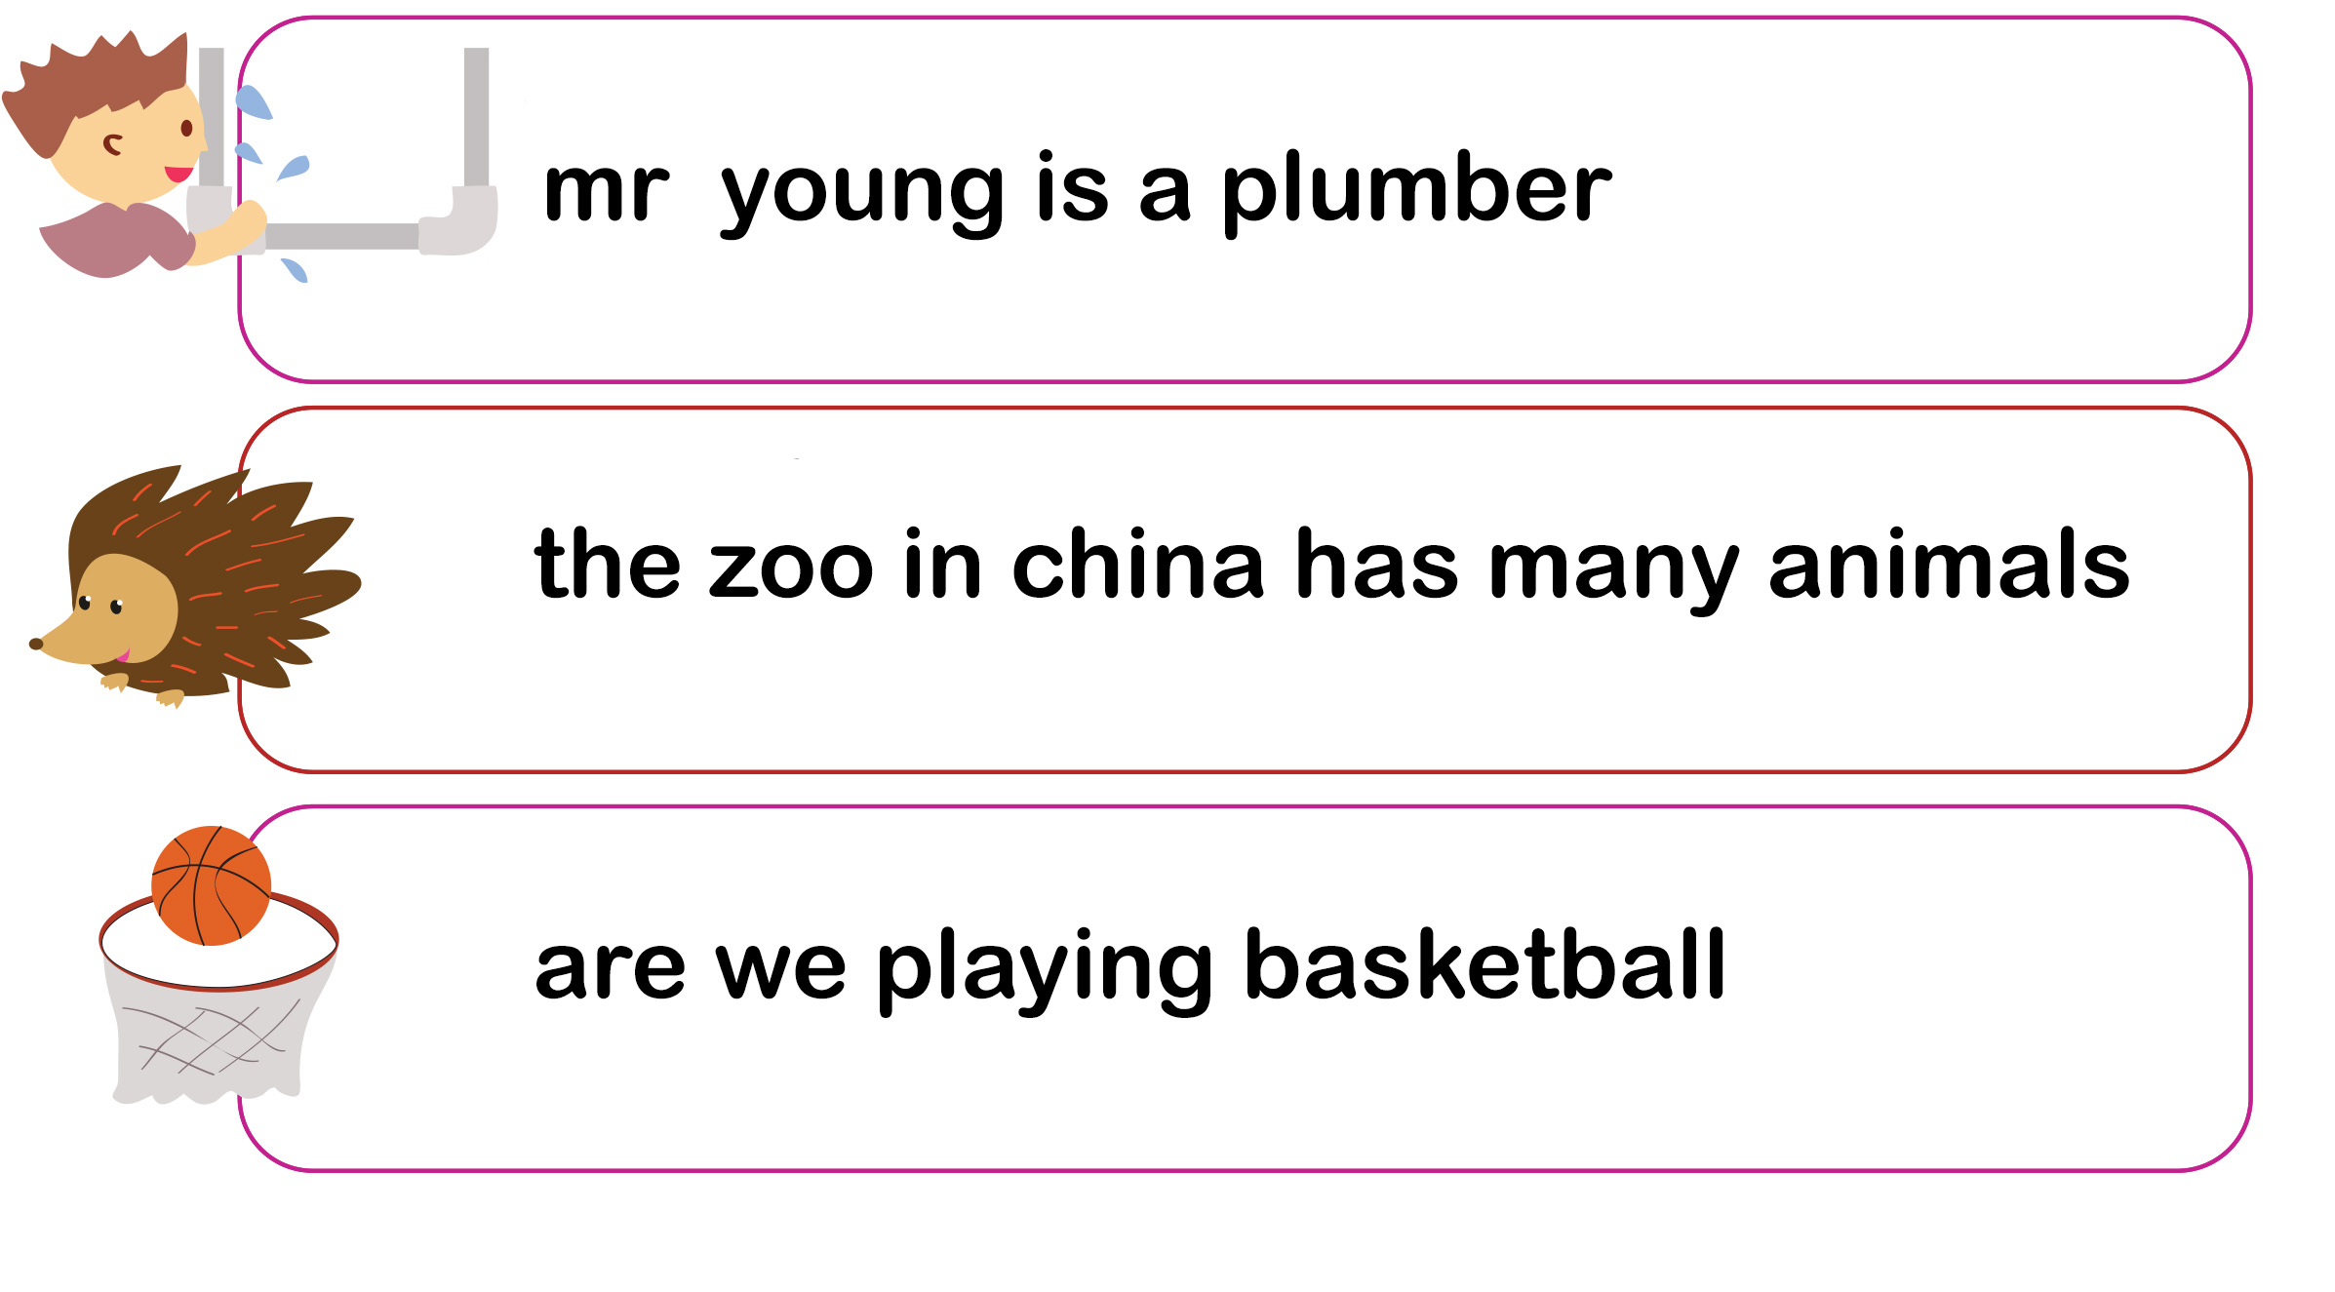
Notes:
Explain the worksheet. Do each sentence individually. Have students write their answer in large print on a blank piece of paper and hold it up for feedback.

Slide 19

Using “but”
The word “but” links two different ideas. We use it to connect events when we do not expect the second event.
Example:
I like going out for ice cream, but I don’t like spending a lot of money.
I called Steve, but he wasn't home.
Notes:
Explain the slide. Emphasize how you should take a pause when reading “but”.

Slide 20


Let’s practice using “but”
I wanted to eat fish for lunch, _______ the restaurant was closed on Mondays.
I like apples, _______ I don't like apple juice.
I had a cute puppy, _______ I lost him.
I like two sugars in my coffee, ____ no milk.
I like the strawberries, ____ my favourite fruit is blueberry.
Notes:
Do the activity verbally. Get the students to read the sentence and fill in the blank.

Slide 21

What did I learn today?
How to pronounce the “KN” sound
How to find and use capital letters, question marks, exclamations, periods and “but”
New “KN” vocabulary
Learning homophones
Notes:
Go over slide.

Slide 22
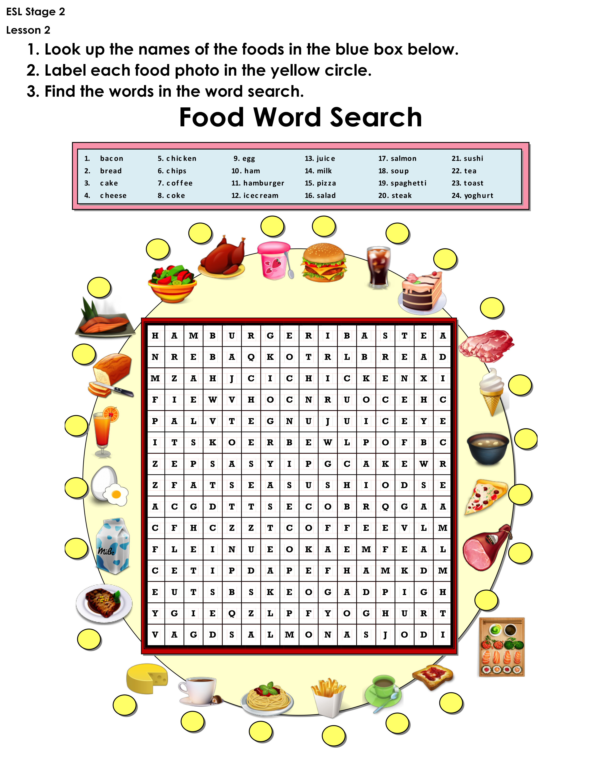
Homework
Complete the “Food Word Search.pdf” handout. Make sure this file is downloaded.
Step 1: Look up the names of each of the foods
Step 2: Label the food photos
Step 3: Find the word
Notes:
Go through the individual questions, and answer each to model answers for the students. Pose the question to each student. Remind students that adjectives are describing words for nouns for question. Ask students to write down the answers before the next class.

