Slide 1
Lesson 2: Tutoring FOOD

Slide 2
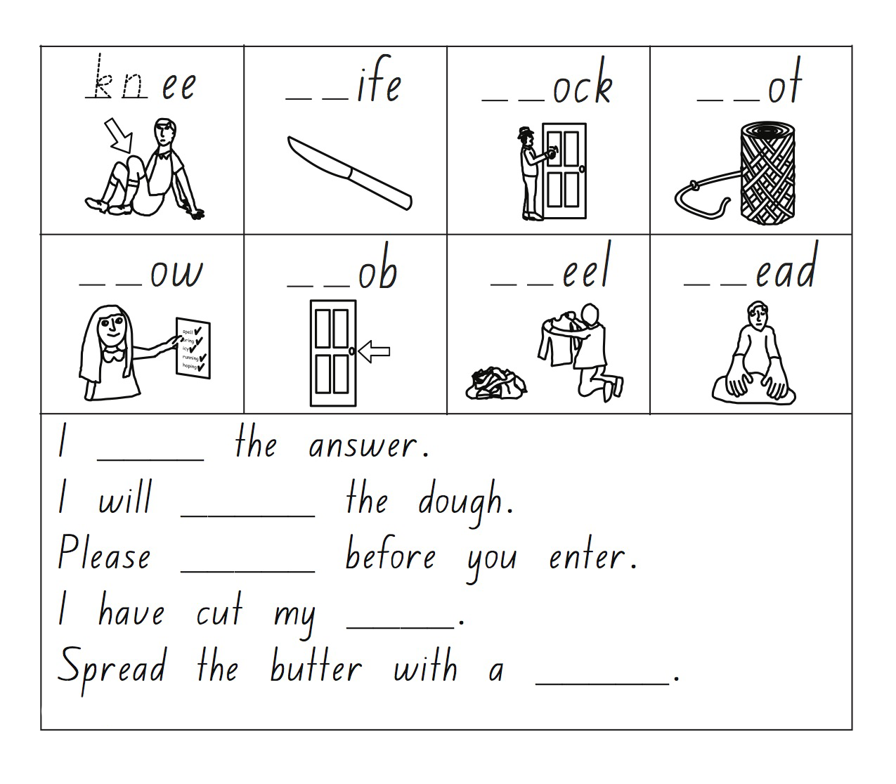
Practice “KN”

Slide 3
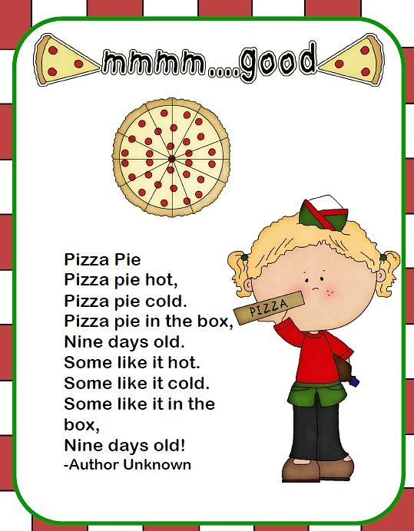
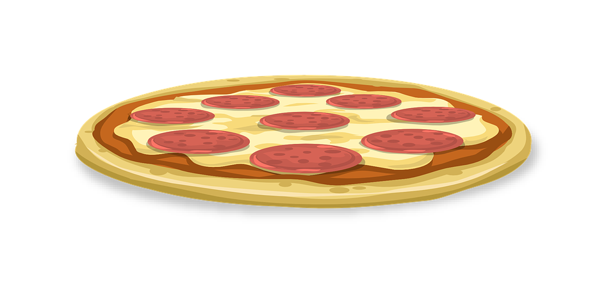
Find the capitals, periods, and exclamation points

Slide 4
“and” practice
“and” is also used to join two events
The subject of the event is the same. He sat down and had lunch.
The subject of the event is different. It combines two simple sentences. We put a comma before “and”.
She got up, and he cooked breakfast.
Sheila is very kind and is my friend.
(we expect the second idea)
Notes:
Explain what “desserts” means (a sweet course usually served at the end of a meal). Have students circle the desserts. Then, go over each of the foods and give the English word for each graphic.

Slide 5
“but” practice
“but” is used to connect events when we do not expect the second event. When the subject of the event is the same, we don’t repeat the subject.
They ran but missed the train.
Lucy was very tall, but she wasn’t nice
(we don’t expect the second idea)

Slide 6
Practice “and” and “but
Complete the sentences with AND or BUT. (sometimes both are possible)
1. The girl wore blue pants……… his pants were pink.
2. I love Italian food ……. I eat pasta every day.
3. They are vegetarian ……. they never eat meat.
4. Helen bought an iPhone ……… she didn’t use it.
5. Mary loves swimming ……… she often goes to the pool.
6. He hasn’t got much money ………. he goes to a good school.
7. He doesn’t look very strong ……… he can lift 100kg.
8. You were very tired ………. you enjoyed the party.
9. Tom wasn’t very happy ……… he came to the festival.
10. Gerald has never been to China ……… he speaks Chinese.
11. My mother parked the car ………. entered the grocery store.
12. Lina can cook ……….. her brother can’t.
13. It was raining ………. it wasn’t cold.
14. My grandfather grows beans ……….. he never eats them.
15. Steve loves animals ……… he has five pets at home.

Slide 7
Practice “and” and “but
16. Lucia studies geography …….. her boyfriend studies math.
17. Hector came home early ………....... had a bath.
18. Richard arrived by taxi ……….. his mother by bus.
19. You can type ………. my sister can’t.
20. The mechanic repaired my car …….. it was very expensive.
21. Barbara ate Indian food ………. you have never tasted it.
22. I want to be a doctor ……… you don’t want to be a nurse.
23. Jennifer needed help ………… I did not want to help her.
24. The children waited for their mothers ………. they were very late.
25. It was very dark ……….. I turned on the light.
26. His birthday was in June ………… mine was in January.
27. My test was very difficult ………. hers was easy.
28. The shop always closes at 5.00pm ……… I arrived at 5.05pm
29. Liliana invited him to the concert …………. he accepted it.
30. It was a stormy night ……….. I was really scared.

Slide 8
What did I learn today?
How to pronounce the “KN” sound
How to find and use capital letters, exclamations, and periods
The difference between “and” and “but”
New “KN” vocabulary
Notes:
Go over slide.

