Slide 1
Lesson 3 FOOD

Slide 2
What we will learn today
New ‘cl’ words
Using the ‘cl’ sound
Using “or”, capitalization and punctuation
Reading practice

Slide 3
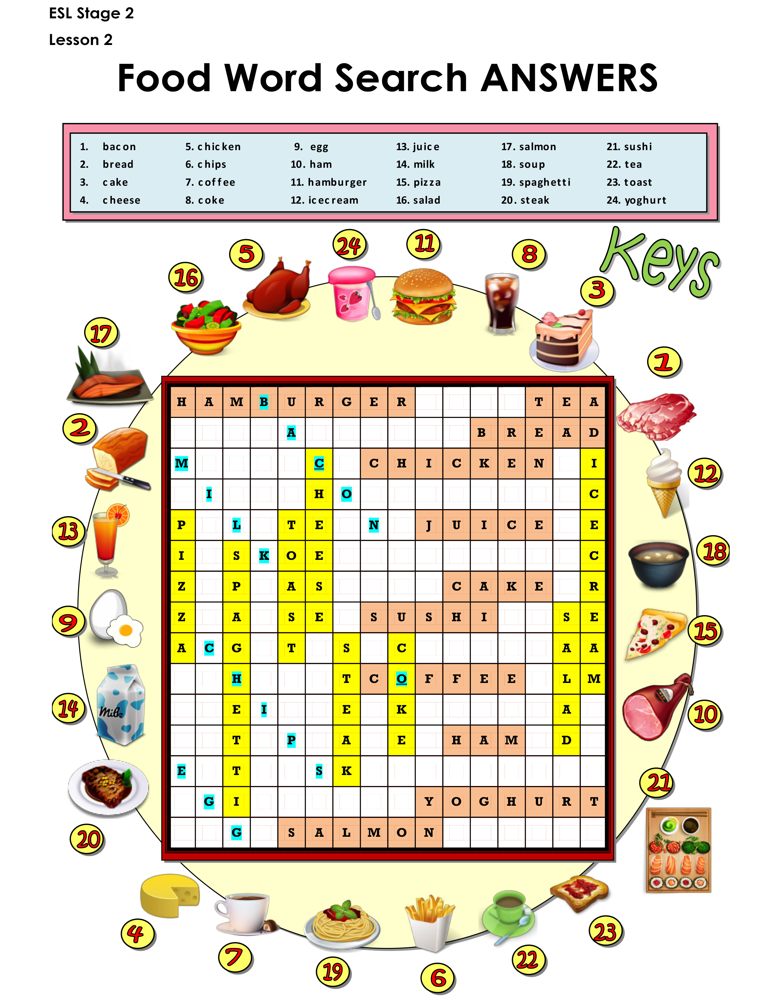
Let’s take up the homework
Notes:
Take up homework. Review each food.

Slide 4
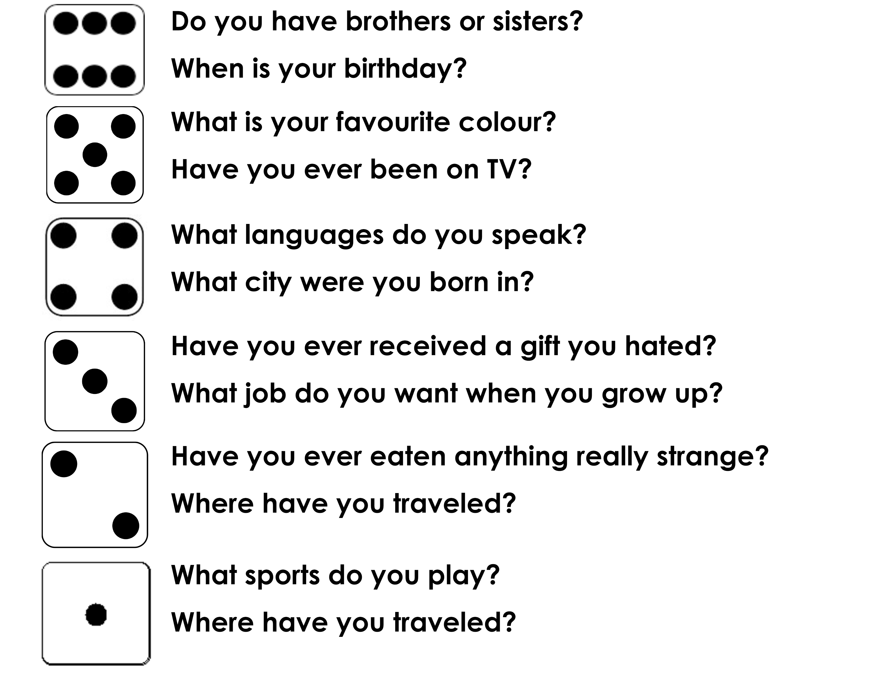
Roll of the dice http://dice.virtuworld.net/

Slide 5
The CL Sound

Slide 6
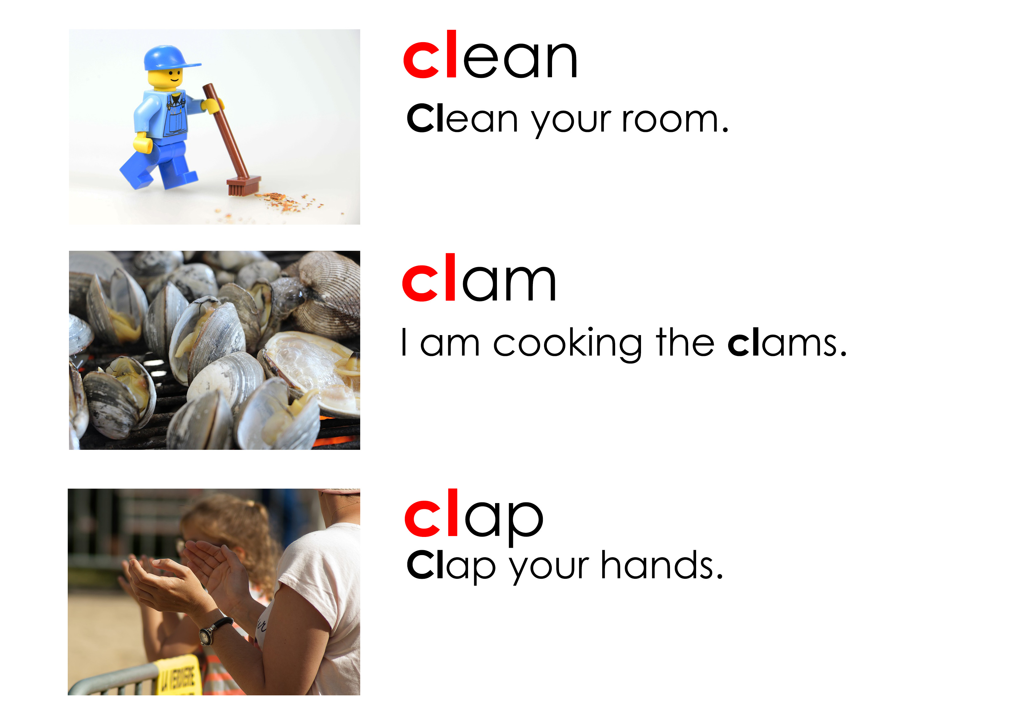
The CL Sound

Slide 7
The CL Sound

Slide 8
Match the picture to the word

Slide 9
Now you practice capitalization and punctuation
Will daniel eat lunch with me
Amy and i are going to the movies
My dog’s name is comet
samantha does gymnastics with jack
We are going to hawaii for vacation
Ouch My finger hurts

Slide 10
Match the animal to the food they eat

Slide 11
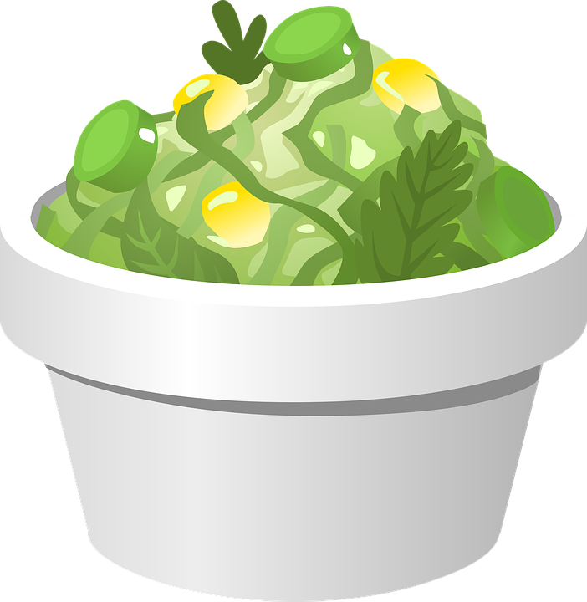
Using “or”
The word “or” links two different ideas.
Would you like coffee or tea?
We can eat chicken or salad.

Slide 12
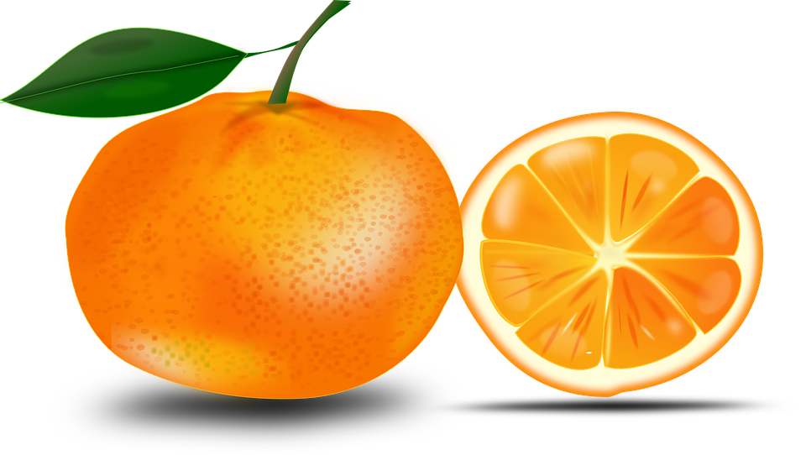
Practice “or”
Add “or” where it is missing in the following sentences.
I like noodles pasta.
Would you like a small, medium, large?
Would you like sugar milk in your coffee?
Did you try the orange juice the apple juice?

Slide 13
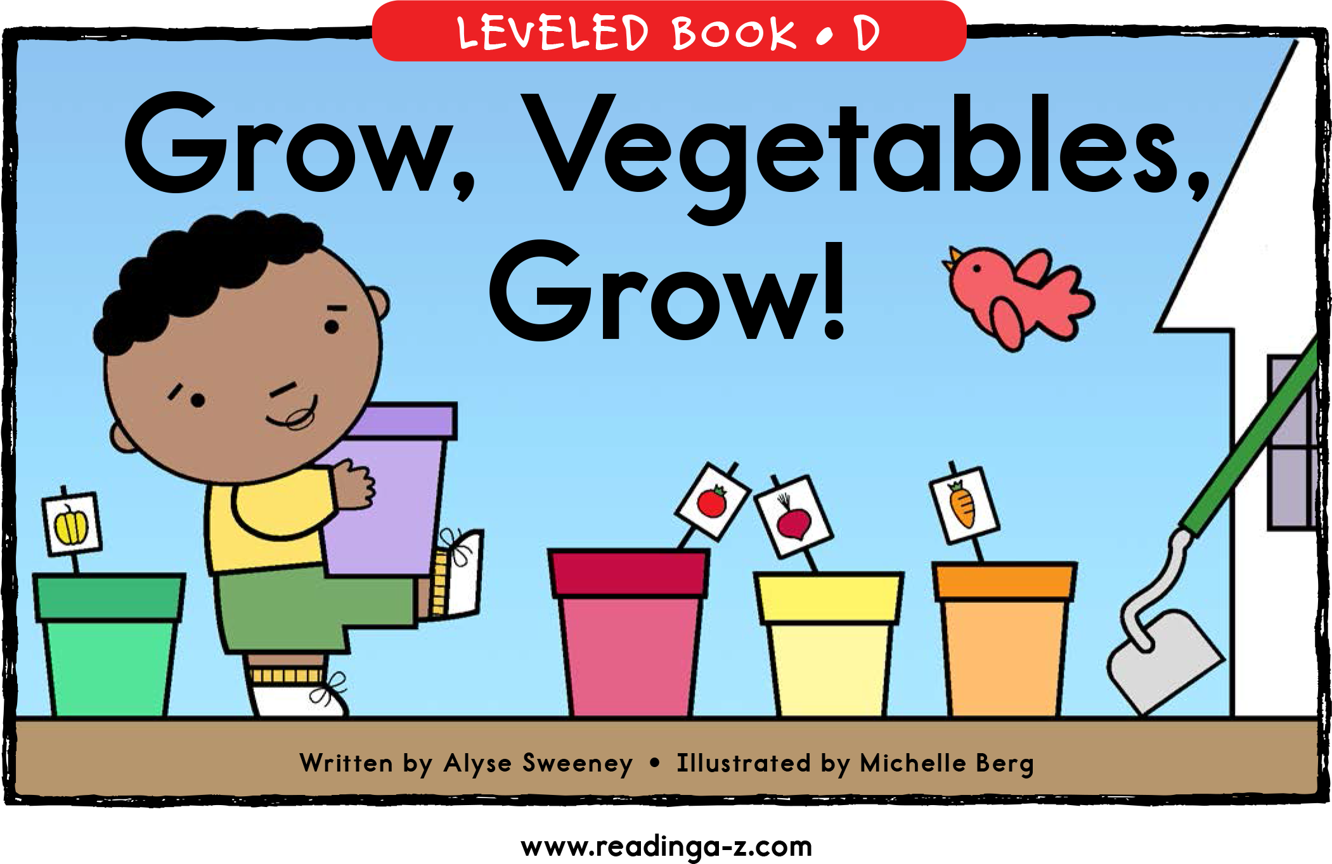
Story Time

Slide 14
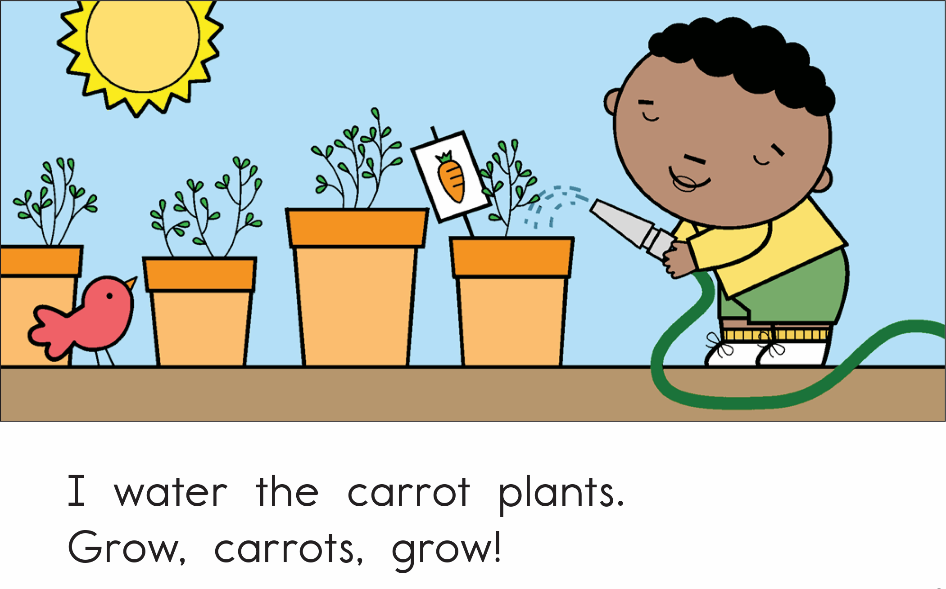

Slide 15
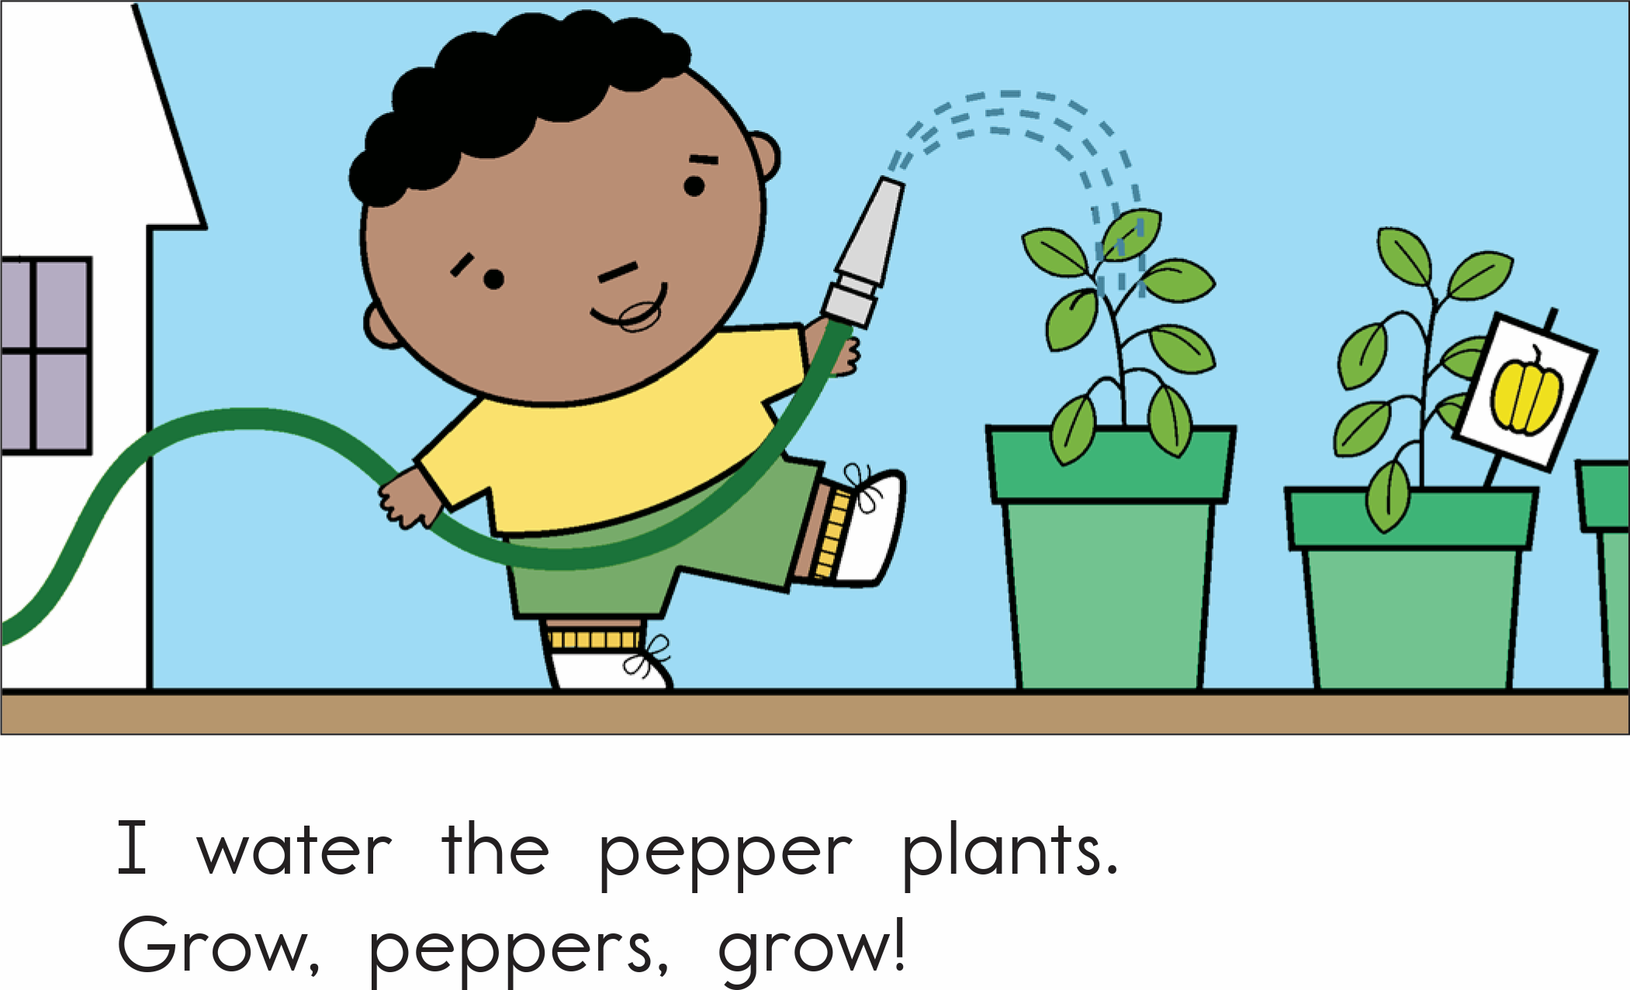

Slide 16
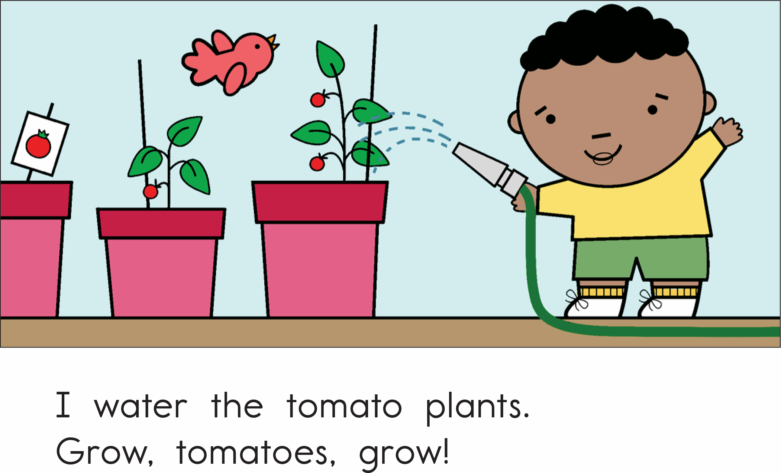

Slide 17
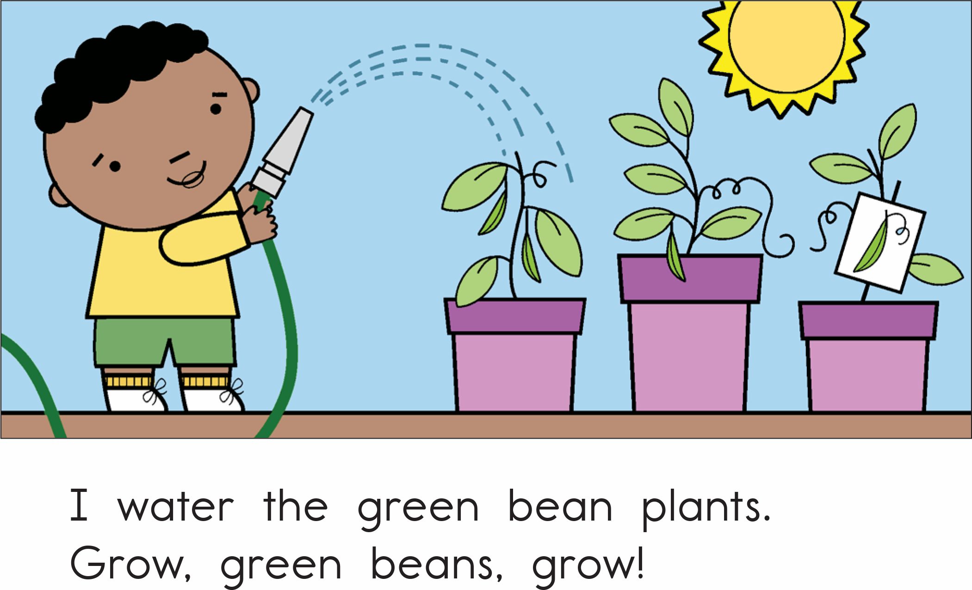

Slide 18
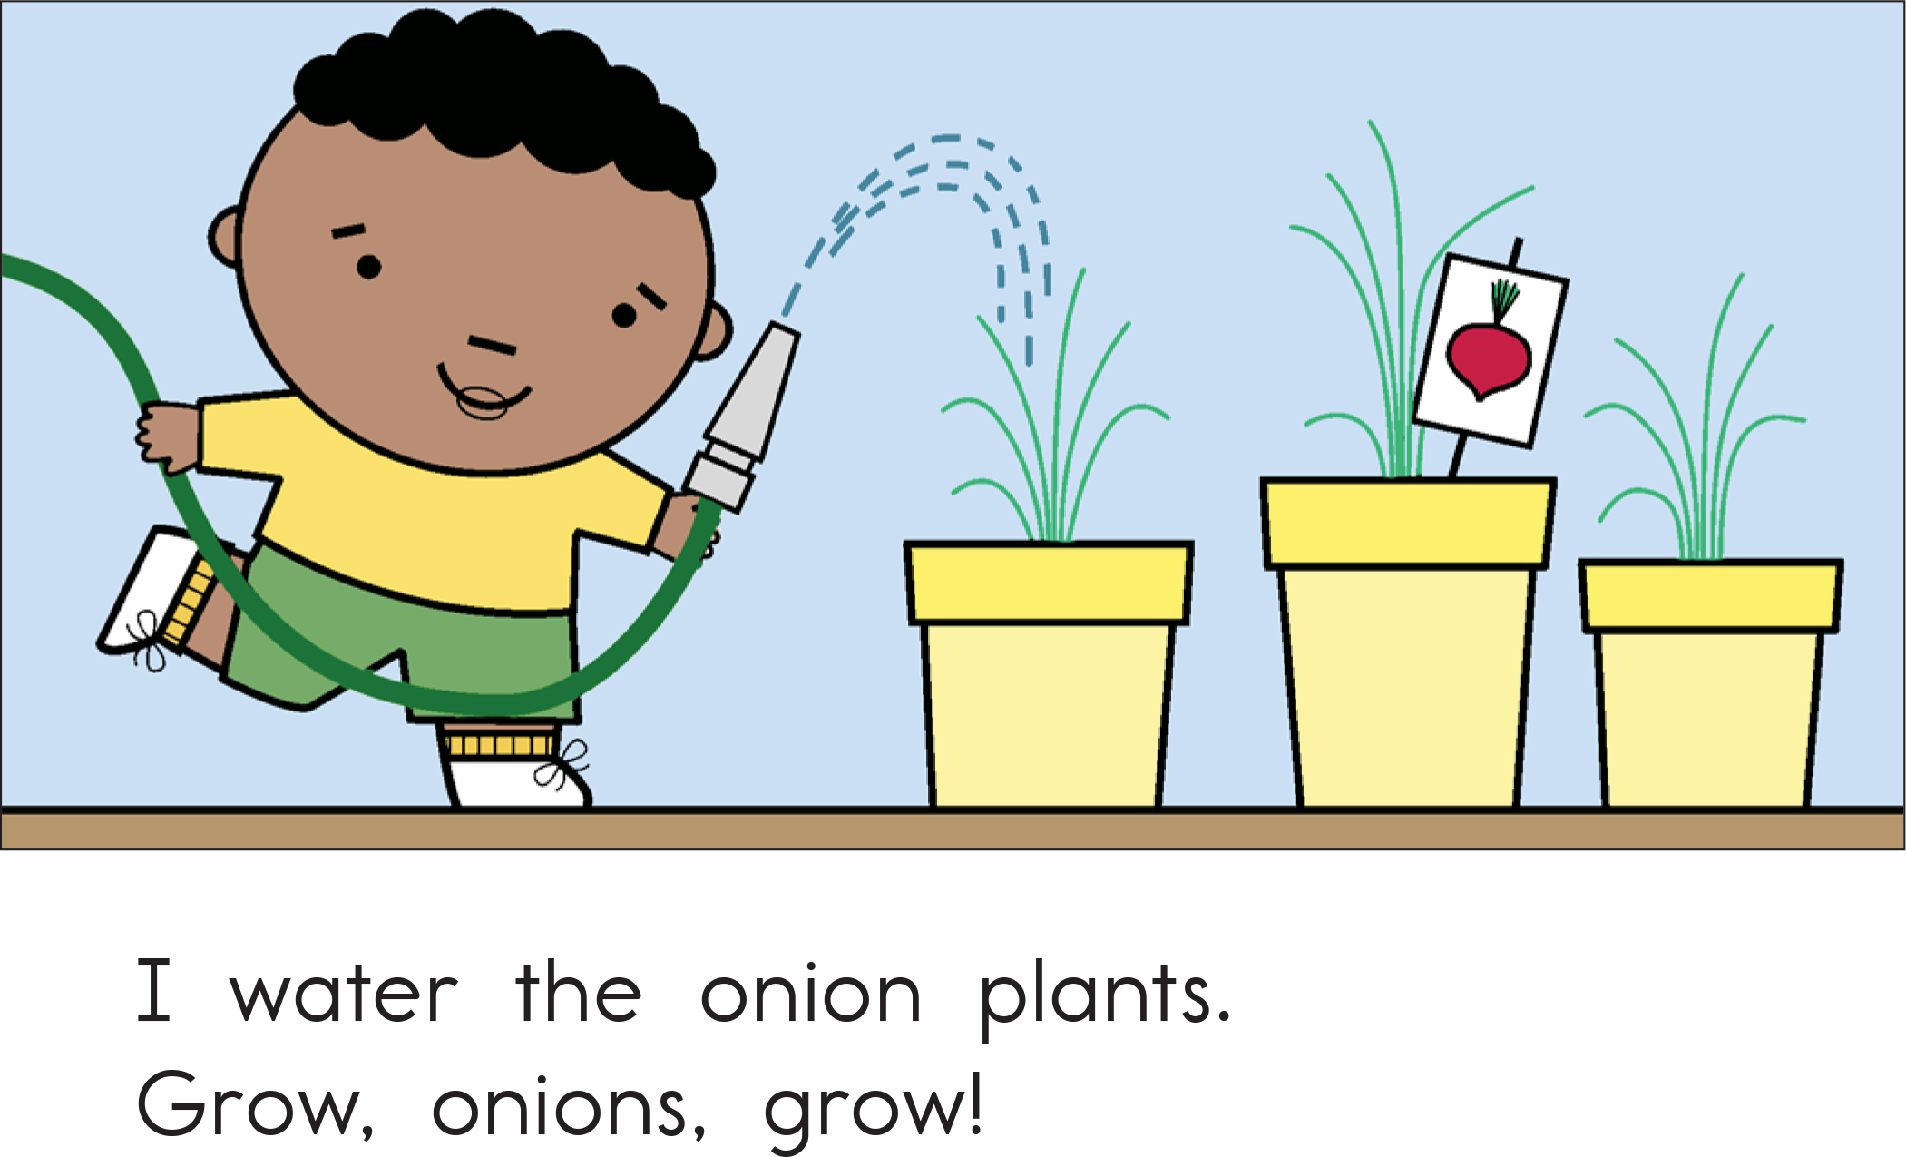

Slide 19
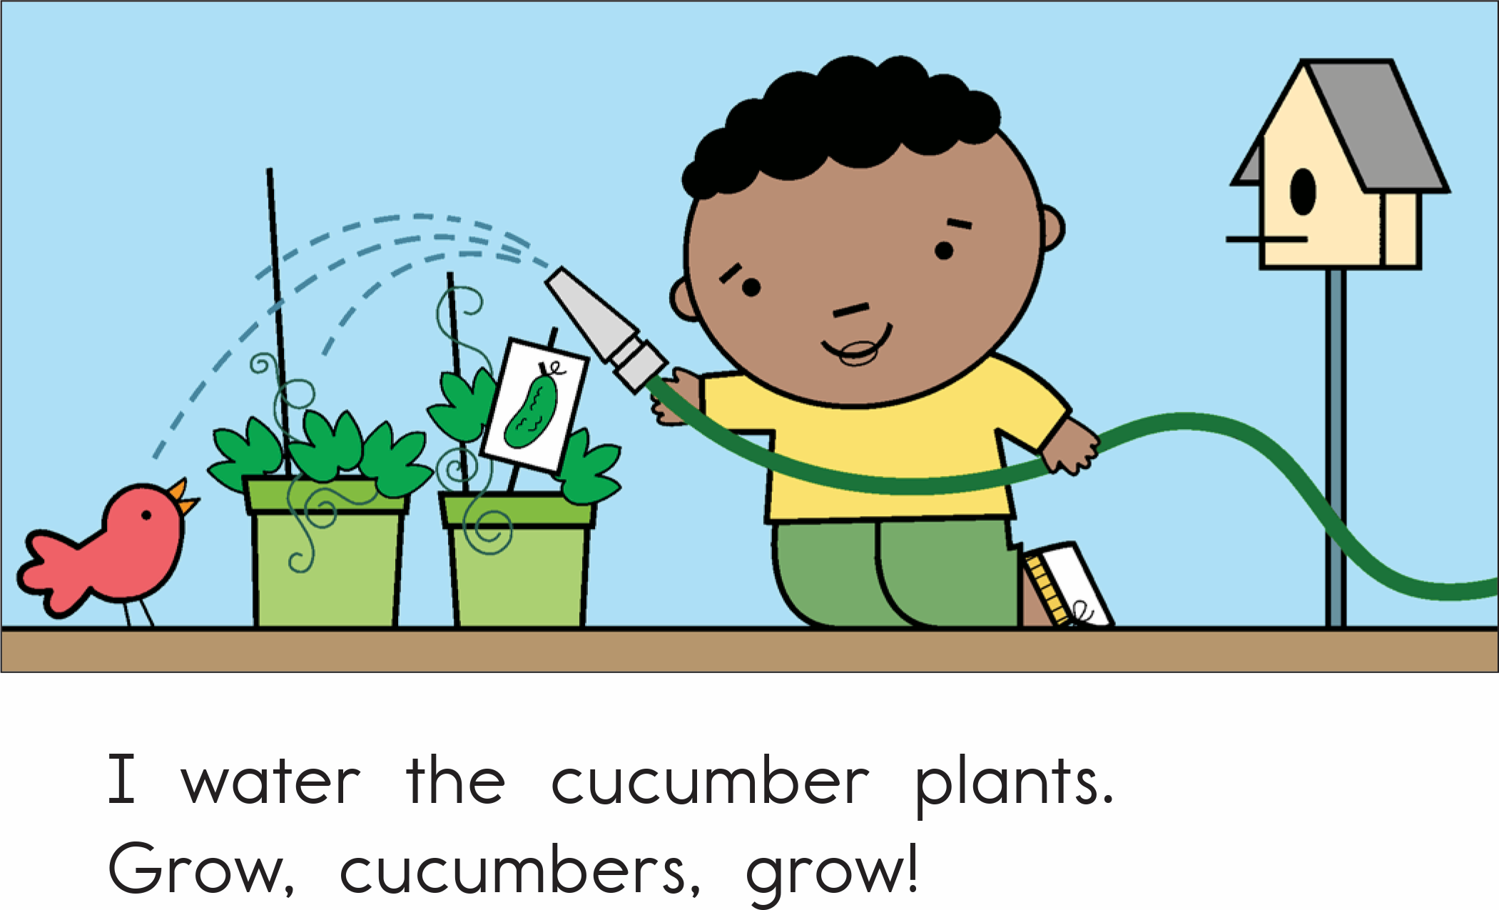

Slide 20
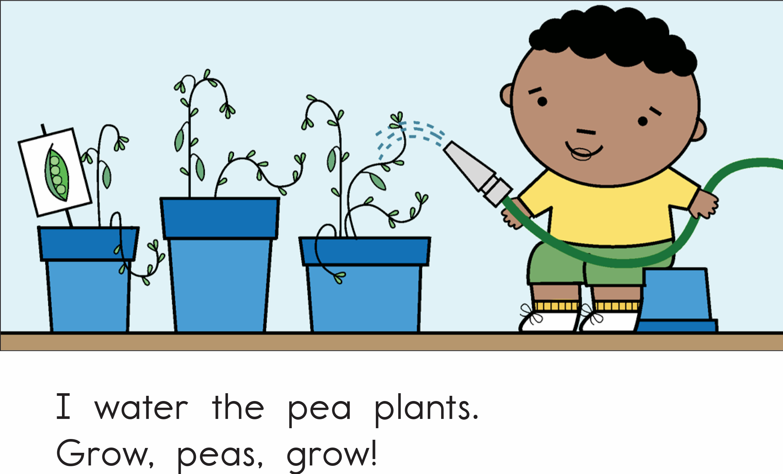

Slide 21
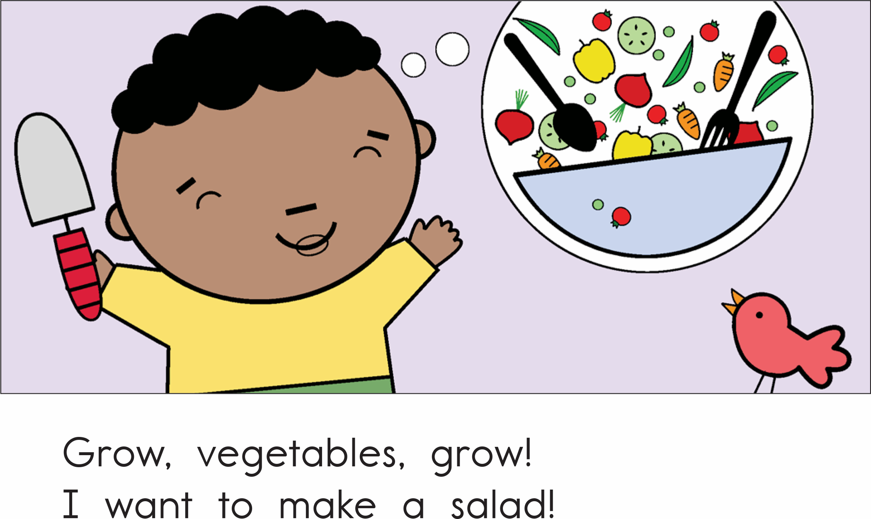

Slide 22
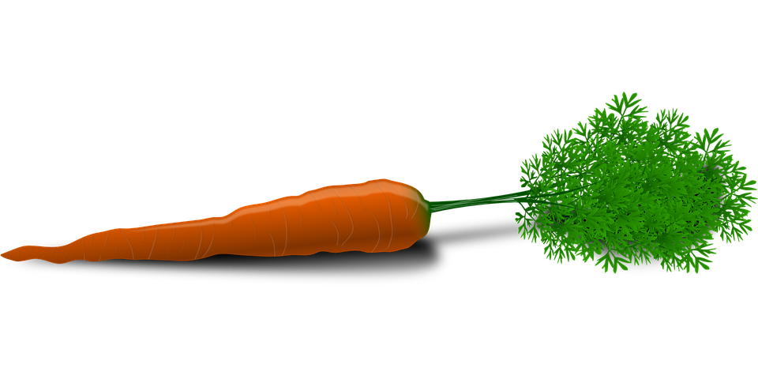
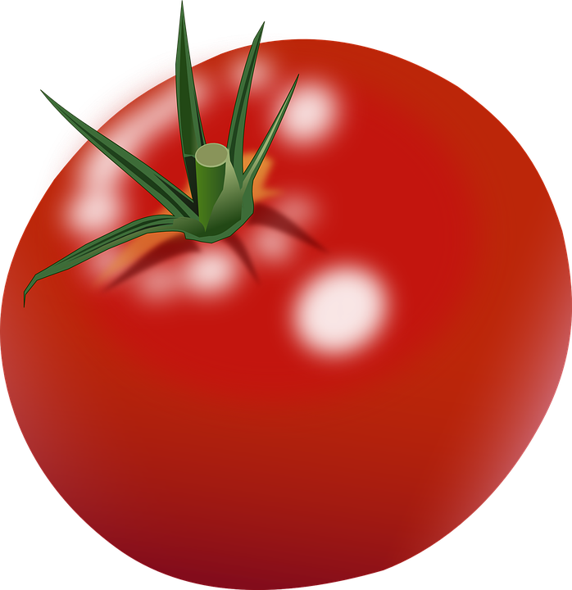
About the story
What did he have to do to make the plants grow?
What kind of vegetables was he growing?
What is he going to do with all his vegetables?

Slide 23
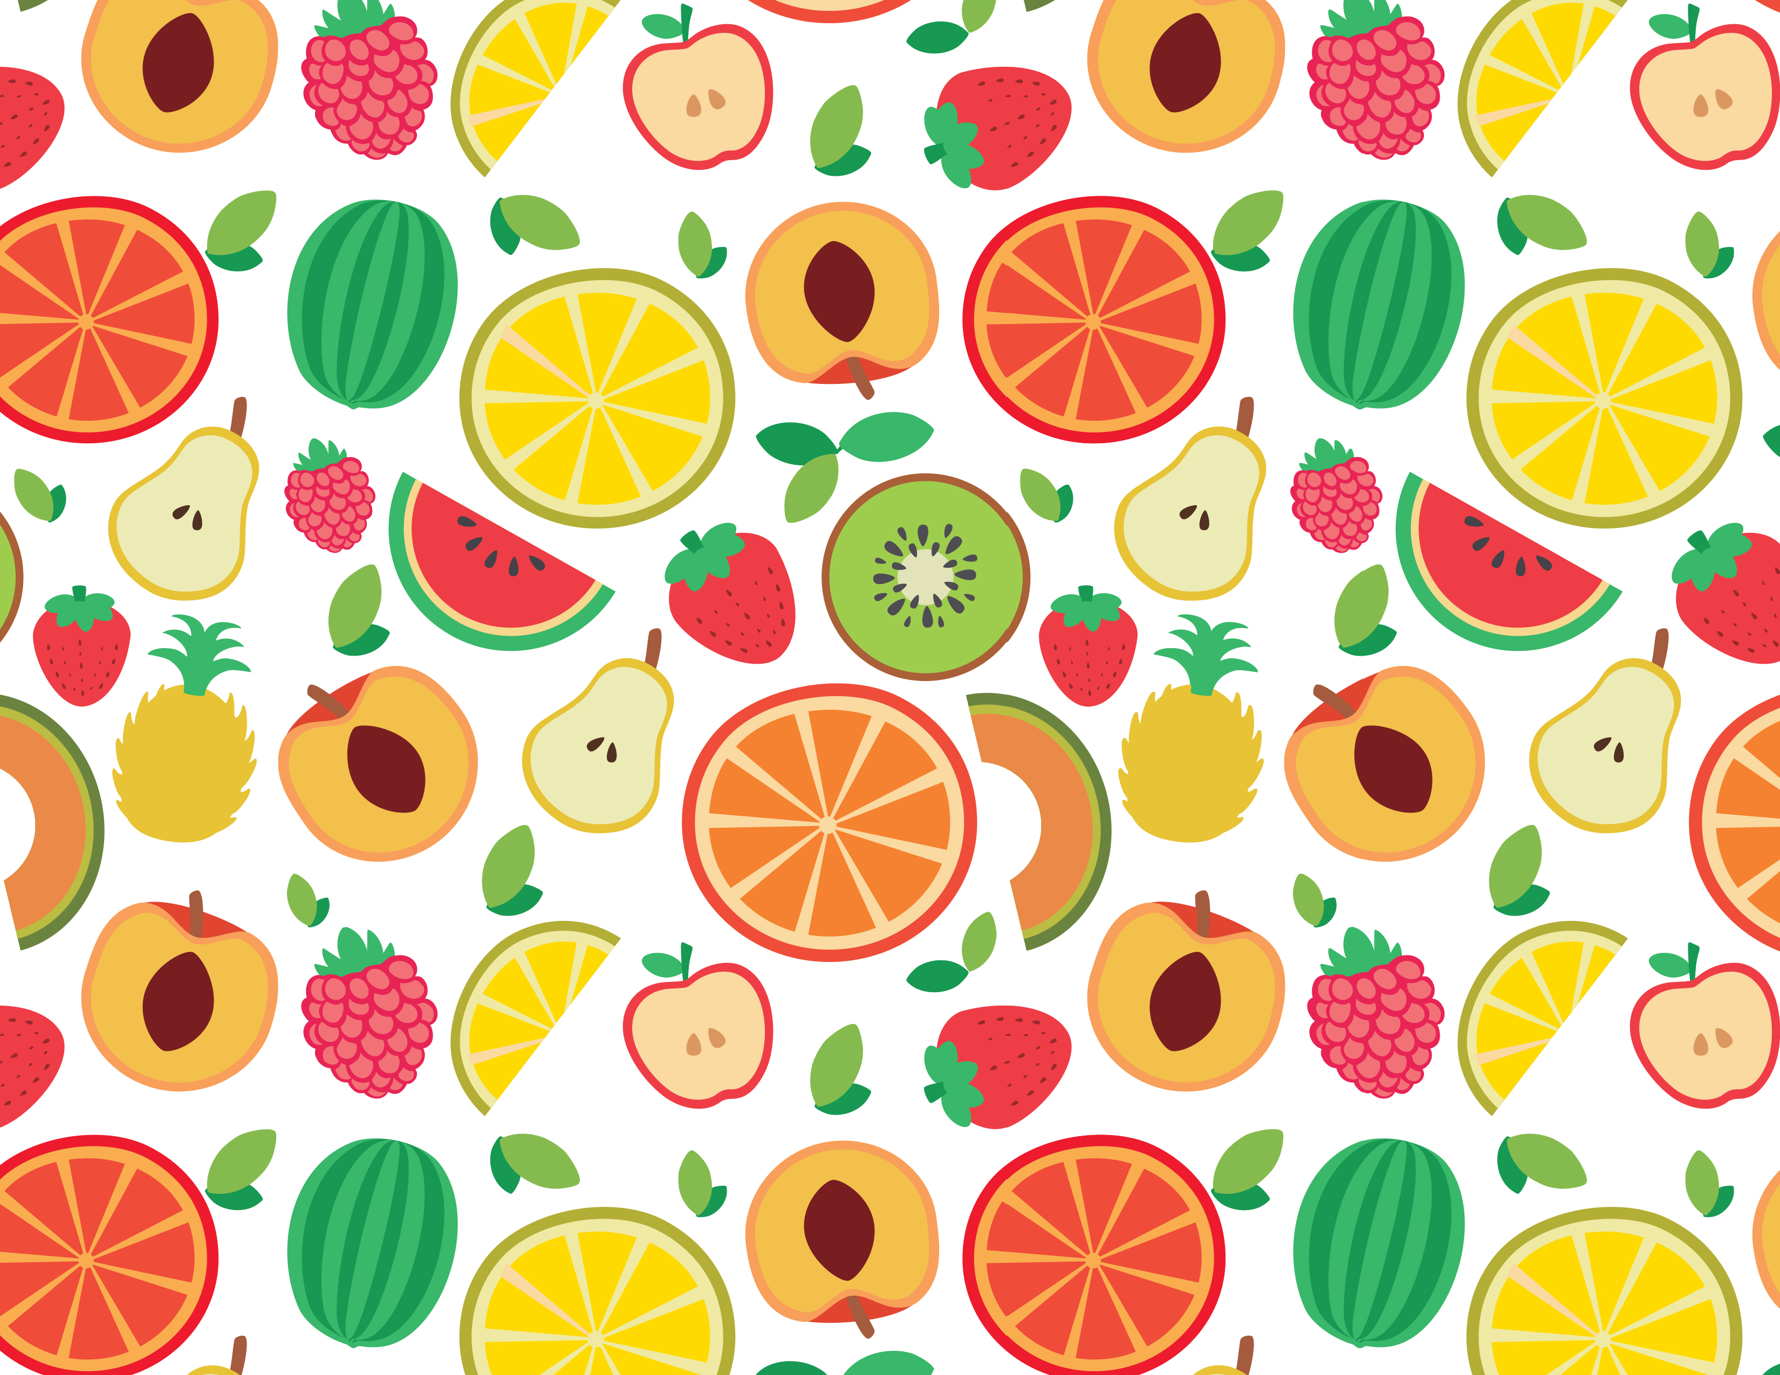
How many?

Slide 24
What did I learn today?
How to use “cl”
How to use “or”, capital letters, and punctuation
New “cl” words
Reading

Slide 25
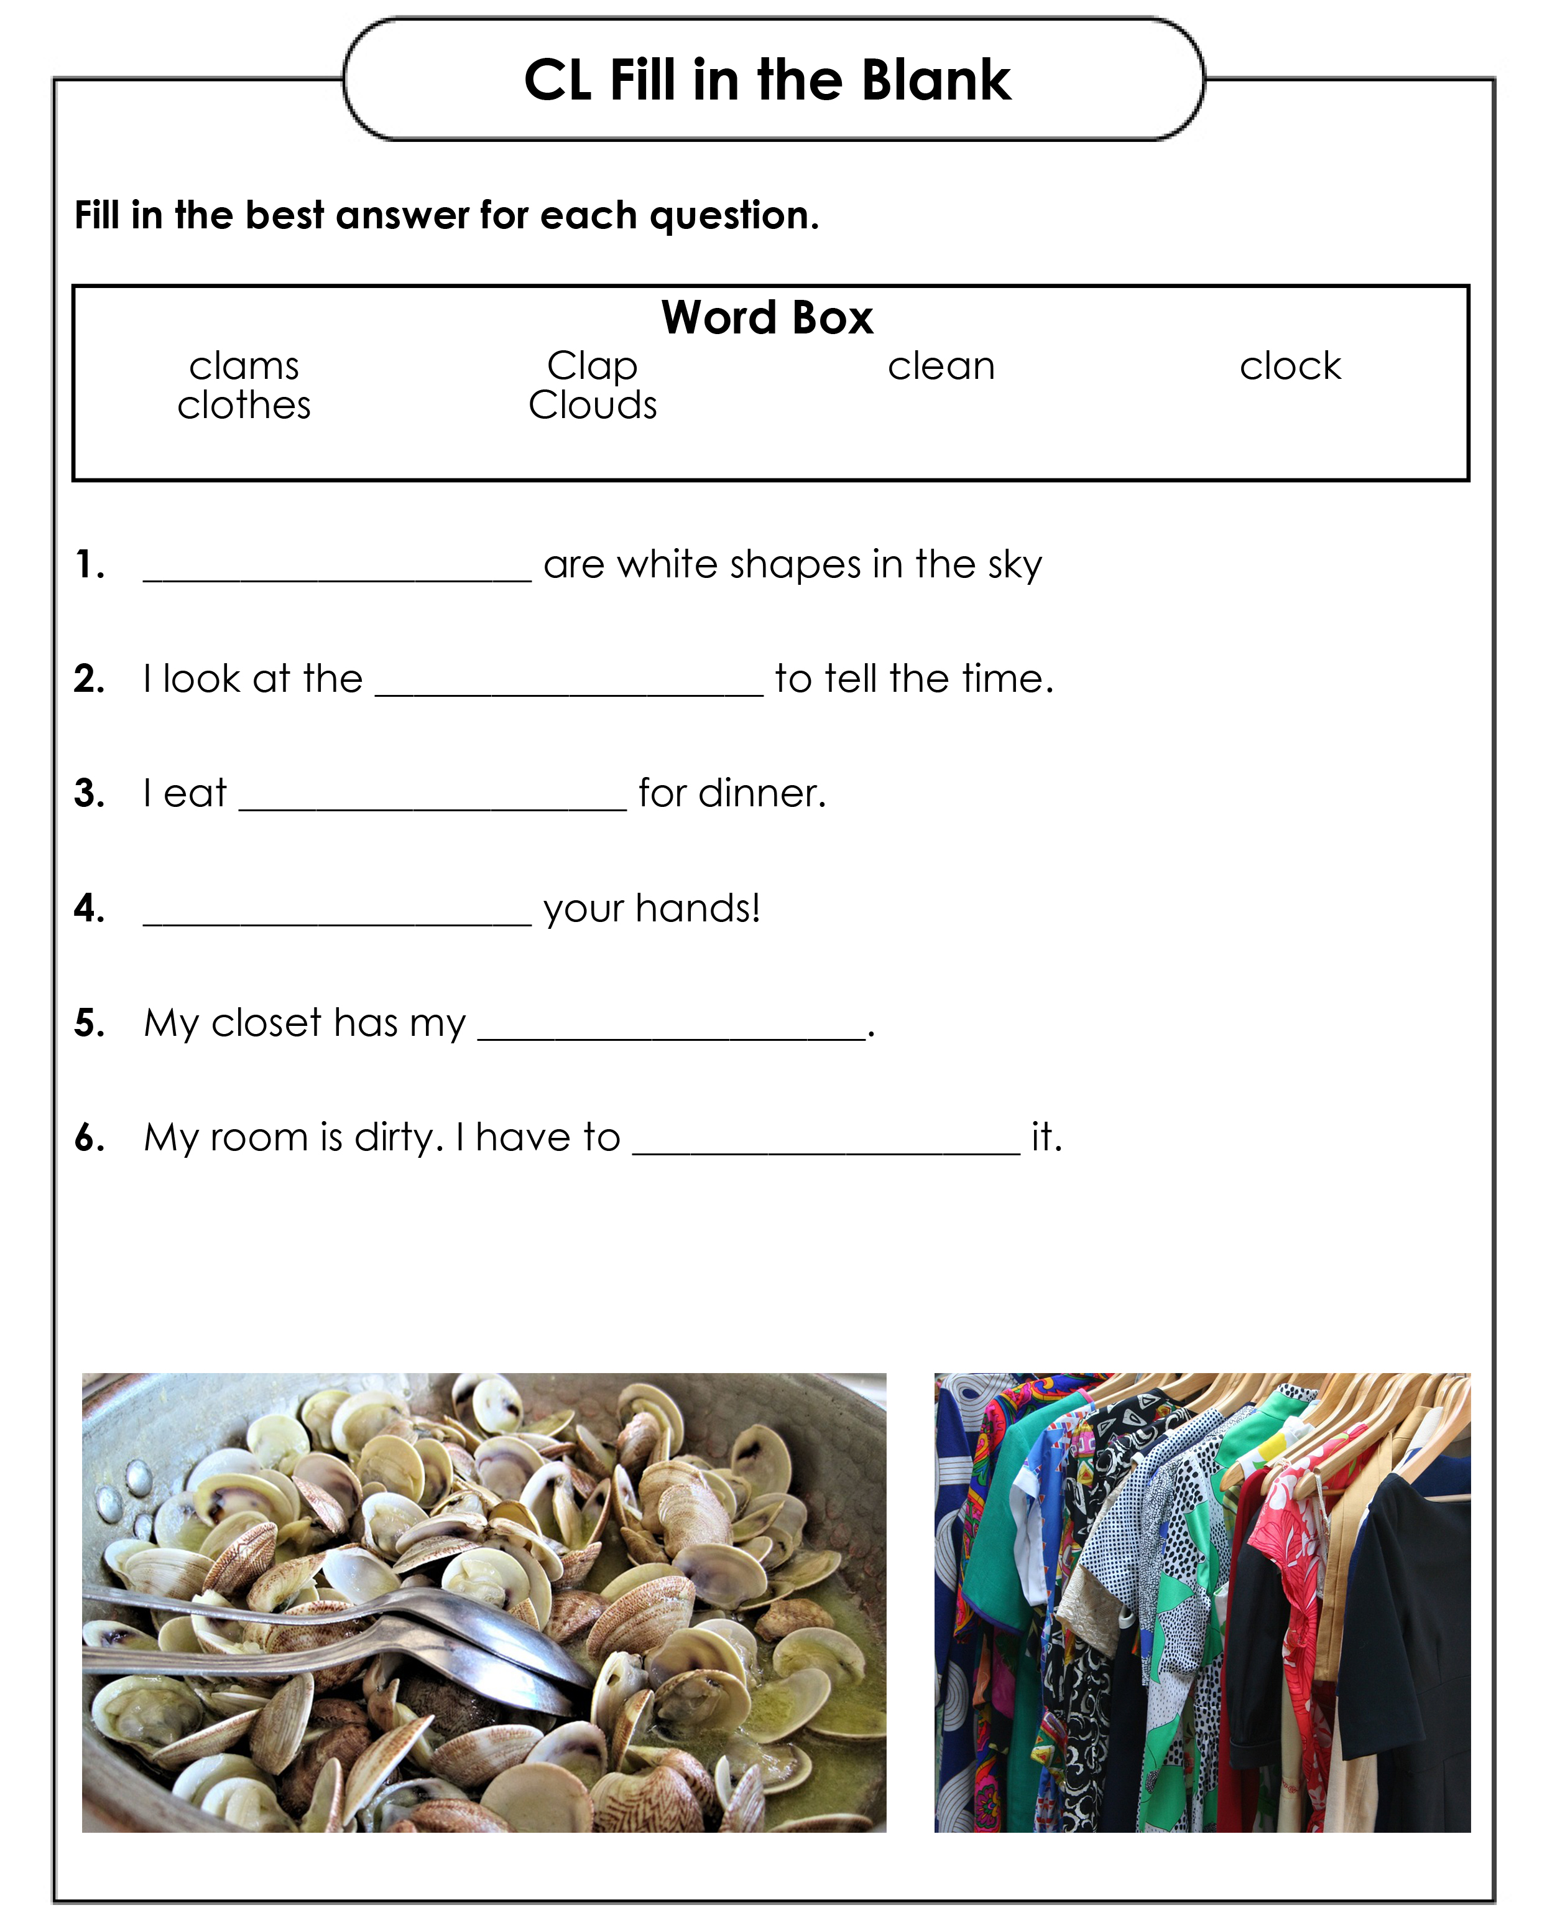
Homework
Download the “CL Fill in the Blank Worksheet.pdf” and complete it.

